Slide 1
Climate & Sea Level Changes

Slide 2
History
Twenty-five or more years ago, some meteorologists were talking about global warming and its consequences; however, few people outside the science were paying much attention. I paid attention, and I’ve been observing atmospheric events.
Global warming doesn’t just mean things get a little warmer everywhere.
They predicted that there would be greater extremes and less predictability in atmospheric behavior.
Higher high temperatures in some places and lower low temperatures in some places.
Stronger storms, particularly hurricanes. The warmer the ocean water, the more powerful the hurricane become. So we have warmer ocean temperatures (a fact). Hurricanes seem to be happening more frequently and with great strength.
Warmer air can hold more moisture, so the potential for precipitation increases.

Slide 3
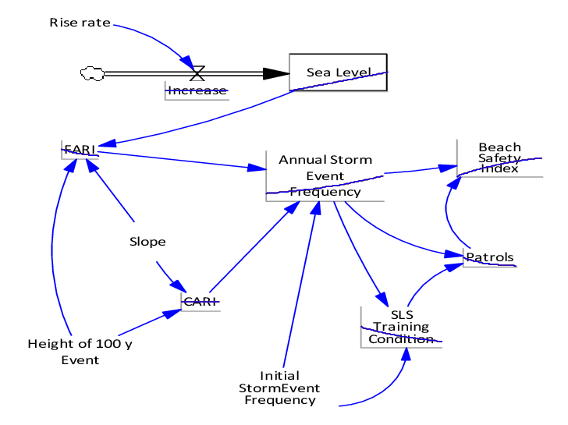
We’re facing a complicated unknown . . . . .
We know there have been natural cycles of the earth warming and cooling: there have been 4 ice ages with warming periods between them.
Humans were only around for the last ice age, and they had no means of understanding what was going on, nor means of measuring and recording changes, and no means to transferring the information to us so we could have something with which to compare what’s going on now.
We have complicated models from which to make projections; however, they are the best we have at the moment. As we learn new things, we readjust the models.
Climate change sub-model simulating sea level rise and resulting changes in a storm event. This is just a piece of the climate change model.

Slide 4
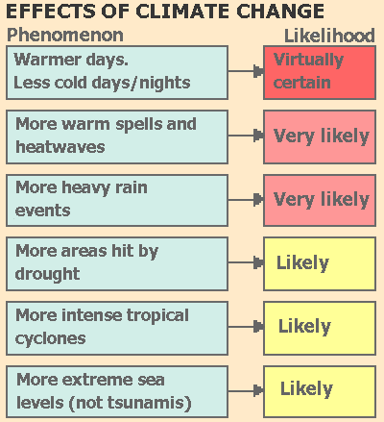

Slide 5
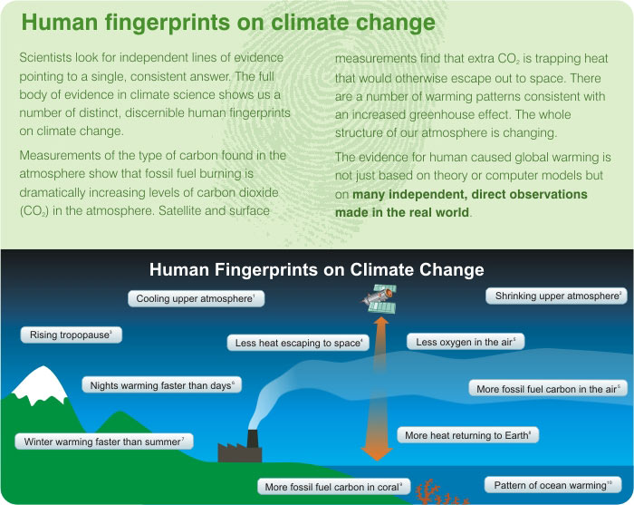

Slide 6
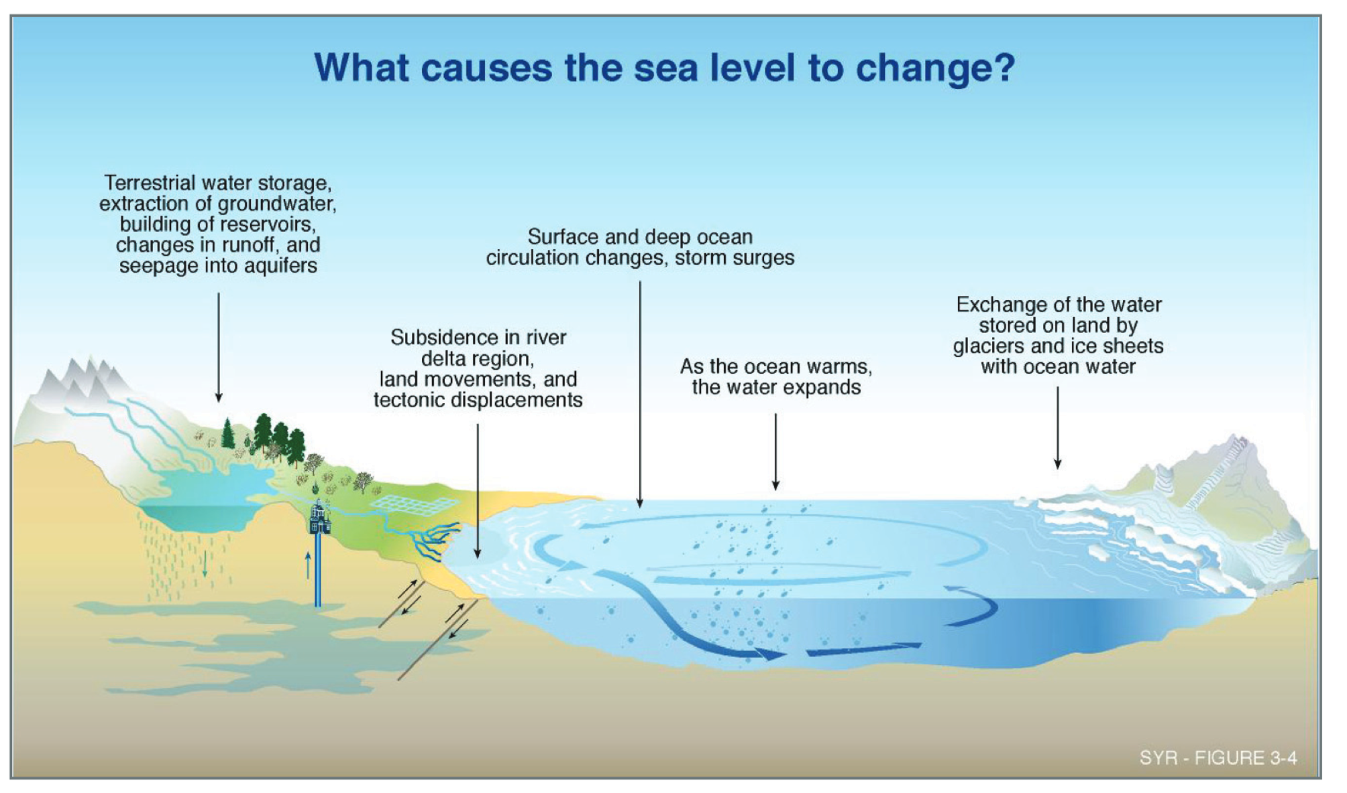

Slide 7
If it seems complicated, it really is!
Always remember, and never, ever forget . . . .
Everything is connected, and I mean EVERYTHING!
Everything goes somewhere- things may change their form, but 99.9% of ever atom and atomic particle still exists in the system in some way!
Nature knows best. Nature can disassemble every molecule which is made by nature – they are BIODEGRADABLE. Humans have created molecules that are non-biodegradable, so manyy keep recycling through the food chain and are harmful.
There’s no such thing as a free lunch. ALL DECISIONS TO ACT OR NOT TO ACT HAVE CONSEQUENCES.

Slide 8
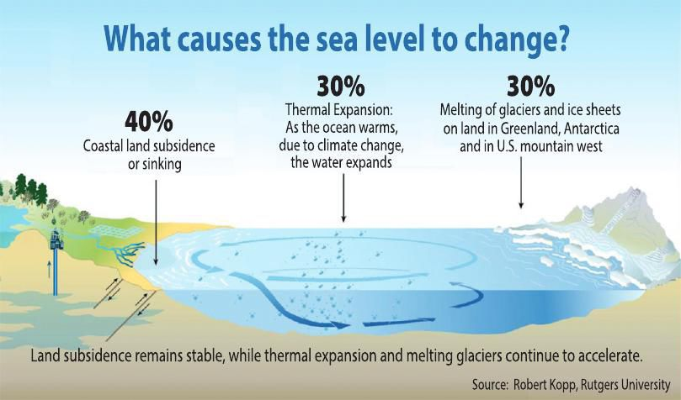

Slide 9
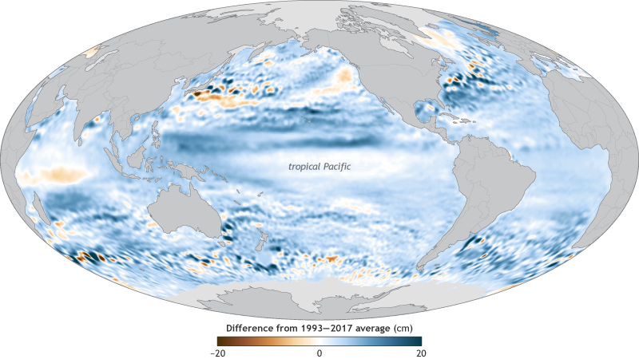
This has already happened
-7.784 inches
7.784 inches

Slide 10
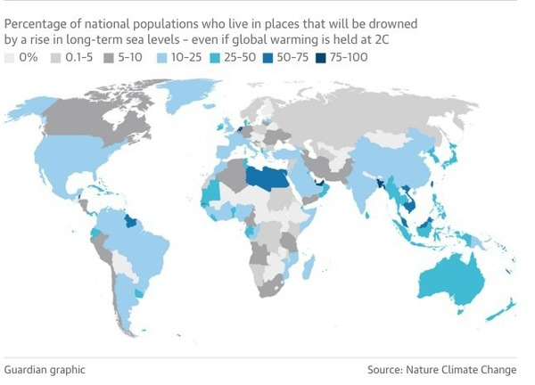
This is a what if? So far most countries have not met their target levels in an attempt to limit the warming to 2ºC. So the outlook isn’t too positive.

Slide 11
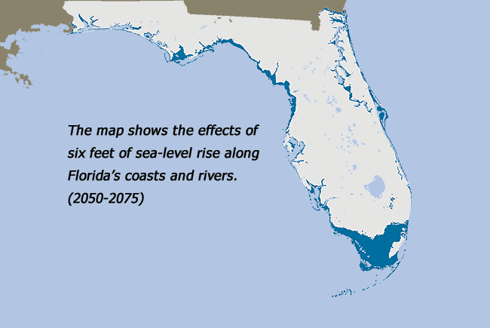
This is one projection of consequences. There are others that project an even greater increases.
How great the consequences of human actions will be are unclear because so many factors and questions are involved.
When will global warming reach it’s peak? How much increase will there be?

Slide 12
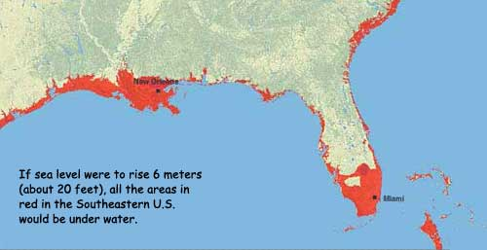

Slide 13
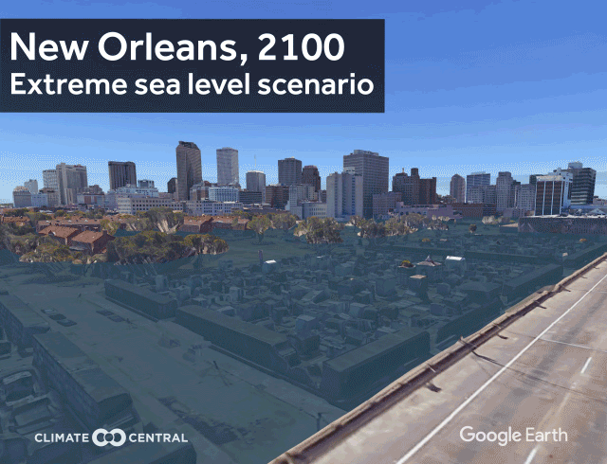

Slide 14
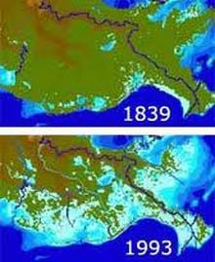
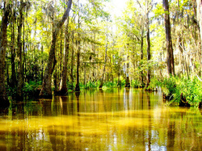
38 minutes Louisiana is losing a football field of wetlands.
Most of New Orleans is below sea level,and South Louisiana's costal wetlands,which once helped buffer the city from giant storms,have been disappearing at a swift pace. At an average of 34 square miles of Louisiana's wetlans has disappeared each year for the past 5 decades. From 1932 to 2000, Louisiana has lost 1,900 square miles of land to the

Slide 15
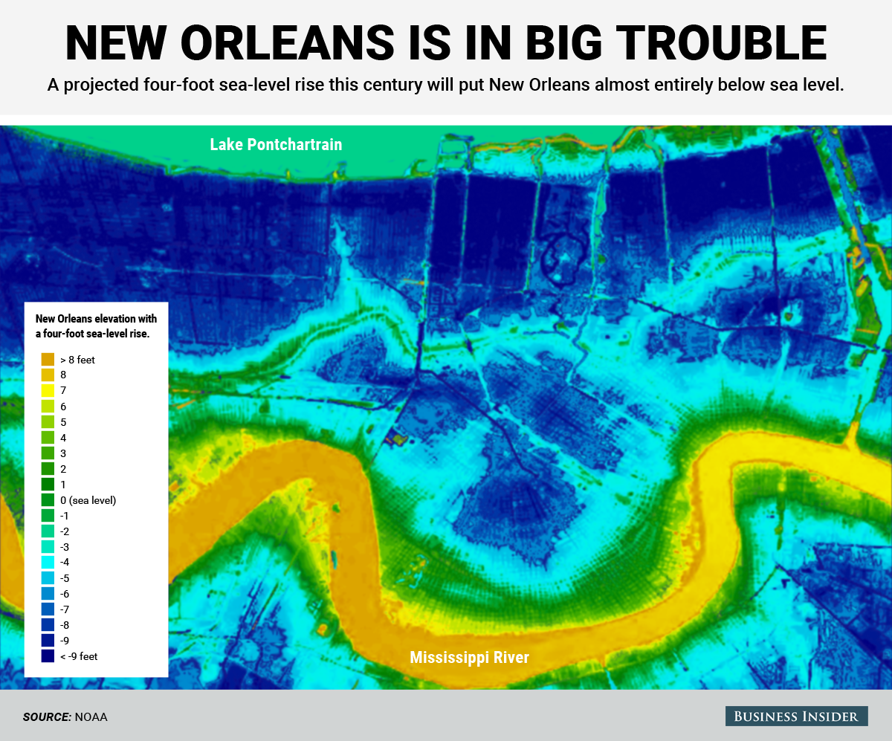
The city is also below the level of the bed of the Mississippi River so that a break in the levy floods the city too. When Katrina hit, they got the sea surge plus the river flooding the city.

Slide 16
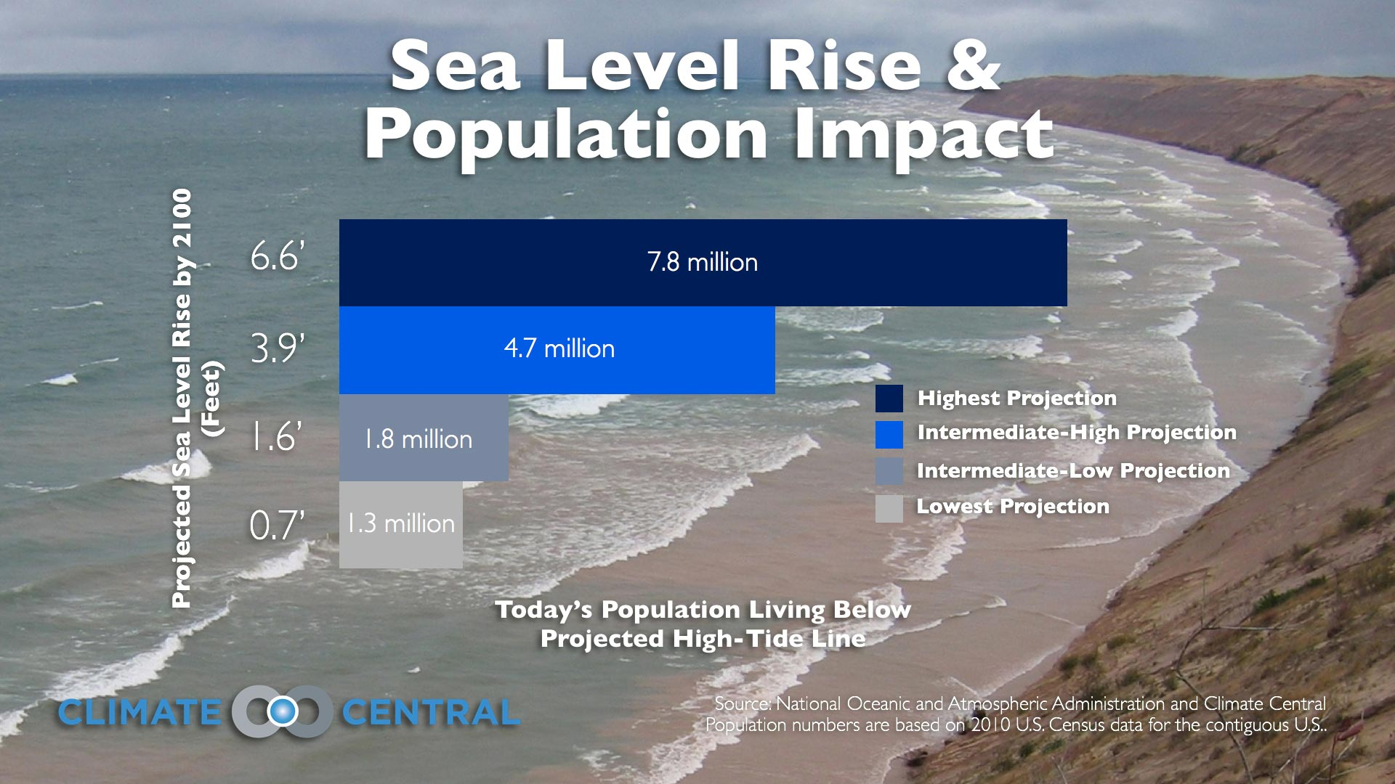
For the U.S.A.

Slide 17
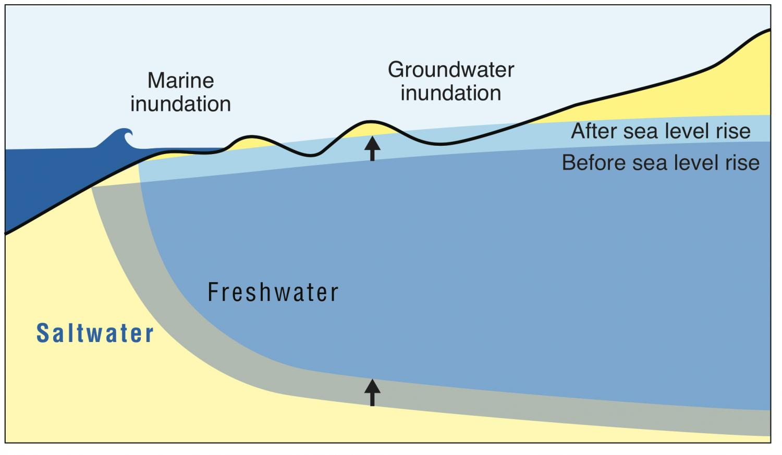

Slide 18
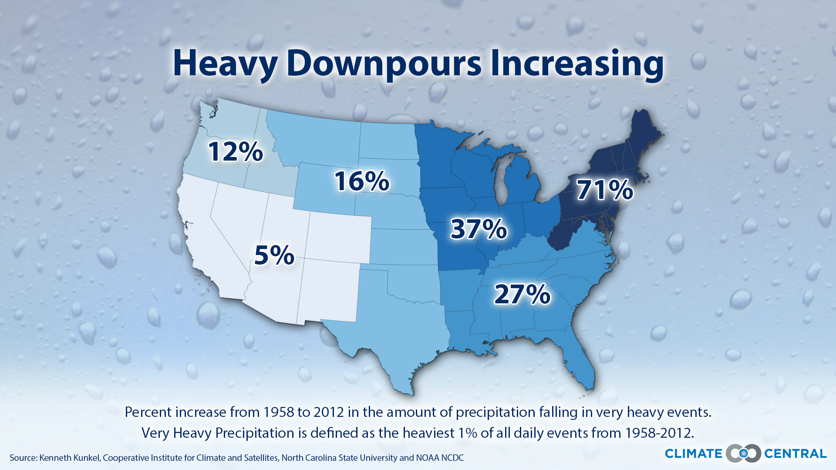

Slide 19
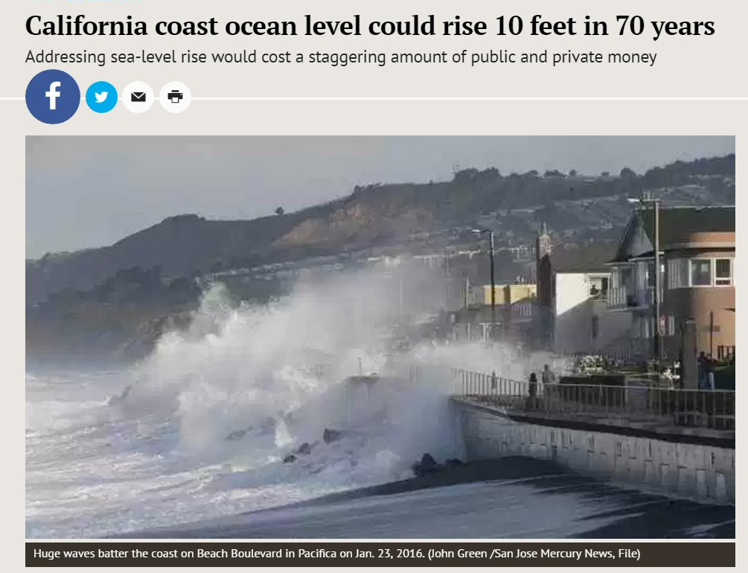
This is a projection – to some degree, coastal cities will have to move to higher ground or build expensive sea walls.

Slide 20
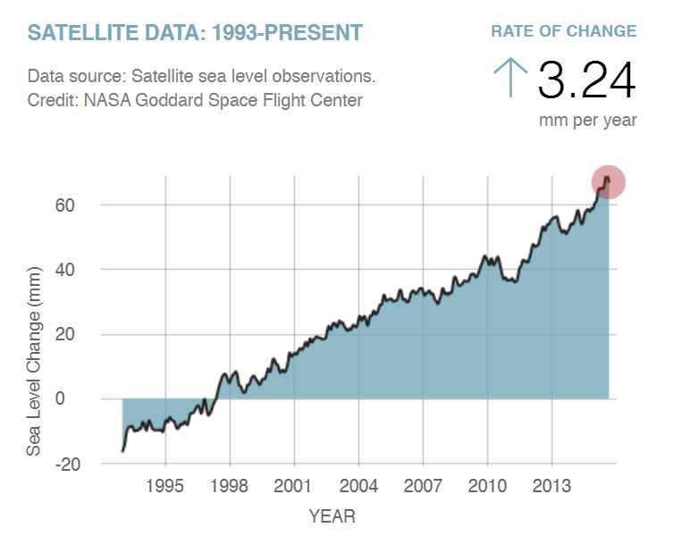
The trend is obvious

Slide 21
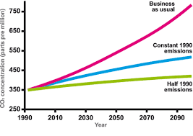
Projected atmospheric CO₂ increase in 3 different scenarios

Slide 22
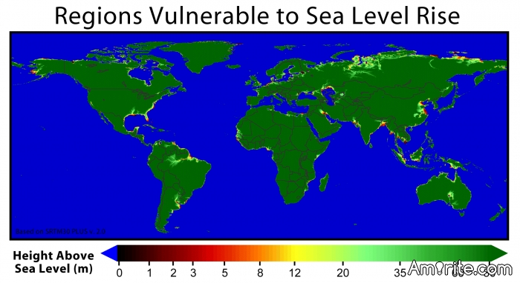

Slide 23
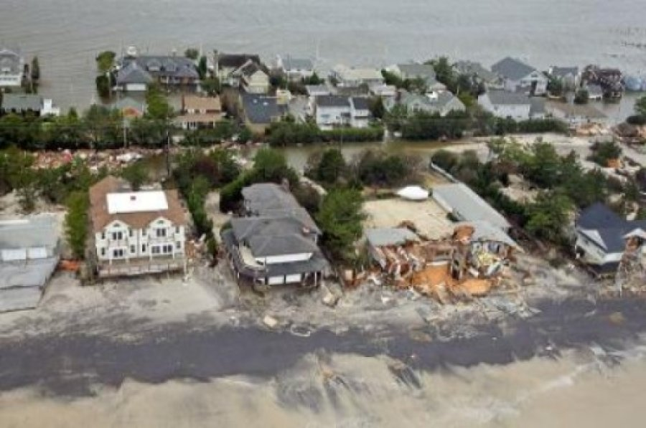
New research predicts that coastal regions may face massive increases in damages from storm surge flooding over the course of the 21st century. Global average storm surge damages could increase...
For now and possibly for the foreseeable future, living near the beach may not be such a great idea.

Slide 24
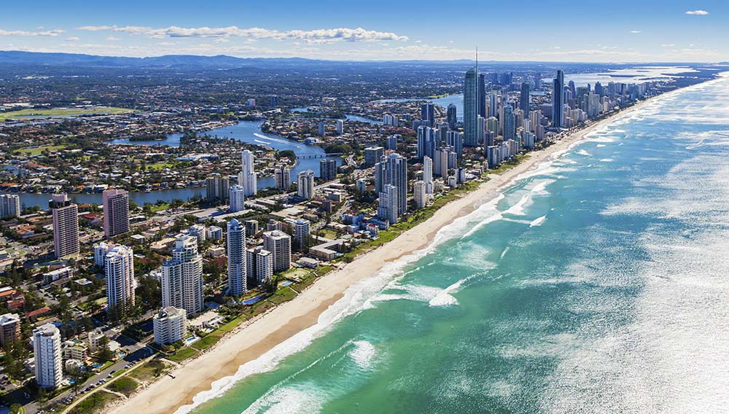
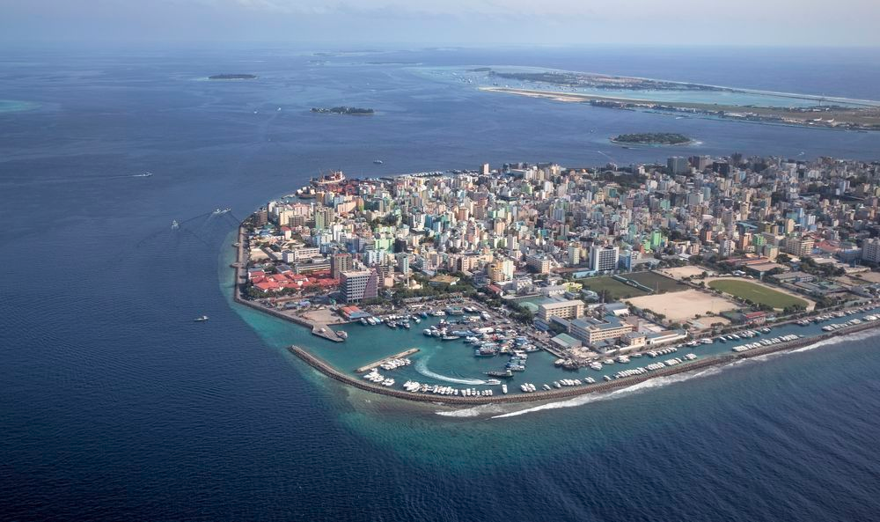
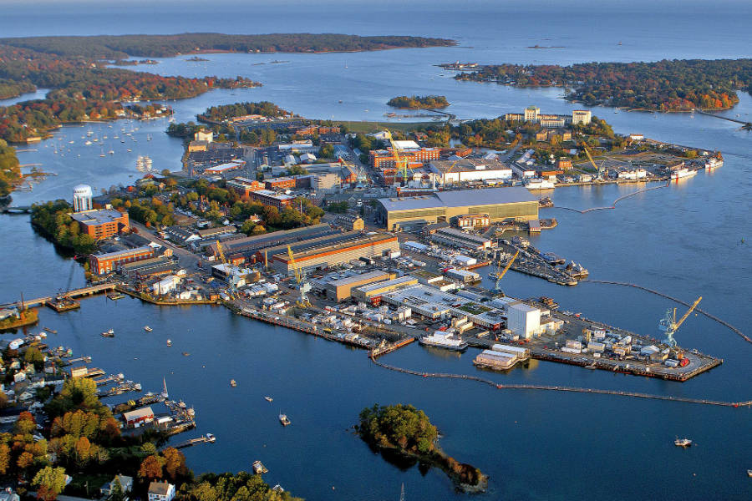

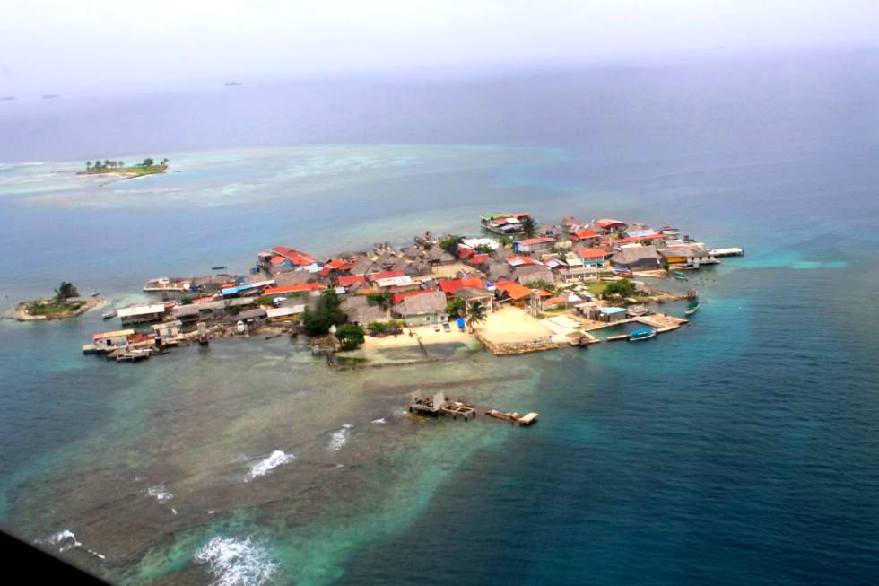

What may have to be relocated or abandoned, other than New Orleans?

Slide 25
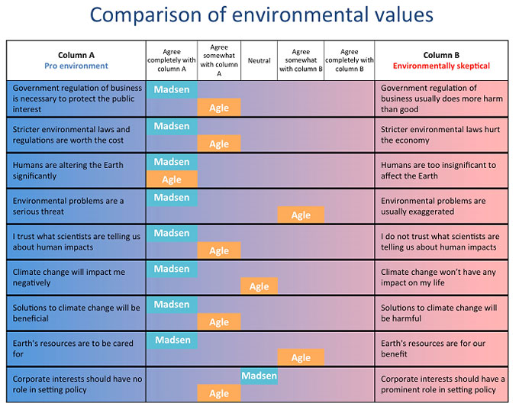
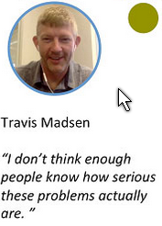
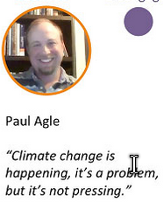
Travis Madsen, 40, lives in Denver, Colorado and is a professional climate advocate.
Paul Agle, 36, is a former oilfield geologist turned high school science teacher.

Slide 26
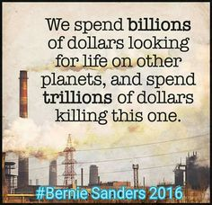
Apply Logic
Situation | If the perditions about global warming don’t come true | If the perditions about global warming do come true
Spend money to try to reduce global warming and the predicted consequences | Spend a lot of money bud did get more efficient fuel use | Spent a lot of money but conditions are mitigated and the consequences aren't as terrible as they might have been
Don’t spend money on trying to mitigate the effects of global warming | Saved tax money but probably didn’t get the efficiencies we might have gotten | Didn’t spend the money and have to endure the [re3docted cpmseqiemces/
AMAZING!!!!!

