Slide 1
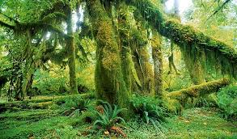
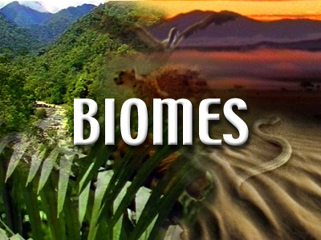

Slide 2
FIRST, SOME TRUTHS ABOUT NATURE

Slide 3
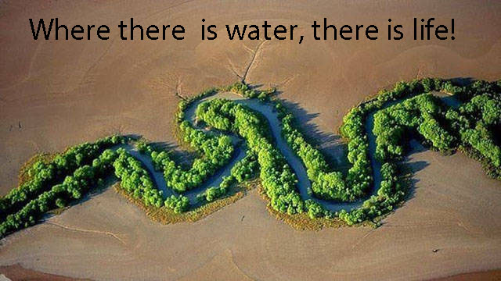

Slide 4
Essentials for Plant Life (base of the food chain for all living things.)
Sunlight – The earth is truly solar powered!
Water
Carbon Dioxide
Healthy soil: a mixture of finely weathered mineral matter, organic matter (living and dead), water, and air.

Slide 5
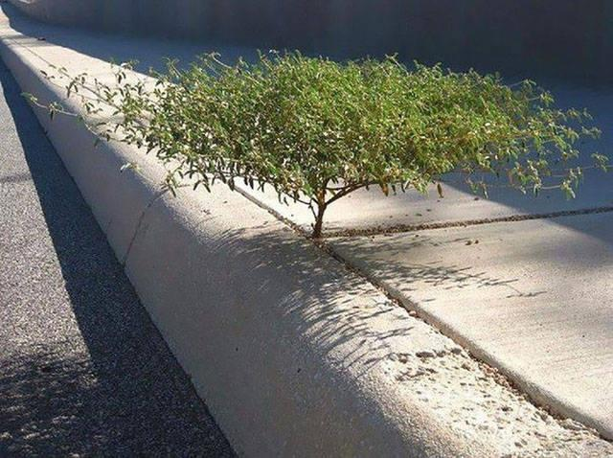
Nature will maintain plant life wherever the possibility exists. Nature is tenacious.

Slide 6
Tenacious meaning: 1. holding tightly onto something, or keeping an opinion in a determined way: 2. persisting in existence; not easily dispelled. 3. unwilling to accept defeat or stop doing or having ...
All living things will struggle to maintain their existence and will struggle to reproduce. These are the fundamental realities of all living things.

Slide 7
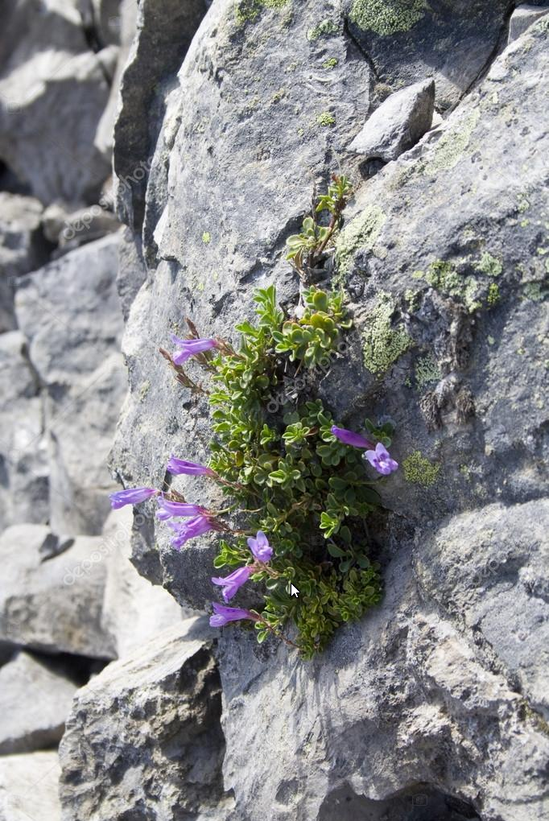
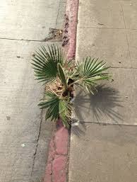
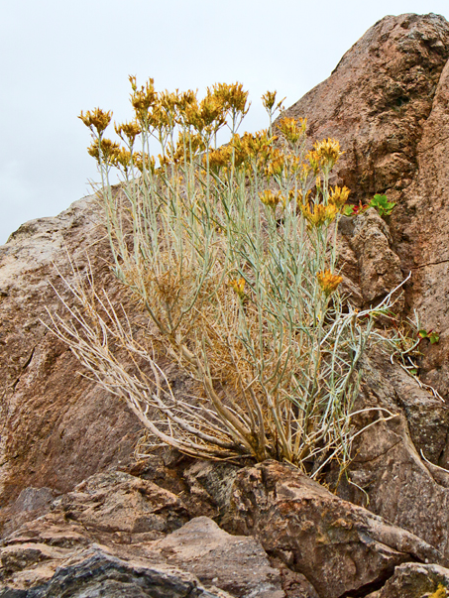
Tenacious

Slide 8
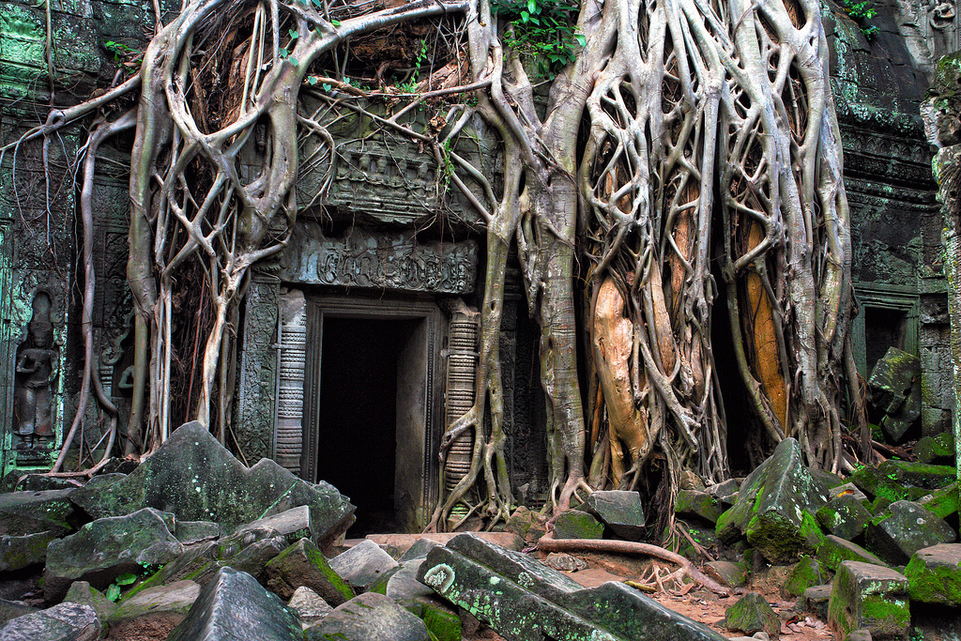
If left unattended, nature will reclaim what humans have made.

Slide 9
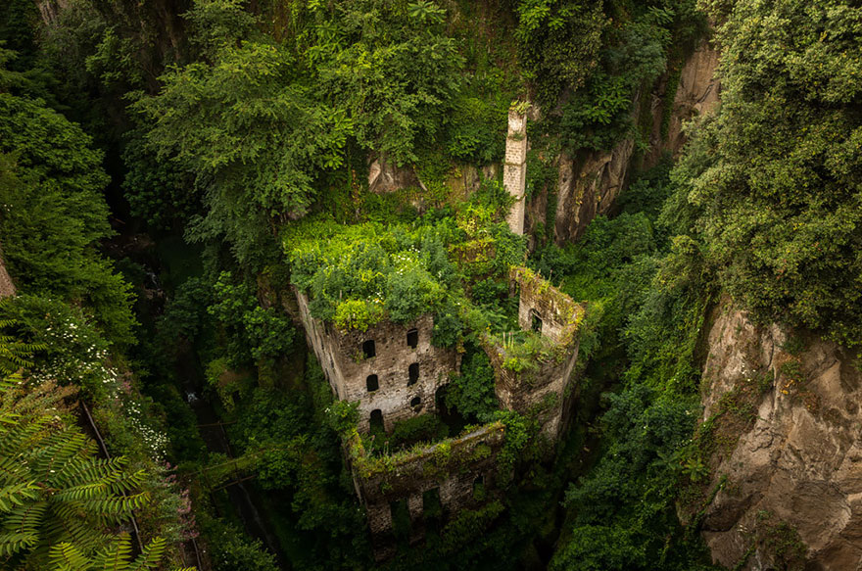
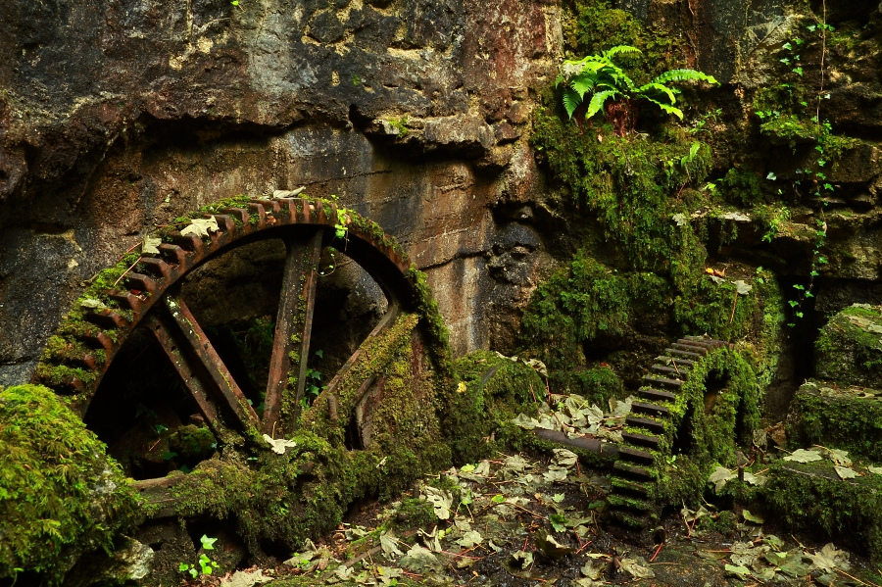
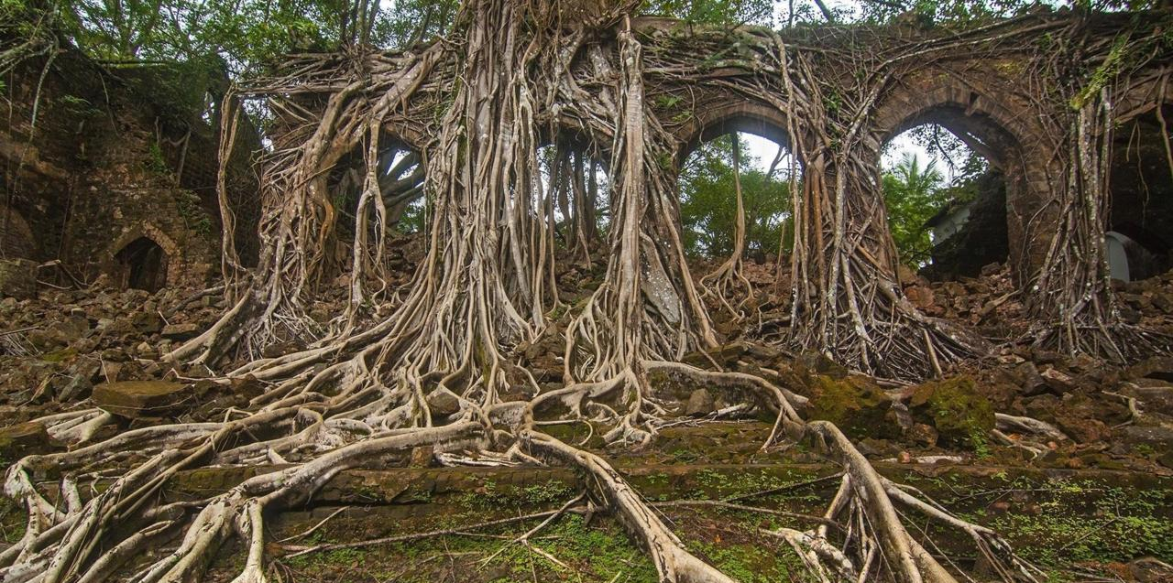
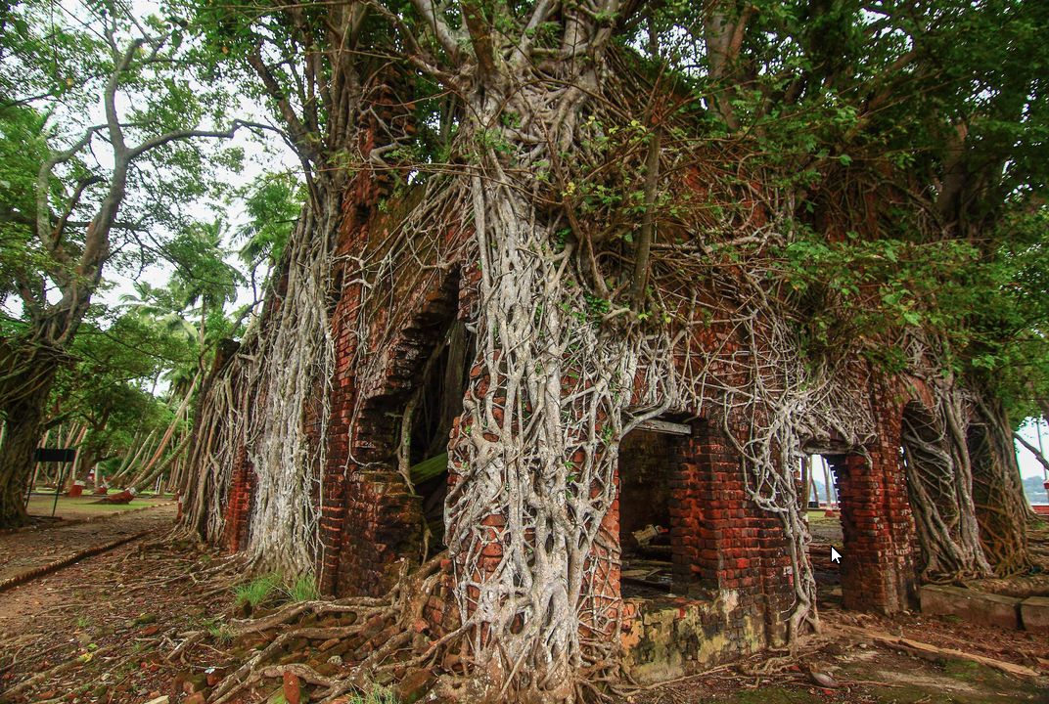
Reclaimed

Slide 10
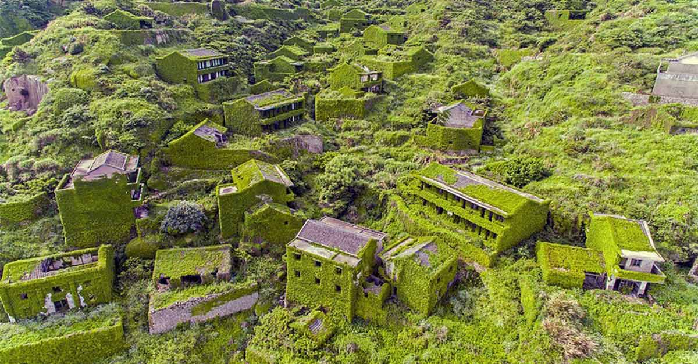
Reclaiming an abandoned fishing village

Slide 11
See how different environments support different varieties of organisms

Slide 12
What are Biomes?
Biomes are regions in the world that share similar plant structures, plant spacing, animals, climate, soil, and weather.

Slide 13
How are Biomes Classified?
Biomes are classified as either terrestrial or aquatic. Terrestrial comes from the Latin word, terrestris, from terra the earth.
Land Biomes
Water Biomes

Slide 14
How Many Biomes Are There?
Scientists disagree over the exact number of biomes, but in general they include around 6 -10 biomes.

Slide 15
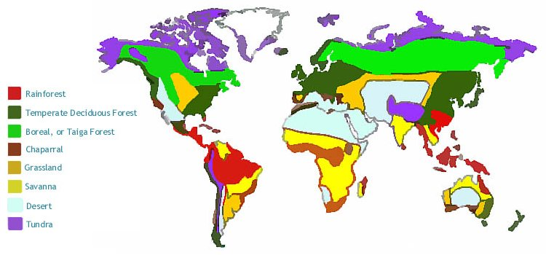

Slide 16
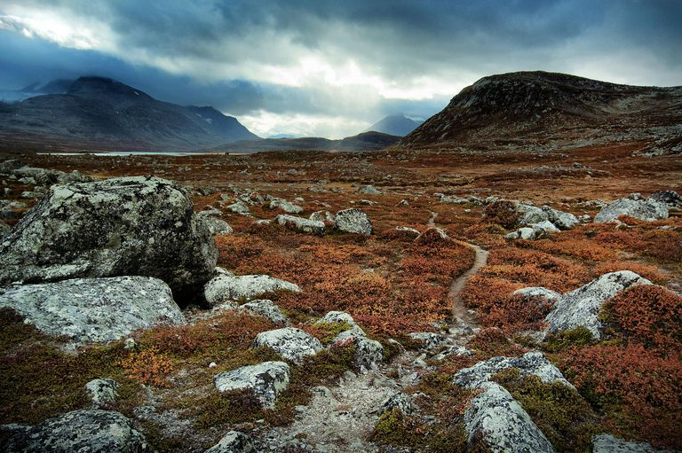
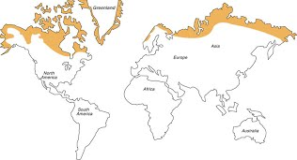
Tundra
Very cold
Low diversity
Simple vegetation
Short growing season

Slide 17
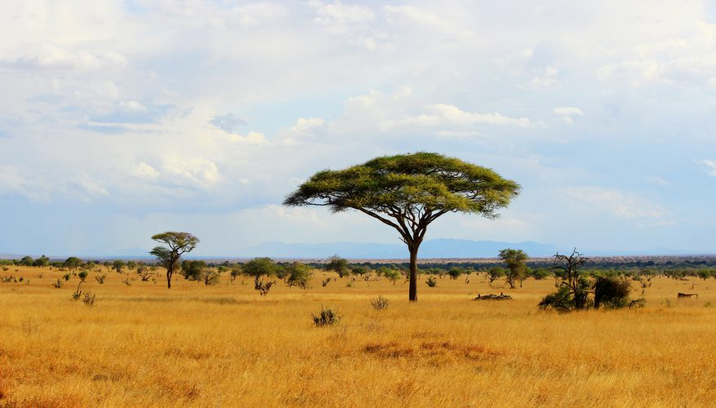
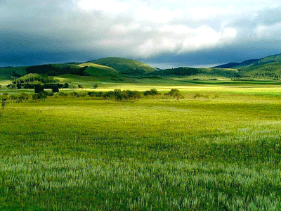
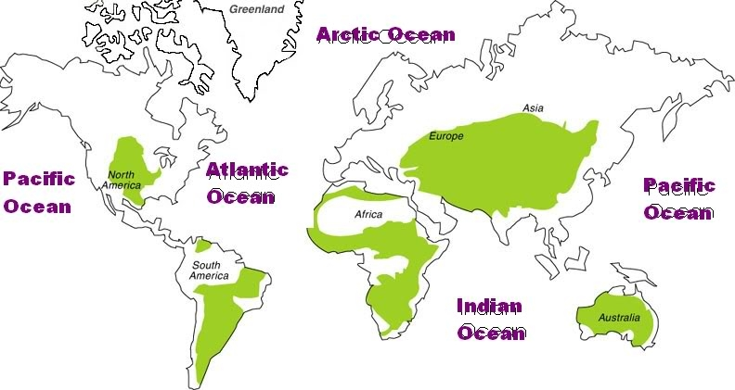
Grasslands
Savanna
There are two types of grasslands. The tropical grasslands (savannah) and the temperate grasslands.
Dominated by gasses
savannah has a wet and dry season
Temperate grassland has a hot summer and cold winter
Temperate Grassland

Slide 18
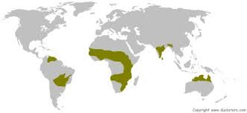
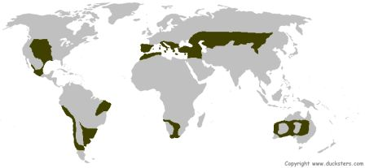
Savana Grasslands
Temperate Grasslands

Slide 19
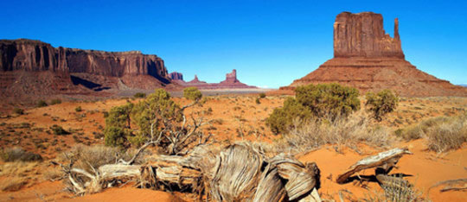
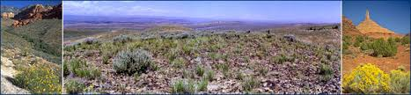
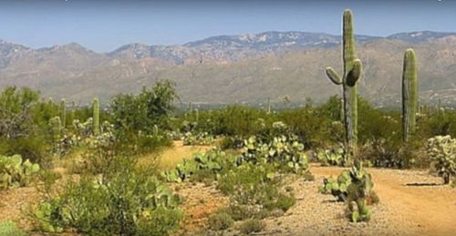
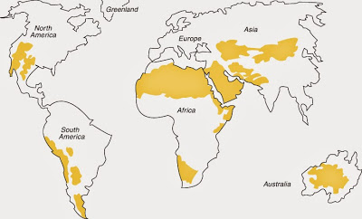
Desert
Animals are small
Many animals are nocturnal
Temperatures can be very hot or very cold
Plants are adapted to conserve water (xerophytes)

Slide 20
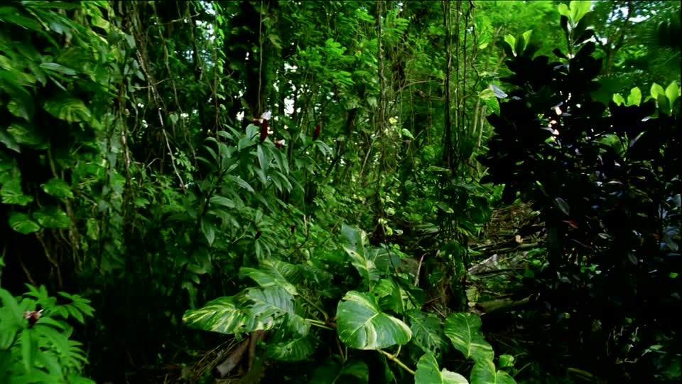
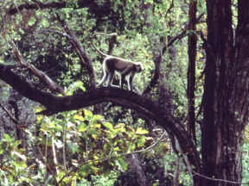
Tropical Forests
Tropical Rainforest
Very rainy
Little variation in climate
Highly diverse species
Soil is nutrient-poor and acidic
Two Categories:
Tropical Rainforest – rains all year
Tropical Monsoon Forest – A short dry season, so there are some deciduous plants
Tropical Monsoon Forest

Slide 21
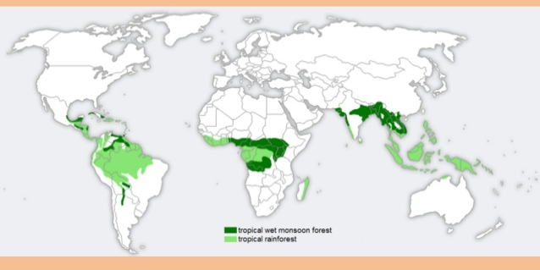

Slide 22
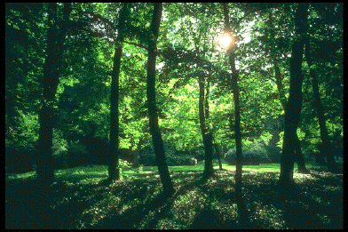
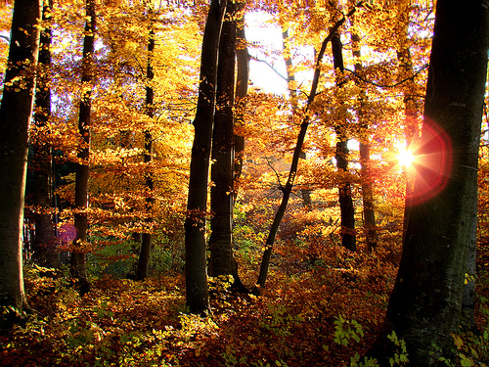
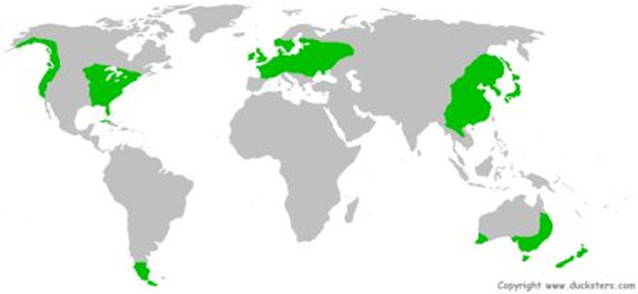
Deciduous Forest
Temperature varies
Soil is rich with decayed matter
Plants consist of broad leave trees
Includes animals such as squirrels, rabbits, skunks, and bear.
Even precipitation throughout the year

Slide 23
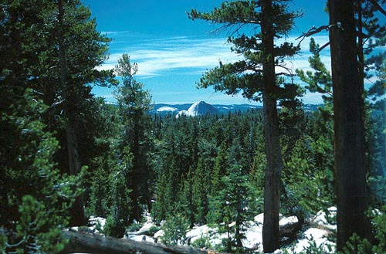
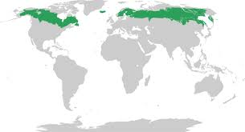
Coniferous Forest
Also called the taiga or boreal forest
The largest terrestrial biome
Temperate Precipitation is primarily snow
Soil is nutrient poor and acidic
Flora is mostly conifers
Animals include woodpeckers, hawks, moose, bear and lynx.

Slide 24
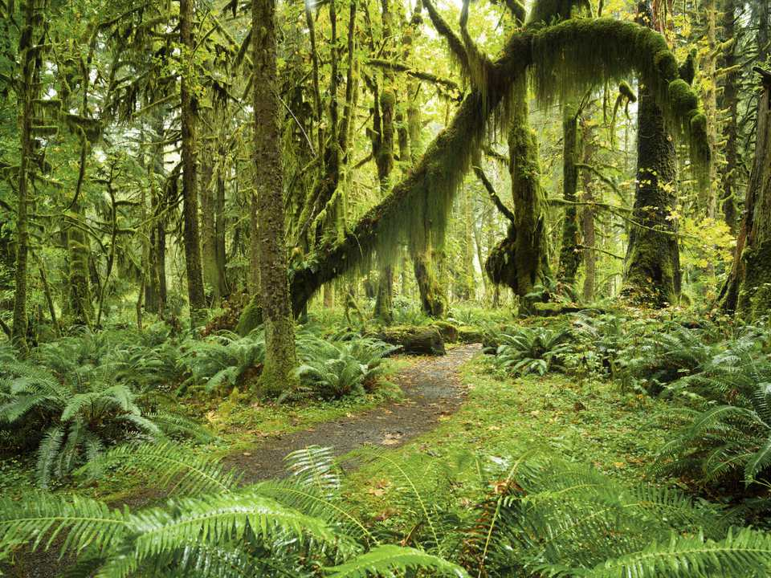
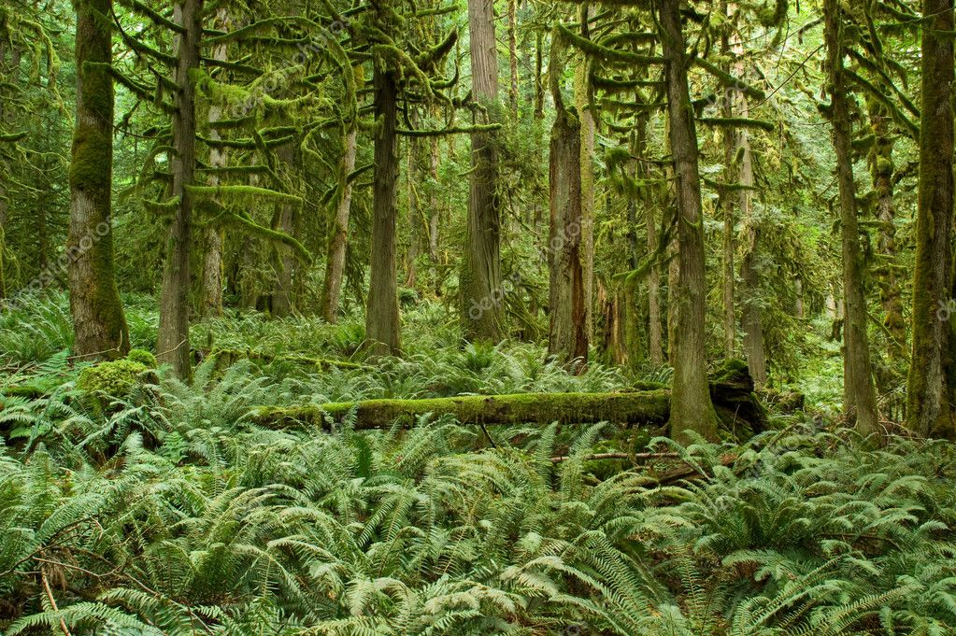
Temperate rainforest
As with the tropical rain forest, water is the main story here. The high humidity means that epiphytes are much more common here than they are in the drier temperate deciduous forest. Plants like mosses and ferns, which rely on water for reproduction, are also common here. Temperate rainforests experience vast amounts of rainfall, but feature a cooler average temperature compared to tropical rainforests.

Slide 25
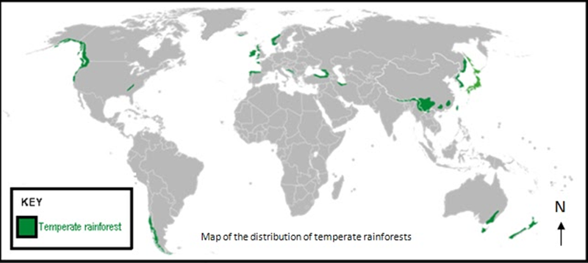

Slide 26
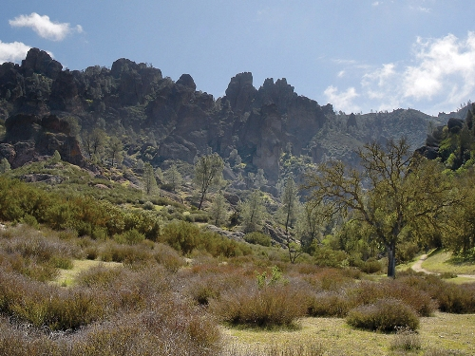
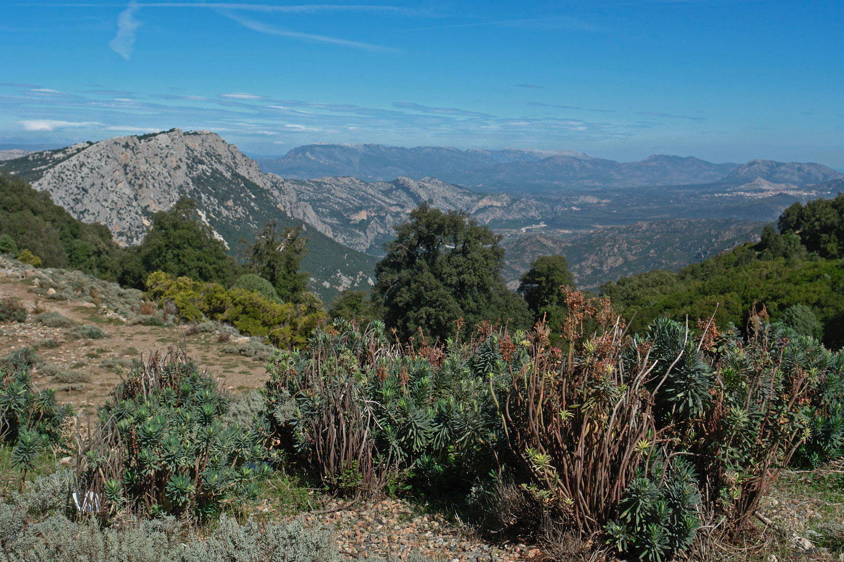
Chaparral & Maquis
Both are responses to the Mediterranean climate (hot dry summers and cool wet winters)
Chaparral is a shrubland or heathland plant community found primarily in the US state of California and in the northern portion of the Baja California Peninsula, Mexico. drought-tolerant plants with hard sclerophyllous evergreen leaves, as contrasted with the associated soft-leaved, drought-deciduous, scrub community of coastal sage scrub.
Maquis (French) or macchia (Italian: macchia mediterranea) is a shrubland biome in the Mediterranean region, typically consisting of densely growing evergreen shrubs

Slide 27
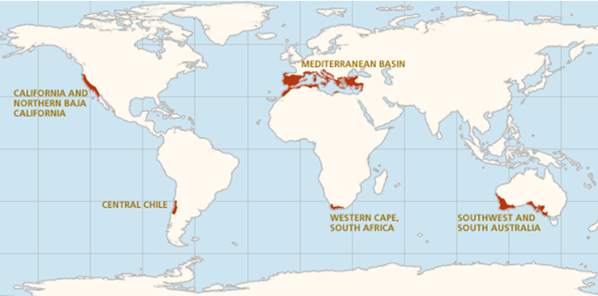

Slide 28
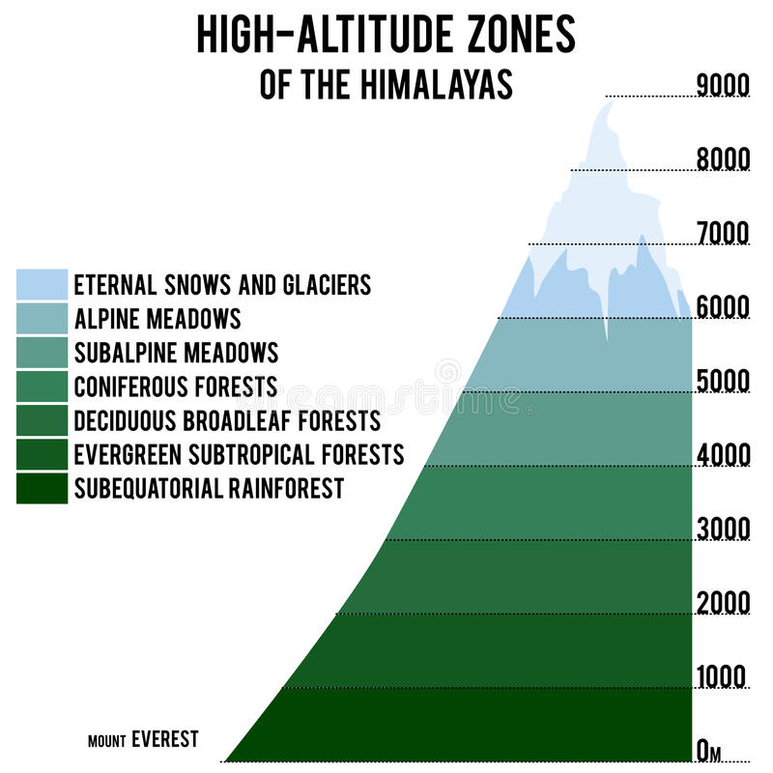
Mountains
Mountain regions are so different, one from another, that it is hard to make too many generalizations about the life-communities that exist there. One factor is true, however. A major influence is elevation. As one moves up from the base, conditions (ecosystems) change. This is called altitudinal zonation. Influences:
Elevation
Latitude
Direction (north to South, east to west, etc.)
Prevailing winds
Distance from large water bodies
Length of exposure to sunlight
The degree of slope of the land

Slide 29
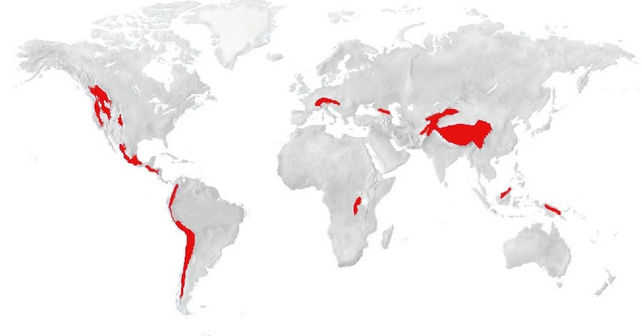

Slide 30
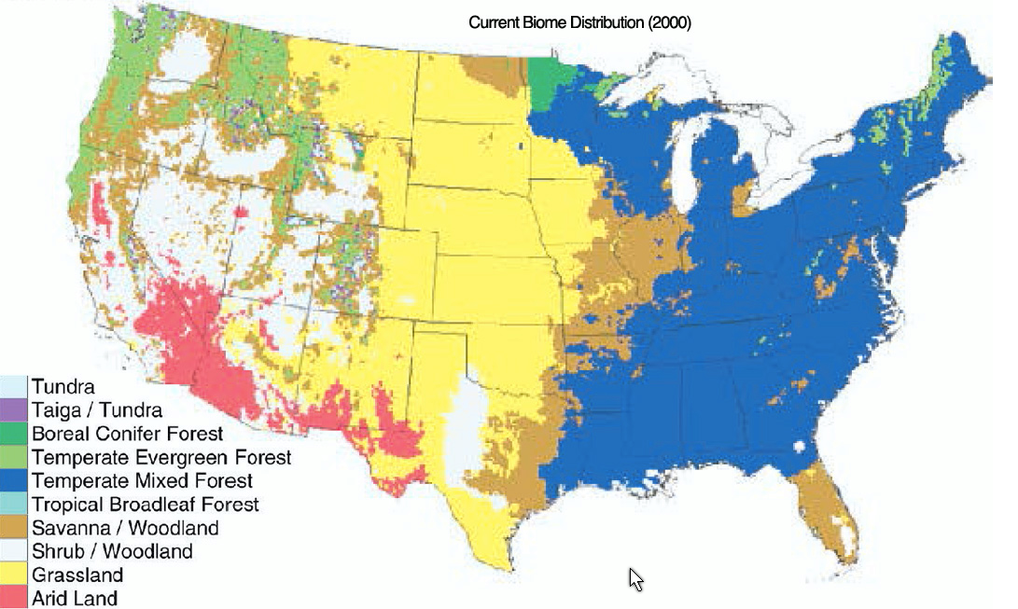

Slide 31
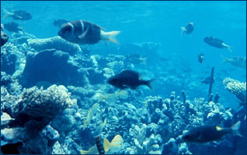
Water Biomes

Slide 32
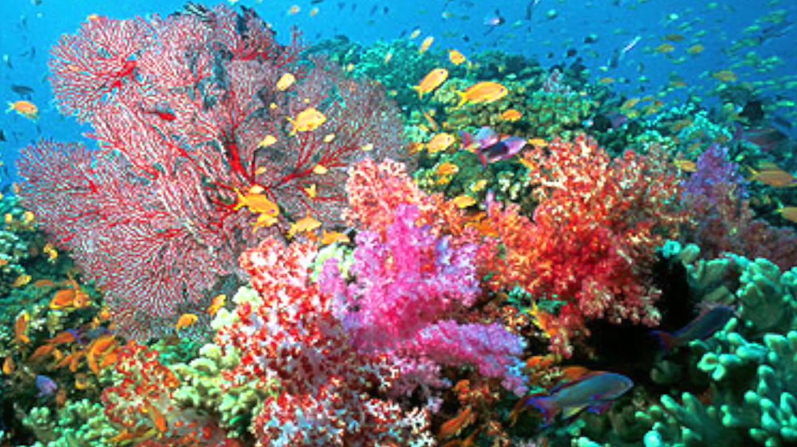
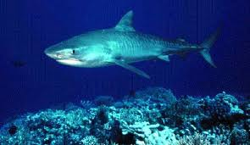
Marine Biome
Consists of oceans, coral reefs, and estuaries
The ocean is the largest of all ecosystems.
The ocean contains a diverse array of plants and animals at various depth zones.
Coral reefs consist mainly of coral.
Estuaries are areas where fresh and salt water environments converge. Mangroves, oysters, crabs and marsh grasses are examples of species in this environment.

Slide 33
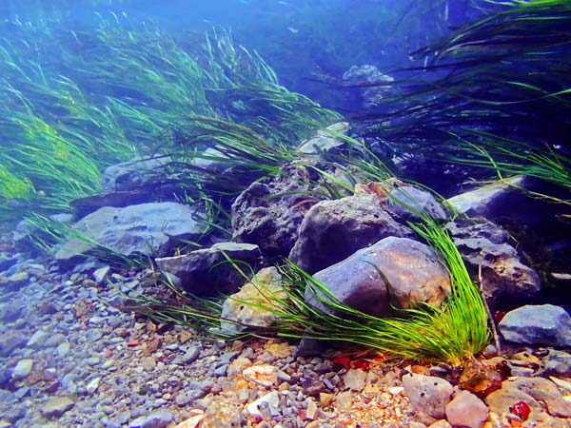
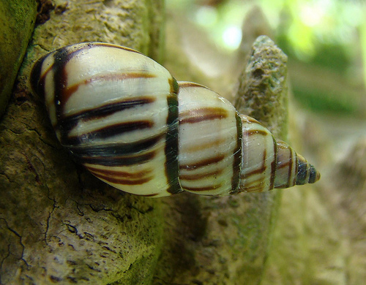
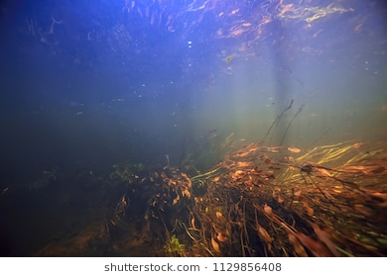
Freshwater Biomes
Includes ponds, and lakes; streams and rivers, and wetlands.
Ponds and lakes have well lit zones and a variety of fish dominate this zone.
Streams and rivers move in one direction.
Wetlands are areas of standing water that support aquatic plants.

Slide 34
Plankton = An extremely important part of the world ecosystem
Plankton, marine and freshwater organisms that, because they are nonmotile or too small or weak to swim against the current, exist in a drifting state.
There are two types of plankton: tiny plants--called phytoplankton, and weak-swimming animals--called zooplankton.
Plankton are the base of the aquatic food chain. All omnivore and carnivore animal life in the ocean depend on plankton. If the plankton population decreases – the higher species will decrease in numbers because there isn’t enough food.
Phytoplankton, grow and get their own energy through photosynthesis and are responsible for producing an estimated 80% of the world’s oxygen.

Slide 35
Plankton are tiny, but they are mighty in the global ecosystem!
Changes in the ocean can affect Plankton. We’ve known for years, we were aware that in El Nino years, the plankton supply of the coast of Peru declines and it hurt the fishing industry.
Now we know it is a much bigger system of interrelated parts, not just offshore Peru. Humans have to stop using the oceans as their ultimate trash dump!
Some things that may negatively affect the plankton population:
Chemical and organic wastes (pollution) that enter the oceans from major rivers and oil spills.
A thinner ozone layer in the atmosphere allows more ultraviolet radiation reach the ocean surface.
Increased dissolved CO₂ in the water turns it more acidic (forms carbonic acid)
The ocean temperatures have gone up a little (enough to harm coral) – In El Nino years, the water off Peru is warmer than usual and the plankton population is smaller.

Slide 36
