Slide 1
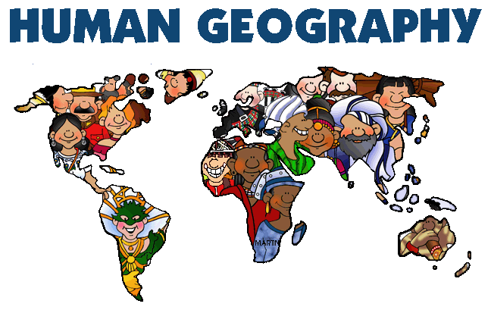

Slide 2
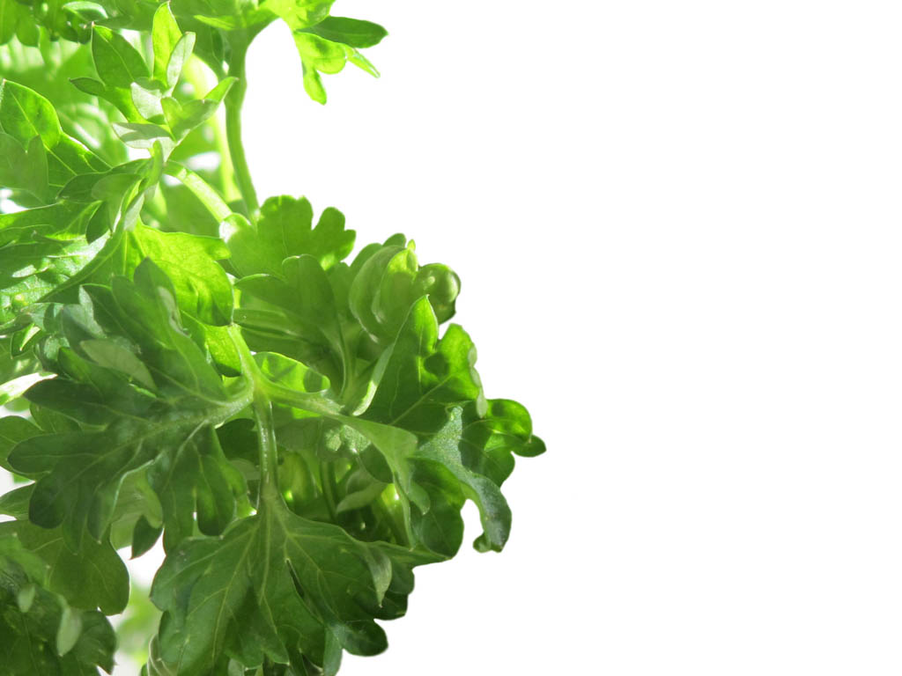
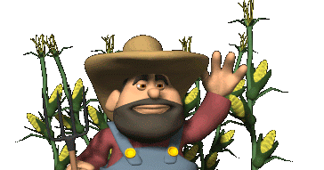
Agricultural Challenges

Slide 3
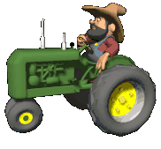
By 2050, the Food and Agricultural Organisation (FAO) has said, food production needs to be increased by 50% to match the projected increase in population. That won’t be easy. “The challenge is to produce this amount of food within the boundaries of this planet, with a limited number of hectares of arable land – while knowing that a lot of the land and the soil is getting degraded,” says FAO emergency and rehabilitation officer Sylvie Wabbes-Candotti.

Slide 4
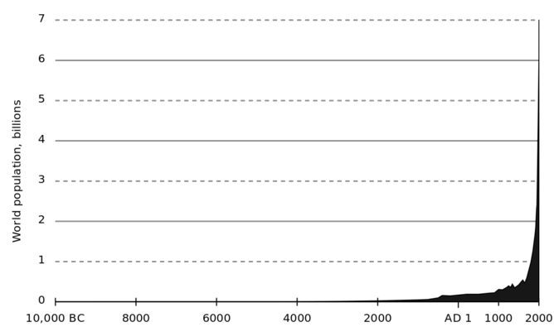
Skyrocketing population growth

Slide 5
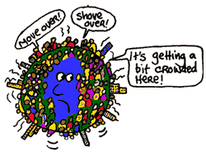

Slide 6
What we are facing
Possibly 12 billion people to feed by 2100
First, some research suggests global food production is stagnating. The green revolution hasn’t run out of steam just yet but innovations such as GM crops, more efficient irrigation and subterranean farming aren’t going to have a big enough impact. The low-hanging fruits of yield improvements have already been gobbled up. The easy gains have been made.

Slide 7
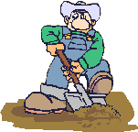
Need for chemicals that will probably cost more in the future.
Second, the current high yields assume plentiful and cheap supplies of phosphorus, nitrogen and fossil fuels – mainly oil and gas. Mineral phosphorus isn’t going to run out anytime soon, nor will oil, but both are becoming increasingly harder to obtain. All things being equal this will make them more expensive.

Slide 8

Soil depletion
Third, soil is running out. Or rather it is running away. Intensive agriculture which plants crops on fields without respite leads to soil erosion. This can be offset by using more fertilizer, but there comes a point where the soil is so eroded that farming there becomes very limited, and it will take many years for such soils to recover.

Slide 9
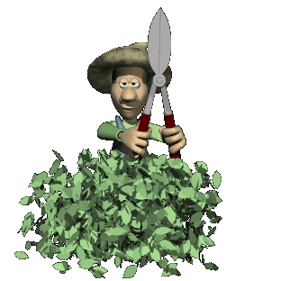
Fourth, it is not even certain we will be able to maintain yields in a world that is facing potentially significant environmental change. We are on course towards 2℃ of warming by the end of this century. Just when we have the greatest numbers of people to feed, floods, storms, droughts and other extreme weather will cause significant disruption to food production

Slide 10
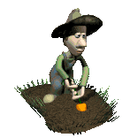
Research and Education Are Linchpins of Increased Productivity
To increase productivity and yield, we need advanced research and outreach. Developing new technologies must go hand in hand with education and extension services to share improved production practices and technologies with farmers. To be effective, technologies must be appropriate to place and people, recognizing the unique characteristics of growing regions, cultures, and economic and political conditions.

Slide 11
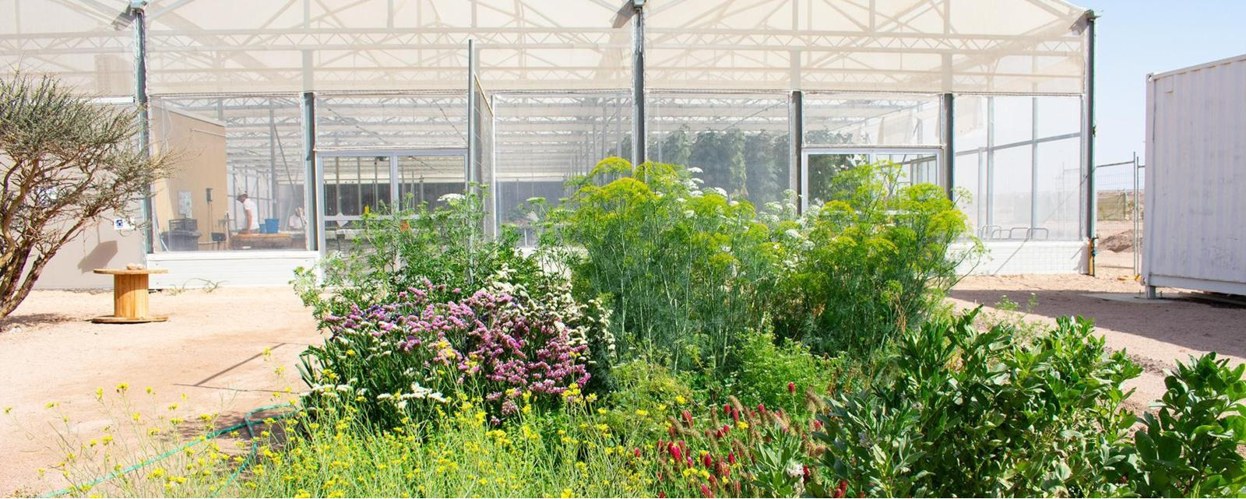
jordan

Slide 12
Seriously short of water!
One resource Jordan needs more of is water. The second most water-poor nation in the world, it has less than 150 cubic meters of water per person, per year. (The US has more than 9,000). Part of the problem is that the country is three-quarters desert. Another problem is agriculture. Farming sucks up half of Jordan’s water supply, but contributes only 3% to the country’s GDP.

Slide 13
What Jordan does have is sunshine – and plenty of it. On average, the country gets about 330 days of sun per year for an hourly average of between 5 and 7kW of energy per square meter. That’s enough to power 100 traditional light bulbs, 10 washing machines or, perhaps most relevant for Jordan, one air conditioner. It’s one reason why the US government’s International Trade Administration calls renewable energy one of Jordan’s best-prospect industries.

Slide 14
How can seawater help?
Jordan also has seawater… sort of. Though mostly landlocked, with its access to the Mediterranean separated by Israel and Lebanon, 26km of the country borders the Red Sea. That isn’t much coastline – but with the approach being taken by the Sahara Forest Project, that may be all it needs.

Slide 15
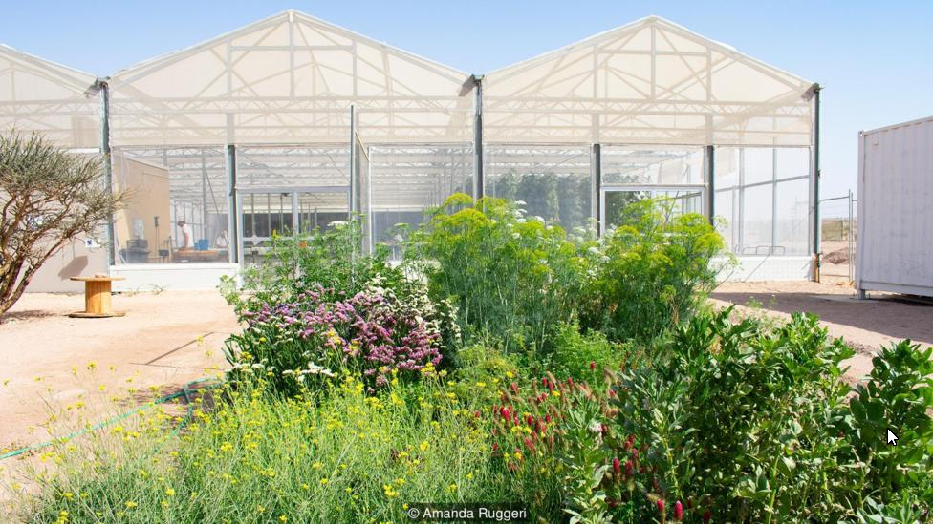
The project tackles challenges of food production, water scarcity and renewable energy at the same time
Currently, the country imports 98% of its food.

Slide 16
The project’s concept is elegant in its simplicity: Jordan’s solar energy desalinates the seawater, the desalinated water grows the crops (and the run-off cools the greenhouse) and the crops help plough carbon from the atmosphere back into the soil. Three tentpole challenges, tackled at once.

Slide 17
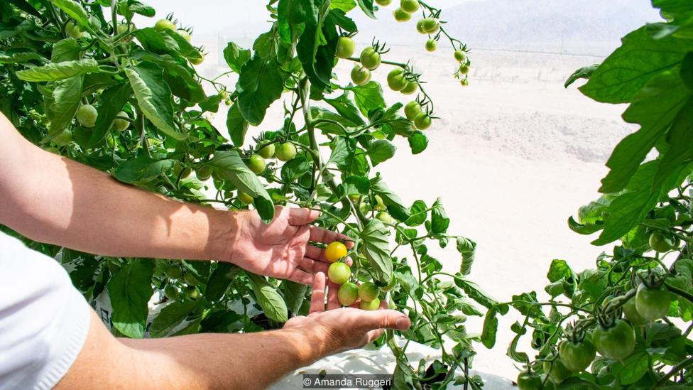
Tomatoes growing in the greenhouse
The team has already started tackling the difficulties of just how you use desalinated water to grow crops in the inhospitable desert.

Slide 18
With Jowett and facility manager Frank Utsola, I walk around the back of the greenhouse to the separate cooling room. The system is switched on: within what feels like moments, the air feels markedly more comfortable. The system can lower the temperature in the greenhouse by about 15C. In a region where summer days can get to 45C, unmanageable for even the heartiest of vegetables, this is key.

Slide 19
How it works “is very easy to explain”, says Utsola. Salt water is pumped into a pipe that runs along the top of the wind-facing wall. The wall is covered with a sort of ‘blanket’ that draws the water down; when the wind blows through, the water evaporates, cooling the air. (It works the same way as hanging a damp towel in your house on a hot day). At the same time, the heavier salt is left behind.

Slide 20
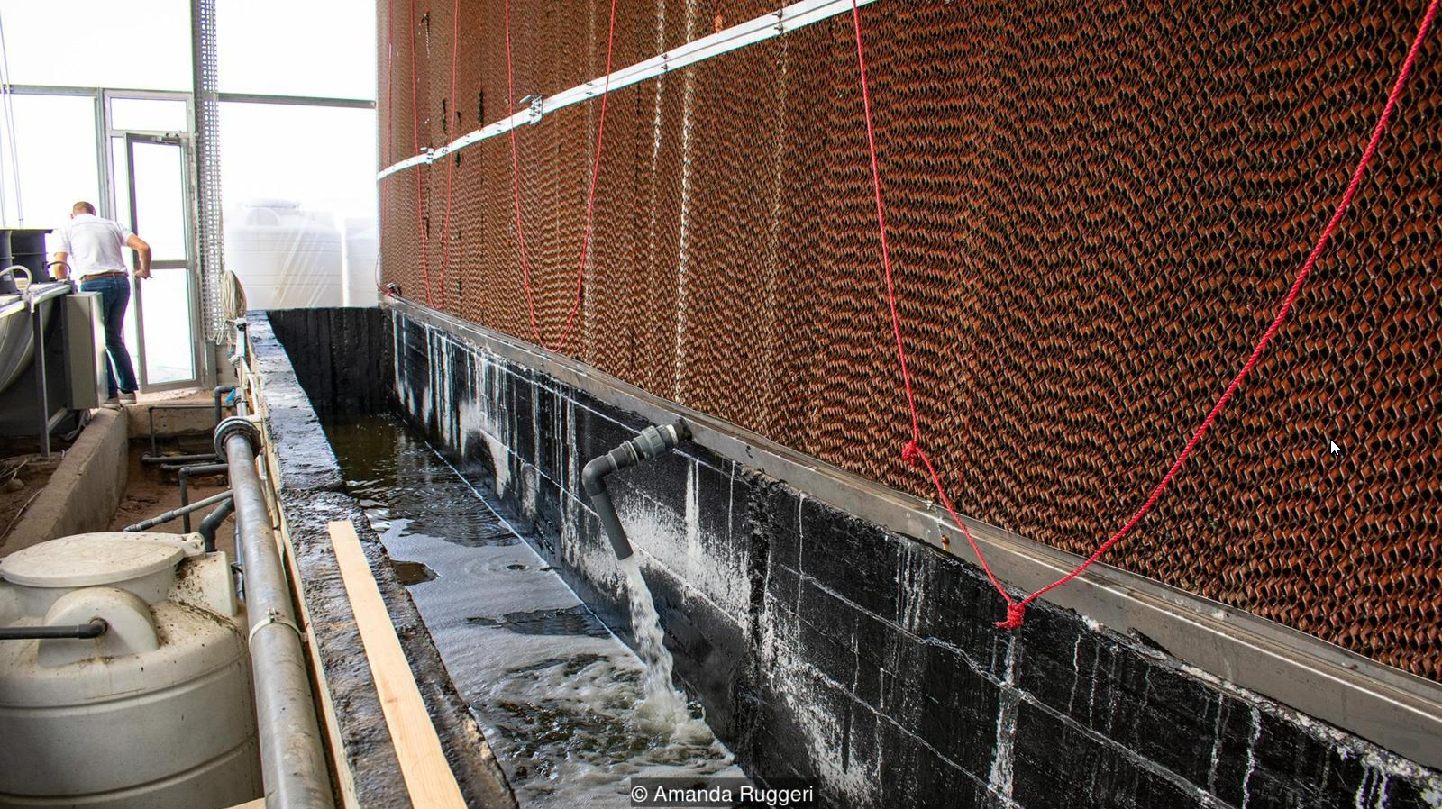
Desalinating air cooler

Slide 21
The Big Challenge
Taking a successful experimental system and turning it into a cost-effective, lareg-scale agricultural system.
Can enough food be produced to offset the cost of building and maintaining greenhouses and the cooling/desalinating machinery. The big plus is the cheap energy from solar power in a place where the sun shines almost every day.

Slide 22
The Challenge of Meeting Future Demand for Food – Meeting the Challenge: On the Ground in Uganda

Slide 23

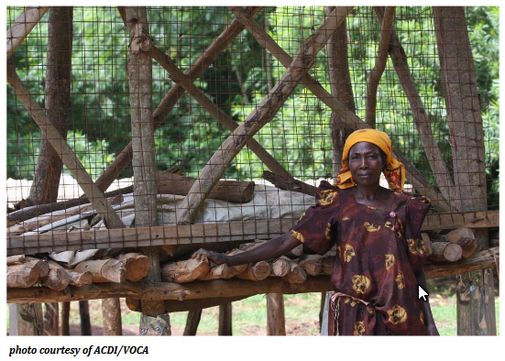
Today Saram no longer farms in isolation .

Slide 24
Five years ago, Saram heard about a Ugandan NGO – supported by a U.S.-based development NGO – that was helping smallholder farmers form farmer groups, grow better crops, reduce post-harvest waste, and sell their surplus. Saram signed up and was soon learning new techniques, such as proper spacing and weeding of crops, how to cultivate better varieties of vegetables, and how to use simple technologies such as maize cribs and elevated cassava-drying racks to reduce post-harvest losses. She also now grows vitamin A-rich foods in her kitchen garden to improve her children’s health.
As the contact farmer for her group, she — and her farm — serve as a model of good farming, health, and hygiene. Her farm now has a pit latrine, shower, and tippy tap (a simple device for washing hands), which reduce the risk of diarrhea, typhoid, and cholera.

Slide 25

It is these basic, yet needed, adjustments — learned through exchange and education between farmers — that producers around the world will need to make if they are to move from growing barely enough for themselves to growing enough to help feed 9 billion people in the near future.
This model could easily be adapted to worik in most developing countries.

