Slide 1
Atmospheric Heating & Cooling

Slide 2
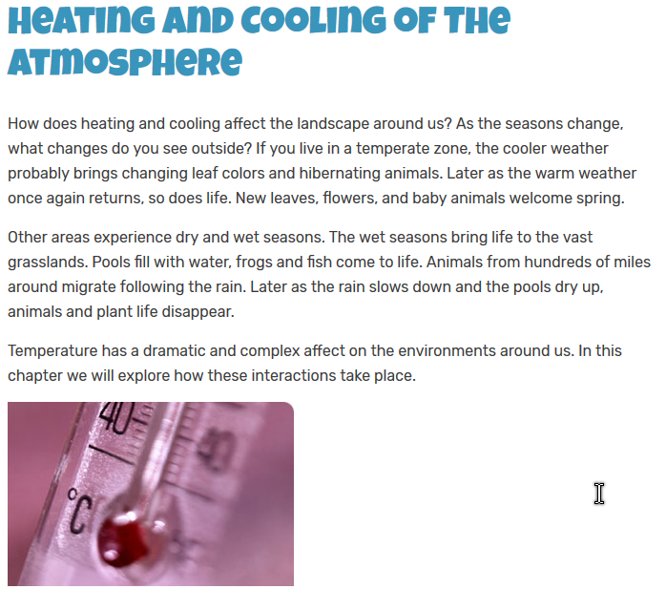

Slide 3
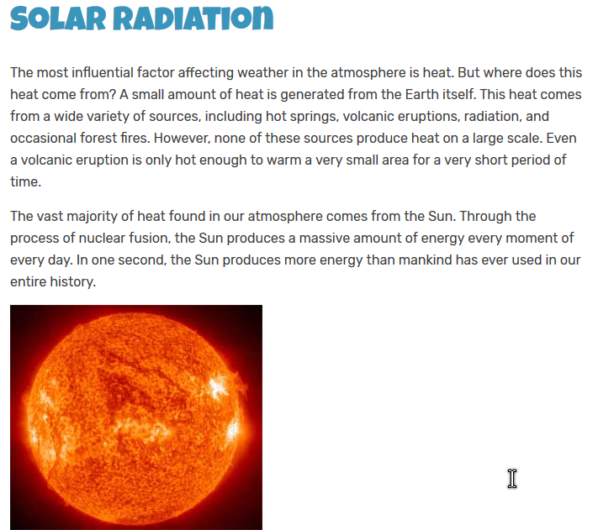

Slide 4
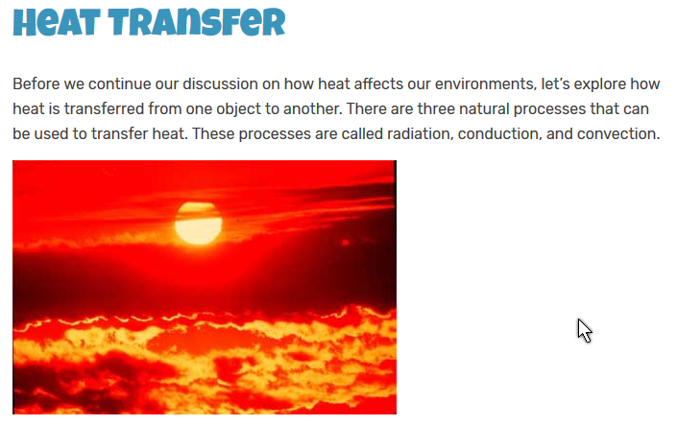
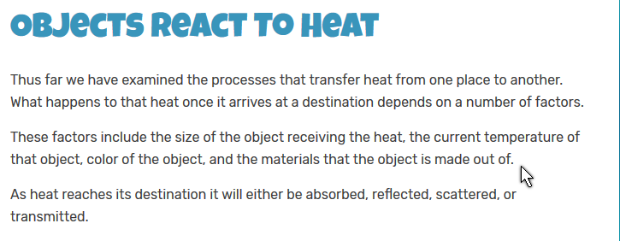

Slide 5
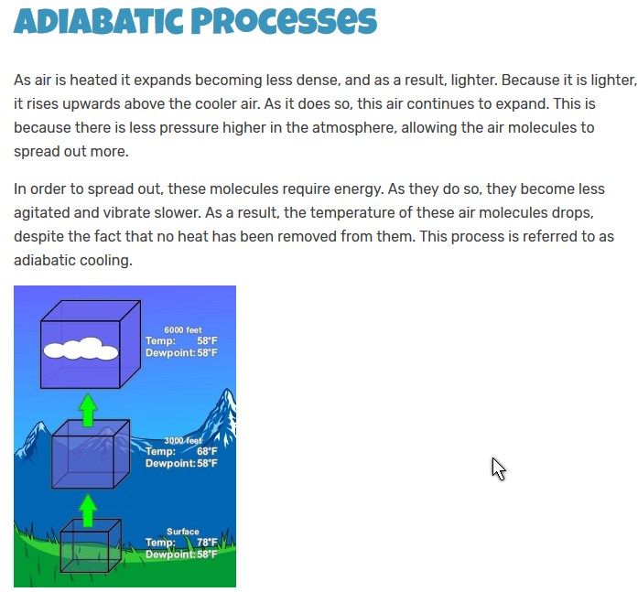

Slide 6
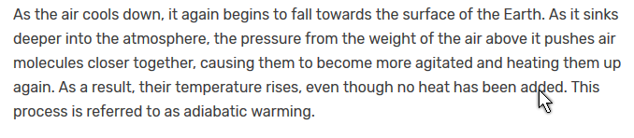
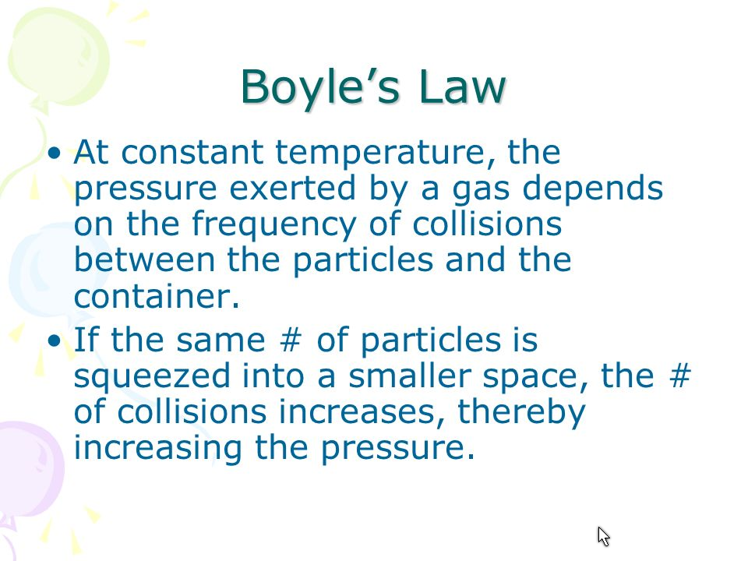

Slide 7
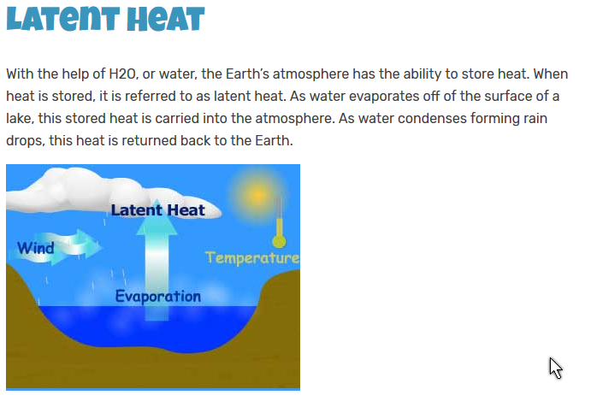

Slide 8
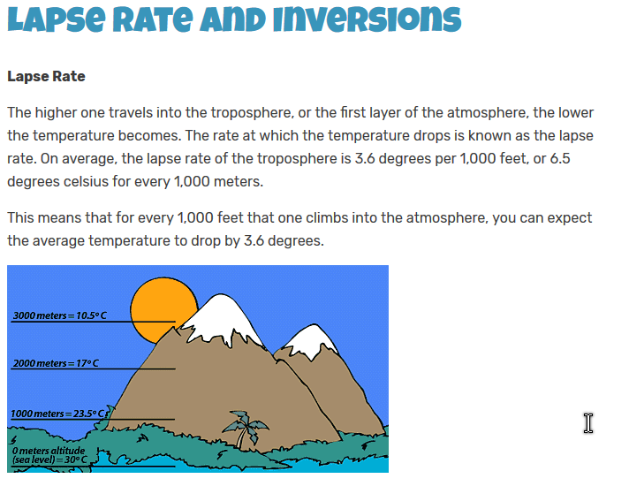
The reverse happens when air is descending = like on the other side of the mountain
3.6⁰F

Slide 9
Basic Principle
This expresses the dry adiabatic lapse rate. If there is moisture in the air, there some difference; however, for our purposes we need to remember that under normal conditions
  When a parcel of air rises, the temperature drops
  When a parcel of air descends, the temperature rises.

Slide 10
