Slide 1
Chapter 6
Air–Sea Interaction
Essentials of Oceanography
7th Edition

Slide 2
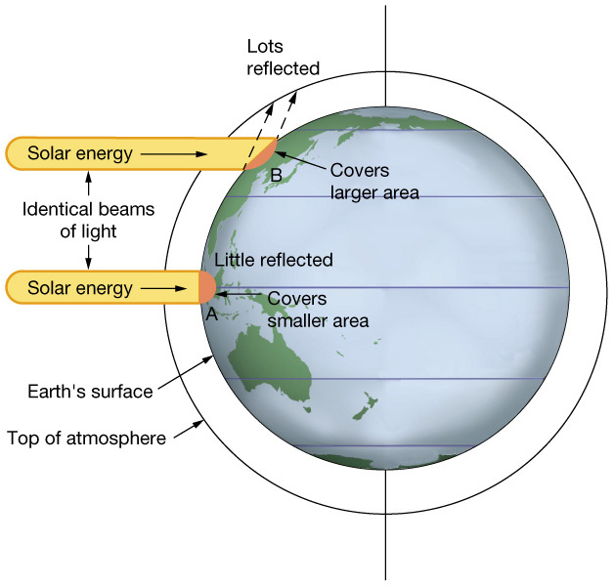
Uneven solar heating on Earth
Solar energy in high latitudes:
  Has a larger “footprint”
  Is reflected to a greater extent
  Passes through more atmosphere
  Is less than that received in low latitudes
Figure 6-1

Slide 3
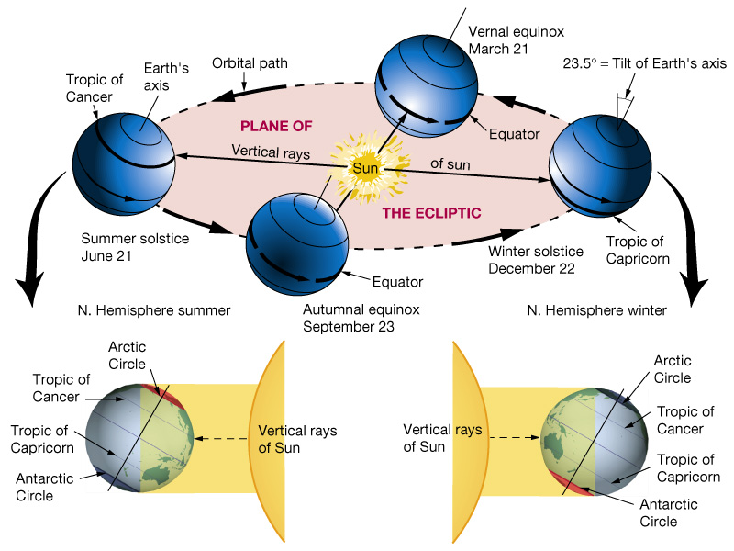
Earth’s seasons
Earth’s axis is tilted 23½º from vertical
Northern and Southern Hemispheres are alternately tilted toward and away from the Sun
Causes longer days and more intense solar radiation during summer
Figure 6-2

Slide 4
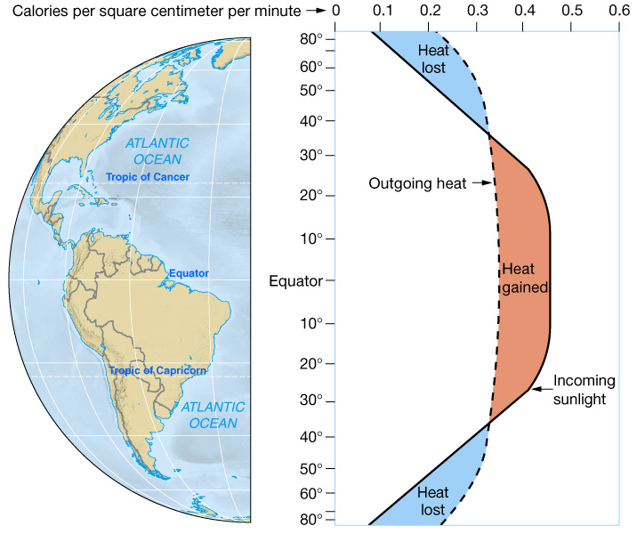
Oceanic heat flow
A net heat gain is experienced in low latitudes
A net heat loss is experienced in high latitudes
Heat gain and loss are balanced by oceanic and atmospheric circulation
Figure 6-3

Slide 5
Physical properties of the atmosphere: Composition (dry air)
Gas | Percent
Nitrogen (N₂) | 78.1%
Oxygen (O₂) | 20.9%
Argon (Ar) | 0.9%
Carbon dioxide (CO₂) | 0.036%
All others | Trace

Slide 6
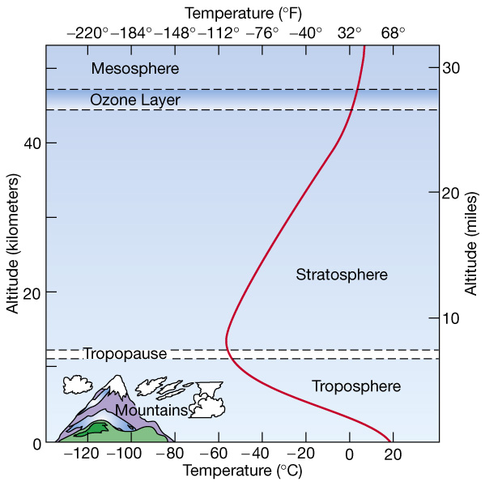
Physical properties of the atmosphere: Temperature
Troposphere is:
  Lowermost part of the atmosphere
  Where most weather occurs
Temperature of troposphere cools with increasing altitude
Figure 6-4

Slide 7
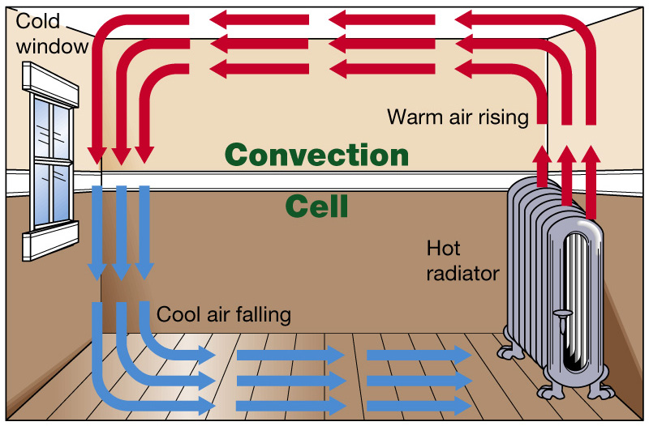
Physical properties of the atmosphere: Density
Warm, low density air rises
Cool, high density air sinks
Creates circular- moving loop of air (convection cell)
Figure 6-5

Slide 8
Physical properties of the atmosphere: Water vapor
Cool air cannot hold much water vapor, so is typically dry
Warm air can hold more water vapor, so is typically moist
Water vapor decreases the density of air

Slide 9
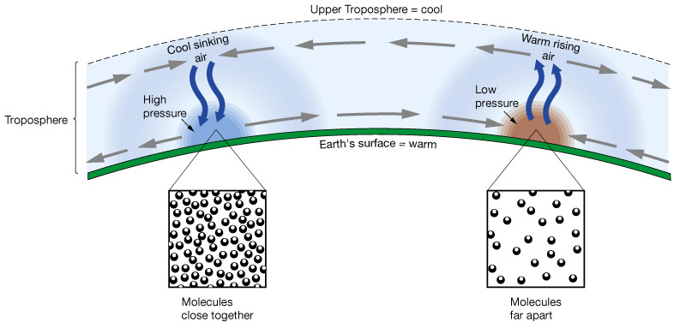
Physical properties of the atmosphere: Pressure
A column of cool, dense air causes high pressure at the surface, which will lead to sinking air
A column of warm, less dense air causes low pressure at the surface, which will lead to rising air
Figure 6-6

Slide 10
Physical properties of the atmosphere: Movement
Air always moves from high-pressure regions toward low-pressure regions
Moving air is called wind

Slide 11
The Coriolis effect
The Coriolis effect
  Is a result of Earth’s rotation
  Causes moving objects to follow curved paths:
    In Northern Hemisphere, curvature is to right
    In Southern Hemisphere, curvature is to left
  Changes with latitude:
    No Coriolis effect at Equator
    Maximum Coriolis effect at poles

Slide 12
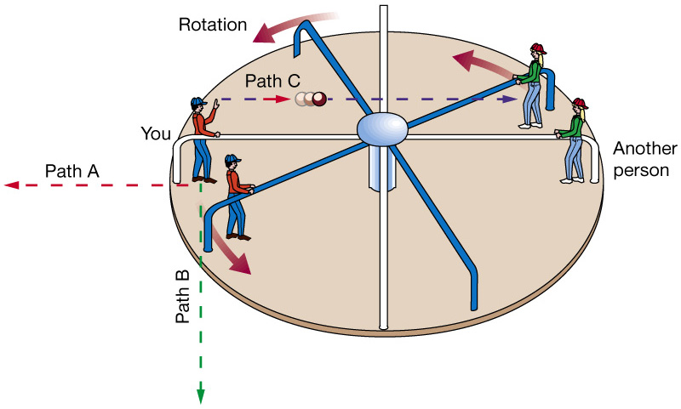
A merry-go-round as an example of the Coriolis effect
To an observer above the merry-go-round, objects travel straight
To an observer on the merry-go-round, objects follow curved paths
Internet video of balls being rolled across a moving merry-go-round
Figure 6-8

Slide 13
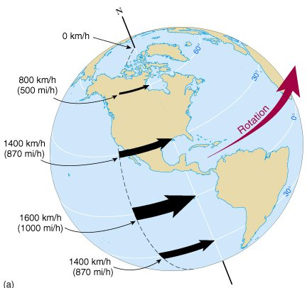
The Coriolis effect on Earth
As Earth rotates, different latitudes travel at different speeds
The change in speed with latitude causes the Coriolis effect
Figure 6-9a

Slide 14
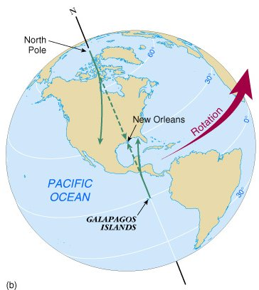
Missile paths demonstrate the Coriolis effect
Two missiles are fired toward a target in the Northern Hemisphere
Both missiles curve to the right
Figure 6-9b

Slide 15
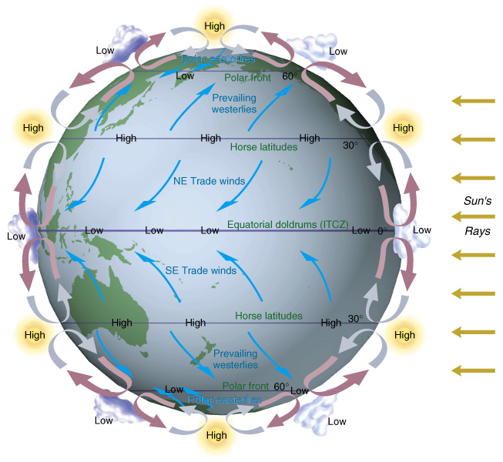
Wind belts of the world
Figure 6-10

Slide 16
Characteristics of wind belts and boundaries
Region/Latitude | Wind belt or boundary name | Characteristic
Equatorial (0-5º) | Doldrums | Low press. boundary
5-30º | Trade winds | Persistent easterlies
30º | Horse latitudes | High press. boundary
30-60º | Prevailing westerlies | Mid-latitude winds
60º | Polar front | Low press. boundary
60-90º | Polar easterlies | Cool easterly winds
Polar (90º) | Polar high pressure | High press. boundary

Slide 17
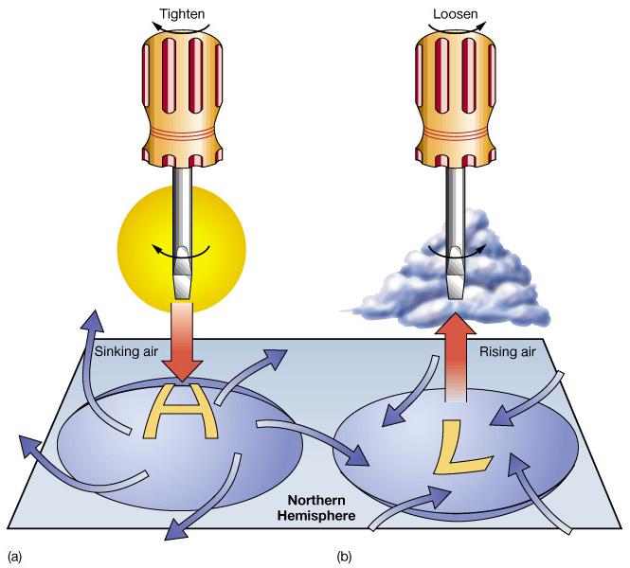
Coriolis effect influences air movement
Northern Hemisphere winds curve to the right as they move from high to low pressure
Causes wind to circulate:
  Clockwise around high-pressure regions
  Counterclockwise around low-pressure regions
Figure 6-12

Slide 18
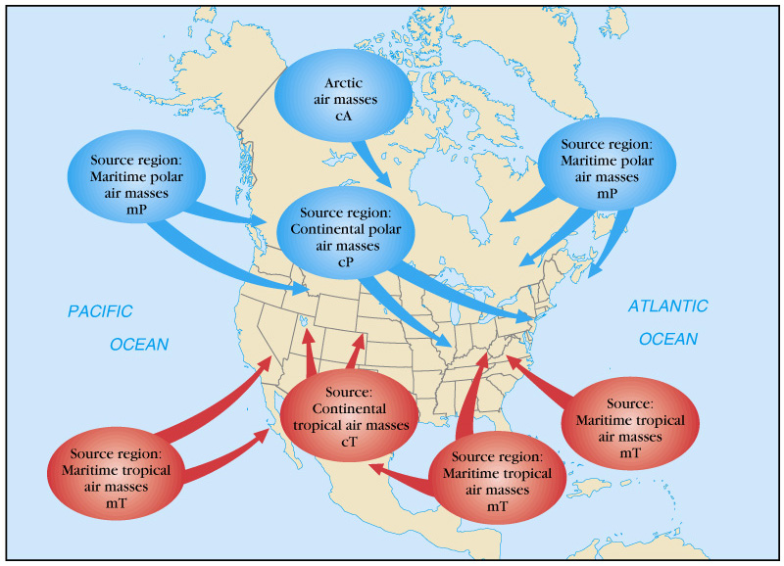
Air masses that affect U.S. weather
Figure 6-14

Slide 19
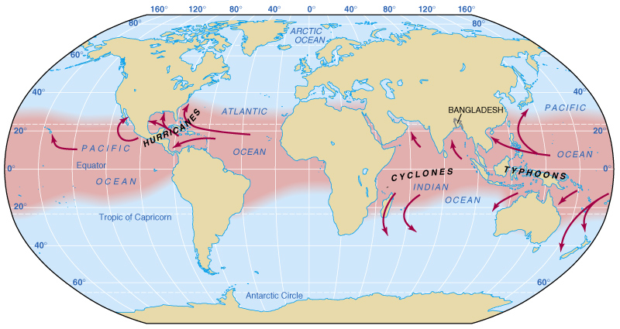
Origin and paths of tropical cyclones
Tropical cyclones are intense low pressure storms created by:
  Warm water
  Moist air
  Coriolis effect
Includes:
  Hurricanes
  Cyclones
  Typhoons
Figure 6-16

Slide 20
Hurricane occurrence
Hurricanes have wind speeds of at least 120 kilometers (74 miles) per hour
Worldwide, about 100 storms grow to hurricane status each year
In the Northern Hemisphere, hurricane season is generally between June 1 and November 30
Current state of the tropical oceans

Slide 21
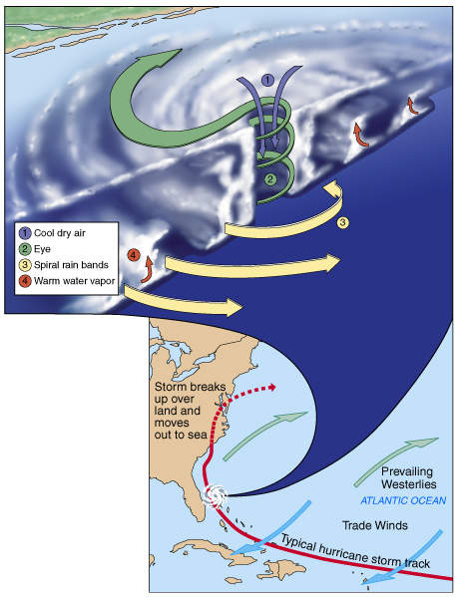
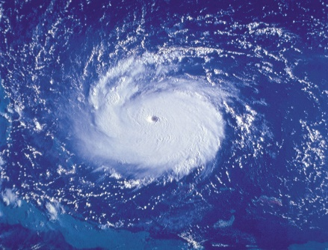
Hurricane structure
Hurricanes have:
  Circular cloud bands that produce torrential rain
  The ability to move into the mid-latitudes
  A central eye
Figure 6-17
Figure 6-19a

Slide 22
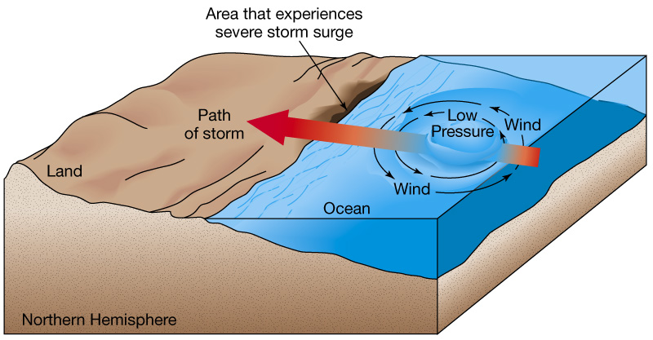
Hurricanes produce storm surge
Storm surge:
  Is a rise in sea level created by hurricane coming ashore
  Can be up to 12 meters (40 feet) high
  Causes most destruction and fatalities associated with hurricanes
Figure 6-18

Slide 23
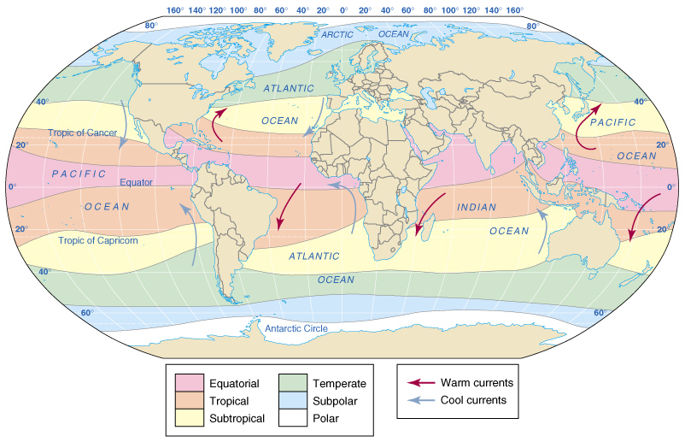
Climate regions of the ocean
Figure 6-20

Slide 24
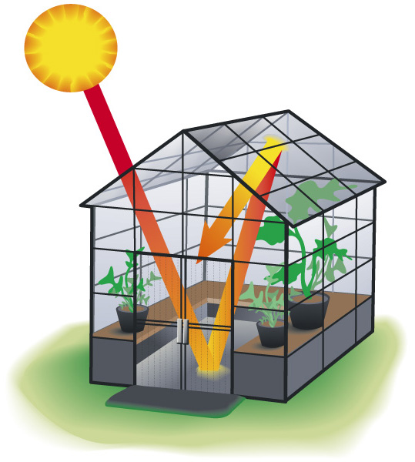
How a greenhouse works
Sunlight passes through the clear covering of a greenhouse
It converts to longer wavelength heat energy
Heat cannot pass through the covering and is trapped inside
Figure 6-21

Slide 25
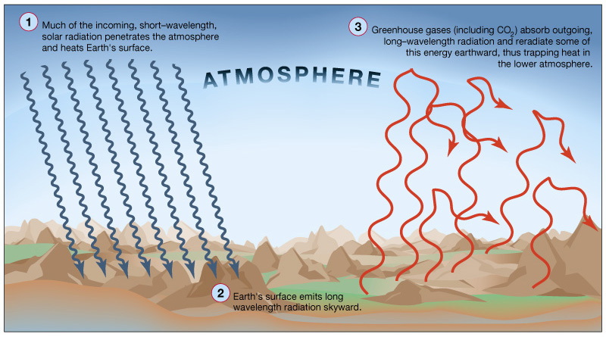
The heating of Earth’s atmosphere
Figure 6-23

Slide 26
Anthropogenic gases that contribute to the greenhouse effect
Greenhouse Gas | Relative contribution
Carbon dioxide (CO₂) | 60%
Methane (CH₄) | 15%
Nitrous oxide (N₂O) | 5%
Tropospheric ozone (O₃) | 8%
CFC-11 | 4%
CFC-12 | 8%

Slide 27
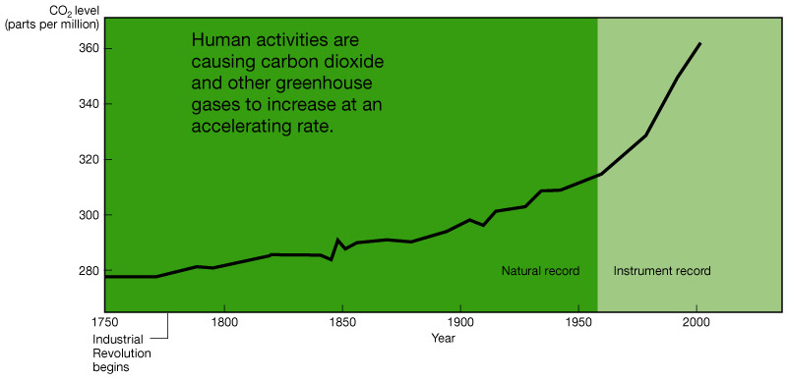
Carbon dioxide is increasing in the atmosphere
As a result of human activities, carbon dioxide in the atmosphere has increased by 30% since 200 years ago
Figure 6-24

Slide 28
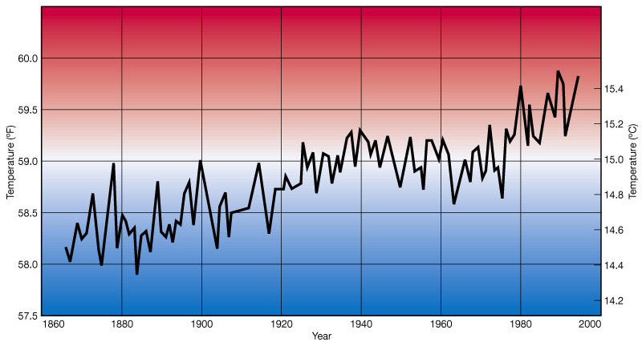
Earth’s average temperature is rising
Earth’s average surface temperature has risen at least 0.6°C (1.1°F) in the last 130 years
May be related to increase in atmospheric carbon dioxide
Figure 6-25

Slide 29
Predicted changes with increased greenhouse warming
Higher than normal sea surface temperatures that could affect world climate
More severe droughts or increased precipitation
Water contamination and outbreaks of water-borne diseases
Longer and more intense heat waves
Shifts in the distribution of plants and animals
Potential melting or enlargement of polar ice caps

Slide 30
End of Chapter 6
Essentials of Oceanography
7th Edition

