Slide 1
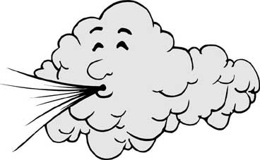
The Coriolis Effect

Slide 2
Air pressure differences cause the movement of air
Air moving parallel to the ground is called wind
Air moving up or down is called a current

Slide 3
Air generally moves from the poles to the equator, this is because air flows from high pressure to low pressure
High pressure forms when cold air sinks (at the poles)
Low pressure forms when warm air rises (at the equator)
But the air doesn’t flow in a straight line

Slide 4
Coriolis Effect
Causes air to move in a curved path
It is caused by the Earth spinning on its axis
The Earth spins fastest at the equator, and slowest near the poles
As air moves from the equator to the pole, it will travel east faster than the land beneath it causing the air to follow a curved path

Slide 5
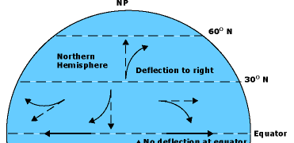
So the coriolis effect causes wind flowing from high pressure to low pressure to curve as the wind moves
In the Northern Hemisphere, the coriolis effect causes things to curve to the Right of the Observer
In the Southern Hemisphere, the coriolis effect causes things to curve to the Left of the observer

Slide 6
Wind
Winds are created because of the uneven heating the Earth
As discussed before, air moves from high pressure to low pressure
Areas that are warmer are low pressure areas, so wind blows toward low pressure
Areas that are colder are high pressure areas, so wind blows away from high pressure
There are two types of winds
Planetary (or global)
local

Slide 7
Planetary wind
These winds blow across the entire planet
They generally blow at the same speed and direction
Some are high in the atmosphere and you cannot feel them on the ground
Each hemisphere contains 3 wind belts that divide up the planetary winds
Trade winds, Westerlies, and Easterlies

Slide 8
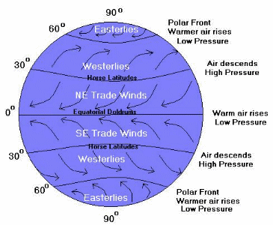
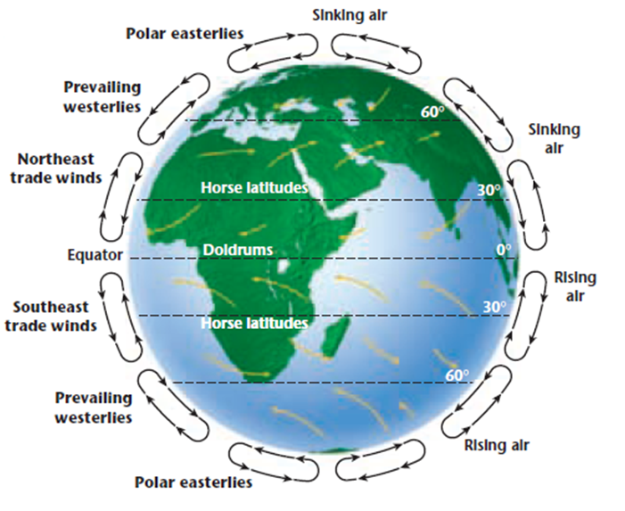
Global Wind Patterns

Slide 9
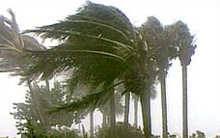
Local Winds
These winds blow over small areas
Unlike planetary winds, local winds can change speed and direct frequently
These are the winds we feel on the ground
They are influenced by local conditions and local temperature variations

Slide 10
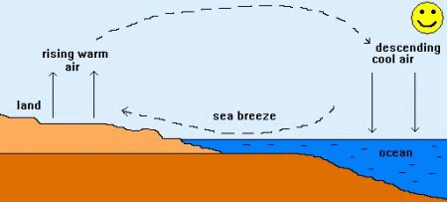
Local Wind cont.
Land and sea breezes
During the day, the land heats up faster than the water, so a breeze will blow from the sea to the land, called a sea breeze

Slide 11
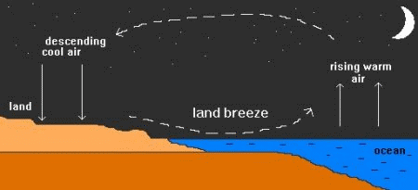
Local winds cont.
At night, the land will cool off faster than the water, so the cool land air will flow toward the warmer ocean water air, creating a land breeze, where the wind blows from the land to the sea

Slide 12
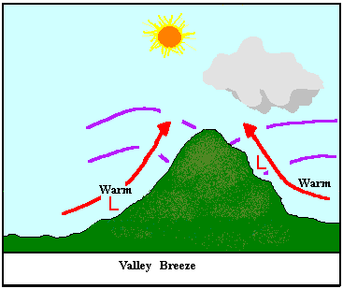
Local Winds cont.
Mountain and Valley Breezes
During the day, the valley heats up, so the warm less dense air flows up the mountain, creating a valley breeze

Slide 13
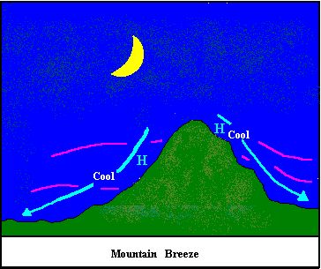
Local winds cont.
At night, the mountain will cool off faster than the valley, so the cool mountain air descends because it is more dense, creating a mountain breeze

Slide 14
