Slide 1
Climate Change and Hurricanes
Some Simple Basic Principles

Slide 2
Formation
Hurricanes are the most violent storms on Earth. They form near the equator over warm ocean waters. Actually, the term hurricane is used only for the large storms that form over the Atlantic Ocean or eastern Pacific Ocean. The generic, scientific term for these storms, wherever they occur, is tropical cyclone.

Slide 3
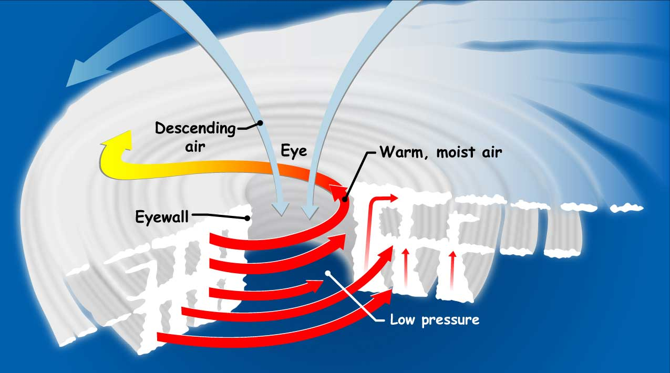

Slide 4
What powers hurricanes?
Warm ocean waters and thunderstorms fuel power-hungry hurricanes.
A pre-existing weather disturbance: A hurricane often starts out as a tropical wave.
Warm water: Water at least 26.5 degrees Celsius over a depth of 50 meters powers the storm.
Thunderstorm activity: Thunderstorms turn ocean heat into hurricane fuel.

Slide 5
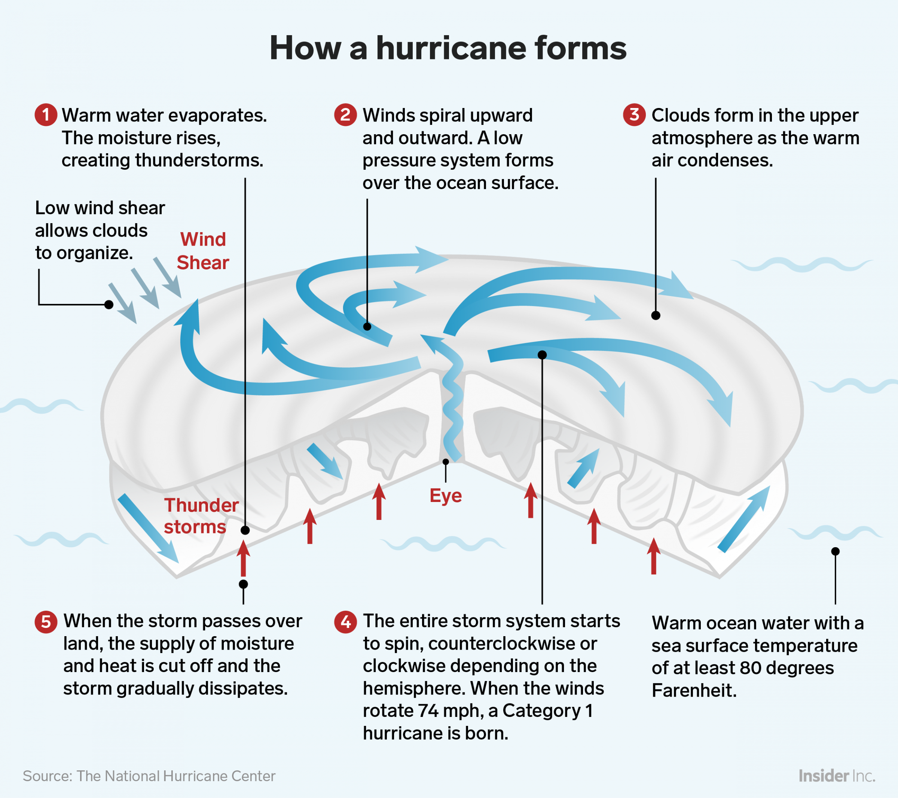
What about global warming?
Warmer ocean temperatures (they are getting warmer) should add warmth to the air and add to increased humidity. This should provide more “hurricane fuel.” This should produce stronger hurricanes.

Slide 6
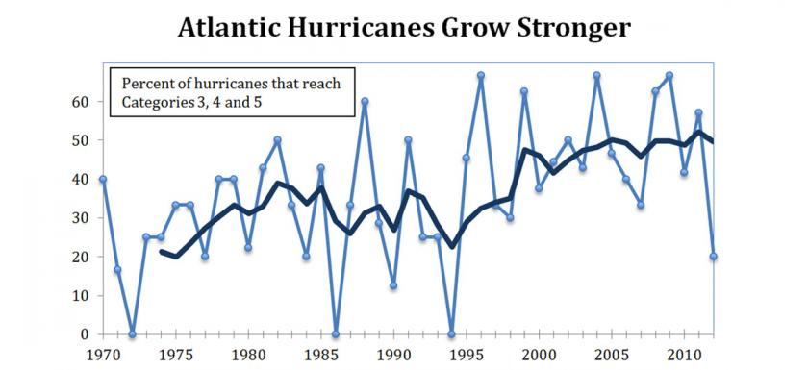
The trend is that the frequency of severe hurricanes has been increasing

Slide 7
Landfall of Stronger Hurricanes Produces:
Faster, stronger winds = more serious damage to structures
Higher storm surges = more damage over a larger area
What in human terms?
More displaced persons
More deaths
More disease
Huge claims on insurance companies

Slide 8
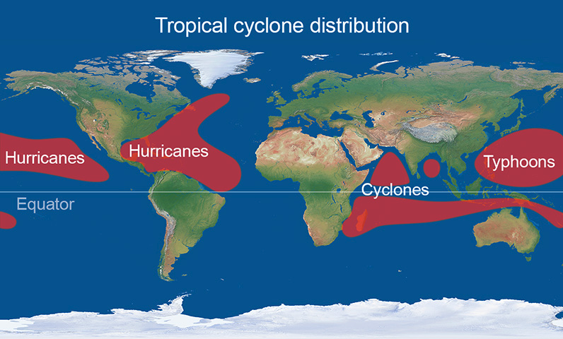
Where do tropical cyclones tend to form?

Slide 9
What happens when hurricanes make landfall?
Let’s use hurricane Michael (October 2018) for an example

Slide 10
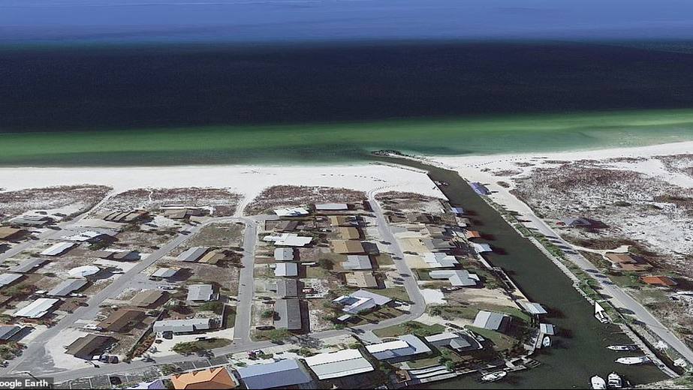
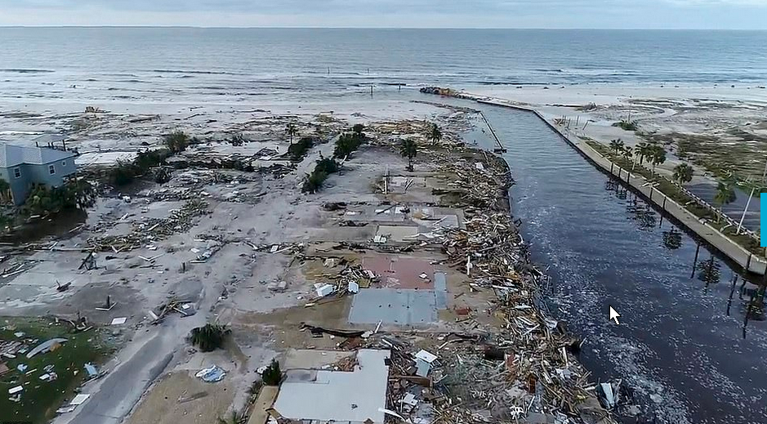

Slide 11
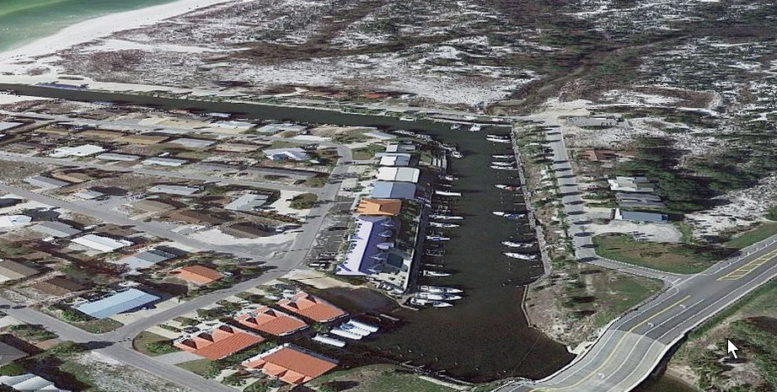
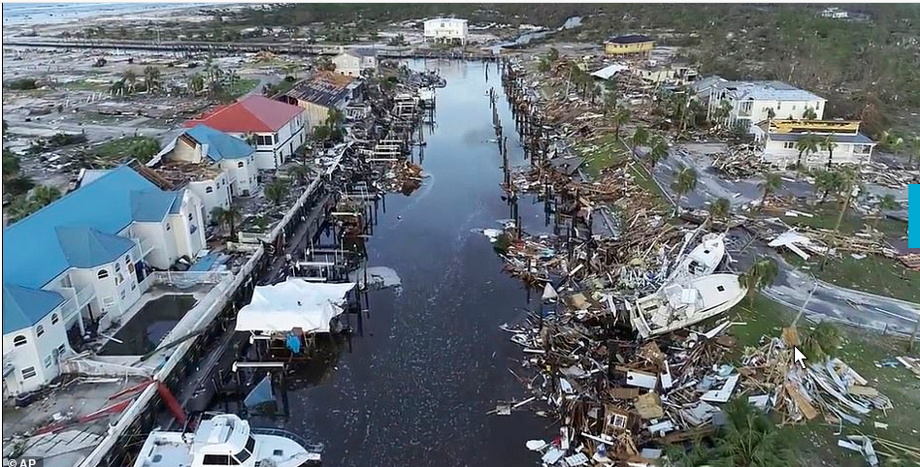

Slide 12
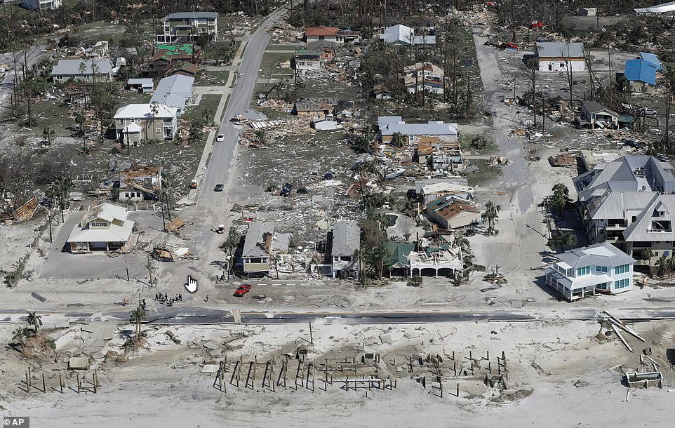
Some homes in Mexico Beach were completely carried away by towering storm surges

Slide 13
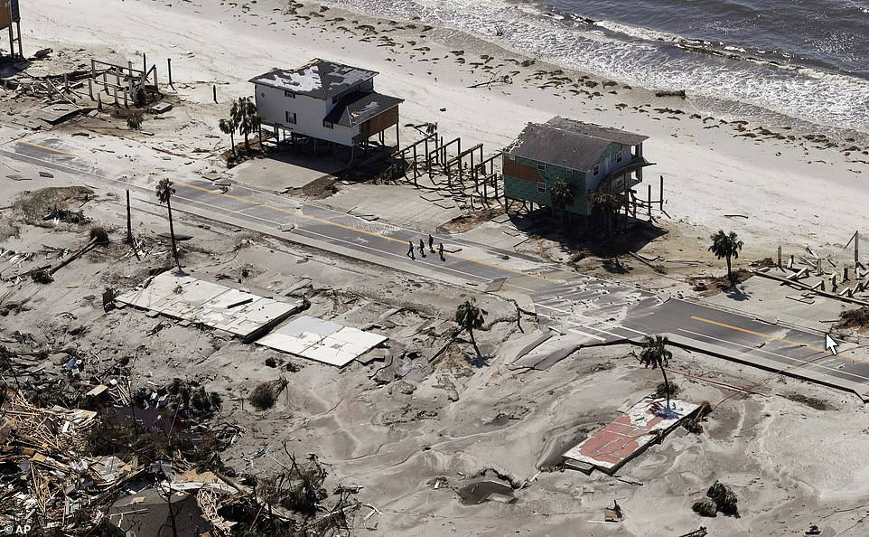
Concrete slabs were all that was left in some parts of Mexico Beach after the hurricane brought strong winds and storm surge

Slide 14
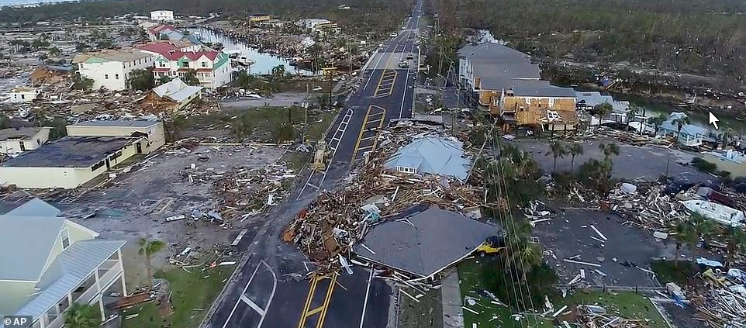
Search-and-rescue teams fanned out on Thursday across Mexico Beach to reach trapped people by Michael

Slide 15
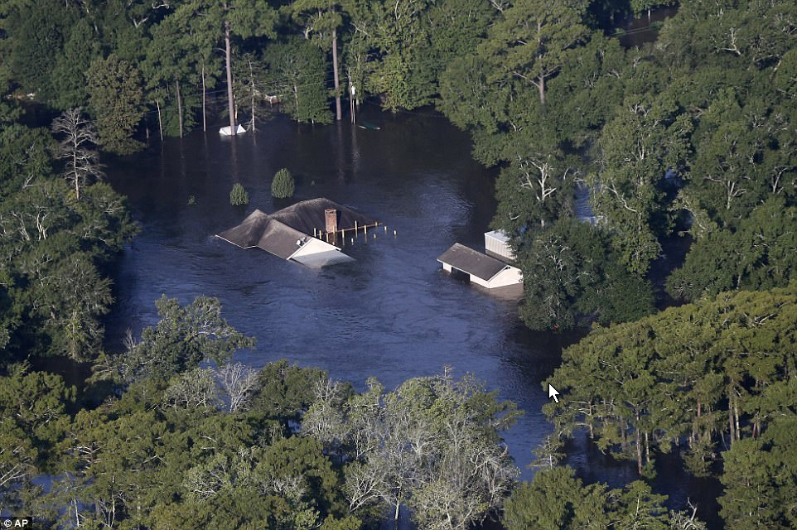
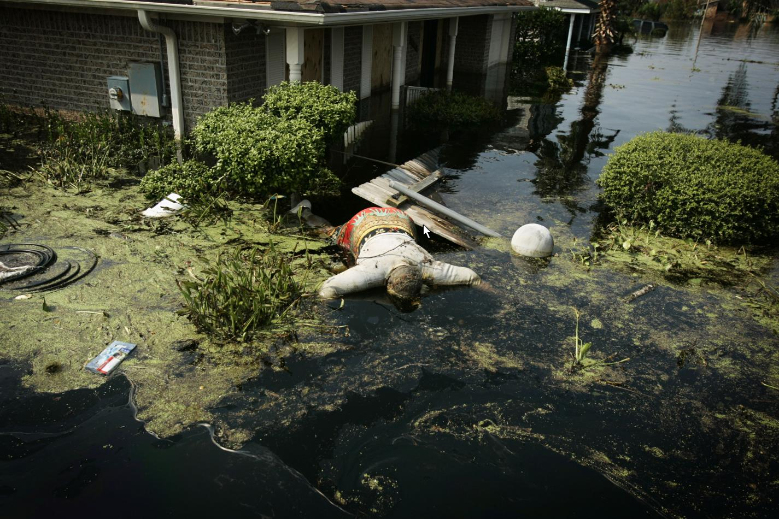
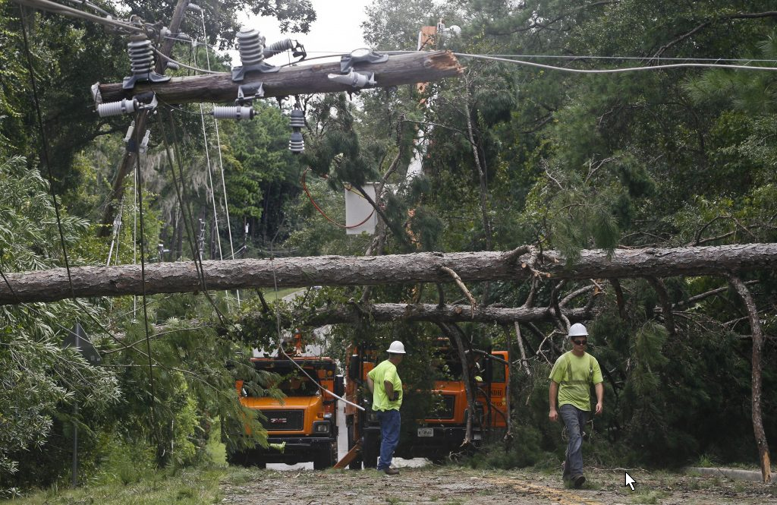
Destruction and Death

Slide 16

Cost estimates

Slide 17
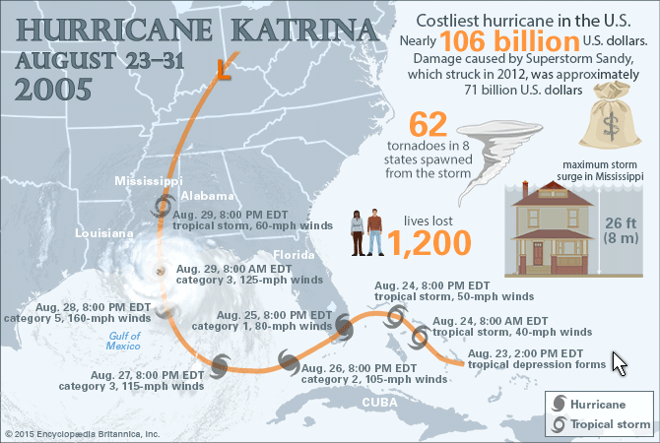

Slide 18
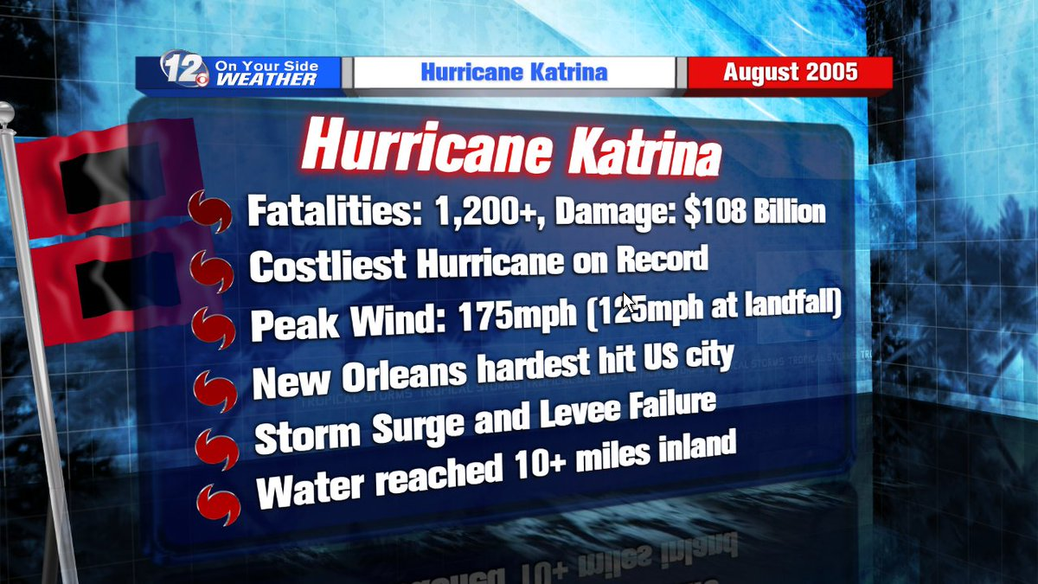

Slide 19
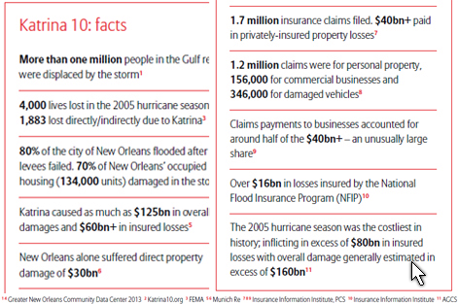

Slide 20
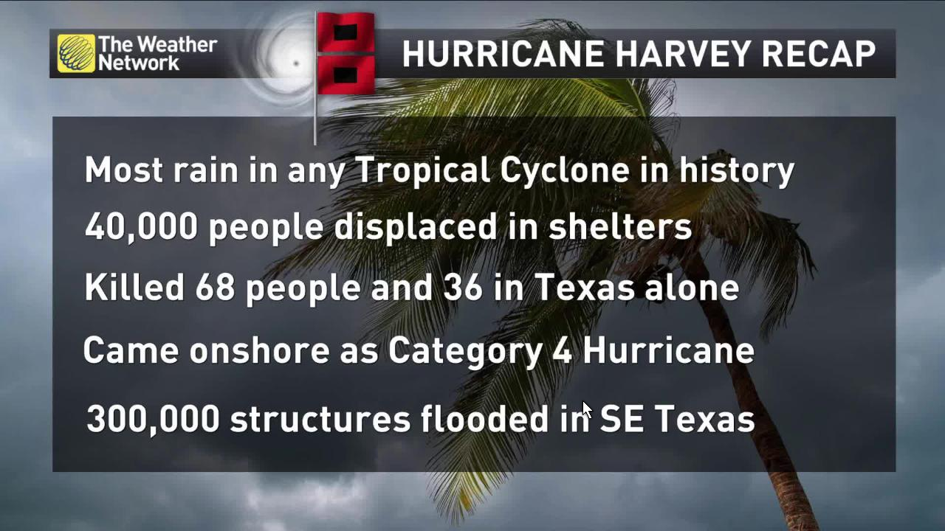

Slide 21
Who/what, besides humans, was affected by the hurricane?

Slide 22
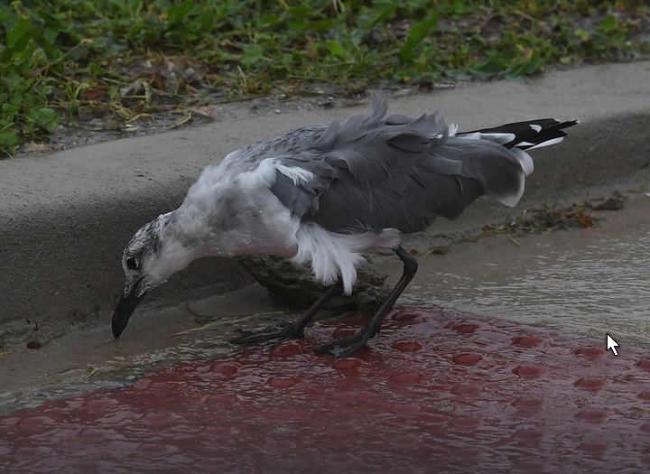
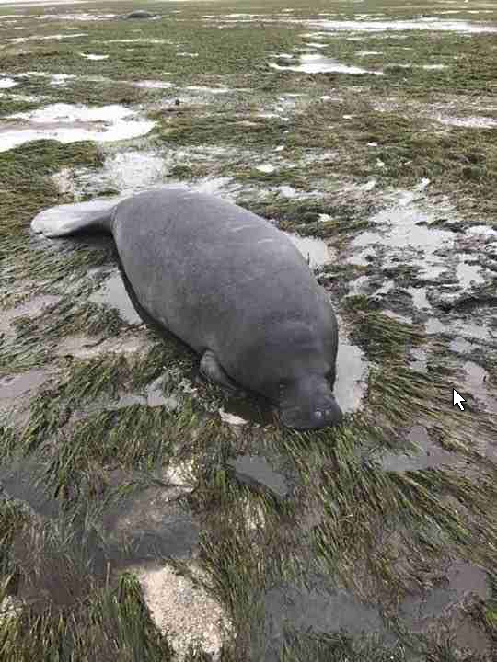
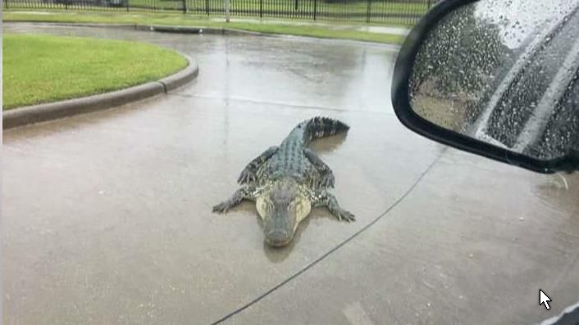
Some animals die, some are injured, some find themselves transplanted to strange places.
injured
Stranded far from its habitat
Temporarily relocated

Slide 23
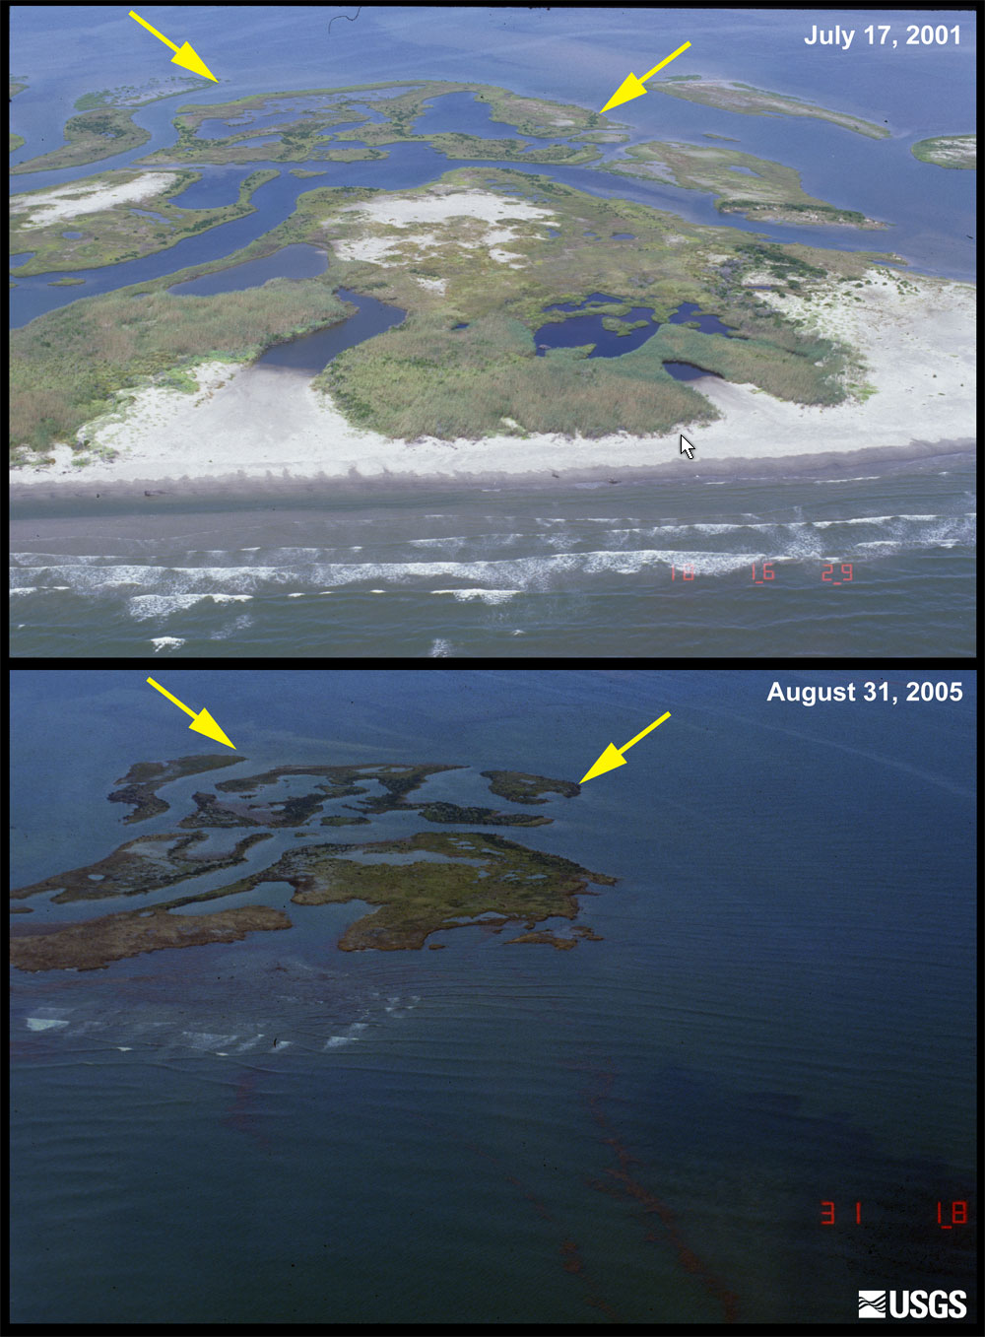
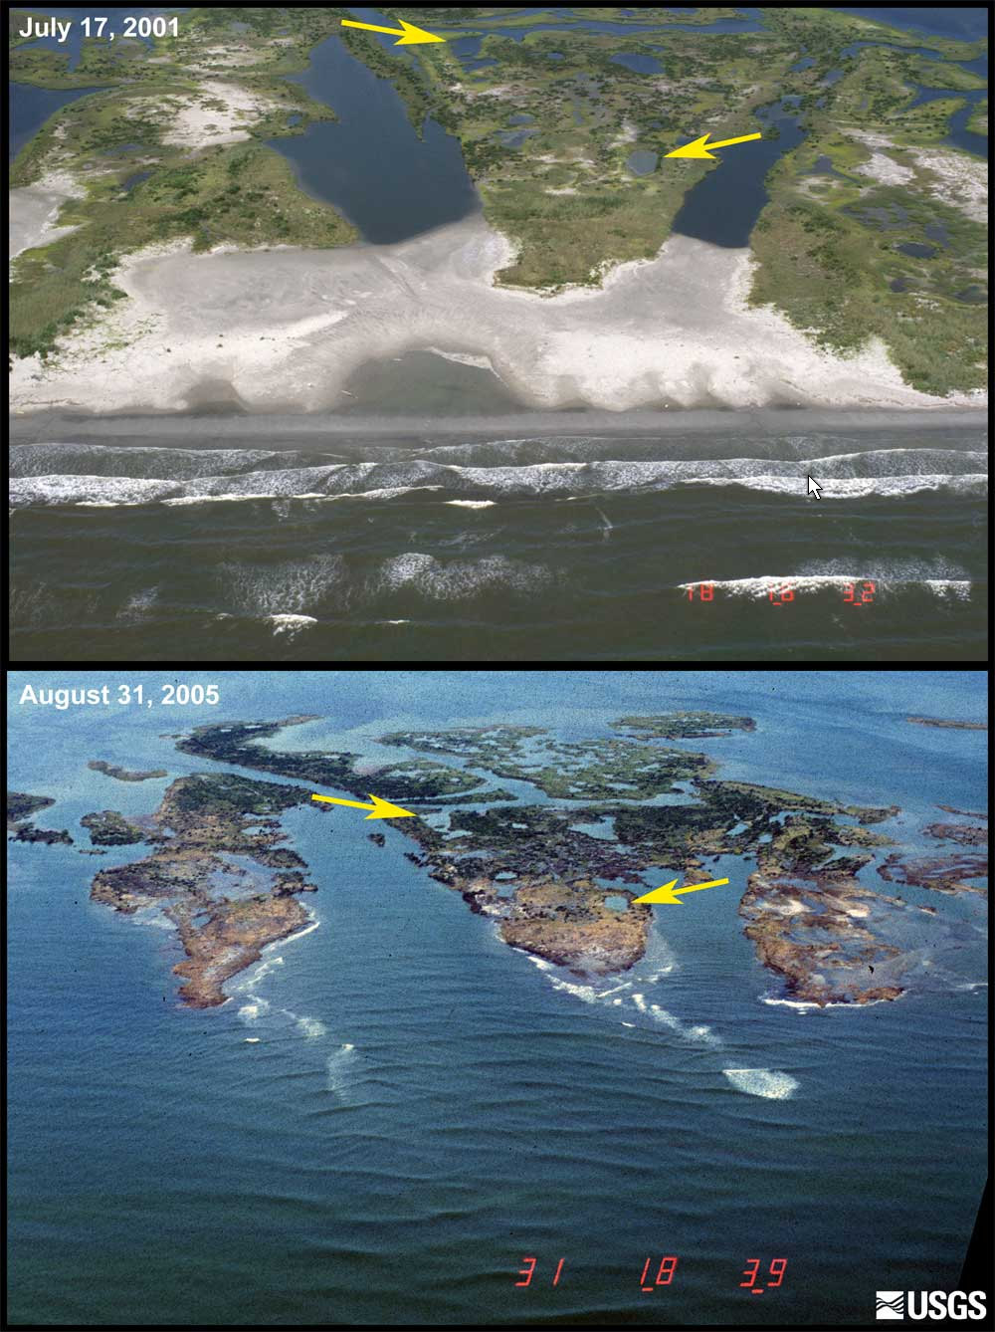
Before and After

Slide 24
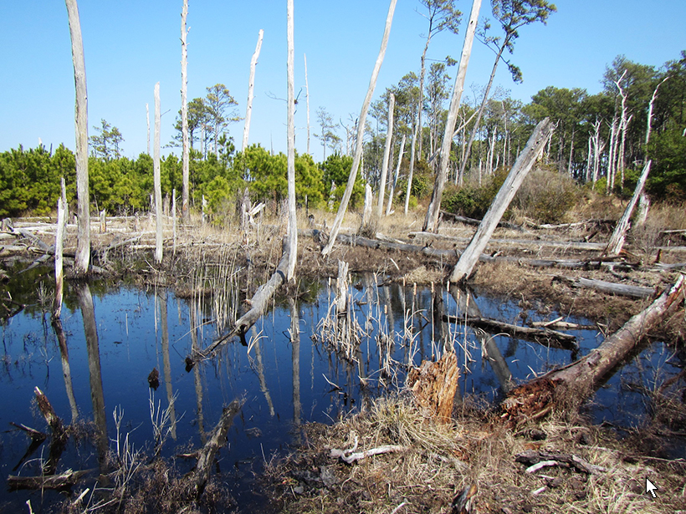
Damaged wetland
Wetlands are breeding and feeding grounds for many species that will be negatively impacted by the temporary loss of this wetland’s full benefits. They also serve as rest stops and fueling stations for many migratory species.
Who is affected?
Fish
Amphibians
Reptiles
Small mammals
birds

Slide 25
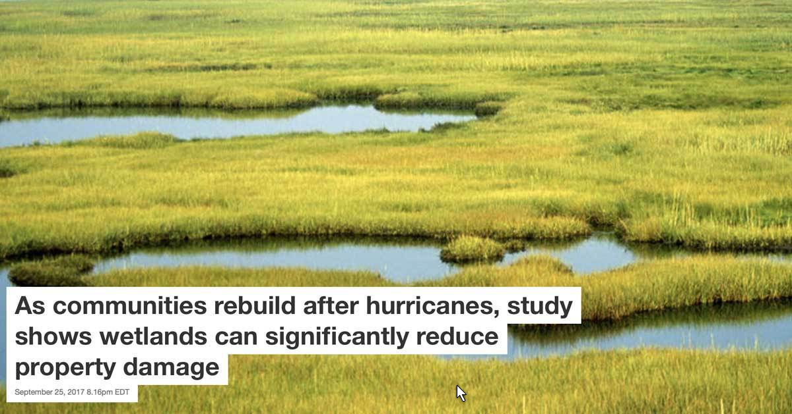

Slide 26
Coastal wetlands can act like ‘shag carpet’ during a hurricane
Wetland areas – broadly defined as the transitional spaces between aquatic and terrestrial environments – impede flooding in two ways.The freshwater type (like the kind you might find within Stone Harbor’s Bird Sanctuary, along a riverbank, at a cranberry bog in the Pinelands, or within the Cape May County Zoo) serve as a sponge, absorbing a million gallons of floodwater per acre before that floodwater can absorb your garage. To a lesser level, coastal wetlands do this, too, but they also work to weaken wave action.

