Slide 1
Introduction to Biomes and Climatograms (Climographs)

Slide 2
Climographs
The temperatures shown are monthly averages
First the daily averages are figured: add the high and the low and divide by 2. If the high was 80 and the low was 50, the average is 65 degrees Fahrenheit
Then add all the daily averages and divide by the number of days in that month (28, 29, 30, or 31)
Then the averages for January for 100 or more years are added and averaged. That’s what goes on the graph.
So when all 12 months are arranged in a line graph, you see the general pattern of temperatures for the year.
What you don’t see are the extremes For example a climograph for St. Louis won’t show that the lowest ever was -23 degrees Fahrenheit and the higest was 115.

Slide 3
Climographs
The precipitation pattern is shown by the bar graph
For each month, they average the amount of precipitation received for 100 or more years (as long as they have been keeping records)
What you get is a general pattern of yearly precipitation – do all months get about the same amount? Are there wet months and dry months.
You also get the average yearly total amount of precipitation.
What you don’t get was the driest for that month and what year was the wettest. What was the lowest yearly total and what was the highest yearly total.

Slide 4
These graphs are quite useful to get an idea of the general patterns of a particular place. But you do not get the extremes. Some climographs give two line graphs. One for the average monthly highs and the other for the average monthly lows. This gives a little more realistic picture; however, it doesn’t show the extremes either.

Slide 5
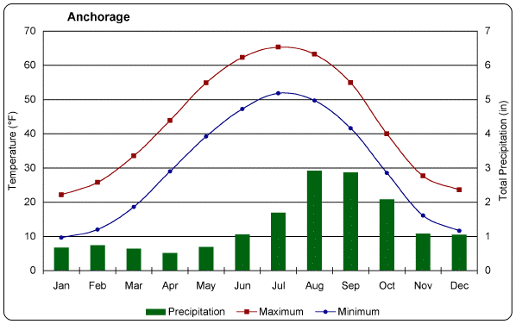

Slide 6
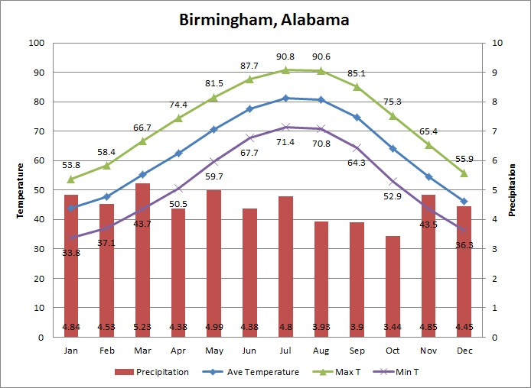
How about this one?

Slide 7
A rather typical climograph is given for each of the biome types
You will notice that there is a great variety among them.

Slide 8
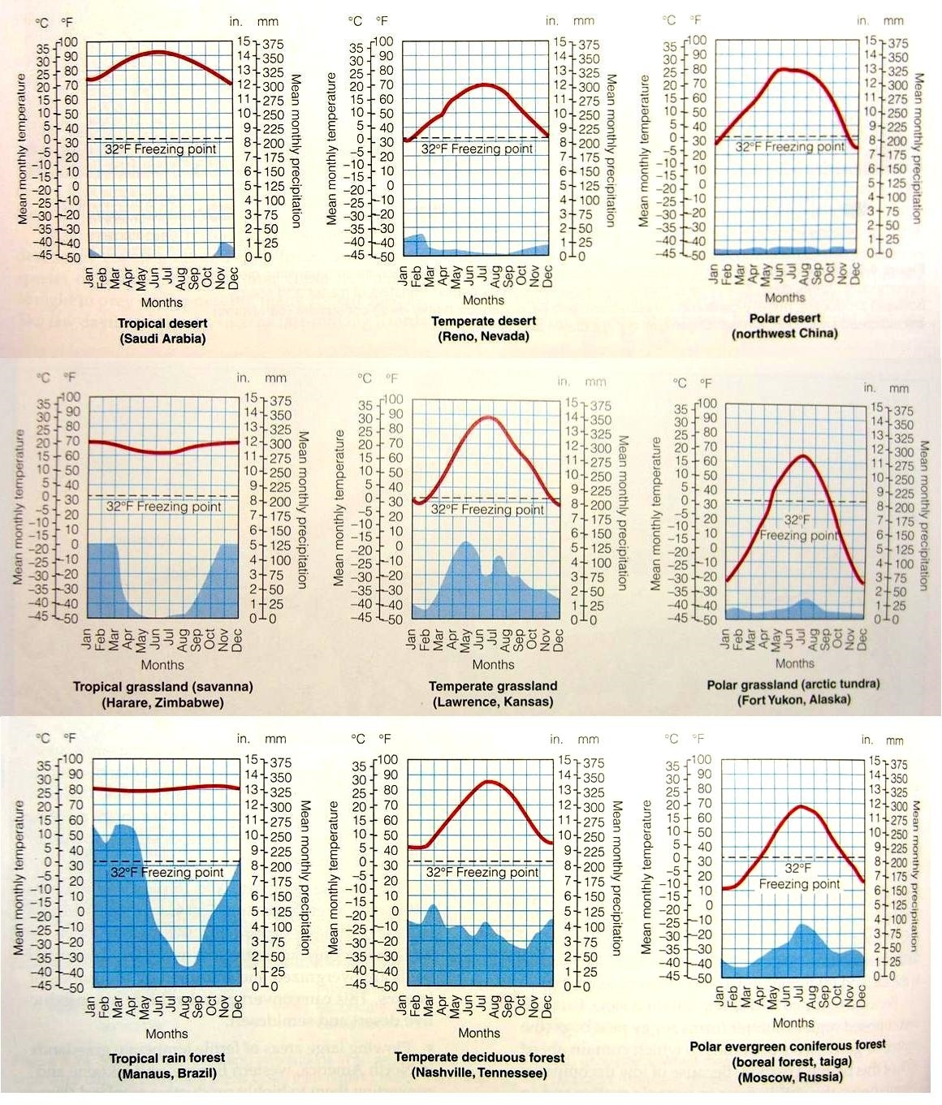

Slide 9
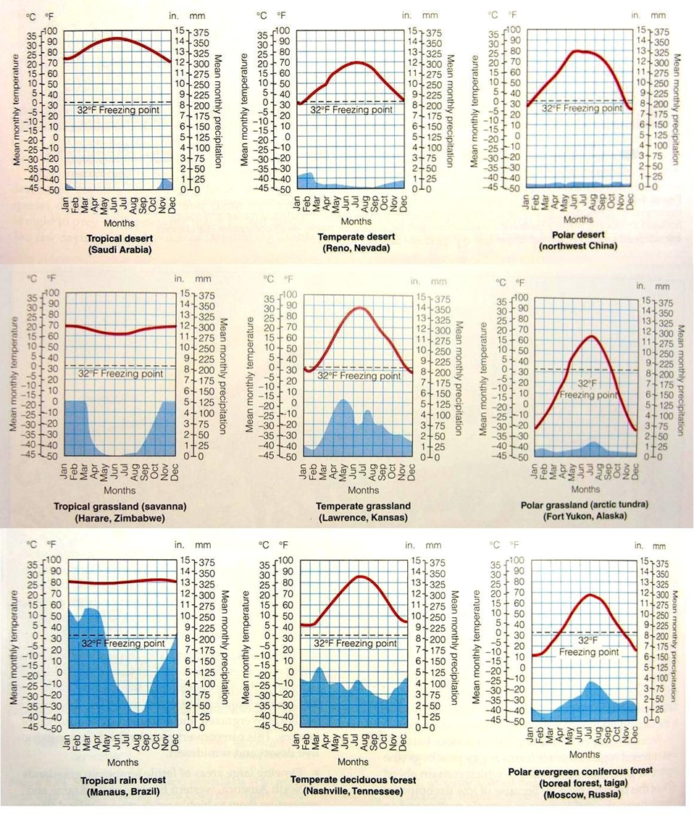

Slide 11
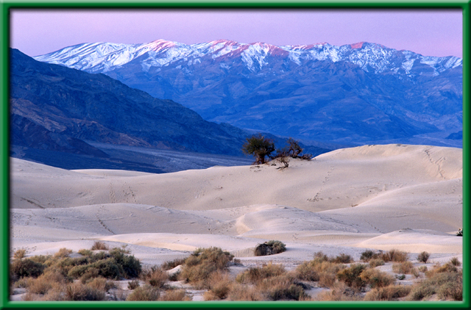
What is a biome?
A biome is a large group of similar ecosystems that share the same type of climate and communities (plant and animal varieties).

Slide 12
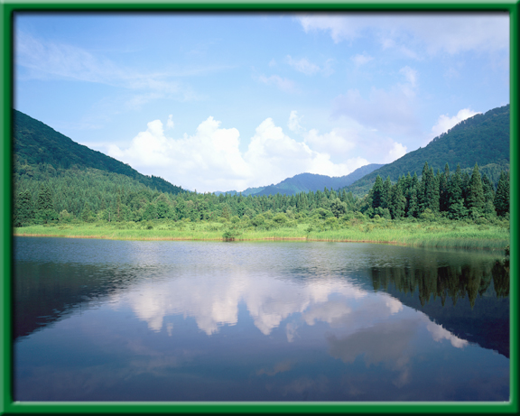

What is a biome?
Terrestrial Biomes
On land
Aquatic biomes
Marine
Oceans
Fresh water
Most Lakes
Streams
Ponds
Rivers

Slide 13
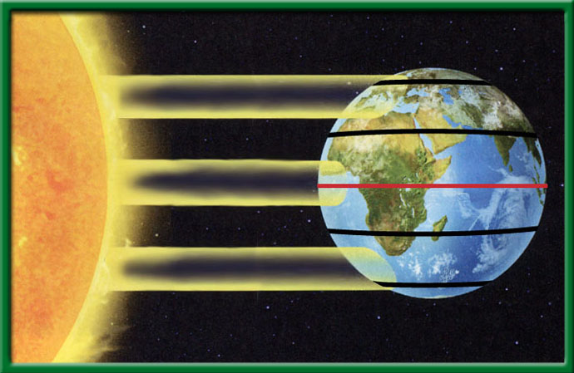
Terrestrial Biomes
Latitude
degrees north and south of the equator
sun strikes Earth differently
As a result, climates (abiotic factors) are different
Altitude also affects climate
North pole
Sun’s rays
66.5º
23.5º
º
O
Sun’s rays
Equator
0
23.5º
Sun’s rays
66.5º
South pole

Slide 14
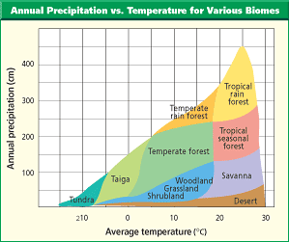
Terrestrial Biomes
Annual precipitation (cm)
400
Tropical rain forest
300
Temperate rain forest
200
Temperate forest
100
Woodland
Savanna
Taiga
Grassland
Tundra
Shrubland
Desert
-10
0
10
20
30
Average temperature (ºC)

Slide 15
What is a climatogram?
A graph that shows a rough approximation of the annual climate pattern of a region
Average Monthly Precipitation
Average Monthly Temperature

Slide 16
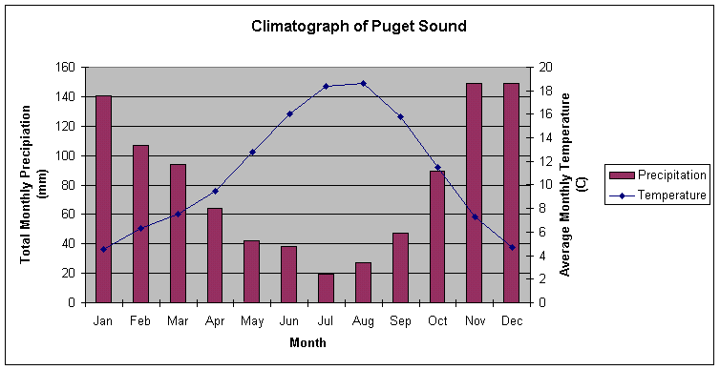

Slide 17
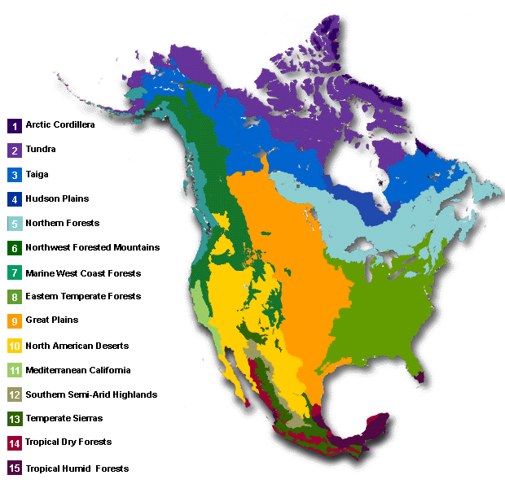
a.
Tundra
a.
b.
Taiga
nothing
c.
Temperate forest
Temperate forest
d.
Grassland
Temperate forest
e.
Desert
Temperate forest
f.
Tropical Rainforest
Temperate forest
Temperate forest
Temperate forest
Temperate forest

Slide 18
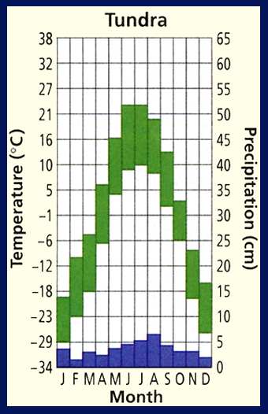
Section 3.2 Summary – pages 70-83
Life on the tundra
No trees
Long summer days
Short periods of winter sunlight

Slide 19
Section 3.2 Summary – pages 70-83
Life on the tundra
Due to its latitude, temperatures never rise above freezing for long
Only the topmost layer of soil thaws during the summer
Underneath this top layer is a layer of permanently frozen ground called permafrost
The soil is lacking in nutrients

Slide 20
Section 3.2 Summary – pages 70-83
Life on the taiga
Just south of the tundra lies another biome that circles the north pole
The taiga (TI guh) also is called the boreal or northern coniferous forest

Slide 21
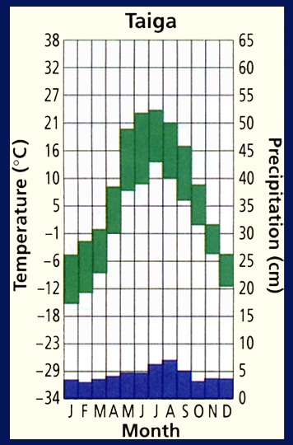
Section 3.2 Summary – pages 70-83
Life on the taiga
Warmer and wetter than tundra
Short, mild summers
Long, harsh winters

Slide 22
Section 3.2 Summary – pages 70-83
Life on the taiga
Topsoil is acidic
Organic material decays slowly
Few minerals

Slide 23
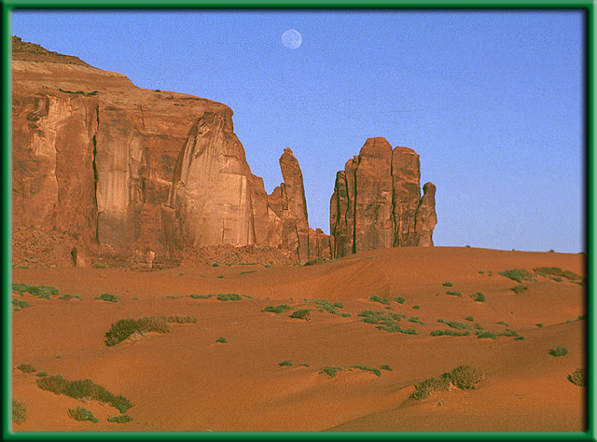
Section 3.2 Summary – pages 70-83
Life in the desert
The driest biome is the desert biome. A desert is an arid region with sparse to almost nonexistent plant life.

Slide 24

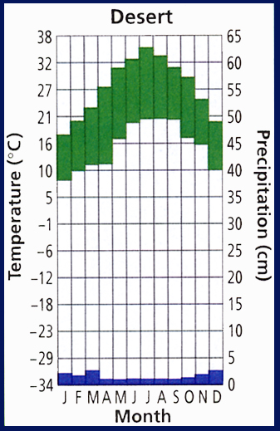
Section 3.2 Summary – pages 70-83
Life in the desert
Deserts usually get less than 25 cm of precipitation annually.

Slide 25
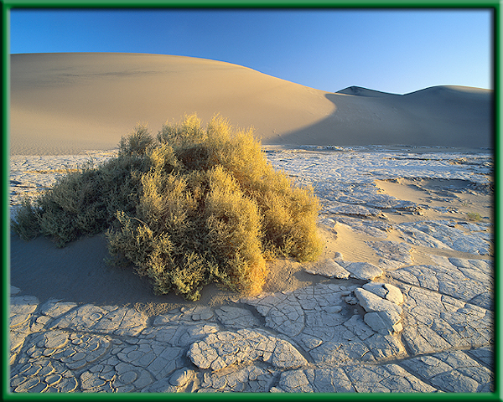
Section 3.2 Summary – pages 70-83
Life in the desert
With rainfall as the major limiting factor, vegetation in deserts varies greatly.
The driest deserts are drifting sand dunes.

Slide 26
Section 3.2 Summary – pages 70-83
Life in the desert
Many desert plants are annuals that germinate from seed and grow to maturity quickly after sporadic rainfall.
The leaves of some desert plants curl up, or even drop off altogether, thus reducing water loss during extremely dry spells.
Many desert mammals are small herbivores that remain under cover during the heat of the day, emerging at night to forage on plants.

Slide 27
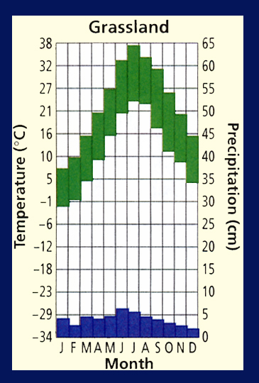
Section 3.2 Summary – pages 70-83
Life in the grassland
Grasslands are large communities covered with rich soil, grasses, and similar plants.

Slide 28
Section 3.2 Summary – pages 70-83
Life in the grassland
Grasslands, occur principally in climates that experience a dry season, where insufficient water exists to support forests.
Grasslands contain few trees per hectare.
The soil is usually rich in humus for a considerable depth.

Slide 29
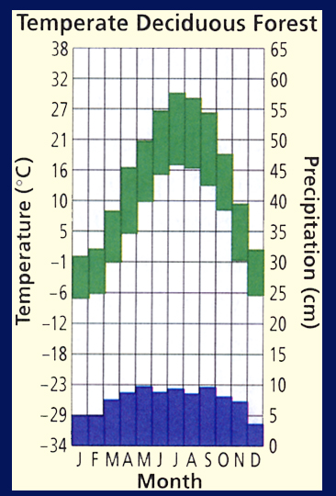
Section 3.2 Summary – pages 70-83
Life in the temperate forest
When precipitation ranges from about 70 to 150 cm annually in the temperate zone, temperate deciduous forests develop.

Slide 30
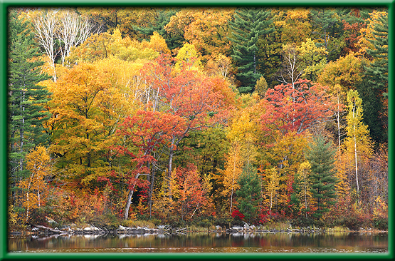
Section 3.2 Summary – pages 70-83
Life in the temperate forest
Temperate or deciduous forests are dominated by broad-leaved hardwood trees that lose their foliage annually.
The soil of temperate forests usually consists of a top layer that is rich in humus and a deeper layer of clay.

Slide 31
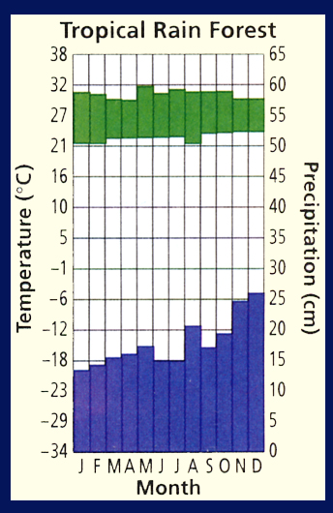
Section 3.2 Summary – pages 70-83
Life in rain forests
The average temperature is about 25⁰C.

Slide 32
Last name: “A” through “F”
Last name: “G” through “Mc”
Last name: “Me” through “Sc”
Last name: “Se” through “Z”

