Slide 1
Weddings – Evolution and Forms

Slide 2
The fact is that there's no such thing as traditional marriage. There are countless marriage customs in countless traditions, and pointing to a single one of them as a monolithic baseline misrepresents the history of the institution as it's morphed through cultures and centuries.
There were many traditional marriages in the past.

Slide 3
But don't take our word for it. Stephanie Coontz, director of research at the non-partisan, non-profit organization The Council on Contemporary Families, literally wrote the book on the history of marriage. Ask her what "traditional marriage" means and you won't find any easy answers.
"There were many traditional marriages in the past," Coontz tells FashionBeans. "In some cultures, the tradition was for a man to marry more than one wife. In others, it was for a woman to marry more than one husband."

Slide 4
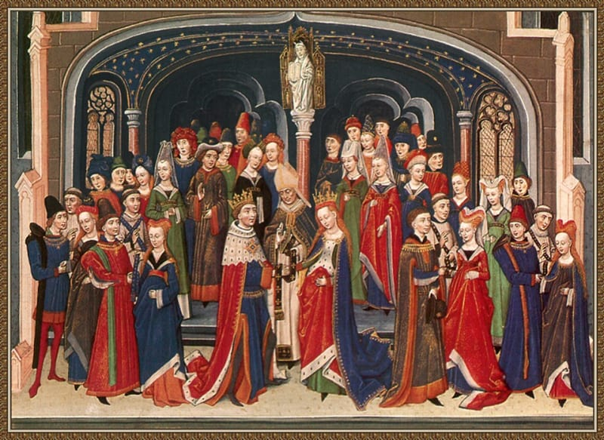
The wedding of Arthur and Guinevere,
Rogier van der Weyden (c. 1400s)

Slide 5
1. Marrying didn't have anything to do with romantic love until relatively recently.
Influence on choice: "In some societies, descent and inheritance went through the husband; in others, it went through the wife," says Coontz, still ticking off the varieties of matrimonial experience.

Slide 6
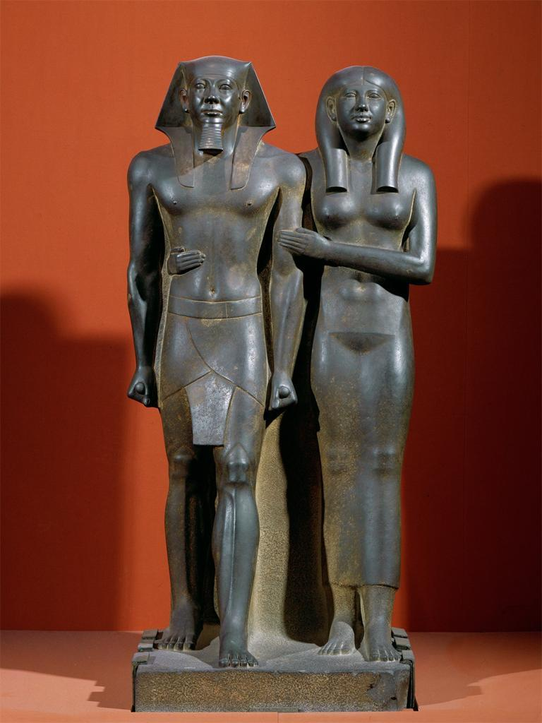
Egypt: Pharaoh married his sister
Descent was through the female line! There is no doubt about who is the mother of the child

Slide 7
"And several societies allowed marriages between people of the same sex, especially if they played distinct gender roles," she continues. "But the one thing that all these varieties of marriage had in common was that they were not primarily about the union of two people who fell in love and married whom they pleased."
The reality of marriage in centuries past was much more practical than throwing the garter, doing the duck dance, and merging your bank accounts.

Slide 8
"For most of history, marriages were about getting in-laws," Coontz explains. "Marriage was the main way you established cooperative relationships with other families."

Slide 9
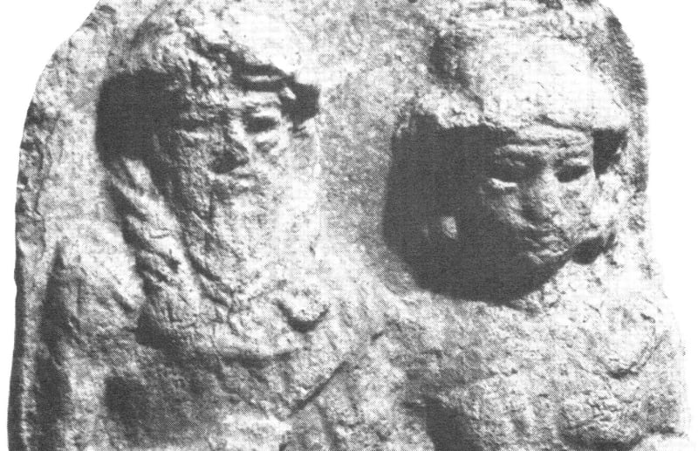
2. Marriage in many societies was anything but voluntary.
If you want to get traditional, you can't go much further back than that "cradle of civilization," early Mesopotamia. There was plenty of romantic love going on among the ancient Mesopotamians, as evidenced by their poetry.
Courtship of Inanna and Dumuzi

Slide 10
Greek historian Herodotus famously described a fifth-century BCE Mesopotamian tradition in which young unmarried women were made to stand on the auction block while men bid on their hands in marriage. A "herald" ran the wife auction.
"He began with the most beautiful. When she sold for a high price, he offered for sale the one who ranked next in beauty. All of them were then sold to be wives," Herodotus wrote, as reprinted by the Ancient History Encyclopedia.

Slide 11
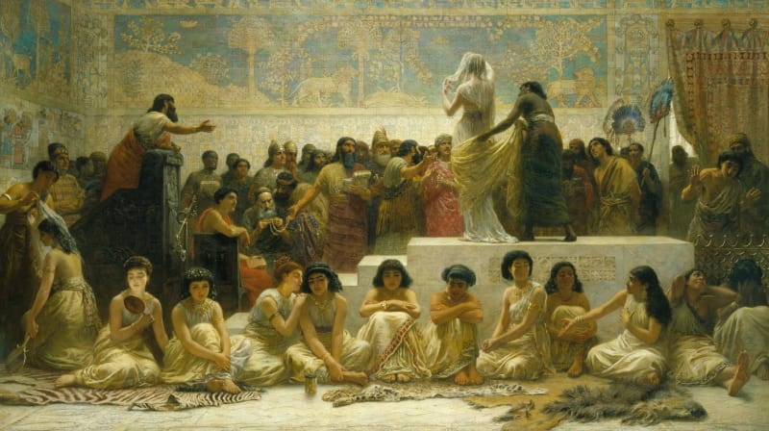
Babylonian Marriage Market, 1875 Edwin Long (1829-1891)

Slide 12
The Arranged Marriage
Goal: establish connections with another family or clan that would be beneficial, particularly in times of trouble.
The prospective groom probably had the power to veto an arrangement more than the prospective bride.
Fidelity was always expected of the wives, but not for the husbands among the “upper classes.”

Slide 13
Even if Herodotus got the marriage auction wrong, though, there's evidence that Mesopotamian women didn't have much say in their choice of husband. Roth points to the Sumerian Laws Exercise Tablet, a record of the ancient Sumerian legal system, which includes the provision that if a man "deflowers in the street the daughter of a man, her father and her mother do not identify(?) him (but) he declares, 'I will marry you"—her father and her mother shall give her to him in marriage."

Slide 14
3. Other societies were a lot more relaxed.
Not every early culture was as paternalistic as the Mesopotamians and some of those that followed in their footsteps. "Traditional marriage" among the Inuit or the San people of the Kalahari region might look a little more attractive to today's marriage-minded woman. (For a more current representation, look to the last matriarchal society known today, the Mosuo tribe of China.)

Slide 15
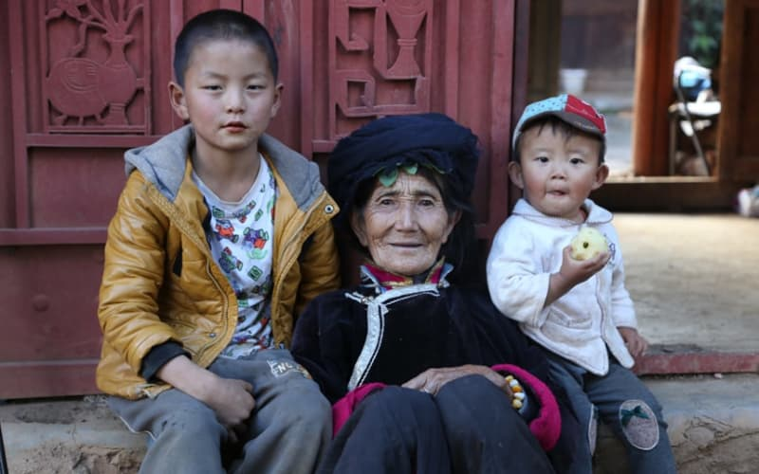
A Mosuo grandmother with her great grandchildren

Slide 16
"Simple band-level societies, without much difference in wealth or social status, tended to have the fewest restrictions on individual choice [in marriage,] though most forbade marriage between members of the same clan or had preferential marriage partnerships with other lineages or groups," Coontz says. "But as societies developed differences in class and rank that could be passed on through marriage and childbearing, the controls over youth increased, and they fell with particular force upon women."

Slide 17
For most of history, marriages were about getting in-laws.
Women in complex, wealth-based societies couldn't be allowed to choose their own husbands, Coontz explains, because the family had to "ensure she only bore children to a man who would further the family's social and economic status.

Slide 18
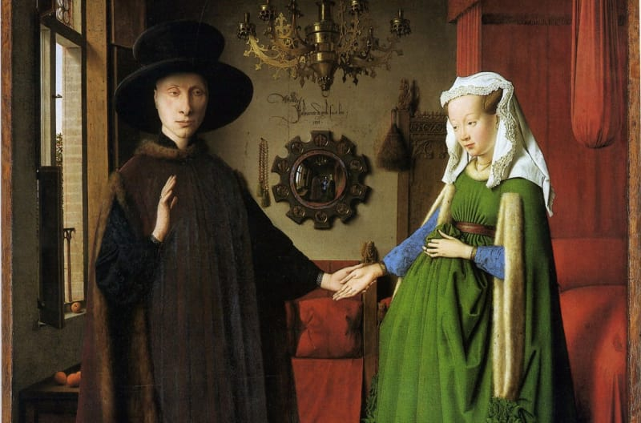

Slide 19
This led to marriage as a system of control over women, suppressing their individual desires for the good of the family unit.
"A lot of the rituals we sentimentalize today, like the father 'giving away' the bride, derive from that time," Coontz says.
Traditions carry old ways into new contexts. That can be a double-edged sword.

Slide 20
Marriage as a Living Tradition

Slide 21
We like to think that traditions are immutable, the unshifting cultural bedrock we stand upon, when in fact they shift and change and crack and tumble through the course of many generations. Marriage is no different. Just look at the changes we've seen throughout the 20th century.

Slide 22
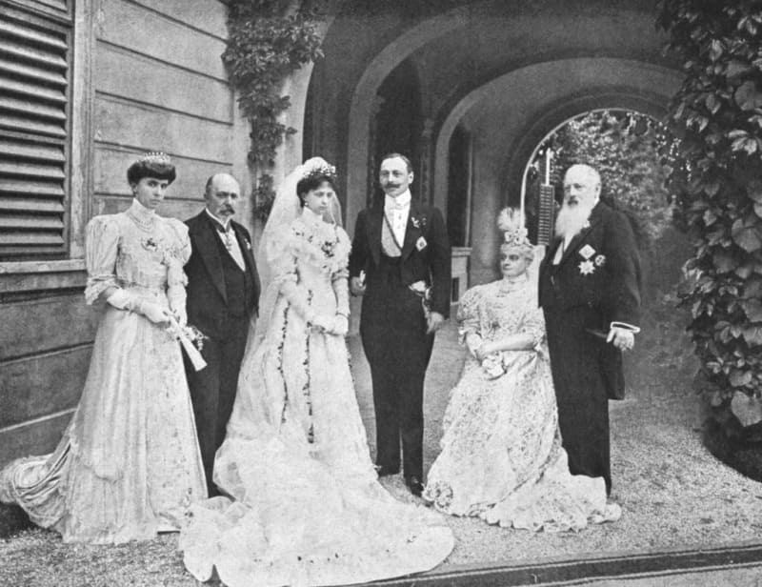
1906 Marriage of Count Pietro Pietro LucchesiPalli and Princess Beatrice of Bourbon Parma, half-sister of Empress Zita

Slide 23
Look at the issue of education, once a sore subject for many men who had less schooling than their wives. Married couples in which the woman had more education, were more likely to get divorced all the way up through the 1980s, Coontz says. That's no longer the case.

Slide 24
"Almost every decade since the 1960s has seen an increase in our expectations of equality [between spouses,]" Coontz says. (For more on the changes in marriage and family life in the second half of the 20th century, see this article from The New York Times, to which Coontz also contributed.)
The move toward parity between husbands and wives—and, since the same-sex marriage revolution of the 2010s, couples of all description—seemed to reach some sort of tipping point in the 1990s, Coontz explains.

Slide 25
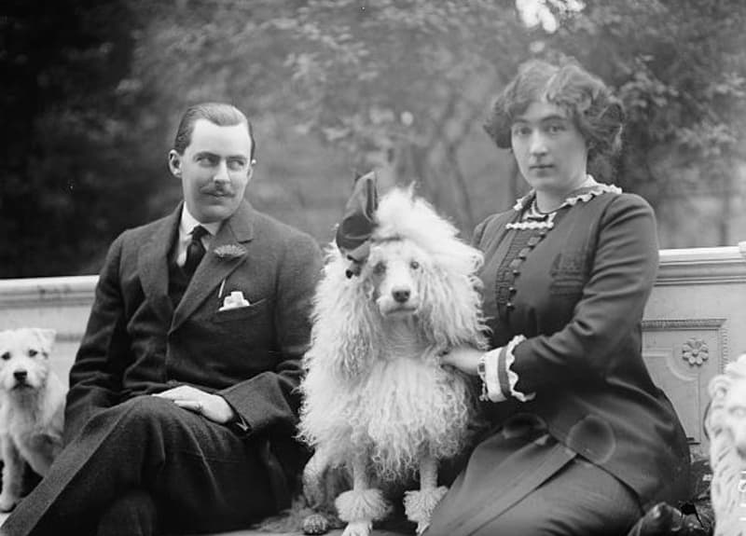

Slide 26
Gone from many romantic unions, too, is the understanding that the husband's role is to provide, while the wife has no choice but to be the homemaker.
"Today, couples that share housework and childcare more or less equally report the highest marital and sexual satisfaction," Coontz says. "The erosion of old stereotypes about gender roles paved the way for acceptance of same-sex marriage and also has offered heterosexual couples new models for organizing their own division of labor."

Slide 27


Slide 28
New Order and Intentions

Slide 29
Living together before marriage
Some couples live together for several years before becoming legally married. In some cases they have children before the actual marriage.

Slide 30
The seriousness of marriage had diminished.
Many no longer see “until death do us part” as a sacred vow – just part of the traditional “formula.”
A lavish expensive reception seems more important than the actual marriage ceremony.

