Slide 1

The Natural Environment – Taking it seriously
Does humanity still have time to avoid seriously dangerous consequences?

Slide 2


Slide 3


Slide 4
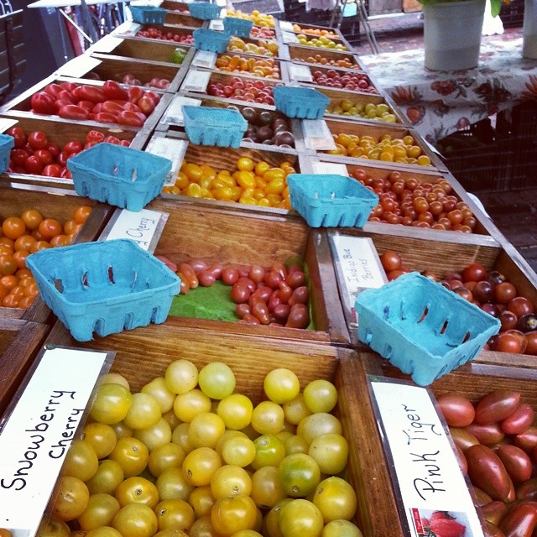
We cannot continue to produce quality food without showing respect for nature and the natural processes, connections, and cycles.

Slide 5
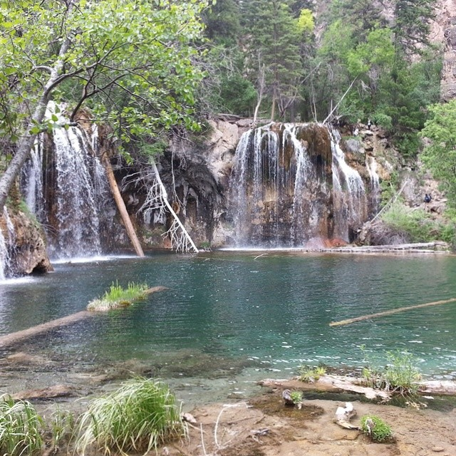
Erosion is a natural process, but human activities can speed up the process and increase its negative consequences.

Slide 6
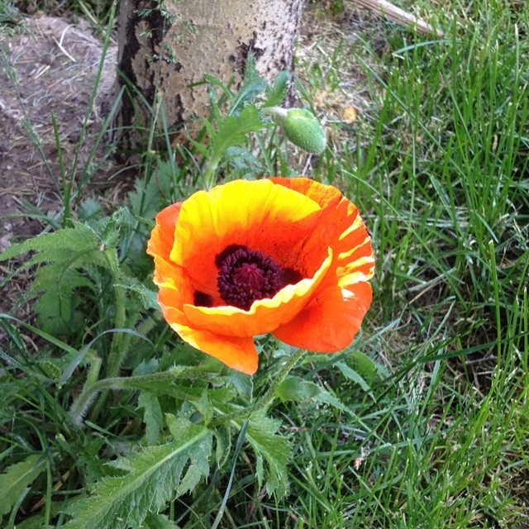
Humans need to reverse their actions and work to maintain biological diversity. Exposure to the beauty in nature helps people maintain a healthy balance in their lives.

Slide 7
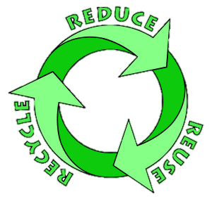
Wise Practices

Slide 8
Some suggestions

Slide 9


Slide 10
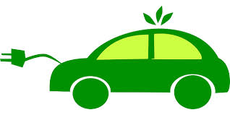
Consider “greener” transportation

Slide 11
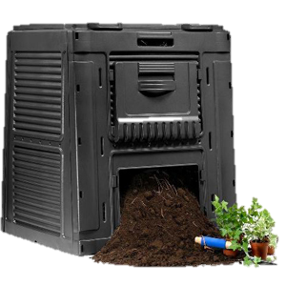
Making your own compost recycles organic wastes

Slide 12
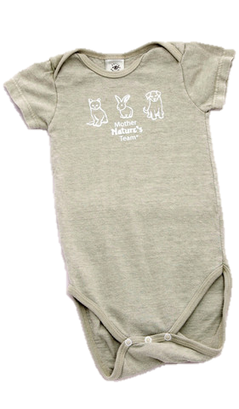
Be an environmentally aware consumer
Examples: organic hemp onesie and cotton, reusable diapers (they need to be washed before reusing them) and reduce the amount of non-biogradeable materials that end up in landfills

Slide 13
Here are some more tips for saving energy while you cook:
Thaw frozen items completely – it takes more energy to heat up a frozen chicken breast then cook it than it does to cook a thawed chicken breast. It’s okay to let these come to JUST room temperature before you grill them, too! Dont put a tiny pot on a large burner on your stove. The heat and energy is wasted as it goes around the pot instead of through it!
Cooking something small? Consider a toaster oven instead of heating the big oven up and cooling it down
Keep your pans & sheets clean – pans with build up take longer to heat and longer to cook – the heat energy has to be passed through the buildup!
Heating the oven? Consider cooking a few things at once to take advantage of the energy expenditure
Use a pressure cooker! This old-fashioned kitchen tool is an energy conscious cook’s best friend! Make a roast with potatoes, carrots and all the fixings in less than an hour on the stovetop! Cooks fast and retains nutrients!

Slide 14
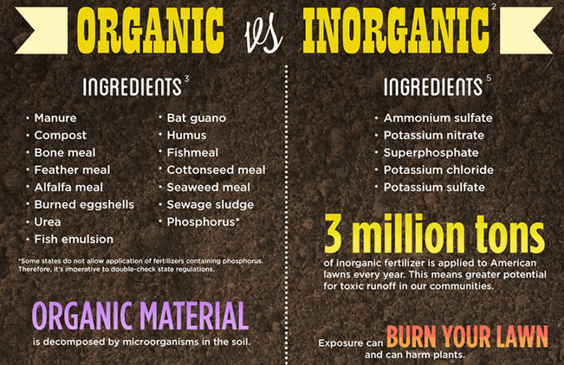
Wise lawn care

Slide 15

Lawn care considerations

Slide 16
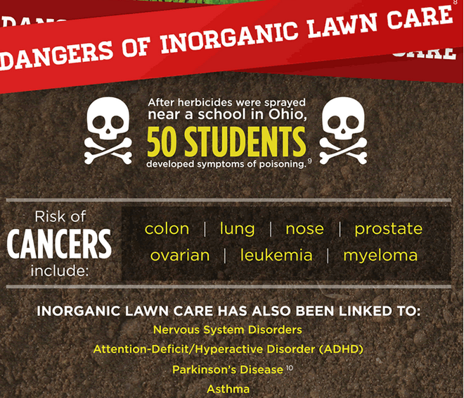

Slide 17
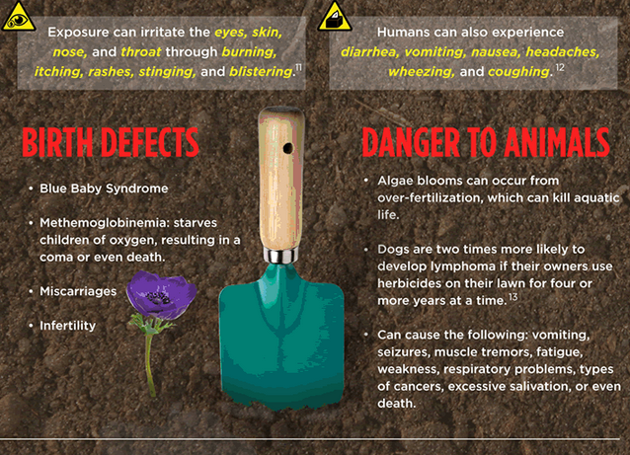

Slide 18
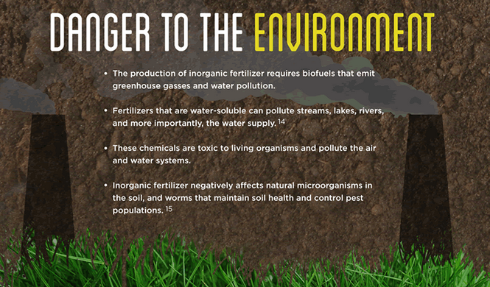

Slide 19
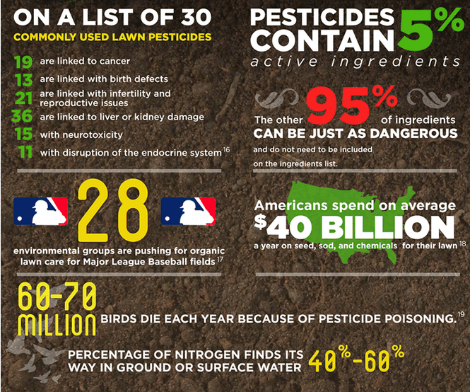
Facts about Synthetics

Slide 20
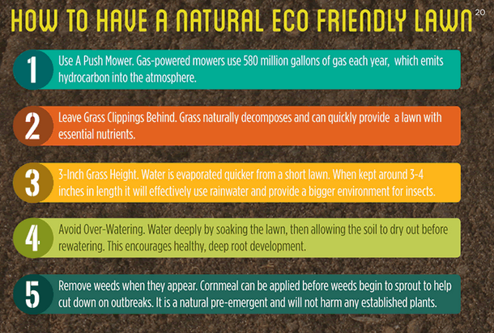

Slide 21

Replace Disposable Products with Reusable

Slide 22
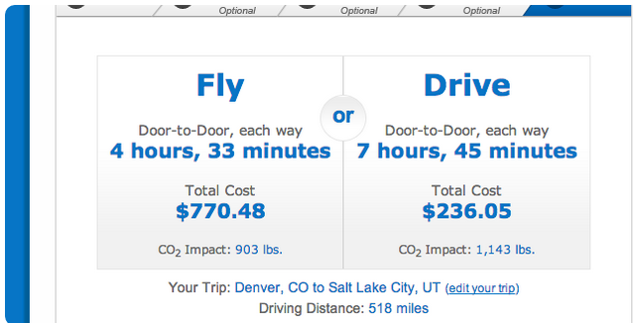
Fly only when you have to!

Slide 23

Conserve Water and Reuse When Possible

Slide 24

Avoid Creating Unnecessary Trash

Slide 25
Creating less trash
When ordering food, avoid getting unnecessary plastic utensils, straws, etc.
Bring reusable shopping bags instead of using plastic bags
Buy your ice cream in a cone instead of a cup
Don’t accept “free” promotional products
Buy products with minimal packaging
Refill your water bottle instead of buying plastic
Don’t take plastic bags at the grocery store for your produce
Only get a glass of water at a restaurant if you’re going to drink it
Buy larger packages – individual packages of chips or cookies uses a lot of packaging waste

