Slide 1
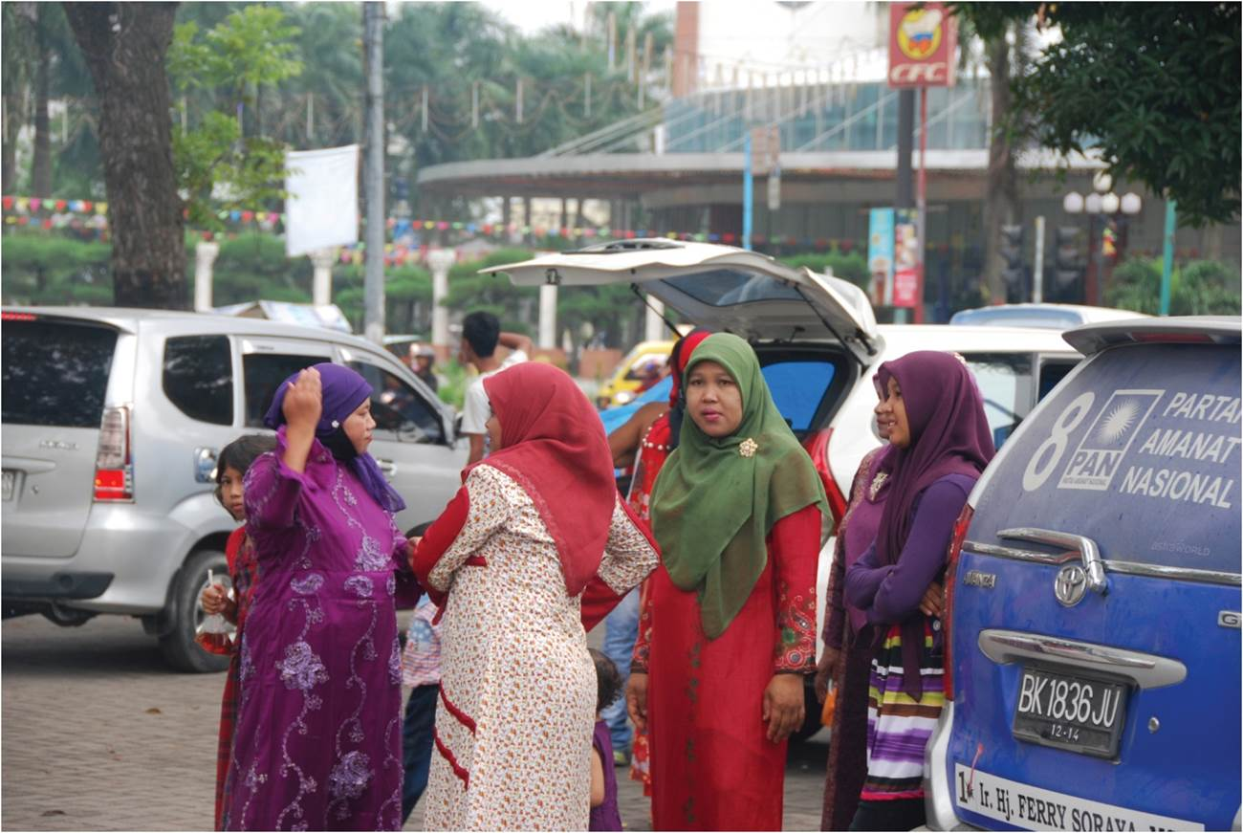
Chapter 9: The Geography of Population
The population is composed of different categories of gender, age, race, ethnicity and other factors of social difference. The social construction and spatial distribution of these categories reveals how social and cultural geographies are created and maintained.
Expanded by Joe Naumann UMSL
Women in Medan, Indonesia.
Notes:
Chapter 9 Opener

Slide 2
Chapter Learning Objectives
Identify the current population of the world, and describe its distribution and associated attributes.
Consider the power and meaning ascribed to national populations within countries and between countries.
Recognize the social categories by which populations differ and reflect the experience of difference within a population.
Explain the forms and reasons for movement of populations in a variety of scales and contexts.
Identify and evaluate the different models of population movement.

Slide 3
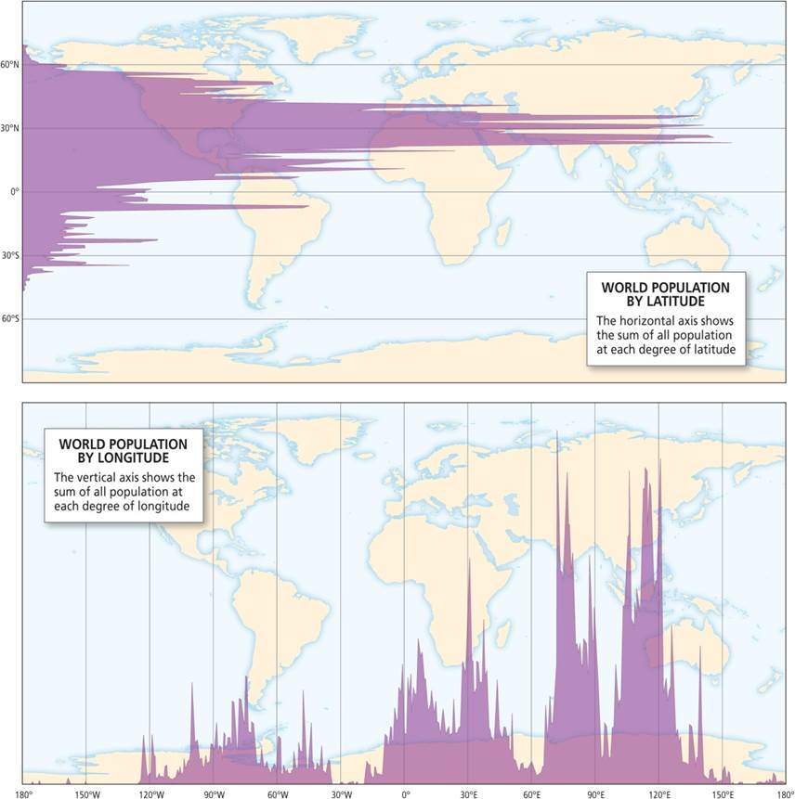
World Population
Close to 7.5 billion
Distribution
Landmass
Northern mid-latitudes concentration
Reflects our historical reliance on agriculture
Currently population concentrated in industrial areas
Global distribution of population (courtesy of Bill Rankin, www.radicalcartography.net).
Notes:
Figure 9.1

Slide 4
Basic Distribution of World Population
More than 50% of the world population is considered to be living in urban areas
Global distribution of population (courtesy of Bill Rankin, www.radicalcartography.net).
Notes:
Figure 9.1

Slide 5
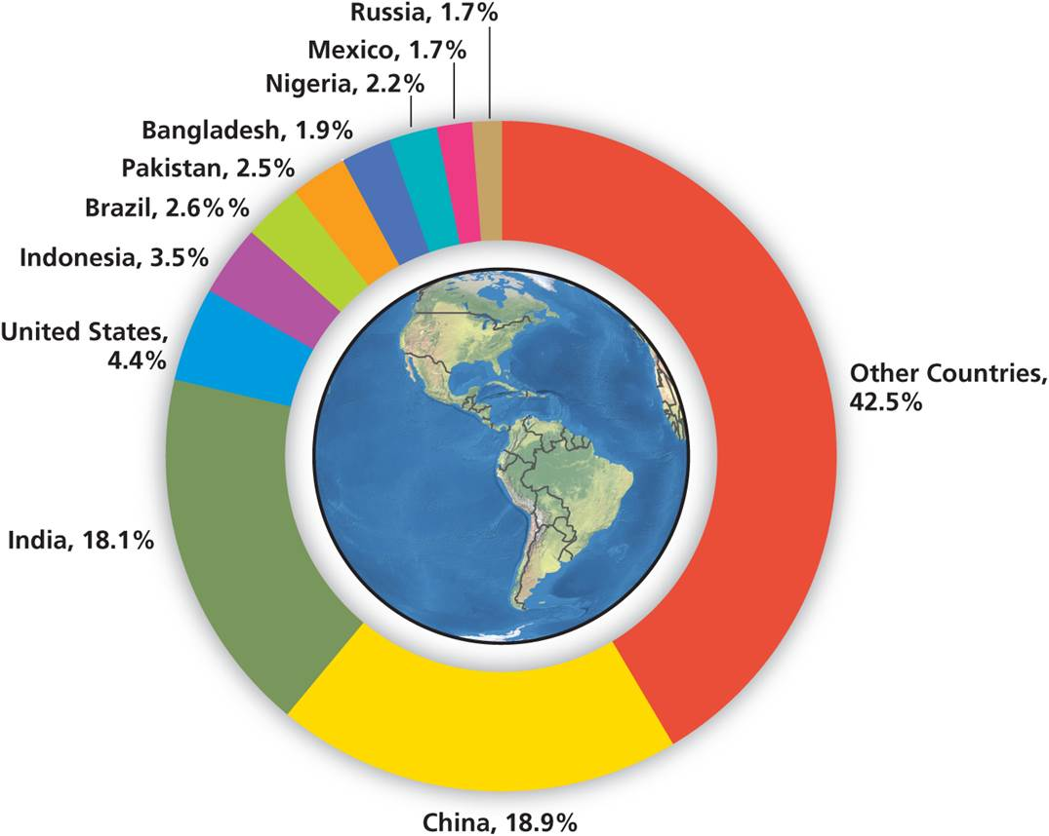
The Distribution of Population
Variant of Tobler’s Law: who you are depends on where you are
International differences
Population and power
Advantages and disadvantages
Large countries have greater weight, but less national coherence
Small countries have homogeneity, but are more vulnerable
Population distribution by country.
Notes:
Figure 9.2

Slide 6
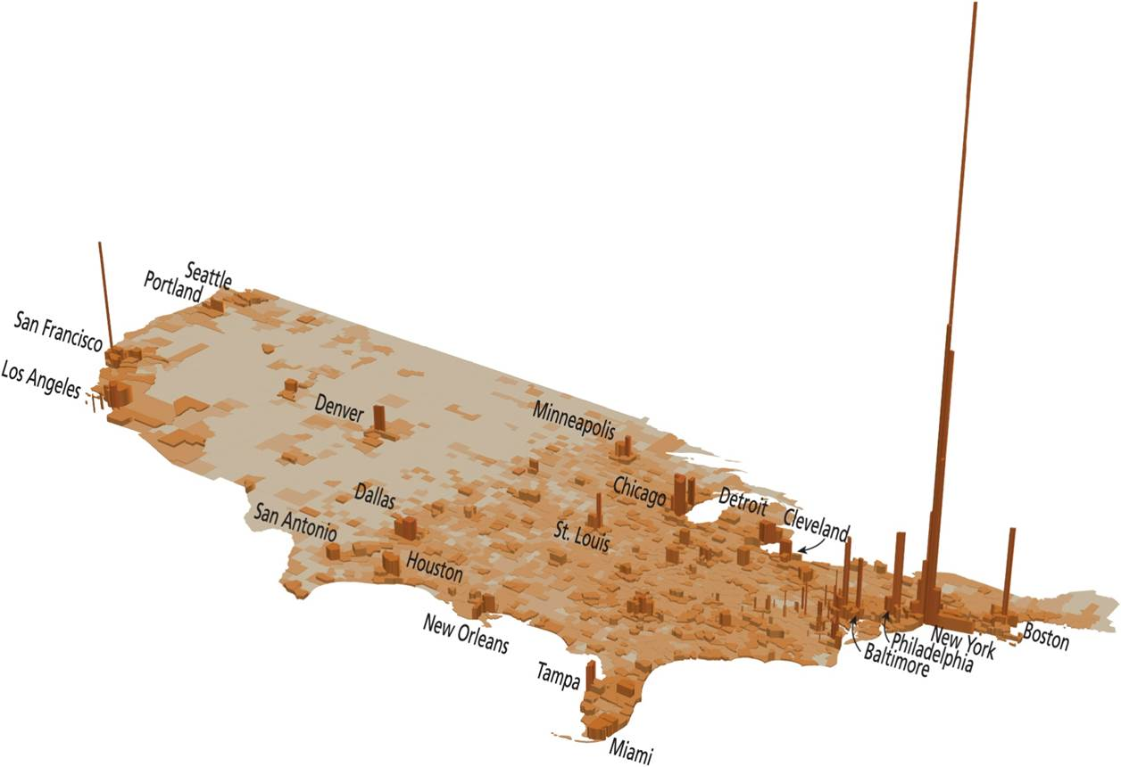
The Distribution of Population
National imaginaries
Refer to spatial nature and representation of the nation state
Difference in demographic reality and political representation
US Senate and House
Other countries
Population map of USA shows its metropolitan nature.
Notes:
Figure 9.3

Slide 7
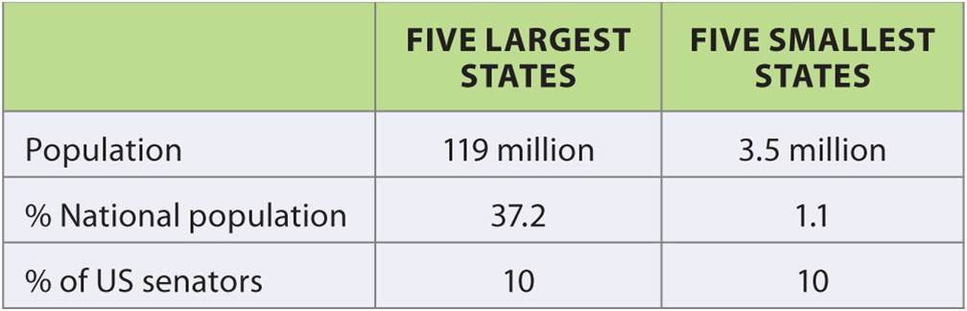
Population and Political Representation in the US Senate
Table 9.1
Shows the disparity between the top most populous states.
The House of Representatives is apportioned on the basis of population
Notes:
Table 9.1

Slide 8
National Populations
Demographic Cumulative Causation
Redistribution of people to areas of greater economic opportunity
Reinforces differences between receiving and sending regions
Governments address regional differences through policy
Should work better in federal republics

Slide 9
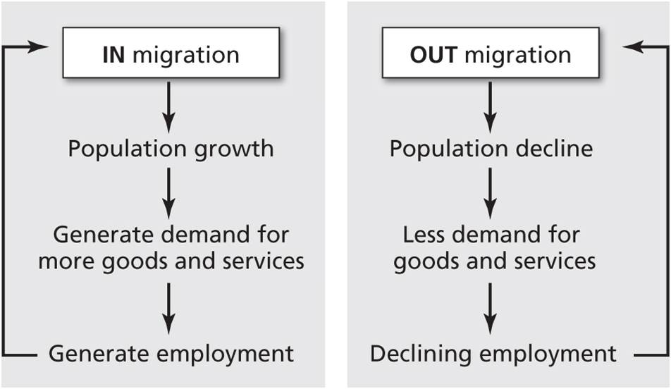
National Populations
Immigrant
Emigrant
Demographic Cumulative Causation
Notes:
Figure 9.4

Slide 10
Population Differences
“Population” is an aggregate term that covers different types of people
Many sources of difference, some biological vs. social
Social difference
Product of social relations that are coded, reinforced, policed
Subject to change
Three major sources
Gender
Age
Race/ethnicity (ability of minority cultures to assimilate varies)

Slide 11

Population Differences
GENDER
Gendering of space and place
Gender occupies space differently
Gender distinctions and cultural identity
Gender roles in the economy highly influenced by culture
Vary across public and private spheres
Vary over time – some cultures accept change more easily than others
Rosie the Riveter, an image of female muscular power, was used to recruit women.
Notes:
Figure 9.5

Slide 12
Population Differences
GENDER
Women in economy
Female participation rates higher in peasant and service economies
Double bind of work in formal and domestic economies
Patriarchal societies and the male gaze – Machismo
Women as chattel
Submissive role for women
Women as equal individuals (resisted in patriarchal societies)
Gendered relations intersect with other relations of power

Slide 13
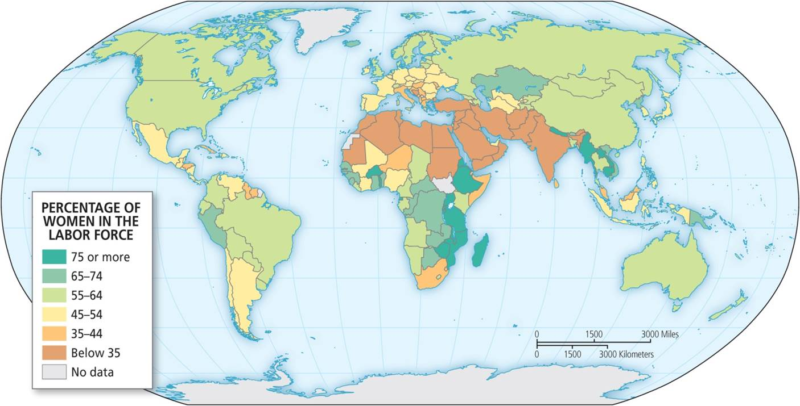
Population Differences
Notes:
Figure 9.6

Slide 14
Population Differences
AGE
Life cycle stages vary across space and time
Historically (agrarian) children seen as labor (economic asset), today (urban/industrial) as receptacles of formal education (economic liability)
Social acceptability of age of childrearing varies around the world
Each society has different religious beliefs (influences attitudes, world view, and objectives) and levels of modernity (technical skills)
Impacts meaning and attitude toward life stages

Slide 15
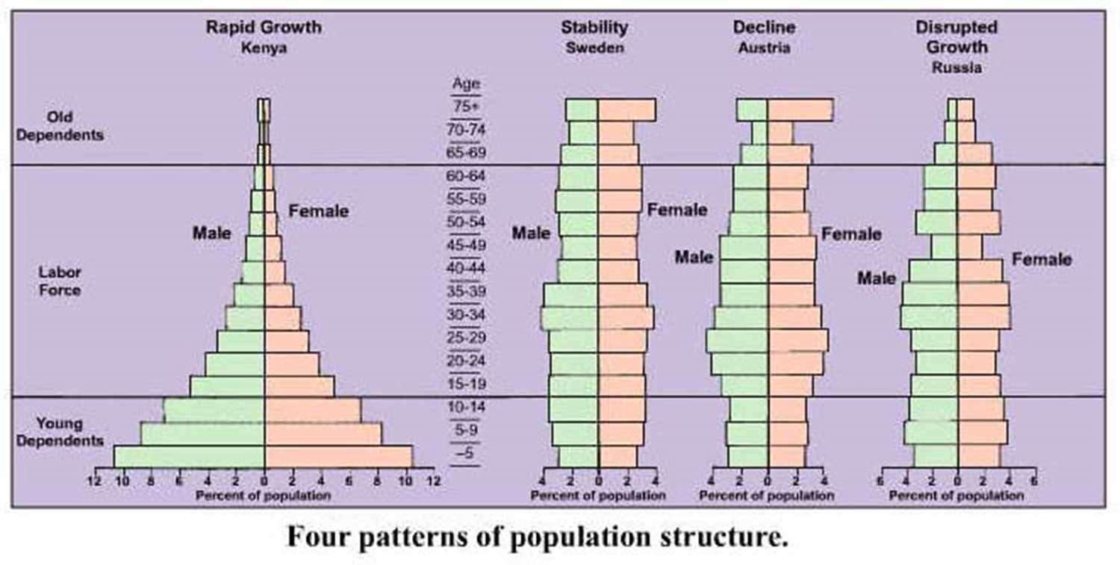

Slide 16
Population Differences
RACE/ETHNICITY
Social constructions are result of socioeconomic, not biological processes
Races are identified in relation to other races – really not very useful
Racialized groups refers to social construction in order to classify and control
REALITY: all are members of homo sapiens sapiens – one species – one race
Ethnicity refers to different collective identities (different cultures)
Imposed ethnicity is a group named and treated as ethnically different
Adopted or symbolic ethnicity is an individual’s choice to express an ethnic identity

Slide 17
Population Differences
RACE/ETHNICITY
Racial/ethnic clustering
Support systems and platforms to new society
Degree of clustering is a function of degree of difference between group and dominant population
May also result from discrimination
Created and maintained by acts of power
Evolution of Chinatown in Vancouver, BC is a result of institutional power
Melting pot gives way to different forms of polyculturalism as various groups interact and change one another

Slide 18
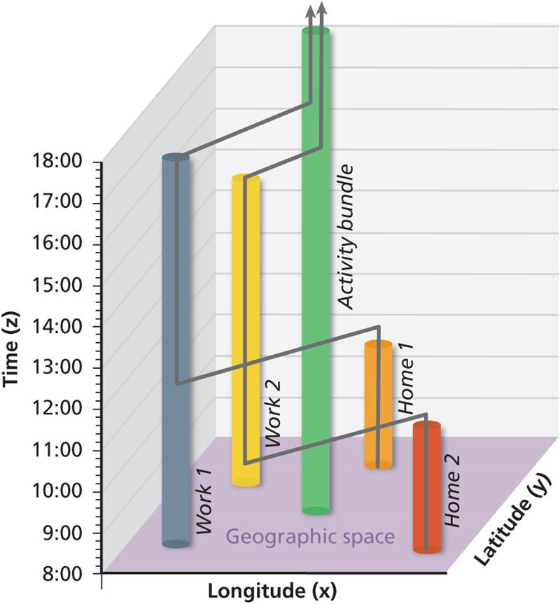
The Movement of Population
People always on the move
Daily Space-Time Paths
Daily rituals constrained by time and access
Seasonal Movements
Transhumance of mountain herds move from summer to winter pasture
Rural to urban migration can be permanent or seasonally circular
Ritual of vacation for the affluent
Traces the path of two people who leave their homes to go to work, then meet up in a café.
Notes:
Figure 9.7

Slide 19
Migration (it takes a lot to overcome inertia)
Push factors (what’s wrong with where you arf?
Famine
War
Lack of job opportunities
Repressive social or political system
Persecution
Pull factors (what seems better somewhere else)
Greater freedom
Greater economic opportunities
Greater social opportunities
More desirable climate
If the possibility of improvement seems real, it will take greater pull factors to overcome inertia.

Slide 20
The Age of Distraction
di
..
People occupy space while communicating with people and things in other places
Age of distraction
Dangers
Suboptimal multitasking
Rushkoff’s digiphrenia (digital schizophrenia: digiphrenia - the constant, insane dual personalities people are immersed in between their phones and the real life ..)
Social media-created
Multiple places and more than one self all at one

Slide 21
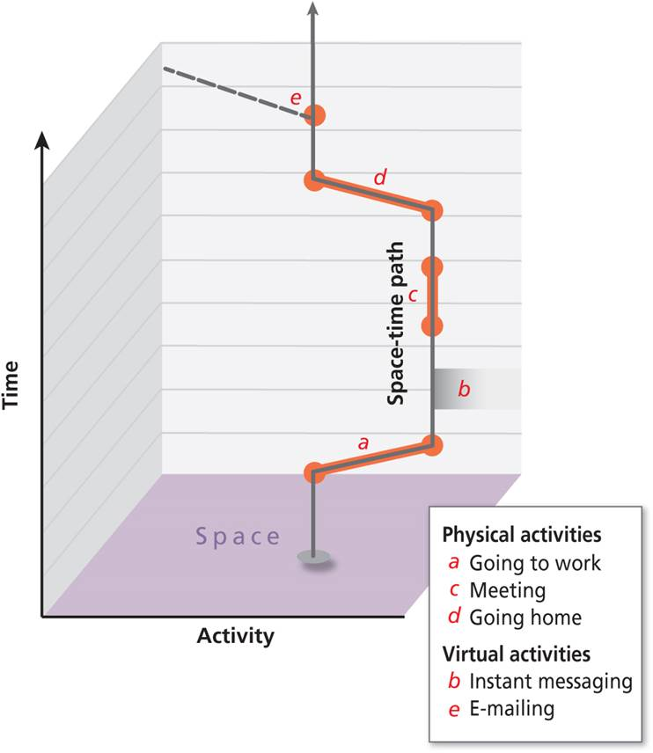
The Age of Distraction
Amend daily space-time paths to include virtual activities occurring in different places.
Notes:
Box 9.1 Figure

Slide 22
The Movement of Population
Metropolitan redistributions
Movement between and within metro areas
Suburbanization and recent shift back to the city (gentrification)
Rural to Urban
Largest permanent relocation in world of last 50 years
Pronounced in countries with rapid population growth, industrialization, and modernization
Remakes cultural identities and the study of immigrant cities by the Chicago School
An assimilationist model of change saw immigrants as the raw material in creation of a new urban society

Slide 23
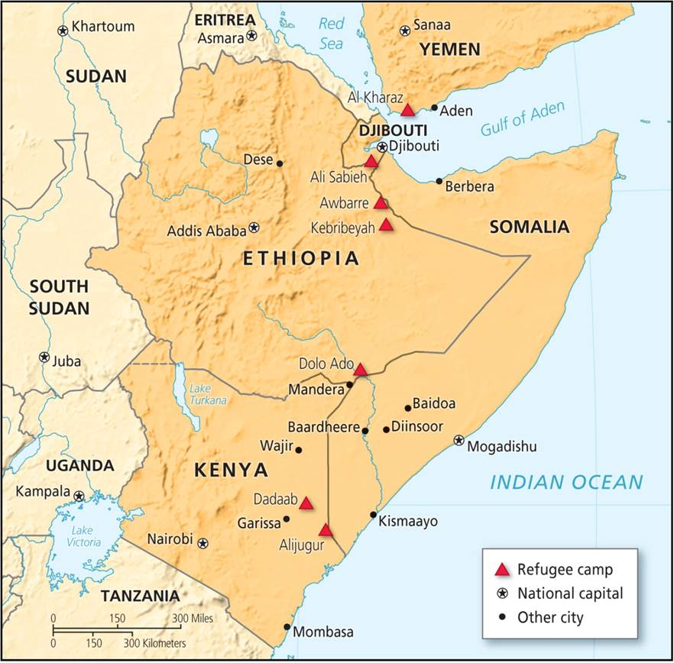
Forced Migrations
Forced migrations occur when people are forced to move
Globally significant slave trade
Triangular trade pattern
Accumulated wealth in Europe and the Americas
Common causes today
War, political conflict, social unrest create both international refugees and internally displaced persons
Economic refugees
The largest refugee camps in the world are in the Horn of Africa.
Notes:
Figure 9.9

Slide 24
International Migration
Characteristics
Voluntary forms
Half are women
Temporary migrants and remittances (guest workers)
Permanent migrants and cultural change
Push-and-pull factors
Countries respond with varying immigration regimes
Brexit
European resistance to massive exodus of refugees from Syria
Notes:
Figure 9.9

Slide 25
International Migration
Affects both origin and destination countries
Periods of increased globalization
US immigration history – not always welcoming to some
Substantial waves of international movement
Countries with very low foreign-born population – a prevalent attitude
Mixture of limits by opportunity or policy

Slide 26
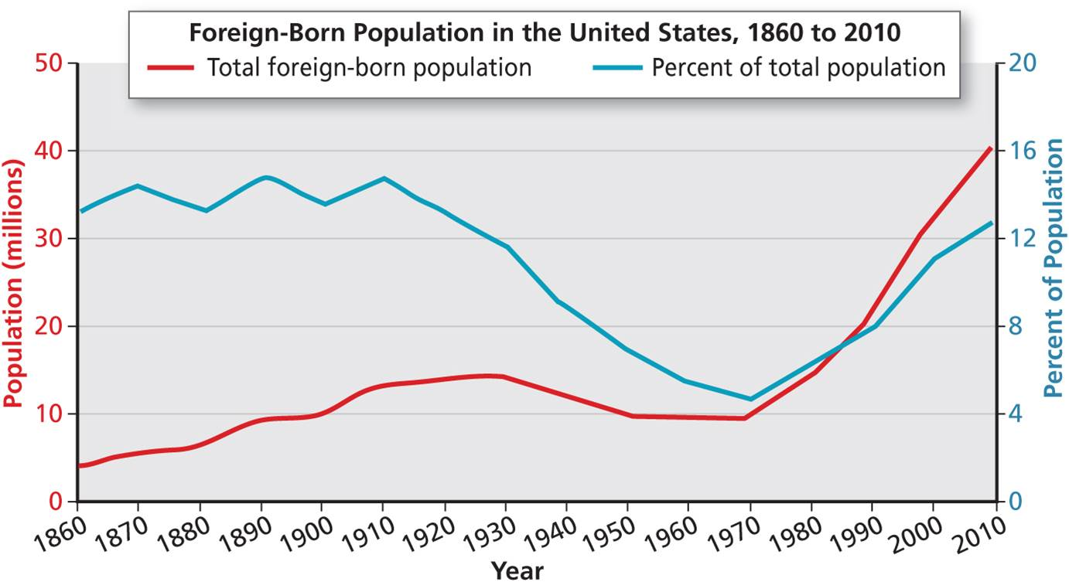
International Migration
Notes:
Figure 9.10

Slide 27
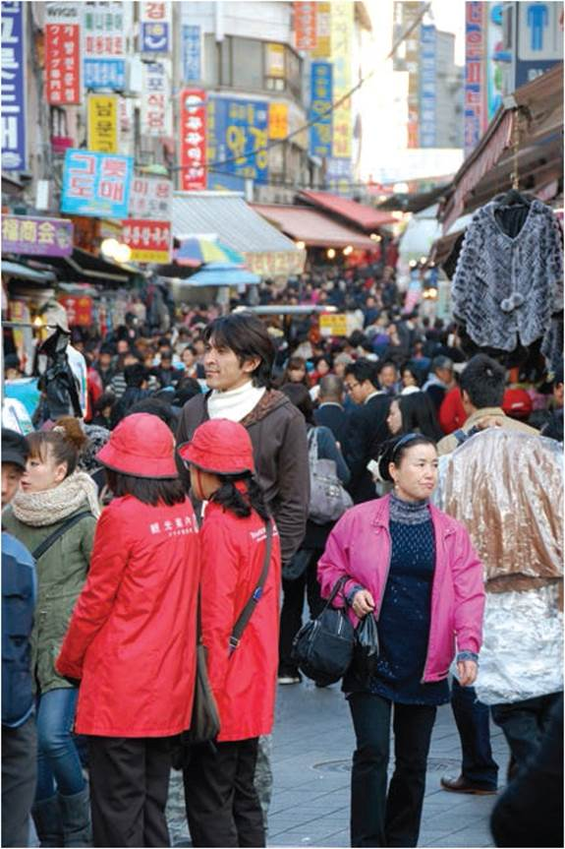
International Migration
Diverse experiences
Investors and flight capital
Construction migrants
Expatriate communities
Gateway cities
Large portions of foreign-born
Global cities are places of:
Minority, diasporic communities and hybrid identities
Ethnic homogeneity in Seoul, South Korea.
Notes:
Figure 9.11

Slide 28
Models of Population Movement
RAVENSTEIN’S LAWS OF MIGRATION
Generalizations of a particular time and context
Most migrants move only a short distance, towards the nearest city.
Migration is stepped. Growing cities attract migrants from nearby rural areas, which then draw migrants from more distant areas.
Each current of migration produces a countercurrent.
Long-distance migrants tend to move to major cities.
Rural people have higher propensity to migrate than urban people.
Women have higher propensity than men to migrate within countries, and more men tend to move internationally.
Migration is driven in largest part by economic forces.

Slide 29
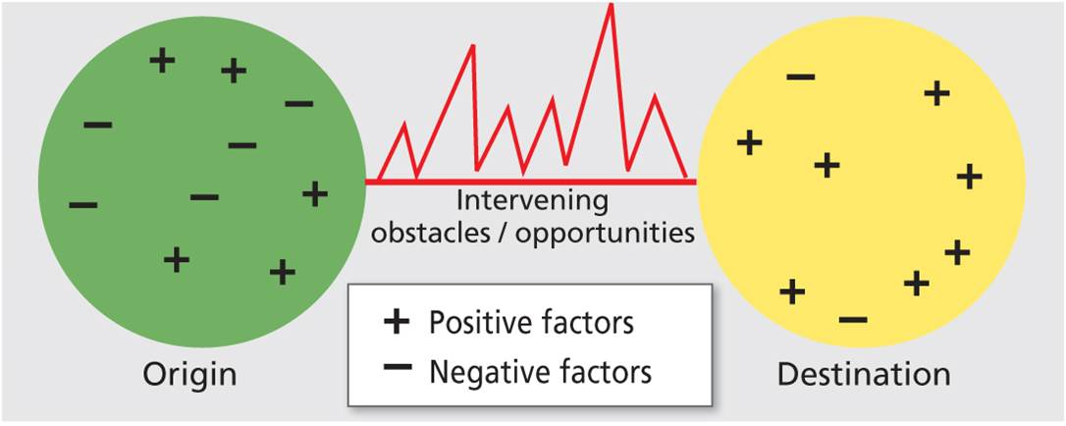
Models of Population Movement
Gravity models
Movement related to population size and distance between areas
Space-time is warped and full of intervening opportunities
Lee’s Push-Pull Model
Origin and destination areas have range of factors
Case of the Great Migration in the US
People’s strong affect to friends and relatives explains existence of chain migration
Lee’s push-pull model refers to specific forces between origins and destinations.
Notes:
Figure 9.12

Slide 30
The Zelinsky and Metz Models
Transition model for mobility
Technology’s impacts
Zelinsky Model
3 phases of increasing residential mobility
Metz model
4 eras start with hunter-gatherers and ends with “peak car” areas

Slide 31
Chapter Summary
Bulk of the world’s population is in the Northern Hemisphere, centered on the Tropic of Cancer. It is distributed and demarcated in cultural, political, and economic space.
More than a third of the world’s population lives in just 2 countries, China and India. Half live in just 6 countries. The 10 largest countries contain almost 58 percent of world population.
Population size is an important element of national power. Very small countries tend to wield less power than larger countries.
Population distribution often connects with national imaginaries.
There are disparities between population distribution and political representation in a number of countries across the globe, including in the major global powers of Japan and the US.

Slide 32
Chapter Summary
As cumulative causation, movement of people to areas of greater economic opportunity can widen regional disparities.
Gender roles in an economy vary over time and space, partly influenced by rarely stable and unfixed gender identities.
Although there are definitive biological definitions for various ages, what it means to be at different stages in life varies across the world and throughout history.
Race and ethnicity are neither natural categories nor are they unchanging. The very definitions of race and ethnicity are social constructions, not biological processes.

Slide 33
Chapter Summary
Population movement takes place on daily, weekly, seasonal, and annual basis in circular and noncircular patterns, sometimes involving permanent relocations. Sometimes people are forced to move, as was the case in the slave trade. Today political conflict and lack of economic opportunities drive forced movement.
International migration channels are often routed very largely, although not exclusively, through major metropolitan areas known as gateway cities. Examples include New York, Amsterdam, Dublin, Washington DC, and Riyadh.
There are numerous models of population movement: Ravenstein’s model; the gravity models that focus on size and distance between places; and Lee’s push-pull model, which focuses on a comparative assessment between locations.

