Slide 1
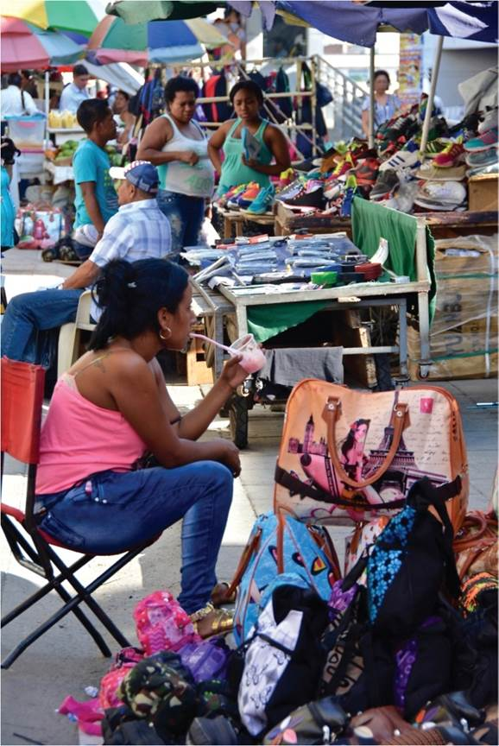
Chapter 8: The Economic Geography of Uneven Development
Across the globe, uneven development of economic activity has caused marked disparities in living standards and quality of life.
Expanded by Joe Naumann, UMSL
Street vendors in Cali, Colombia.
Notes:
Chapter 8 Opener

Slide 2
Chapter Learning Objectives
Describe global differences in development and relate them to relevant models of economic development.
Consider what factors shape distributions of economic activity at the regional scale.
Discuss the role of government in economic development along with examples of state economic policy.
Reflect on changing geographies of capital and labor and the impact on the global capitalist economy.
Outline the shift in capitalist economies toward mass consumption; describe the geographies associated with this shift.

Slide 3
Global Differences
Uneven development of economic activity
Relates to disparities in living standards
Initial geographical advantages turned into economic advantages
Economic order varies over space and time
Igbo in Nigeria
Culture fit well with British capitalism theytionate developed a disproportionate presence politically and economically under colonial rule and in early independence
Tribalism, oil deposits
Civil war

Slide 4
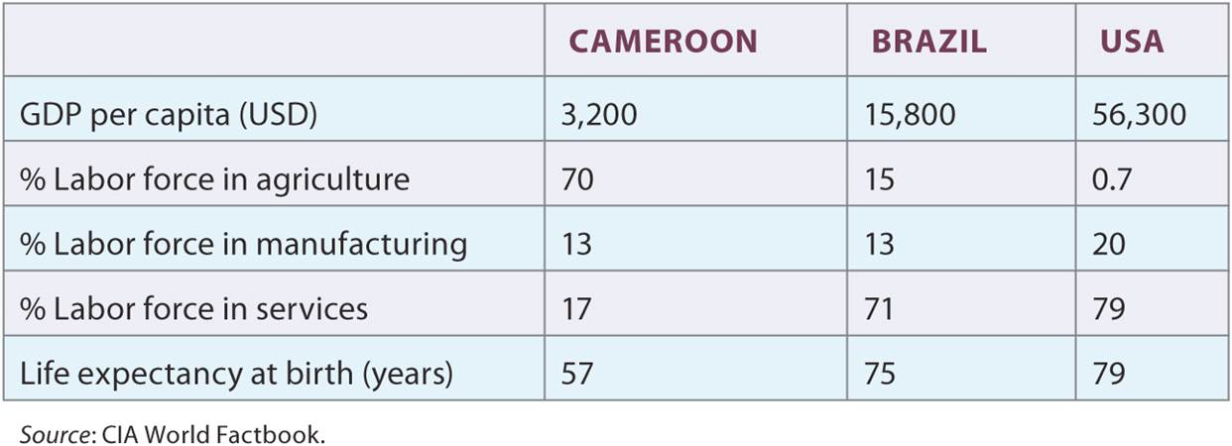
Global Differences
Table 8.1
Global Differences highlighted by data from three different countries.
Notes:
Table 8.1

Slide 5
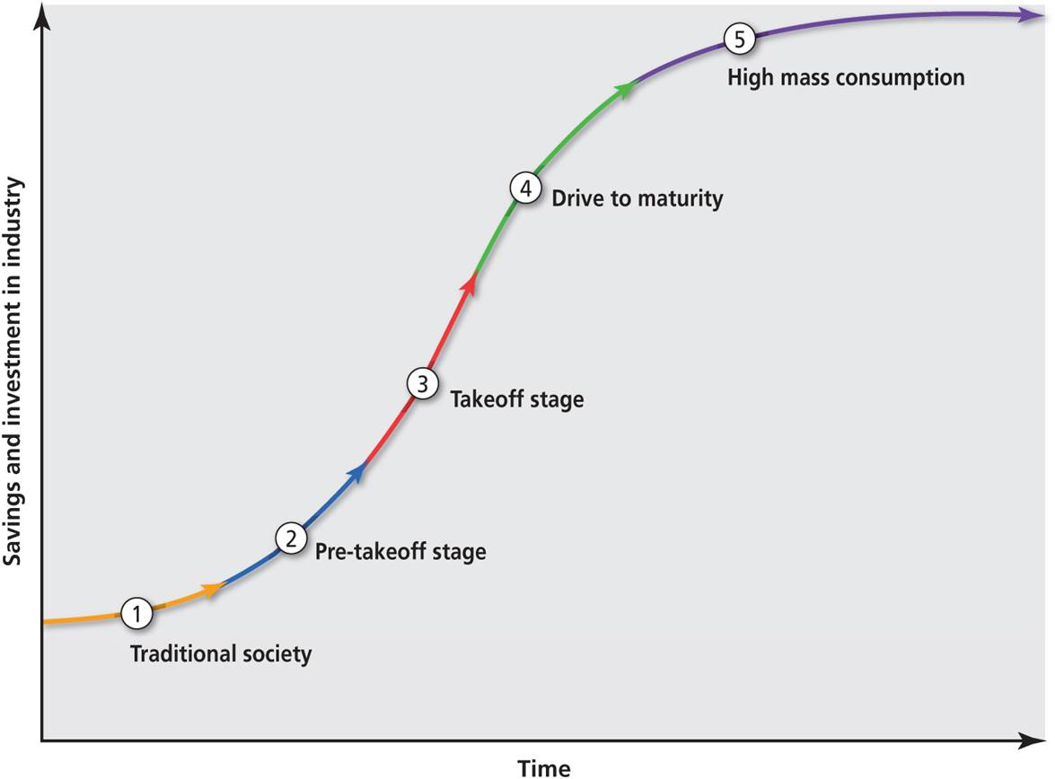
Rostow Model
Stages of economic development
Traditional society
Transitional or pre-takeoff
Takeoff and rapid industrialization
Drive to maturity
High mass consumption
Assumptions
Historical sequence to economic growth only a matter of time
The Rostow Model of the five stages of economic development.
Notes:
Figure 8.1

Slide 6
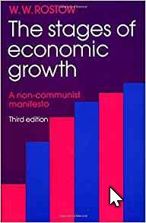
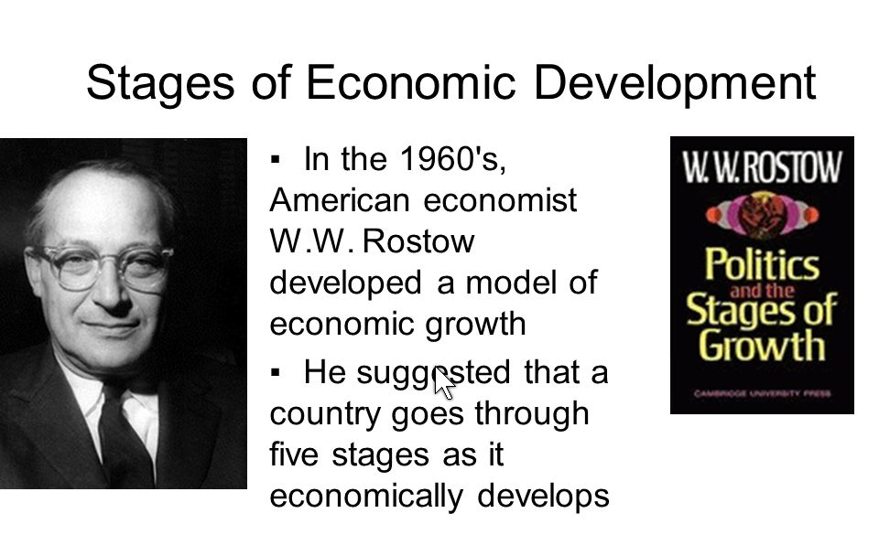
W.W. Rostow

Slide 7
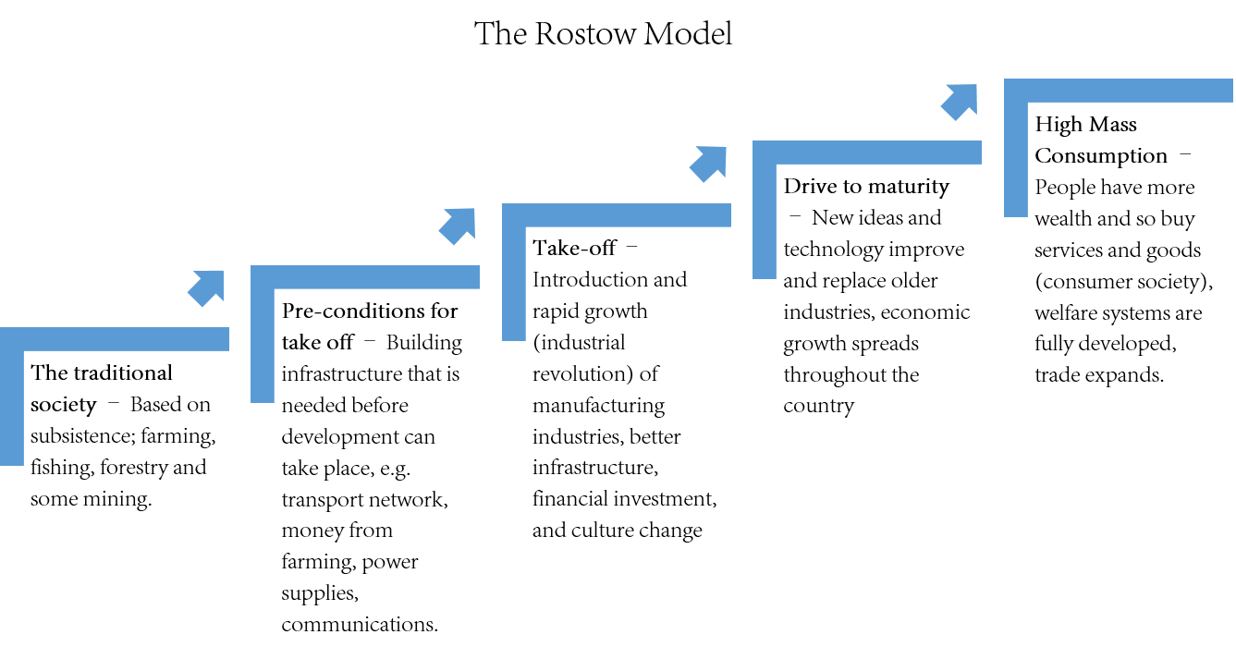

Slide 8
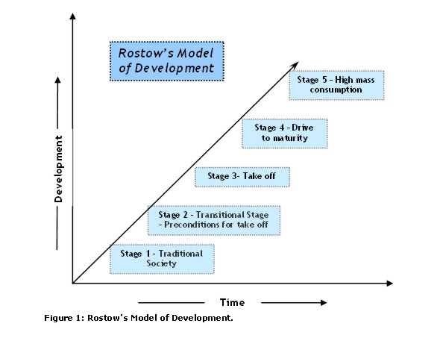

Slide 9
Different Economies
Formal economy is recorded in official statistics
Informal economy is unrecorded and response to lack of formal employment opportunities
Illegal economy is wide variety of illegal, violent, or deceptive practices
Social economy is the ‘third’ sector of not-for-profit activities
Communal economy is cashless exchange of goods and services among neighborhoods
Domestic economy refers to amount, type, and division of labor in the home
Sharing economy around owners sharing assets in peer-to-peer exchanges, often enabled by social media apps

Slide 10
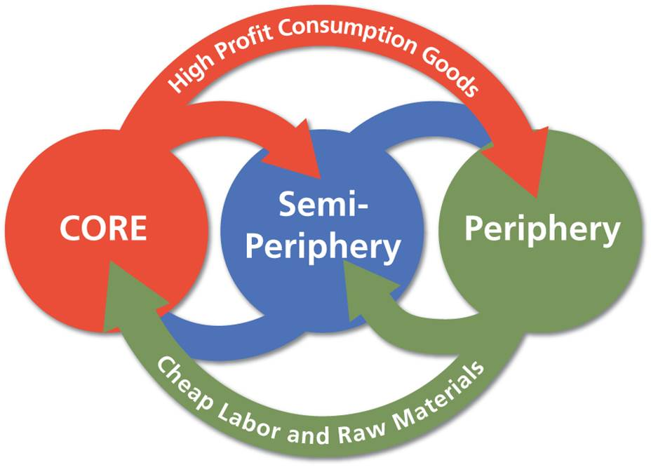
Global Differences
Core-periphery model
Countries part of spatially connected world system
Core, periphery, and semi-periphery
Advantages reinforced by colonialism and imperialism
Globalizing historical events and incorporating political economy
The core-periphery model is an alternative to the Rostow model.
Notes:
Figure 8.2

Slide 11
Regional Differences
Models of Regional Economic Growth
Process of cumulative causation as growth feeds back into itself
Growth’s spread and backwash effects
Unevenness is essential to capitalist production – some may question the morality and justice of such a system

Slide 12
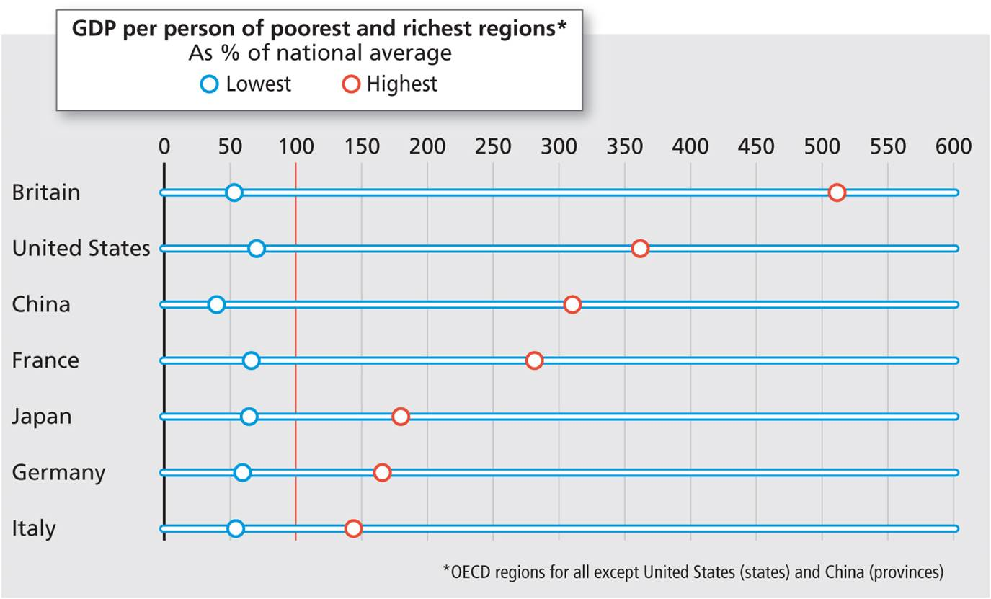
Regional Differences
GDP per capita does not reflect then disparities within countries
Regional disparities in Britain are among the widest of the world’s larger economies.
Notes:
Figure 8.5

Slide 13
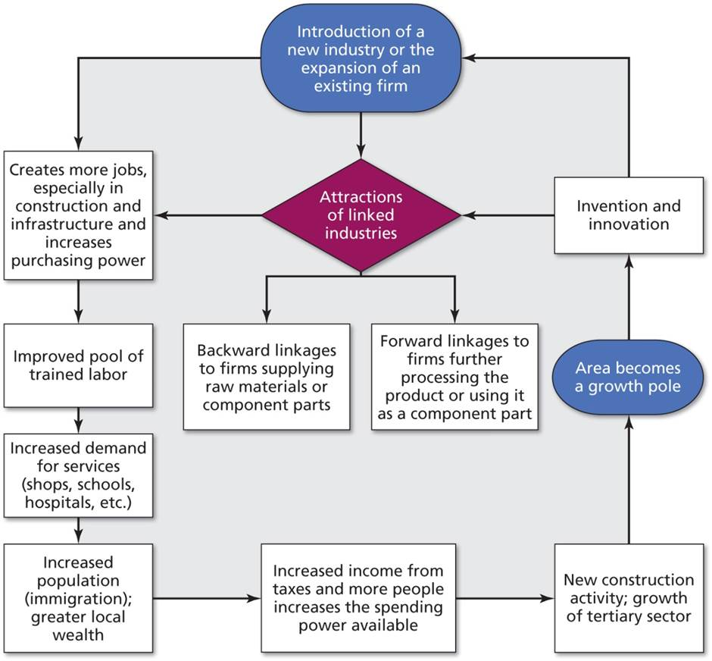
Cumulative Causation
Agglomeration
Diagram courtesy of Barcelona Field Studies Centre.
Notes:
Figure 8.4

Slide 14
Regional Differences
Regional economic dynamics
Product cycle and new product trajectory
Product phases through creation to decline
Relationship between profits and the location of product firms

Slide 15
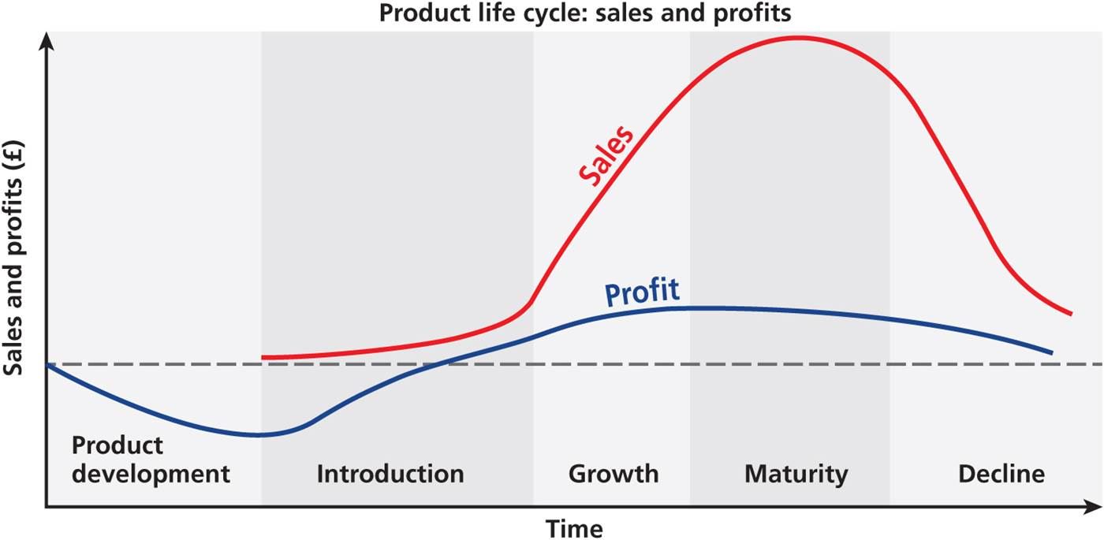
Regional Differences
Product and profit cycles
Notes:
Figure 8.6

Slide 16
Regional Differences
Factors of regional economic clusters
Locational pull of resources
Concentration of firms and labor
Subsidiary trades and services attracted to core industry (agglomeration)
Spillover of innovative ideas from firm to firm
Provide a “thick market” of labor and specialized firms, market access, and savings in public goods
Centrifugal forces can disrupt production if clustering leads to increasing cost of land and labor
Some industries defy trend, like the contemporary industrial complexes or technopoles

Slide 17
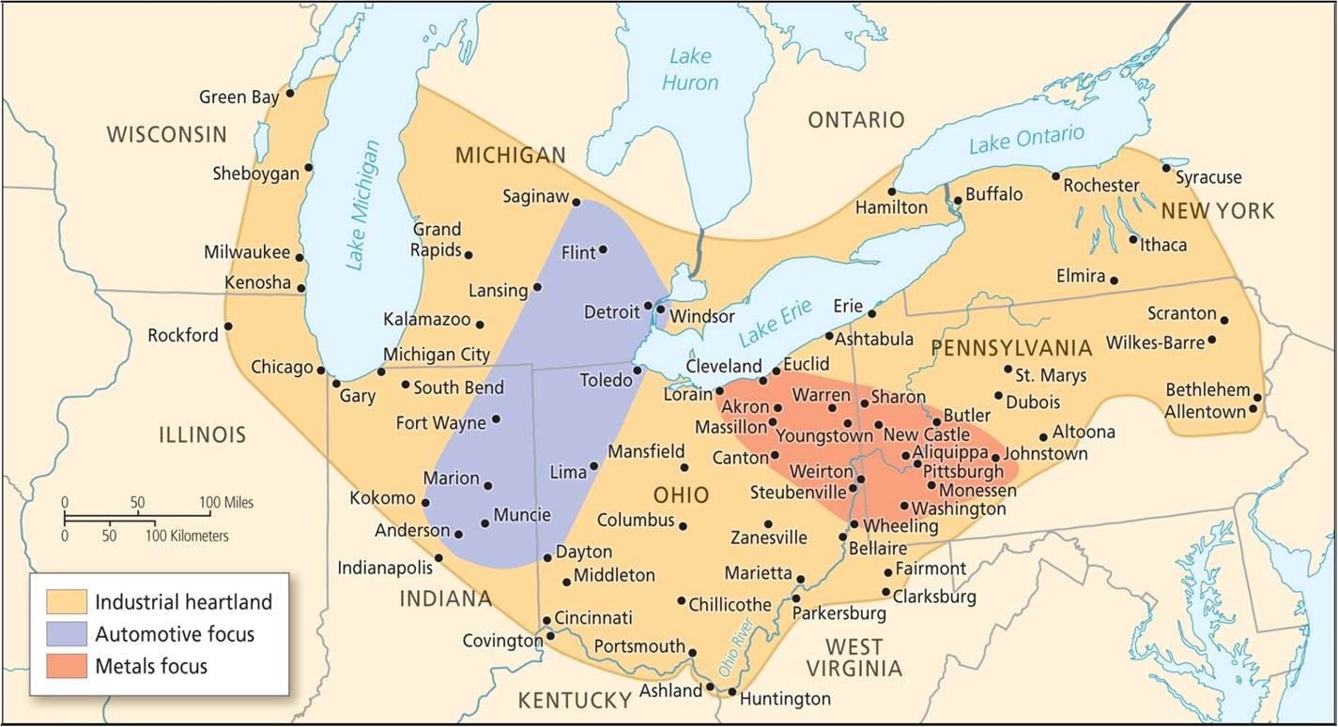
Regional Economic Clusters in the US
New geography of employment in US
Three types
Brain hubs of innovation
Dying manufacturing hubs, like the Rust Belt
City regions in the middle
Rust Belt
Notes:
Figure 8.7

Slide 18
RISE OF INTERNATIONAL CONGLOMERATES
Budgets bigger than budgets of many countries
Facilities and branches in many countries
Difficult for government of one country to regulate
Exporting pollution – Japanese factories in Southeast Asia
Other abuses
Buy successful small business and drive into bankruptcy for a tax advantage that makes the conglomerate more money
Buy small pharmaceutical company and raise cost of a cancer drug from $17 to $1000

Slide 19
Shrinkage of Competition
US Auto companies 1940s
General Motors 6 brands
Ford (3 brands)
Chrysler (4 brands)
Hudson
Nash
Studebaker
Packard
Willies/Jeep
Kaiser/Fraser
US Auto companies 2018
General Moters (4 brands)
Ford (2 brands)
Tesla (non-traditional)
Chryslers/Jeep now owned by Italian company, Fiat

Slide 20


What Is An American product?
My Chevrolet Trax was built in South Korea
My daughter’s Hyundai Elantra was built in the USA

Slide 21
The Role of the State
Role of national regulation and markets
State is a collection of institutions and agencies
Set the context in which firms operate
Multiple and varied roles affect economic activity
Example of workfare policies
State and the Global Economy
From closed economies to loose regulation of firms
Developing country governments follow either import substitution or export-oriented industrialization
Debate between protectionism and free trade

Slide 22
The Role of the State
Development states
States successful in export-led economic development from periphery toward core
Reliance on exports means global vulnerability
The China model
Public spending toward infrastructure and education
Lacking democratic accountability
Relationship between development and authoritarianism
Equitable wealth does correlate with democratization

Slide 23
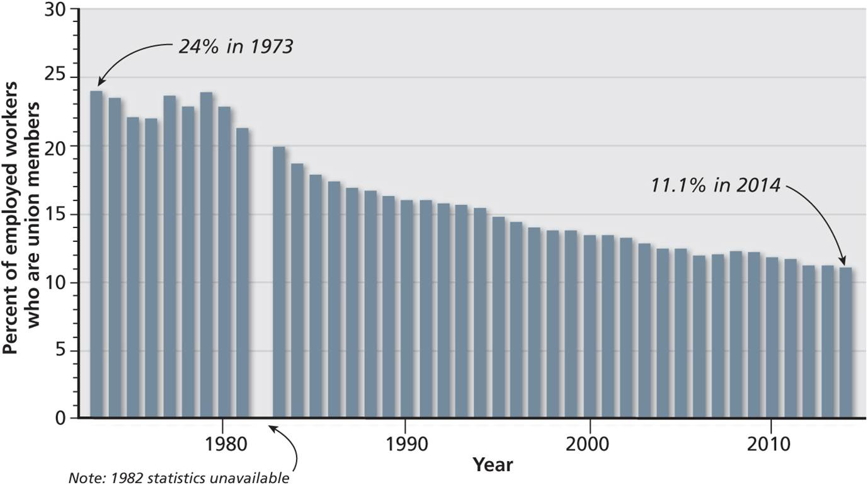
Capital and Labor
Changing dynamic of capital and labor
Each struggles to gain advantage from the other
Each has different mobility, which has widened
Capital has become more mobile than labor, thus a stronger force
Declining union numbers.
Notes:
Figure 8.8

Slide 24
Capital and Labor
Capital: real assets and social relationship
Mobility of capital reinforced by changes to production
Under Fordism, capital and labor were fixed in a location of production
Recently just-in-time, flexible production systems allow capital to flow where costs are lowest
Harvey’s analysis of capital as a social relationship
Recurring crises of capitalism and its globalization

Slide 25

Capital and Labor
Labor: place and politics
Organized labor and labor legislation
Weakened by global shift and mechanization
Differential mobility to capital
Paradox of Mass Consumption
Labor are consumers
Under appreciation of unions’ role in creating American prosperity of the 1950s -80s
Decline of middle income Americans
Union hall in Baltimore.
Notes:
Figure 8.9

Slide 26
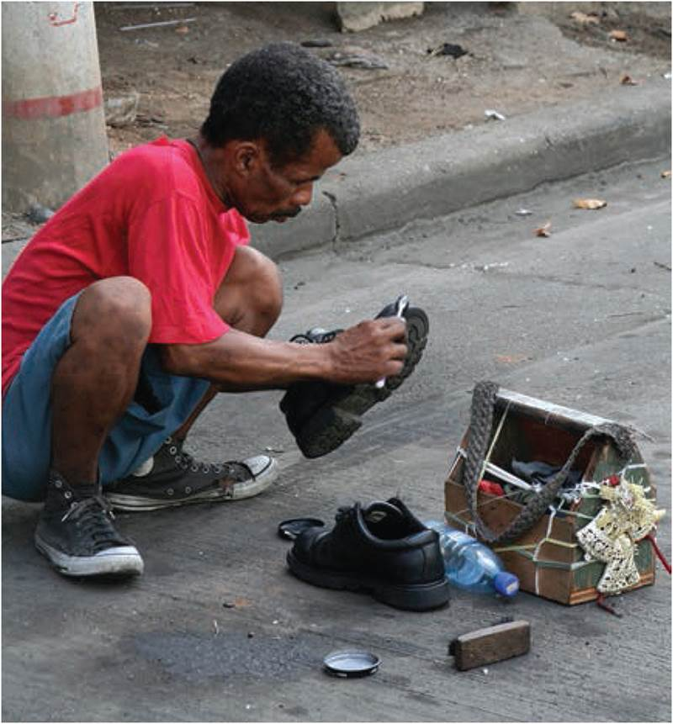
Capital and Labor
Social difference in the workplace
Work and income are economic and social differentiators
Resources, sector opportunities and economic strategies vary by household
Getting-by or survival strategies
Informal employment in Panama.
Notes:
Figure 8.10

Slide 27
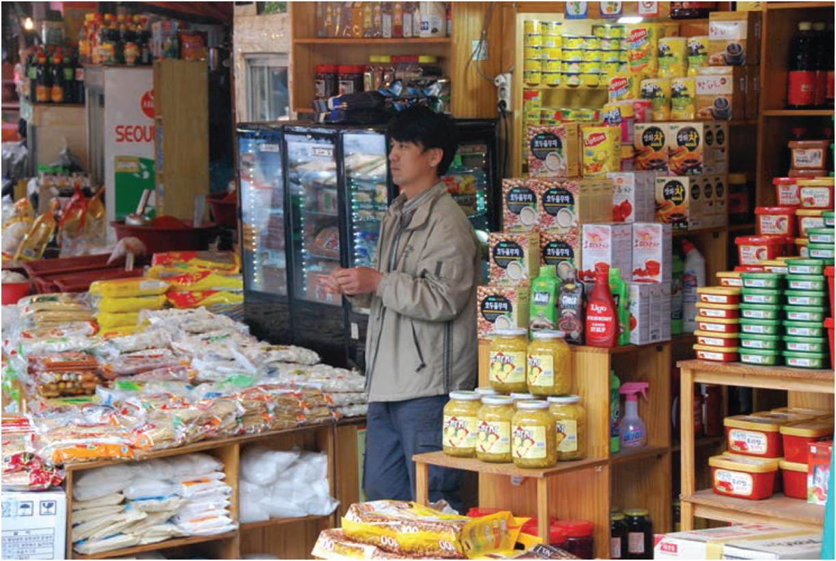
The Rise of Mass Consumption
Mass production and mass consumption
Drivers of consumer spending
Importance of advertising
Consumption and status
Access to credit
Places of consumption and Hotelling’s Law
Dominance of retailers over producers
Retail clustering in market in Seoul, Korea.
Notes:
Figure 8.11

Slide 28
The Changing Concerns of Economic Geography
Early theories of industrial location
Produced during times of industrial growth, assumed perfect economic rationality
Instead, it is a complex negotiation and bargaining with other agents in wider social and political context
New economic geography
Marxist political economy explains uneven development as part of capitalist economies
Feminist perspectives studying gender relations in economic geography

Slide 29
Chapter Summary
Uneven development of economic activity results in marked disparities in living standards and quality of life.
The Rostow model’s five stages: traditional stage, pre-takeoff stage, takeoff stage, drive to maturity, high mass consumption.
Global economy has winners and losers, not just as historical accident but part of process of economic development.
The core-periphery model as historical evolution of a rich core and poor periphery, w/ some countries transitioning to semi-periphery.
Economic disparities are evident at regional level, some regions growing faster and becoming more industrialized than others.
Uneven regional development is not a temporary condition, but essential to capitalist production as uneven waves of investments cause some regions to be more developed than others.

Slide 30
Chapter Summary
Four factors contribute to regional clustering of economic activity including locational pull of resources, concentration of firms and workers, subsidiary trades and services attracted to core industries, and spillover of innovative ideas between firms.
Regional economic clusters make markets more efficient, but often with increased costs of land and labor.
Regional economic dynamics also considered from the perspective of product and profit cycles. In early stages of product development, when super profits can be made, new firms are attracted to the location of the initial innovation. As more firms enter the markets, new spatial forces may relocate closer to markets or away from higher-wage areas in order to maintain and increase profitability.

Slide 31
Chapter Summary
Governments of developing countries, seeking industrialization of the national economy, follow either import substitution strategy to protect local industry or export-oriented form of industrialization.
The development state can achieve success as public and private interests focus on the goal of rapid growth. However, reliance on export-led growth makes economies vulnerable to global shocks.
Capitalist economies have grown from being based on the production of commodities to being based on the mass production and consumption of goods. Implications of mass consumption include: desire trumping need, consumption being equated to social status, different levels of access to credit, geographies shaped by consumption, and a growing dominance of retailers over producers.

Slide 32
Chapter Summary
Differential mobility of capital and labor at the national and global level is becoming more pronounced. Capital is more mobile while organized labor is more fixed.
Capitalism is capable of amazing growth and innovation, but is subject to recurring crises and continual turmoil, as the crisis solved in one area becomes a crisis in another area.
Employment in the formal economy involves sale of labor in the marketplace, formally recorded in government and official statistics, while the informal economy is of unrecorded transactions and a response to lack of formal employment opportunities.

