Slide 1
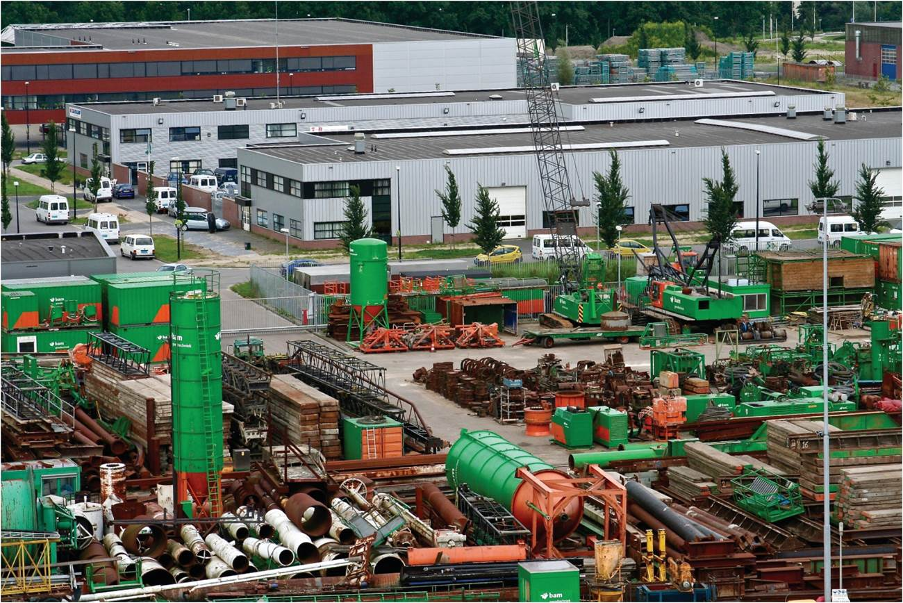
Chapter 7: The Geography of Three Economic Sectors
Economic geography looks at the changing nature and spatial distribution of different sectors of the economy.
Expanded by Joe Naumann, UMSL
Metalworks, Amsterdam
Notes:
Chapter 7 Opener

Slide 2
Chapter Learning Objectives
Recall the three sectors of economic activity and relate to von Thünen’s model of land use.
Describe the Agrarian Transition, and relate its changes and challenges.
Discuss the requirements that accompany the commercialization of agriculture and specifically reference the Green Revolution.
Identify the secondary sector of economic activity and the four Kondratieff cycles of historical periods of manufacturing innovation.
Reflect on the rise and location of the tertiary and quaternary sectors.

Slide 3
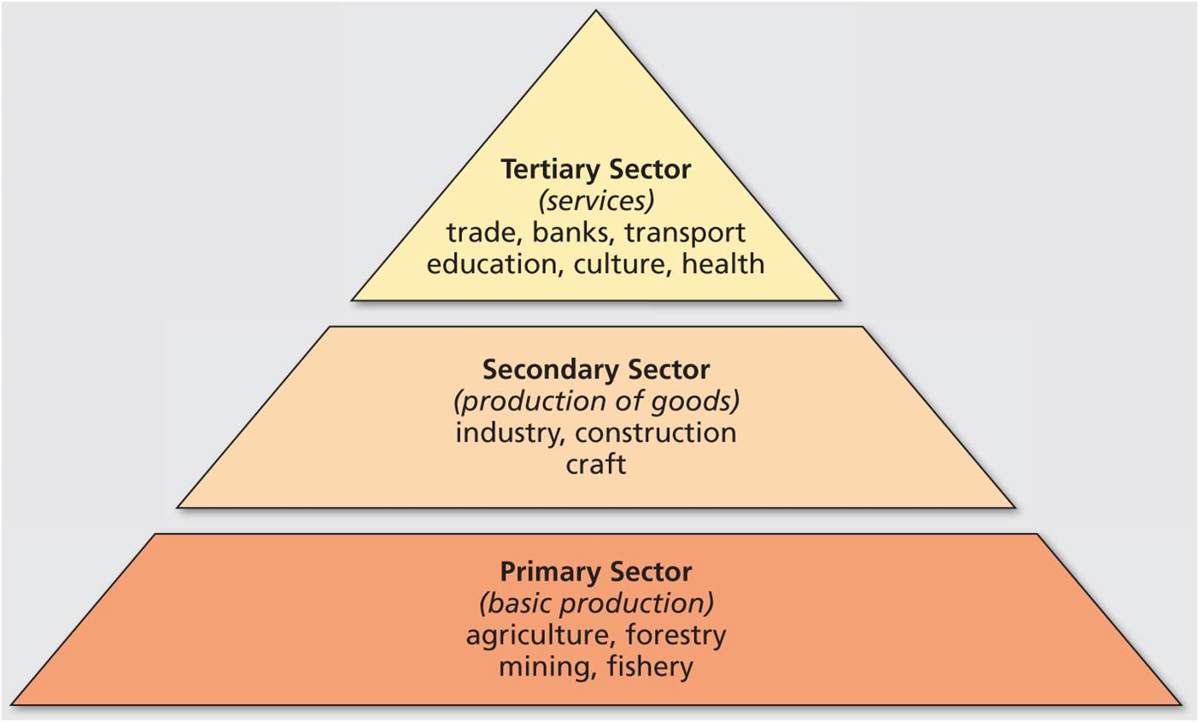
Economic Activity
Three distinct sectors
Primary and secondary sectors
Tertiary sector becomes important in more mature economies
All three sectors are connected in complex arrangements, networks, and flows
Three sectors of the economy. In reality there is considerable interaction among sectors.
Notes:
Figure 7.1

Slide 4
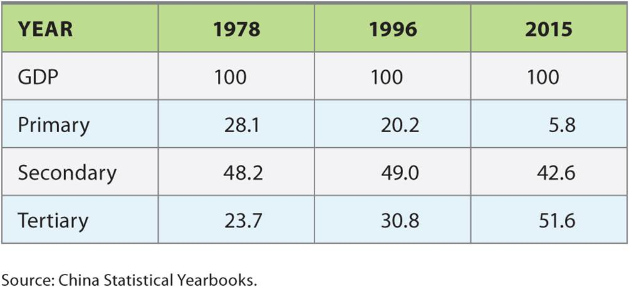
Changing Sector Composition in China
Table 7.1
Data from 1978-2015
Notes:
Table 7.1

Slide 5
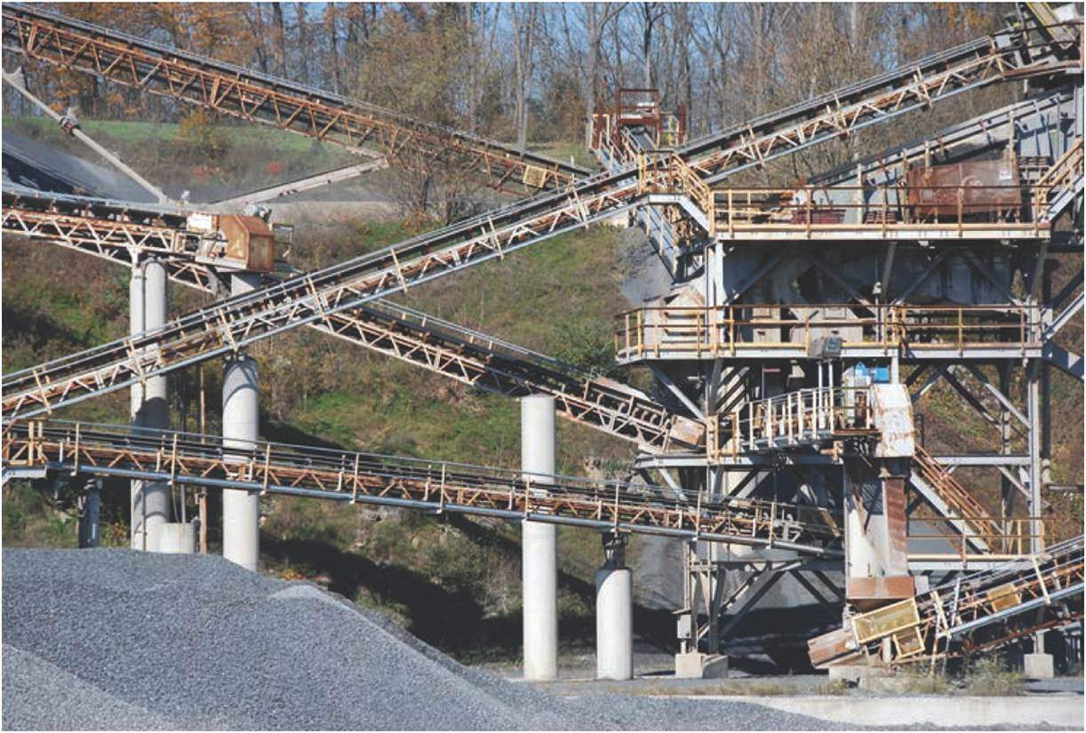
Agriculture
Primary sector
Agriculture, forestry, mining, and fishing
Agriculture and location
Depends on climate and weather, soils and water
Wheat belt of world’s temperate grasslands
Unsure of the effects of climate change – i.e. coffee growers
Primary sector activity: rock quarry in Pennsylvania.
Notes:
Figure 7.2

Slide 6
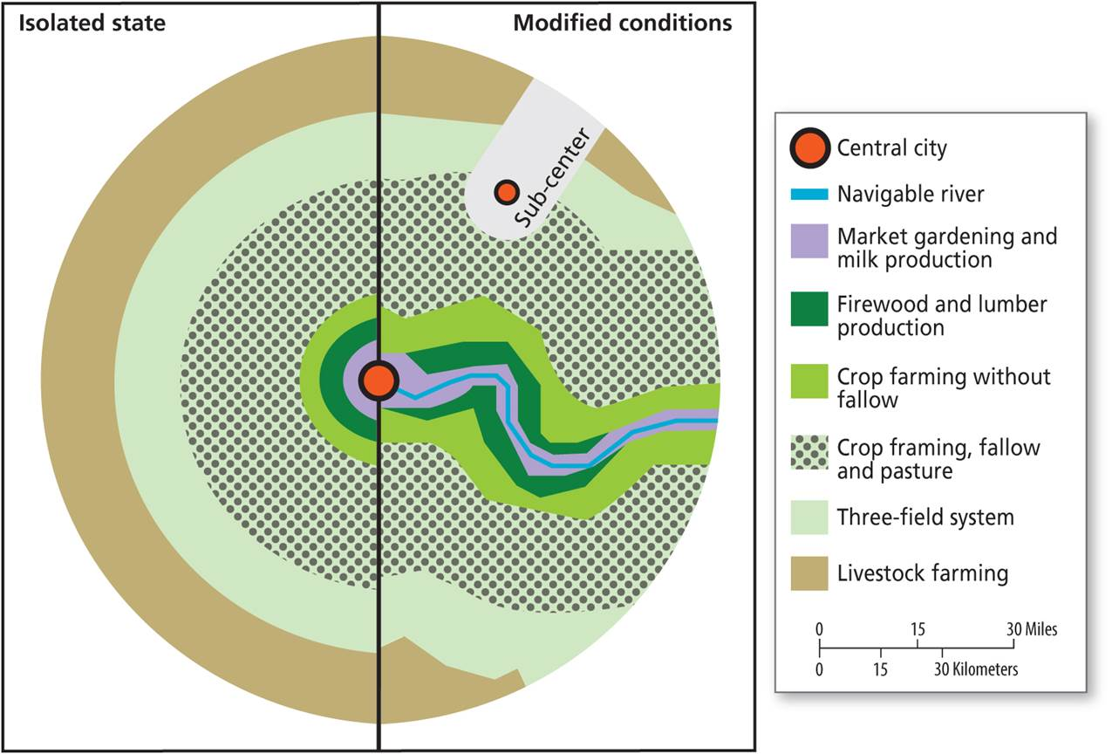
The von Thünen Model
Markets and agricultural production
von Thünen model of land use, simplified to focus on location
Applications
Historical developments
Megalopolis
Studying land use change
The von Thünen model of land use around an “isolated” market city situated on a flat plain.
Notes:
Figure 7.3

Slide 7
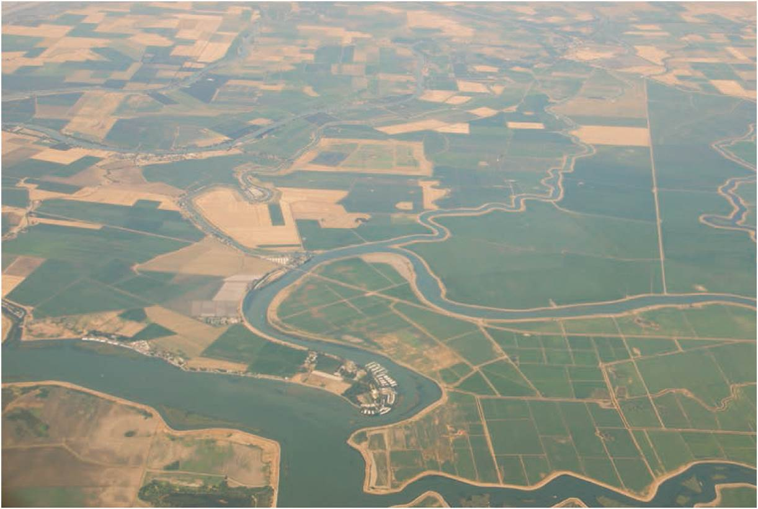
The Agrarian Transition
Agrarian transition
Subsistence, local to commercial, global
Growth in global food supply chains
Global expansion in arable land
More intensive farming methods
San Joaquin Valley, California
Notes:
Figure 7.4

Slide 8
The Agrarian Transition
Market integration of farmers and farmland
From subsistence to commercial farmers
Access to capital and technology
Rise in land grabs, forced commodification of land
England’s Enclosure Movement
Minority peasantry, often marginalized, are particularly vulnerable
Instances of resistance
USA – decline of the family farm

Slide 9
Food Supply Chains
Growing breadth and complexity
Demands of a growing urban population
Household income, dietary transition, and Bennett’s Law
Increased globalization of trade in foodstuffs
Different consumers may access different types
Four types
Buyer-driven chains of small retailers, few suppliers, flexible
Producer-driven chains may establish cartels
Bilateral oligopolies form of large-scale producers and retailers
Traditional markets of domestic smallholders

Slide 10
The Commercialization of Agriculture
Greater productivity (needed if population continues to grow)
Result of invested capital in machinery and biotech
Hybrids have limited useful time (insects adapt & diseases mutate)
Need to maintain wildlife areas for new genes from plants related to commercial plants (where cross pollination will work)
Environmental costs
Heavy pesticide use
Fertilizers and eutrophication
Genetically modified organisms (GMOs)

Slide 11
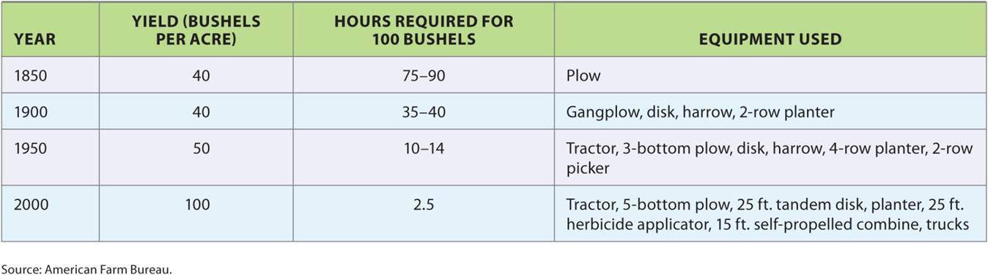
The Commercialization of Agriculture
Table 7.2
US farm increased productivity from 40 bushels of grain per acre in 1900 to 100 bushels in 2000.
Notes:
Table 7.2

Slide 12
The Commercialization of Agriculture
Original Green Revolution
Series of innovations applied to developing world from 1940s to 1970s – focused mainly on grains
Increased production through high-yield crop varieties, irrigation practices, application of pesticides and fertilizers
Flawed experiment considering the environmental damage and harm to the health of local communities
Great need to improve the nutritive value of the crops of the humid tropics (not as financially lucrative as grains)

Slide 13
Manufacturing
Secondary sector
Has decreased in importance in more developed countries – “rust belts”
Industrial Revolution and Kondratieff cycles
Each associated with a primary industry, innovation, and city
Factory towns to industrial metros
Growth of conglomerates; mega-mergers and reduced competition
Global shifts
Role of unions in gaining better pay and working conditions for everyone
Reduced influence with the rise of the tertiary sector and the decline of the secondary sector

Slide 14
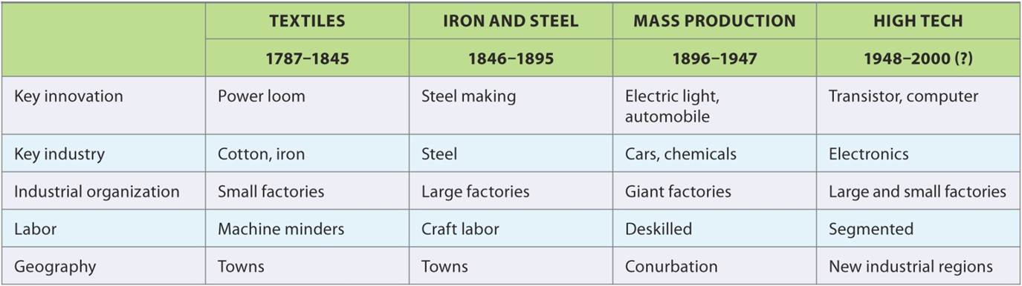
Manufacturing
Table 7.3
Four Kondratieff cycles are associated with key innovations that structure society and space.
Notes:
Table 7.3

Slide 15

Manufacturing
The First Cycle
Textile manufacturing
Exemplar city: Manchester
The Second Cycle
Iron and steel industry
Exemplar city: Pittsburgh
The Third Cycle
Automobile manufacturing and Fordism
Exemplar city: Detroit
Paterson, New Jersey, was a site of textile production in the US industrial revolution.
Notes:
Figure 7.5

Slide 16
Global Shift
Global shift to the third cycle since 1970s
Move from high-wage areas to low-wage areas (U.S. textiles to the South)
Enabled by low transportation costs
Newly industrializing Asian Tigers moved up the value added chain to more complex manufacturing
Consequences of manufacturing in a flat world
Deindustrialization in developed world
Sustained growth in new manufacturing regions
New class and gender identities associated with labor changes
India – small but growing “middle class” – educated women rejecting some customs associated with marriage.

Slide 17
Manufacturing
The Fourth Cycle
High-tech information technology industries
Distinction between invention and innovation
Exemplar region: Silicon Valley
Movement to the “Sun Belt”

Slide 18
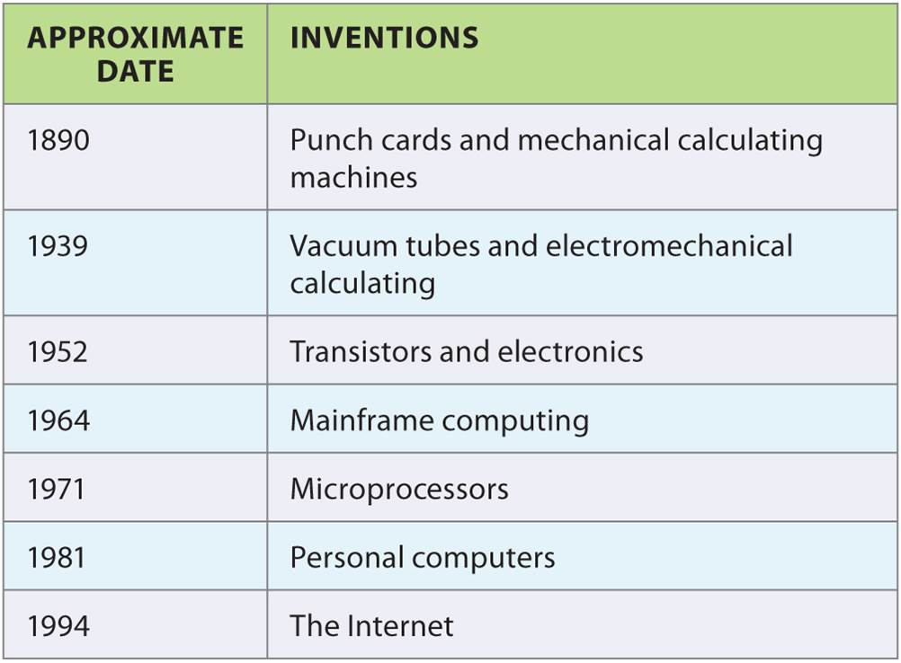
Manufacturing
Table 7.4
The IT wave took over a century to turn inventions into the wave of innovations since the 1980s.
Notes:
Table 7.4

Slide 19
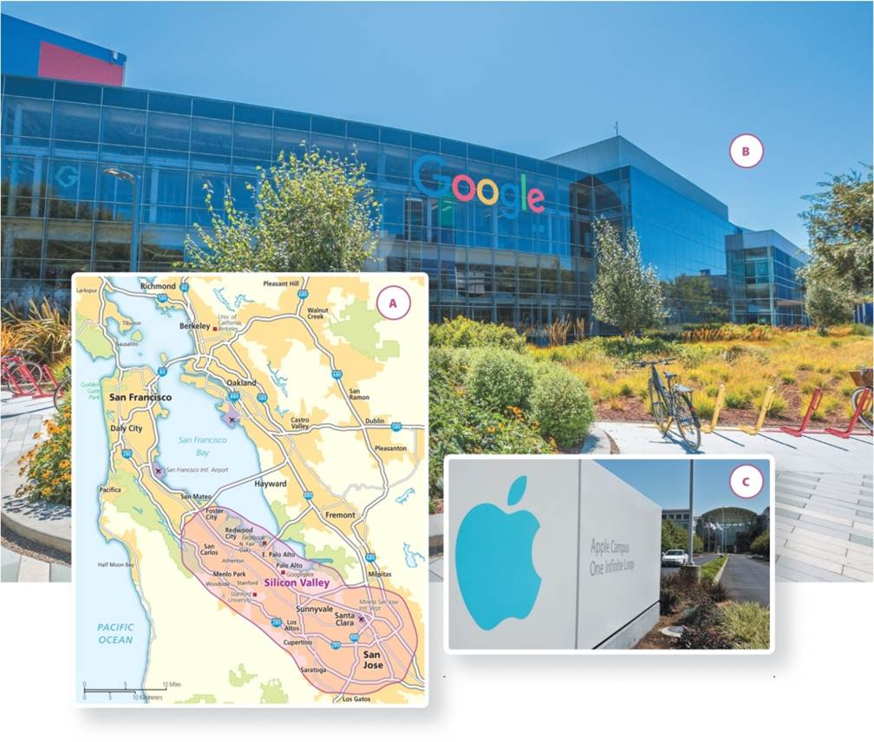
Manufacturing
Opening new possibilities
Creating new concerns and problems
Notes:
Figure 7.8

Slide 20

Services
Mature economies
Shift from manufacturing to services (biggest employer)
Wide range of activities and job experiences
Evolution of services
Breakaway activities from secondary sector
Tertiary sector: Wall Street is a center of financial services.
Notes:
Figure 7.9

Slide 21
Services
Characteristics
Polarized job market and wide range in compensation
Income distribution and employment opportunity
Increased female employment
Dangers of Baumol’s disease
As service employment increases, costs rise in the service sector
Price of goods in decline due to manufacturing efficiencies, yet cost of services keep rising both in absolute and relative terms
Particularly essential services

Slide 22
Services
Quaternary sector of knowledge and information services
Producer services
Quinary sector of executive decision-makers
Specialized, highly paid sector of “advanced producers services”
Increasingly important in more developed economies
Global Shift in Service
Economic globalization and new changes in technology
Lower wages and human capital advantages drive outsourcing
New global centers of service employment in China and India

Slide 23
The Cultural-Creative Economy
Cultural industry
Artistic industries and ‘cultural-products sectors’
Enhances products and services in other sectors
Concentrated in world cities based on “path dependence”
Creative economy
Creative class of workers

Slide 24
Chapter Summary
Three distinct sectors of economic activity are primary, secondary, and tertiary.
The primary sector includes the agriculture, forestry, mining, and fishing industries.
The von Thünen model predicts land use around a city. Land closer to the city is expensive, used for more intensive market-oriented agriculture.
Agrarian transition is the shift from subsistence to commercial and moves from meeting local market demands to provisioning national and global food supply chains. Involves changes to agriculture.
Food supply chains have become longer and more complex due to urbanization, changing diets, and increased globalization. Four types of food supply chains.

Slide 25
Chapter Summary
Market integration of agricultural products happens when subsistence smallholders become commercial farmers or through land grabs and forced commercialization.
Commercialization of agriculture involves greater capital investment in machinery and biotechnology, leads to greater productivity, and has environmental costs.
Most sustained commercialization of agriculture in the developing world that involved large inputs of biotechnology was the Green Revolution, which increased agriculture prediction through new high-yielding varieties of crops, irrigation, and liberal helpings of pesticides and fertilizers.

Slide 26
Chapter Summary
Four Kondratieff cycles of manufacturing depict fifty-year waves of increased innovation and invention.
Tertiary sector is the service industry, of selling, assistance, and providing expertise as opposed to making a tangible product.
Knowledge- and information-based activities, or advanced producer services, form the quaternary sector and with executive decision making levels defined as the quinary sector.
A region’s success rests more on the extent to which it can generate, retain, and attract knowledge-based employment.
Shift from a manufacturing-based economy to a service-based economy has profound effects on income distribution, gender relations, and urban growth.

