Slide 1
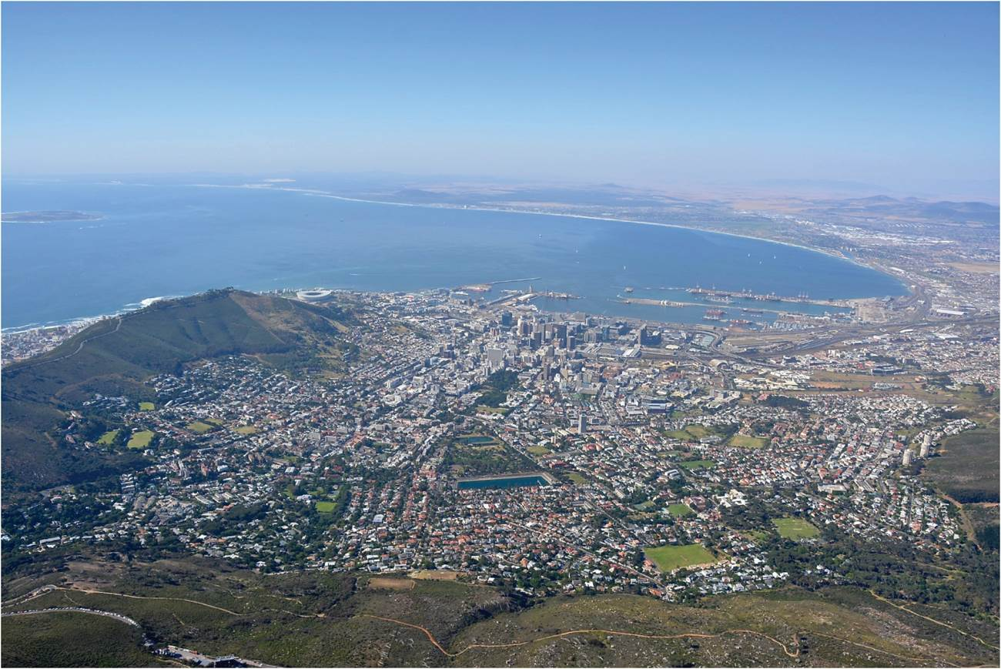
Chapter 6: People and the Environment
The environment is a source of economic opportunity, a repository of meaning, a sometime hazardous context, and always the background to our individual and collective lives.
5 themes of geography: Human – environment interaction
Adaptation
Alteration
View of Cape Town, South Africa from Table Mountain.
Expanded by Joe Naumann, UMSL
Notes:
Chapter 6 Opener

Slide 2
Chapter Learning Objectives
Identify the three basic forms of socio-spatial-economic relations and their spatial significance.
Describe ways that humans have managed the environment and how economic dynamics have impacted perceptions of the environment.
Discuss societies’ growing environmental awareness and the changing social construction of the environment.
Explain political ecology and relate it to the impacts of human activities on the global environment.
Outline some examples of major natural hazards and disasters by citing both their human and physical features.

Slide 3
To adapt or to alter, that is the question!
At low levels of technology, humans mostly have to adapt to the environment
In the high latitudes, they have to develop warm clothing (adapting to the environment), particularly for winter. In the low latitudes clothing is less necessary
If people traveling by canoe reach a point where nthey need to use a different nearby river, they have to portage (carry – adapting to the environment) the canoe to the other river. People with a higher level of technology may dig a canal to connect the rivers (altering the environment), saving time and effort to make that trip.
The higher the technology, the more the environment can be altered.

Slide 4
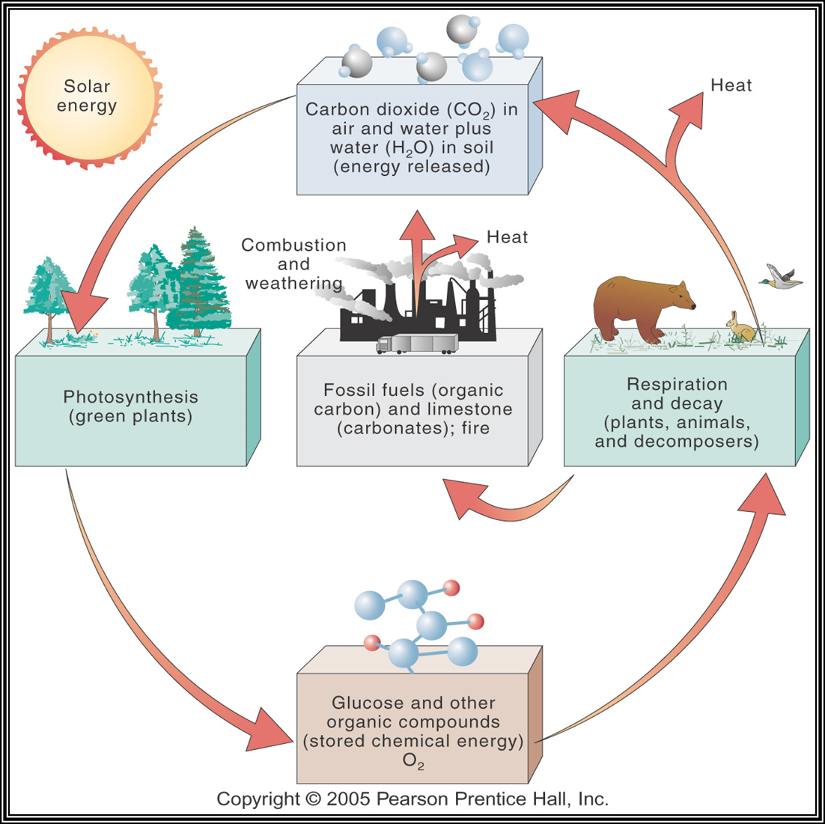
Most Life is based on carbon

Slide 5

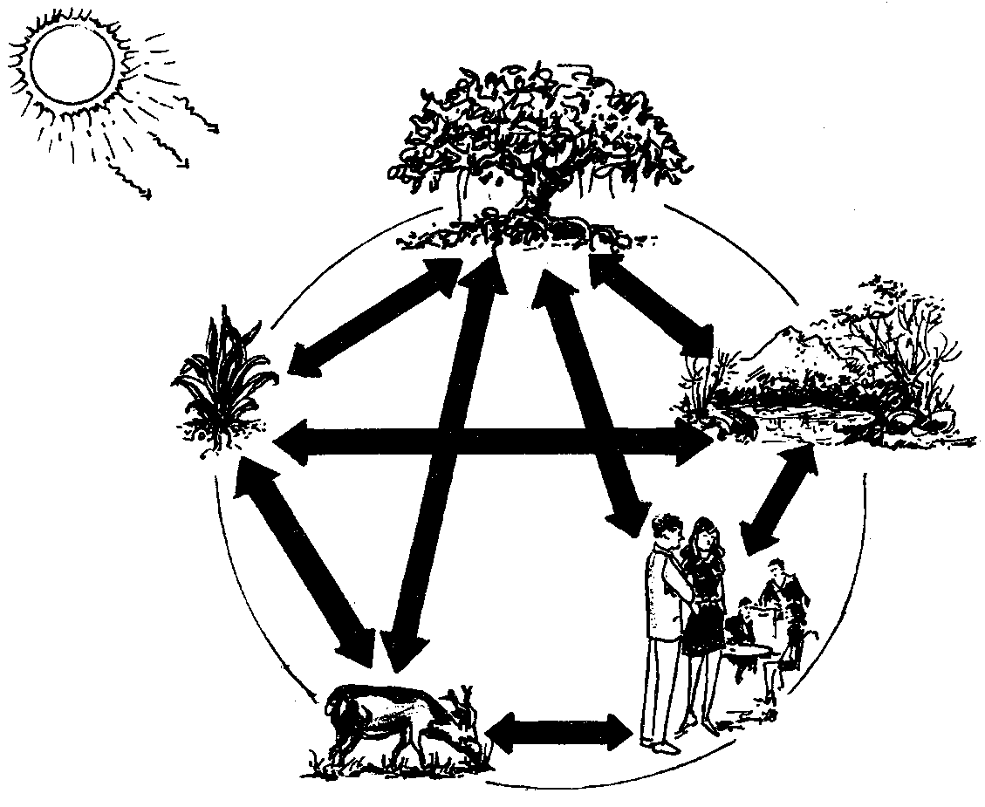
Recycled & Recycling Solar-Powered World
Studying patterns and relationships, one discovers that the world is one gigantic system composed of intrerconnected and interdependent cycles and sub-systems.
Everything & everyone is connected and recycled!

Slide 6
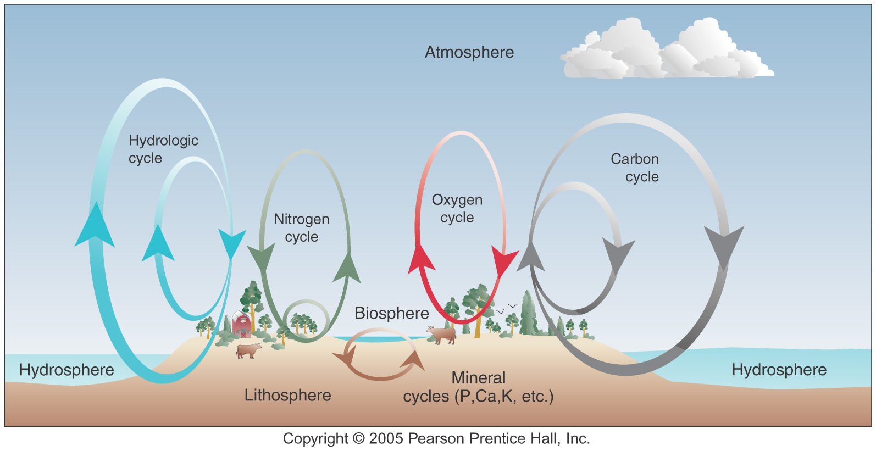
Key Cycles
Rock Cycle ALSO

Slide 7
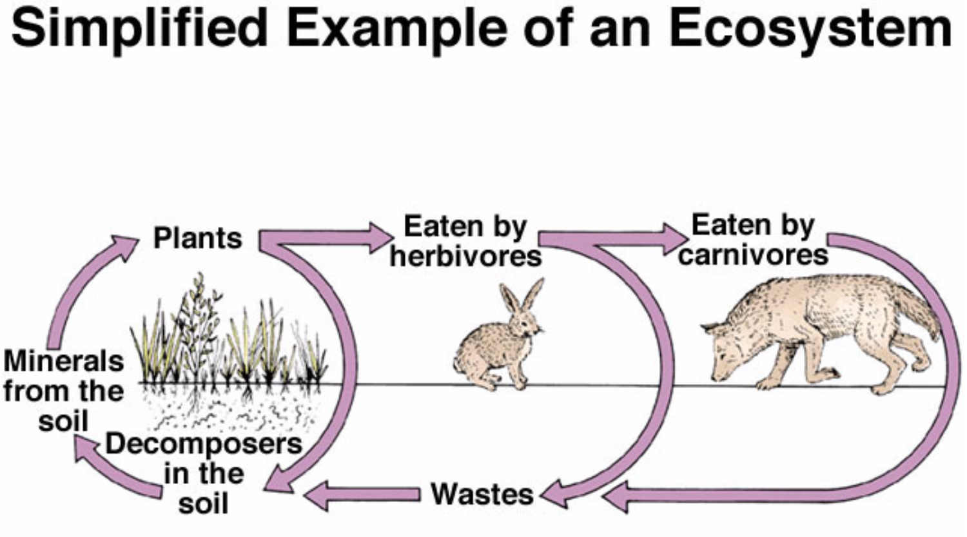

Slide 8
To alter or not to alter?
Important maxim: Just because we can do something, that doesn’t mean we should do it? Or, when in doubt, don’t!
Examine the 4 laws of ecology as they relate to the decision
Everything is connected (even if you don’t see it)
Everything goes somewhere
Nature knows best
There’s no such thing as a free lunch (there are always consequences)
Before altering, STUDY DEEPLY
What are the connections? Where are things going? What are they doing? Are there more good consequences or bad consequences?

Slide 9
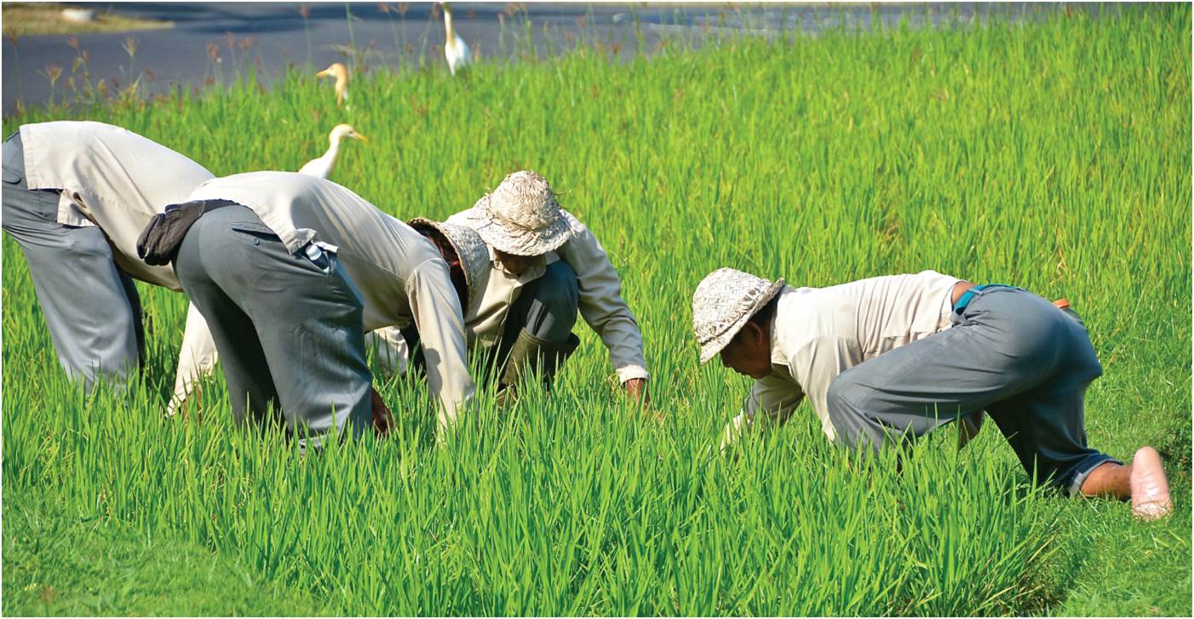
Environment and Cultural Meaning - Cultural factors: world view objectives, & level of technology
Three basic forms of socio-spatial-economic relations
Environment’s affect
Conceptions of environmental space
Hunter-gatherers and sacred space
Cultural encounters between hunter-gatherers and other societies
Traditional agriculture and productive space
Urban-industrial systems and managed space
The productive space of a rice paddy in Bali, Indonesia.
Notes:
Figure 6.1

Slide 10
Social-Spatial-Economic Relations
Hunting-gathering societies and Sacred Space
Gendered and age division of labor
Close connection with environment as sacred space
Human-nature based on sustenance and spirituality
Cultural Encounters
Interaction of societies with different cosmologies and environmental views
Example: Canadian and Indigenous encounters
Mapping of lands an outcome of native knowledge
Symbiotically destructive relationship

Slide 11
Social-Spatial-Economic Relations
Shift from sacred to productive space
Annual cycle of festivals and rituals
Agriculturalists stress sacrifice and fertility
Commodified agriculture for profit
Land as commodity, to accumulate wealth
The productive space of a rice paddy in Bali, Indonesia.
Notes:
Figure 6.1

Slide 12
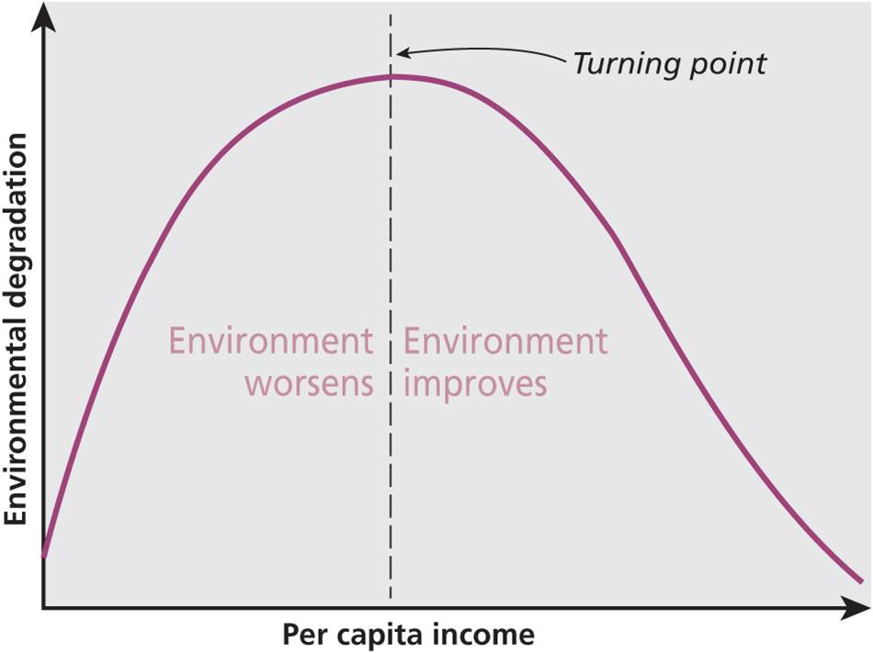
Managed Space
Managed space emerged with urban industrialization
Control over nature
Romanticism reaction to scientific rationalism
Ecology concern with links between living things
Environmental awareness
Environmental Kuznets Curve
Deep ecology to moderate sensitivity
New debates linking political issues, like ecofeminism
Shows the link between economic growth and environmental quality.
Notes:
Figure 6.2

Slide 13
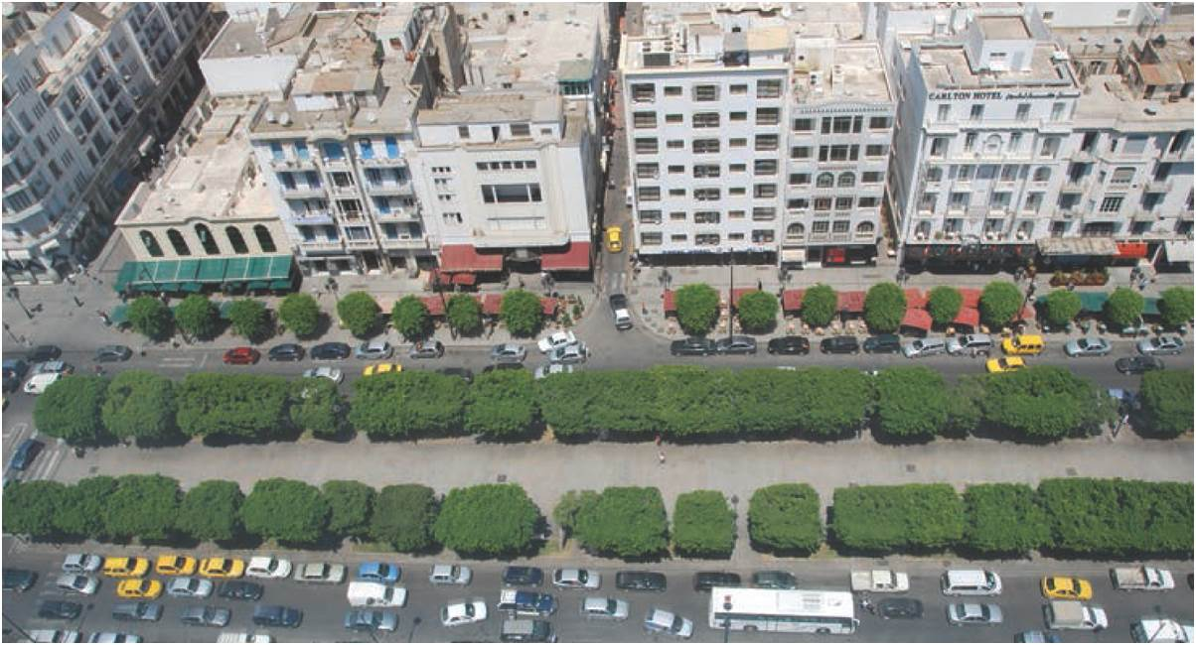
Environmental Impacts on Society
Emotional “affect” of space to feel or act
Influence individuals
Encoded with specific behaviors
Bystander effect
Context of place
Complex social construction
Changes over time
Avenue Habib Bourguiba in Tunis, Tunisia. Constructed during French occupation.
Notes:
Figure 6.3

Slide 14
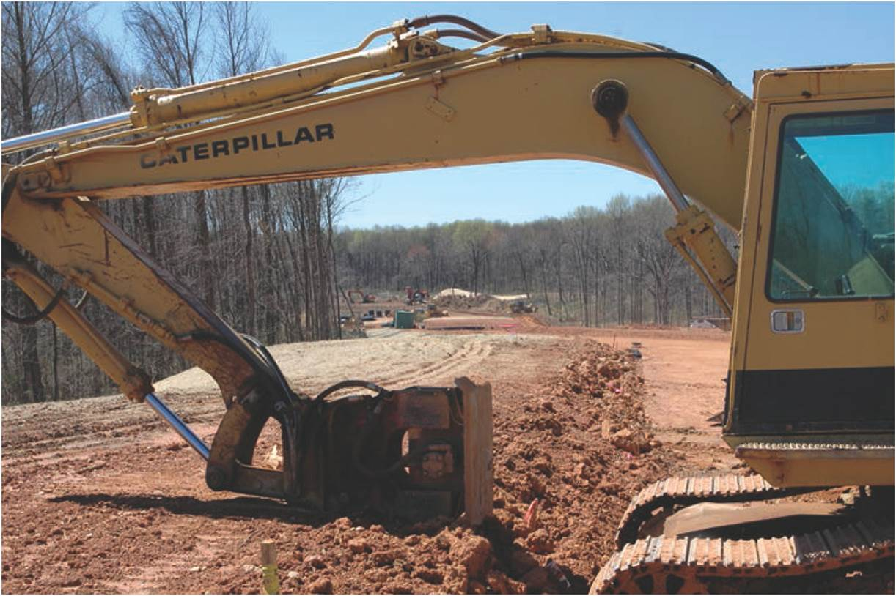
Human Impacts and Environmental Change
Geographers describing human impacts
The Earth as Transformed by Human Action (1990)
Major impacts
Habitat destruction and loss of biodiversity
Pollution of water and soil
Land use changes (desertification, deforestation, soil loss)
Global climate change
The urbanization of the rural landscape, Maryland.
Notes:
Figure 6.5

Slide 15
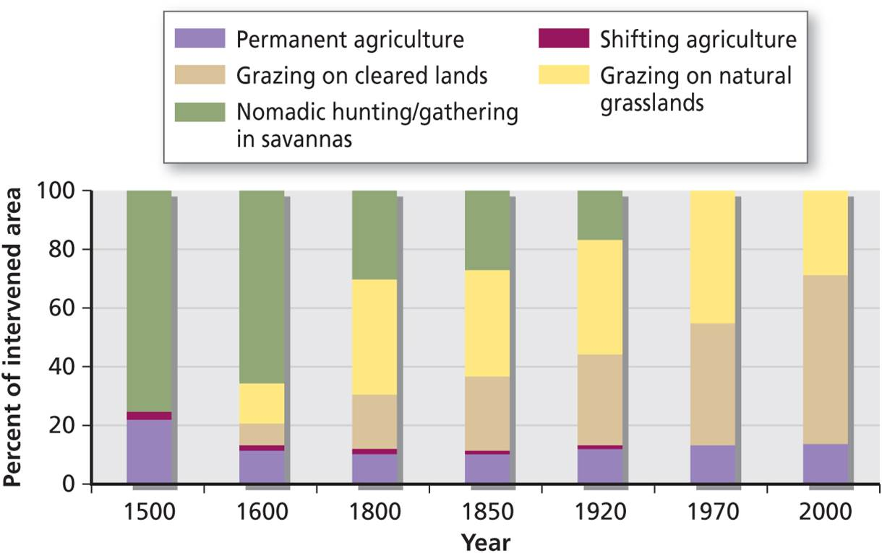
Human Impacts and Environmental Change
Consider social and political effects that drive change
Case of Colombia
Decline in forest cover and hunting-gathering
Periods of landscape change: conquest, colonization, state, and international markets
Land use change in Colombia is linked to political and economic changes. See Table 6.1.
Notes:
Figure 6.6

Slide 16
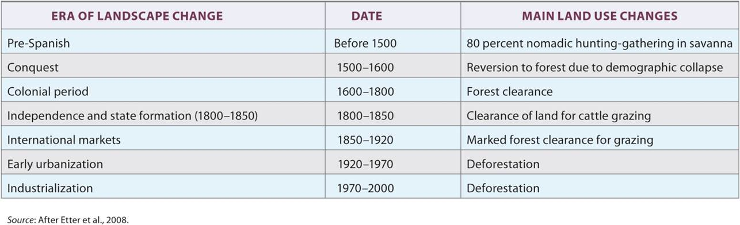
Land Use Changes in Colombia 1500-2000
Table 6.1
Researchers identified seven periods of landscape change. From 1500 to 2000, there was a marked long-term decline in forest cover, a drastic reduction in nomadic hunting-gathering in savannas, and increase in grazing on cleared land and natural grasslands.
Notes:
Table 6.1

Slide 17
Human Impacts and Environmental Change
Ground Truthing
Finer-grained processes to see effects and impacts on households, vulnerabilities, and coping strategies
Use of varying tools like traditional map comparison to more modern remote sensing
Use of different scales of analysis
Aware of locational bias in ecological studies
Political Ecology
Socioeconomic factors and environmental change
Struggle over resources: how control, costs, and benefits are apportioned among corporations and households

Slide 18
Human Impacts and Environmental Change
Global climate change
Many factors; most important is heavy use of fossil fuels
Range of global dynamics
Produces a variety of household and regional effects, like “double exposure” of accompanied political or economic changes
Impacts Related to Climate Change
Climate change produces a variety of different effects. The official federal site that collates data on the United States has a regional breakdown. Much of the basic data and some striking images are available at the NASA website (http://climate.nasa.gov/).
Notes:
Figure 6.7

Slide 19
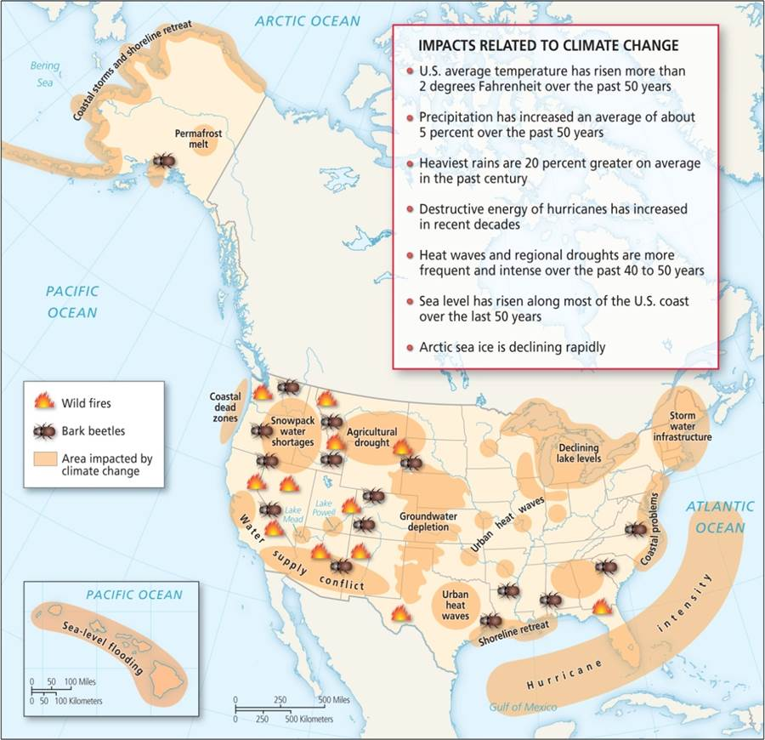
Notes:
Figure 6.7

Slide 20
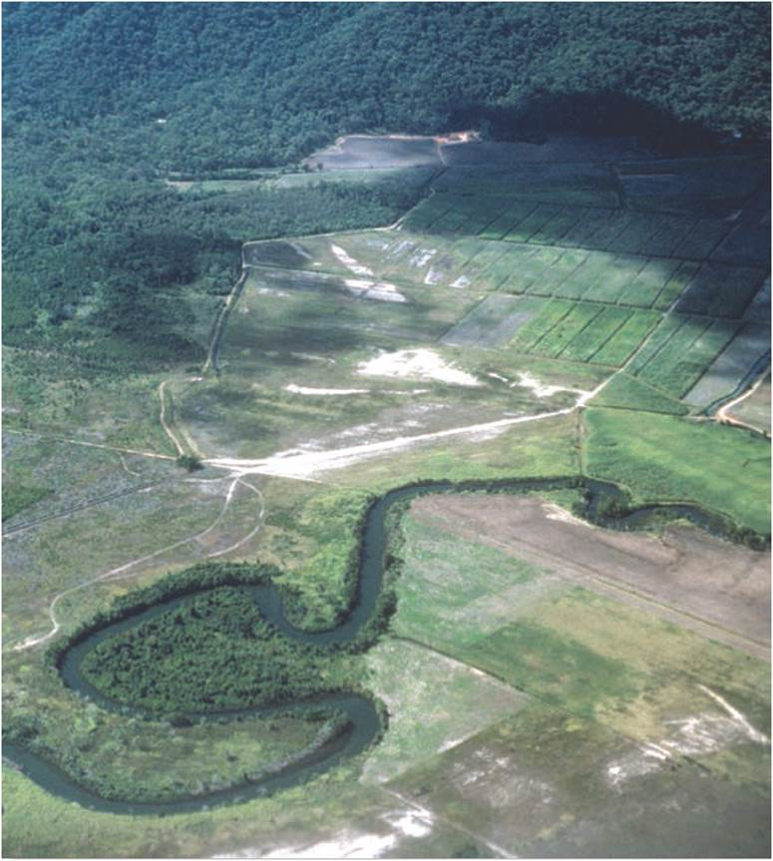
Human Impacts and Environmental Change
Landscape as text
Revealing power and deeper economic and political relations
Reflect dominant cultures, traces of alternative cultures
Landscape important in creation of place identities and historical memory
Creating sugar cane plantations from tropical rainforest in Queensland, Australia
Notes:
Figure 6.4

Slide 21
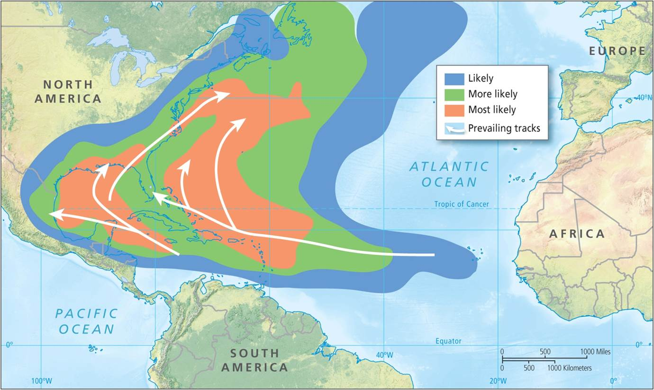
Human Impacts and Environmental Change
Hazards and Disasters
Hazards become disasters when vulnerability is high
High vulnerability: large, dense populations and high marginality
Disasters do not effect everyone equally
Hurricane forecasting and mitigation varies
Global warming will have different effects
Hurricane Katrina worse impact on most vulnerable
Hurricanes in the Caribbean and Eastern United States.
Notes:
Figure 6.8

Slide 22
The Tragedy of the Commons?
Garrett Hardin (1968)
When individuals use collective resources, each individual maximizes personal interest
Overuse results in decline of common space
Solution? Government regulation or privatization
Elinor Ostrom (1990) argues against simple solution
Principles of common-pool resource management

Slide 23
Sequent occupance reveals culture changes
Cultural landscape – the total impact of human action upon the natural conditions – changes made by humans – an expression of their culture.
Cultures rise and fall
Cultures change
Cultures are replaced by other cultures
The cultural landscape changes in response to the growth of a culture or its replacement

Slide 24
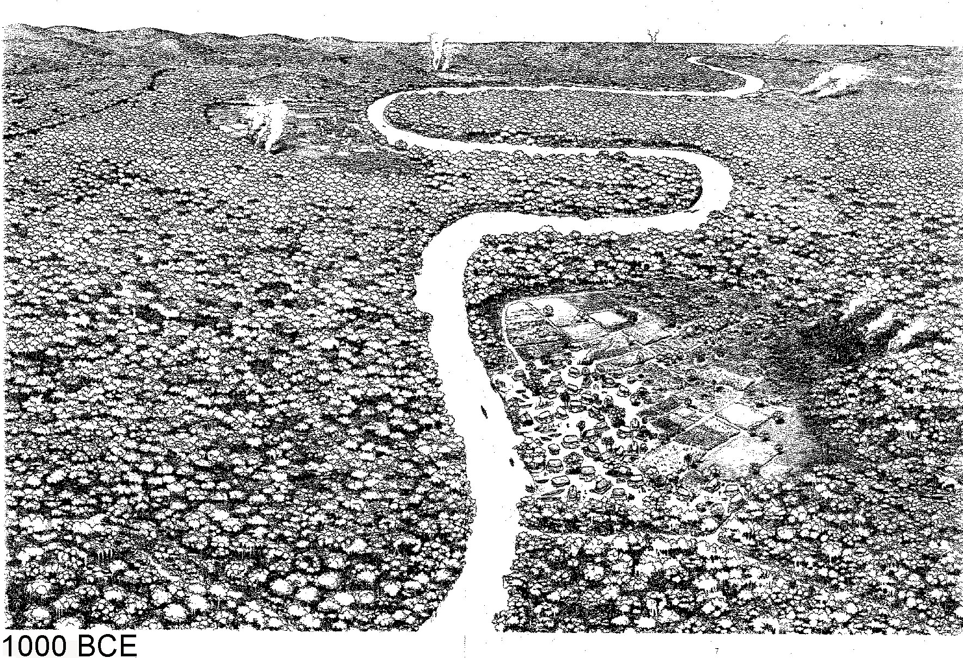
Central America Sequence

Slide 25
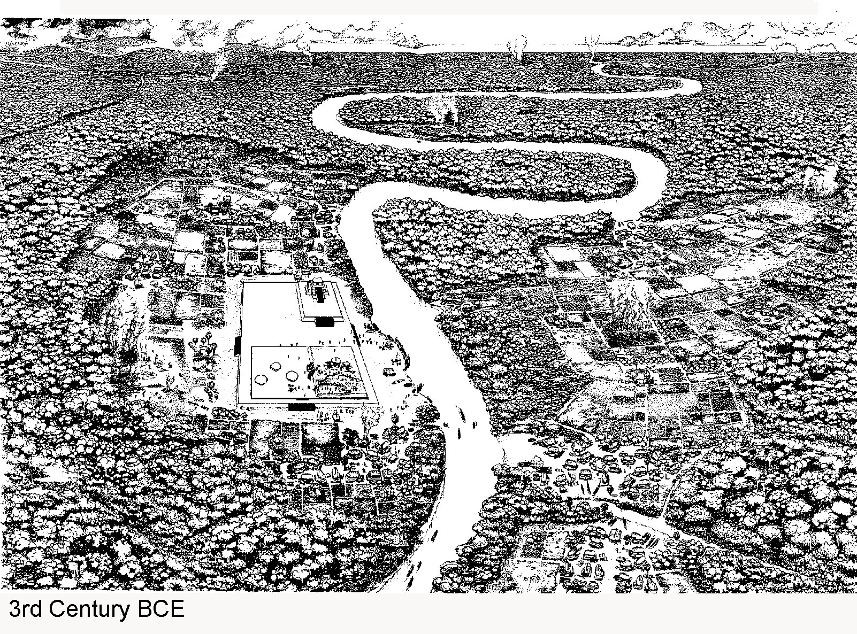

Slide 26
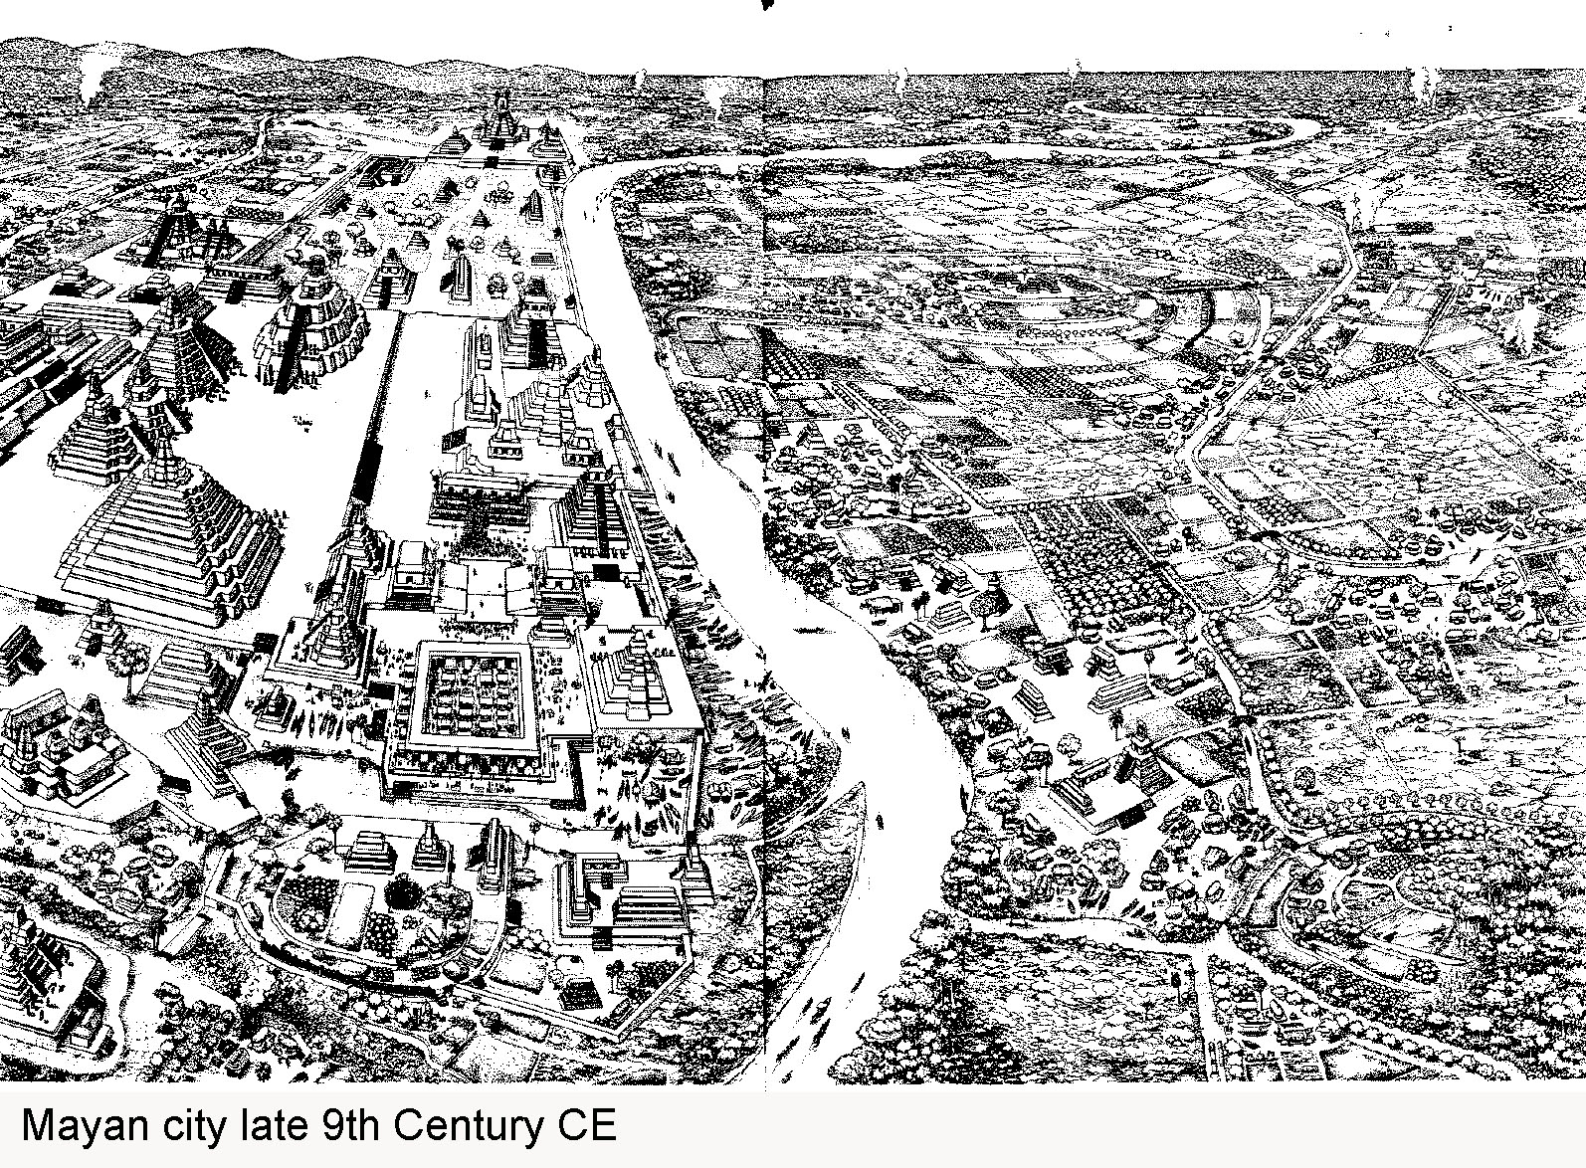

Slide 27
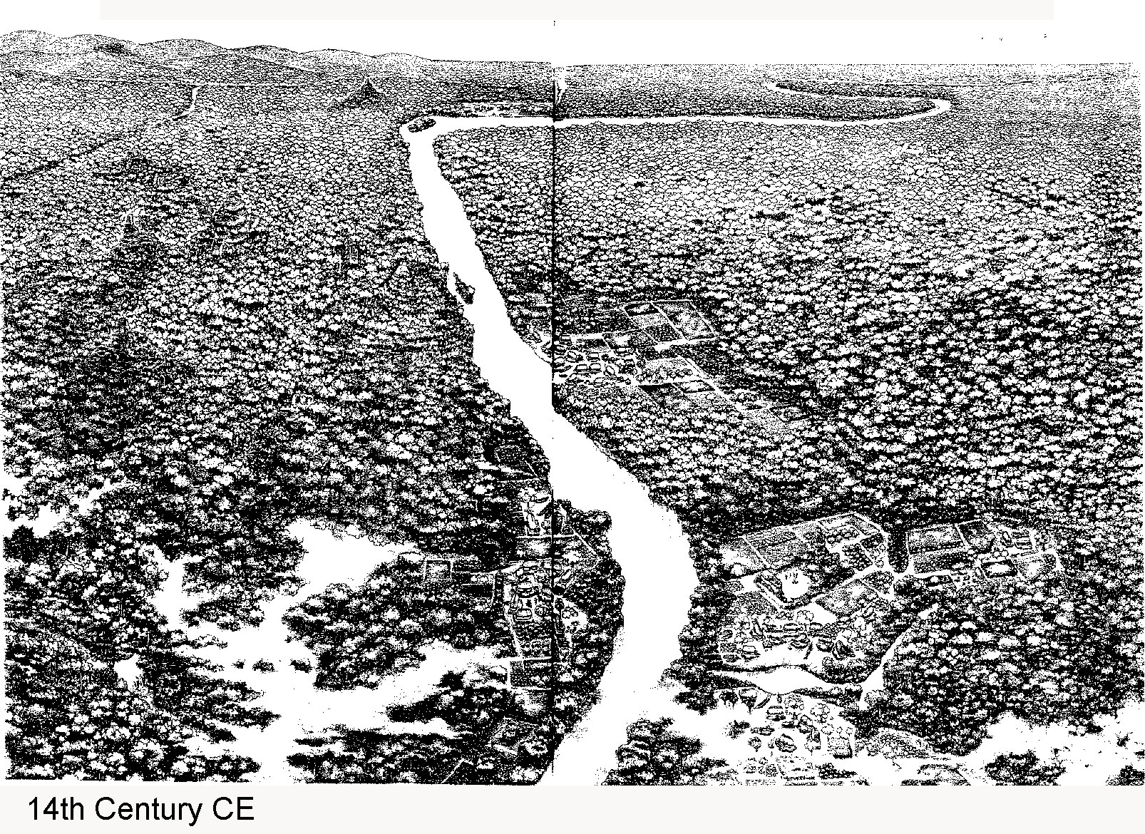

Slide 28
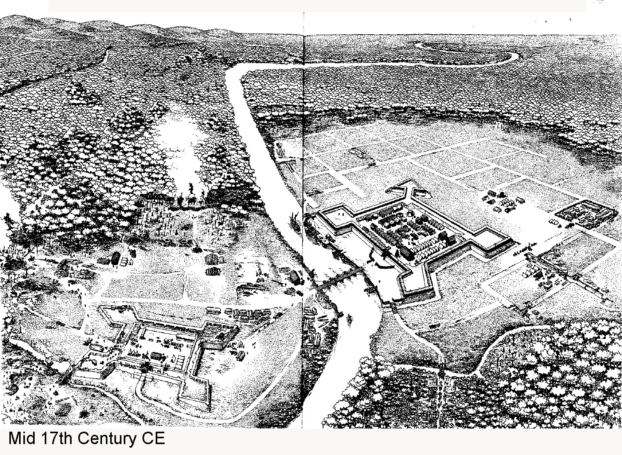

Slide 29
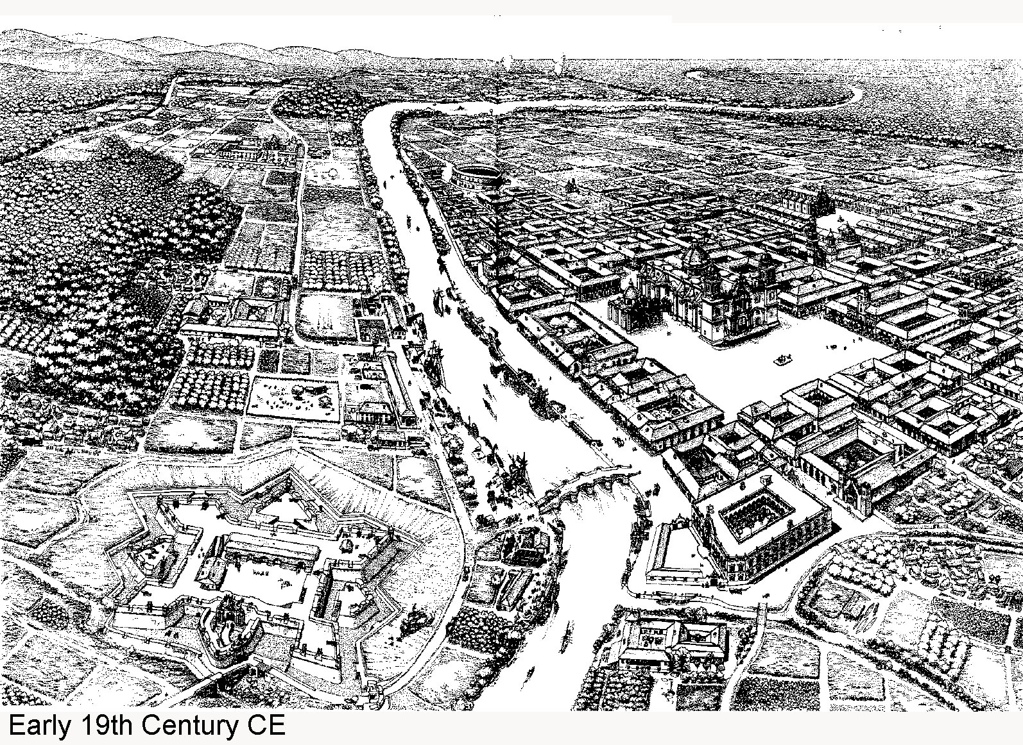

Slide 30
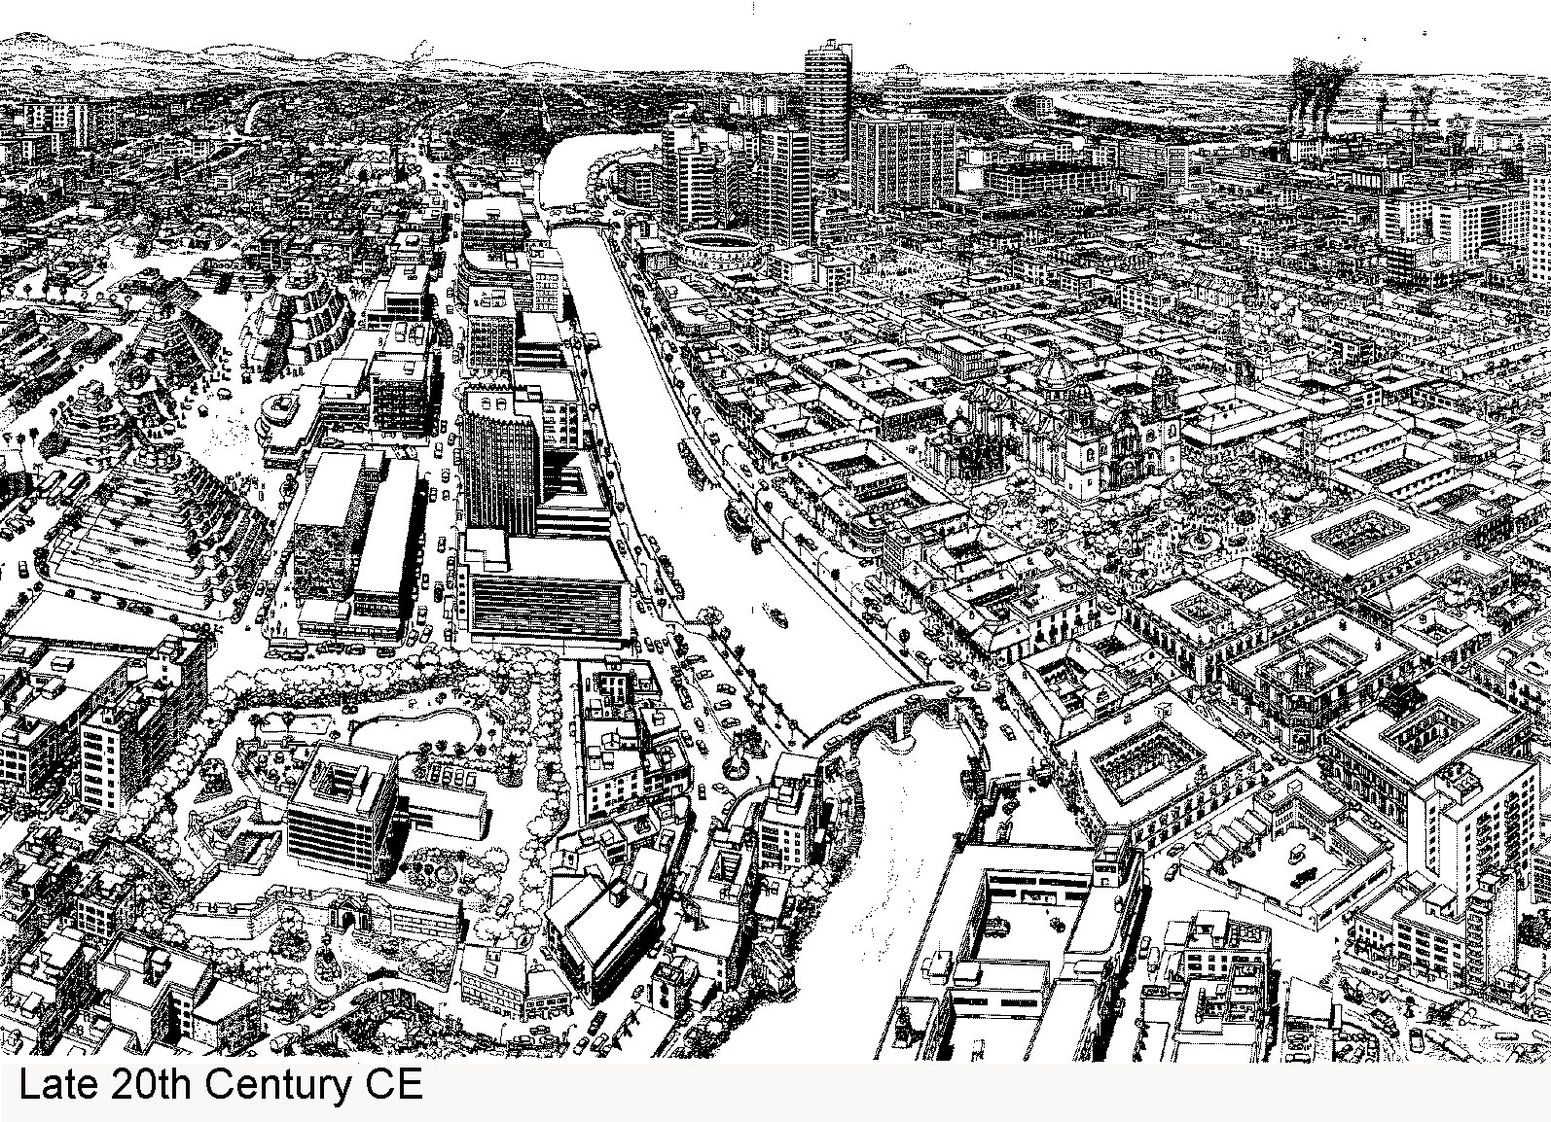

Slide 31
The Anthropocene
The End of Nature ?
New form of earth being created by humans
Associated with permanent changes
Anthropocene and world anthromes
Natural ecosystem loss,
Benefits are short-term and has long-term costs
Decline of biodiversity
Rewilding movement

Slide 32
Chapter Summary
Human-environment relations at the heart of human geography. Three basic forms of social-spatial-economic relations: hunting-gathering, traditional agriculture, and urban-industrial systems.
For hunting-gathering societies, nature is functional and economic, and is filled with spiritual and cosmological meaning.
Shift to agriculture production also shifted from the notion of sacred space to view of spaces as being productive.
Competing claims on the importance of the environment. Powerful forces promoting continued economic growth and tend to see nature as a commodity. Also increasing powerful awareness of unrestrained growth’s environmental consequences.
The environmental Kuznets Curve suggests a relationship between growing environmental awareness and increasing income.

Slide 33
Chapter Summary
Variety of opinions on appropriate policy responses to promote environmental awareness, ranging from “deep ecology” to an environmental sensitivity emphasizing alternative technologies, pollution reduction, and sustainable development.
Research shows mood and behavior both affected by environment and surroundings play a role in people’s sense of well-being.
Most significant human impact is global climate change.
One line of research in human geography looks specifically at landscape as an embodiment of the people/nature relationship.
Of the most visible and dramatic examples of people-nature relations is the experience of hazards and disasters. These experiences tell about the human geography of class and power.
We live in the Anthropocene, a world of our own making.

