Slide 1
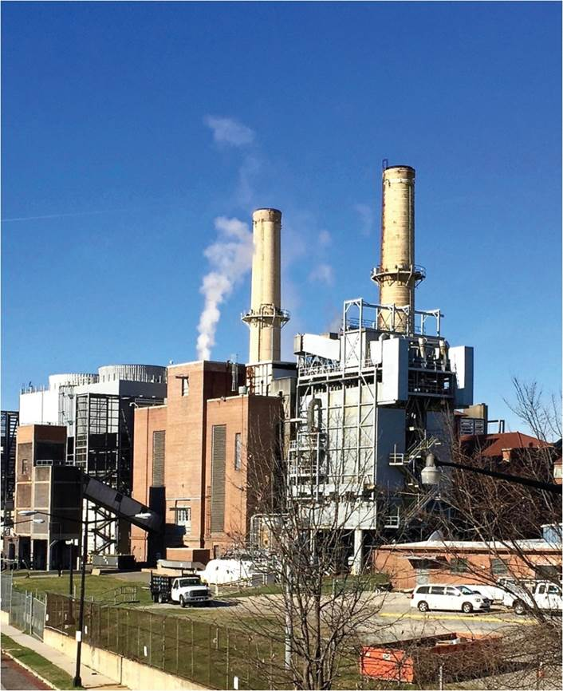
Chapter 5: Population and Resources
How nature is turned into a resource depends on many factors, including changing technologies and modes of activity.
Expanded by Joe Naumann, UMSL
Coal-fired power station, Washington DC.
Notes:
Chapter 5 Opener

Slide 2
Chapter Learning Objectives
Explain how humans have come to value nature and commodified resources.
Summarize the history of global coal consumption and production, along with its contemporary uses and their consequences.
Recall the five laws of resource use and relate them to specific resource examples.
Outline the twentieth-century history of oil production and consumption followed by present-day changes affecting the industry.
Consider the environmental impacts and growing costs associated with the continued use of oil and gas.

Slide 3
Culture’s world view affects recourse use
Western Civilization (industrial revolution/capitalism)
Dominate nature (nature as the enemy)
GOAL: make maximum profit by whatever the means and consequences
REALITY: rape of the environment – short term gain for a few but long term loss for the many
Traditional Asian, African, Native American
Seek harmony with nature (nature as a friend)
GOAL: sustained yield
Slash & burn – corn, beans, squash
Traditional Chinese agriculture
REALITY: minimal environmental damage – Chinese fertile soil in continual use for 5000 years

Slide 4
Culture’s level of technology affects resourse use
Machine power, large fields, and chemicals greatly increase the possibility of of environmental damage
Dead soil
Erosion
Chemical runoff
Damage to animal habitats
Animal powered tools, smsller fields, & organic fertilizers much less possible environmental damage
Healthy, living soil
Minimal fertilizer runoff
Less eroeion
Less damage to animal habitats
Remember that just because we can desn’t mean we should

Slide 5
Wise people heed the 4 laws of ecology; foolish, short-sighted people ignore them
Everything is connected
Everything goes somewhere
Nature knows best (and ultimately has the last word)
There is no such thing as a free lunch (every action has consequences)

Slide 6
Categories and Definitions
Natural resources (primary products) something useful and of value to human beings that was created by nature in finite quantities and not processed by humans:
Iron ore, wheat, petroleum, water, trees (logs), domesticated animals etc.
Resource (a broader term): something that humans value because it is useful and exists in finite quantities.
Includes natural resources
Includes intermediate products (processed but not a finished product) and recyclable human-made products and waste products of other processes:
Plastic, sulfuric acid, paper, steel, lumber, sawdust and wood shavings, etc.

Slide 7
Examples
Primary product (natural resource) | Intermediate processed good | Finished product
Cow | Side of beef, leather made from skin, bones, intestines made into sausage casings, etc. | Rump roast, wallet, bone meal for garden use, Italian sausage in natural casing
Iron ore | Steel & wrought iron Fenders, hoods, trunk lids, appliance housings | Automobile, toaster, Wrought iron patio furniture, etc.
Wheat | Various types of flour, bran, wheat germ | Bread, cakes, cookies, cereals, health food products, etc.
Logs | Lumber of various dimensions Plywood (plain or with hardwood finished surface = paneling) Masonite made from sawdust (waste) Particle board made from wood shavings (waste) | Buildings, furniture, pegboard, etc.

Slide 8
Population and Resources
“Resource”
Socially constructed
Nonrenewable resources: Oil and Coal
Fossil fuels only of value with creation of carbon economy
“Commodification”
Interconnected with technical change
Requirements of a natural Resource
A primary good (raw material)
Limited quantity (scarce)
Its extractable with current technology
Desired by humans because they have a use for it.
Notes:
Figure 5.1

Slide 9
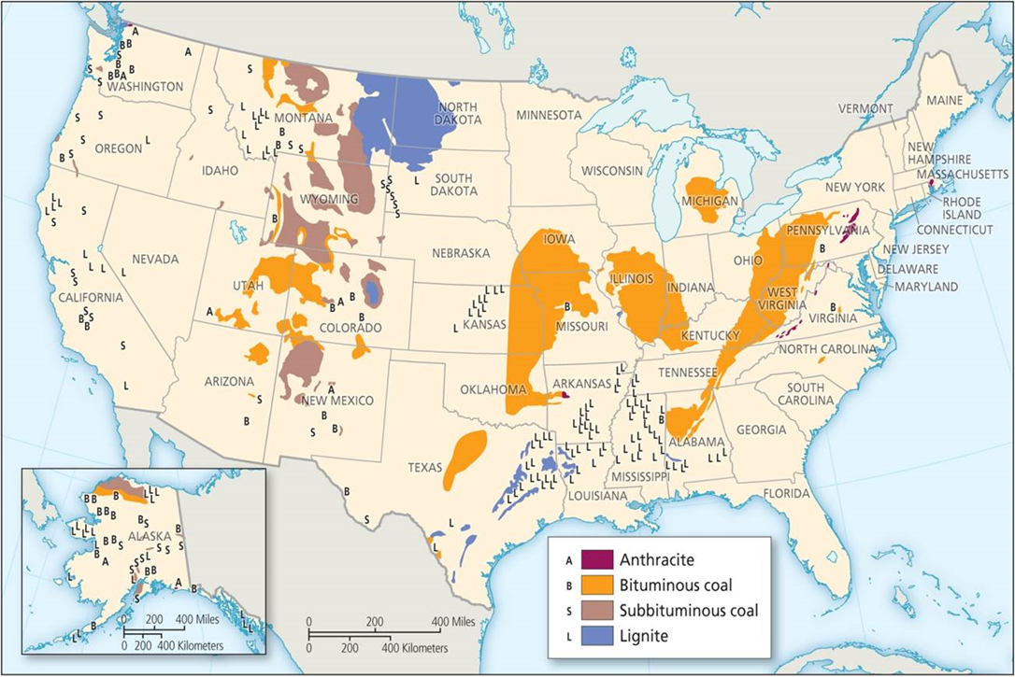
Coal regions in the United States.

Slide 10
The Hubbert Curve
Hubbert Curve
Prediction of decline in US oil production
Suggest nonrenewable use rises quickly to peak production then falls off
Ideally bell-shaped, but reality not symmetrical
Future possibilities with new technologies or timing of global peaks
Graphics on the next slide
Notes:
Box 5.1 Figures

Slide 11
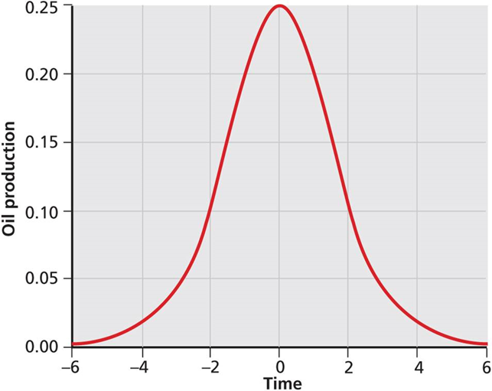
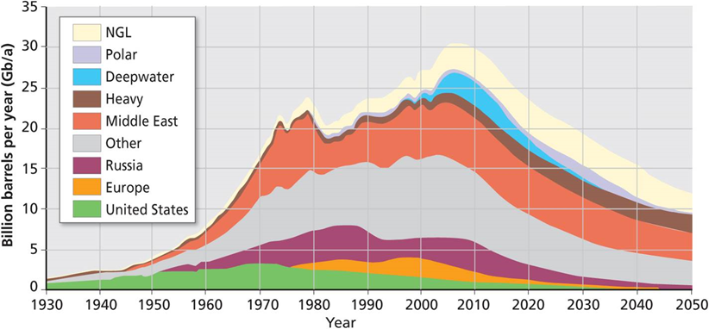
The Hubbert Curve
empirical, NCL=natural gas condensates
The Hubbert Curve: the ideal

Slide 12
Classifications
Nonrenewable – fossil fuels - One use and it’s “gone”
Extending the use of them (if that’s even desirable
Replaced with alternatives if that is possible
Efficiency in extraction and in the consuming of them
Maximum output per unit of input
Reusable – Nonrenewables that can be used again – eg. Metals
Include manufactured products which can be reused – glass, paper, etc.
Efficient recycling programs
Wealth from waste such as sawdust and wood shavings become particle board. (waste that used to pollute rivers become a useable product)

Slide 13
Classifications continued
Renewable – living things plus water and air
Efficient, wise use (conservation)
Good substitutes
Efficient use
Folrests – selective cutting and replanting
Fishing – leave enough fish that they can breed and recover
Water – clean it at the source of pollution
Air – clean it at the source of pollution
Farming – keep soil healthy – don’t over plant in semi=arid areas
Animal husbandry – Avoid over grazing
Strive for sustained use

Slide 14

The Case of Coal
Early uses of coal
Energy resource
Immediate noxious air
Investing in coal production and technology
Industrial Revolution
Industrial prominence powered by coal
From UK to US
Coal regions in the United States.
Notes:
Figure 5.1

Slide 15

The Case of Coal
Environmental health
Tension between economic growth and environmental legislation
1970 US Clean Air Act established new standards of air quality
Producers always trumpet the benefits and try to ignore or downplay the costs
Clean coal – an oxymoron
Air pollution in Shanghai. Chinese cities have high levels of air pollution from coal-fired plants.
Notes:
Figure 5.2

Slide 16
The Case of Coal
Coal Production
US rapid growth in shallow mining with new equipment
90 percent is destined for electricity-generating power plants
Decline in production
Cheaper sources available
China’s slowing growth
Resources only worth extracting when it is economically feasible
The United States remains a major coal producer, ranking second in the world after China.
Notes:
Figure 5.1

Slide 17
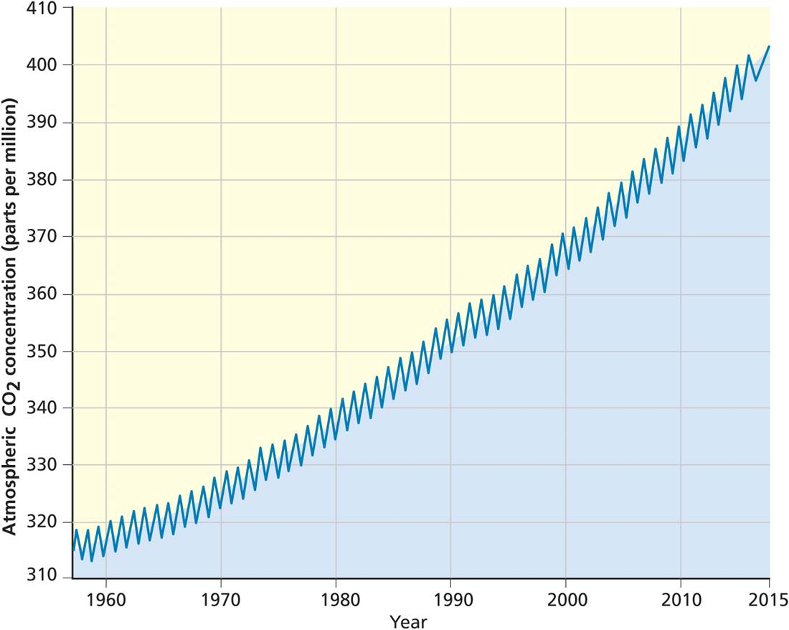
Problems with Coal
Burning coal
Pollutes the skies and contributes to acid rain
Causes global climate change by releasing CO₂
Steady rise of CO₂ in atmosphere recorded in the Keeling Curve
The Keeling Curve plots the concentration of the carbon dioxide gas in the atmosphere.
Notes:
Figure 5.3

Slide 18
Problems with Coal
Mining coal
Environmental destruction: loss of land, vegetation, and generates pollutants
Mountaintop removal (MTR) disrupts local ecosystems, loss of biodiversity, polluted air, soil, and water
Safety & health problems for workers
Reclamation of old mining areas costly
Back-filling shaft & tunnel mines
Filling, grading, and replanting strip-mined areas
The Keeling Curve plots the concentration of the carbon dioxide gas in the atmosphere.
Notes:
Figure 5.3

Slide 19
Laws of Resource Use
Resources become resources because previous resources become exhausted, unavailable, depleted, or too expensive.
Resource use creates new geographies.
All resource usage tends to have wider social and political consequences.
All resource use has implications for public spaces and the wider community as well as for private enterprises.
Initiatives to regulate and diminish the negative public consequences of resource use and exploitation always come up against powerful interests that firstly deny the problem and then minimize it.

Slide 20
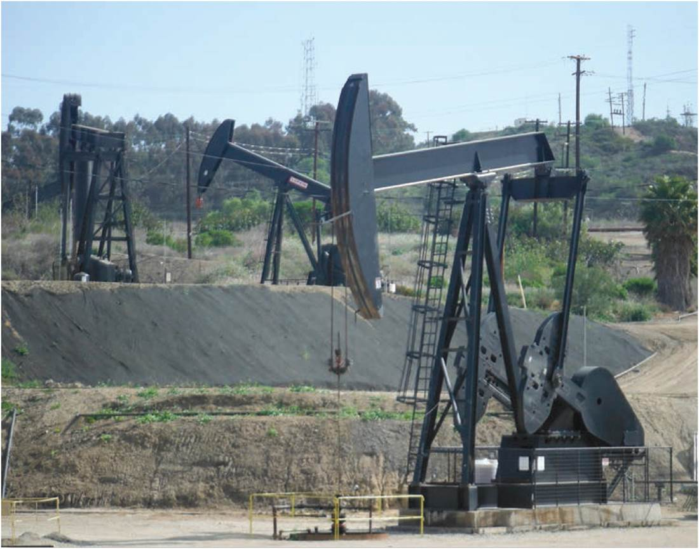
The Limits to Growth?
The Limits to Growth
Limits of supply would check continuous economic growth
Application of biological concepts like carrying capacity
Nonrenewables have a finite supply
1973 oil shock
Strengthened notion of sustainable resource use
Oil derricks in Los Angeles. This oil field, like many around the world, is coming to the end of its life.
Notes:
Figure 5.4

Slide 21
The Case of Oil
Never-ending demand from industrialization
Demand, production, price, and oil cartels
Organization of Petroleum Exporting Countries (OPEC) used power to increase oil prices and profits
Continued demand funded oil companies’ search for new reserves
Uncertain of new oil reserves, may be at peak oil
Most of easy oil reserves have been tapped
Now in the era of tough oil reserves that are deeper, further offshore, and more expensive to access and potentially more likely to create serious ecological problems – Remember the big oil leak in the Gulf of Mexico!

Slide 22
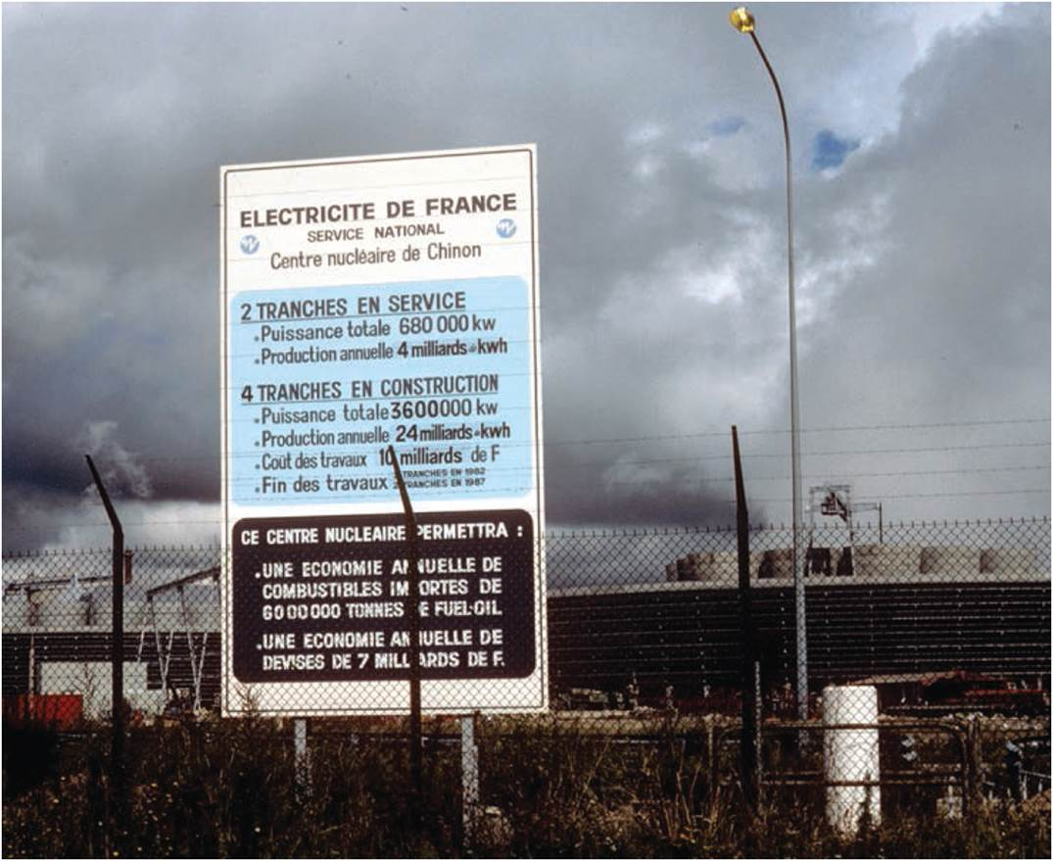
The Geopolitics of Oil
Energy security is national security
Oil demand as mutual interest between oil importer and consumer
Foreign policy impact
Securing reasonable price and stable supply
Importers tactics and consequences
Would US have invaded Iraq in 1990 and 2003 if they weren’t a major oil producer?
1995 US did nothing about the genocide in Rwanda (they have nothing we need, like oil)
Without oil reserves and with coal reserves long depleted, France relies heavily on nuclear power.
Notes:
Figure 5.5

Slide 23
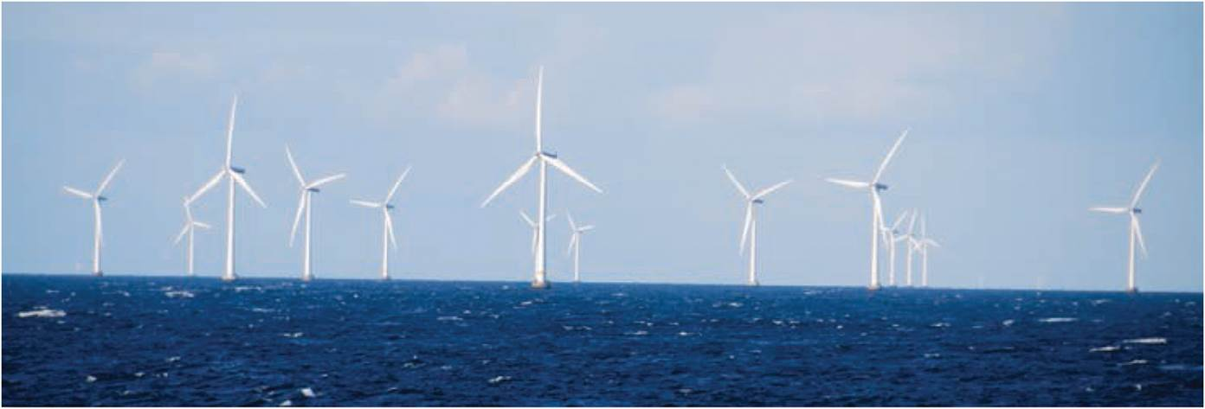
Consequences of Oil Supply Peaking
The search for alternate sources
Renewable energy
Biofuels
Long-term future of oil exporting countries
Implications for economies and socio-spatial assemblages predicated on cheap oil
Windmills off the coast of Denmark, a leader in wind power generation.
Notes:
Figure 5.6

Slide 24
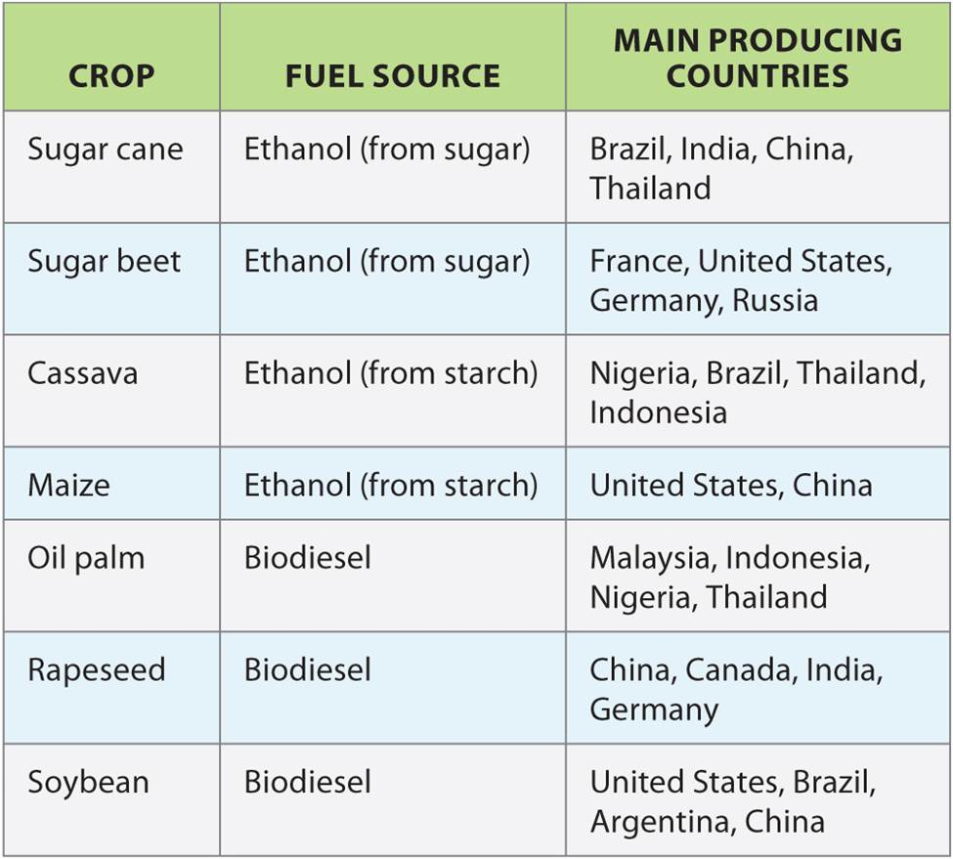
Biofuels
A list of biofuels. In many cases, the costs of alternative energies are still high, but as more efficient renewable energy technologies are introduced, we may be at the cusp of a major shift in energy supply.
Notes:
Table 5.1

Slide 25

Fracking in the USA
Heavy reliance, but limited supply
Directed geopolitical and economic considerations
Oil crunch
Growing gap between national supply and demand
US oil companies turned to difficult or expensive reserves
Small cars, hybrid vehicles, and electric cars become more popular as gas prices increase.
Notes:
Figure 5.7

Slide 26
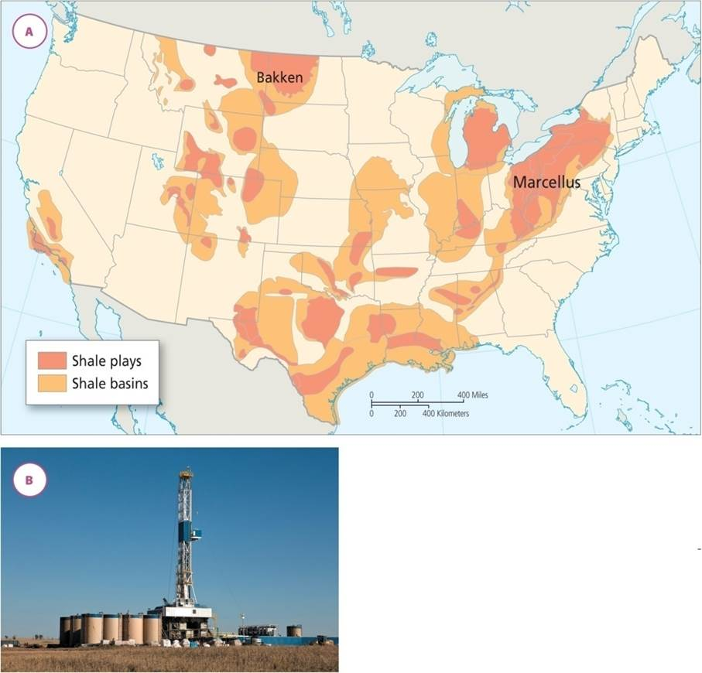
Fracking in the USA
Tough oil in the US
Offshore drilling and deepwater wells
Fracking and natural gas in shale deposits
The technology of hydraulic fracturing
Damgers
Temporarily staved peak oil
(a) Shale deposits in the USA. (b) Flex drilling rig in North Dakota.
Notes:
Figure 5.8

Slide 27
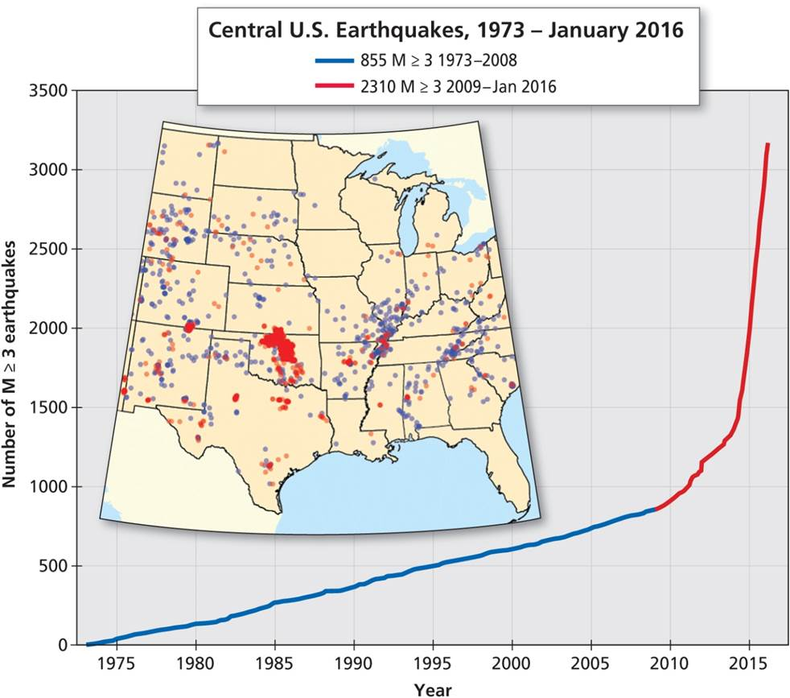
Fracking in the USA
Downsides to fracking revolution
Pollution of local water supply
Air pollution due to natural gas leaks
Fracking-induced earthquakes due to underground injection of wastewaters
Central US Earthquakes, 1973- January 2016. In Ohio, Oklahoma, and Texas, fracking has increased earthquakes.
Notes:
Figure 5.9

Slide 28
Commodity Cartels
Commodity cartels
Primary producers join up to ensure high prices for their resource
Arise from national dissatisfaction with private companies
Success of OPEC stimulated other cartels
Depends on nature of the commodity & number of major producers
Great demand
Few or now substitutes
Non-presishables
Bargaining positions differ among cartel members

Slide 29
The Limits to Growth Revisited
Initial argument was misplaced
Real issue is that continued supply may create other costs and negative consequences
Ultimate law of resource use
Pay a price for what we get
Cost can be shifted from private to public, local to national, one country to another, but the world is a closed system
Costs and benefits are always exacted, even if they may be shifted across space

Slide 30
Chapter Summary
Realize how “nature” becomes commodity, with all social and political consequences involved in its valuation and revaluations. Translation from inert material to valuable resource occurs through process of technical change and commodification.
Resource use creates costs/benefits for private and social interests. Benefits may be privatized, the costs are often socialized.
Coal used as a resource when timber was depleted, eventually came into common enough use that it became a significant air pollutant.
Coal powered the Industrial Revolution, an important ingredient for future manufacture of iron and steel, as well as driver of world’s most successful economies.
Top coal producers in the world are, in order, China, the United States, India, the European Union, and Australia.

Slide 31
Chapter Summary
Major environmental concerns from use of coal: 1) burning coal pollutes the skies and causes global climate change; and 2) coal mining involves environmental destruction.
Coal burning is responsible for CO₂ emissions in Earth’s atmosphere. Increase in such greenhouse gases now has a well-established link to global climate change.
Five laws of resource use: 1) prior resources become exhausted, unavailable, depleted, or too expensive; 2) use creates new geographies; 3) usage has wider social and political impacts; 4) implications for private enterprise and wider community; 5) attempts to regulate or diminish negative public consequences always come up against powerful interests.

Slide 32
Chapter Summary
Most of 20th century’s economic growth was spawned by steady, cheap, and easily available oil. As oil prices rise, alternative supplies of oil and gas turn economically feasible.
Consequences of peak oil supply include cost and difficulty of implementing alternative sources, long-term economic outlook of countries dependent on oil, and concerns for existing socio-spatial assemblages that favor oil-dependent transportation.
For traditional supplies of oil, we’ve moved from an era of easy oil, with large, easily exploitable reserves, to an age of tough oil with reserves that are deeper, further offshore, and expensive. New fields are smaller, not long-lasting; peak and decline fast.

Slide 33
Chapter Summary
Oil is essential lubricant of economic growth in the US. Oil crunch, gap between national supply and demand, has led to search for domestic oil reserves.
Fracking in the US has provided a new and cheap source of oil and gas. However, there are environmental costs and greater risk of earthquakes associated with fracking.
The initial limits-of-growth argument was misplaced. The real issue is not that supplies of resources will run out, but that their continued supply may create other costs and negative consequences.

