Slide 1
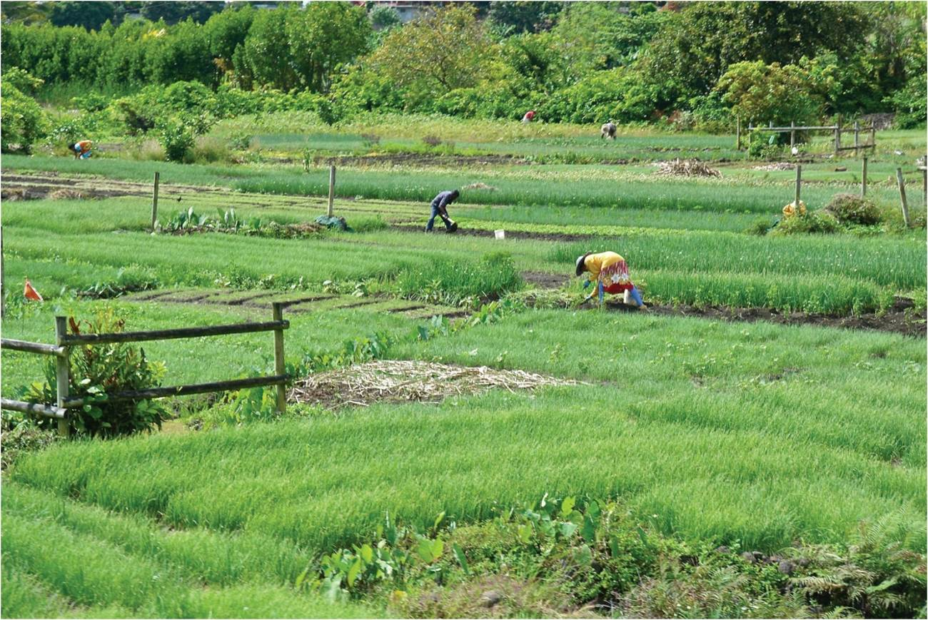
Chapter 4: Population and Food
Consider how population connects with one of the most important resources, food.
Expanded by Joe Naumann, UMSL
Woman farming in Mauritius.
Notes:
Chapter 4 Opener

Slide 2
Chapter Learning Objectives
Explain the historical context of Malthus’s theory.
Understand Boserup’s contribution.
Summarize the ways that the global food supply has kept up with world population size.
Discuss the lack of access to food, threats to food security, and limits to food production.
Reflect on the corporate industrialized food production system and associated concerns over food quality, health, and the environment.
Consider the unevenness of contemporary food production and consumption patterns.

Slide 3
Population and Agriculture
Settled agriculture
Increase in population beyond that of hunting-gathering societies
Improvements in agricultural technology produced more food
Rich, fertile soils and reliable source of water supported high densities of people
Connection to growth of early civilizations
Developed near sites of early plant and animal domestication
Woman farming in Mauritius.
Notes:
Chapter 4 Opener

Slide 4
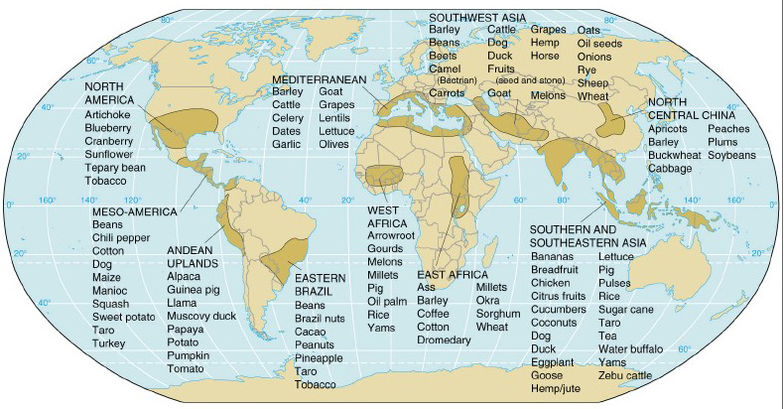
Domestication Sites
On the next map, notice that the early cradles of civilization tended to develop in or very near centers of domestication

Slide 5
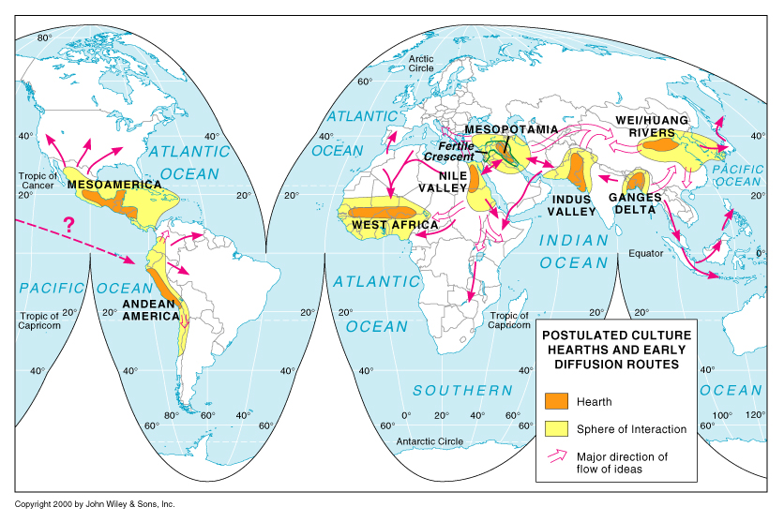
Cradles of Civilization
Note the similarity with the previous map.

Slide 6
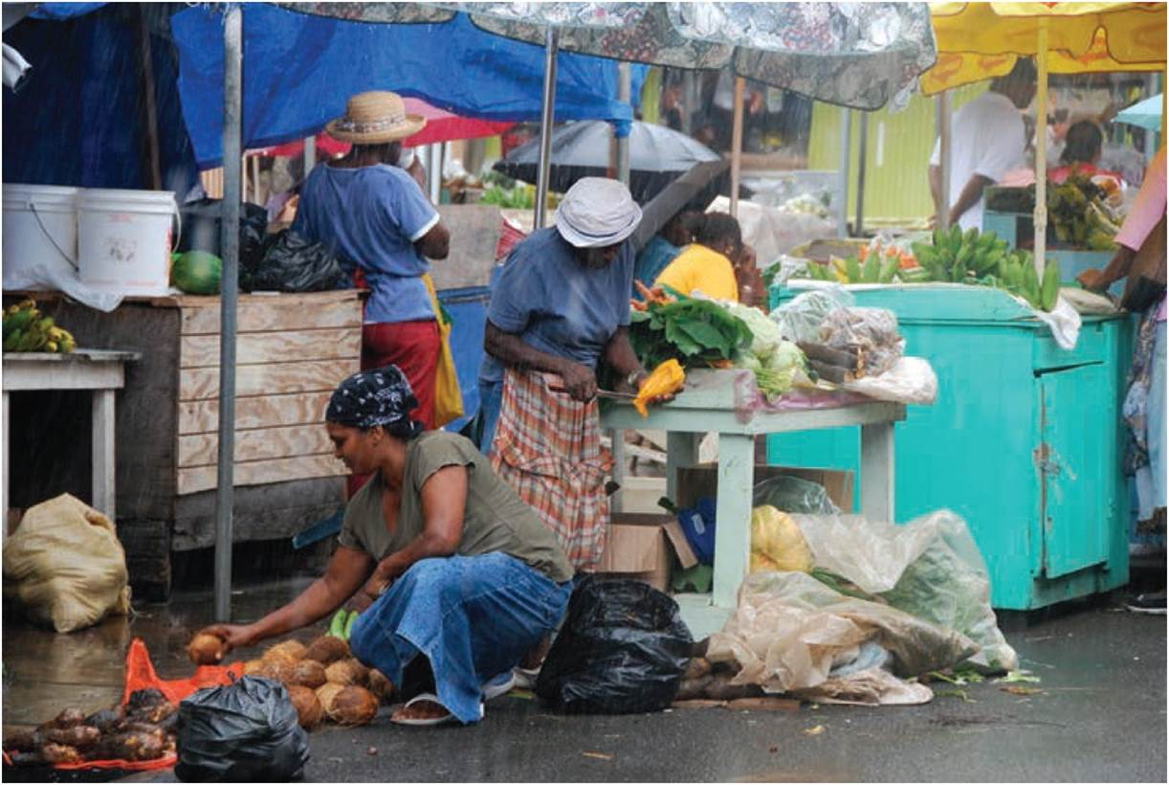
Malthusian Melancholy
Historical context
General argument
Population increase at geometric rate, food supply at arithmetically
Malthusian checks: misery, poverty, famine
Social welfare stance
Later applied to social Darwinism
Food preparation and sale in Grenada.
Notes:
Figure 4.2

Slide 7
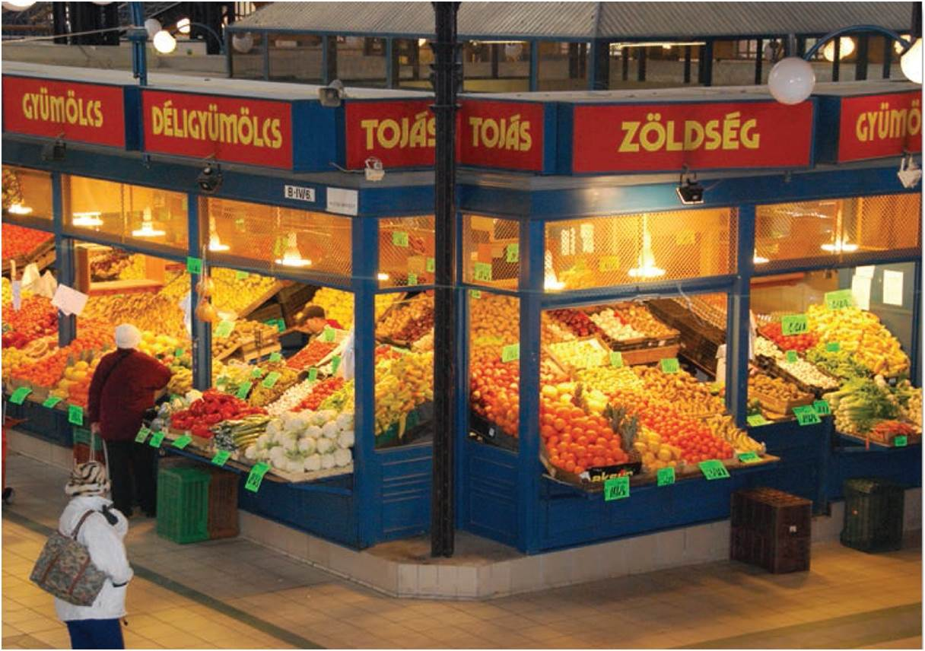
Malthusian Melancholy
Incorrect predictions
Agricultural revolution and larger food supply base (vast arable lands of N. & S. America)
Global population growth
Ester Boserup
Population will drive agricultural technology
Population and food supply have increased
Grocery store in Budapest, Hungary.
Important fact: There are limits to how much agriculture can produce!
Notes:
Figure 4.1

Slide 8
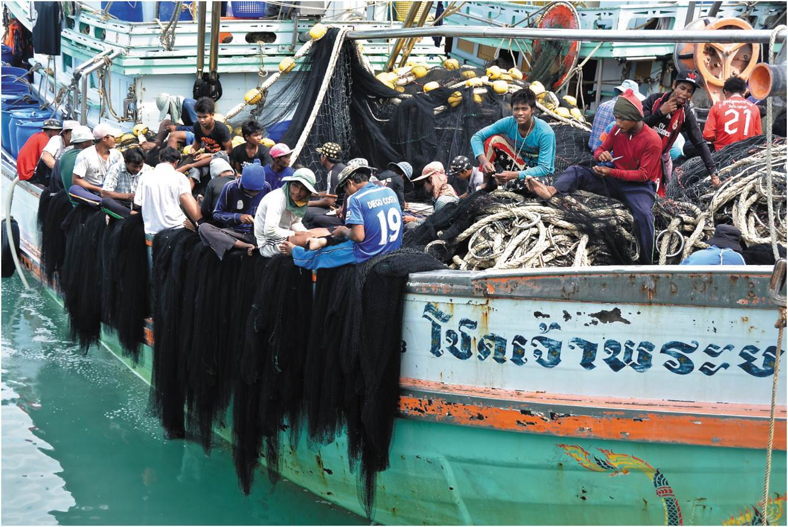
Malthusian Melancholy
Evidence suggests further increases can meet further demands
Variety of methods
Closing the yield gap
Further increasing production past Green Revolution increases
Reducing waste
Changing diets
Expanding aquaculture
Large commercial fishing boats in Gulf of Thailand. Most fishermen are indentured Burmese workers.
Notes:
Box 4.1 Figure 2

Slide 9
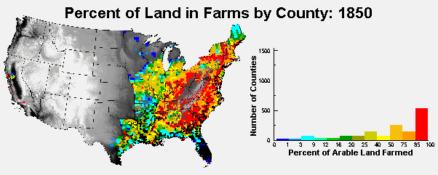
No More Virgin Lands
The discovery of the “New World” postponed the consequences of Malthus’ conclusions. All the land is under cultivation now.

Slide 10
Negative factors to consider
As urban areas expand around the world, they usually remove land from agricultural production.
Poor land management plus climatic factors
Desertification of semiarid grasslands
Grassification of tropical rain forests
Salinization of irrigated lands
Loss of topsoil by wind and water erosion
Acidification of oceans (from increased levels of CO₂ in ocean)
Bleaching of coral reefs & what kind of effect might it have on the phytoplankton (the base of the ocean food chain)

Slide 11
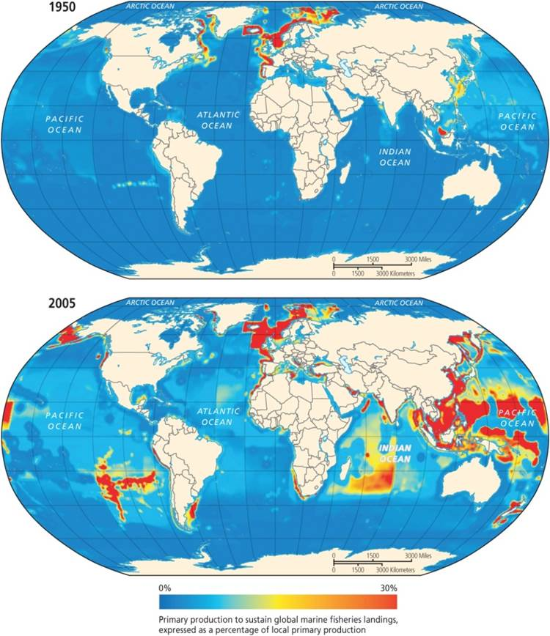
Overfishing
Oceans as food source
Industrial-style fishing is endangering supply
Overfishing
Wild fish supply peaked in 1980s
Global fisheries decline
Species extinction
Growth of fish farming to replace wild losses
Fisheries exploitation, 1950 and 2005.
Notes:
Box 4.1 Figure 1

Slide 12
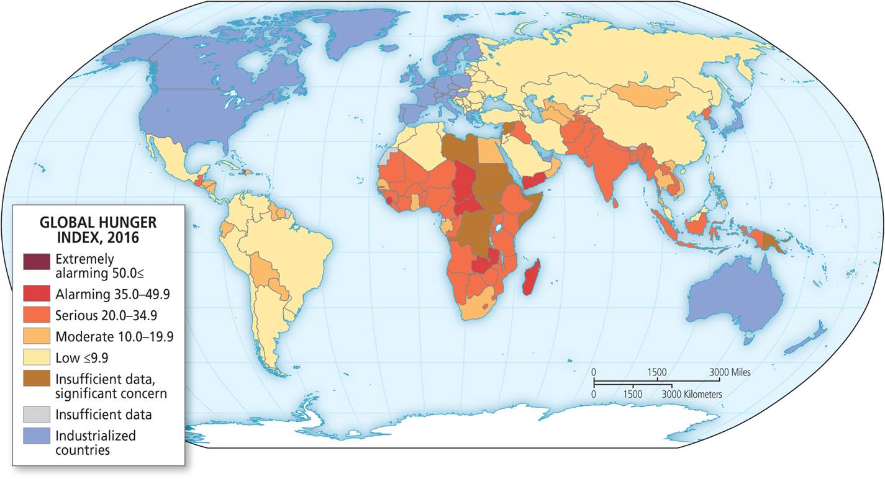
Hunger, Famine, and Food Insecurity
Food security
Relatively easy access to safe and nutritious food
Food insecure can be permanent or transitory
Susceptibility to disease
Famine
Three causes: redirection of food; destruction of capacity to produce; and total neglect of starving
Political factors of the Potato Blight
Global Hunger Index. Shows the distribution of global hunger, notice the concentrations.

Slide 13
Food Deserts
Producing enough food to feed all the people in the world does not mean that everyone will get a sufficient diet. In the US, obesity is a major health problem while in many developing nations, people are starving. Also, in spite of the abundance of ood produced in the US, there are people suffering from hunger.
Variation in access
Food deserts have very limited access to cheap, nutritious food
Prevalence in low to median income areas and African American neighborhoods
Correlates with lower rates of fresh food consumption and higher obesity rates

Slide 14
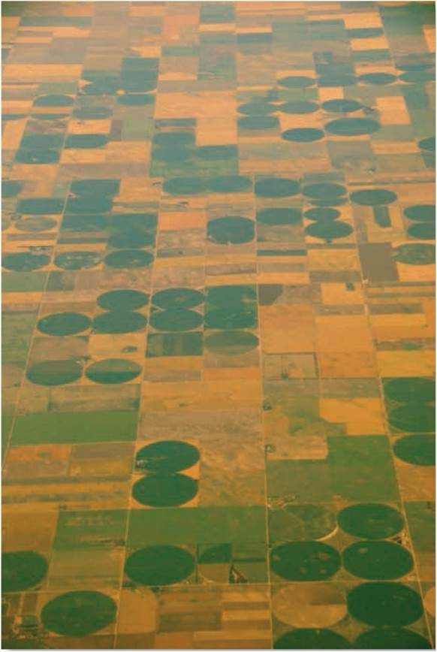
Limits to Food Supply
Precarious balance
Gains to be made, but systemic problems
Declining land and water availability
Land deficit with increasing population
Loss of irrigated land to salinization and erosion
Future trends
Declining insecurity or increasing costs
Irrigation in Midwest United States.
Notes:
Figure 4.4

Slide 15
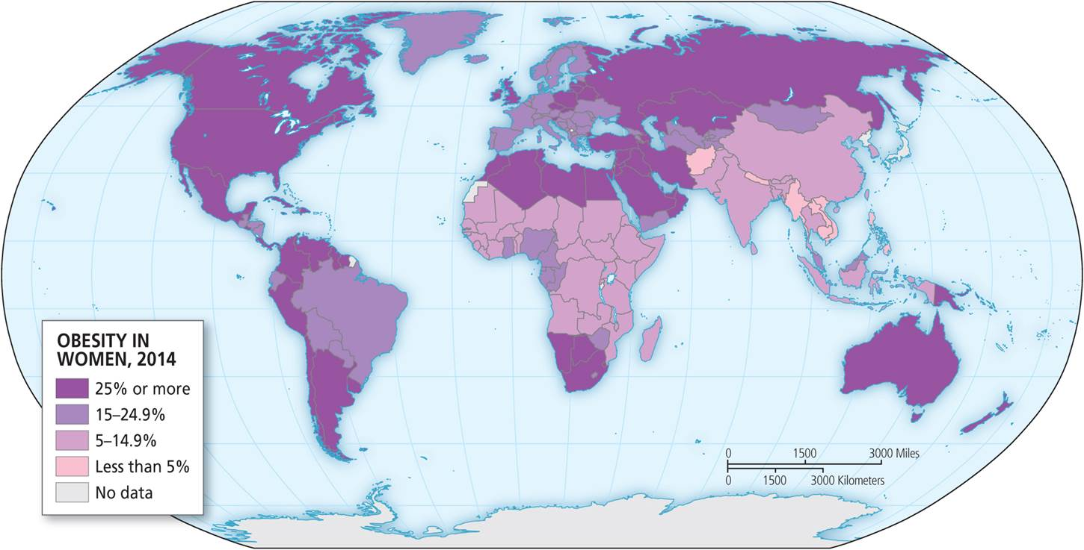
Questioning the Food Production System
Industrialized agricultural system
Produce large quantities
Questions of quality and nutritional content
Obesity epidemic
Rise of processed food and overweight adults
Obesity defined by body mass index (BMI)
High levels in affluent and middle-income countries
Geographic distribution of obesity for women. Map is similar for men.
Notes:
Figure 4.6

Slide 16
Questioning the Food Production System
Roots of obesity
More than just an individual choice
Obesogenic spaces create higher risk
Food movements and nutrition concerns
Heavy use of corn syrup
Heavy chemical usage with rise of corporate industrialized food production system
Overuse of salt in processed foods
Low levels of protein in foods marketed toward children
Geographic distribution of obesity for women. Map is similar for men.
Notes:
Figure 4.6

Slide 17
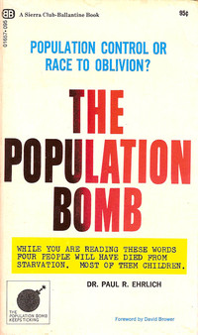
Overpopulation Reexamined
Paul Ehrlich’s The Population Bomb
Overpopulation and belief in population controls
Critiques
More than population
Too many people in affluent countries with high ecological impact
Politics of population control
People are a resource
The Population Bomb, published in 1968.

Slide 18
Subsistence and Commercial Agriculture
Subsistence Traits
Relies mostly on human labor – little animal or machine power
Low technology use
Smaller average farm size
Most food is consumed by farmer
Commercial Traits
Relies on capital investment in machinery, chemicals, improved seeds
Large average farm size
Products sold to agribusiness companies
Fewer family owned farms

Slide 19
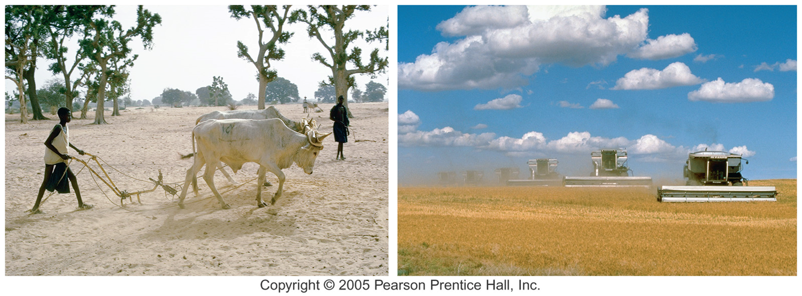
Subsistence Commercial

Slide 20
Types of Agriculture
Defined by five variables
Natural environment (sets initial parameters)
Crops that are most productive in that environment
Degree of technology used
Market orientation
Raised for human or animal consumption
Human
Raw material for industry
Food
Animal – feed

Slide 21
Chapter Summary
The agricultural revolution led to growth of human settlements.
Malthus argued that population growth outpaced increase in food supply. Led to development of programs to reduce and control populations.
Boserup theorized that increased populations would be followed by an increase in food production technologies that would enable larger populations to survive.
Some researchers suggest it’s possible to meet food demands by closing the yield gap, increasing production limits, reducing waste, changing diets, and expanding agriculture.
Decline in hunger and malnutrition are result of agricultural production ability to surpass Malthusian limits.
Three causes of famine: redirection of food, destruction of productive capacity to grow food, and total neglect of those who are hungry.

Slide 22
Chapter Summary
Despite agricultural productivity, there is disagreement over world’s ability to sustain population growth, especially with decline of productive land, water resources, and fisheries. Further, climate change may negatively impact that ability.
Even with more food available worldwide, quality of food and the environmental impacts of new food production technologies and processes are questionable. One problem is processed food associated with greater rates of obesity found around the world, especially affluent and middle-income countries.
Food movements emerge to call attention to concerns over quality of food, environmental impacts of producing foods, sustainability of food sources, and access of nutritious food to different communities.

Slide 23
Chapter Summary
The idea of overpopulation is a politically charged debate that often ignores the greater environmental impact of more affluent populations. So it is not just a case that there are too many people; rather, too many of them have a heavy ecological footprint, which can only be solved when understanding the influence of politics as well as the opportunity that humans are a potential resource for talent, creativity, and creation of solutions.
Although the basic food-supply limits first proposed by Malthus may no longer apply, out of 7.5 billion people, 1 billion remain hungry, 800 million malnourished, and another 1 billion are obese, confirming that there are still food-related concerns far beyond what Malthus or other early researchers may have considered.

