Slide 1
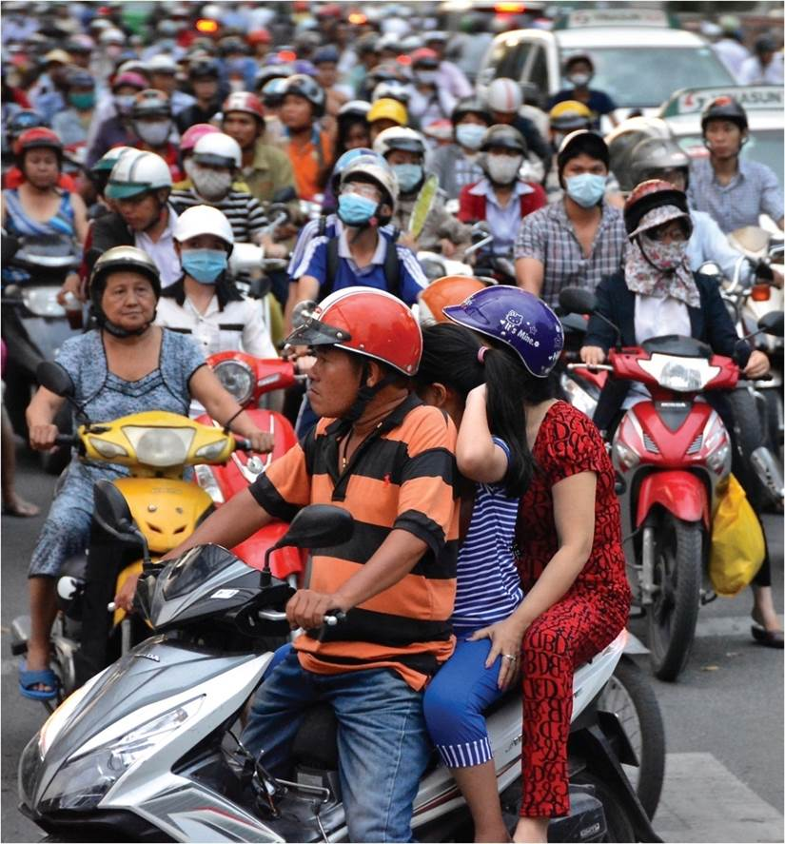
Chapter 3: Population Dynamics
In the past two hundred years there has been a steady increase in the world’s population.
Expanded by Joe Naumann, UMSL
Ho Chi Minh City, Vietnam
Notes:
Chapter 3 Opener

Slide 2
Chapter Learning Objectives
Describe the historical factors that trigger major population changes.
Describe the main trends of world population change with associated economic and cultural impacts.
Identify the four phases of the demographic transition.
Explain the social and economic concerns that accompany each stage of the demographic transition.
Relate current global cultural and political occurrences to contemporary population geographies.

Slide 3
Definition of Demography
Statistical analysis of human population
Spatial Density
Humans are quite unevenly distributed over the Earth’s surface
Population densities range from zero to over 2,000 people per square mile
What is studied?
Fertility
Gender
Health
Age
Nutrition
Mortality
Migration

Slide 4
Density and Distribution
Population distribution and density
Uneven population distribution by continent
Density divided into categories also uneven within a country
Density does not indicate standard of living, overpopulation, or under population
Physiological density difficult to measure
More useful than the arithmetic density
Agricultural Density better for comparing countries
Shifting population densities
Migrations

Slide 5
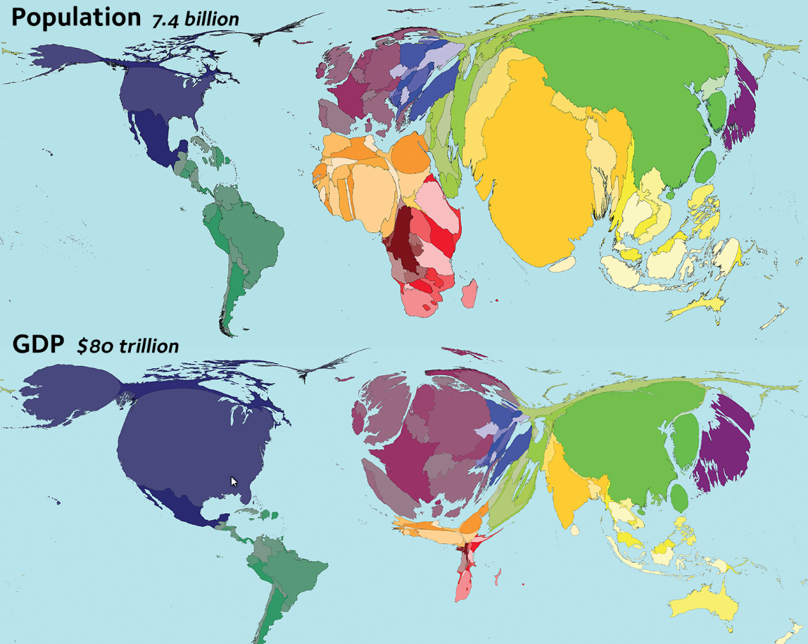
Distribution of people by continents
Cartograms: Size is based on something other than land area.
Eurasia 73.3 percent
North America 7.3 percent
Africa 12.7 percent
South America 5.5 percent
Australia and Pacific Islands < 0.5 percent

Slide 6
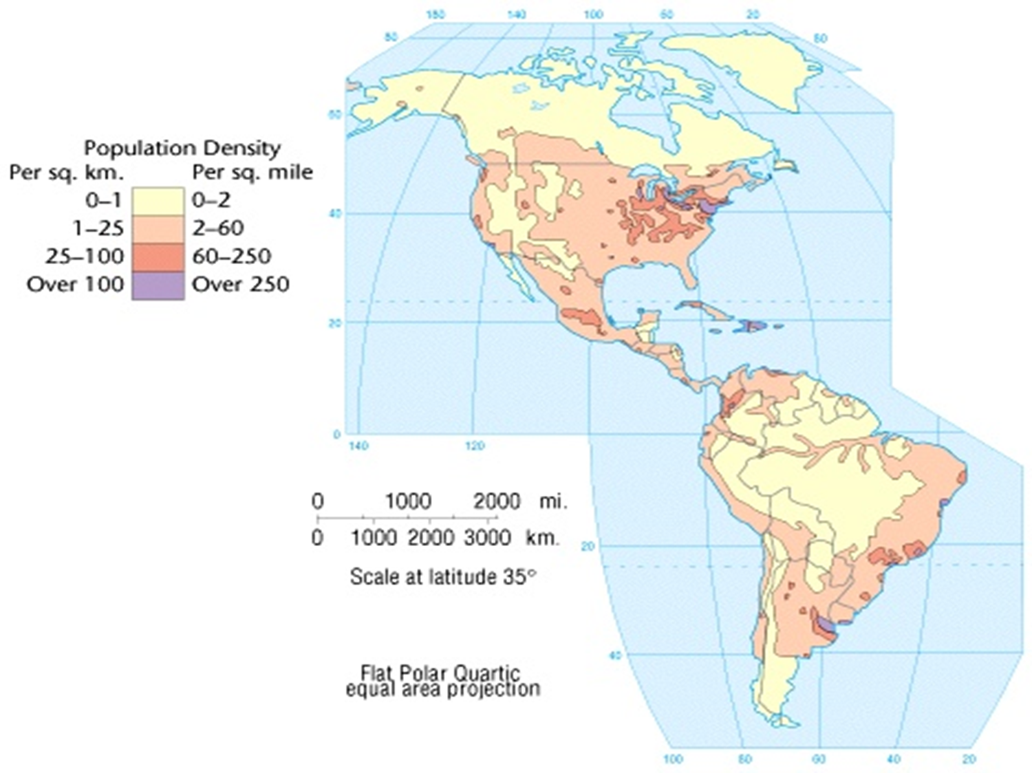
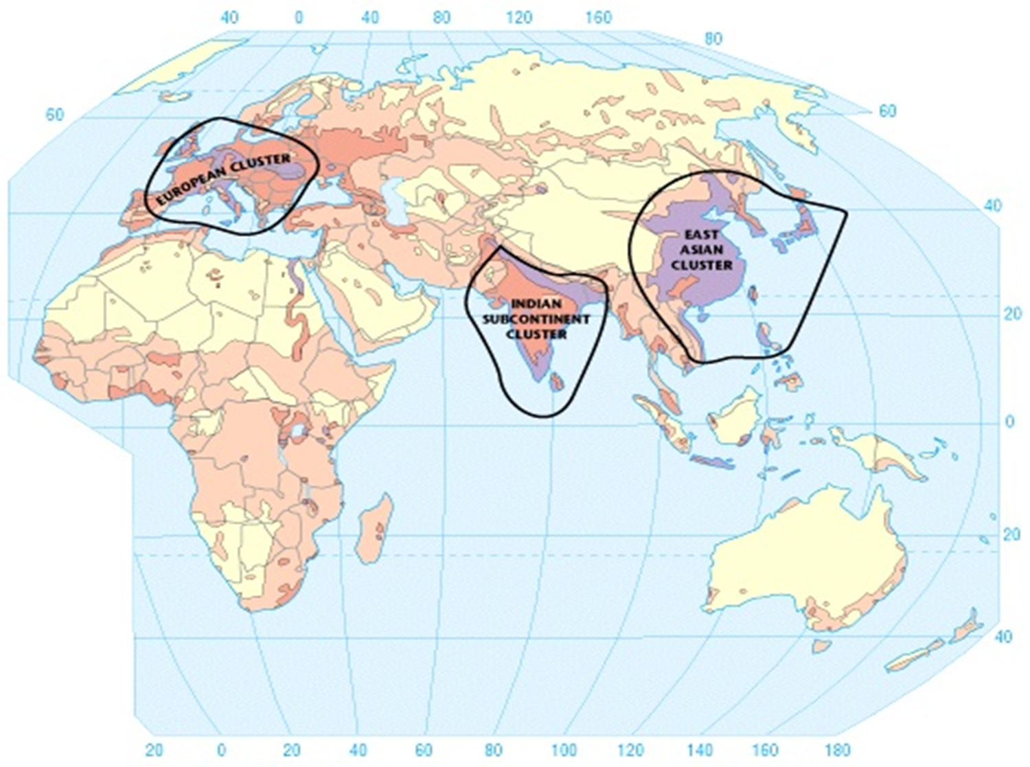
Population Clusters: Big Three (or 4?)
3
4
1
2

Slide 7
Also study the spatial variation of other demographic qualities
Birthrate differences
Death rates
Overpopulation
Sex ratios
Age groups
Crime
Quality of life
Human mobility

Slide 8
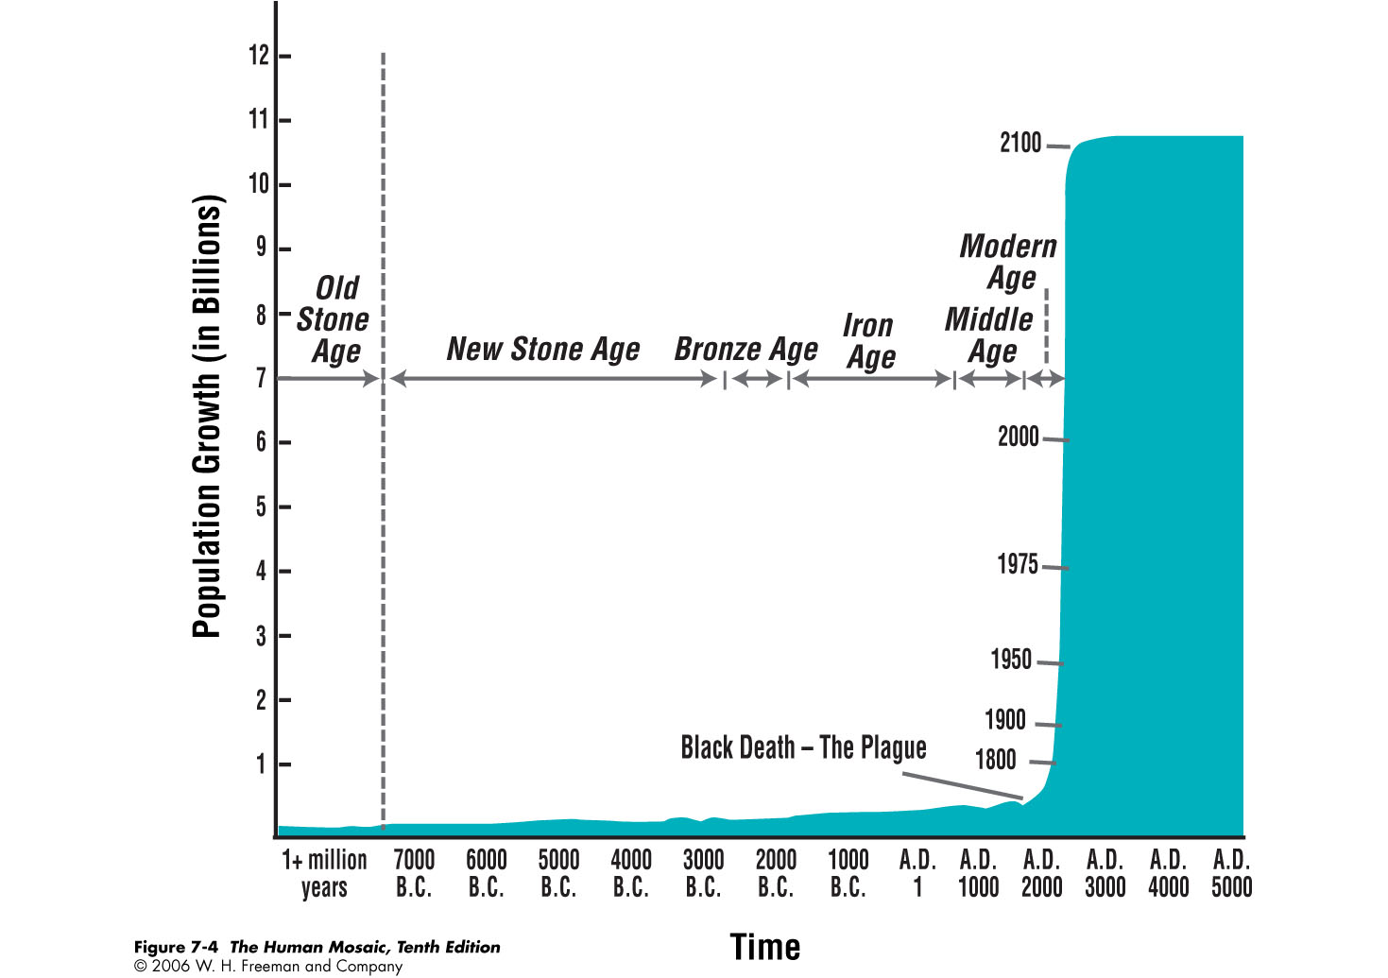

Slide 9
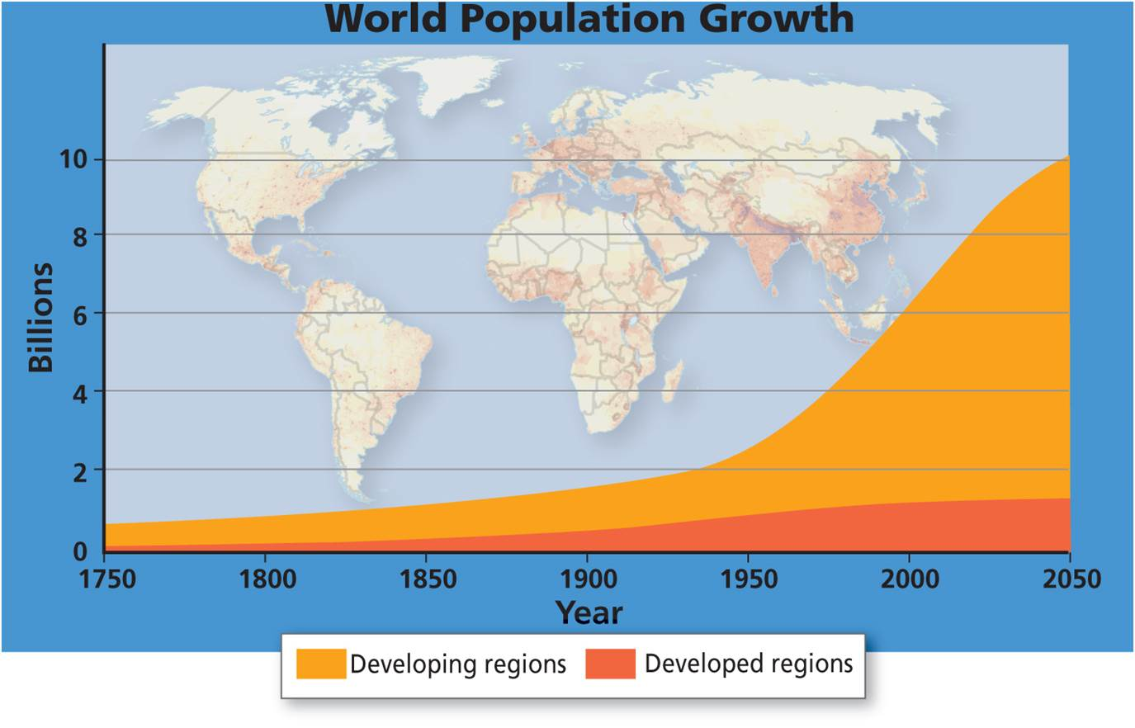
World’s Population
Now close to 7.5 billion
Grew from a small group out of Africa
Explosive growth ca. 1800
Adding billions faster
Population bottlenecks and genetic diversity
World population
Growth, masks declines
Long-term declines from disease, climate change
World population growth is now close to 7.5 billion, but it grew from a very small base.
Notes:
Figure 3.1

Slide 10
Population Declines
DISEASE
Pandemic occurs on a wide geographic scale
3 major past pandemics
Bubonic plague hit as waves across the world in 6-8th centuries
Spread along trade routes
Mass death created social confusion

Slide 11
Population Declines
DISEASE
“Black Death” in Asia, North Africa, Europe in 14th century
Rapid population loss
Switch from arable agriculture to pastoral farming
Peasants’ Revolt
Columbian Encounter of Europeans in the Americas (Columbian Exchange)
Devastation to indigenous populations from disease
“Pristine Myth” of North America’s wilderness

Slide 12
Population Declines
CLIMATE CHANGE
Agricultural productivity
Humans more reliant, so declines in output, decrease population
Little Ice Age of 17th century
Food shortages and population decrease
URBANIZATION/INDUSTRIALIZATION (developed countries)
Two working parents & desire for much higher material lifestyle
Children seen as a financial liability
Total Fertility Rate of most developed countries is below 2.1 (needed to keep a population stable (neither shrinking nor growing)

Slide 13
The Reproductive Revolution
Patriarchy (agriculture based)and reproductive efficiency
High infant mortality rates and low life expectancy
Role of women – subservient
Children, particularly males, seen as helpful laborers
Demographic transition
Increased efficiency of reproduction and birth control
Calls into question the basis of patriarchy
Urbanization/Industrialization
Educated, working women
Children are a financial liability rather than an economic asset (helpful laborers)

Slide 14
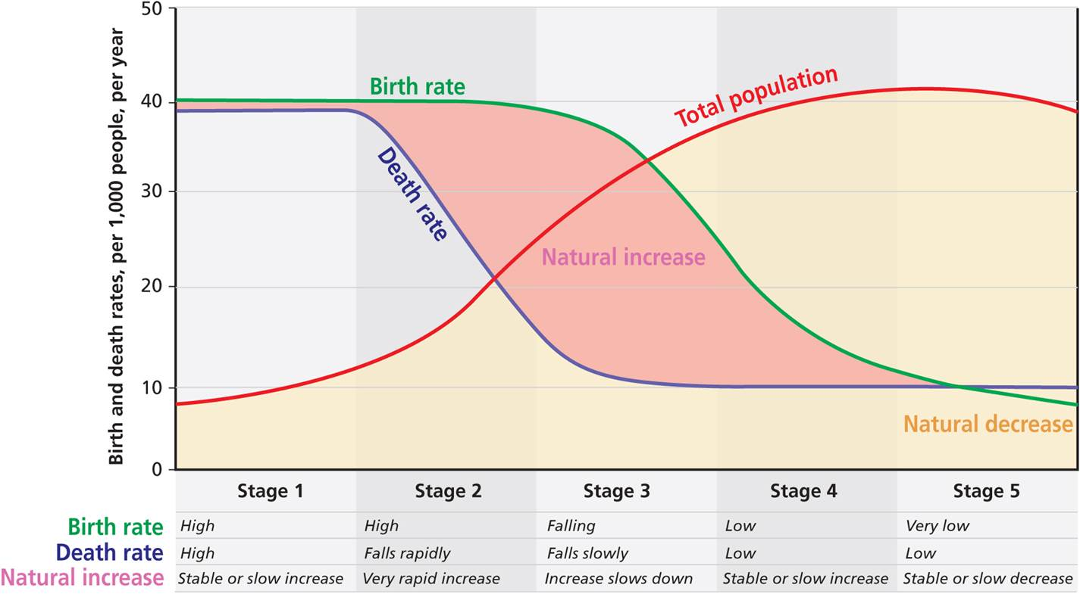
The Demographic Transition
Demographic transition
Decline in mortality rates
Increased life expectancy
Followed by decline in fertility
Uneven geography of replacement rates
Five phases of demographic transition. Brought population and cultural changes.
Notes:
Figure 3.2

Slide 15
Five phases of demographic transition. These phases brought population and cultural changes.

Slide 16
Demographic Base of the Celtic Tiger
Demography of Ireland
Steady increases until peak in 1840
Population plummets from Great Famine, emigration, low births
Availability of contraception
Demographic dividend
Economic growth but hit hard by recession

Slide 17
The Demographic Transition
Population transformation
Longer lives and graying populations
Cultural consequences
Gender roles change with education and fertility change
Takes longer in cultures that are more resistant to change
Intergenerational inequities and conflicts with graying population
Five phases of demographic transition. Brought population and cultural changes.
Notes:
Figure 3.2

Slide 18
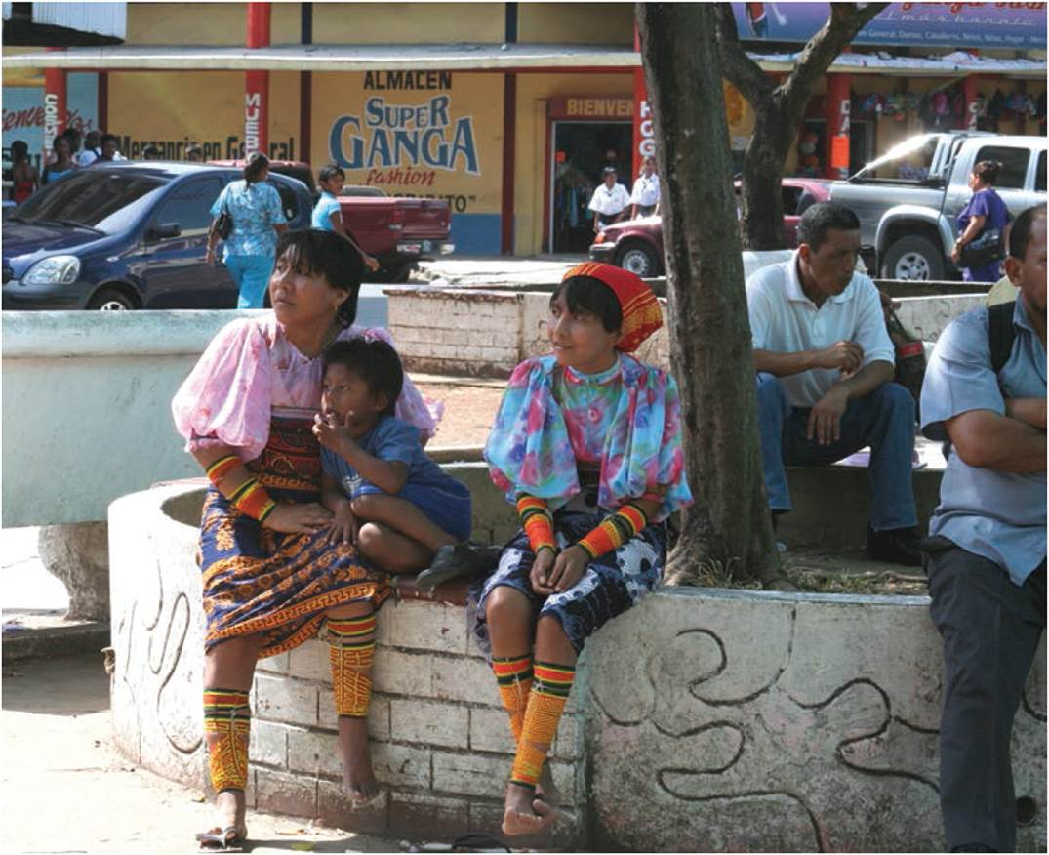
Phases of the Demographic Transition
First Phase
High birth and death
Stable slow increase
Second Phase
High births, deaths fall
Young and growing
Gender inequalities
Third Phase
Effects of family planning
Population growth slows
In Central and South America, indigenous birth rates are much higher than for nonindigenous.
Notes:
Figure 3.4

Slide 19
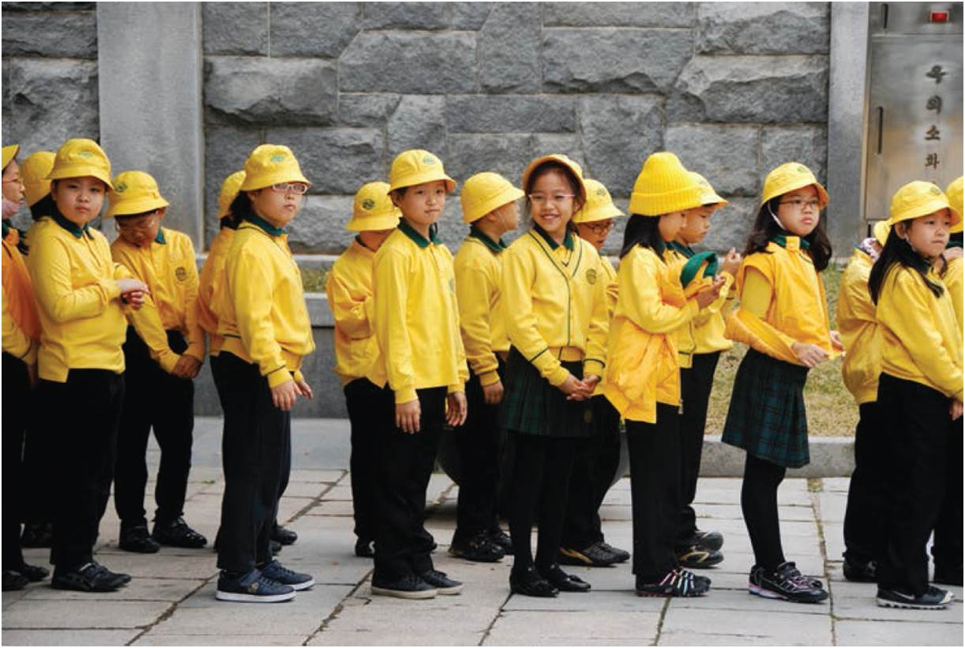
Phases of the Demographic Transition
Fourth Phase
Low birth and deaths
Stable or very slow increase
Most of the world
Fifth Phase
Very low births/deaths
Population is stable or decreasing
Associated with affluent countries
In richer societies with low birth rates, children often receive significant public and private investment.
Notes:
Figure 3.7

Slide 20
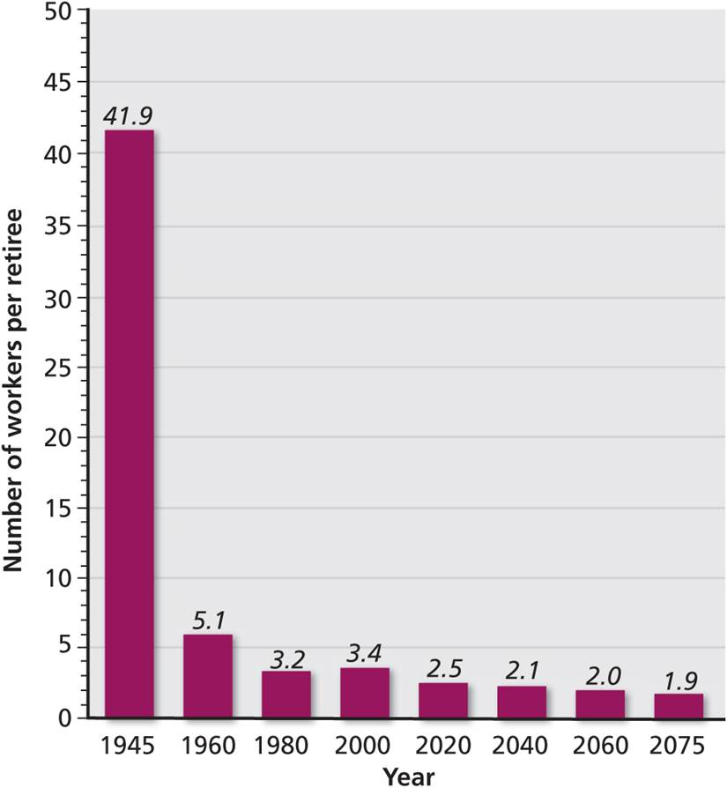
Phases of the Demographic Transition
Demographic dividend
Moving between phase 3 into phase 4
More people of working age compared to dependent populations
Dependency ratio
Payouts are increases labor supply and reduces relative size of dependent population
Number of workers to retirees in United States Social Security system.
Notes:
Figure 3.10

Slide 21
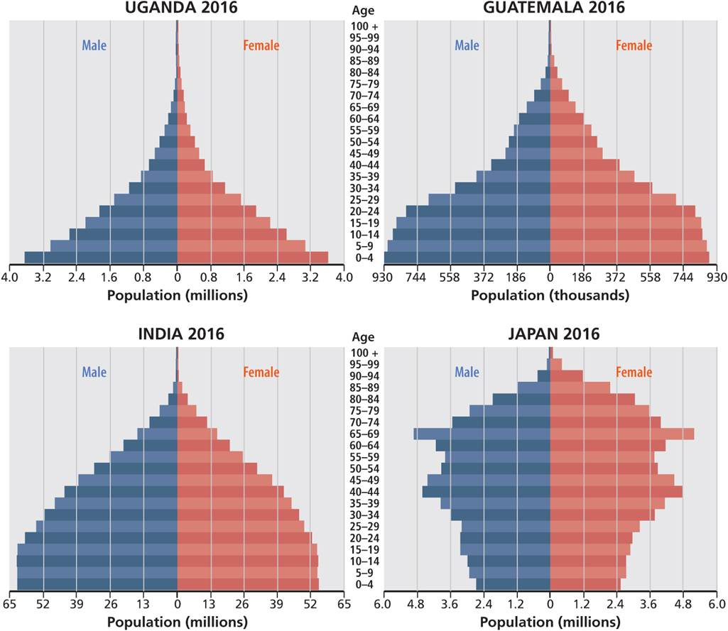
Population Pyramids
Population pyramid of four countries at different stages in the transition. The vertical axis shown in five-year cohorts, with males and females to the right of the vertical line.
Notes:
Figure 3.3

Slide 22
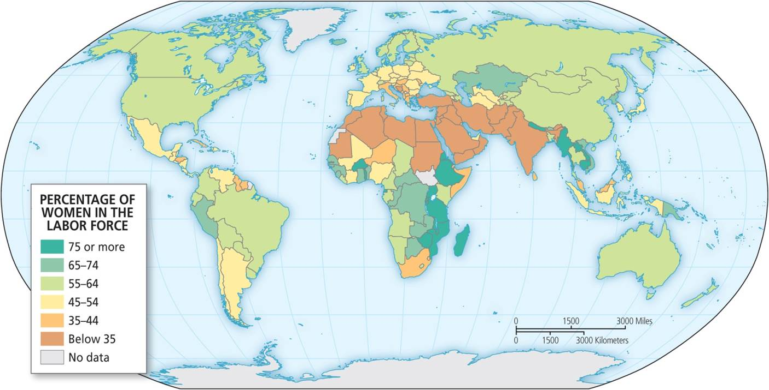
Phases of the Demographic Transition
Opportunity and the demographic dividend
Full dividend only possible with high female participation rates
Relatively cheap labor supply will run out as theorized by the Lewis Turning Point
Today’s female labor force participation rates in the world.

Slide 23
Components of Change
Patterns of natality
Birthrate – measured as the number of births in a year per thousand people.
Total fertility rate (TFR)
More useful measure than birthrate
Varies greatly from one part of the world to another
Key number is 2.1 (replacement rate)

Slide 24
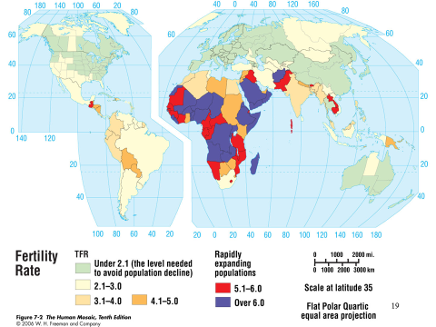

Slide 25
Brazil and the Demographic Dividend
Brazil’s growth
1872: 10 million
2016: 209 million
Demographic transition
Birth decline with more family planning with urbanization and secularization
Demographic dividend since 1970
Increased democratization and social welfare programs
Ageing just starting

Slide 26
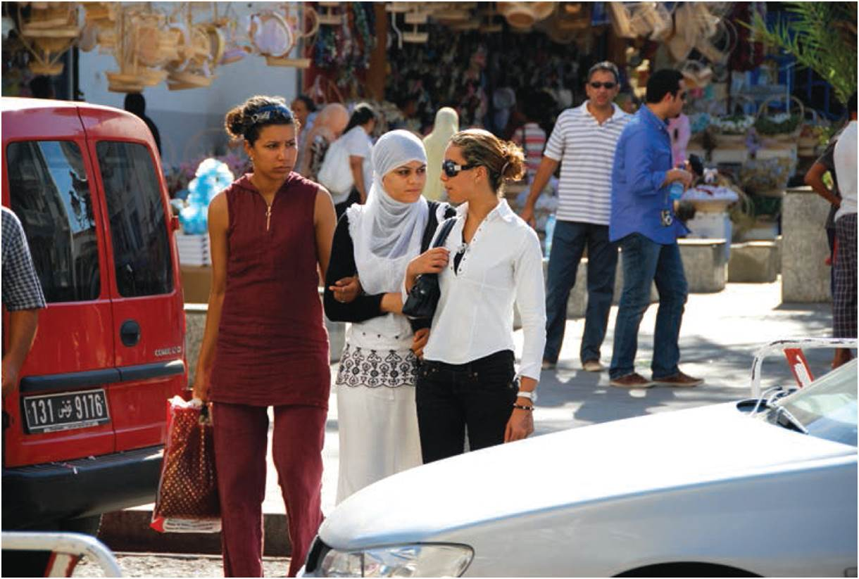
The Youth Bulge
Youth bulge
Rapid increase of ages 15 to 24
Follows reductions in child mortality occur before fertility declines
Social conflict and youth bulges
Easterlin hypothesis over size of cohort relative to overall population
Social effects of demographic troughs
Decline in crime
A youth bulge can occur at the middle stages of the demographic transition. Young people in Tunis, Tunisia.
Notes:
Figure 3.6

Slide 27
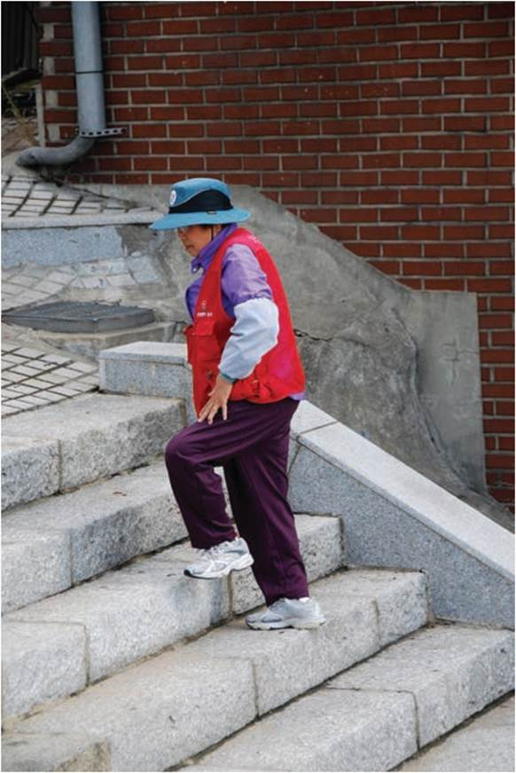
The Fifth Phase
“Shock of grey”
Doubling of over-65 people in next 50 years
Changing definitions of aging
Intergenerational transfers
Social changes
Subsequent economic and political effects
The elderly will double in population over the next fifty years. An elderly lady in Inchon, South Korea.
Notes:
Figure 3.8

Slide 28
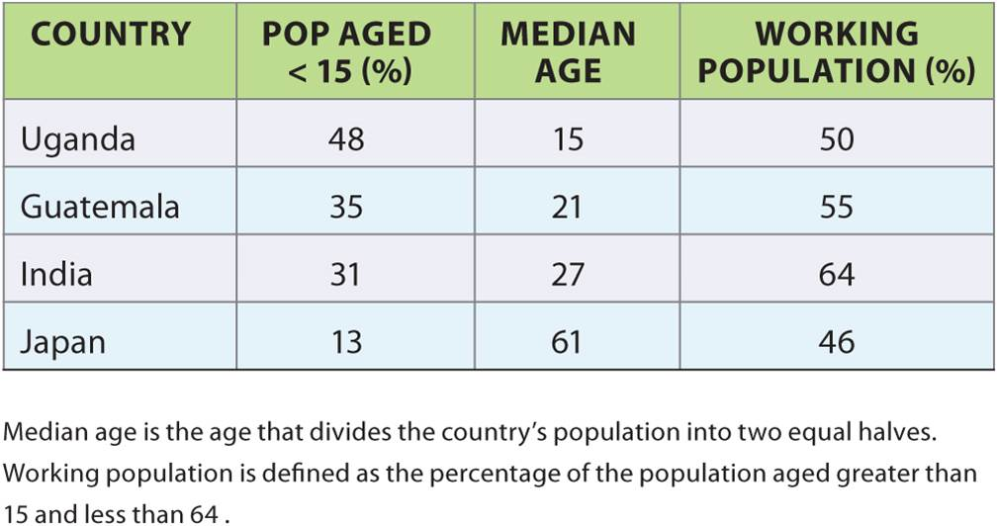
The Fifth Phase
Demographic differences between selected countries’ population ages and percent working. Notice relative distribution of population and variation in countries across the stages of the transition.
Notes:
Table 3.1

Slide 29
Russia’s Changing Population
Population collapse
Increased mortality of men with alcoholism
Post-soviet economic and political transition (nothing like this had ever happened in the world, so there were no examples to learn from)
Fertility changes (economic uncertainty and political uncertainty can result in a lowering of the birth rate)
Demographic recovery
Male life expectancy rebound
Small rebound in birth rates with improved living standards

Slide 30
Problems and Opportunities
Each stage has problems and opportunities
Phases 2 and 3 have very youthful populations and potential of instability
Middle phases must have supporting economic growth
Later phases hang on how society makes use of aging population
Global geography to the transition
Three types:
Graying countries
Demographic and economic growth countries
Rapid demographic growth with limited economic growth

Slide 31
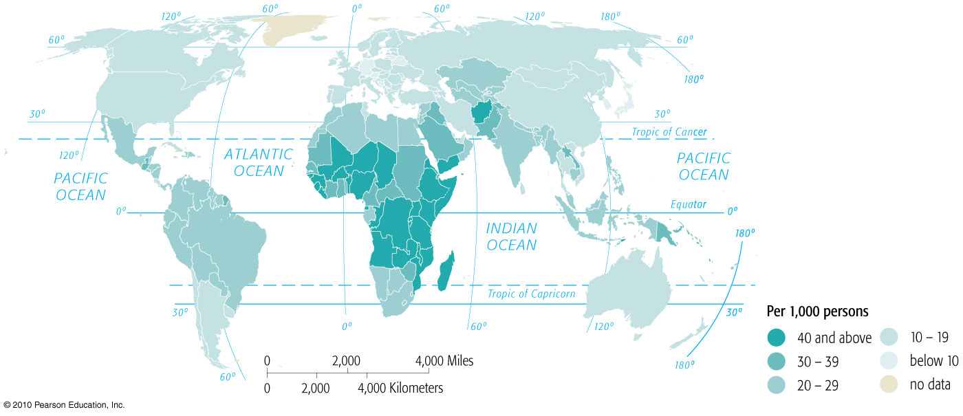
Birth Rates

Slide 32
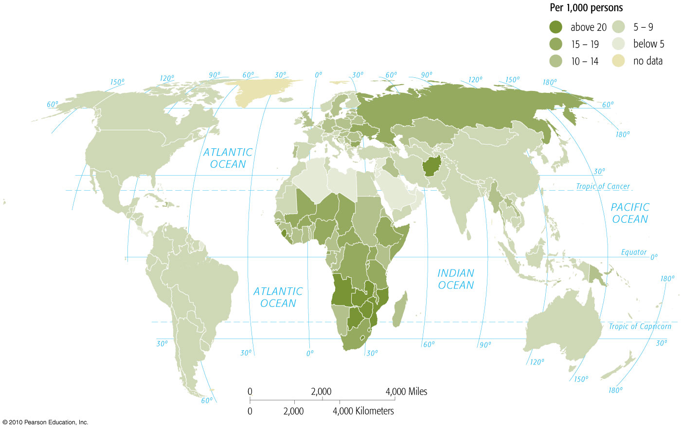
Death Rates

Slide 33
Components of Change
Death comes in different forms geographically
In developed world – age-induced degenerative conditions
Enter the “sandwich generation”
In developing nations contagious diseases are leading cause of death

Slide 34

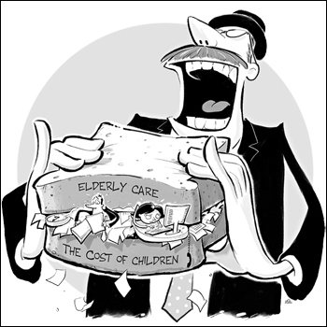
Sandwich Generation: problem of developed countries
The middle-aged group gets pressure (demands for time and money) from both sides of the age spectrum. Result of the “greying” of the population.”

Slide 35
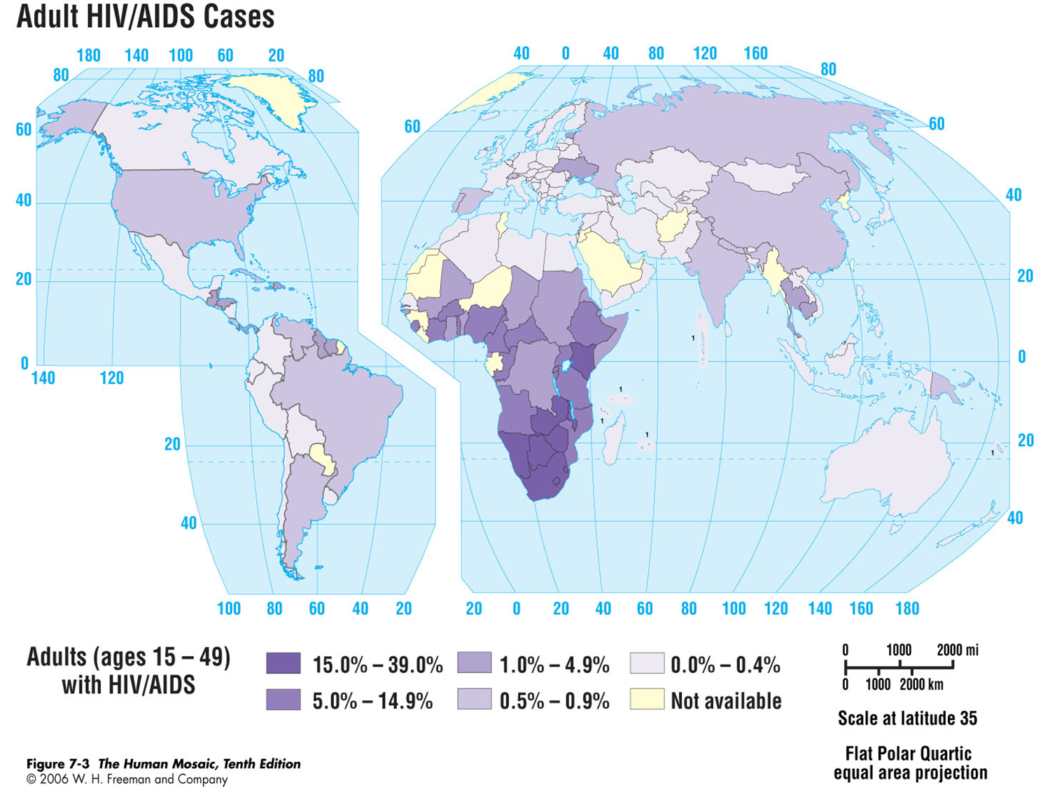
In spite of high rates of HIV/AIDS infection, Africa is still the continent with the fastest growing populationh

Slide 36
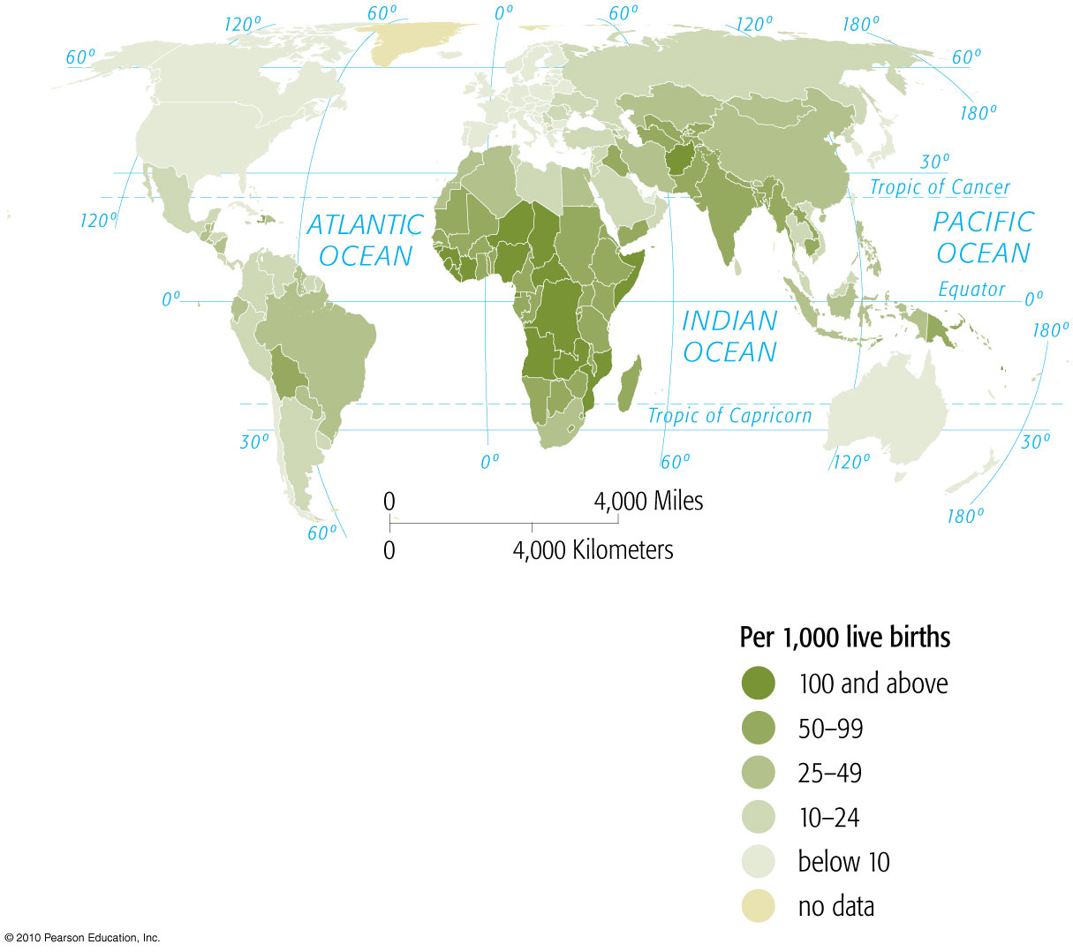
Infant Mortality Rates

Slide 37
Infant Mortality Rates Compared for Selected Countries
YEARS |  | USA | UK | Japan | Italy | Belarus | India | China | South Korea | Jordan | Israel | Haiti | Brazil | Afghan- istan | Mexico
1950-1955 |  | 28 | 29 | 51 | 60 | 75 | 190 | 195 | 115 | 160 | 41 | 220 | 135 | 225 | 121
1955-1960 |  | 26 | 24 | 37 | 48 | 44 | 173 | 179 | 100 | 145 | 36 | 193 | 122 | 214 | 101
1960-1965 |  | 25 | 22 | 25 | 40 | 30 | 157 | 121 | 70 | 125 | 29 | 176 | 109 | 203 | 88
1965-1970 |  | 22 | 19 | 16 | 33 | 24 | 145 | 81 | 58 | 102 | 25 | 165 | 100 | 189 | 79
1970-1975 |  | 18 | 17 | 12 | 26 | 21 | 132 | 61 | 38 | 82 | 23 | 152 | 91 | 184 | 69
1975-1980 |  | 14 | 14 | 9 | 18 | 22 | 129 | 52 | 30 | 65 | 18 | 139 | 79 | 178 | 57
1980-1985 |  | 11 | 11 | 7 | 13 | 20 | 107 | 52 | 23 | 54 | 14 | 124 | 65 | 177 | 47
1985-1990 |  | 10 | 9 | 5 | 10 | 16 | 94 | 50 | 14 | 44 | 11 | 106 | 55 | 173 | 40
1990-1995 |  | 9 | 7 | 4 | 7 | 16 | 79 | 47 | 12 | 33 | 9 | 74 | 47 | 167 | 34
1995-2000 |  | 8 | 6 | 4 | 6 | 12 | 73 | 41 | 8 | 27 | 6 | 68 | 42 | 165 | 31
2005 |  | 6 | . . . | . . . | . . . | . . . | . . . | . . . | . . . | . . . | . . . | . . . | .. . | . . . | . . .
 |  | Equal to or better than the USA figure for those periods.
... | not available Source: Encyclopedia Britannica 2008
This should be an embarrassment for the United States

Slide 38
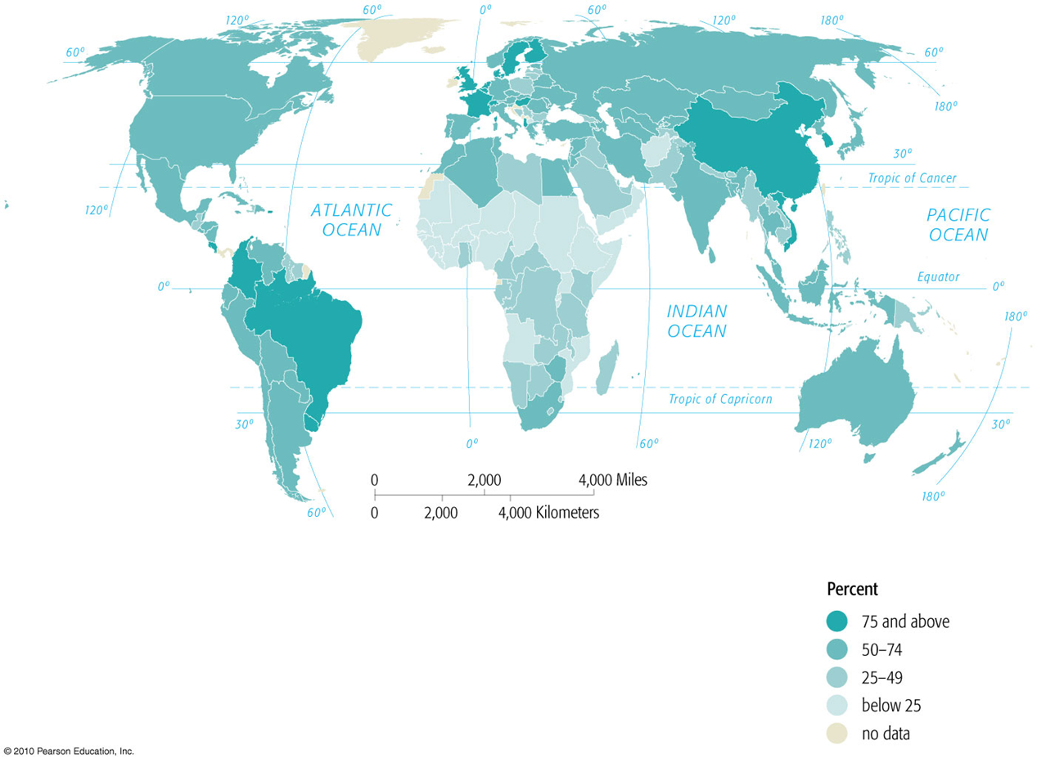
% of Women Using Family Planning

Slide 39
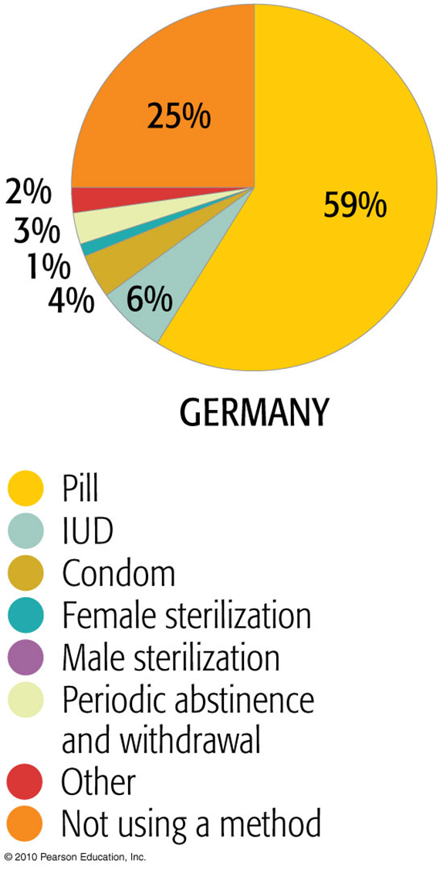
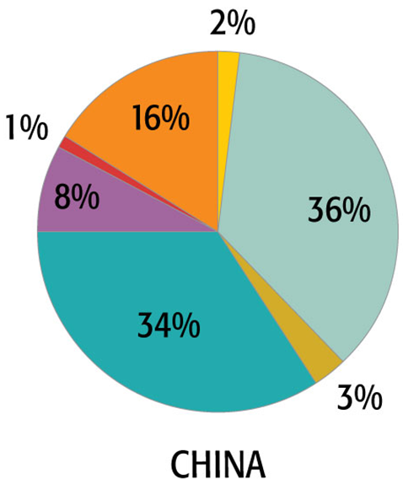
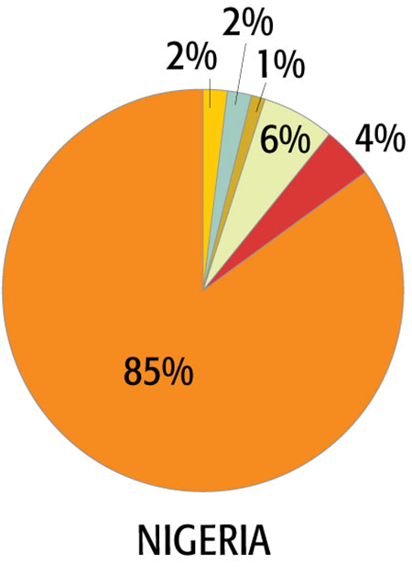
Family Planning Methods

Slide 40
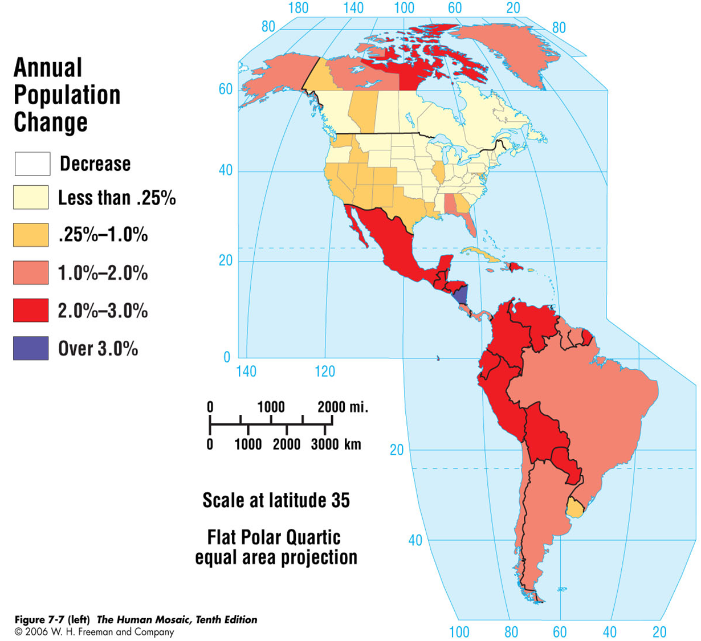
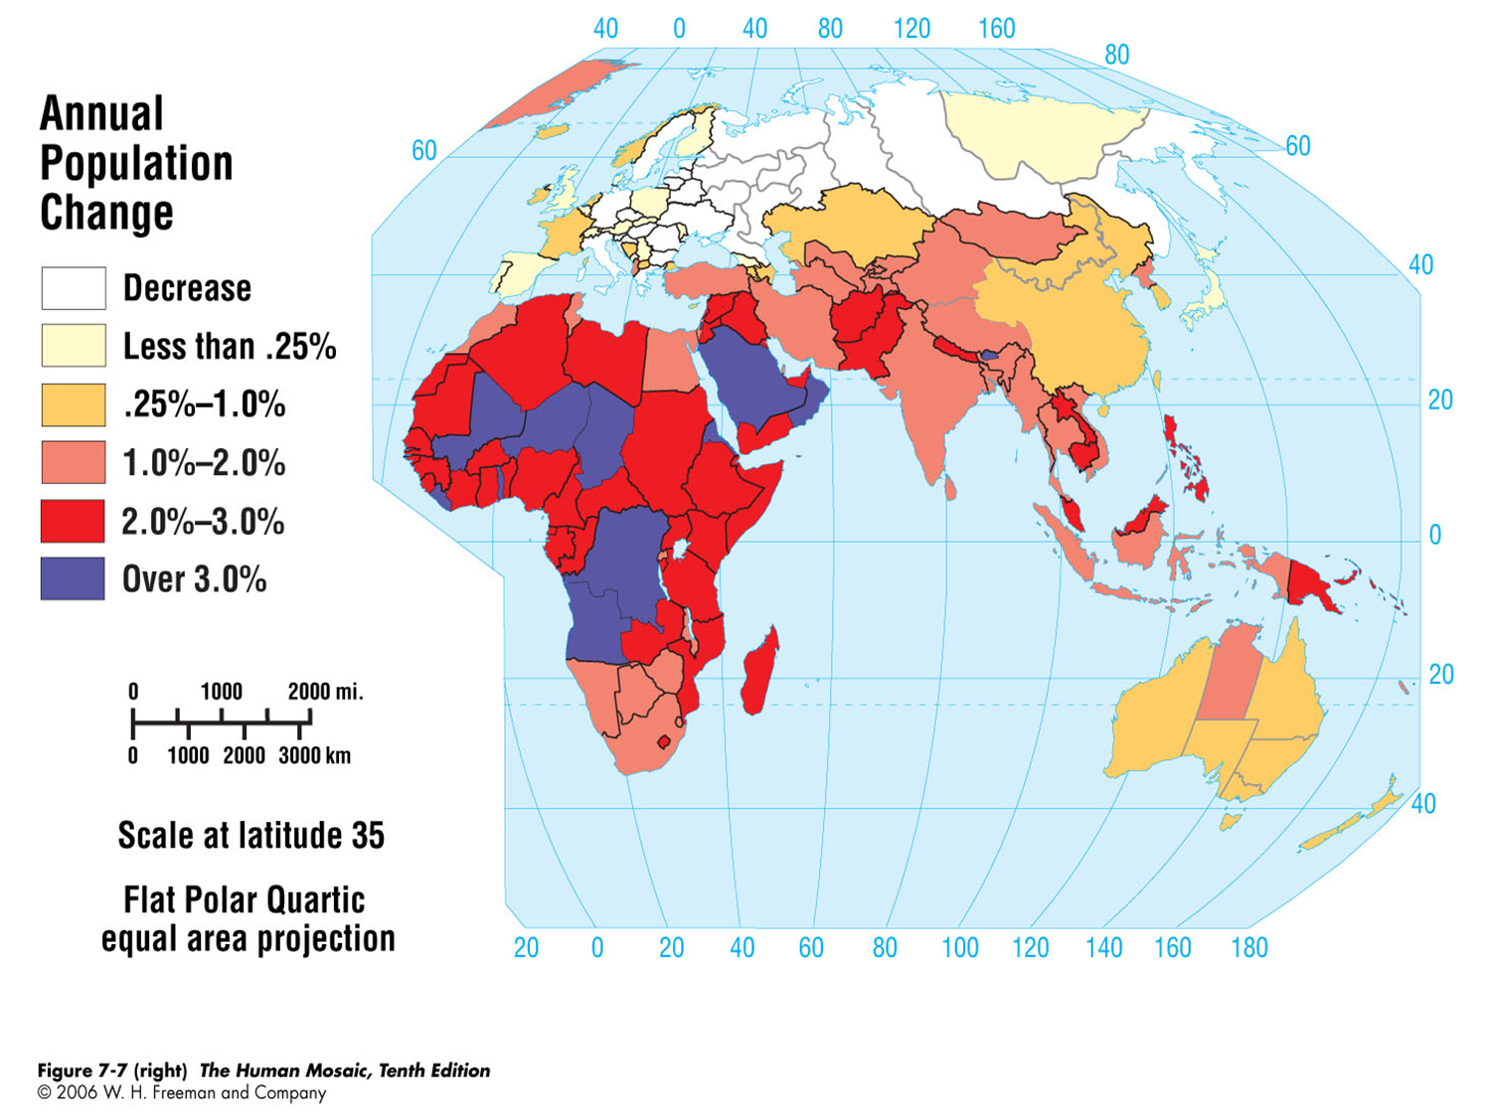

Slide 41
Chapter Summary
Earth began with relatively small human population that left Africa to populate the world, population explosion occurred in 19-20th century.
Three major pandemics had social effects: bubonic plague impeded growth yet led to technological advances; the “Black Death” swept over most of the world and killed up to half population; and Columbian Encounter reduced indigenous populations in the Americas up to 90 percent.
Population levels influenced by long-term climate changes, particularly as humans are more dependent on agricultural productivity.
Demographic transition resulted in declining mortality rates, improved health, increased life expectancies and economic productivity.

Slide 42
Chapter Summary
More reliable birth control methods led to lower birth rates; changes household economies so that children were seen as dependents, not workers.
Major demographic shift toward older populations, especially in richer countries. With aging population, intergenerational inequities and conflicts can become more pronounced.
During the transition, richer countries have increased life expectancies and lower births, poorer countries increase life expectancy but with slower declines in birth rates. Results in complex patterns of demographic regimes across the world.
Four distinct phases of demographic transition: 1) high births and fluctuating deaths; 2) declining death and birth rates; 3) birth rates declining; 4) low births and high life expectancy.

Slide 43
Chapter Summary
Demographic dividend with more younger and productive workers increases labor supply relative to those who are dependent, allowing for more investments. Supported strong economic performance and growth of several countries in last 20 years. Full dividend only possible if female participation rates are high.
In early and middle stages of transition, youth bulge can appear and may bring social conflict.
Later stages may bring another demographic dividend from older populations, greater reliance on immigration, and disconnects between marriage and children.
Each stage creates problems and opportunities: demographic ratio; demographic dividends; high dependency; need for increased immigration; cultural and political debates.

Slide 44
Chapter Summary
A distinct global geography is created by the demographic transition, resulting in three types of countries: aging countries, demographic and economic growth countries, and demographic growth countries with limited economic growth opportunities.
Demographic changes are at the heart of some of the most profound cultural transformations and intense political debates occurring around the world.

