Slide 1
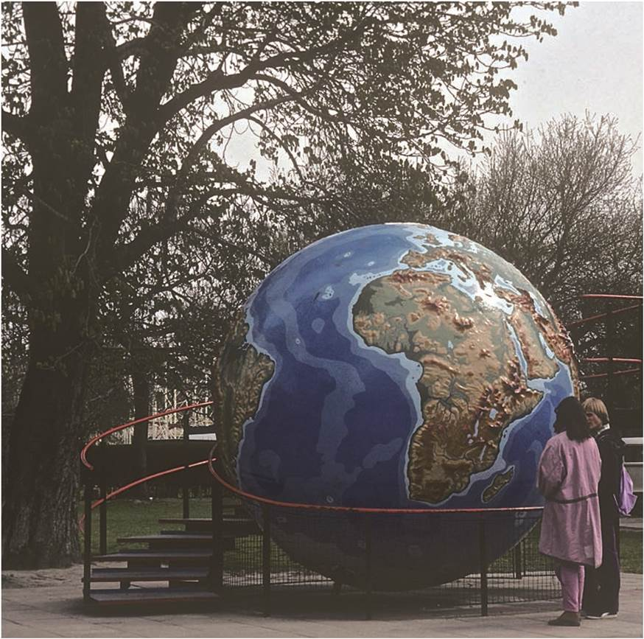
Chapter 2: The Nature of Geography
“Human geography of today is shaped by the debates of the past.”
Two young people studying a globe in a park in Vienna, Austria.
Notes:
Figure 2.9

Slide 2
Chapter Learning Objectives
Recall the key historical developments that have shaped the nature of geography overall and human geography specifically.
Explain the contributions made by ancient world scholars and early explorers in expanding geographical knowledge.
Summarize geography’s human applications as well as the expressions of the discipline in early modernity.
Describe the variety of approaches in contemporary human geography and the major critiques of the discipline.

Slide 3

Let’s consider the typical American level of geographic knowledge and concern. Check the following few slides.

Slide 4
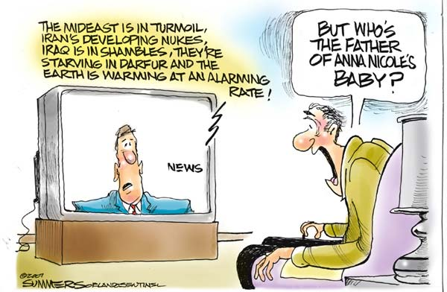

Slide 5
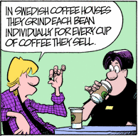

Slide 6
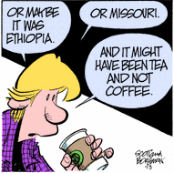

Slide 8
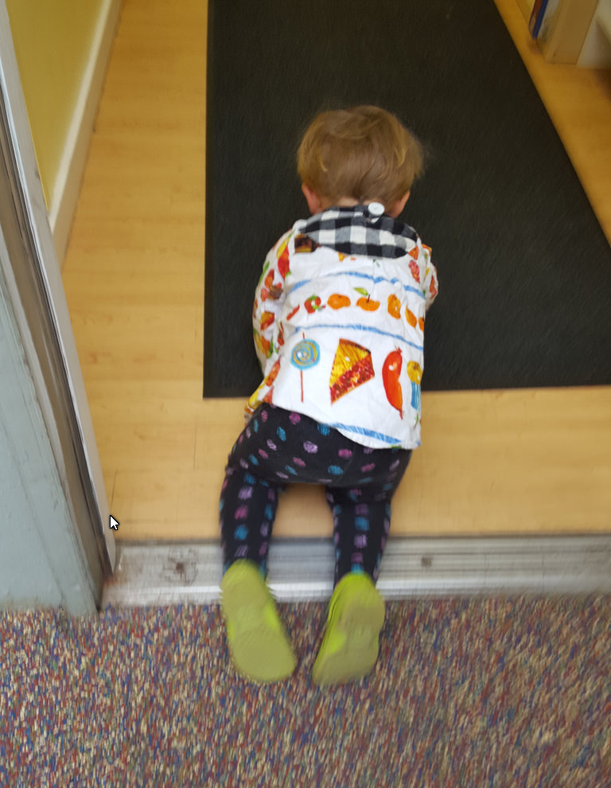
Introduction
Humans are by nature geographers – it begins in infancy.
  Possess awareness of and curiosity about the distinctive character of places
  Can think territorially or spatially
  Each place on Earth is unique
  Places possess an emotional quality and significance that contribute to our identity as unique human beings
  Geographers, over the centuries, generated a number of concepts and ideas that literally changed the world

Slide 9
Seven Cultural Geographical Ideas That Changed the World
Maps
Human adaptation to habitat
Human transformation of the earth
Sense of place
Spatial organization and interdependence
Central place theory
Megalopolis

Slide 10
Geography as an academic discipline
Natural human geographical curiosity and need for identity
First arose among the ancient Greeks, Romans, Mesopotamians, and Phoenicians
Arab empire expanded geography during Europe’s “Dark Ages”

Slide 11
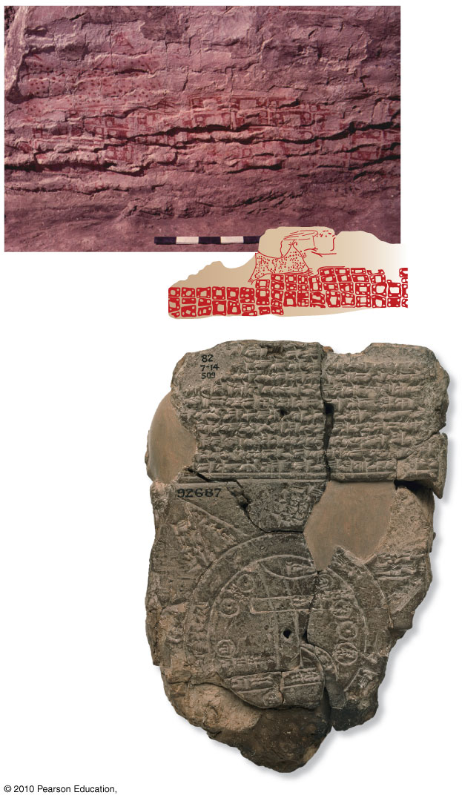
3 of the Oldest Maps
The inate geographic interest inspired the first attempts at mapping the world.
These were produced between the 7th and 6th centuries B.C.E.

Slide 12
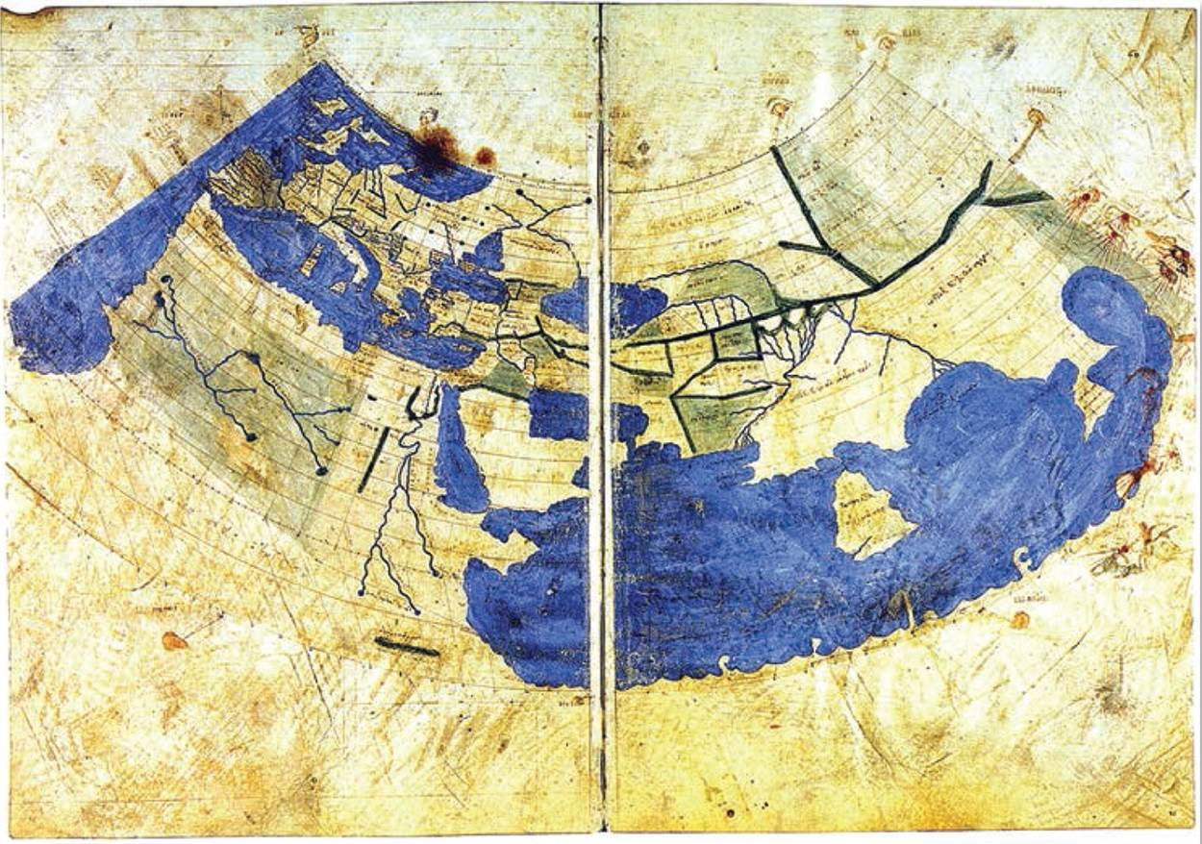
Mapping Absolute Space
Humans have long sought to accurately map the world
Ptolemy in Alexandria
  Latitude and longitude
  Proposed two map projections, like conic projections
  Writings diffused to Arab and Byzantine scholars before back to Europe
Map of Ptolemy’s world, centered on the Mediterranean. Presented in a conic projection, circa 1300.
Notes:
Figure 2.1

Slide 13
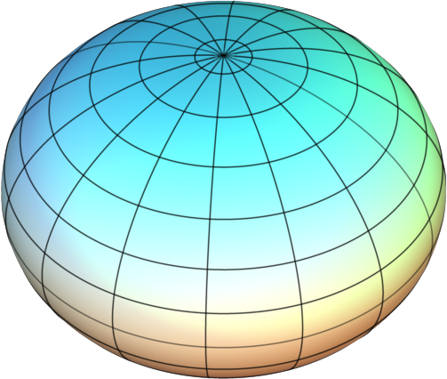
Measuring the World
Calculating Earth’s circumference
  Eratosthenes calculated to a 1-2% difference
  Ptolemy’s less accurate measure often diffused with rest of his writings
  Frenchman Jean Picard’s inaccurate measure illustrated Earth’s oblate shape
An exaggerated illustration of Earth’s oblate spheroid shape.
© AugPi via Wikimedia Commons.
Notes:
Source: © AugPi via Wikimedia Commons.

Slide 14
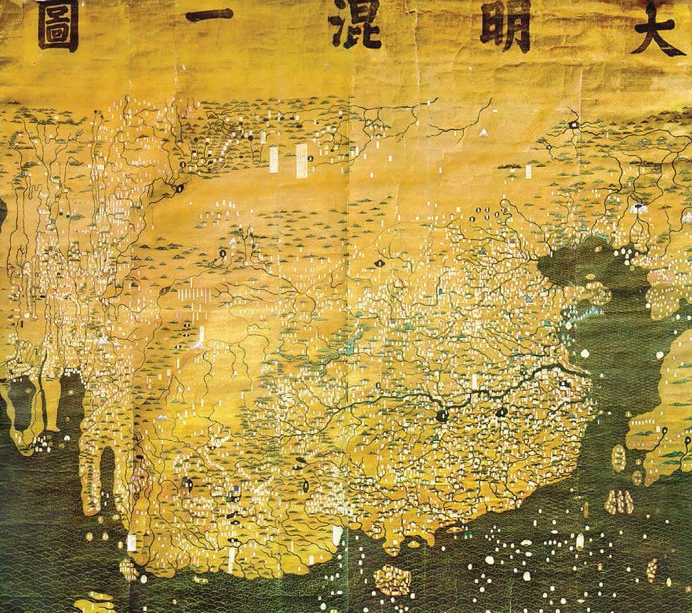
Mapping Absolute Space
Ptolemy’s legacy
  Geography editions
  Cartographic standards
  Earth’s coordinate grid
  Map projections
Ptolemy’s view of the world still centered on the West
One of the oldest extant world maps from East Asia. A Korean map of the world, circa 1389.
Notes:
Figure 2.2

Slide 15
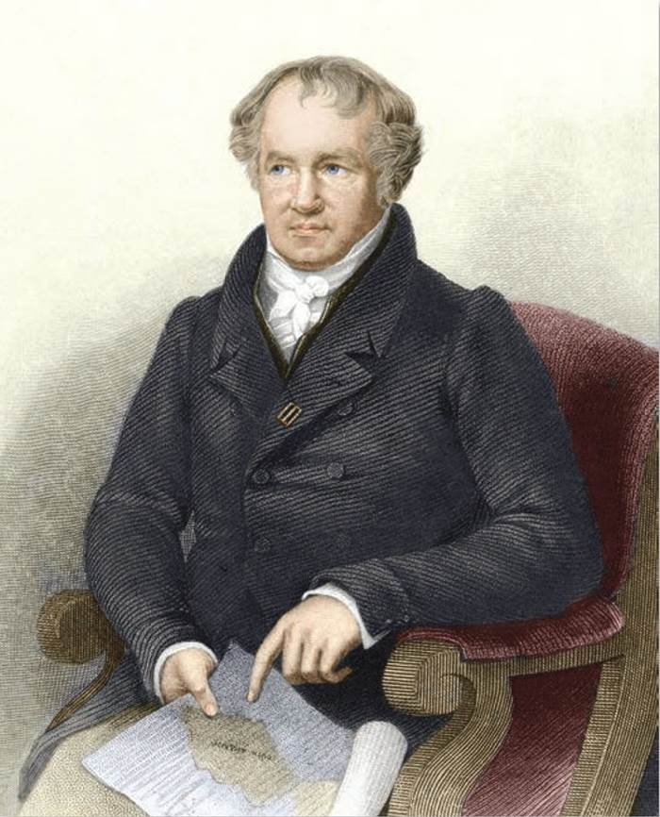
Shift from Cosmography to Geography
Geography part of wider understanding of interconnected cosmos
History of geography is a dismemberment of cosmographic view
  From Renaissance to Scientific Revolution
  Mercator’s Atlas to Humboldt’s expeditions
Portrait of Wilhelm Heinrich Alexander von Humboldt
(1769-1859).
Notes:
Figure 2.3

Slide 16
Cosmography Has Its Place
the science that deals with the general features of the universe, including the earth. The branches of cosmography include astronomy, geography, and geology.
  Past: built on religious beliefs that tried to explain how humans fit in the grand scheme of things and how to successfully navigate through life.
  Today: science gives us a slightly better understanding of a universe which is really beyond human comprehension
    No need to reject religious beliefs – religions tell the WHY of it all; whereas, science tells the HOW of it all – there doesn’t have to be a conflict between them
    Apply the 4 laws of ecology to the cosmos – the scale and timeline is vastly greater than it is when we apply them to the earth, but they are applicable.

Slide 17
What is Geography?
The study of the spatial characteristics of the interaction between humans and the physical environment through time with a particular emphasis on understanding the spatial characteristics of the present world in which we live.
  The processes which shape the earth both natural and human.
  Identify PATTERNS
  Identify cause and effect relationships
  Identify and project trends

Slide 18

The Five Themes in Education
All elementary and secondary textbooks currently are built around the Five Themes of Geography
The Five Themes are easy to remember and use

Slide 19
The 5 Themes of Geography
Source: National Geographic Society
The Five Themes
  LOCATION – relative & absolute
  PLACE – physical & cultural (human)
  MOVEMENT – material & non-material
  HUMAN/ENVIRONMENT INTERACTION – adaptation & alteration
  REGIONS – formal & functional (relational)

Slide 20
Location – determining the position of a place on the earth’s surface
Absolute location – precise positioning – latitude and longitude are the best.
  GPS & GIS give this new meaning
  Automobile systems linked to satellites – OnStar, Apple & Android phones
Relative location – describing in relation to other, known places such as landmarks and unusual, easily recognizable features.
  Used by most people in giving directions

Slide 21
Place – those features that give character to a location (a degree of uniqueness).
Physical place – natural features – what nature provides – climate, landforms, vegetation, etc.
  Can many places no longer be called physical places – where might the human influence be absent today? This relates to the theme of human/environment interaction.
Human (cultural) place – features added by humans – distinctive dress, architecture, language, religion, burial practices, agricultural practices, etc.

Slide 22
Human/Environment Interaction
Human adaptations to natural conditions.
  Heavy coats in winter
  Elevated housing in areas prone to flooding
Changes (Alteration) in natural conditions made by humans.
  Digging canals
  Changing the vegetation – farming, etc.

Slide 23
Movement – the transfer of material and non material things from place to place
Material things – involving tangible objects transported in a variety of ways
  Animal and animal-powered means
  Land, water, and air vehicles
Non-material things – information, power, culture traits
  Fashions, trends, fads, etc.
  Electronic media, etc.

Slide 24
Regions – mental constructs expressing some commonality or uniformity
Formal Regions – possesses a single common feature or a limited combination of features throughout the area
  Political units such as states and counties
  Language regions
Functional Regions – An operational unit based on organization, structure, and interactions – an area organized around a node.
  The hinterland of a major city

Slide 25
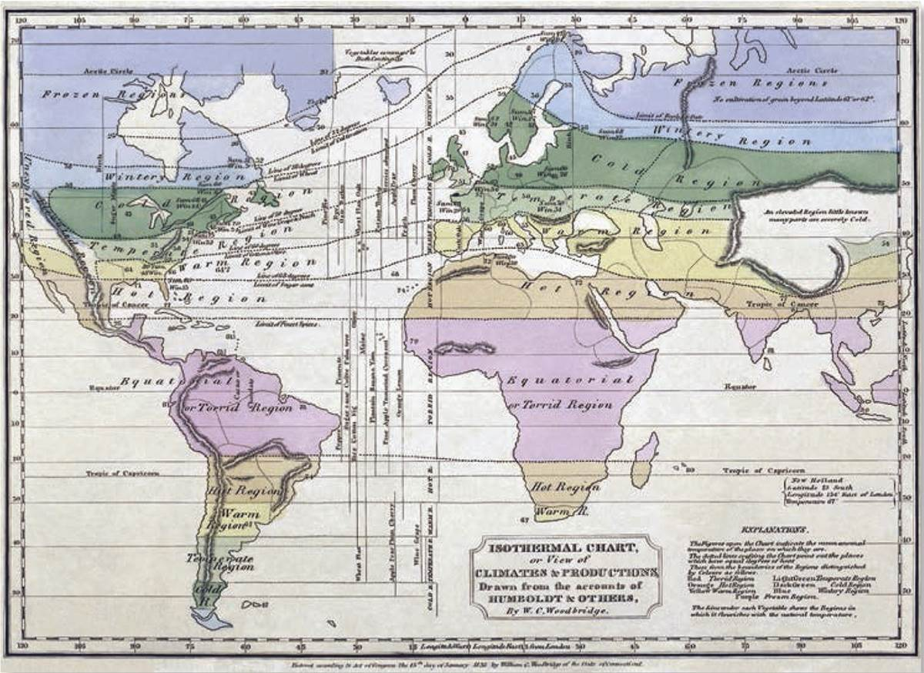
Thinking About Maps
Maps and mapmaking an integral part of history of geography
Cartography and increase of scientific rationality
Postmodern turn saw maps as reflecting power relations of wider social world
An 1823 isothermal map of the world. The text attributes the account of Humboldt and others.
Notes:
Figure 2.4

Slide 26
Mapping Relative Space
Absolute Space
  Grid of latitude and longitude
  Accurate, absolute locational fix
  Tells nothing about character of places
Relative Space
  Concern of human geographers
  Comprised of social connections, political arrangements, and economic conditions

Slide 27
Mapping Relative Space
CRIME
Early data termed “moral statistics”
Mapping predated statistical techniques
Today, still important element in policing
  Crime maps
  Geographic profiling

Slide 28
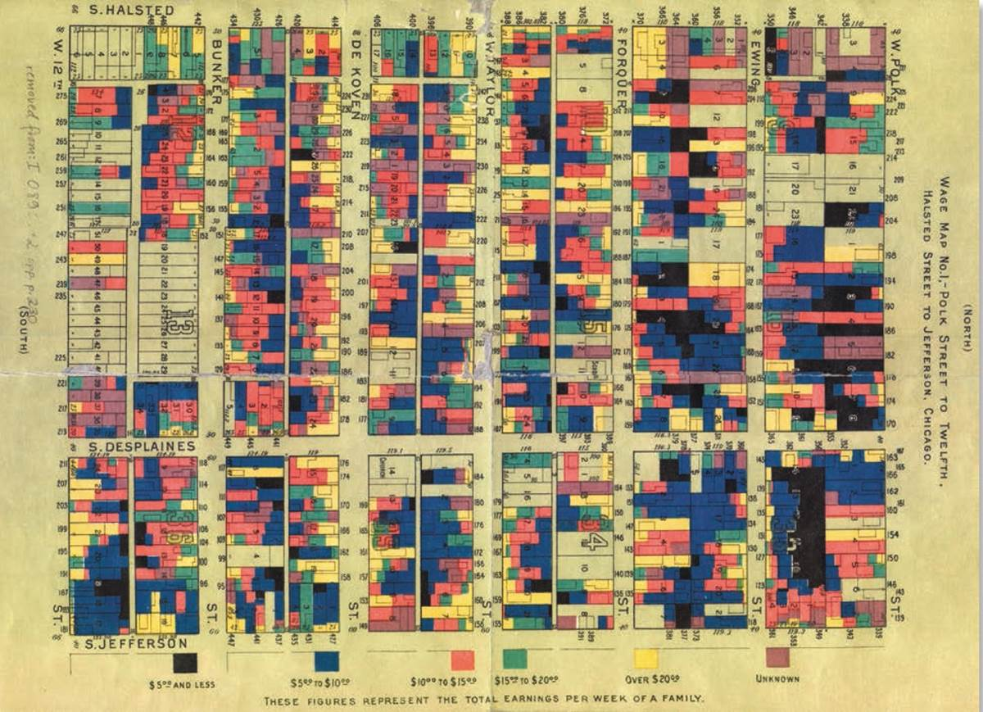
Mapping Relative Space
PUBLIC HEALTH
AND DISEASE
Industrial cities and spread of disease
  John Snow’s 1855 Cholera map
Social geography and health inequality
  Andrew Lawson’s disease mapping shows environmental racism
Wage map published in Hull-House Maps and Papers in 1895. Courtesy of the Newberry Library, Chicago, Illinois.
Notes:
Figure 2.6

Slide 29
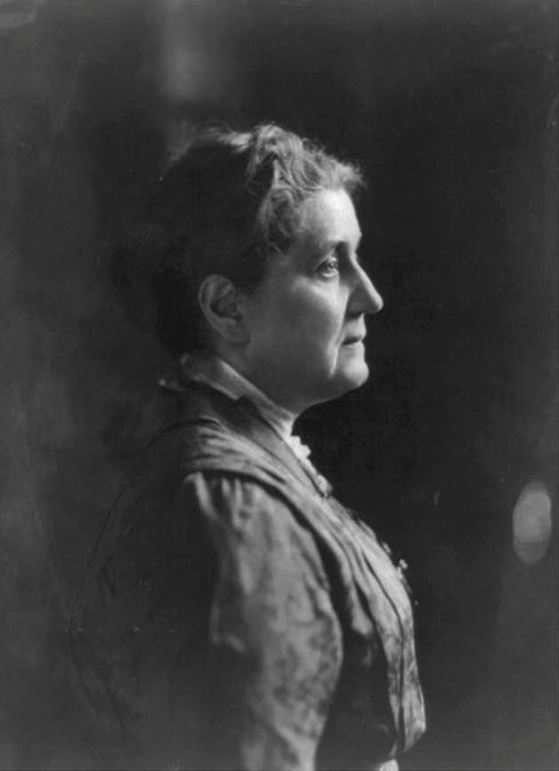
Mapping Relative Space
DEPRIVATION AND INEQUALITY
Urban research into social problems of industrial cities
  Activists and collection of social statistics
  Hull House, neighborhood services, area surveys and maps
Social Activist Jane Addams, 1914. Addams founded Hull House in Chicago from 1889-1935.
Notes:
Figure 2.5

Slide 30
Environment and Society
Environmental determinism (discredited in 20th century)
  Huntington’s
  Civilization and Climate
  Semple’s Influences of Geographic Environment
Socially sensitive environmentalism
  Parenti’s Tropic of Chaos explores the tropical zone and its unique environmental issues
  Diamond’s work on social collapse and environmental decline

Slide 31
Geography and Society
History of Geography bound up in broader social developments
  Livingston argues a series of situated geographies, depend on time and place
  In past social contexts, casual racism common
  Evolution of human geography has its own historical geography
Geography and Politics
  Human geography used to serve interests of powerful groups
  Geopolitical strategies used in statecraft
  Mackinder’s heartland theory
  Bowman’s geographical imagination in The New World

Slide 32
Geography and Society
Some geographers were antiestablishment
  Kropotkin’s society was anarcho-communist
Intellectual radicalism and the focus of inquiry
  Growing call that scholarship should address social issues
  Harvey argues the city is part of social processes in an epistemological break
Contemporary Debates
  “Turns” in human geography never involved entire discipline due to its breadth and variety
Quantitative turn
  Quantitative geography, statistical techniques, and spatial modeling
  Also, flows over space/ time and Tobler’s Law

Slide 33
Contemporary Debates
Radicalized human geography decried “scientific” objectivity, emphasizing social organization of space
Humanist critique argued statistical focus ignored feeling, perception, and intersubjectivity
  Moreover a radically informed cultural geography investigated landscapes as socially contested, cultural artifacts
Feminist critique brought attention to reality and complexity of gendered spaces and lives
Postmodernism further argued that knowledge production is a social construct of the scholars and subjects involved
Subaltern geographies represent growing inclusion of marginal perspectives, marginalized spaces and subjects

Slide 34
The Spatial Turn
Greater emphasis on space and place
  Namely in other disciples
Occurs in two trends
  Recognition that space and place have key role in their scholarship
  Growth in use of GIS to map and analyze topics of study
The “spatial turn” is the greater emphasis of geography in social sciences and humanities.
Notes:
Figure 2.9

Slide 35
The Concerns of Human Geography
Key questions: where and why?
Fundamental concepts: space and place
  Active moments, not static settings
Range of spatial categories used to investigate human geographies
  Full of cultural meaning, political significance
  Distributions, movements, distributions
  Regions of a variety of types and scales

Slide 36
The Concerns of Human Geography
Methods
  Variety of scales and techniques
Example: Human Development Index (HDI)
Notes:
Figure 2.7

Slide 37
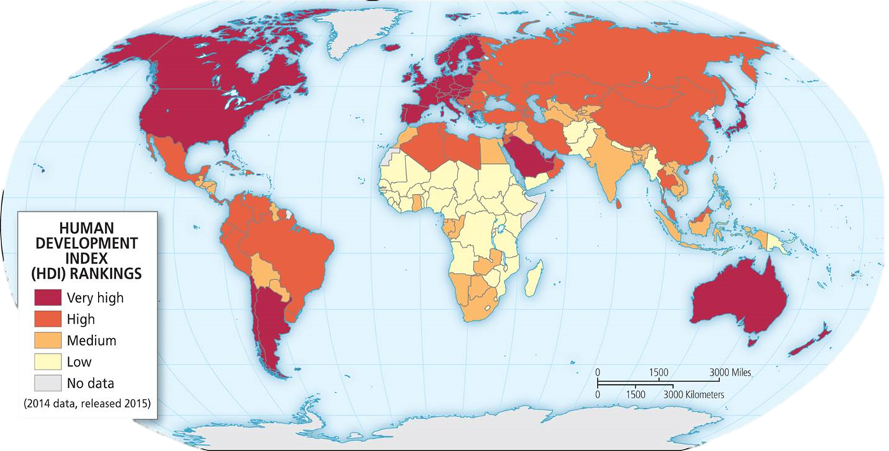

Slide 38
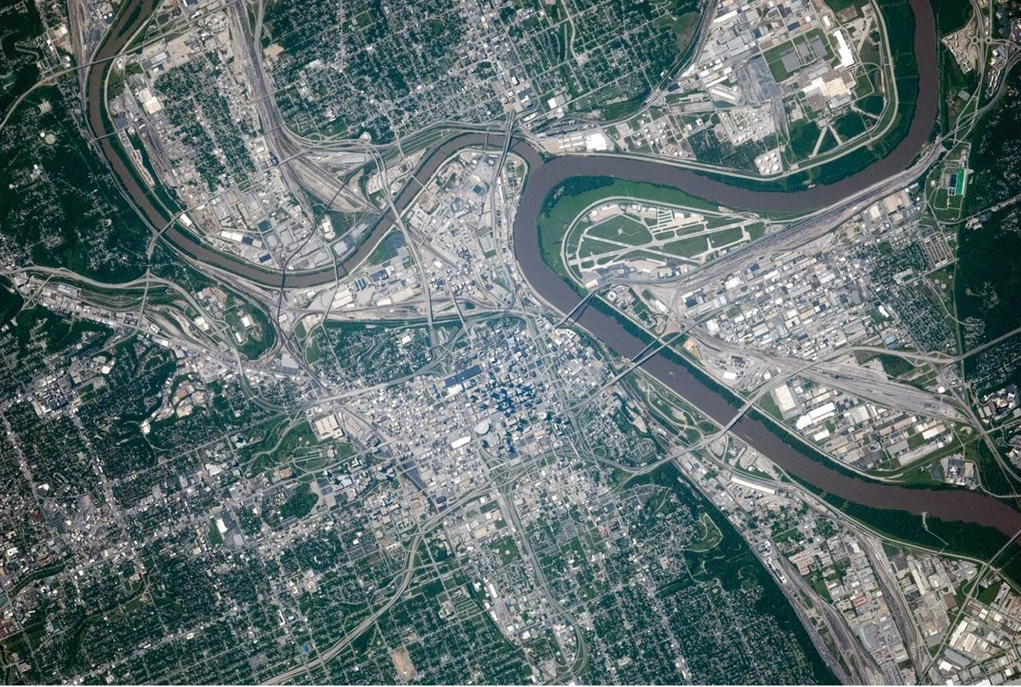
The Concerns of Human Geography
Methods
  Geographic Information Systems (GIS)
  Remote sensing
  Geographic profiling and ground truthing
  Wide range of other techniques, i.e. quantitative and/or qualitative methods
Remotely sensed image of Kansas City metro in September 2014 to show space-based perspective.
Notes:
Figure 2.9

Slide 39
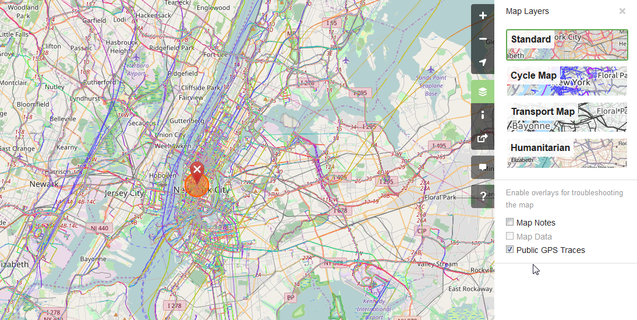
GIS, Remote Sensing, and the Democratization of Mapping
Growing use beyond national security or corporate research
Democratization of mapping
  Crisis mapping and OpenStreetMap
  Global volunteer networks open access to tools and information
OpenStreetMap is a collaborative effort of users who generate a free map of the world.
Notes:
Source: OpenStreetMap.

Slide 40
Deep Culture Surface Culture
Difficult to discern Easily observed or experienced
World view
  Foundational attitudes & objectives
  Ranking of life goals
  Foundational religious assumptions or “realities” –cosmology
  Foundation for social mores
The “roots” that support and nourish surface culture
Language
Distinctive dress
Distinctive architecture
Crops grown – methods used
Customary rituals
Gender roles
Art & music (distinctive instruments)

Slide 41
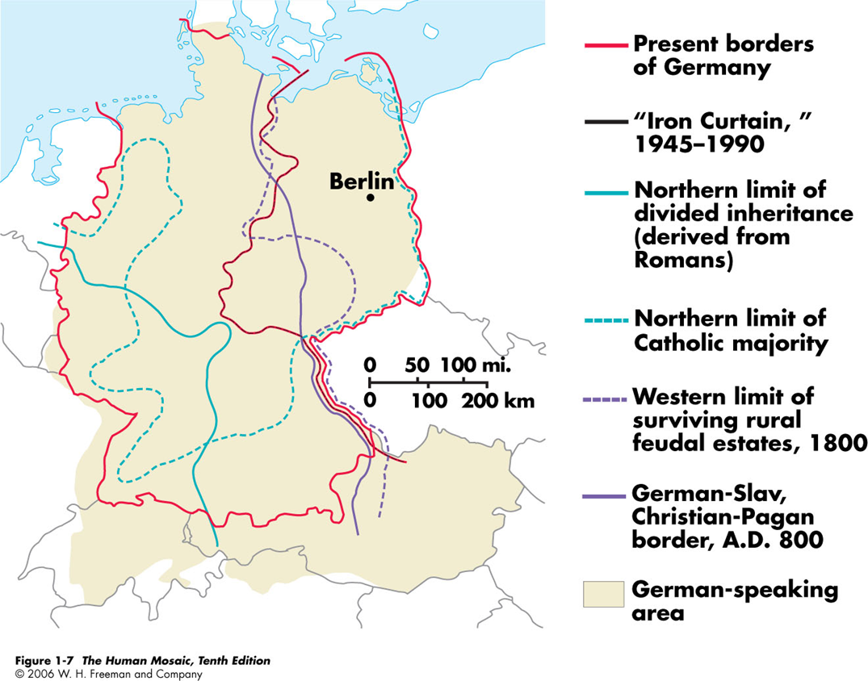
themes in cultural geography
A. Culture region
  Functional culture regions
    Organized to function politically, socially, or economically
    Nodes
    Core-periphery configuration
    Example of newspaper circulation area
    May not coincide with formal region—example of Germany

Slide 42
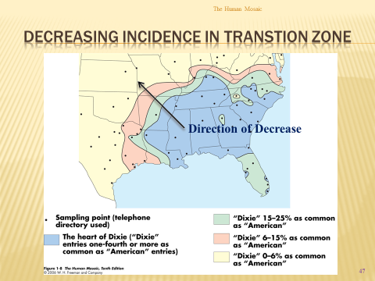
Culture region
  Vernacular culture regions: Vernacular regions are those loosely defined by people's perception (i. e., The South, The Middle East).
    Perceived existence
    Generally lack sharp borders

Slide 43
Chapter Summary
Human geography is shaped by past debates and has five themes: absolute space, geography from cosmography, relative space, environment and society, and links between geography and society.
From early mapmakers like Ptolemy to Humboldt on the cusp of the shift from cosmography to geography.
Human geography’s interest in mapping and explaining socio-spatial patterns like crime, public health, and inequality.
Geography reflects and embodies current beliefs and ideologies, like the field’s historical use to justify imperial adventures and back up belief systems that rank society.
Modern geography is more sensitive to environment understanding, uses a variety of techniques and scales to understand a wide range of topics, and has a social awareness that developed out of response to various critiques.

