Slide 1
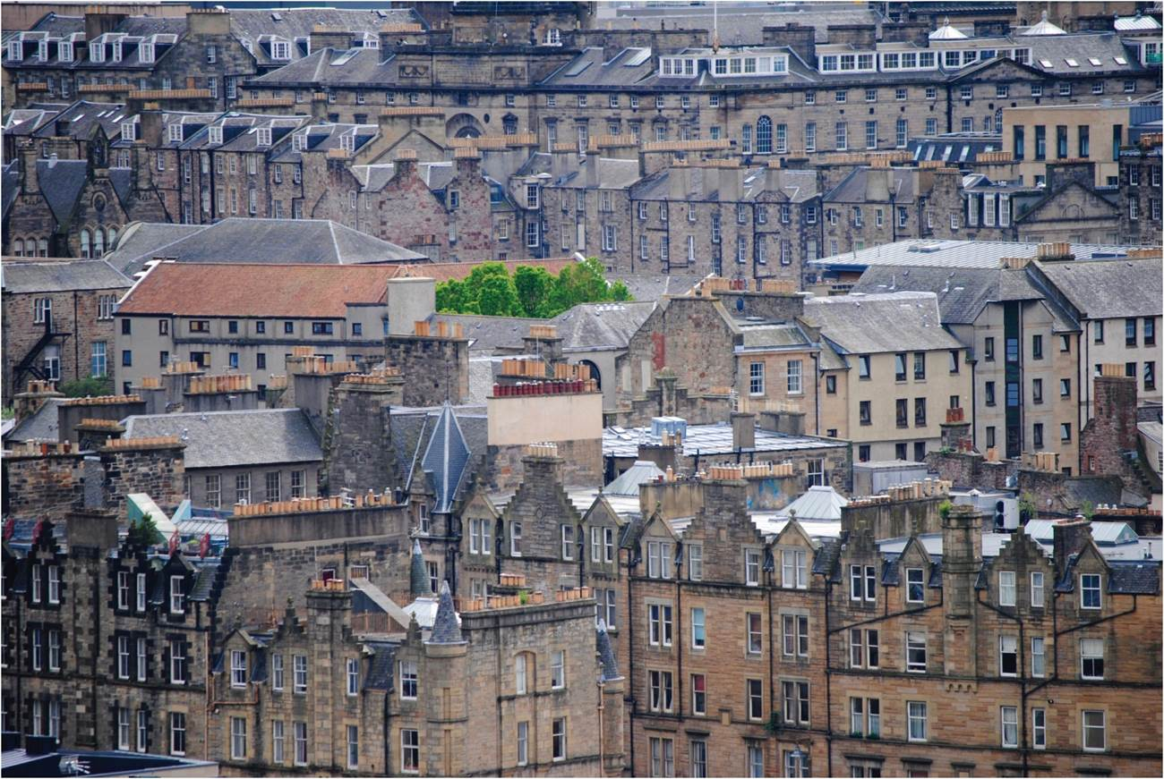
Chapter 18:The Internal Structure of the City
In this chapter, we will focus on the internal structure of the city and, in particular, on four specific themes: the city as investment, as residence, as social context, and as political arena.
Expanded by Joe Naumann, UMSL
Edinburgh skyline.
Notes:
Chapter 18 Opener

Slide 2
Chapter Learning Objectives
Identify how the internal structure of the city is shaped over time.
Understand the city as a site for investment and the role of building cycles.
Relate the internal structure of the city as residence, and how economic, social, and cultural factors form residence patterns.
Outline models that describe patterns of the urban housing market and neighborhood development.
Reflect on how the city’s internal structure forms the social and political setting for people’s movement, attachment, and interaction.
Consider the social and economic changes that cities in the developing world particularly are experiencing today.

Slide 3
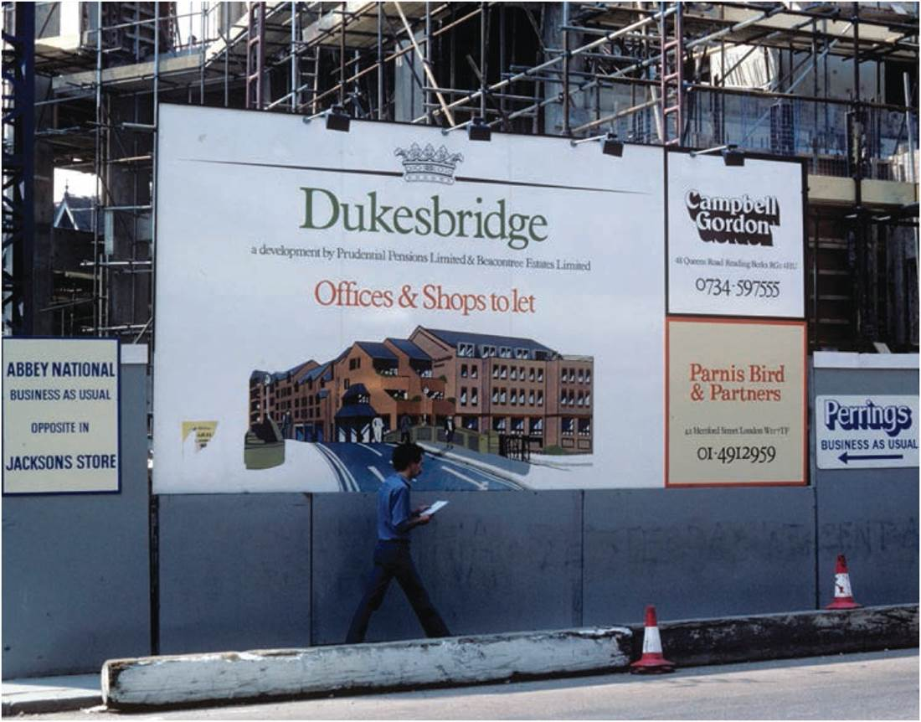
The City as Investment
In a site of investment, building occurs when rates of return are high
Building cycles periodicity
  Trough, upswing, peak, downswing, and crash
  Varies in different sectors of the market
  Transportation and the building-transport cycle
Office development in Reading, UK. A pension company, eager for secure, high-return investments, funded the project.
Notes:
Figure 18.1

Slide 4
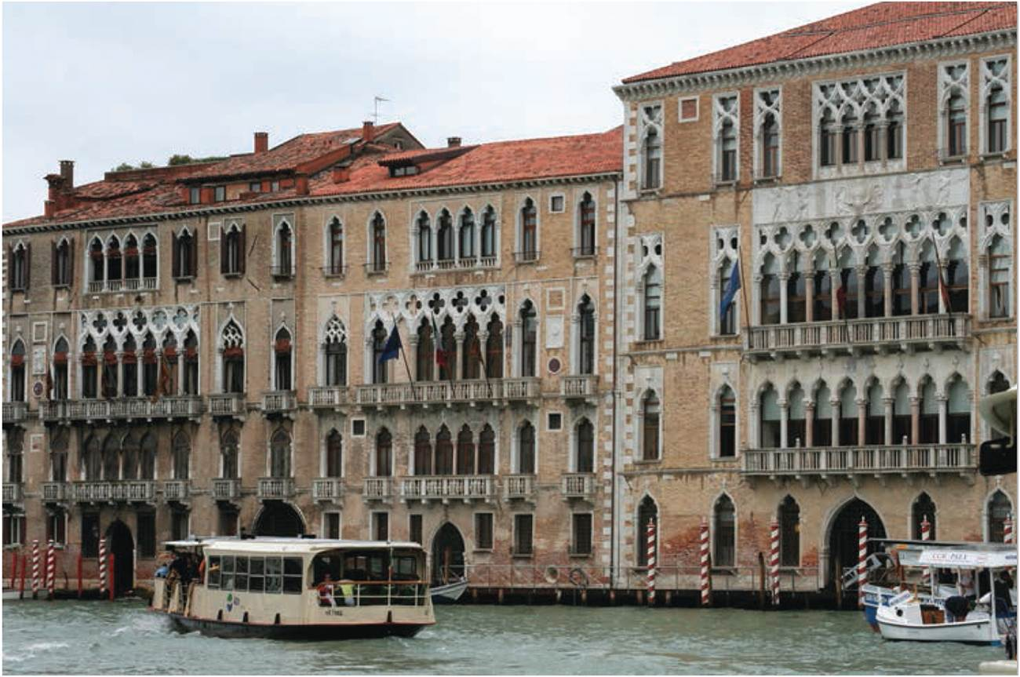
Built Form as Visible Legacy
Renaissance architecture in Venice, Italy. Capital is locked into place, with architecture of the day acting as a date stamp. The very largest and oldest cities have examples of all major building cycles. Yet some cities, in contrast, experience massive growth only at specific times.
Notes:
Figure 18.2

Slide 5
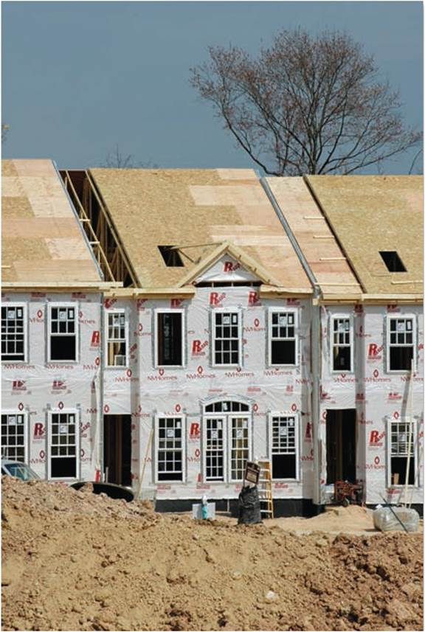
The City as Residence
PRODUCTION OF HOUSING
Individual contract, a household contracts a custom-home
Institutional contract, institution or government contracts larger buildings to rent or sell
Speculative building, as builders invest in housing to meet market demand
Self-build housing, residents build own homes, e.g. slums in developing world
Falls in housing stock
  Natural aging, destructive building cycles, or environmental shocks
Speculative house-building in Maryland.
Notes:
Figure 18.3

Slide 6
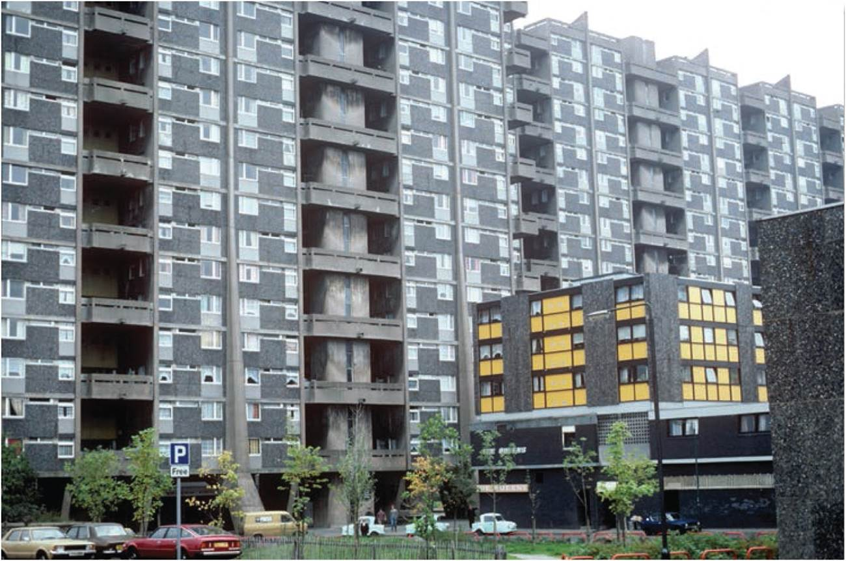
The City as Residence
THE SUPPLY OF HOUSING
Public housing provided by government agencies
  Privatization
  Social Housing in Europe
Private renting by landlords
  Landlord-tenant conflict
Owner occupation or homeownership
  Specific to affluent societies
  Economic encouragement of homeownership
Public housing in Glasgow, Scotland.
Notes:
Figure 18.4

Slide 7
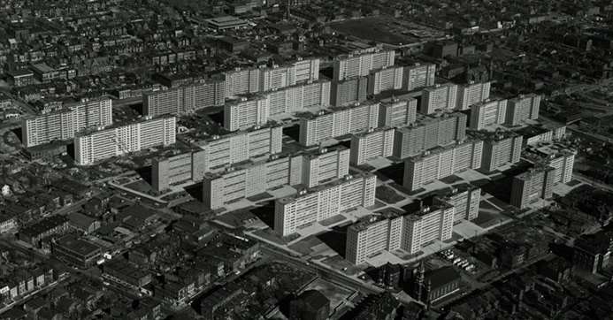
Pruit-Igo
The Wendell O. Pruitt Homes and William Igoe Apartments, known together as Pruitt-Igoe, were joint urban housing projects first occupied in 1954 in the US city of St. Louis, Missouri. Living conditions in Pruitt–Igoe began to decline soon after completion in 1956. By the late 1960s, the complex had become internationally infamous for its poverty, crime, and racial segregation. All 33 buildings were demolished with explosives in the mid-1970s, and the project has become an icon of failure of urban renewal and of public-policy planning.

Slide 8
LaCede Town, St. Louis
LaClede Town was a mixed-income, federally funded housing project in St. Louis, Missouri. Located near St. Louis University, it opened in 1964. It incorporated a mix of housing types and had spaces dedicated to social interaction and artistic production. It was an intentionally diverse community with respect to residents' income and race/ethnicity. This experimental urban development was "cool, hip, cheap and populated by people committed to making integration work." It became an incubator for new music, dance, poetry and other arts, especially jazz. Loyal former residents began organizing reunions in 1997.
Eventually, LaClede Town became run down, and the complex was demolished in the late 1980s. Some of the Grand Forest Apartments, a part of LaClede town, still exist as student housing for St. Louis University. Berea Presbyterian Church, which was central to the community and predated the LaClede Town development, still stands. However, it has been redesigned for commercial use.

Slide 9
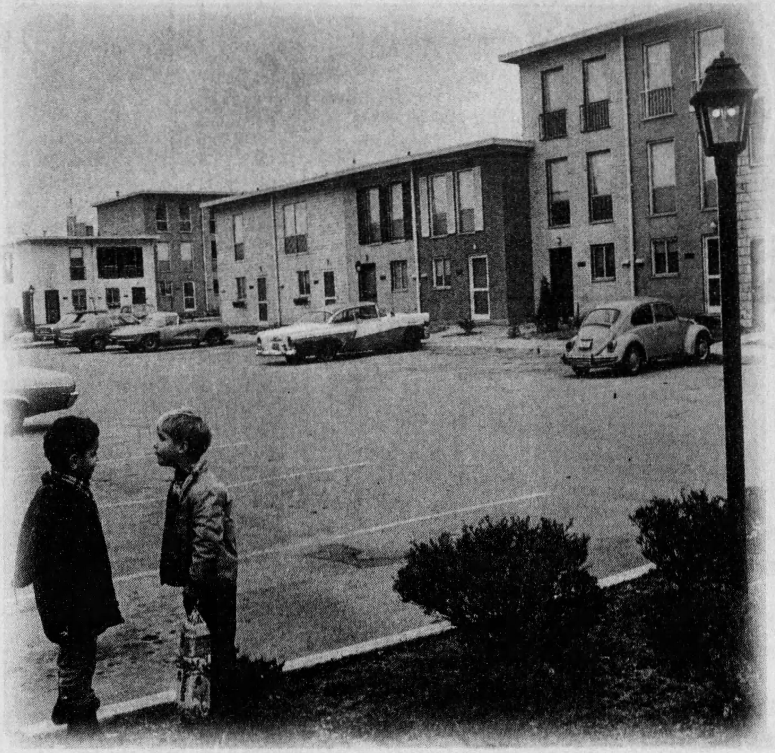
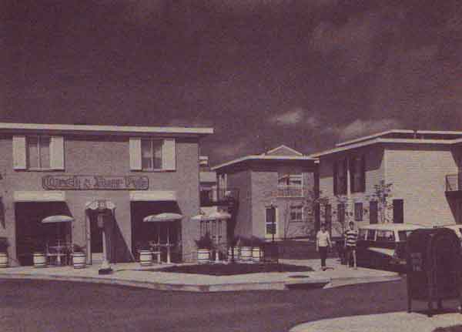
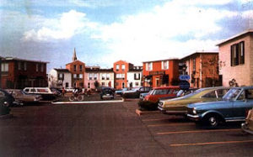
LaClede Town

Slide 10
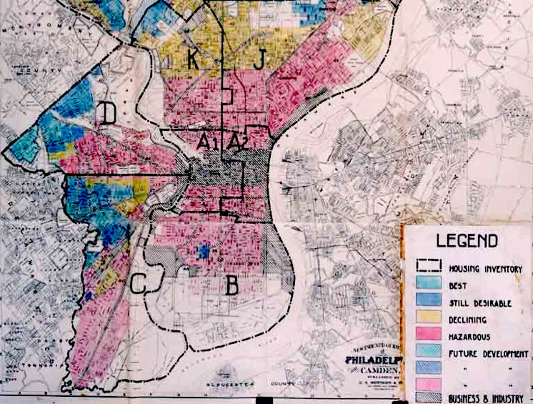
The City as Residence
THE SUPPLY OF HOUSING
Financial institutions influence urban market
  Lending’s resulting spatial patterns
Redlining areas for lending risk
  Low-income, minority neighborhoods
  Inner city decline
“Shady” Real Estate Practices
  Block-busting (illegal now)
Home Owner’s Loan Corporation of Philadelphia “security map.” Source: © Hillier at the Cartographic Modeling Laboratory at UPENN.
Notes:
Source: © Hillier at the Cartographic Modeling Laboratory at UPENN.

Slide 11

Real Estate
Home Owner’s Loan Corporation of Philadelphia “security map.” Source: © Hillier at the Cartographic Modeling Laboratory at UPENN

Slide 12
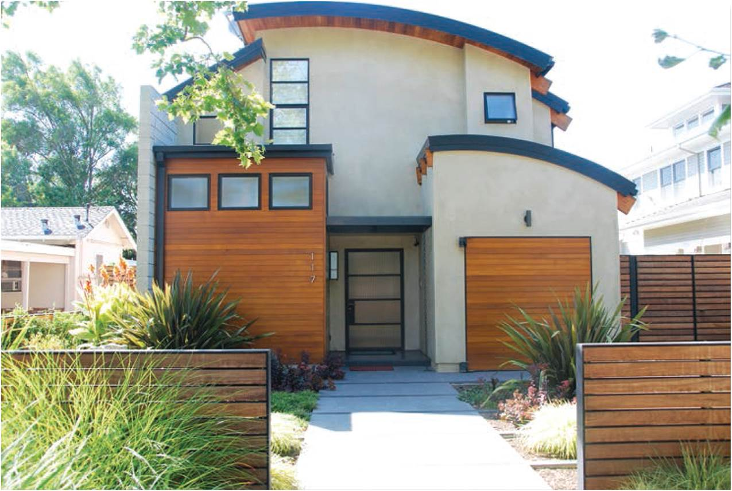
The City as Residence
THE SUPPLY OF HOUSING
Ease on lending requirements and banking regulations
  Prime mortgages were eclipsed by subprime
  Securitization and mortgages as commodity
  Toxic mortgages lead to global recession
Luxury home in exclusive Palo Alto, California.
Notes:
Figure 18.5

Slide 13
Home Sweet Home
Social significance of home
  Central element of our socialization into the world
Meaning of home – Changing concept of “ideal”
  Space becomes place
  Family relations, gendered and class identities are negotiated, contested, transformed
  Home as an active moment in identity creation, social relations, collective meaning – status symbol
  Home is a node in a series of polarities: private-public
“McMansions” on “postage-stamp” lots go for big bucks

Slide 14
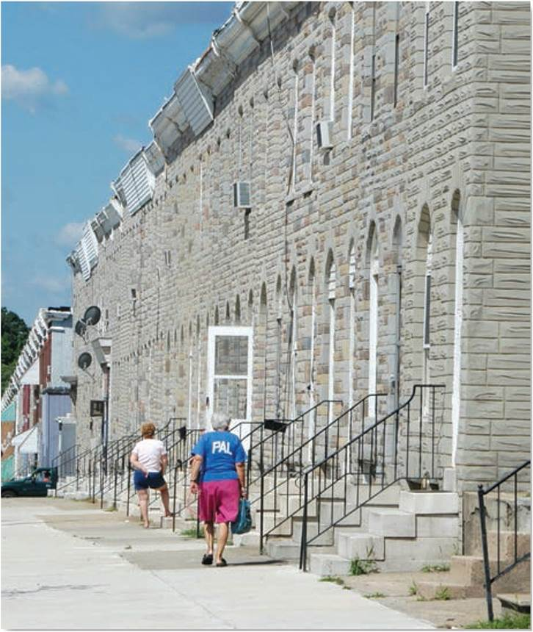
The City as Residence
DEMAND FOR HOUSING
Dimensions of demand
  Housing reflects the income hierarchy
  Varies over course of life
  Regional variations
Influence of culture
  Choices and constraints vary for social groups
  Discrimination and segregation
  Clustering and immigrant communities
Modest row houses in inner-city Baltimore.
Notes:
Figure 18.6

Slide 15
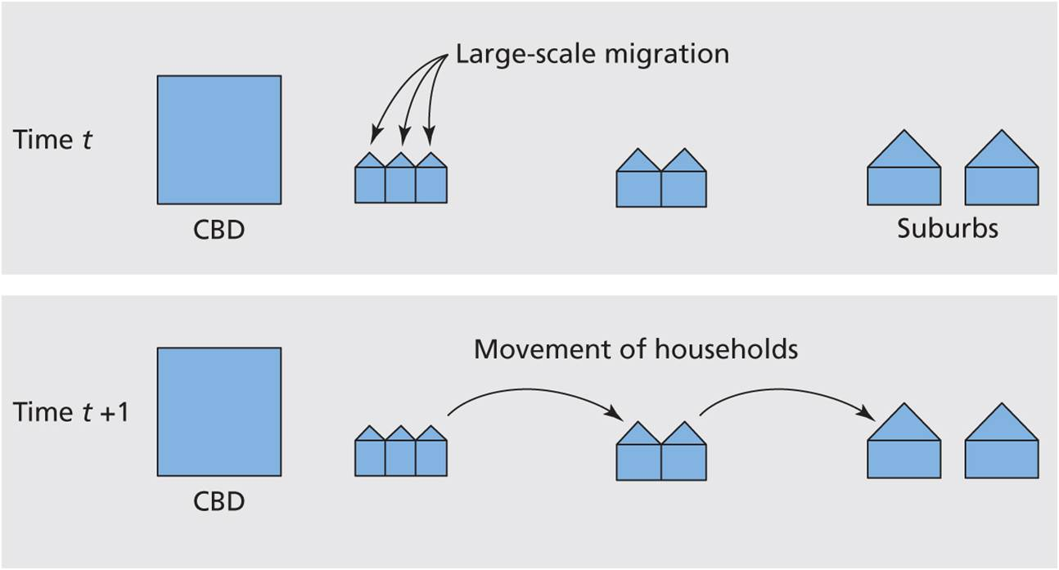
The City as Residence
RESIDENTIAL MOSAIC MODELS
Neighborhood types
Each had own focus
Burgess model
  Chicago and immigration
  Process of movement
  Concentric ring pattern
Hoyt model
  Sector arrangement
The process underlying the Burgess model.
Notes:
Figure 18.7

Slide 16
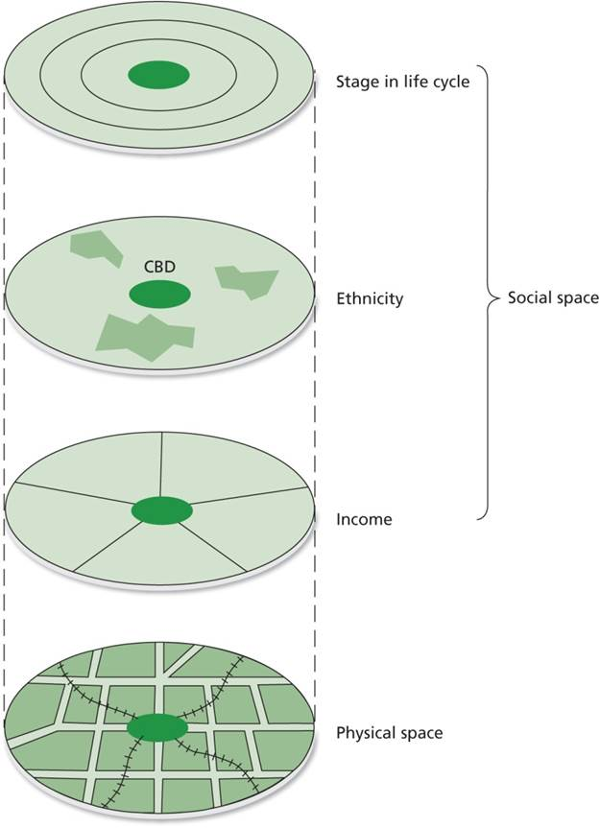
Residential Mosaic Models
Murdie Model
  Layered model of concentric rings
  Each ring is household in a different life cycle
LEFT: Murdie’s composite model.
Notes:
Figure 18.8

Slide 17
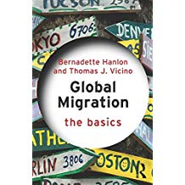
Residential Mosaic Models
Hanlon-Short-Vicino model
  Recent composite
  Pockets of poverty and gentrification
  Inner suburbs in crisis
  “Boomburbs” and affluent exclaves
American history and culture do not develop deep roots to a place
Europe – deep attachment to the house/land that has been in the family for centuries!

Slide 18
A Caution About Models
No city or urban area fits any model exactly. The models serve as “rulers” against which actual cities are compared.
Why cities diverge from models
  Seldom is terrain perfectly level so a perfect grid of streets may not be feasible
  A river may run through the middle and each side may be in a different country or different state or province
  Different histories and different cultures (different values)
    Some see buildings as important and value their history and maintain them
    Some see buildings as temporary and are quick to tear down the old and replace them

Slide 19
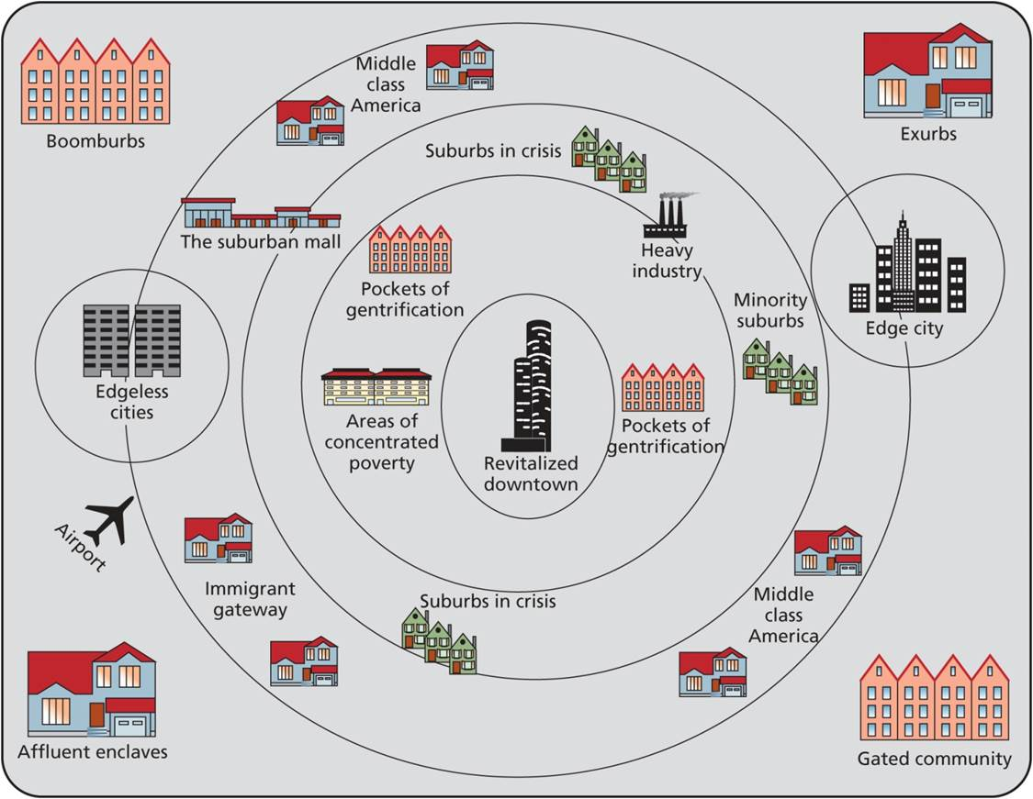
Residential Mosaic Models
The Hanlon-Short-Vicino model.
Notes:
Figure 18.9

Slide 20
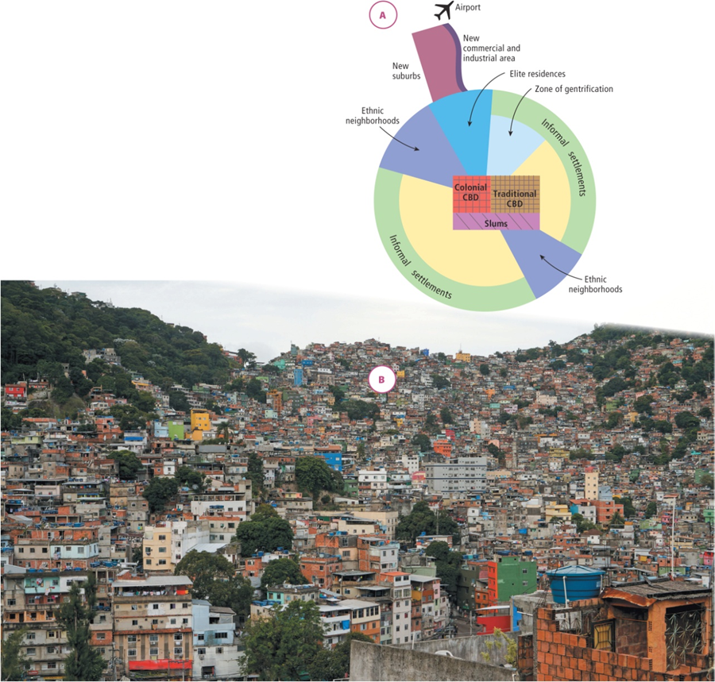
Residential Mosaic Models
[Figure 18.10A]
Developing world urban form
  Colonial legacy
  Informal settlements
  Marked segregation or fuzzy separation between social groups
LEFT: The Short Model of City Structure in the Global South.

Slide 21

The Short Model of City Structure in the Global South.

Slide 22
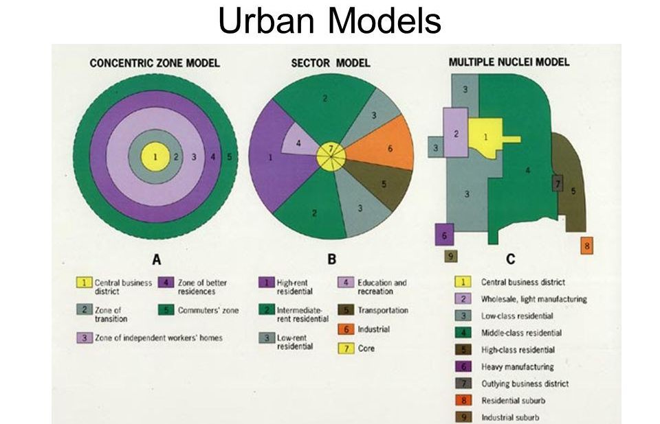

Slide 23
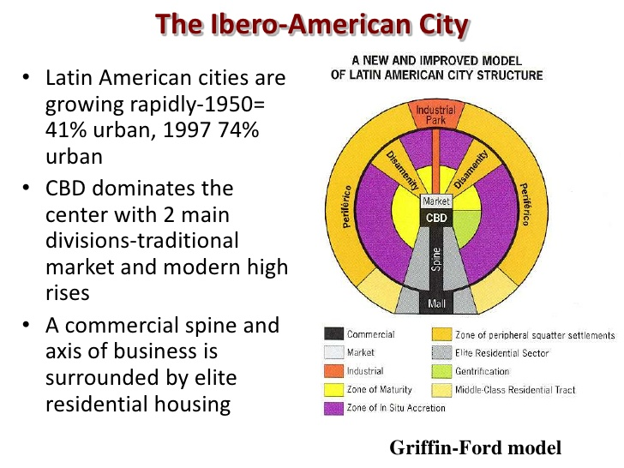

Slide 24
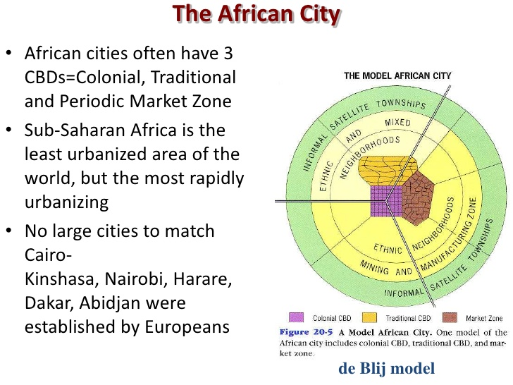

Slide 25
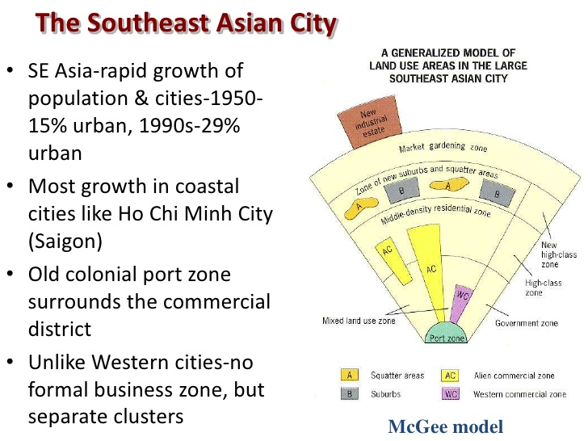

Slide 26
The City as Social Context
Interlinked processes of people and urban space
  Movement, how people move through space;
  rest, the physical attachment to place; and encounter, how we interact in place with other people
Certain spaces change through time as timed space and spaced times
  Influence on behavior, “front stage” and “back stage”
“Strategy” and “tactics” in the official city
Cosmopolitan canopy as islands of civility in the segregated city
  space where diverse people converge and interact

Slide 27
Measuring Segregation in Cities
Index of dissimilarity measures unevenness in distribution of two groups across space
  High dissimilarity in spatial spread of blacks and whites
  High for all groups
Index of segregation measures distribution of one group compared to total population
  Consistent, pronounced levels of segregation for all groups

Slide 28
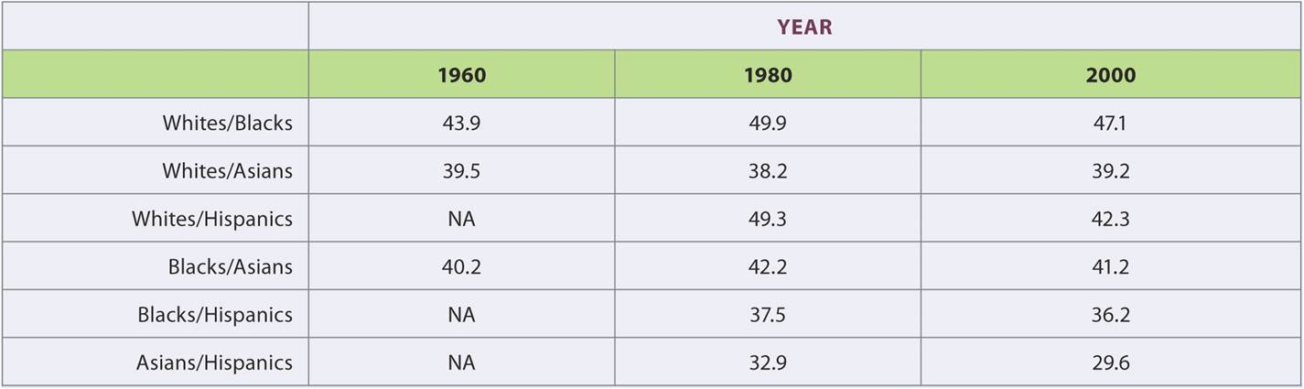
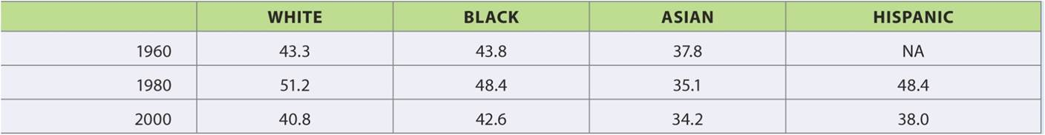
Measuring Segregation in Cities
TOP: Index of Dissimilarity in Megalopolis. BOTTOM: Index of Segregation in Megalopolis.
Notes:
Tables 18.1, 18.2

Slide 29
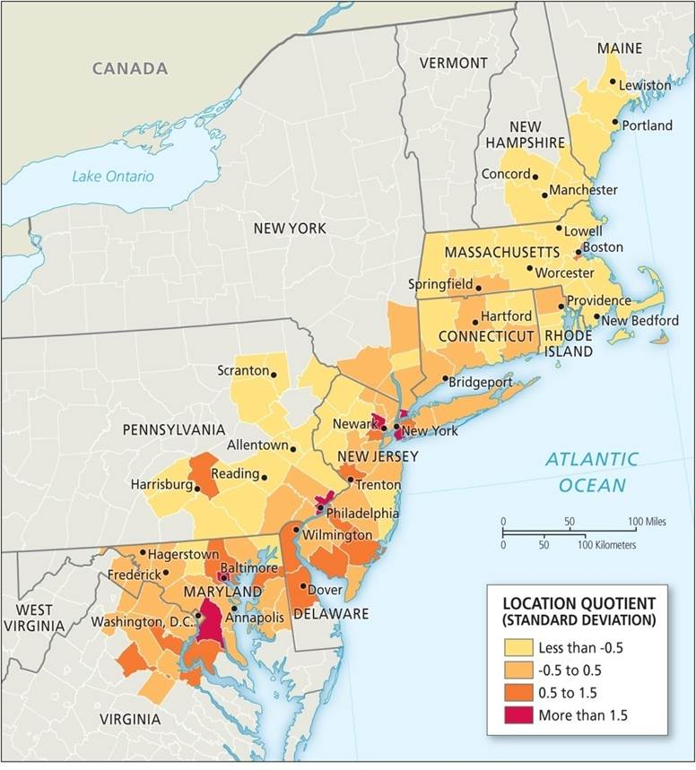
Measuring Segregation in Cities
Location quotient (LQ) measures the degree of concentration of one group compared to total population
  Divide subgroup percent by total population of each spatial unit
  For blacks, increased concentrations in urban centers and inner suburbs of largest cities
Location quotient for blacks in Megalopolis, 2000.
Notes:
Box 18.2 Figure

Slide 30
The City as Political Arena
HOUSEHOLDS
Diverse interests
  Demand for public goods and services
  Public bads and NIMBYism
Poorer, minority communities and negative externalities
  Direct correlation between socioeconomic status and quality of the urban environment
Taxation considerations
  Minimize taxes, maximize benefits, highest quality services
  Attitudes of society toward taxation varies

Slide 31
The City as Political Arena
HOUSEHOLDS
Action in the face of declining services or higher taxes
Exit as households move
Voice their concern
  Sources of protest
  Forms of collective action
  Protest is a failure to influence political process through direct action

Slide 32
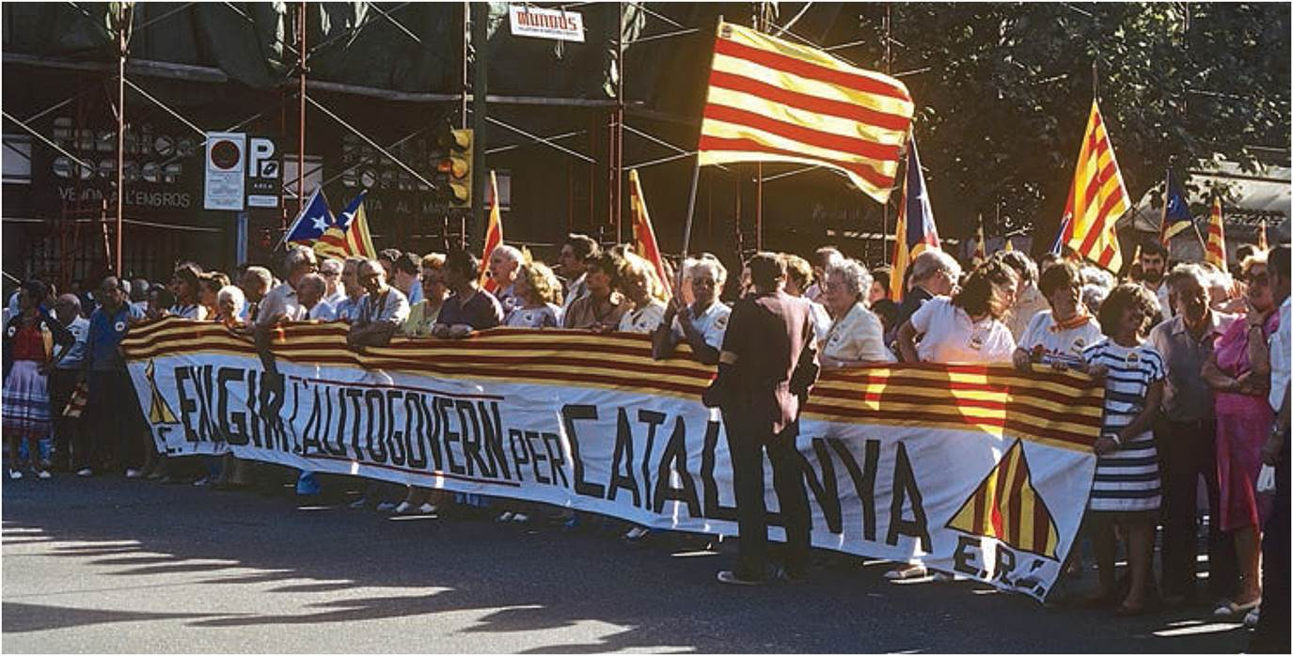
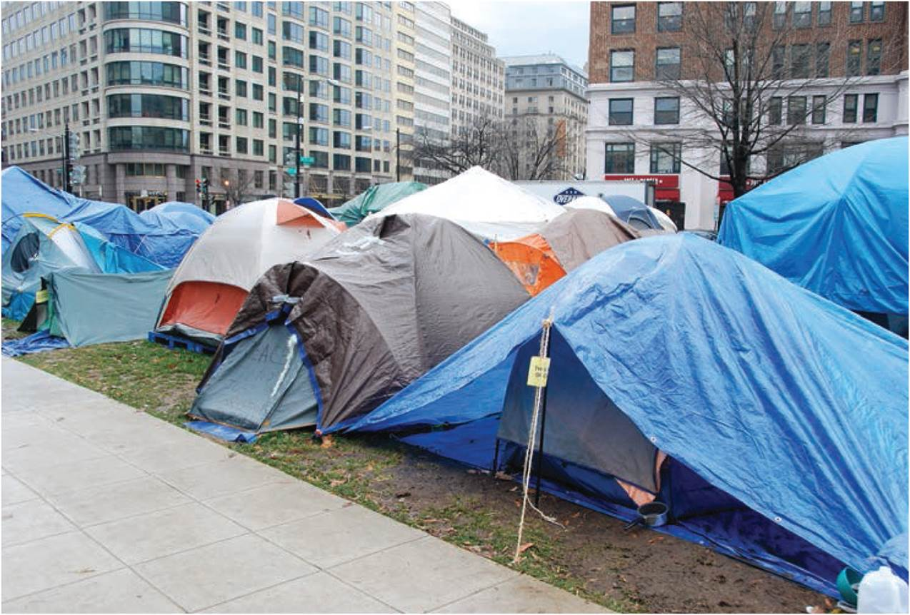
Political Action
TOP: Political protest in Barcelona for Catalan autonomy. BOTTOM: “Occupy” tents in Washington, DC.
Notes:
Figures 18.11, 18.12

Slide 33
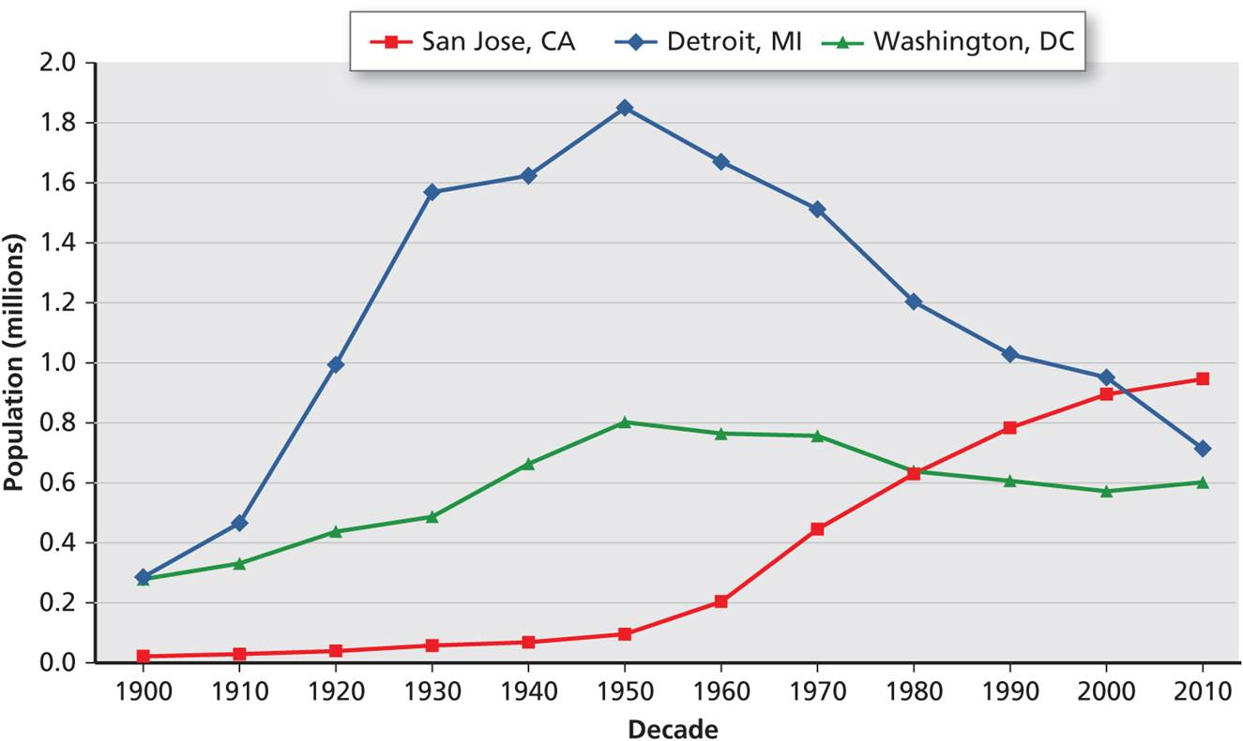
Population Change in US Cities, 1900-2010
Four model types
  Derived from experience of 100 largest US cities
Steady decline
  Rise and rapid fall, older industrial cities
  Fiscal crisis with loss of population and tax base
Continuous increase
  Rising economic, political growth
  Annex suburban territory
Population change in three US cities.
Notes:
Box 18.3 Figure 1 (top)

Slide 34
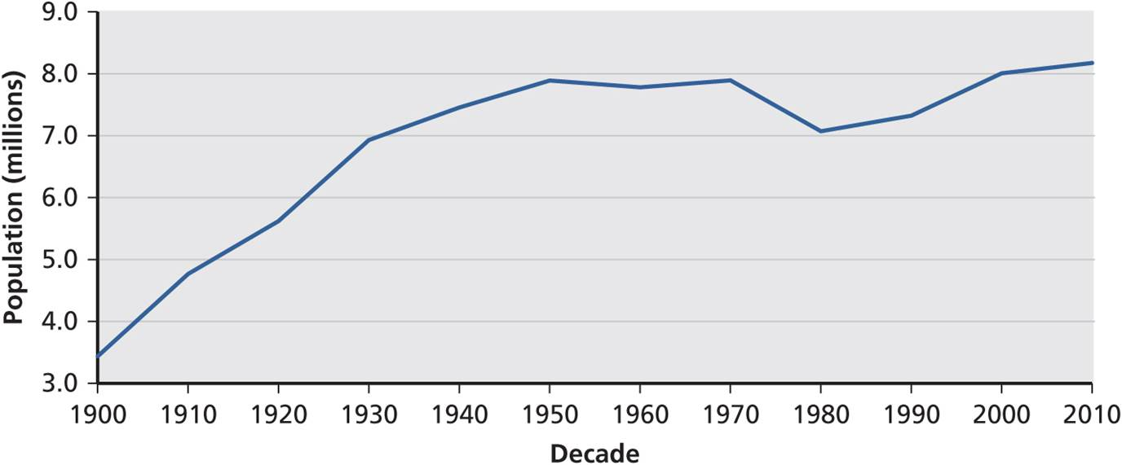
Population Change in US Cities, 1900-2010
Growth interrupted
  Upward trajectories saw decline before growth
  Within stable boundaries
Slowly resurgent city
  Slow and steady return of population
  Big urban areas with neither peak decline or growth
Population change in New York City.
Notes:
Box 18.3 Figure 1 (bottom)

Slide 35
The City as Political Arena
Urban regimes
  Informal coalitions that make decisions
  Local urban regime is combination of political and economic logic
US urban regimes, not mutually exclusive
  Organic regimes of small towns and suburban districts with homogenous population, strong sense of place
  Instrumental regimes are more focused upon specific targets developed by the partnership between government and business interests
  Symbolic regimes occur in rapidly changing cities where wider perception of the city is being transformed

Slide 36
Changes in the Contemporary City
Gentrification
  Form of urban change
  Movement of higher-income households into city neighborhoods
  Contested in a variety of cities around the world
  Rewriting of urban space in association with urban authorities
Why move to St. Louis (city)? What has it Got? Library system with deep roots. Good public transportation. World Famous Institutions: Mo Botanical Garden, Zoo, St. Louis Cathedral (mosaics). Cardinals & Blues. 2medical schools & related hospitals. Fox theater, Powel Symphony Hall
Notes:
Figure 18.13

Slide 37
What else does St. Louis have?
Gateway Arch. Soulard Market, Old Court House (historic), Art Museum, Municipal Opera (1 of 2 in the USA); Forest Park (bigger than Central Park, NY), Universities in or on the outskirts of Stl Louis: St. Louis U., Harris Stowe U., Washington U. Fontbonne U., UMSL, Webster U. Entertainment/Dining area: Laclede’s landing, Central West End, South Grand, The Hill, area around the City Museum. The Major CBD. Left Bank Books (last major independent bookstore)
Gentrification: Lafayette Square, Shaw East, Old North St. Louis
  Revitalization of 14th Street Business District
What do the suburbs have? Bedrooms, shopping malls, hospitals

Slide 38
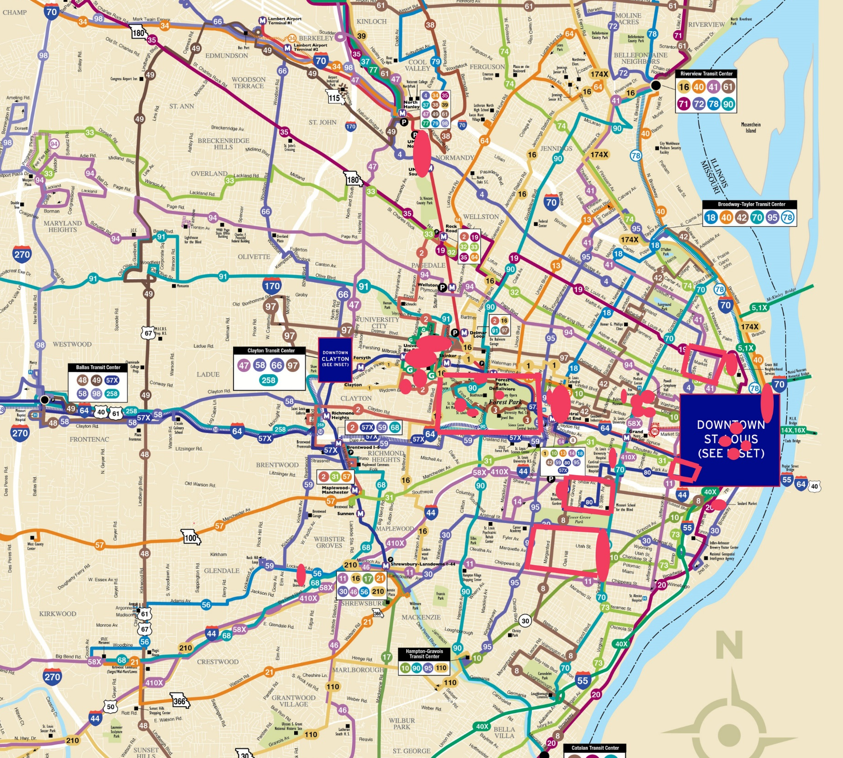
The pink circles and ellipses indicate special places in or very near St. Louis and the pink quadrilaterals indicate Forest Park, and gentrification areas

Slide 39
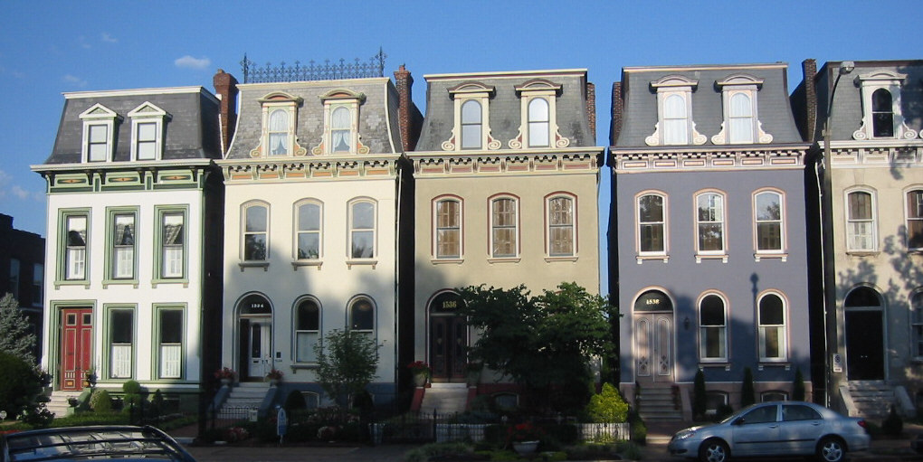
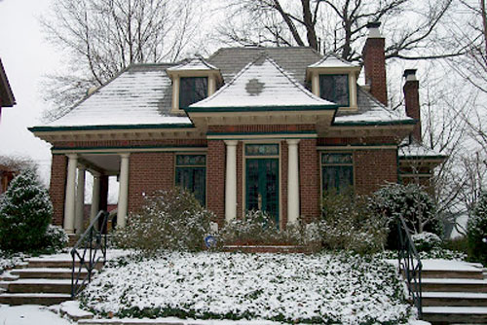
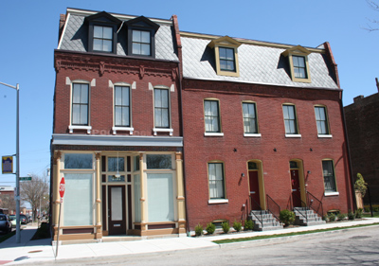

St. Louis Gentrification
Lafayette Square
Shaw East
Old North St. Louis

Slide 40
STL Metro Problems
St. Louis is no longer part of St. Louis County
No area-wide means of coordination and planning, and funding (a big disadvantage when trying to attract new development here, like the second Amazon headquarters – good location, but passed over)
  100s of municipalities, fire districts, school districts,
  St. Louis infrastructure used by 2.5 million people, but only 300,000 live in the city and pay taxes to maintain it (a real impossibility)

Slide 41
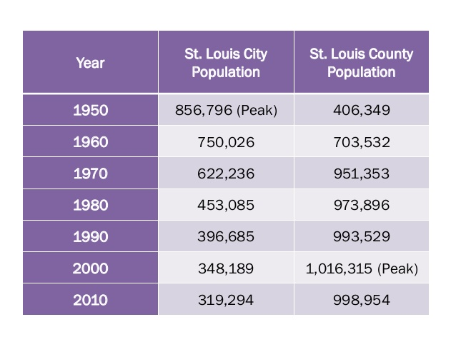

Slide 42
Changes in the Contemporary City
Suburban decline
  In between urban decentralization and recentralization
  Symptoms of aging
  Population loss
  Also loss of investment resources
Notes:
Figure 18.13

Slide 43
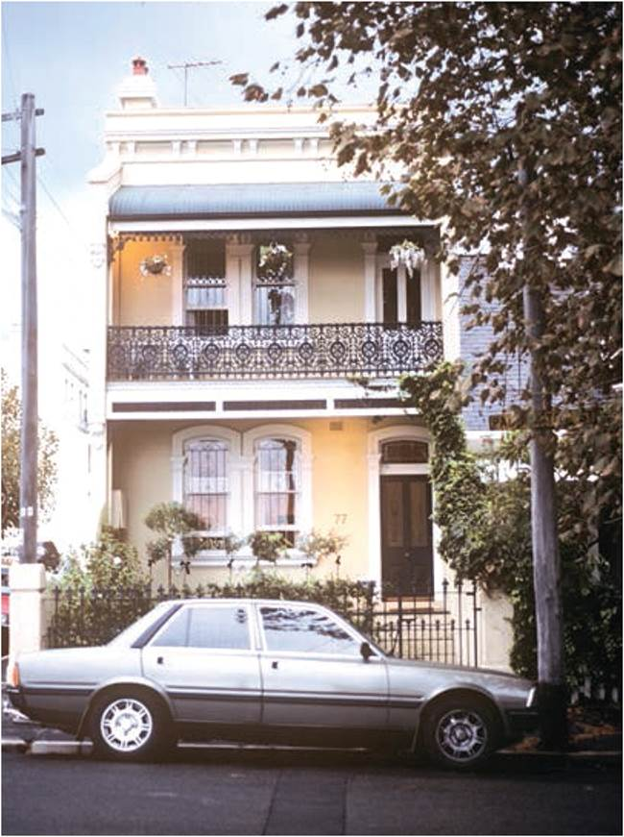
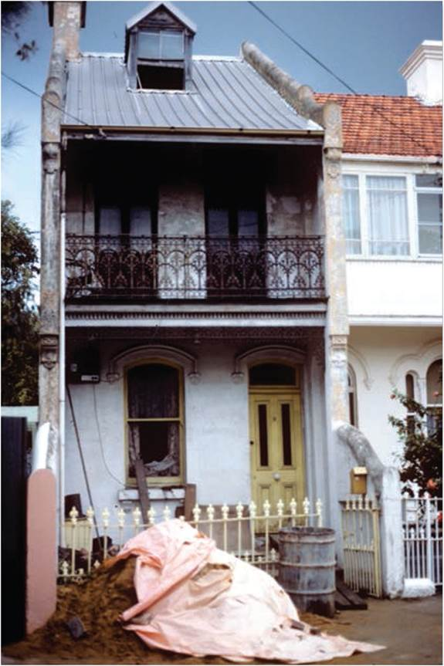
Changes in the Contemporary City
Struggle of postwar suburbs caught in middle of urban processes. Gentrification (left: before and right: after) in Paddington, Sydney, Australia.
Notes:
Figures 18.13, 18.14

Slide 44
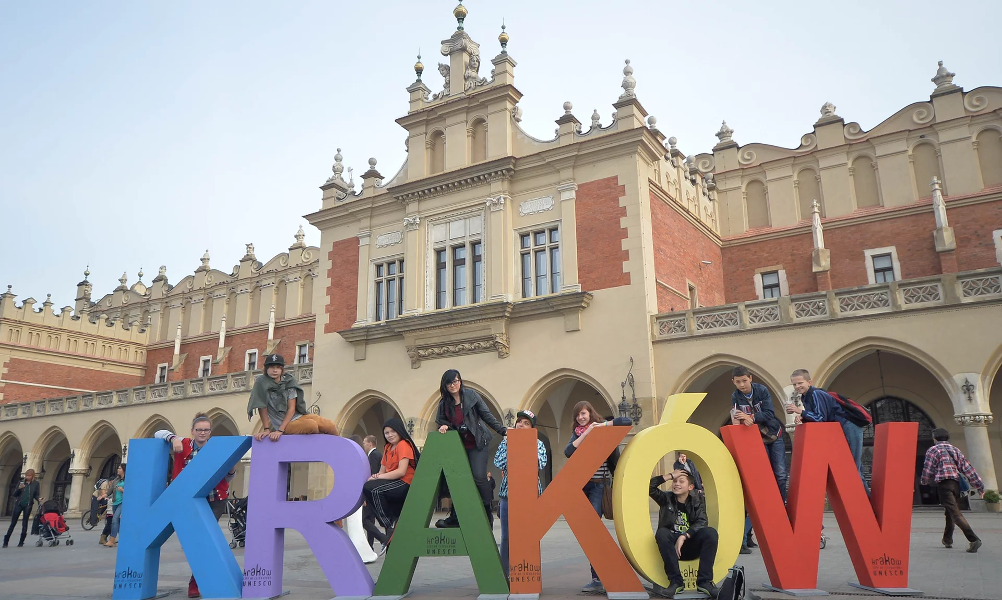
Changes in the Contemporary City
City branding or marketing of the city
Contemporary forms
  “Post-” industrial city
  City as global
  City as business-friendly
Exclusions and silences in city marketing
  Themes represent power of dominant groups
In Poland, Krakow was named one of Europe’s Capitals of Culture in 2000, an international event associated with city branding and urban revitalization projects.
Source: © Art Widak/Demotix/Corbis at the The Guardian Cities.
Notes:
Source: © Art Widak/Demotix/Corbis at the The Guardian Cities.

Slide 45
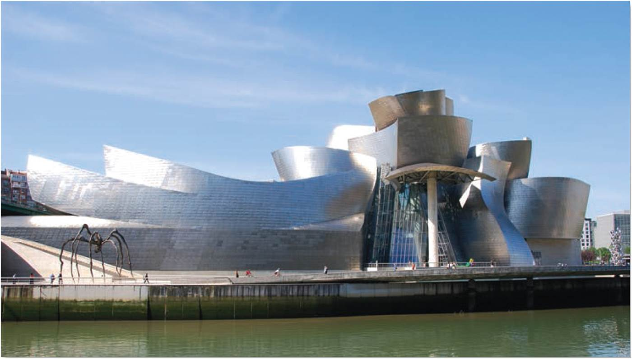
Signature Buildings and Global Events
Marketing of cities involves construction of symbolic capital
  Starchitecture buildings by prominent architects
  Often part of urban renewal projects
Guggenheim Museum in Bilbao.
Notes:
Figure 18.15

Slide 46
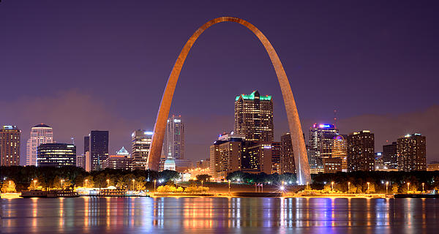
Even known in Campobello di Mazara, Sicily

Slide 47
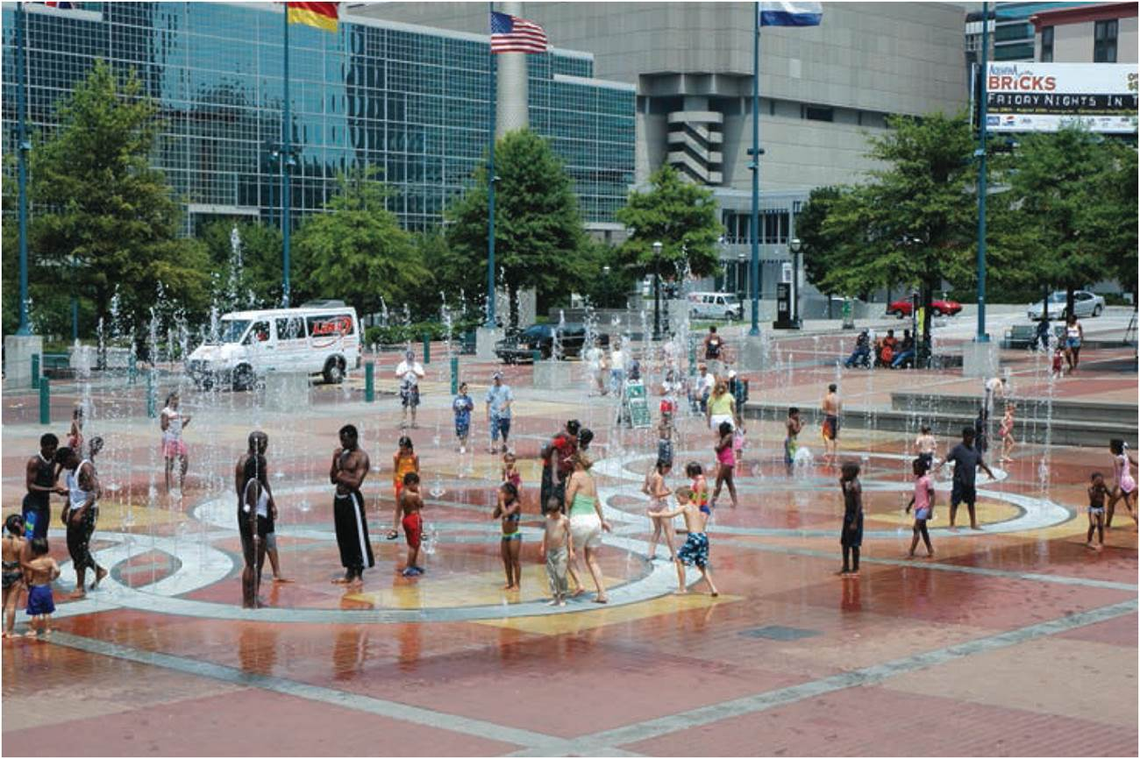
Signature Buildings and Global Events
Hosting events
  Spotlight events,
  scale and audience
  Opportunities for the city’s elites
Olympic games
  Hosting city has opportunity to gain venues and improve infrastructure
  Target areas of decline
  Costs to city residents
  Impacts on marginal groups
Olympic ring fountain in downtown Atlanta, built for the 1996 Games.
Notes:
Figure 18.16

Slide 48
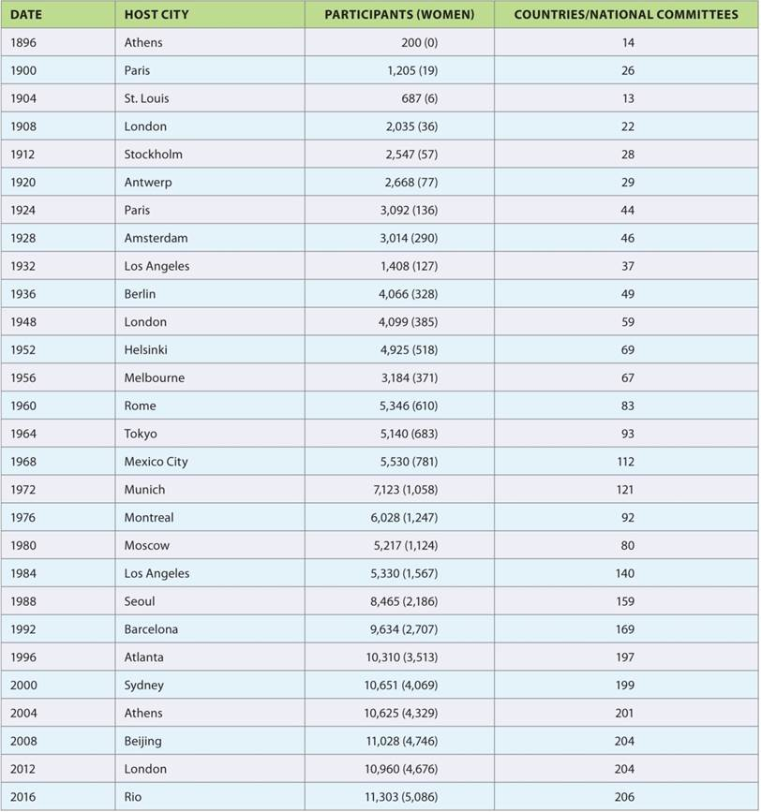
The Modern Summer Olympic Games
From humble beginnings in Athens in 1896, when only 200 athletes from fourteen countries competed, with limited press coverage, the modern Olympic Games have now grown to a truly global spectacle involving most countries in the world.
Notes:
Table 18.3

Slide 49
Chapter Summary
The four specific themes of the internal structure of a city are the city as an investment, as a residence, as social context, and as a political arena.
As a site of investment, capital flows into the built environment when relative rates of return are high in a distinct cycle of troughs and peaks, known as the building cycle. Often align with transport improvements and changes in architectural style.
The supply of housing can be broken down into public housing, private renting, and owner occupation.
The demand for housing varies by income and wealth, the stages of the life cycle, and other cultural factors causing clustering and segregation.
There are various models of the residential mosaic from the Burgess and Murdie models to the Hanlon-Short-Vicino model.
The Short Model of City Structure in the Global South highlights some of the distinctive features of the city in the developing world.

Slide 50
Chapter Summary
The social context of cities can be viewed through various processes based on how we move, how and where we rest, and how we interact with others.
Cities are political arenas where different groups and stakeholders compete and cooperate.
In the United States, three types of informal urban governing regimes have been identified: organic, instrumental, and symbolic.
Contemporary urban change includes gentrification, suburban decline, and city branding.
Gentrification tends to occur when there is recentralization in central city areas.
There is also decline in many postwar suburbs caught between city gentrification and outer sprawl.
Cities are marketed and branded. Among the many types are the marketing of the postindustrial city, the marketing of a global city, and the presentation of a business-friendly city.

