Slide 1
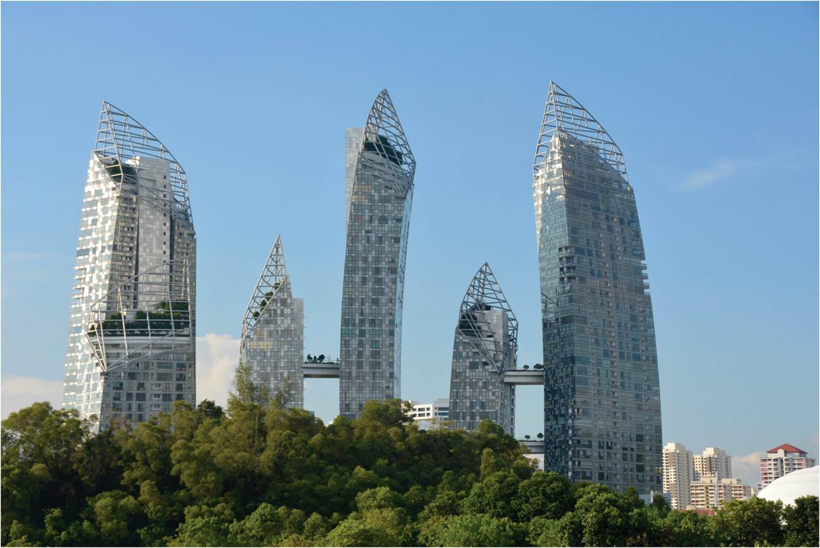
Chapter 16: The Urban Transformation
A majority of the world’s population now lives in urban areas. This shift constitutes a major change, because for most of humanity’s occupancy of the Earth, most people lived in rural areas.
Expanded by Joe Naumann, UMSL
Skyline in Singapore.
Notes:
Chapter 16 Opener

Slide 2
Chapter Learning Objectives
Outline the agricultural context that brought about the First Urban Revolution.
Describe the preindustrial city.
Relate major technological and economic changes that initiated the Second Urban Revolution with its new types of cities.
Consider causes and consequences of today’s Third Urban Revolution and the great diversity of cities around the world.
Describe the occurrence of slums in developing world cities.

Slide 3
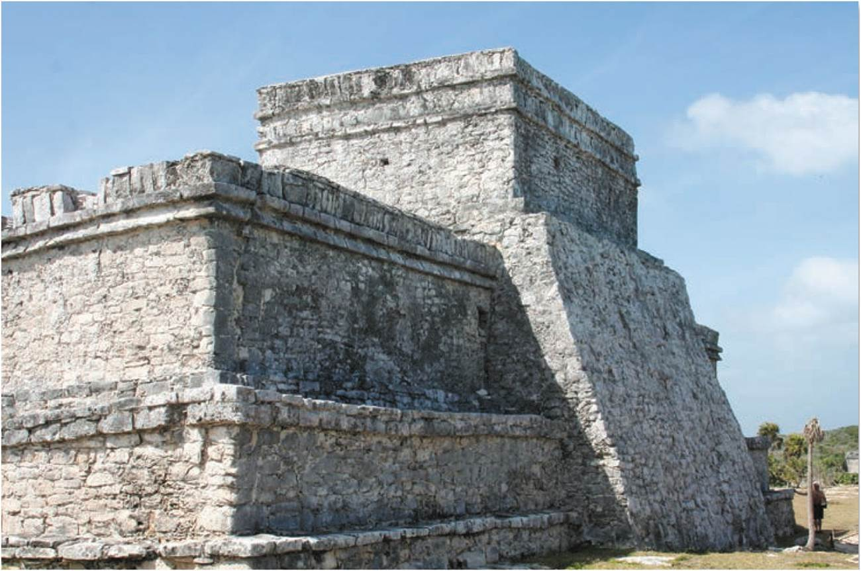
The First Urban Revolution
First Urban Revolution
  11,000-5,000 years ago first cities emerged
  Permanent settlements created agriculture
Progress or regress?
  Pre-agricultural, hunter-gatherers had more free time
  Shift to settled agriculture involved more work
Mayan city of Tolum, now in Mexico, was a typical preindustrial city with a prominent central religious site.
Notes:
Figure 16.1

Slide 4
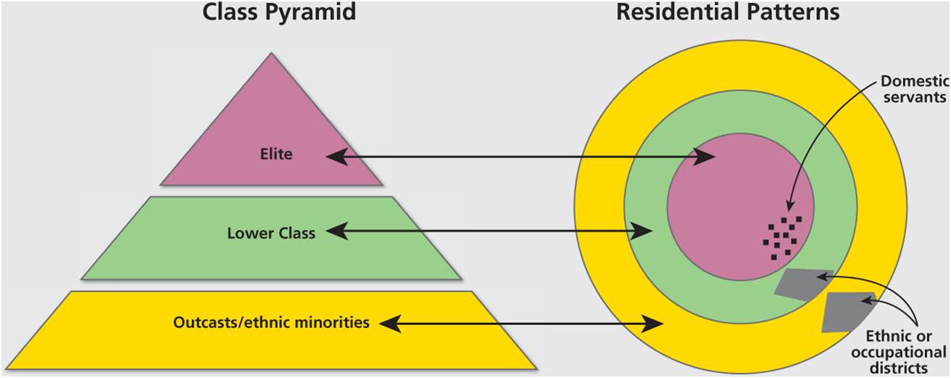
The First Urban Revolution
Impacts with shift to settled agriculture
  Declining living standards
  More farming to keep up with population
  Constant growth of early empires
  Imposed social orders
Preindustrial city
  Spatial layout and social hierarchy
Model of the preindustrial city.
Notes:
Figure 16.2

Slide 5
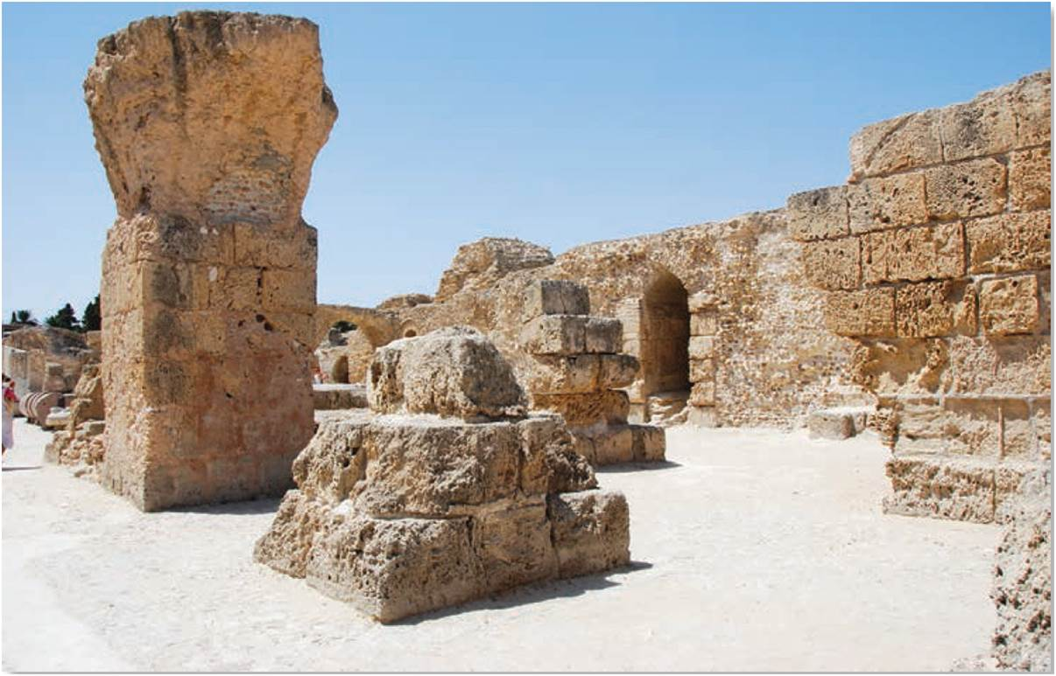
The First Urban Revolution
Urban vulnerability
  Early cities and ecological collapse
    Salinization of soils in Mesopotamia
  Constant demands for food and water
  Risks of climate change and ecological disruption
Ruins of Carthage in North Africa. Silent testimony to the rise and fall of cities and urban empires.
Notes:
Figure 16.3

Slide 6
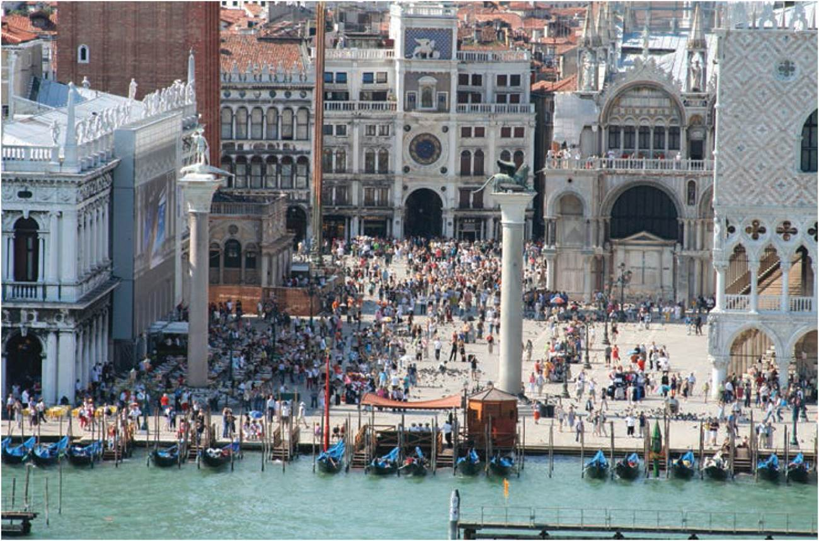
The First Urban Revolution
Cities and Social Change
  Urbanization as spatial redistribution from rural areas to urban areas, also social reorganization of space
  Merchant city, growth of trade and emergence of a merchant class
  Creation of public realm and civic society
In Europe, early merchant cities developed, such as Venice with its trade links to Ottoman and Chinese Empires.
Notes:
Figure 16.4

Slide 7
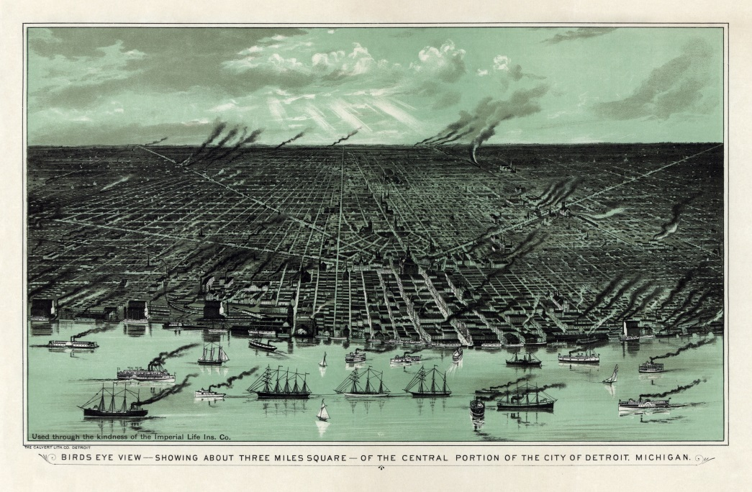
The Second Urban Revolution
Second Urban Revolution
  Late 18th century with industrial city
  Factory replaced household production
  Industry replaced agriculture
  Industrialization generated unparalleled levels of urbanization
Bird’s eye view of Detroit, Michigan in 1889.
Notes:
Source: © International Astronomical Union on Wikimedia Commons.

Slide 8
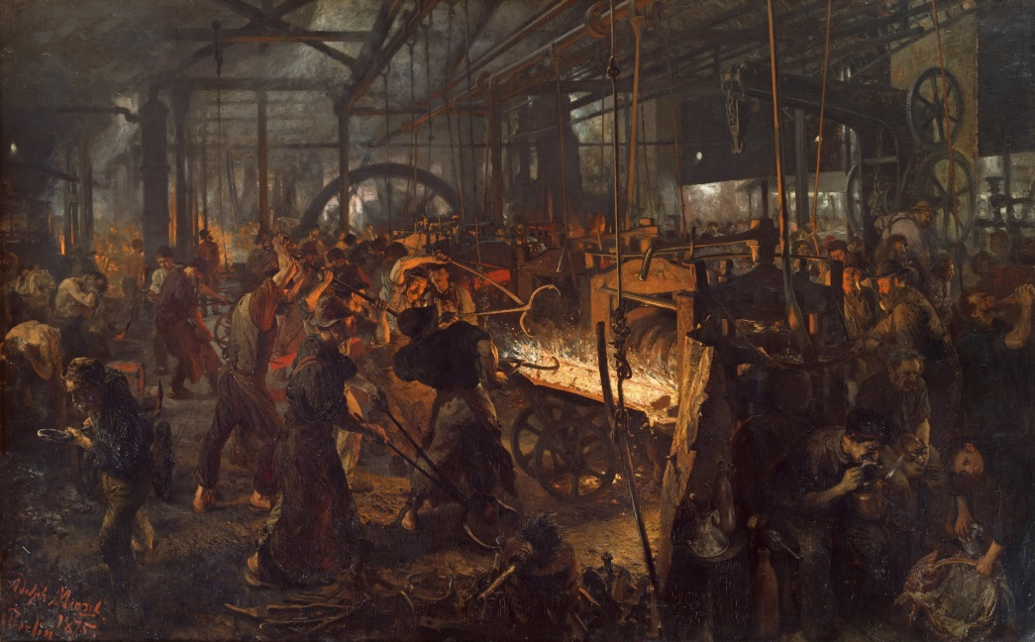
The Second Urban Revolution
Cities and Class Struggle
  Industrial city as arena for struggle between capital and labor
  Social reformers point out appalling conditions, and demand improvements
  Some like Karl Marx argued the city would bring social revolution
The Iron Rolling Mill, ca. 1872.
“In the steam-filled gloom, flickering lights and bizarre shadows merge to become a demonic drama depicting the struggle between men and machines.”
Notes:
Source: Adolph Menzel on Google Arts & Culture.

Slide 9
The Third Urban Revolution
Third Urban Revolution truly global trend
  With modernity, the city rises
Rapid change
  Sheer scale and pace of change
  New urban majorities
  Fastest rates of growth in developing regions
  Social change
    While a large family on the farm was an asset, in urban areas it becomes a liability, particularly after child-labor laws were enacted.
    The cost of adequately educating children encourages smaller families tool.

Slide 10
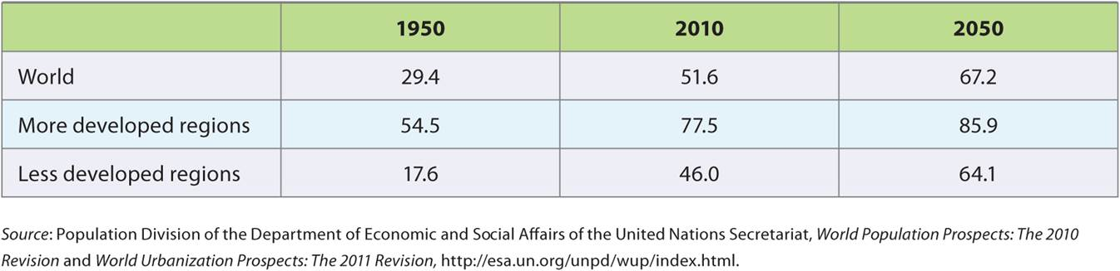
The Third Urban Revolution
Table 16.1
Percentage Urban, 1950-2050. By 2050, 6.2 billion will live in cities and 5.1 billion in developing world.
Notes:
Table 16.1

Slide 11
The Third Urban Revolution
Increasing size of cities
  More cities with more than 1 million people
  Megacities of 10 million and new form of social organization
Metropolitanization of activity into large metropolitan regions
  Advances in transport allowed dispersal away from tight urban core
  Continued dispersal formed into clustered networks of regions, as megapolitan regions
Megalopolis

Slide 12
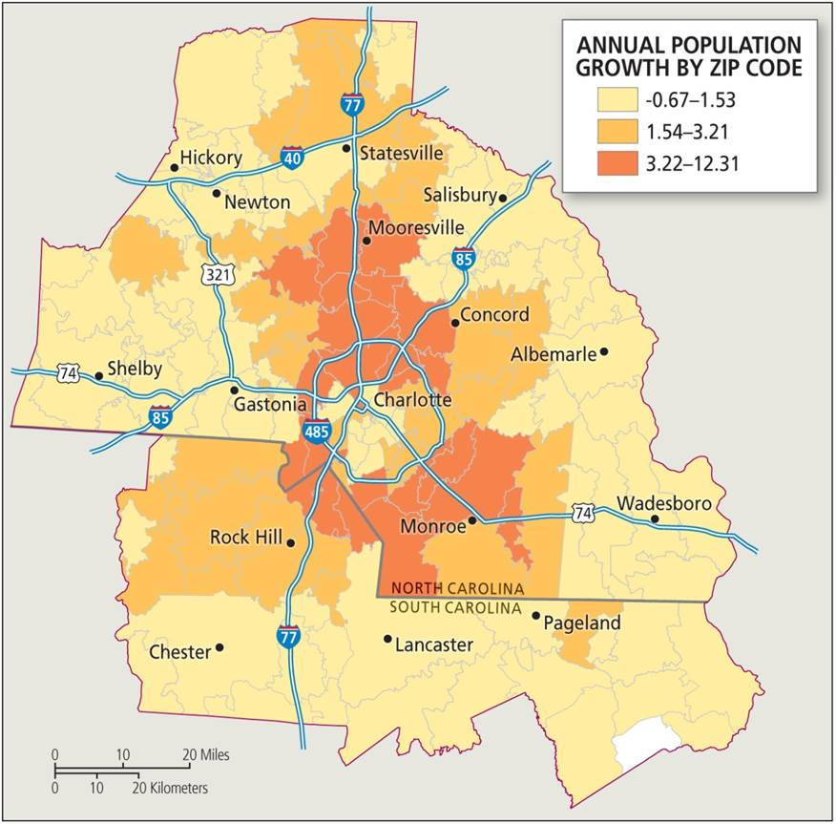
The Metropolitan United States
Metropolitan statistical areas (MSA)
  US Census measure for urban cores with at least 50,000 people and economic links to surrounding counties
  Show growth in size of cities
  Also sites of growth for US population overall
Charlotte’s MSA is 34th largest and 4th fastest growing in the nation.
Notes:
Box 16.1 Figure (top)

Slide 13
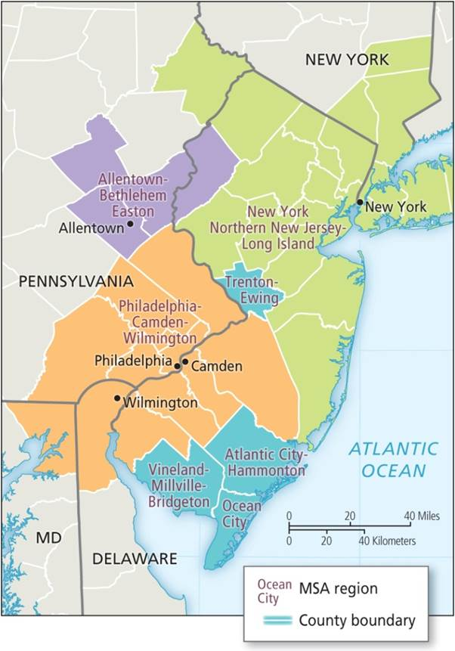
The Metropolitan United States
Geography of MSA boundaries differ from political boundaries
  Realities of population and economic links
Micropolitan statistical areas
  Urban cores between 10- to 50,000 people
The state of New Jersey includes seven different MSAs.
Notes:
Box 16.1 Figure (bottom)

Slide 14
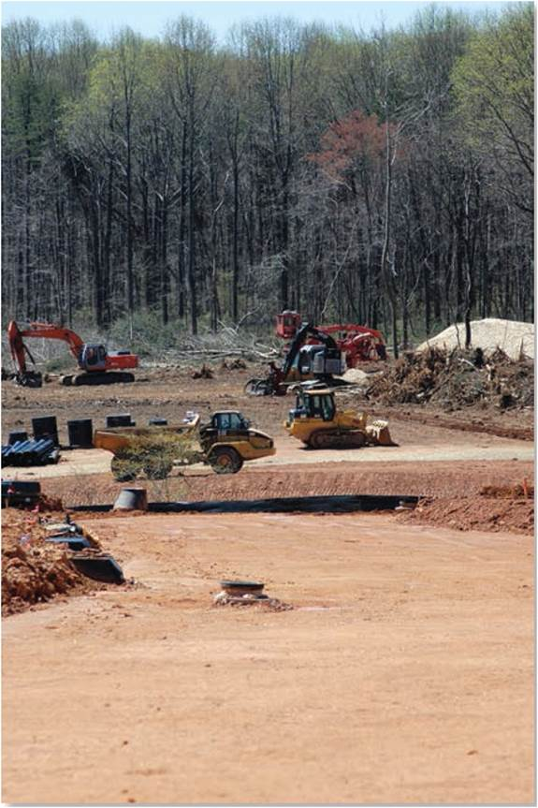
The Third Urban Revolution
Urban sprawl
  Suburbanization of jobs and residences
  Polycentric cities
  Negative environmental impacts with reliance on private auto transport
  Long-term sustainability of sprawl only possible with cheap fuel and lack of environmental concern
Outside Baltimore, Maryland, sprawl creates land cover change and hybrid rural-nonfarm landscape.
Notes:
Figure 16.5

Slide 15
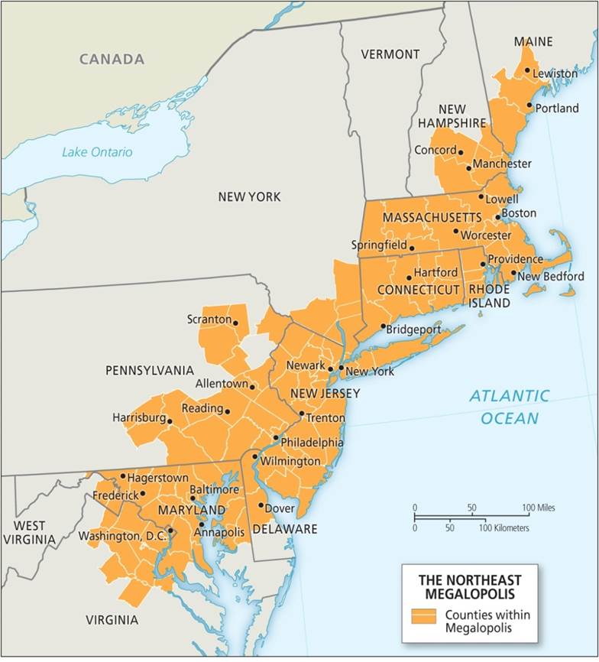
Megalopolis
  Region spanning 600 miles along northern Atlantic coast
  Contains just over 14 percent of entire US
  Overwhelmingly suburban and place of increasing diversity
  Destination for overseas immigrants
Developing in other parts of the USA, Japan, and elsewhere.
Megalopolis, United States.
Notes:
Box 16.2 Figure

Slide 16
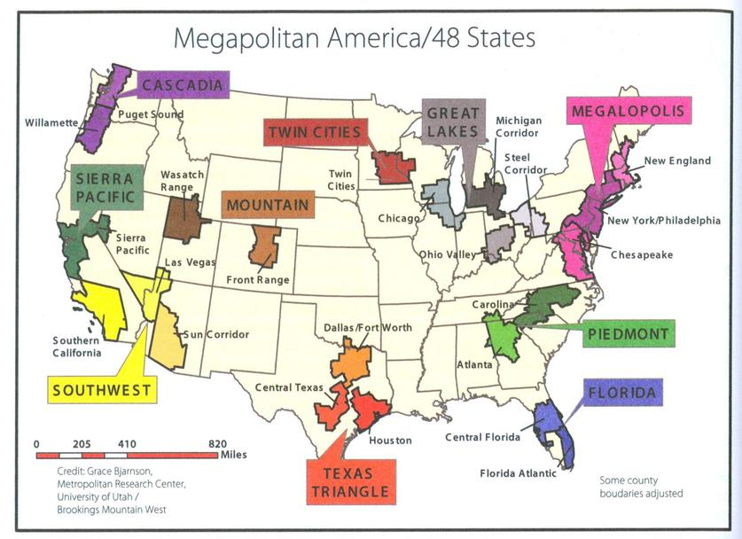
Some new possibilities

Slide 17
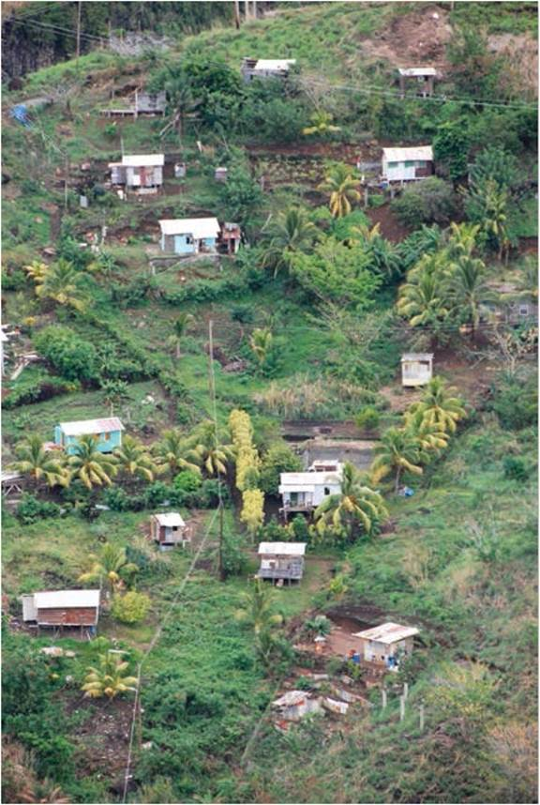
The Third Urban Revolution
Slums of unplanned, illegal, informal housing
  Markets or authorities fail to provide accessible housing
  Poor living conditions
  Vulnerable residential status
  Some upgrade into fully formed city neighborhood
Different types of slums
  From slums of hope to slums of despair
Informal housing on a steep slope on the Caribbean island of St. Vincent.
Notes:
Figure 16.6

Slide 18
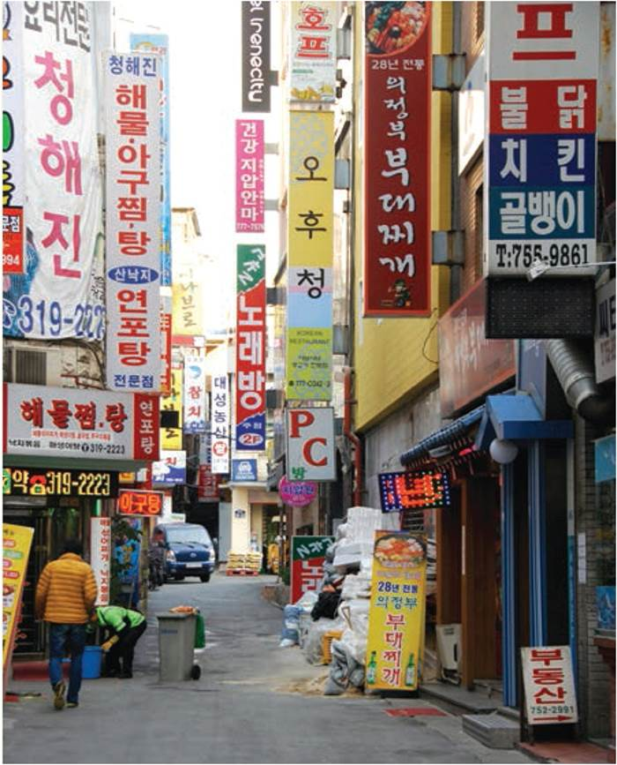
SEOUL
South Korea’s most important global hub
  Enforced export-led economic growth
  Rapid urbanization and environmental damage
  Authoritarian leaders managed development
Dominates Korea’s economy, politics, culture
  Moving toward postindustrial economy
  Ethnic homogeneity and foreign immigration limits
Seoul, an older part of the central city that is rapidly transforming.
Notes:
Box 16.3 Figure

Slide 19
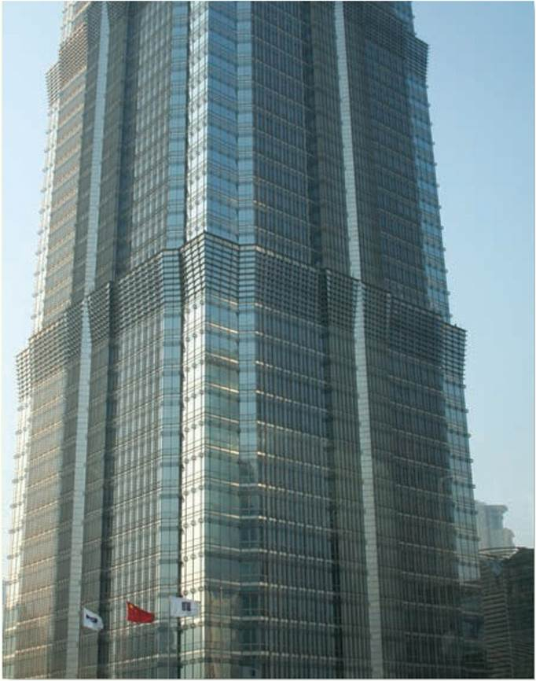
SHANGHAI
Long history as an “open” city
  Colonial port to industrial center
  Targeted under Communist regime for its foreign influences
  Reglobalization as a post-Communist “open” city
Today has infrastructure upgrades and new spaces of consumption
Shanghai. A new skyscraper in the Pudong neighborhood.
Notes:
Fox 16.4 Figure

Slide 20
Chapter Summary
Although people have lived in rural areas for most of history, we can identify three distinct urban revolutions.
The First Urban Revolution occurred between 11,000 and 5,000 years ago and was marked by the development of the world’s first cities alongside settled agriculture, domesticated animals, and complex irrigation systems.
As cities began to develop, so did the need for advanced agricultural practices to supply larger groups of stationary people.
The urban-agricultural revolution actually marked a loss of freedom, greater work discipline, and more time devoted to the drudgery of work and the compulsion of social order.
The distinct pattern of the first cities was marked by a legitimization of social order by locating elites in the center, with poor at the periphery.

Slide 21
Chapter Summary
The Second Urban Revolution began in the late eighteenth century with the creation of the industrial city.
While the first merchant cities developed during the First Urban Revolution, industrial cities dominated the Second Urban Revolution, leading to early capitalism, factory life, class struggle, and unprecedented levels of urbanization.
The Third Urban Revolution of today is marked by five distinct characteristics: rapid urbanization, increases in the size of individual cities, increased metropolitanization, increased urban sprawl, and the proliferation of slums.
A majority of the world’s population is now urban—expected to include two out of every three people by 2050—and in many countries this new urban majority appeared in less than a generation.

Slide 22
Chapter Summary
World’s cities have substantially grown in size during the Third Revolution, with several hundred exceeding populations of one million, more than thirty exceeding 5 million, and the inception of cities with populations greater than 10 million, a new phenomenon known as a megacity.
Technological improvements in transportation have allowed for greater metropolitanization, the dispersal of people and activities away from the tight urban cores of preindustrial and industrial cities.
The vast expansions of urban sprawl during the Third Revolution are now associated with a number of negative environmental impacts, such as lost agricultural land; increased impermeable surfaces allowing for more pollution runoff; and heavy, pollution-emitting vehicular traffic.
The size and number of slums throughout the world have increased due to the inability of formal markets and public authorities to provide enough affordable and accessible housing for low-income populations.

