Slide 1
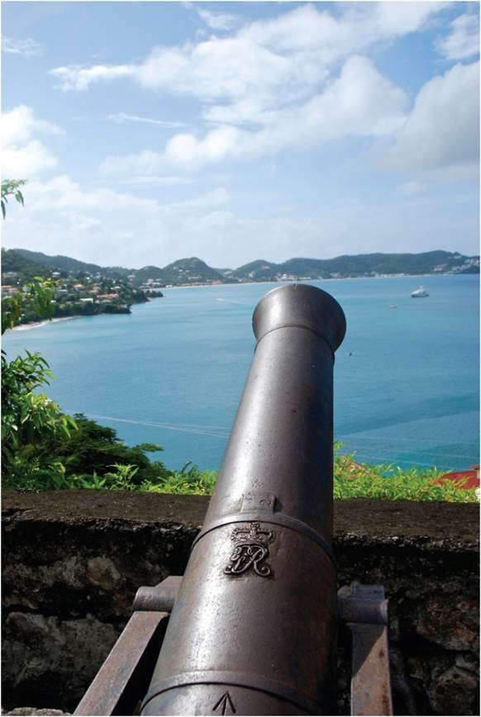
Chapter 14: World Orders
The very earliest form of human society was small groups of extended families that, over time, merged into larger social units, eventually creating such diverse socio-spatial entities as empires, city-states, and nation-states.
Expanded by Joe Naumann, UMSL
Cannon in old British fort in Grenada.
Notes:
Chapter 14 Opener

Slide 2
Chapter Learning Objectives
Summarize the iterations of human societies from their initial small-group forms and into more diverse, complex political forms.
Discuss the rise and fall of global empires and their impact on the current political geography of the world.
Explain how empires promoted global integration as they spread spatially and incorporated a variety of peoples.
Outline examples of the limits to empire, imperial overstretch, and imperial disintegration.
Describe the trends associated with the emergence of a new world geopolitical order.

Slide 3
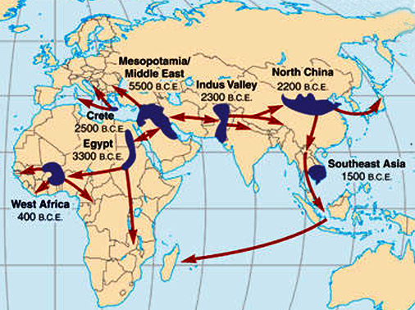
Early Cradles of Civilization

Slide 4
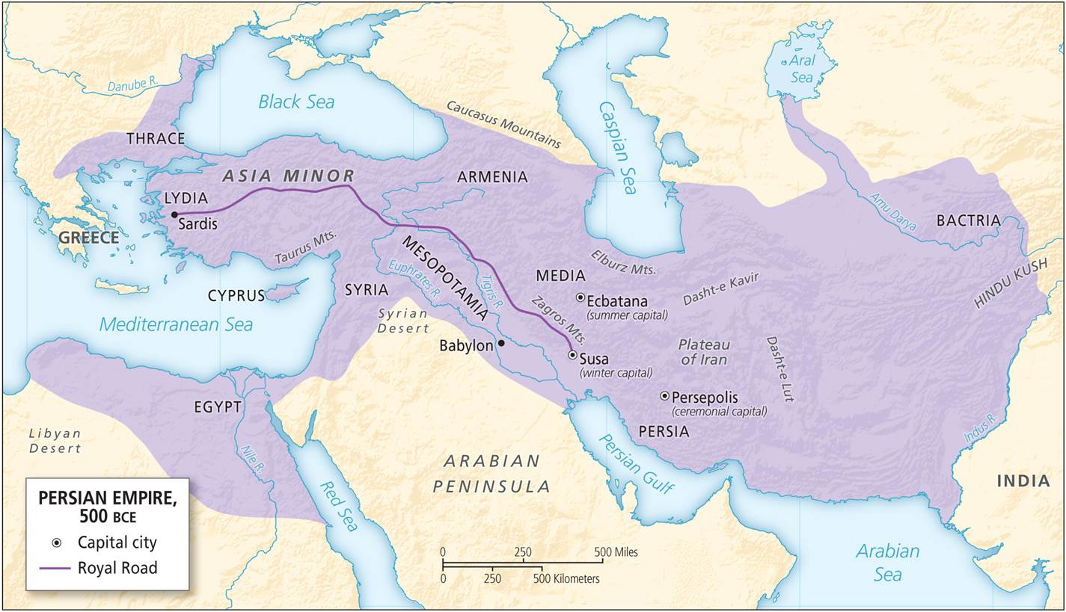
Early Empires
Human society
Early forms of extended families
Over time, larger social units with more socio-spatial structures
Themes from early Mesopotamia
Uruk expansion and decline
Repeating process for empires
The Persian Empire covered a vast area, its spatial expansion aided by greater use of cavalry and better roads.
Notes:
Figure 14.1

Slide 5
Early Empires
Rise and fall of imperialism
With globalization, territorial extent grows and impact of imperial incorporation endures
Empires grow with better transportation and technology
Then distance decay impacts military and political reach
Empires promoted global integration
More recent empires, greater enduring influences
Spatial elements: global integration, imperial overstretch, and imperial disintegration

Slide 6
Global Integration
Early modernity and empires of 1400 to 1800
Empires facilitated movement of peoples, cultures, knowledge, and practices
Push to empire largely driven by economics and access to resources
Core-periphery spatial structure to global political economy is a legacy of this period
Colonization involved rewriting space to show who was in control and who was controlled
Cities and settlements segmented by race
Central spaces of observation and in/out distinctions displayed and maintained colonial power

Slide 7
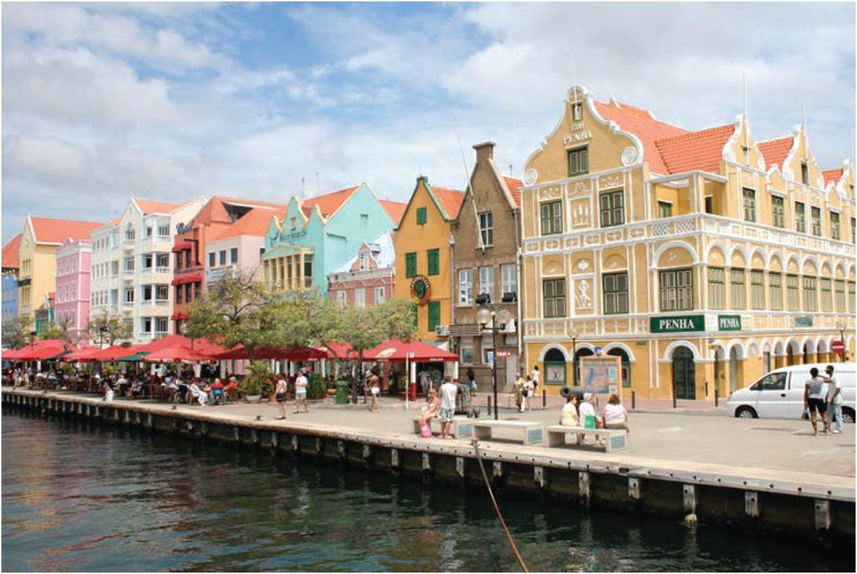
The Caribbean as Imperial Shatter Zone
Changing ownership of island groups
Difficult to control
Sugar colonies
Slave trade
Need for labor
Transformed culture, economics, and politics in the region
Imperialism in the region
Islands had shifting, multiple allegiances
Imperial control still evident in region
Willemstad, Curaçao, retains its Dutch architectural heritage. From 1634, under Dutch control, it was center of the slave trade.
Notes:
Figure 14.2

Slide 8
Global Integration
Local elites reproduce the imperial center
Can encourage and secure colonial rule
Must maintain legitimacy, or colonial powers intervene
Core-Periphery spatial structure
Periphery as source of raw materials and market for goods produced in the core
Basis for subsequent economic development of the core that industrialized at the expense of periphery
Unequal exchange remains between core and periphery; liable for developing world poverty

Slide 9
Global Integration
Age of Imperialism from 1880 to 1918
Scramble to incorporate more of the periphery
Growing competition between core powers
Territorial expansion of US and Russian/Soviet Empire
The Cold War between US and USSR
1947 to 1964: Postwar phase as USSR claimed most of Eastern Europe by establishing communist regimes
1964 to 1979: Phase of détente ends with USSR invasion of Afghanistan
1980 to 1991: Military buildup and escalation
USSR collapse left US as only global superpower

Slide 10
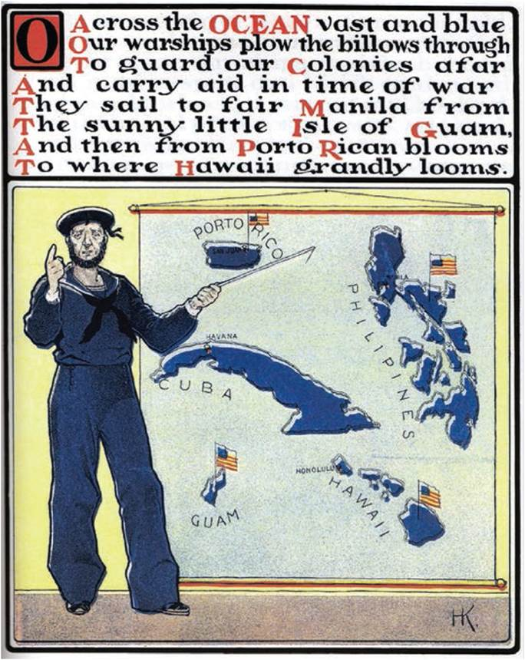
Global Integration
The US ‘Empire’
Not traditional colonial empire
Worldwide military-industrial-security complex of military bases
Visions of global hegemony and order
Less about territory and more maintaining economic connectivity
Economic neocolonialism in the Caribbean and Central America
Teaching the US Empire, 1900.
Notes:
Figure 14.5

Slide 11
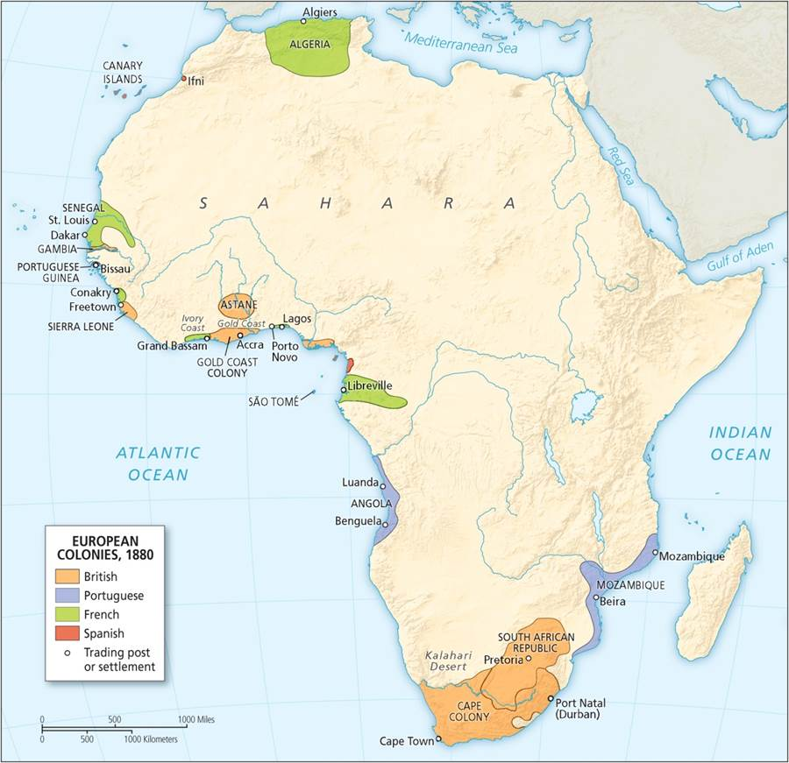
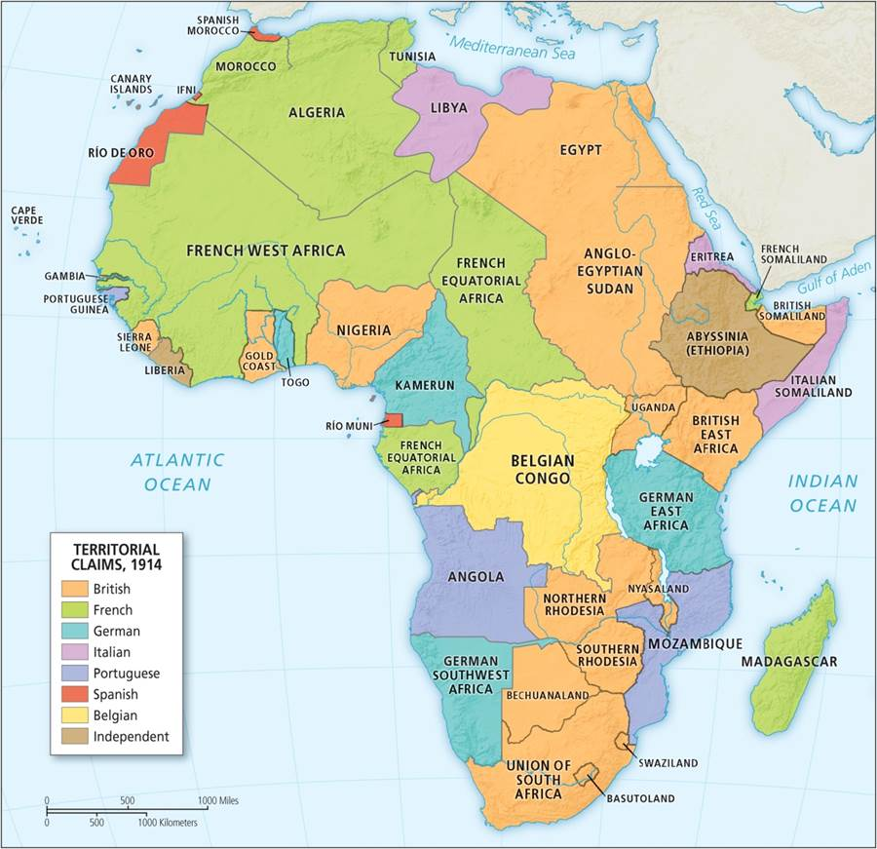
Global Integration
LEFT: Africa 1880 RIGHT: Africa 1914
Notes:
Figures 14.3, 14.4

Slide 12
Imperial Overstretch
Tendency for empires to expand beyond their ability to maintain economic and military power
Limits to empire
Information overload
Fiscal limit and ability to pay for all commitments
Strategic limits, as nature of conflicts change and large powers are slow to change
“Legitimation crisis” emerges when public support is lost, especially for military involvements

Slide 13
Imperial Disintegration
Decolonization
Imperial powers left or lost to independence movements
First wave: 1945 to 1954 in Asia
Second wave in Africa
Colonial borders remained and conflicts reawakened with independence
Irrational boundaries
Lacked knowledge of the physiography and the cultural boundaries of tribes, kingdoms, and empires

Slide 14
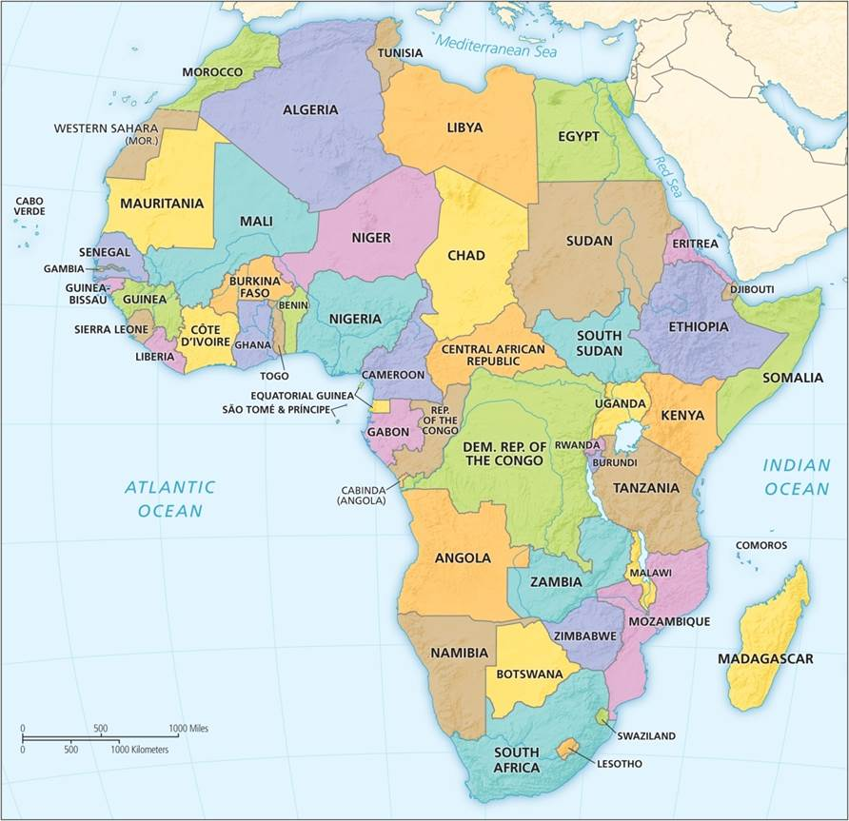
Imperial Disintegration
Political map of contemporary Africa. Compare with Figure 14.3 (slide 10, left) to see the enduring legacy of colonial borders.
Notes:
Figure 14.4

Slide 15
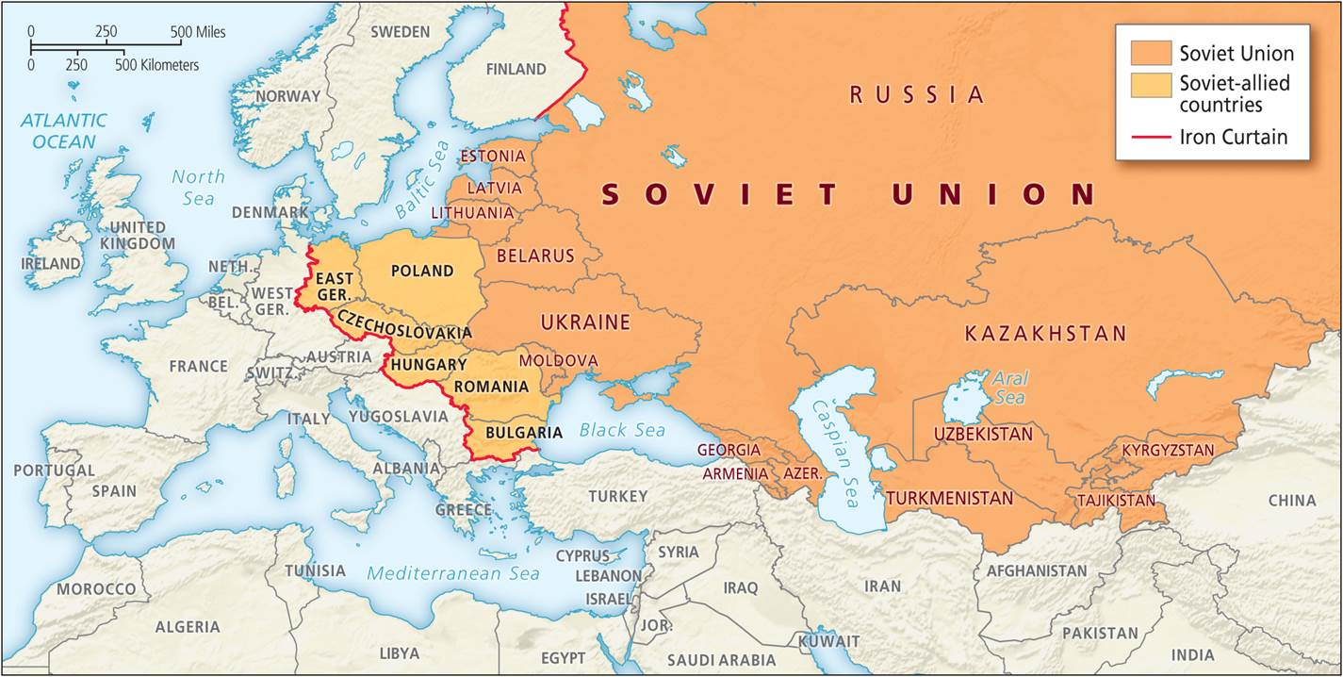
Imperial Disintegration
Collapse of the Soviet Union in 1991
Stopped cracking down on uprisings
Fall of the symbolic Berlin Wall
Former republics left the Union
Variety of new independent countries emerged
The Soviet breakup
Notes:
Figure 14.7

Slide 16
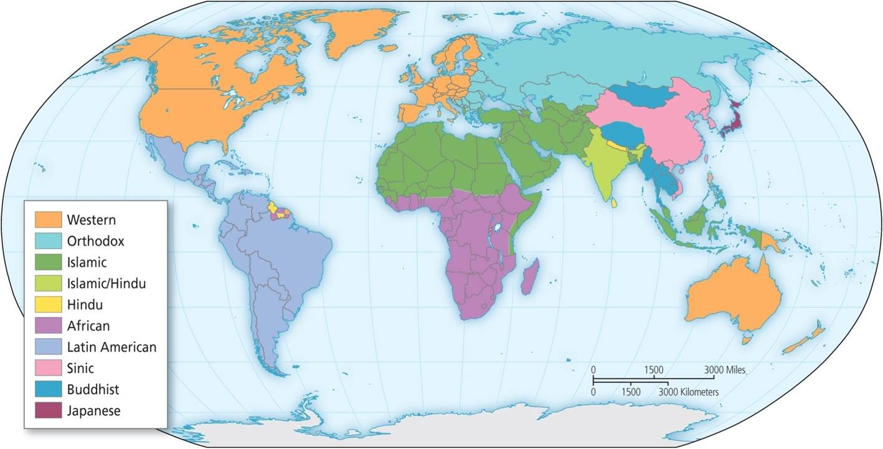
The Clash of Civilizations?
Huntington’s “Clash of Civilizations”
Peoples divided along cultural lines of religion, history, and geography
Nine different types
Criticisms
Real world is more fractured, spatial units more heterogeneous
Arab Spring, the democratic uprisings of 2011, disproved his Islamic world premise
Huntington’s clash of civilizations.
Notes:
Figure 14.9

Slide 17
Elements of a New World Order
Four trends
US as world’s only global superpower
Military and economic hegemony, costs of power
Rise of security groupings and mutual defense organizations
Diplomacy, security, and “peacekeeping forces” of the United Nations, NATO, etc.
Reemergence of alternative power sources to the US
Alternative economic centers that share US goals, like the EU, to economic and military rivals like China and Russia
Rise of non-state actors
Includes social movements, like Arab Spring, as well as transnational terrorist groups, like Al Qaeda and ISIS

Slide 18
Elements of a New World Order
RISE OF CHINA
Second largest world economy
Trade liberalization success
Demand for resources has meant significant investment in South America and Africa
Founded the Asian Infrastructure Investment Bank (AIIB) as alternative to IMF
Military buildup, mostly on regional scale – building islands in the South China Sea
High growth difficult to maintain long-term
Wages are rising in China
Potential political unrest
Other countries reacting and responding to China’s rise

Slide 19
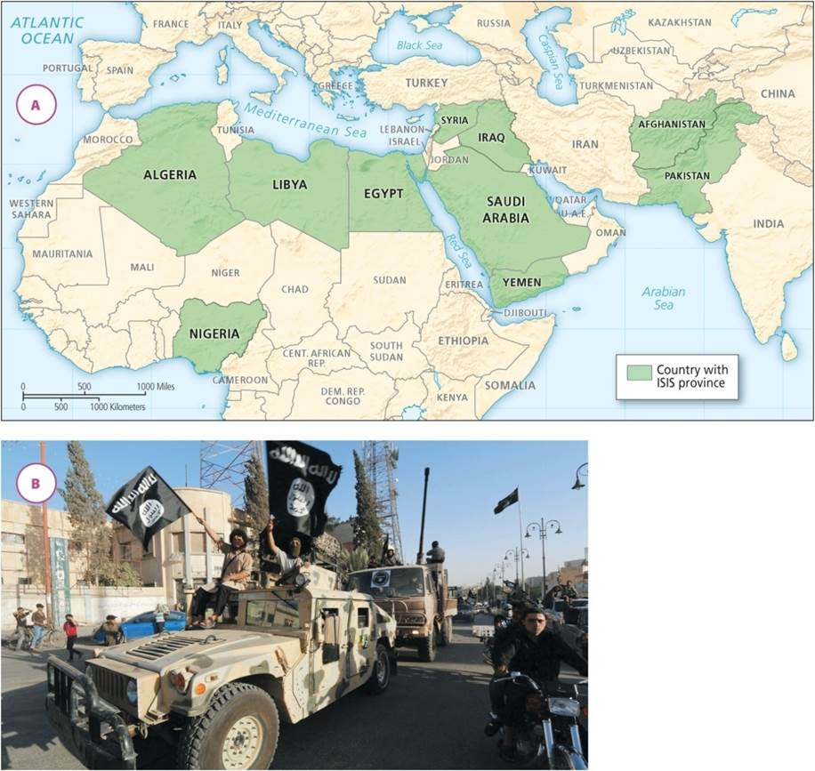
Elements of a New World Order
NON-STATE ACTORS
Al Qaeda
Global terrorist organization with regional offshoots
Promote Islamic fundamentalism against non-Muslims, non-Sunni
ISIS, ISIL, or Daesh
Sunni movement out of post-invasion Iraq
Territorial conquest in region’s failed states
Affinities from alienated Muslim youth in the West
(a) Countries with ISIS provinces; (b) ISIS militants parade through Northern Syria in 2014.
Notes:
Figure 14.10A and B

Slide 20
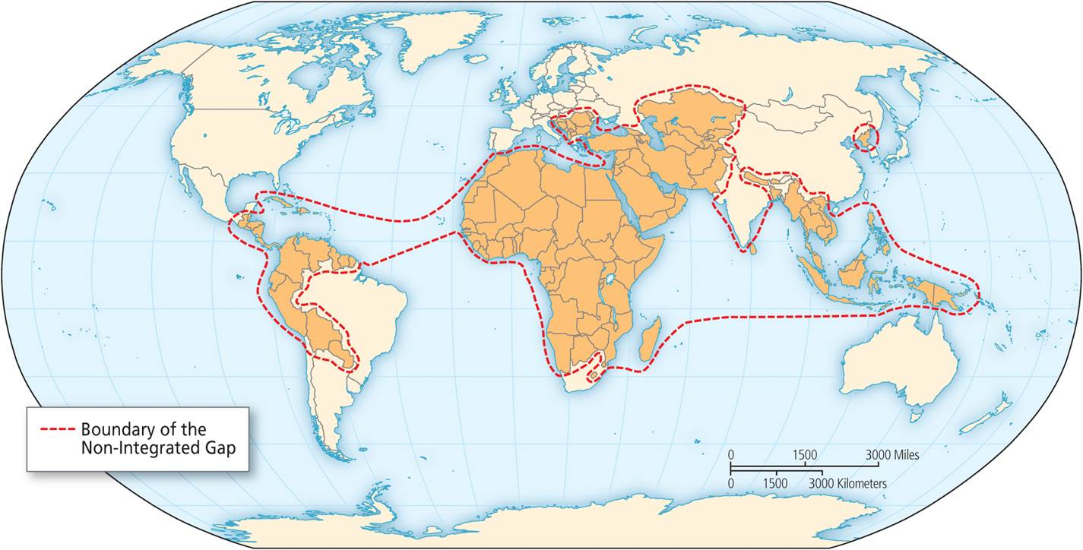
Pentagon’s View of the World
End of Cold War and disintegration of Soviet Bloc made US world’s sole superpower
Pentagon’s worldview
Functioning core of relative stability
Non-integrating gap of instability; places of US involvement
The Pentagon’s world map.
Notes:
Box 14.2 Figure

Slide 21
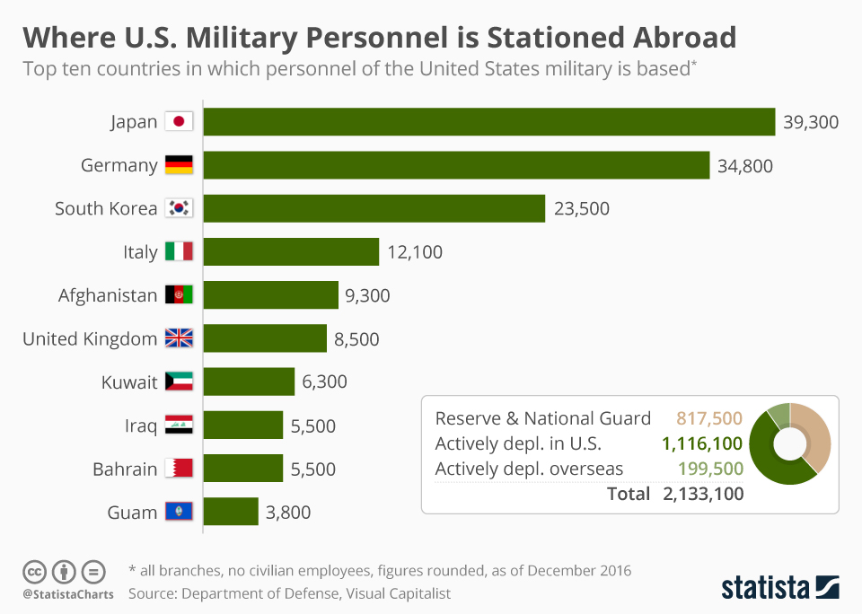
Also as part of NATO force:
Kosovo
Estonia
Poland
Latvia
Lithuania

Slide 22
Chapter Summary
Although the earliest forms of human activity were but small groups of extended families, they eventually merged into larger social units and even highly diverse and widespread empires.
Across time and over space, the same process repeats itself: empires emerge, extend their reach, and then collapse from external pressures and internal conflicts.
Better transport and improved road networks enable empires to extend their spatial reach. Yet empires, no matter how vast, have territorial limits to their power.
Recent empires have greater global influence.
The recent history of empires has three distinct spatial elements: global integration, imperial overreach, and imperial disintegration.

Slide 23
Chapter Summary
Some researchers have identified three broad strategies for the framing of colonial states: producing a plan of urban segmentation that includes racial segregation, creating a fixed distinction between inside and outside, and constructing central spaces of observation to keep an eye on things and to show the presence of colonial power.
Whether in intellectual discourses and practices, such as cartography and mapmaking, or in sports, language, religion, and forms of government, modern empires have integrated much of the world.
The push to empire in the modern world was largely driven by economics.

Slide 24
Chapter Summary
There is a tendency for empires to expand beyond their ability to maintain economic dominance and military power, deemed “imperial overreach.”
Among the numerous limits to maintaining and expanding an empire are information overload, fiscal limitations, and strategic limits.
Although empires may develop into vast economic and geographic worldwide forces, throughout history empires have eventually disintegrated. However, rarely has the process come easily and without dramatic impact on the people and locations left in their wake.
In the emerging world order, important trends include the continuing hegemony of the USA, the growth of international military authorities, the reemergence of Russia, the rise of China, and the danger of non-state terrorist actors.

