Slide 1
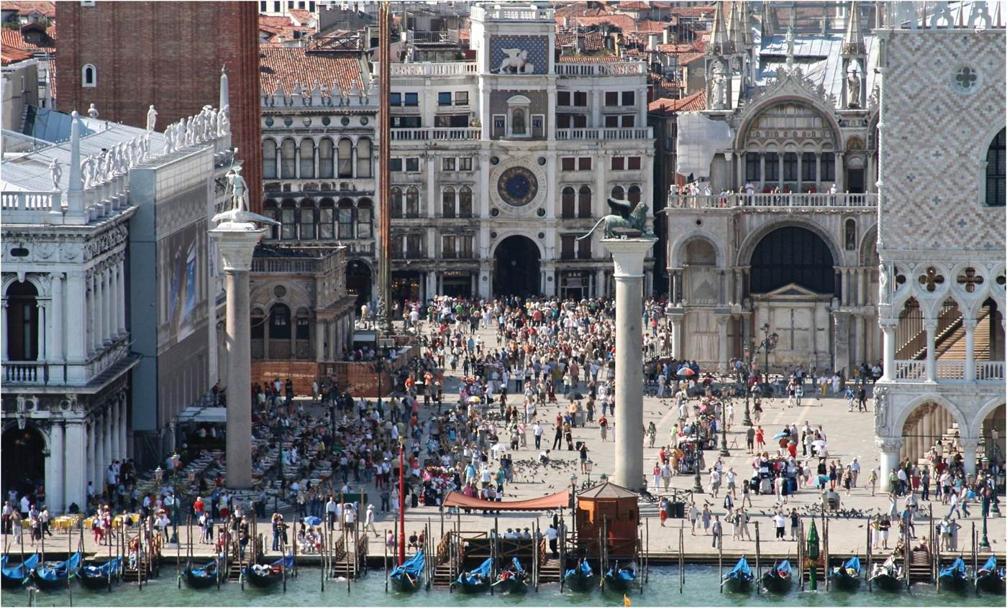
Chapter 13: The Global Geography of Culture
Cultural forms are rarely fixed; they are best considered as circulating flows of ideas and practices that are always in the process of being embedded in place well as diffusing over space.
Tourists in St. Mark’s Square, Venice.
Notes:
Chapter 13 Opener

Slide 2
Chapter Learning Objectives
Understand the concept of the cultural region.
Describe the process of spatial diffusion of culture.
Summarize the sources of cultural production.
Explain how cultural products become deterritorialized or reterritorialized, and cultural practices transplanted or transformed.
Reflect on the global production of culture.

Slide 3
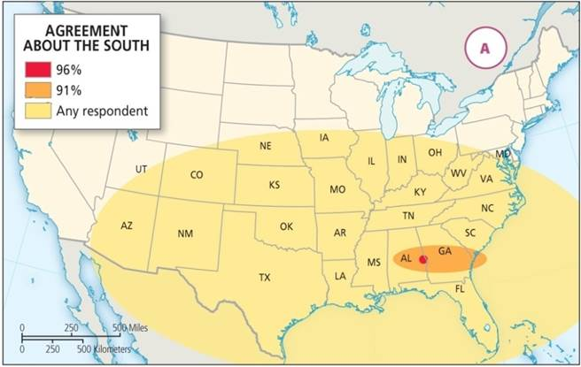
Culture
Culture
  Material things and beliefs, ideas, practices
  Elastic, continually made and remade
Culture and globalization
  Globalization resistance as concerns grow for national and local cultures
  Those groups interact with wider social forces
Levels of agreement about the location of the US South by Michigan and Indiana survey responses.
Notes:
Figure 13.1A

Slide 4
Prof. Joe Naumann’s Definition
Expansion of Preston James’ definition
Culture is the dynamic (ever changing) learned (by observation and teaching)and generally accepted pattern or way of life of a group of people which results from their:
  World view (cosmology)
  Attitudes(conscious and unconscious)
  Objectives
  And technical skills levels
The foundation (deep culture) may be largely unexamined and unconscious. The deep culture is the major shaper of the surface culture traits which are observable.

Slide 5
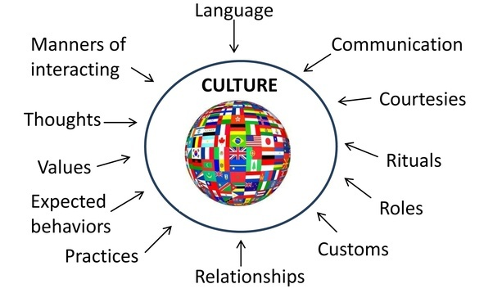
World View
Religion
Technology Level

Slide 6
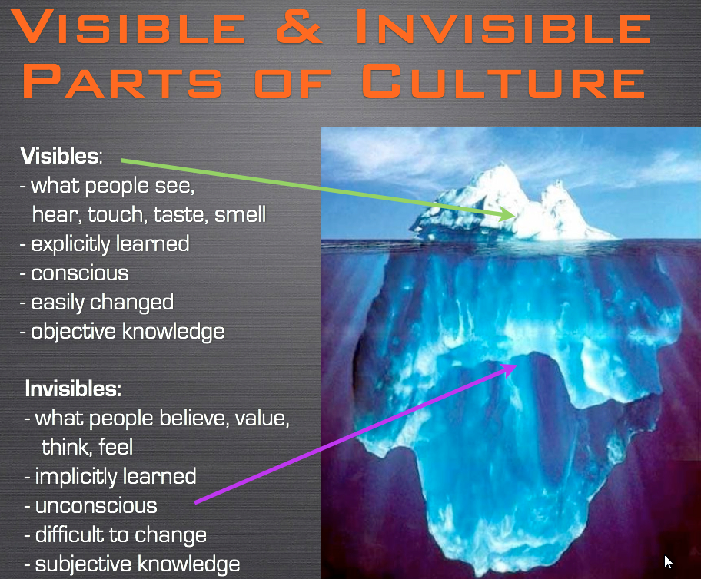
Surface Culture
Deep Culture

Slide 7
Cultural Regions
Cultural or culture region
  Areas with common language, religion, ethnicity, or history
  Boundaries are fluid (transition zones), with a core and periphery
  Exist through self-identification and external perception
  Defining culture can be source of contention, since regions are complex and not homogenous

Slide 8
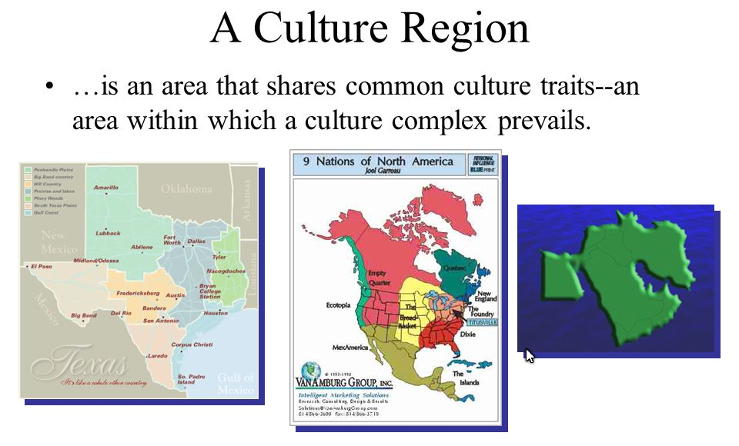

Slide 9
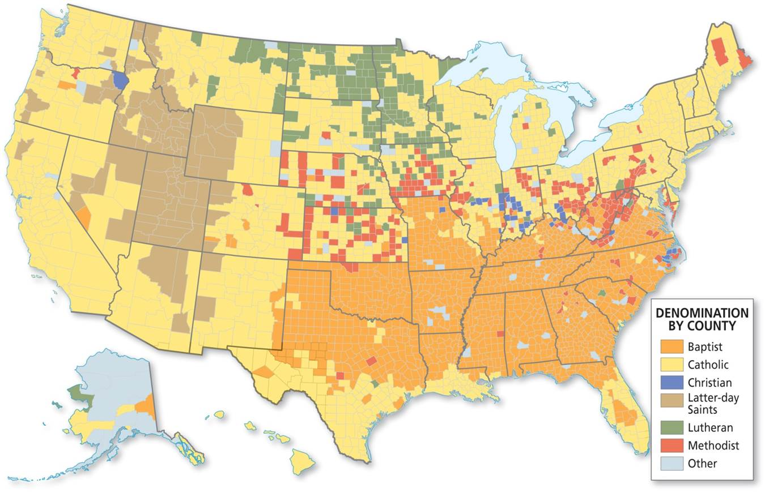
Cultural Regions
Mormon culture region consisting of a core in Utah and Idaho, and a wider sphere from Oregon to Mexico.
Fig 10.9
Notes:
Figure 109.

Slide 10
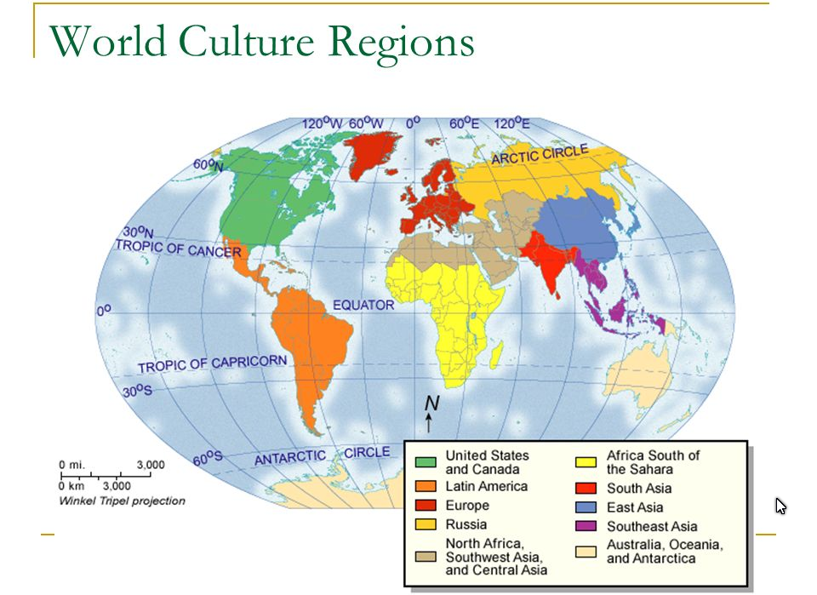

Slide 11
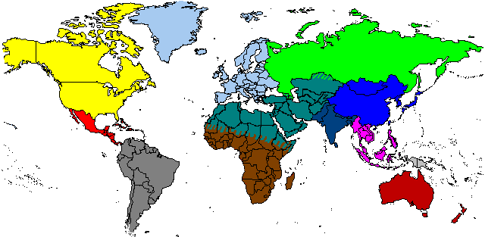

Slide 12
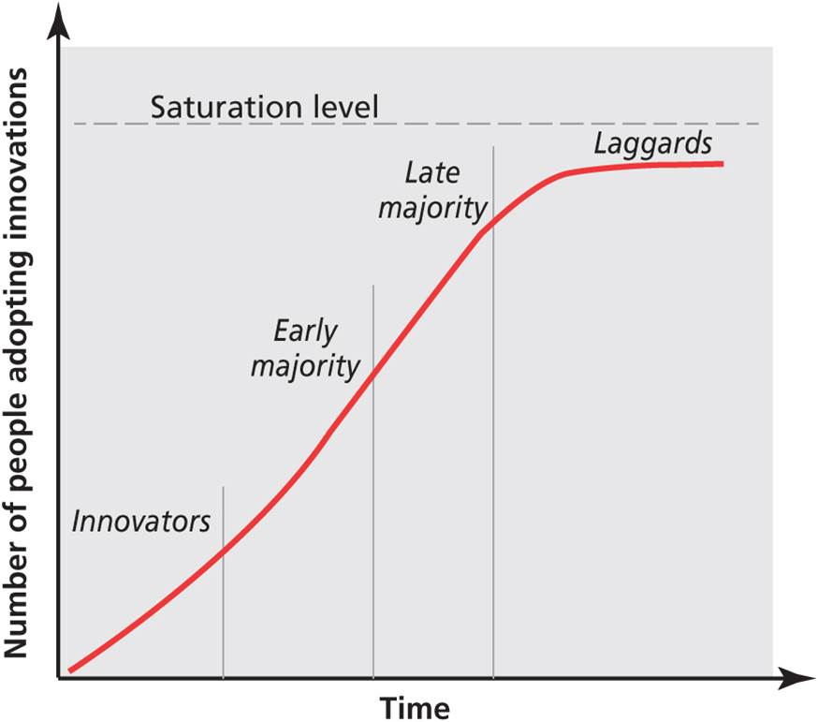
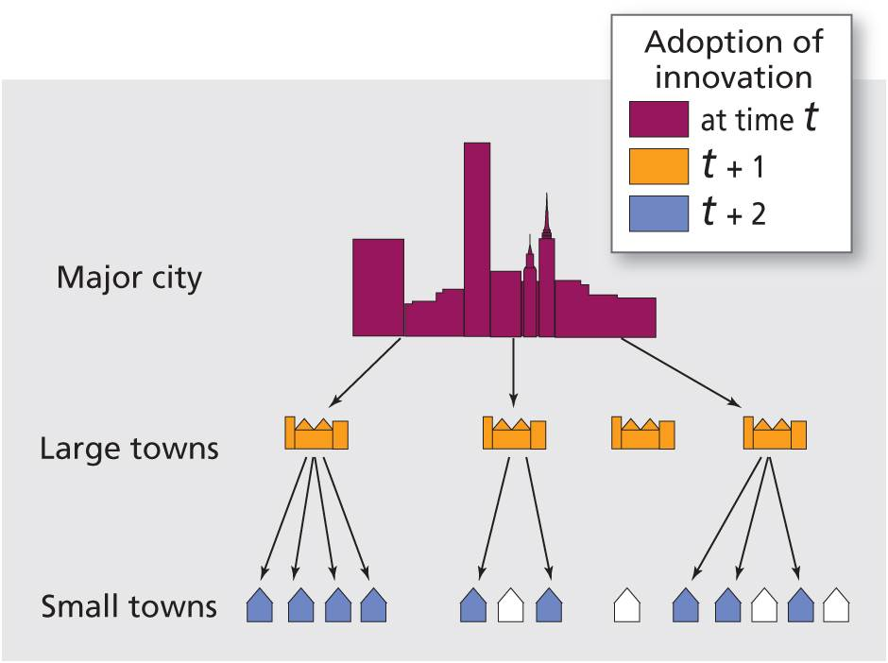
Spatial diffusion
  Movement of new ideas, things, practices through time and space
  Adoption of trend can follow predictable patterns
  Diffusion varies across the urban hierarchy
Notes:
Figures 13.2, 13.3

Slide 13
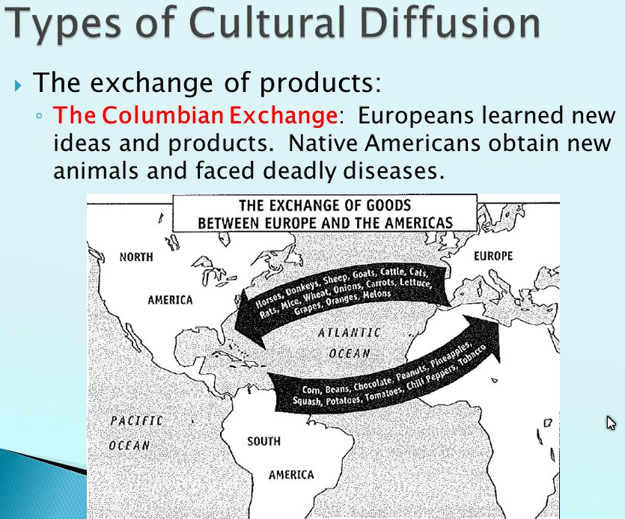
Spatial diffusion
  Paracme refers to a rejection of a former innovation
  Three situations of paracme:
    Symmetry between diffusion and paracme
    Long, slow adoption and quick rejection
    Quick diffusion and slow paracme
Categories
  Contagious
  Hierarchial
  Relocation

Slide 14
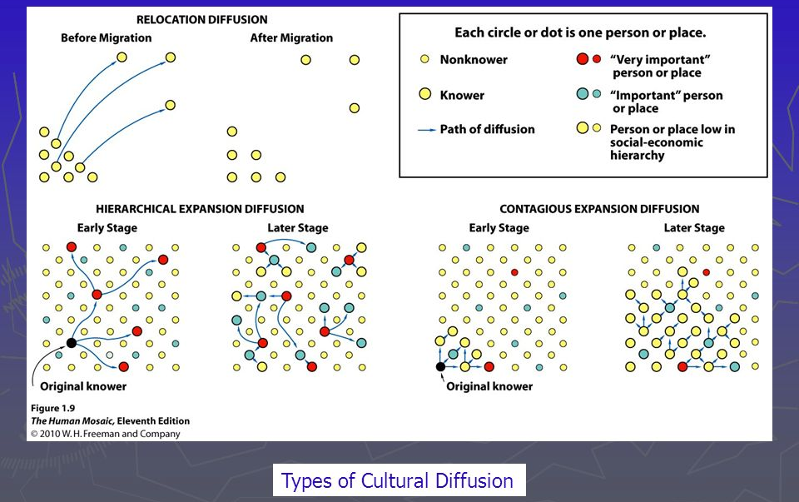

Slide 15
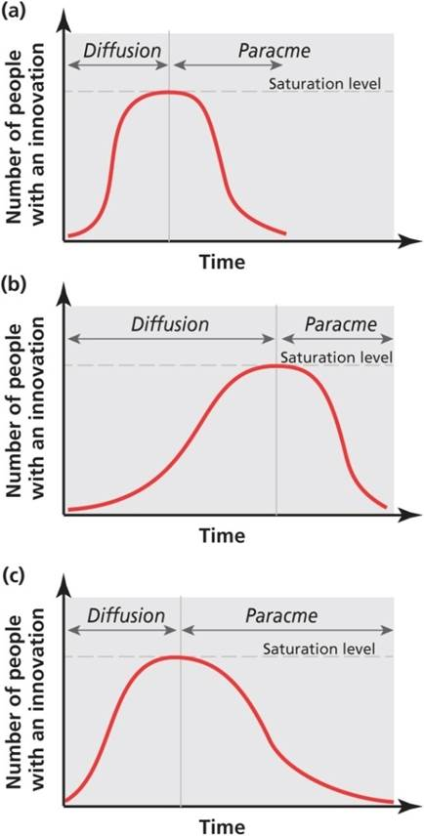
Spatial Diffusion
The three situations of diffusion and paracme.
Example: Bell bottom trousers for men
Introduced in the early 70s – gained acceptance gradually and were quickly dropped when the style changed back to straight-leg trousers.
Notes:
Figure 13.4

Slide 16
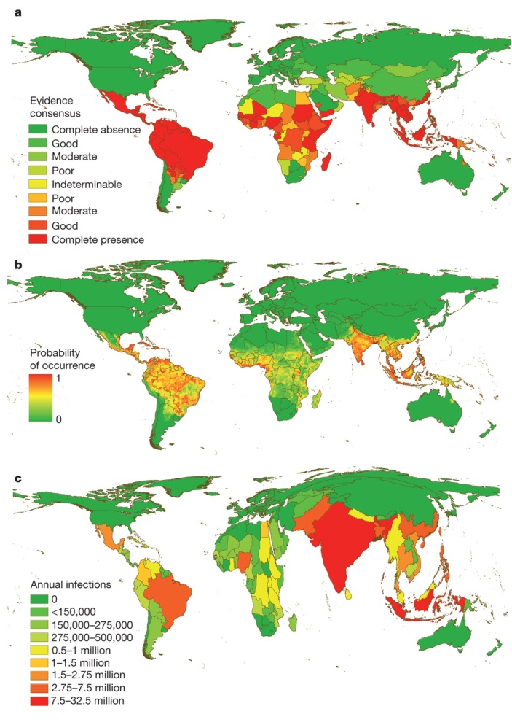
The Diffusion of Diseases
Spread of disease illustrates diffusion and space-time convergence
  As time shrinks distance, disease diffusion increases
  Ease, frequency of transfer for communicable diseases
  Global pandemic potential
Global dengue fever risk.
Source: © Hay on Humanosphere.
Notes:
Source: © Hay on Humanosphere.

Slide 17
Culture as Flow
Culture is active process, not fixed in time and place
  Flows circulate globally, (re)expressed in local contexts
  Territorialization of culture signifies connection between culture and specific places
  Deterritorialization of culture occurs when cultures are lifted from particular places
  Reterritorialization occurs as cultural practices are transplanted and transformed
Importance of international migration communities
  Shape culture of both destination and origin areas

Slide 18
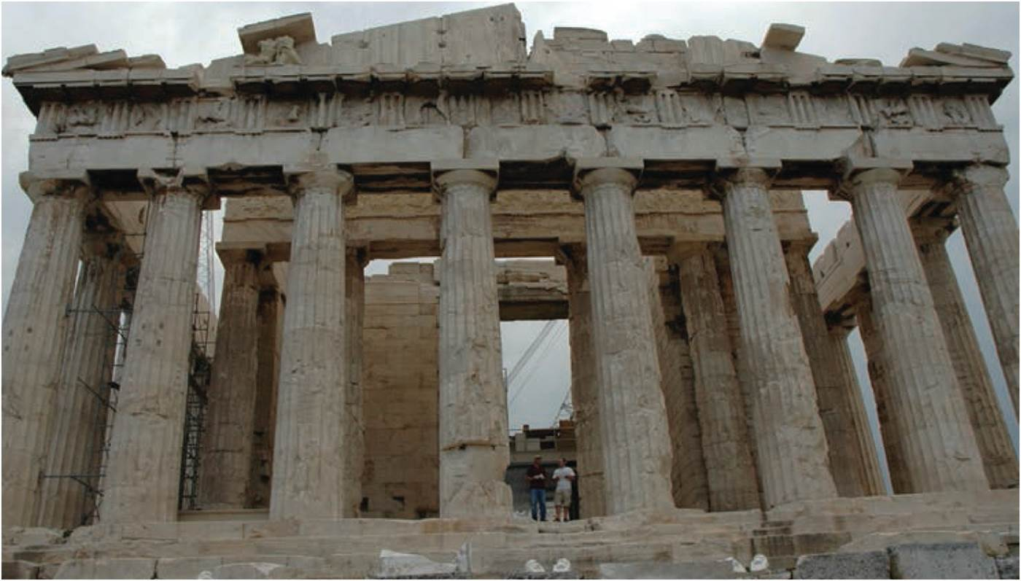
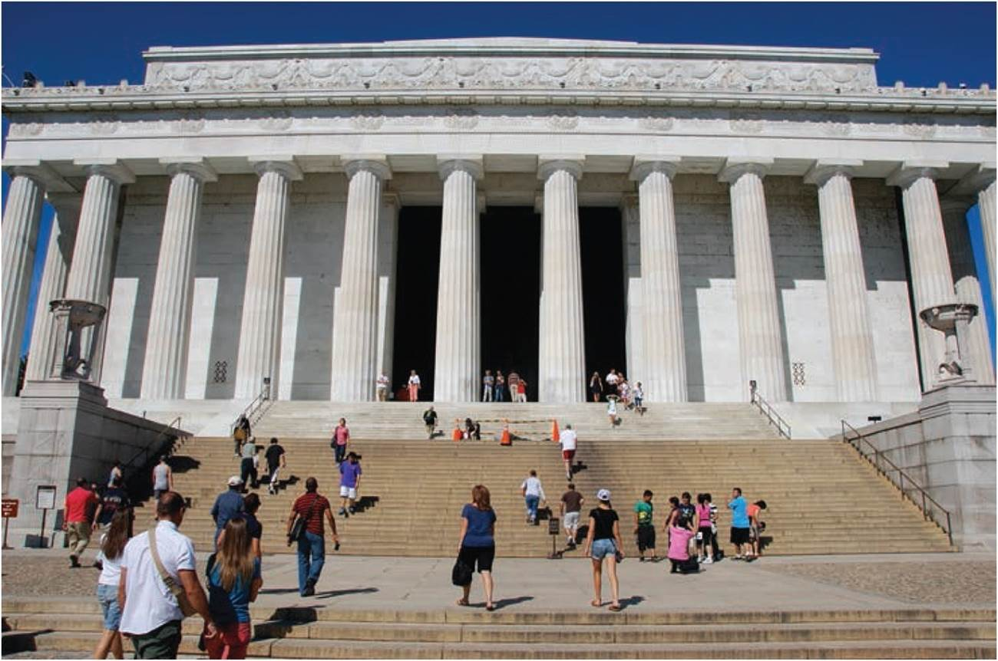
Culture as Flow
ARCHITECTURE
Vernacular architecture uses local resources and traditions
Transnational architectural styles transcend place
  Neoclassical architecture
  Modernist architecture
  Postmodernism forms and Deconstructivism
Notes:
Figures 13.5, 13.6

Slide 19
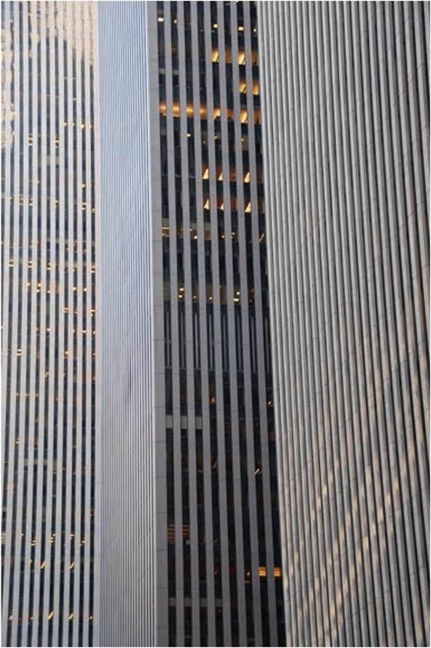
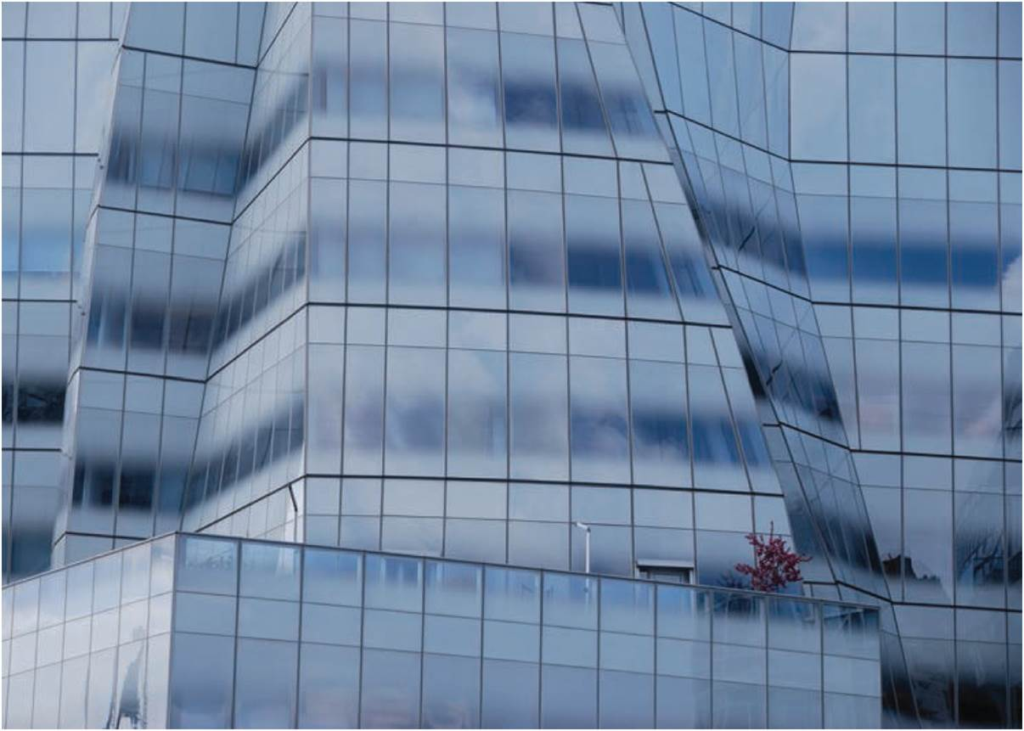
Reterritorialization and Architecture
Postmodern building in NYC designed by Frank Gehry, completed in 2007.
Modernist buildings along 6th Avenue, NYC.
Notes:
Figures 13.7, 13.8

Slide 20
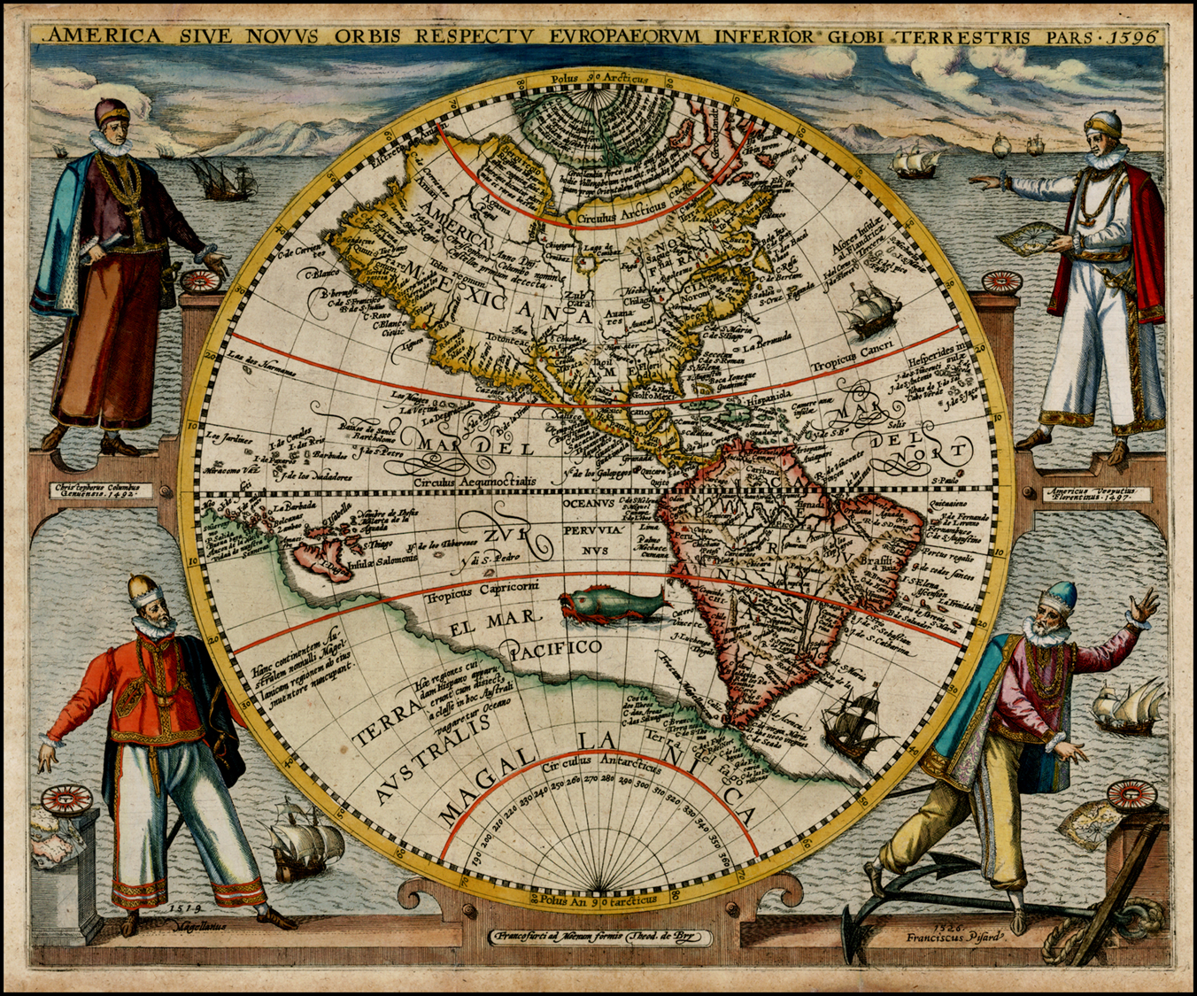
The Global Production of Culture
PRODUCTION OF
GLOBAL SPACE
Two meanings
  Create the understanding of the world’s geography
  Representation of world in cartographic form
Cartographic modernity
  Eurocentric process of creating new, modern forms of mapping
  Interactions with indigenous people
Map of the New World in 1596, by Flemish cartographer Theodor de Bry, featuring four famous explorers.

Slide 21
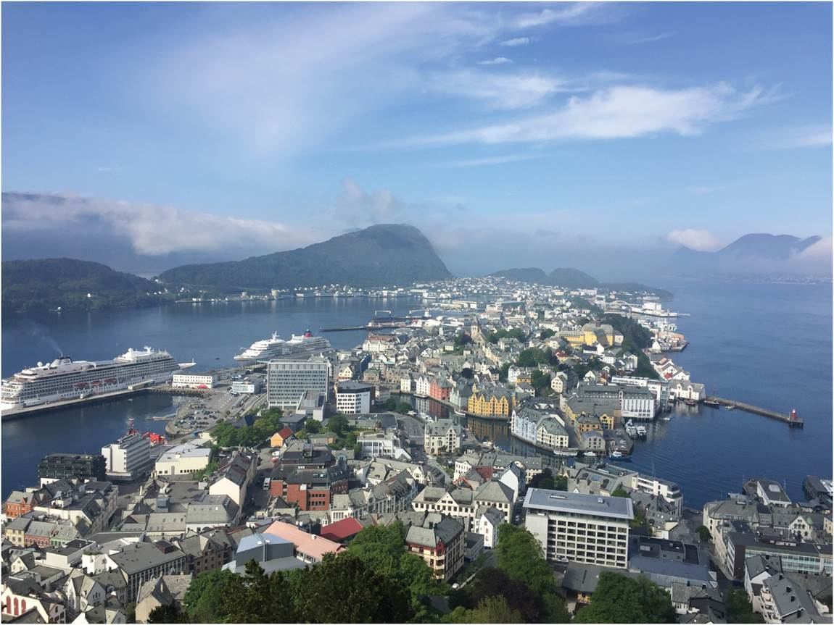
The Global Production of Culture
THE TOURIST GAZE
Global industry and mass tourism
  Space-time convergence and access
  Vast array of tourist landscapes
  Tourist gaze as socially organized, pre-conceived perceptions about place
  Changing meaning of tourist landscapes
Luxury cruise ship visits Ålesund, Norway.
Notes:
Figure 13.9

Slide 22
The Global Production of Culture
PRODUCTION OF GEOGRAPHICAL KNOWLEDGE
Writing and describing parts of the Earth by the globally privileged
  Component of imperialism
Positionality reflects political meanings and operation of military power
  Orientalism is a discourse formed in the writing of non-Western places, or the Orient, by those in the West
  Ornamentalism is a discourse around similarities between elite social groups of East and West
  Occidentalism is a counter discourse of anti-Western ideas

Slide 23
The Commodification of Culture
Selected local cultural forms commodified into globalized forms
  Nature of US culture was appropriate for global audiences
Glocalization
  Worldwide operations attuned to local markets and conditions
    Coca Cola offers locally favored flavors in addition to Coke – Likewise McDonalds
Culture and commerce
  Especially in late stage capitalism, symbolic meaning and association determines economic value of goods
  Range of cultural industries and “cultural-product” sectors

Slide 24
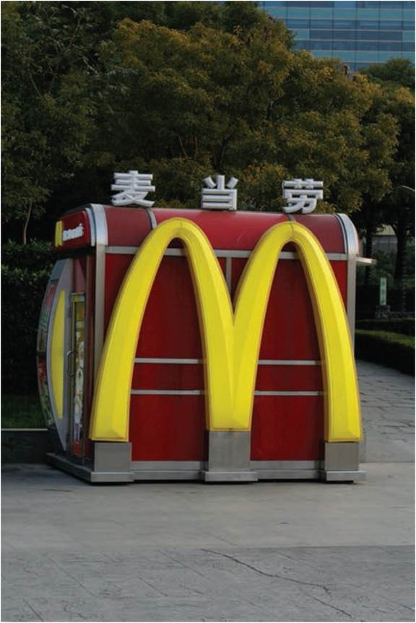
The Myth of Homogeneity
Debate on sameness with globalization
  Homogenization thesis assumes same cultural products are consumed in same ways everywhere
  Yet global culture is consumed within national contexts and local circumstances
Local cultures are being generated and recreated in response to globalization
Fast food in Shanghai.
Notes:
Figure 13.10

Slide 25
Chapter Summary
Cultural regions share similar cultural features such as language, ideas, religion, or practices. Often divided into core and periphery.
Spatial diffusion is the movement across space and time of an innovation, idea, or practice.
Three dynamically linked sources of cultural production: connection with local, relationship with national, and interaction with global.
Whenever a globalization wave sweeps the world, a corresponding revival of concern and promotion of national and local cultures occurs for groups to forge, redefine, or reestablish their place.
Important to consider the process of deterritorialization of culture, in which cultures are lifted from particular places, and the reterritorialization of culture, whereby cultural practices are transplanted and transformed.
Architecture offers examples of the de- and reterritorialization of culture.

Slide 26
Chapter Summary
Two forms of architecture that affect human geography are vernacular and global. Vernacular architecture uses local resources and traditions in the design and construction of buildings, while global architecture can incorporate elements of design from around the world, or have elements that eventually transcend national boundaries and impact cultures and geography around the world.
The world is described from the viewpoints of the West and the East, often referred to as Orientalism and Occidentalism.
The commodification of selected cultural forms has transformed some local cultures into globalized forms, while allowing other local cultures to influence global cultural forms.

