Slide 1

Chapter 11: The Geography of Language
Language is an important part of culture that is intimately connected to place and space. We make sense of the world by naming places and spaces.
Expanded by Joe Naumann, UMSL
Street Philadelphia. sign in
Notes:
Chapter 11 Opener

Slide 2
Chapter Learning Objectives
Summarize the various influences of culture and locality on the development of language.
Consider how languages get distributed through global political and economic interactions.
Describe the differences that emerge in spoken languages and the variation in usages across assorted spaces.
Discuss the important role of language in national identity and politics, with consideration of the spoken and written word.
Reflect on the reasons for contemporary losses in linguistic diversity and the ways that populations are responding.

Slide 3
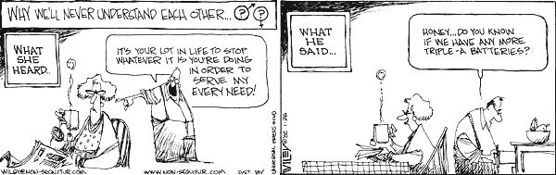
Language & Religion
Two most important forces that bond and define human cultures – act as filters of the input from the real world that unconsciously affect the perception of reality that results in the human brain.
Two most important factors defining culture regions

Slide 4


Subconscious Filtering of Objective Reality
Other filters: political philosophy, economic philosophy, gender roles, etc.
Language filter: the words available to express the stimuli which reach the human brain
Religious filter: cosmology, attitudes, objectives, evaluation of the “human condition,” concepts of “right and wrong,” etc.
Objective reality
Individual’s Perception of reality
Individual #1 sees pornography
Individual #2 sees artistic beauty

Slide 5
Languages’ Limitations
Difficulty expressing abstract concepts such as “LOVE” - If I say, “I love my wife,” you can’t really know what is in my head and the specific emotions that I connect with that word, and visa versa.
Translating from one language to another may lack precision.
  Inuit may have a dozen words for “snow” (in Alaska, knowledge of the specifics of snow may be a life or death issue) whereas English has one (because it’s not a life or death issue).
One language may not have a word with the identical meaning as another language. Spanish doesn’t have an identical word for “like” the Spanish literally say, “It is pleasing to me.”

Slide 6
A legitimate Question
Can any human being ever know objective reality?
Even if some one could do that . . . .
Does any human language have an adequate vocabulary with which to express that reality”

Slide 7



Difficulties
Speaker Harold says, “I’m anxious about the interview tomorrow.”
Hearer Joe thinks that Harold is nervous about the interview.
The reality may be that Harold is on the verge of a panic attack – it’s far more serious than being nervous.

Slide 8
Defining Language
Pronunciation and combination of words (sounds) used to communicate within a group of people
Important cultural index
Structures individual perception of world
Language is a flawed means of communication; however, it is the best means we have at our disposal.

Slide 9
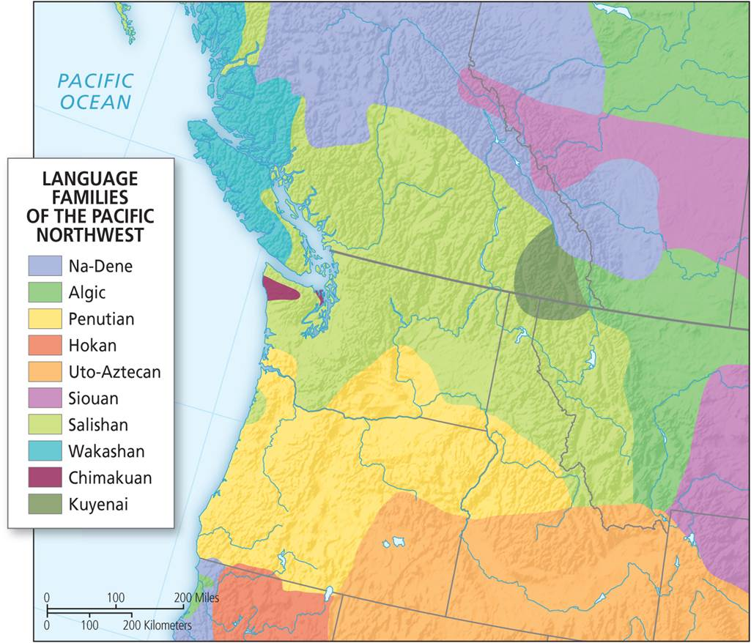
The Geography of Language
Rooted in place, but emerges from spatial diffusion and contact
Language of the Local
  Connected to specific places, local geographies as a speech community
  Way of understanding and describing the environment
Complex linguistic map of indigenous languages of the Pacific Northwest.
Notes:
Figure 11.1

Slide 10
The Distribution of Languages
By the numbers
  6,000 to 7,000 world languages
  Areas of high linguistic diversity
  Languages diffused over large areas
Diffusion of language
  Trade and multilingualism
Main language groups. Half the world’s population speak only ten languages.
Notes:
Figure 11.1

Slide 11
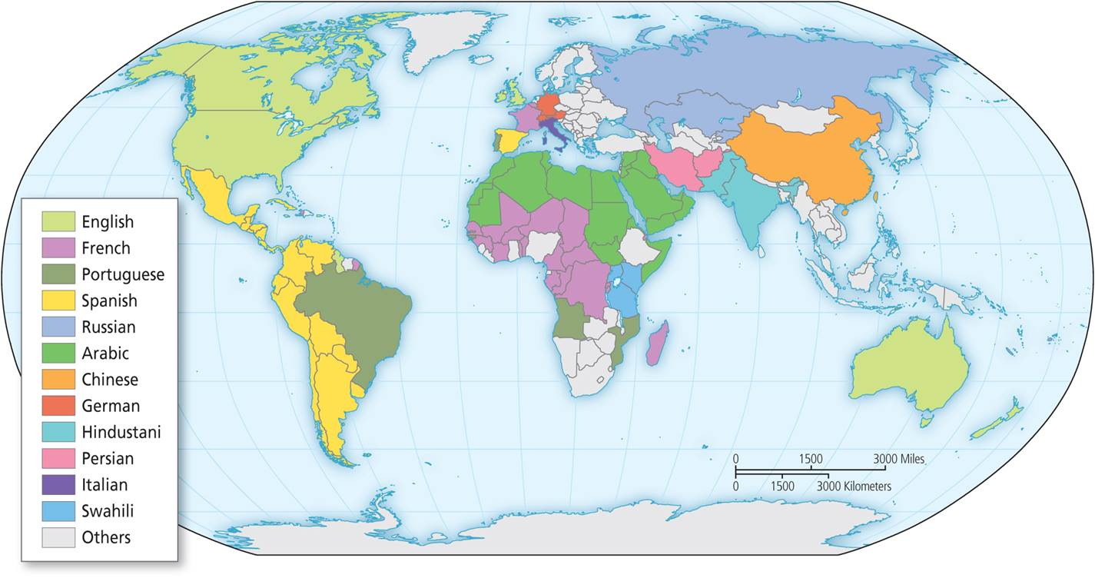
The Distribution of Languages
Core cultural region of dominant languages
  Dominant versus global languages
  Certain languages are highly localized, others more diffuse
  Degree of multilingualism
Current distribution of dominant languages in the world today.
Notes:
Figure 11.2

Slide 12
Distribution of Dominant Languages
Notice how certain languages are highly localized in particular countries: Chinese in China and Hindi in India. Others are more diffuse, like Arabic spoken across the Middle East and North Africa.
Notes:
Figure 11.2

Slide 13
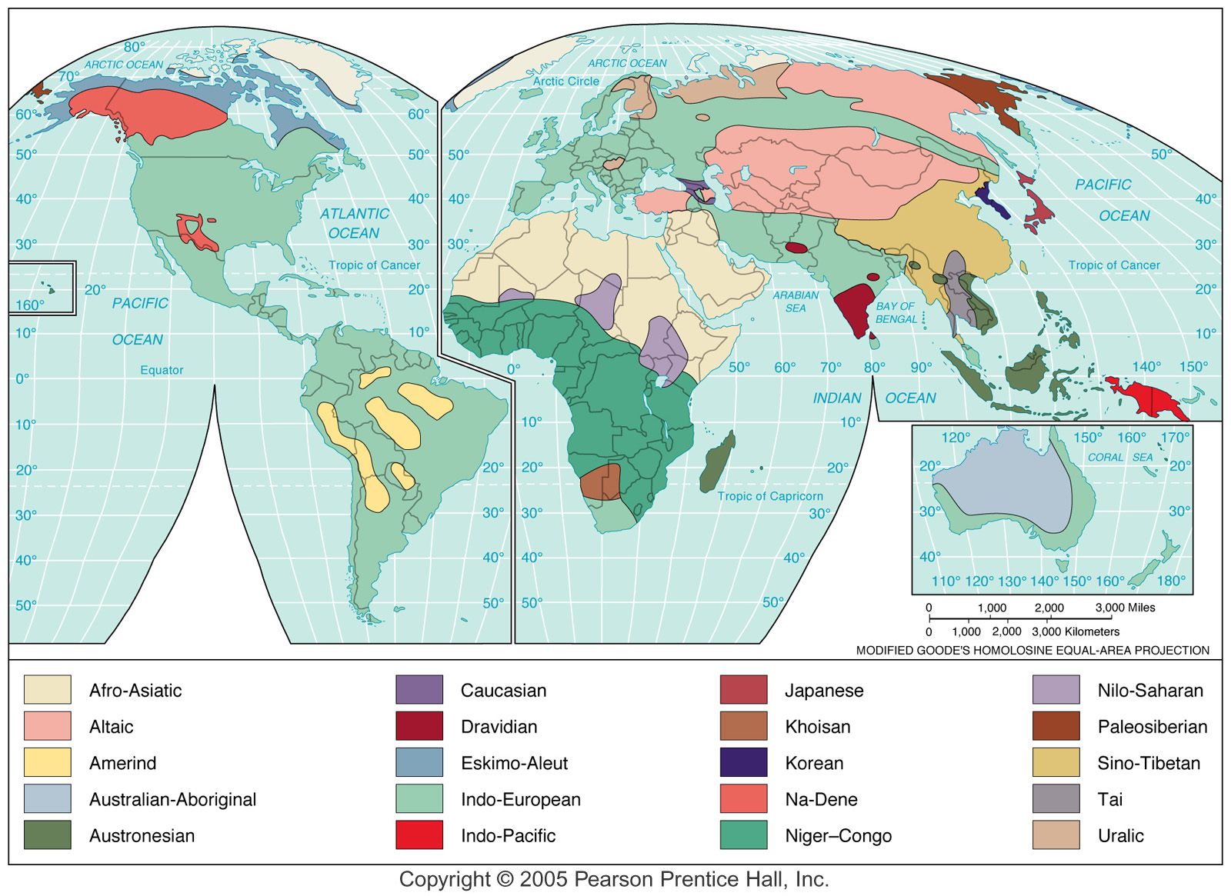
Language Families

Slide 14
Language and Power
Language as a marker and legacy of power
Empire and elites
  Roman Empire and European language geography
  Muslim empires and Arabic
  Colonial diffusion and imperial incorporation
Dominant world languages. The language areas shown are in large part results of imperial expansion.
Notes:
Figure 11.2

Slide 15
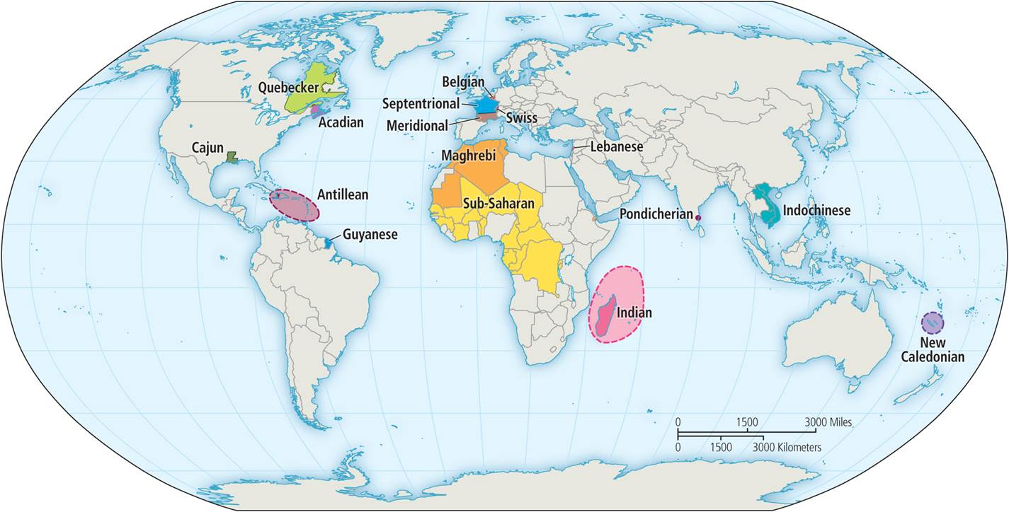
Language and Power
Naming the world
  Turns space into place
  Not innocent of politics
3 basic toponymic eras
  Indigenous, Colonial, & Postcolonial
Toponymic colonialism
  Colonial naming replaced many indigenous names
  An act of appropriation and control
Dialects of the French language in the world.
Notes:
Figure 11.3

Slide 16
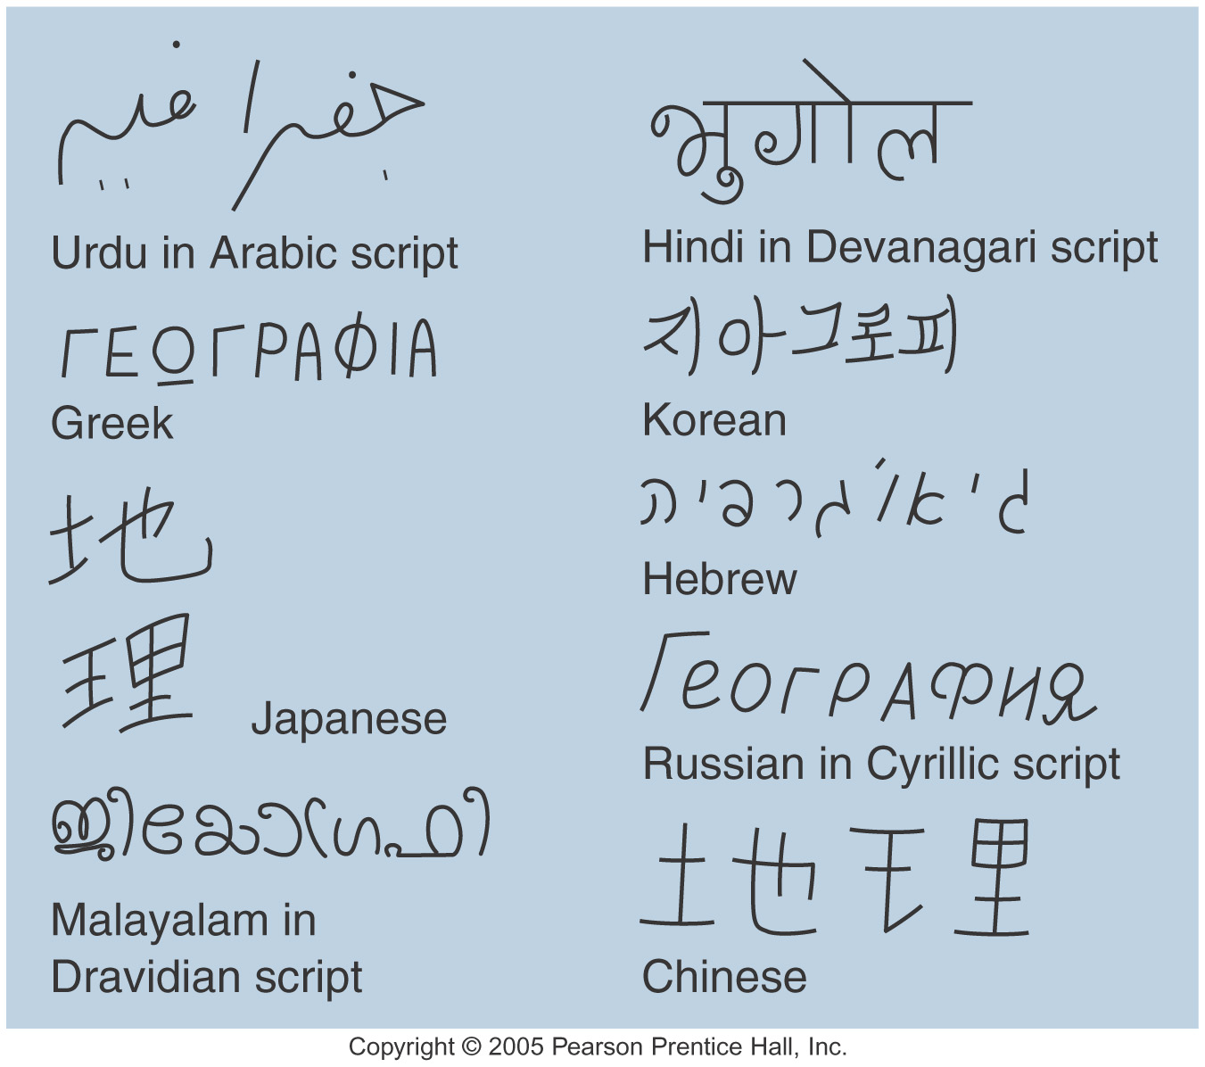
The same spoken language but different scripts
Related
script

Slide 17
Language and Power
Naming the seas
  Contentious since no simple hegemony over naming rights
  Must be globally intelligible and have postcolonial sensitivity
Decolonization
  Upon independence, rename the landscape
    Break up of the Soviet Union
    End of Communist Party in Russia

Slide 18
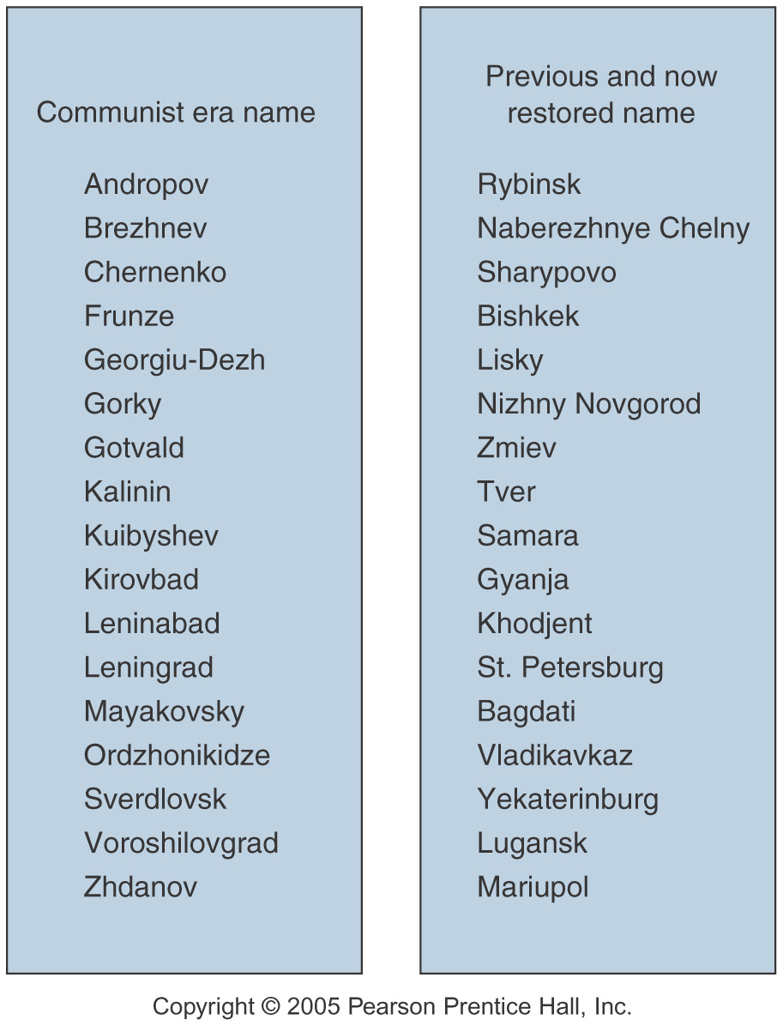
Political Change & Name Change

Slide 19
Language Regions
Dialects
  Minor variations within a language
Standard language
  Following formal rule of diction and grammar
Official language
  Primary language for any given country
  Defacto or Dejure? USA English – Defacto, not Dejure
Lingua franca
  Current language of international discourse

Slide 20
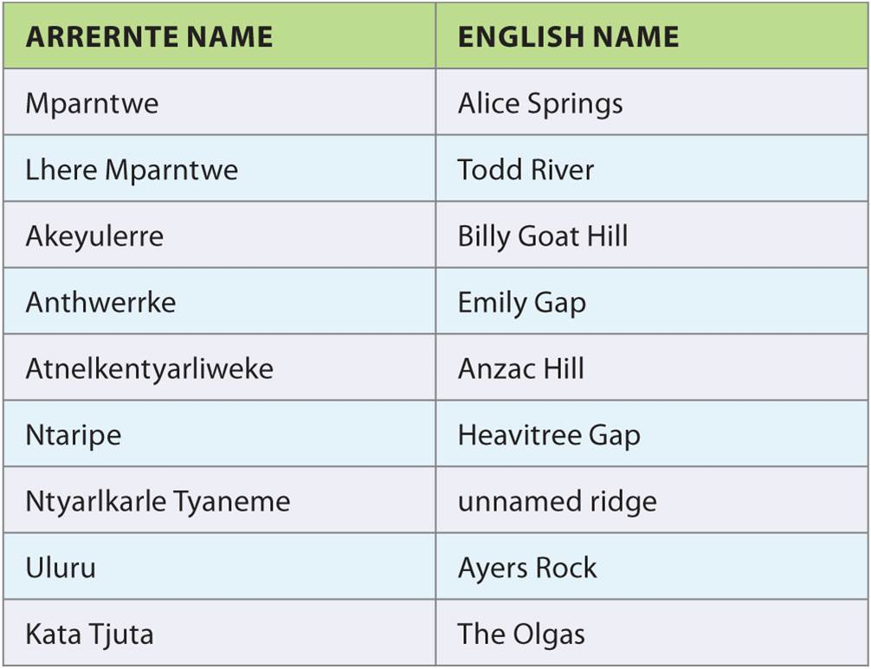
Language and Power
Table 11.2
Toponymic Colonialism in Central Australia.
Notes:
Table 11.2

Slide 21
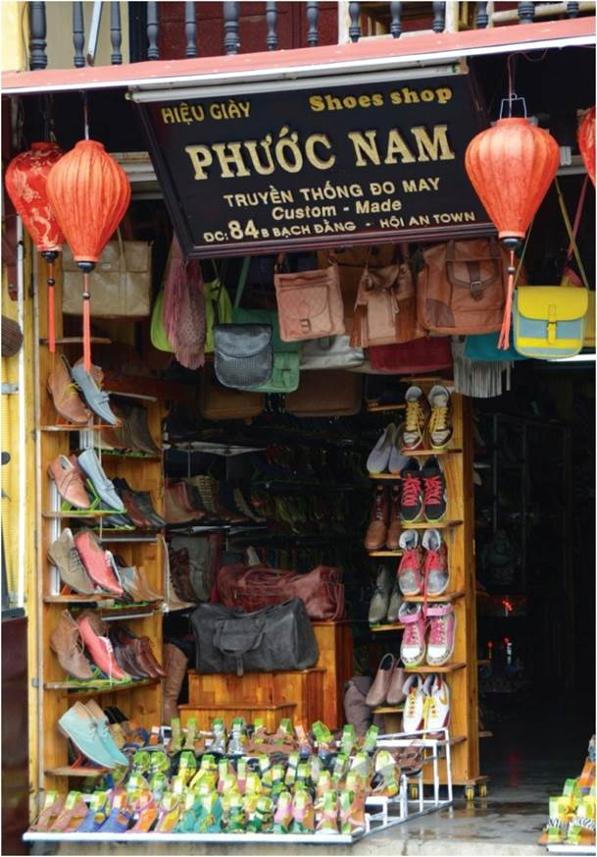
Language and Power
Contact languages from interaction of commercial and political empires
  Pidgin is simplified, used for communication between different languages
  Creoles form between dominant and local languages, they are adopted permanently
    i.e. Creole in Louisiana
Commercial street sign in Hoi An, Vietnam.
Notes:
Figure 11.5

Slide 22
The Regional Geography of Language
Dialects are localization of language
  Dialect maps come from mapping varying enunciation or terms
  Regional variation and function of time
  Social connotations and political power
  Variations within regions
American English would be considered a dialect

Slide 23
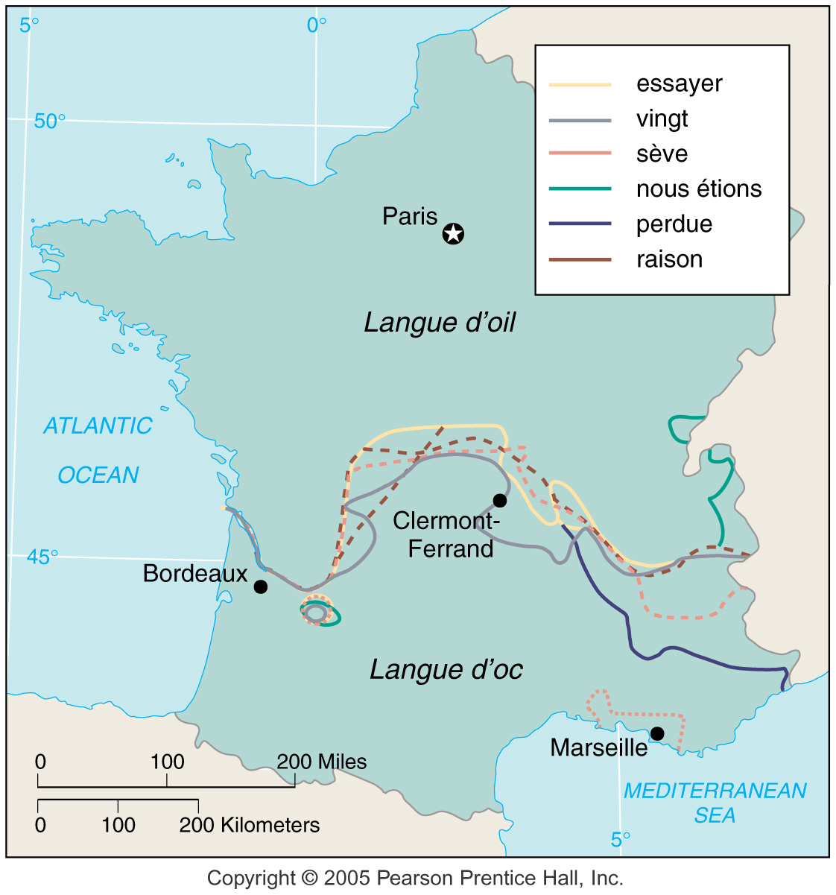
Isogloss is used to establish boundaries among dialect regions – in reality, the boundaries are transition zones
ISOGLOSS

Slide 24
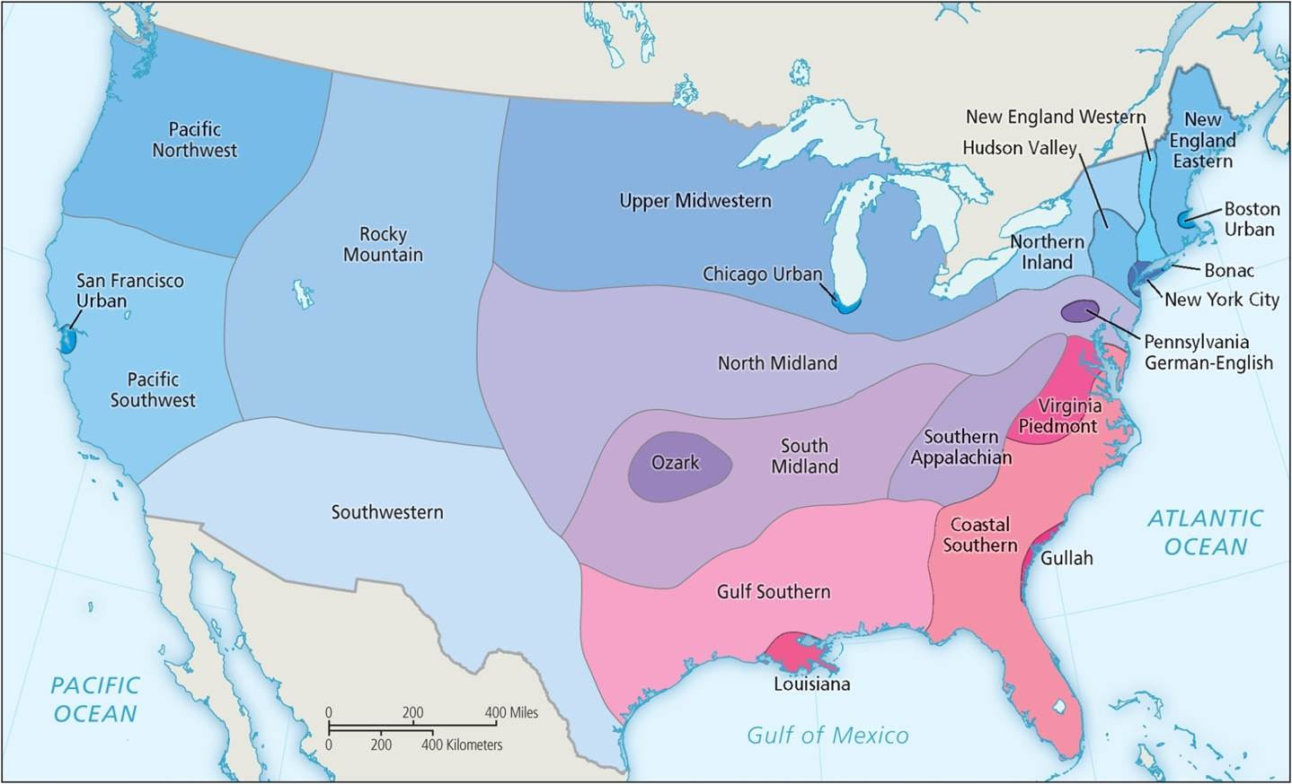
The Regional Geography of Language
Dialect map of the USA.
Notes:
Figure 11.7

Slide 25
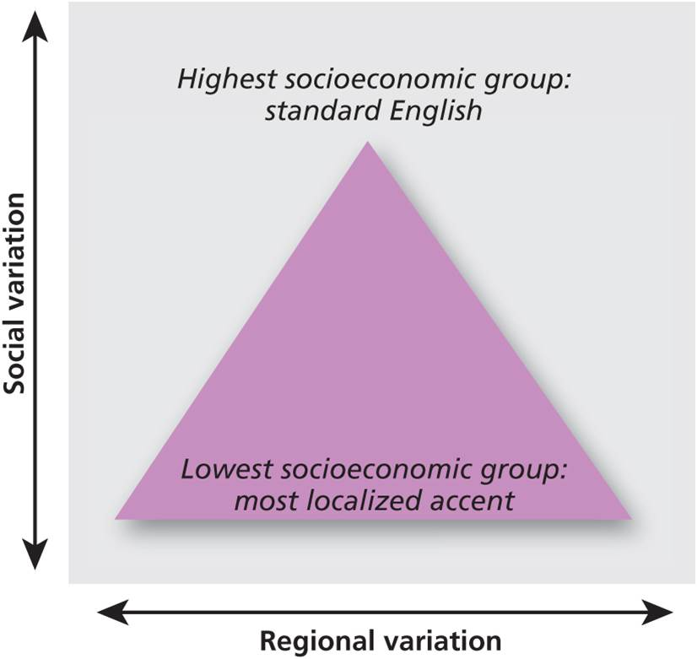
Language, Place, and Social Differences
Social geographies of language
  Variation occurs by social differences
  Embodied in different ways of speaking
  Socioeconomic status, gender, and age
Social and regional accent variation.
Notes:
Figure 11.8

Slide 26
The Place of Language
Importance of place in language use
  Language use change by context
Language domain
  Context by place, role, and topic
  Performance depends on role being played
  Informal and formal domains
Disglossia
  Two or more varieties of language in a speech community
Code switching
  Different languages used in different domain

Slide 27
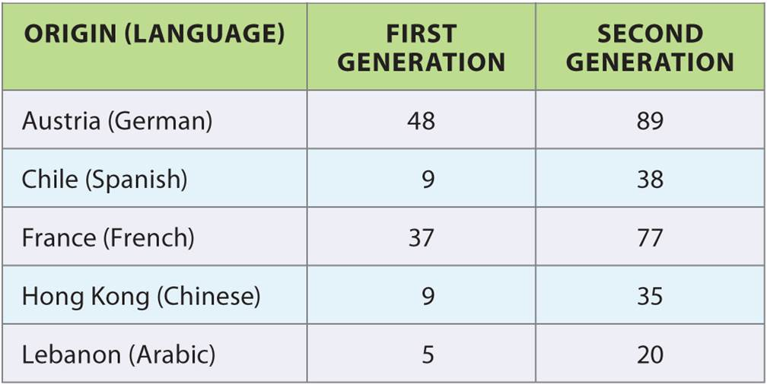
The Place of Language
Table 11.3
Language shift
  Occurs as children are socialized into a dominant language
Language Shift in Australia.
Notes:
Table 11.3

Slide 28
The Political Geography of Language
Language and National Identity
  National-level, self-conscious creations
  Work of institutions and language policies
  Rebirth of Hebrew from liturgical language to national language
The Written Word
  More standardized
  Institutional ‘promotion’
Social and regional accent variation.
Notes:
Figure 11.8

Slide 29
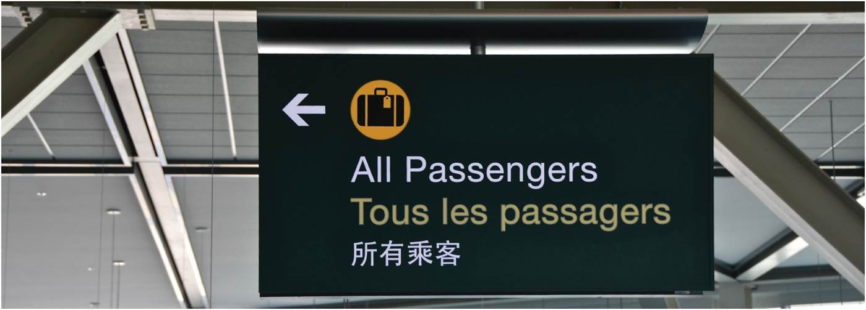
The Political Geography of Language
Language Policies
  Domination/exclusion
  Assimilation
  Pluralist
  Confederation
Multilingual and monolingual
  Linguistic diversity still prevalent
  Growing tolerance of linguistic diversity
Sign at Vancouver airport.
Notes:
Figure 11.9

Slide 30
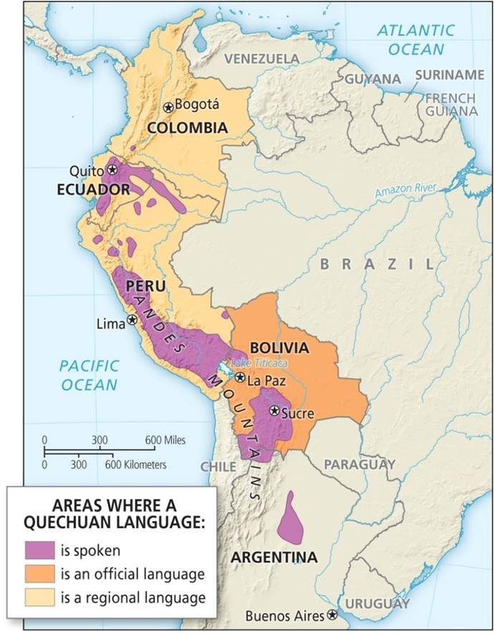
The Political Geography of Language
Language Loss
  Losing linguistic diversity
  Consequences
Replacement and Rebirth
  Overcome by dominant language speakers or national policy
  Minority languages survive with large numbers of speakers
  Formal recognition can improve survival
Quechuan language.
Notes:
Figure 11.11

Slide 31
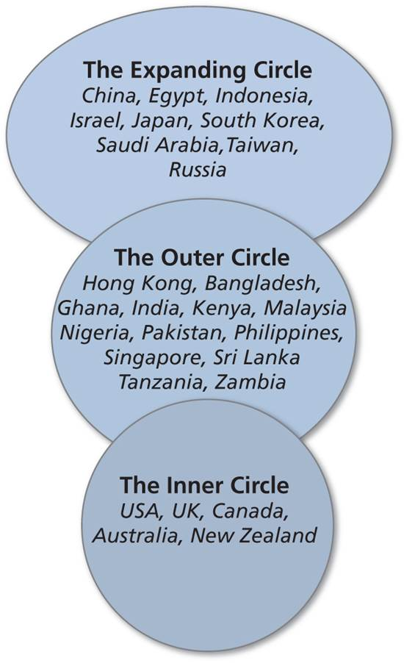
Globalization of Language
Relatively recent trend of globalized language
  Empires and diasporas
Most global in diffusion and adoption
  English is hegemonic language of global interaction (lingua franca)
  Over 75 countries recognize English
Circles of English Use. Suggests a core-periphery model of global Englishes.
Notes:
Figure 11.12

Slide 32
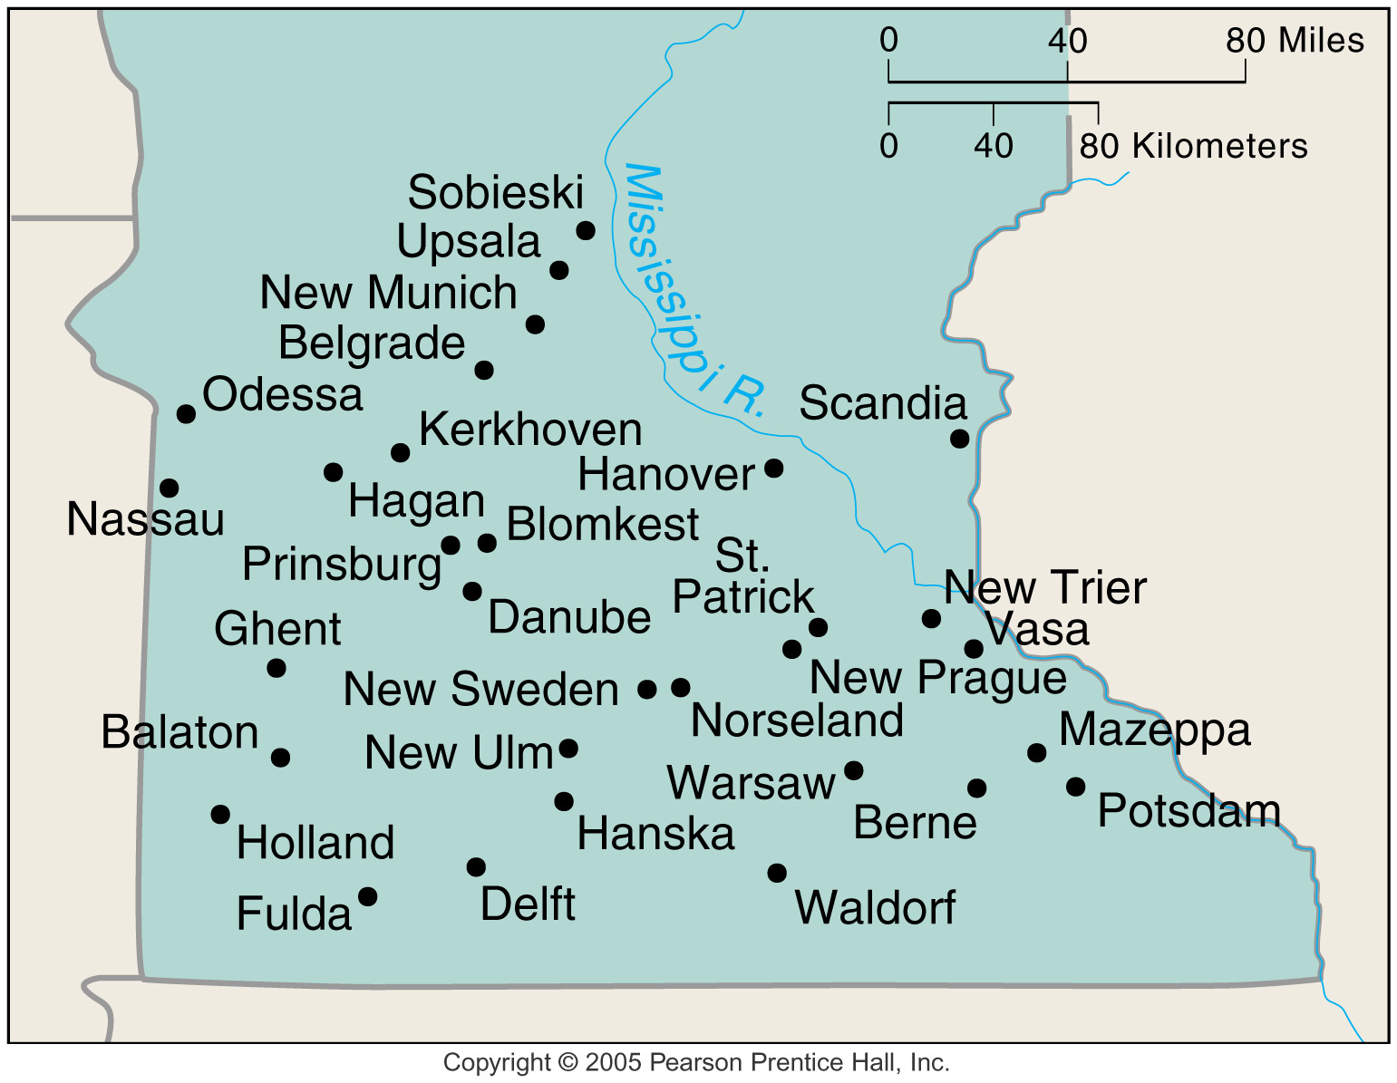
Toponymy
The study of place names
Consists of:
  Natural features
  Origins/values of inhabitants
  Belief structures, religions
  Current or past heroes

Slide 33
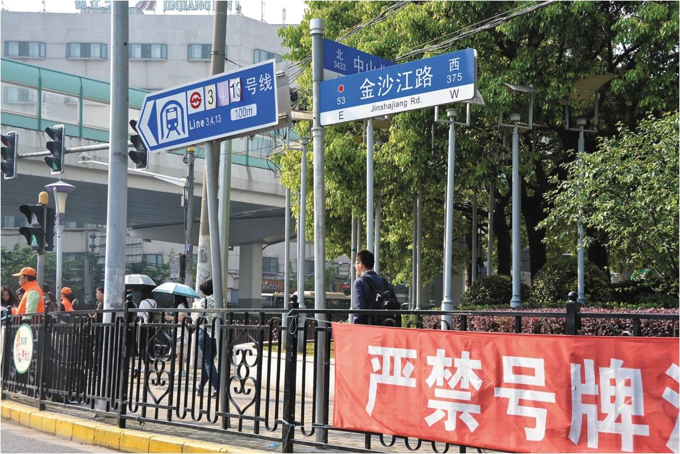
Globalization of Language
Growing English competency and cultural globalization
  Conscious adoption to participate fully in international activities
Reinvention of English
  Deterritorialized from its hearth and reterritorialized to best suit their purposes
Street signs in Shanghai now use English as well as Chinese.
Notes:
Figure 11.3

Slide 34
English is the world Lingua Franca
Lingua Franca: language that is adopted as a common language between speakers whose native languages are different.
British Empire spanned the globe – English was the language of government, business, and education
  19th century England was the dominant economic power
  English has the status of national language in 50 countries (approximately 200 countries in the world)
20th century, the USA became the dominant economic power in the world and was at the early art of the 21st Century

Slide 35
Globalization of Language
The Written Language
  Written English more rule-bound and slow to change
  Reterritorialization of written English less apparent
  Dominant written language of the global epistemic community
  Using English, these communities construct a global intellectual discourse involved in production, reproduction, and circulation of knowledge
  Of these communities are academic disciplines like Geography, with research journals primarily in English
  Major language of the internet

Slide 36
The Linguistic Landscape
Linguistic landscapes
  Monopolistic landscape
  Bilingual and Trilingual
    Where countries are multinational political stability may be threatened if the nations tend to live in separate parts of the country.
Local language usage can vary from official policies
  Other languages that dominate the neighborhood level reflected in landscape

Slide 37
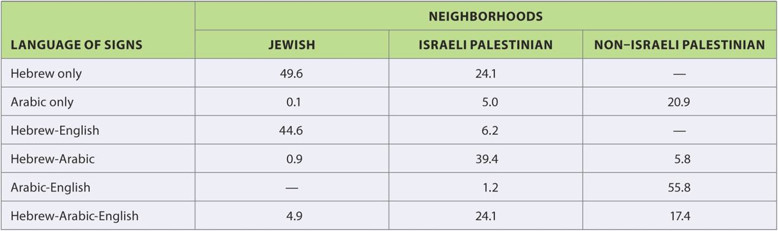
The Linguistic Landscape
Table 11.4
Linguistic landscapes in Israel. The languages on signs in three types of Israeli neighborhoods.
Notes:
Table 11.4

Slide 38
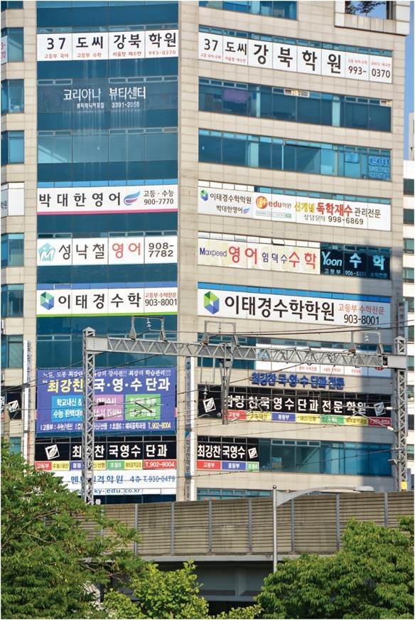
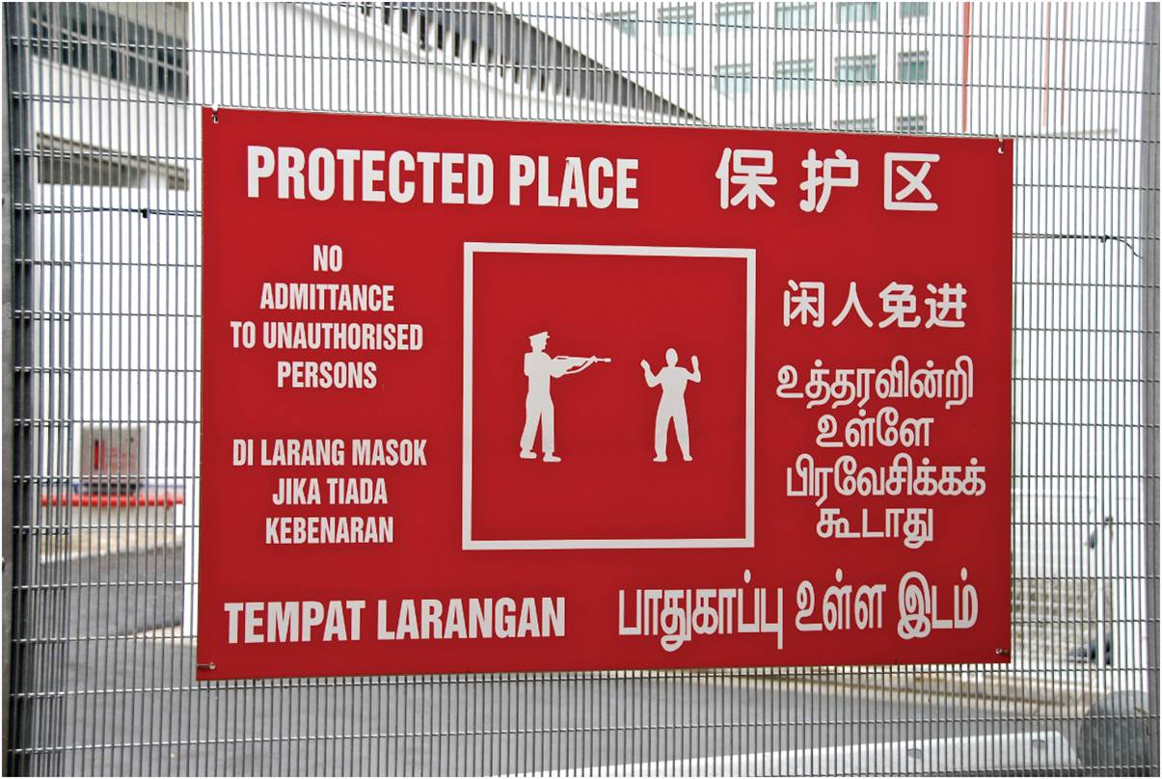
The Linguistic Landscape
A monolingual streetscape in Seoul (left). Four languages commonly used in Singapore on a sign (right).
Notes:
Box 11.1 Figures 1 and 2

Slide 39
Chapter Summary
Language is an important part of culture. Local indigenous languages have sophisticated description of their local environment. Historically connected to specific places, language has diffused with empires and an ever-flattening world.
Three trends in geography of language: (1) the emergence of distinct linguistic geographies; (2) the interaction and sometimes replacement of local variants with outside languages because of population movement, social change, and the operation of political power; and (3) the globalization of certain languages.
Although over 6,000 languages are spoken around the world, half of the world’s population speaks only 10 languages. Dominant languages are Chinese, Hindi, English, Spanish, and Arabic.

Slide 40
Chapter Summary
We give meaning to our world by describing it with language. Colonial powers expressed power by naming the landscape, and postcolonial societies embody their independence by renaming it.
The contact between languages can produce pidgins and creoles.
Language varies by regional dialects. Socioeconomic differences map onto the difference between standard and regional dialects. Language use varies by where people are and who they are. Language varies by context, referred to as language domains.
Language use is flexible. In code switching, people use different language depending on context. Language shifts occur as people move to different language regions.
Language use is bound up with national identity as national languages are crated and maintained. Language policies of minority languages vary from exclusion to encouragement.

Slide 41
Chapter Summary
While the spoken word varies, the written word is more standardized. National written languages emerge with education systems and shared print cultures of national readership.
We are losing many of the smaller languages, although there are attempts at language revival. Creation of monolingual geographies has increased global communication, but has decreased linguistic diversity, which is strongly correlated to biodiversity and can lead to an increasingly impoverished world.
Growing global English competency has accelerated cultural globalization by the movement of ideas and information. Also led to modification or creolization and ensuing reterritorialization of the language as local communities adapt it to local needs.
English is most globally pervasive language, and its use fosters cultural and economic globalization. Language of a global epistemic community.

