Slide 1
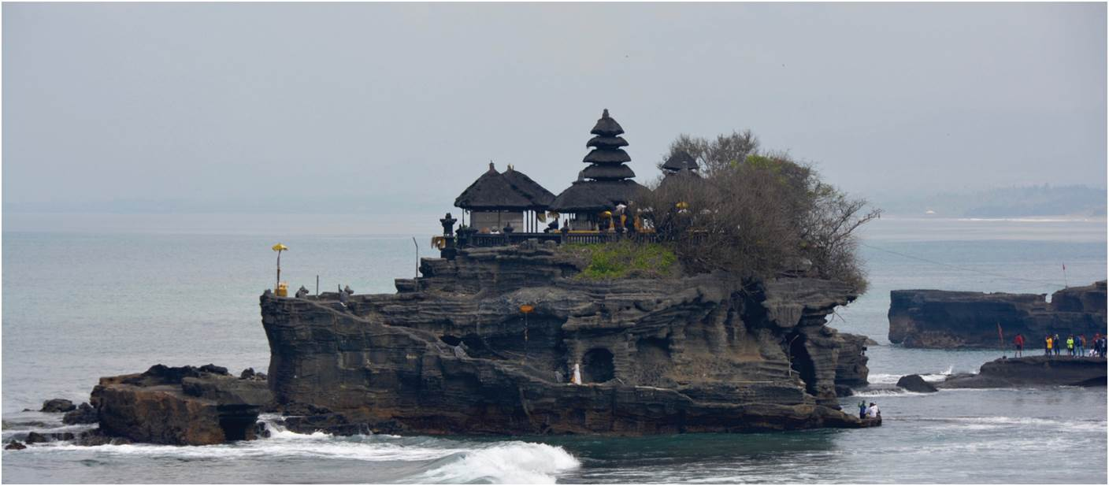
Chapter 10: The Geography of Religion
Many people define themselves primarily in terms of religious affiliation. Religious beliefs order society.
Hindu temple in Bali, Indonesia.
Expanded by Joe Naumann, UMSL
Notes:
Chapter 10 Opener

Slide 2
Chapter Learning Objectives
Describe the three types of religion, their origins, and global distributions.
Explain the differences that exist within each major religion.
Consider the ways that religion is used to interpret the environment, to organize and regulate spaces.
Discuss the complex reasons why religious conflict occurs over space.
Reflect on how religious beliefs and practices inform social dynamics and affect social relations.

Slide 3
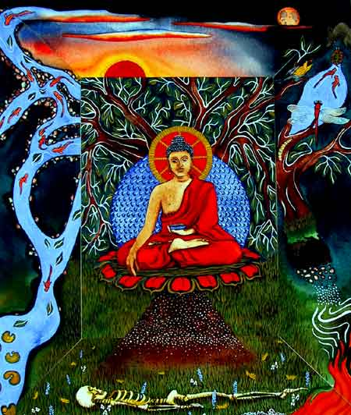

Religion—transmitter of culture

Slide 4
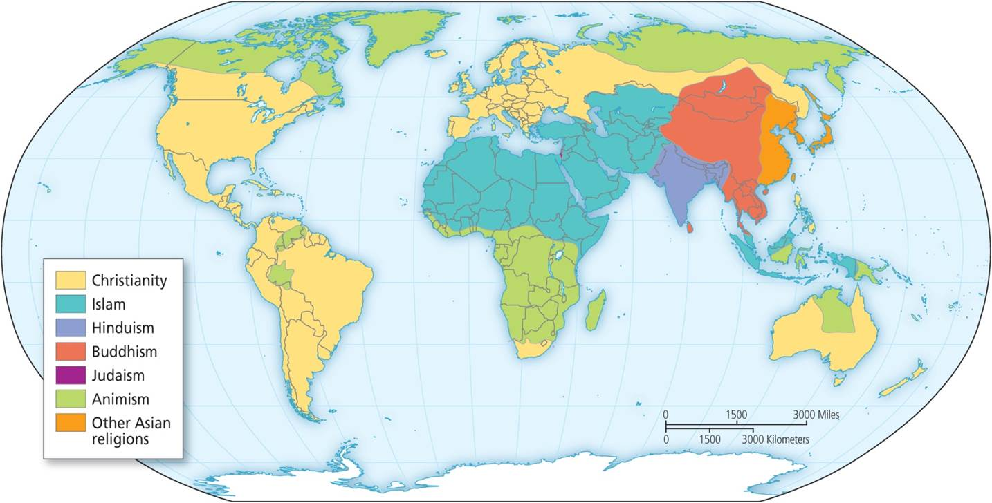
The Geography of Major Religions
Three broad types
  Animist religions
  Great religions of Asia
  Monotheism
Traits of all religions
  Core of believers
  Global diffusion
Main world religions.
Notes:
Figure 10.2

Slide 5
Main World Religions
Shows the main religions across the world and reveals how the traditional animists are now restricted to more peripheral and marginal lands of desert, tundra, and rainforest.
Notes:
Figure 10.2

Slide 6
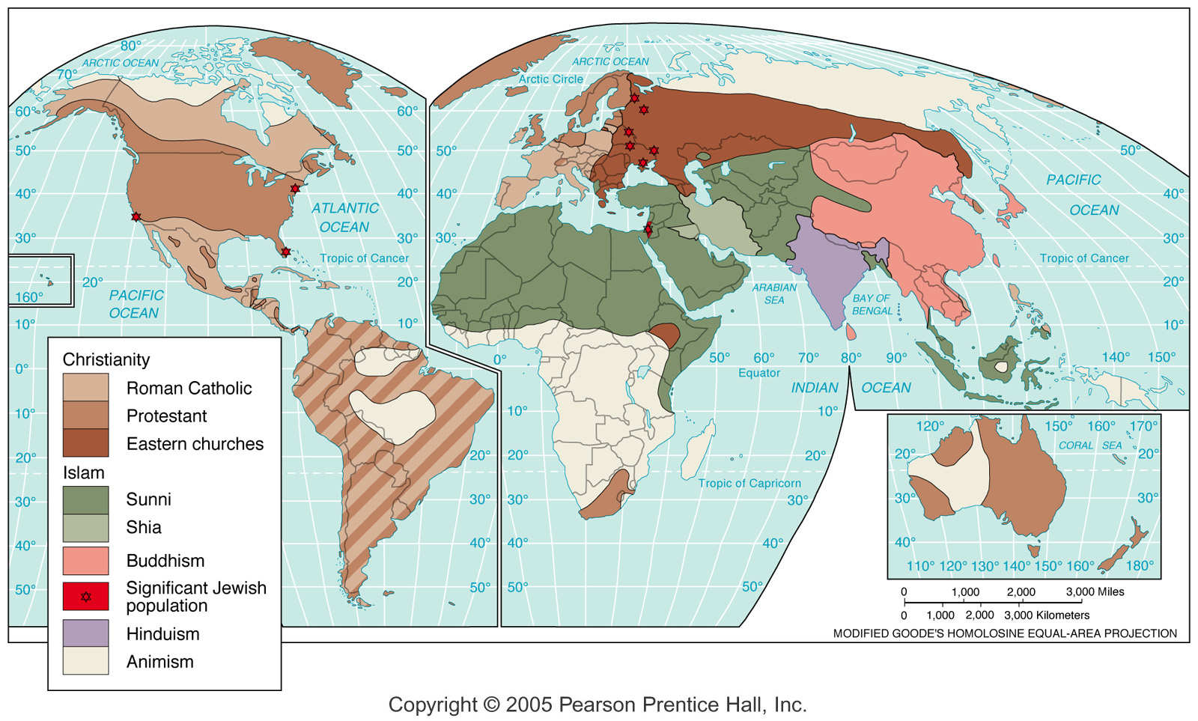
Religion Regions

Slide 7
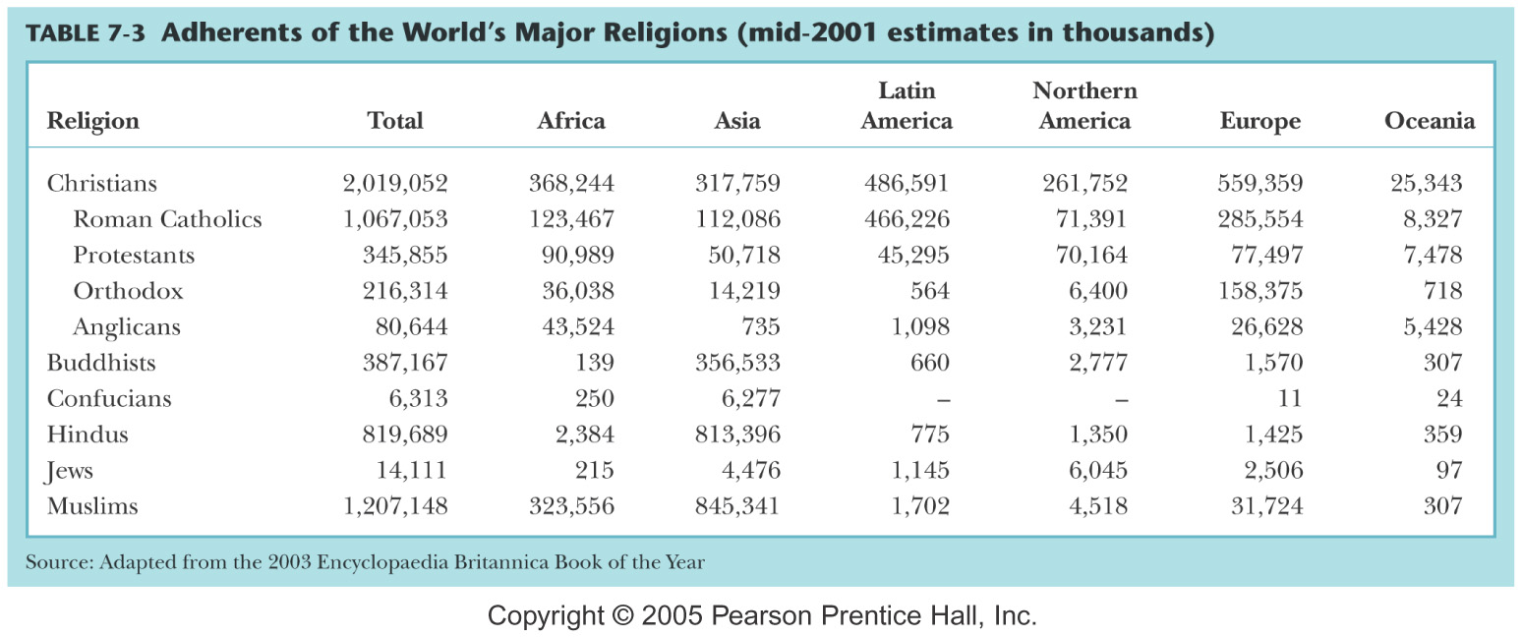

Slide 8
World’s Major Religions
Systems of beliefs guiding behavior
  Orthopraxy (correctness of action or practice)
    Behavior oriented
  Orthodoxy (“correctness” of belief or verbal expression)
    Theological/philosophical
Fundamentalism -- the strict maintenance of the ancient or essential doctrines of any religion or ideology.
Secularism -- a philosophy or world view that stresses human values without reference to religion or spirituality

Slide 9
Religions
Classification and Distribution of Religions
  Universalizing: Christianity, Islam, Buddhism all proselytize
  Christianity is currently the most widespread
  In Africa, Islam is the fastest growing
    In SubSaharan Africa - Christianity
  Ethnic: Judaism, Hinduism, Shintoism
    Tribal (traditional animistic) – small-size ethnic

Slide 10
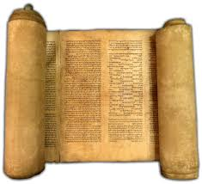
Major Religions: Commonalities
Religions have a tendency to splinter
Have a founder or key figure
Have scriptures
Have rituals
Have structures for prayer or religious rituals
Teach a form of the Golden Rule
Prize Peace

Slide 11
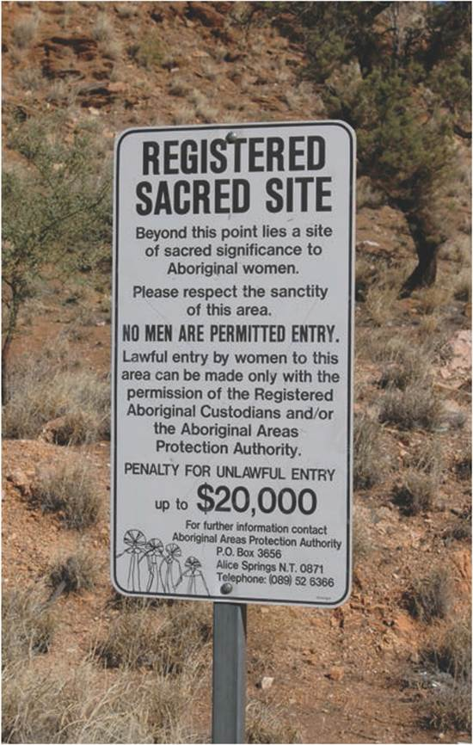
The Geography of Major Religions
THE ANIMIST TRADITION
Space and nature are sacred
  Cosmologies of hunting-gathering societies
  Not exempt from environmental overuse
Traditions are transformed and reinterpreted
  Inform today’s environmental movement
  Religio-ecological mainstream incorporated reinterpreted elements from the ecology of animists
Role of the Shaman in danger
Sacred site in Alice Springs, Australia.
Notes:
Figure 10.1

Slide 12
Alternative Visions
Huichol Indians of western Mexico
  Impacted by Columbian Encounter, still retain belief system
  Form of animism sees landscape as sacred
    Value working with nature – in harmony
    Do not try to dominate nature
  Resistance to silver mining proposals
  Competing notion of the environment as commodity
Navajo example (like mysteries? Read Tony Hillerman novels & learn about Navajo culture too)
  Evil Is seen as the result of being out of harmony with nature
  Shaman has ceremonies believed to restore harmony

Slide 13
The Geography of Major Religions
THE RELIGIONS OF ASIA
Indic region of northern India
  Center on Indus Valley
  Crossroads
Hearth of 4 religions
  Hinduism
  Buddhism
  Other Asian religions like Sikhism and Jainism
Spread throughout the world
  Changes ritual and practice
Main world religions.
Notes:
Figure 10.2

Slide 14
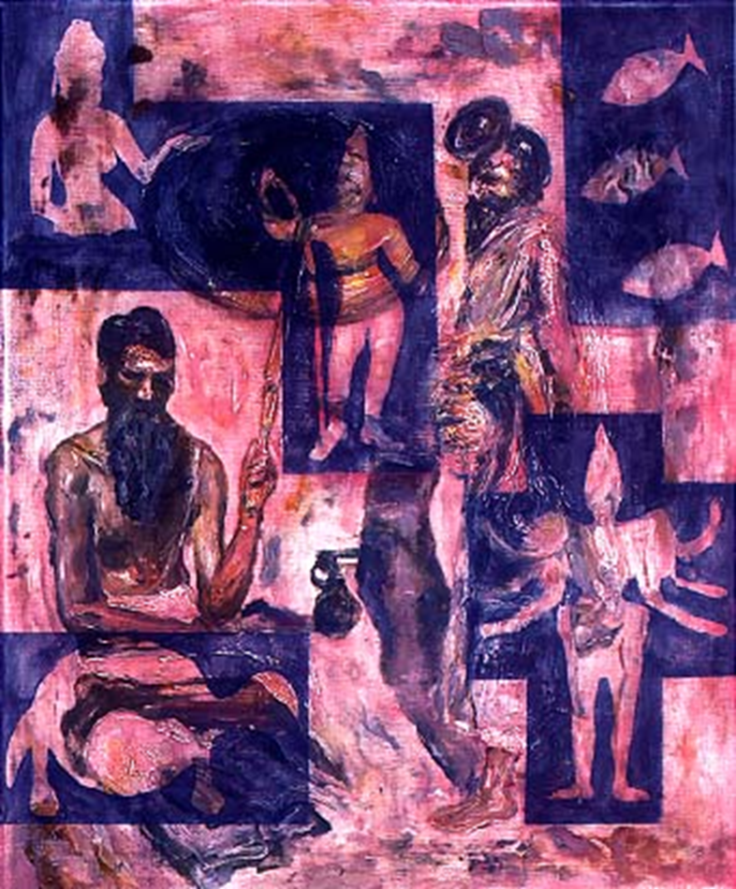
Hinduism
Oldest of the world’s current religions
Practice Ahimsa – reverence for all living things. Refrain from killing animals (including humans) if possible.
Worship very individualized – no set required rituals or practices.
Do not proselytize & no known “founder”

Slide 15
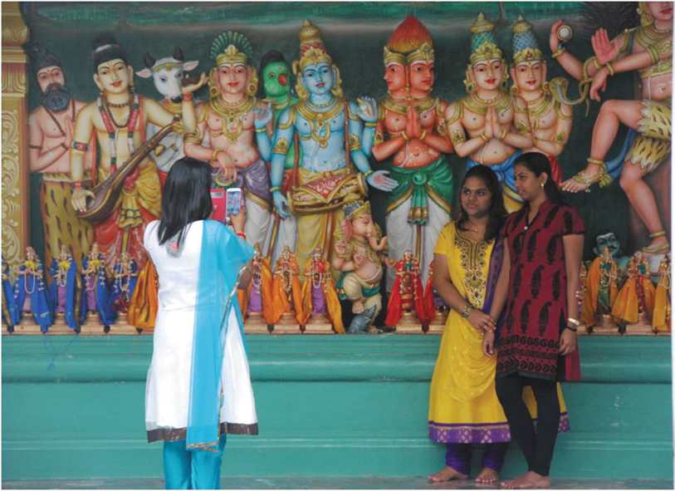
Hinduism
  Most ancient religious tradition in Asia (world?)
  Vedas – Hindu sacred texts
  May be viewed as monotheistic
  Castes
    Brahman, priestly
    Kshatriya, warrior/ruler
    Vaisya, tradesman and farmer
    Sudra, servant and laborer
  Untouchables (de facto 5th caste)
  Central belief is in reincarnation
    Transmigration of the soul
    Cycles of creation – birth to death to birth
    Role of dharma & karma
    Effect on diet
Hindu temple in Kuala Lumpur, Malaysia.

Slide 16
Characteristics of Hinduism
No clergy or religious requirements –
No real splintering or sects
  Can be practices in many ways & at many levels so there was no need to “split off.”
No concept of a personal God
Each individual is seeking to comprehend the ultimate reality while living out his/her dharma with the goal of union with Brahman, thus ending the cycle of reincarnation. Once one truly knows his/her true self, he/she unites with Brahman and is no longer reincarnated.

Slide 17
Dharma & Karma
Dharma – duty – received at birth according to which caste into which a person is born – no choice and no social mobility in the current lifetime: Example – a farmer
  His son will be a farmer, period.
  His daughter will only be able to marry a farmer’s son, period!
Karma – the law of consequences
  A person who faithfully lives out his/her dharma will have good Karma and will be reincarnated in a favorable form i.e. a higher caste, a sacred cow, etc.
  A person who doesn’t live his/her dharma (chooses a different path in life) will be reincarnated in a less favorable form i.e. lower caste, a snail, etc.

Slide 18
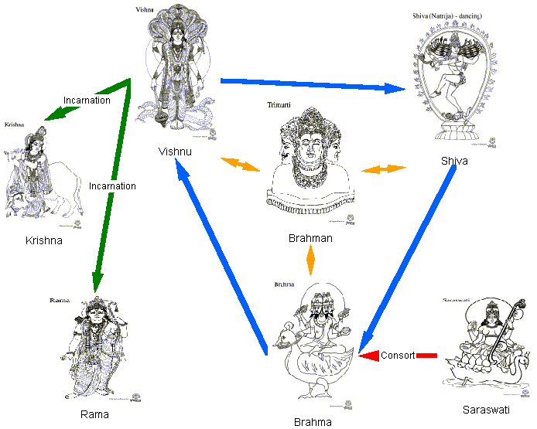
Monotheism?

Slide 19

Buddhism
More a philosophy of living than a religion. Teachings are about how to live properly and break the cycle of reincarnation – don’t deny God but consider it beyond understanding.
Founder: Siddhartha Gautama – a Hindu of the Ruler/Warrior caste
Sought to understand the causes of suffering and how to escape the cycle of reincarnation which resulted from unrelieved suffering.

Slide 20
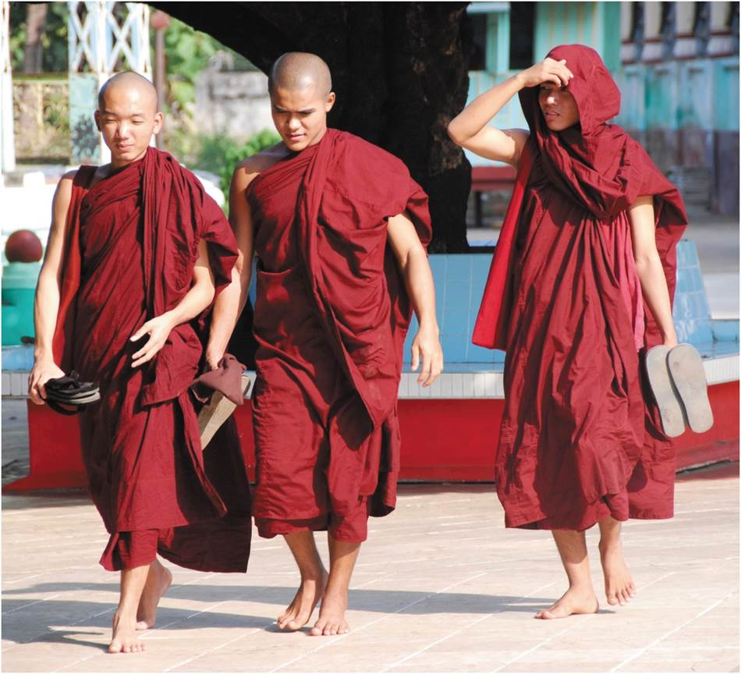
The Geography of Major Religions
BUDDHISM
Offshoot of Hinduism
  Spread across East and Southeast Asia
  Distance from caste
Fundamental beliefs
  Overtime and space, two major forms: Mahayana and Theravada
  New form a response to British colonialism and Christian proselytizing
Buddhist monks in Yangon, Myanmar.
Notes:
Figure 10.4

Slide 21
Siddhartha Gautama – Kshatriya Caste
  Referred to as “The Buddha”
Buddha – anyone who becomes enlightened
  Rejected the idea of a caste system – start on a level playing field
Four Noble Truths (Siddhartha’s understanding the suffering cycle)
  Life involves suffering (an indisputable fact)
  Cause of suffering is desire (craving)
  Elimination of desire ends suffering & reincarnation – Nirvana
  Right thinking and behavior eliminate desire
Diffused from India – later practically eliminated in India (Mongol invasion which brought Islam to India.

Slide 22
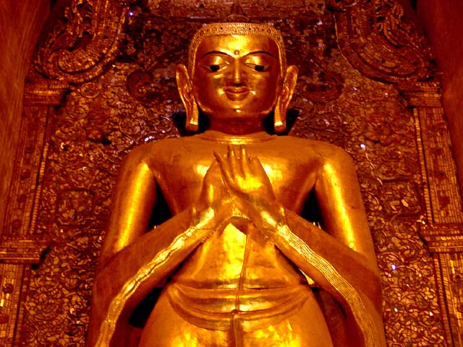
Follow the Eight-Fold Path to end desire or craving
The Way (the 8-Fold Path)
The threefold scheme of morality
1. Right understanding
2. Right thought
Faith
(initially)
Wisdom: III
(ultimately)
3. Right speech
4. Right bodily action
5. Right livelihood
Morality: I
6. Right moral effort
7. Right mindfulness
8. Right concentration
Meditation: II

Slide 23
Scriptures: Vinaya (discipline) – expanded later
Branches:
  Theravada (south) – monk seeks own deliverance ( closer to the teachings and example of Siddhartha Gautama) – all males spend some time as a monk – a week to a lifetime
    Buddhist nuns – not all women get involved
  Mahayana (north) – role of bodhisattvas & ritual (somewhat syncretic) more focused on orthopraxy
    Zen Buddhism – the Japanese version
  Tibetan Lamaism – example of syncretism – use of prayer flags and prayer wheels

Slide 24
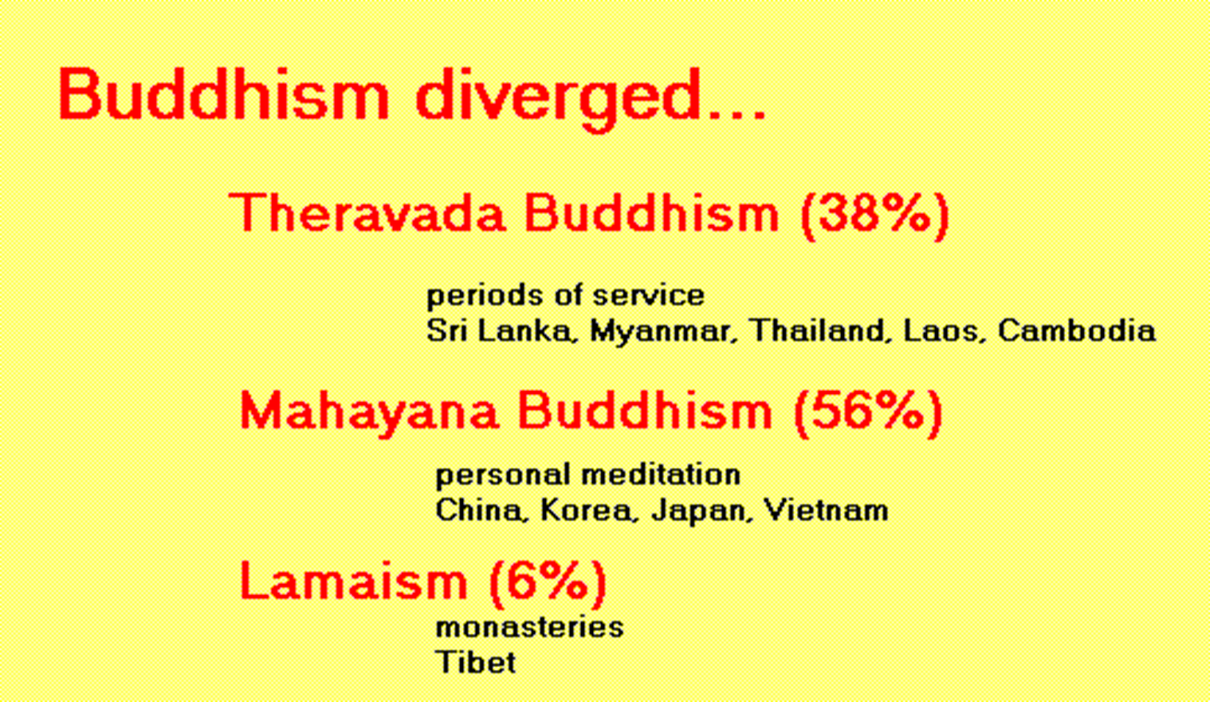

Slide 25
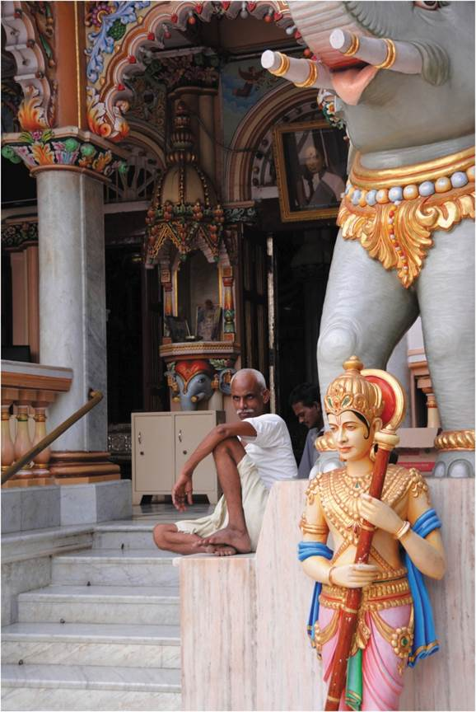
The Geography of Major Religions
OTHER ASIAN RELIGIONS
In South Asia (somewhat related to Hinduism)
  Sikhism: combines Hindu and Muslim qualities
  Jainism: ancient religion teaching extreme form of nonviolence
In East Asia
  Shinto: Japan’s traditional religion
  Confucianism: philosophy and religion stressing family loyalty and social harmony
Jain Temple in Mumbai, India.
Notes:
Figure 10.5

Slide 26
Where?
Other Eastern Religions
  Jainism - India
  Sikhism – Punjab region of India & Pakistan
  Confucianism – China (basically a philosophy of living)
  Taoism – China
  Shinto – Japan
  Zoroastrianism – Iran
  Baha'i – Iran
Animism and Shamanism (usually in remote areas) – not only in Asia
  Animism
    Belief in influence of spirits or spiritual forces in all creation
  Shamanism
    Shaman

Slide 27
The Geography of Major Religions
Semitic region is hearth of 3 global religions
  Judaism
  Christianity
  Islam
Abrahamic religions
  Monotheistic
  Religious beliefs in texts
  Myths and shared stories
  Same figures, varied tellings
Main world religions.
Notes:
Figure 10.2

Slide 28
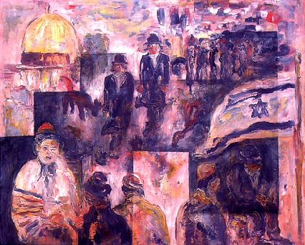
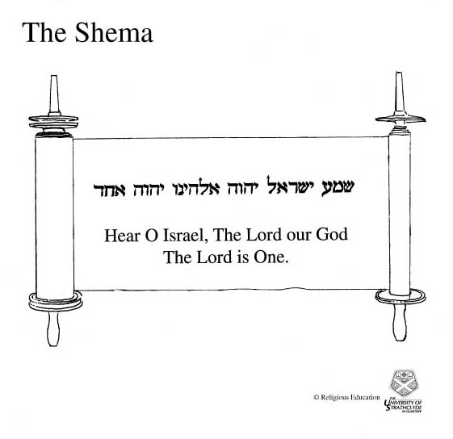
Judaism

Slide 29
The Geography of Major Religions
JUDAISM
Monotheistic but not universalizing religion
Early Mesopotamian urbanists
  Purposeful nature evidence of an all-powerful God testing their faith
  Environmental disasters like floods, famines
Forced dispersing throughout Middle East, later Europe and the New World
  Ages of conflict and discrimination, culminated in Holocaust
  Creation of Israel 1948 and Zionism
  Jewish diaspora and “Israel lobby”

Slide 30
14 million adherents
Monotheistic (claims to the oldest one)
Based on covenant with Abraham
Scriptures: Torah – 5 books of the “Law”
  Genesis, Exodus, Leviticus, Numbers, Deuteronomy
Sects
  Orthodox, Conservative, Reform
Israel – More Jews in New York City than in Isreal
  Homeland for Jewish people
  Created 1948
  Conflict between Israel and Palestine

Slide 31
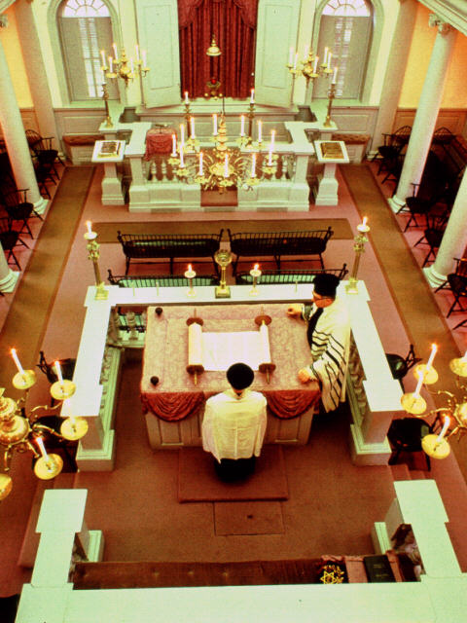
Jewish Worship
Synagogue came into existence during exile after the temple, which had previously been the center of worship, had been destroyed and many Jews had been taken to Babylon as captives.

Slide 32
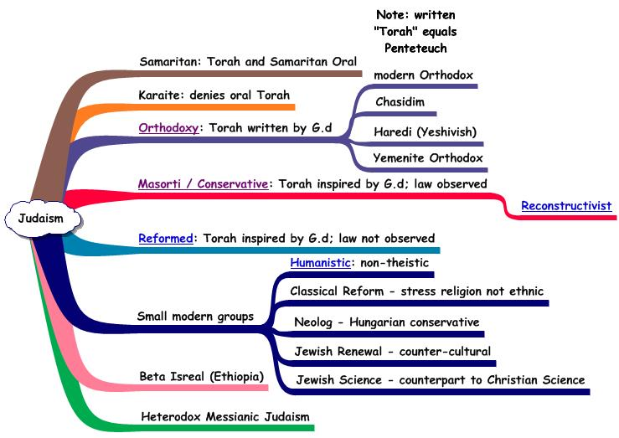
Jewish Sects
We will concentrate on the three major sects found in the USA:
  Orthodox
  Conservative
  Reformed

Slide 33
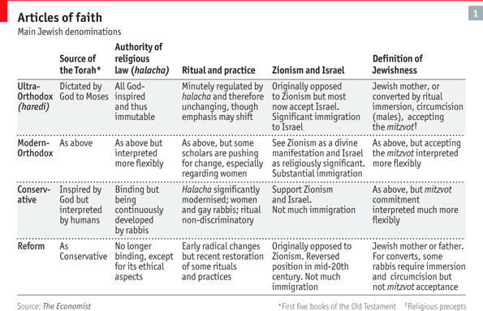

Slide 34
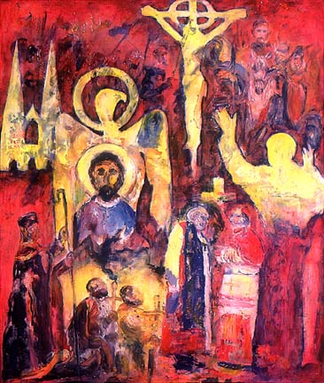
Christianity
Originally a sect of Judaism – the separation into separate religions came somewhere around 60-80 C.E.
Spread in the eastern part of the Mediterranean and Rome. Became the official religion of the Roman Empire shortly after 312 C.E. under the Emperor Constantine and based on the Nicene Creed.
Latin speaking churches and Greek speaking churches separated around 1055 C.E. over the authority of the Bishop of Rome (Pope). West called Catholic, and East called Orthodox.
Martin Luther in 1517 posted his 95 Theses for debate. Thanks to the printing press (a relatively new invention) his 95 areas of dispute with the official Catholic church became widespread. While his intention was to reform the church (he was a Catholic priest and professor of theology), it ended up in another major split in Christianity: Protestant Christianity

Slide 35
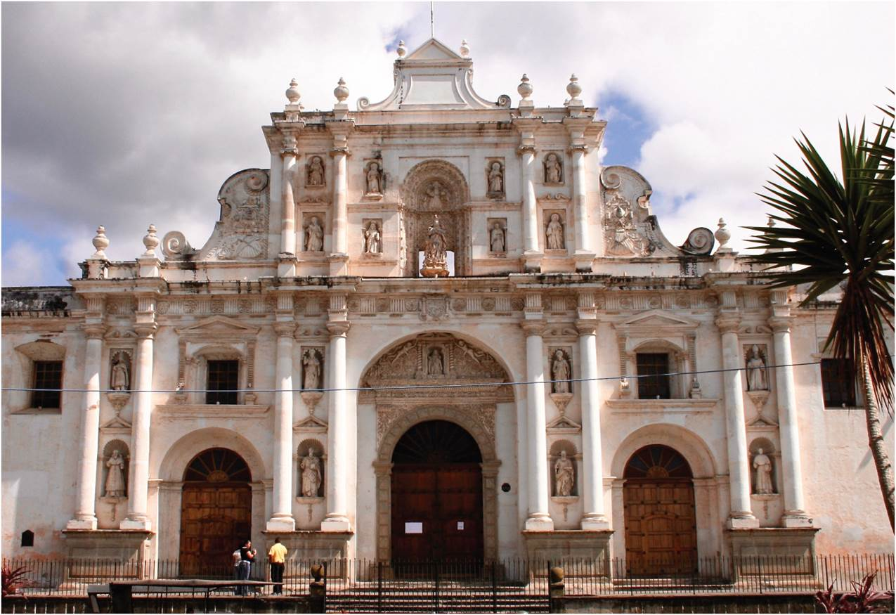
The Geography of Major Religions
CHRISTIANITY
Expansionist religion
Judaic sect on edges of the Roman Empire
  Spread along trade routes
  Eventually official religion of empire
Exporting during the European colonialism
  Some places resisted, some created blends
St. Joseph’s Cathedral in Antigua, Guatemala, first built in 1594.
Notes:
Figure 10.6

Slide 36
7 Sacraments
Roman Catholics, the Anglican Communion, Eastern Orthodox recognize and administer all seven, others may not
  Baptism (all require Baptism – they differ on how it is administered)
  Communion (all practice it but differ on frequency and meaning)
  Reconciliation (confession) – one on one is not required by most
  Confirmation - only practiced by those who baptize infants
  Matrimony – it may not be considered “sacramental” by some
  Holy Orders – Ordaining priests or ministers (not all are ordained)
  Rite of the sick – administered to chronically ill or seriously ill or dying persons – its prays for healing (physical, spiritual, or both)

Slide 37
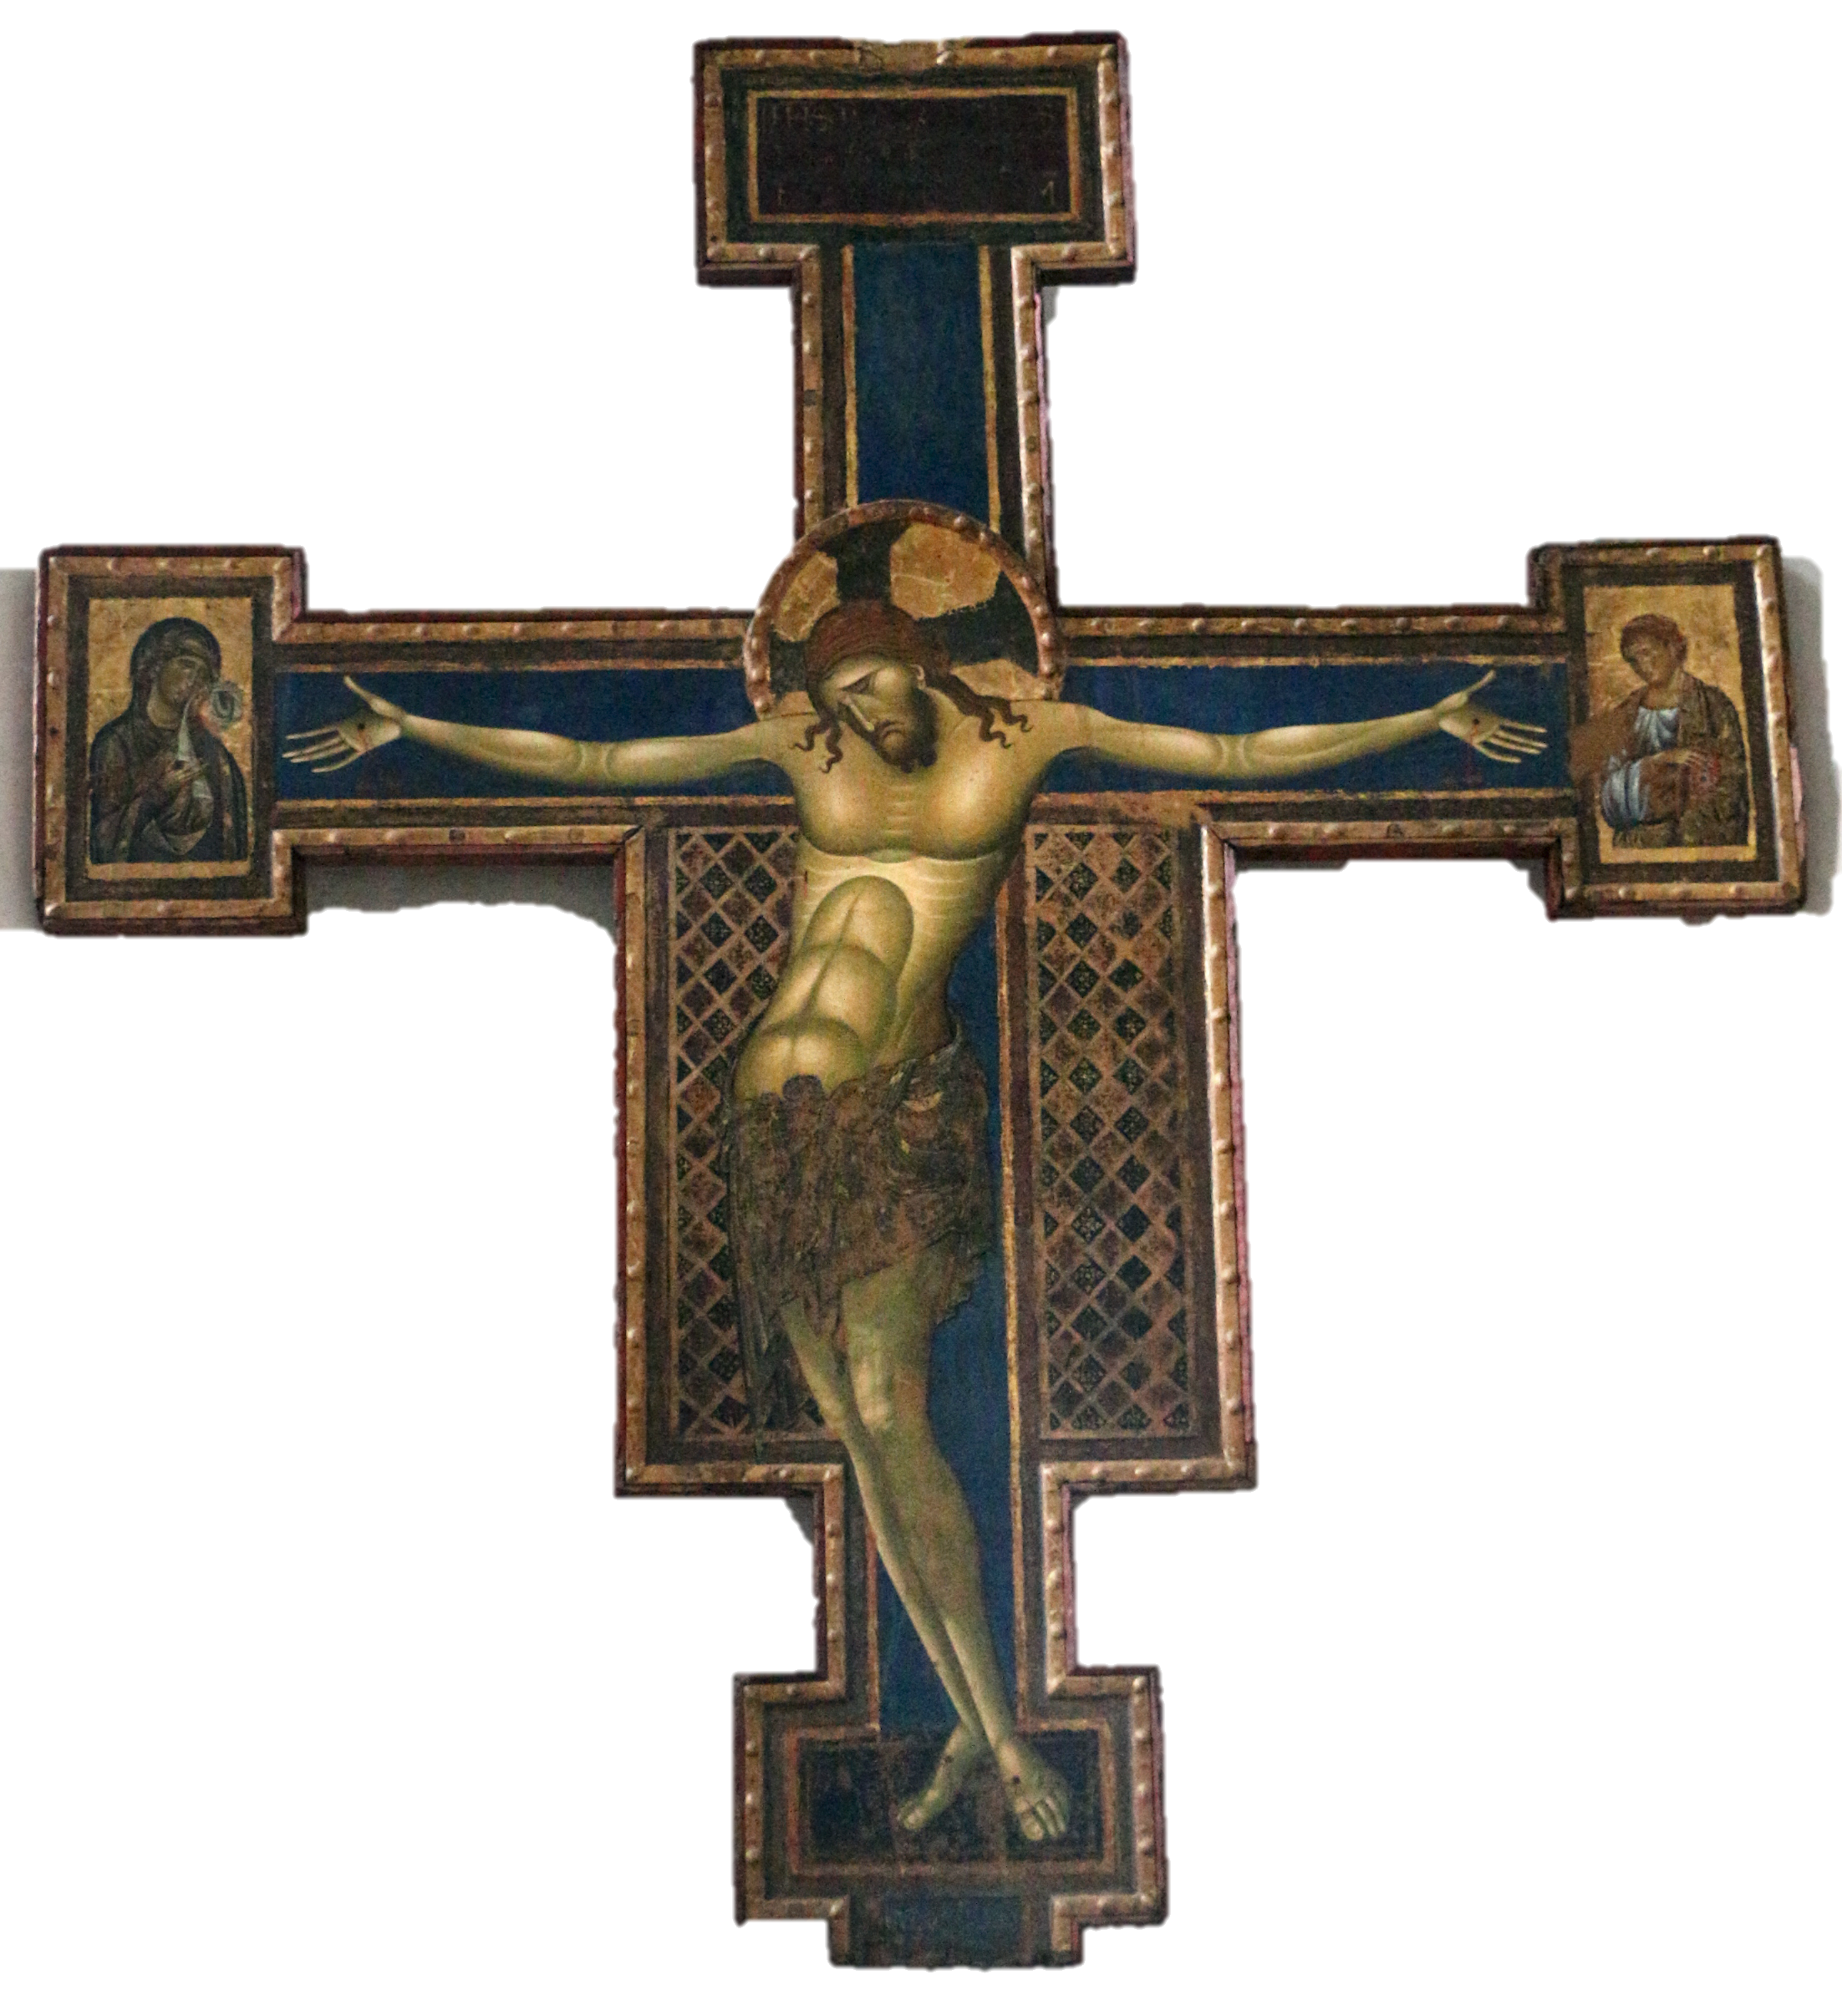
Emerged from Judaism – Jesus was a Jew!
Coptic Church
  Founded in Alexandria in CE 41
  Still present in Egypt and Ethiopia
Official religion of Roman Empire – 312 CE
  Facilitated geographical spread
  Model for its bureaucratic structure
Split with Eastern Orthodox 11th century CE
Dark Ages – preserver of European culture
Protestant Reformation 1517 CE
Significant growth in Africa, Asia and Latin America

Slide 38
Christian Fundamentals
Areas of almost complete agreement
  Sacraments of Baptism & Matrimony
  Monotheism involving one God in a trinity of persons (referred to as a mystery)
  Blessing and sharing bread and wine at least in memory of Jesus sacrifice
  Jesus was/is 100% God and 100% human
  Salvation comes from belief in and acceptance of Jesus as one’s savior
  There will be a second coming at the end of time

Slide 39
Christian Denominations
Coptic
Eastern Orthodox
  Greek, Serbian, Russian, Armenian, etc.
Roman Catholic – Latin Rite & Greek Rite
  Largest single denomination in the USA
Protestant – hundreds of denominations
  Luther, Calvin, Zwingli, etc.
Peripheral – significant differences from the mainstream Christian denominations
  Mormon, Jehova Witnesses, etc.

Slide 40
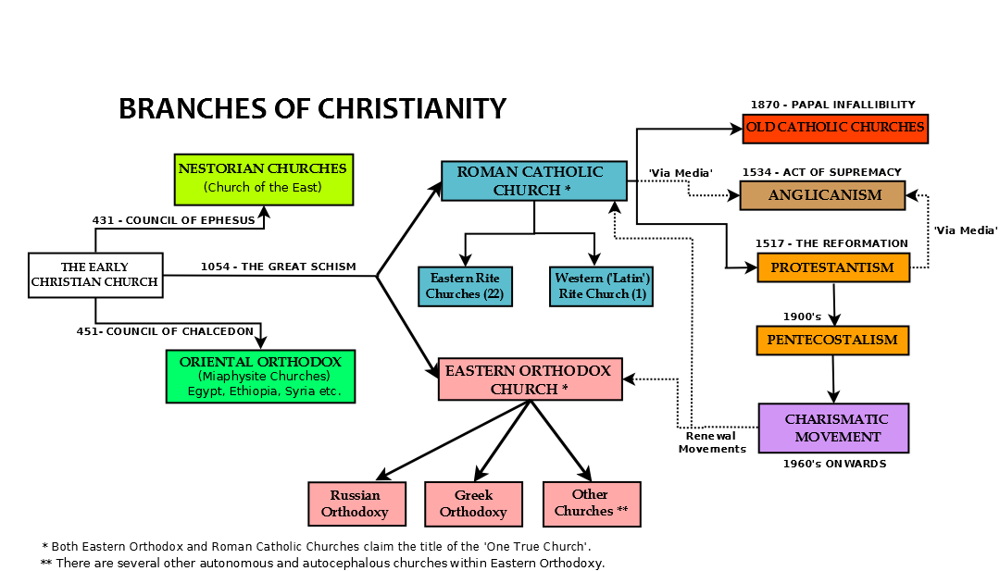

Slide 41
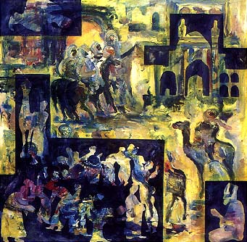
Islam
Youngest of the Abrahamic religions
  Angel Gabriel reveals God’s final teachings to Muhammad and he preaches against the pagan polytheism being practiced in Mecca.
622 C.E. is given as the year of the beginning of the Muslim calendar.
  Hijra, Muhammad flees for his life to Medina and converts the people there.

Slide 42
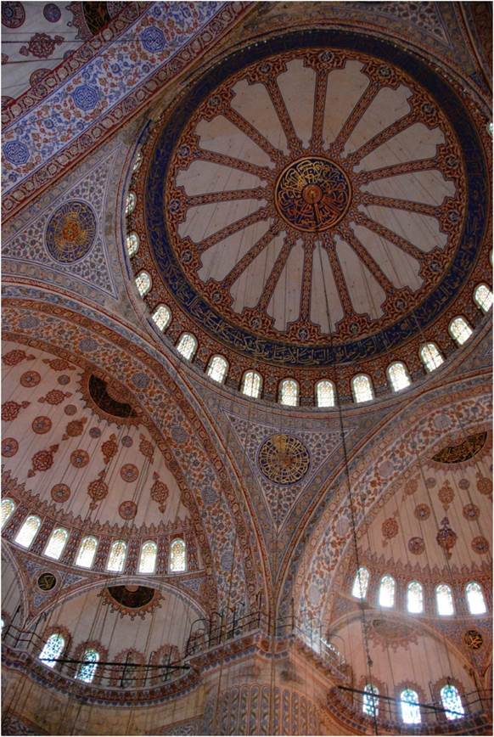
Islam
ISLAM
Universalist religion
Muhammad and the Quran in Arabic
  Spread through imperial expansion
  Related spheres of religious and politics
As it diffused from the core, it was influenced by local traditions
The interior of the Blue Mosque, Istanbul.
Notes:
Figure 10.7

Slide 43
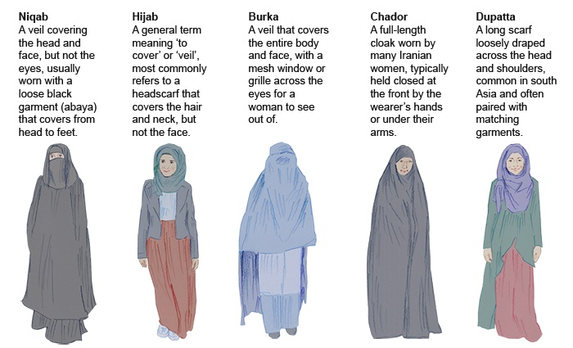

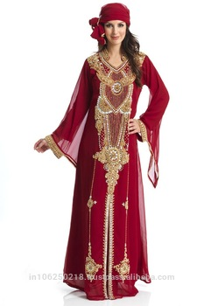
influence of local culture
Appropriate dress for women: the Quran only says that women should dress modestly. Modestly means different things in different cultures,.

Slide 44





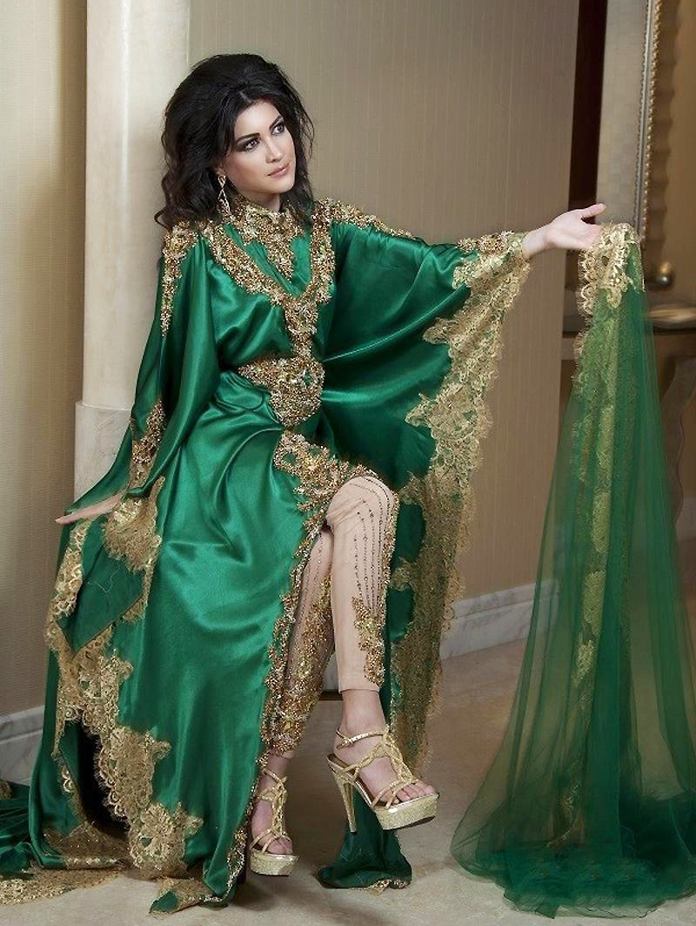
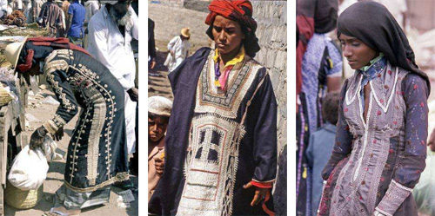
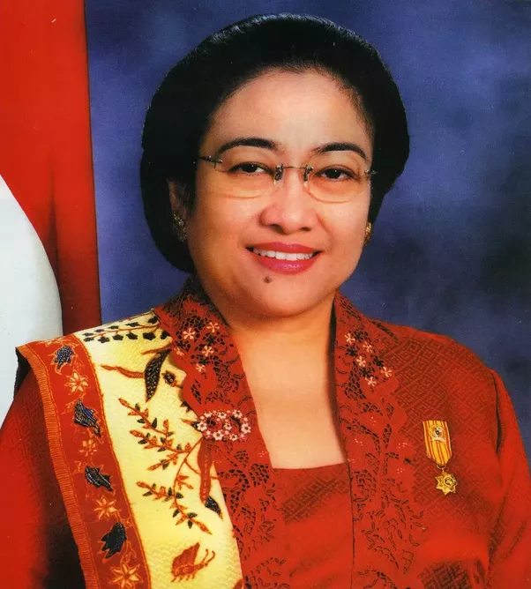
First lady of Indonesia

Slide 45

Islam
Muhammad the final prophet– 622 CE
Allah (word for God)
Monotheistic
Major Sects: Sunni – 85% and Shiite – 15%
Koran (only in Arabic) is sufficient to direct all aspects of life
No clergy or building required
Jews & Christians – people of the book (supposed to be respected and not persecuted according to Muhammad)

Slide 46
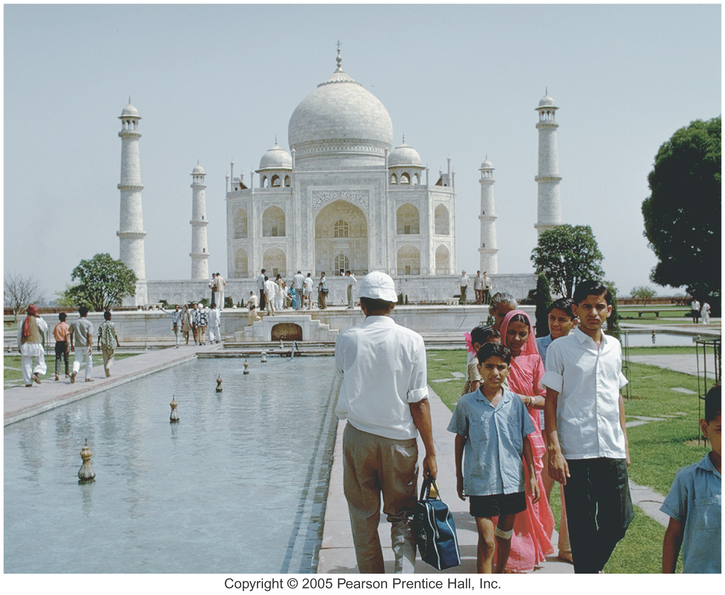
Five Pillars
Five Pillars of Islam
  Belief in one God
  Five daily prayers facing Mecca
  Generous alms (help to poor)
  Fasting during the holy month of Ramadan
  Pilgrimage to Mecca (hajj)
And, of course, read and follow the teachings of the Quran.

Slide 47
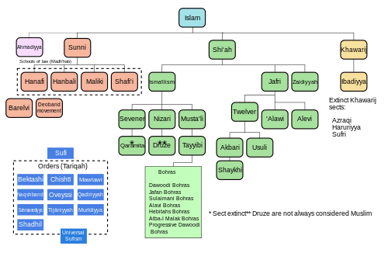

Slide 48
The Geographies of Religious Belief
Scale and regional variation of belief
The Sunni-Shia Split in the Middle East
  Both share basic tenets of Islamic teaching
  Division was over who would be next prophet
  Sunni dominates in number of followers
  Shia found in pockets in the Middle East region

Slide 49
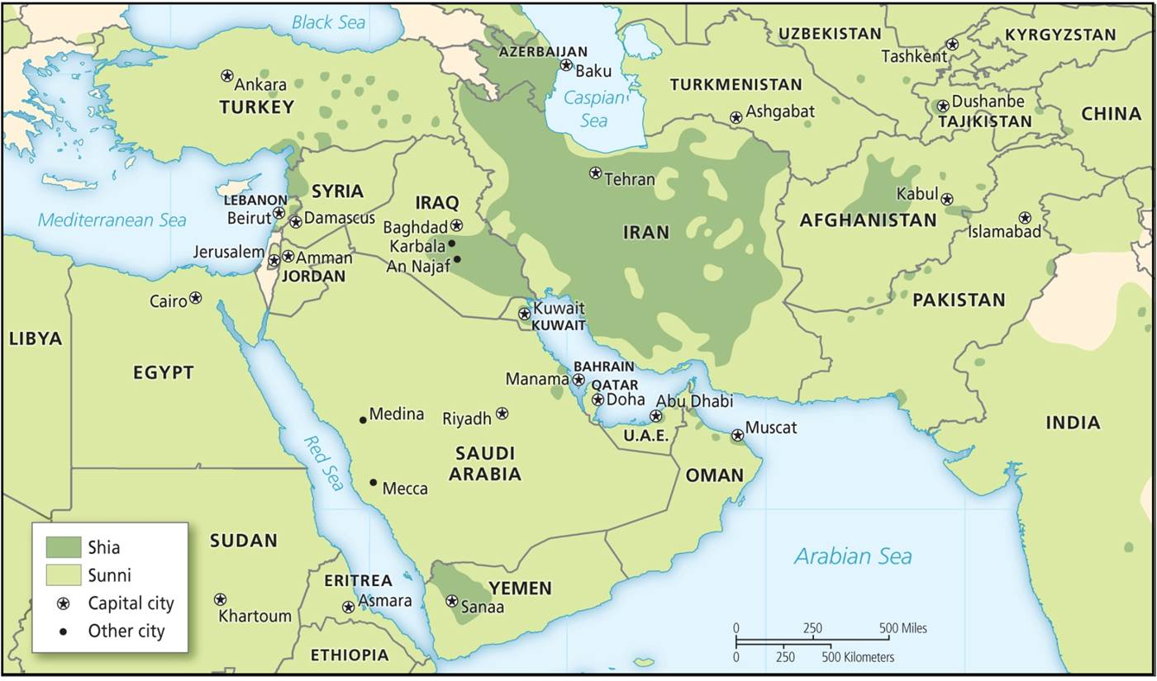
The Geographies of Religious Belief
The Sunni–Shia divide in the Middle East.
Notes:
Figure 10.8

Slide 50
The Geographies of Religious Belief
The Case of the USA: distinct regional groups
  Reflect settlement patterns
  Mormons in mountain West
  Bible Belt Baptists south of the Mason-Dixon Line
  Lutherans in upper Midwest
  Growing Catholicism associated with Hispanic immigration
  Catholic and Jewish presence is more noticeable in large metropolitan areas
    New York, Chicago, St. Louis, Boston, New Orleans, etc.

Slide 51
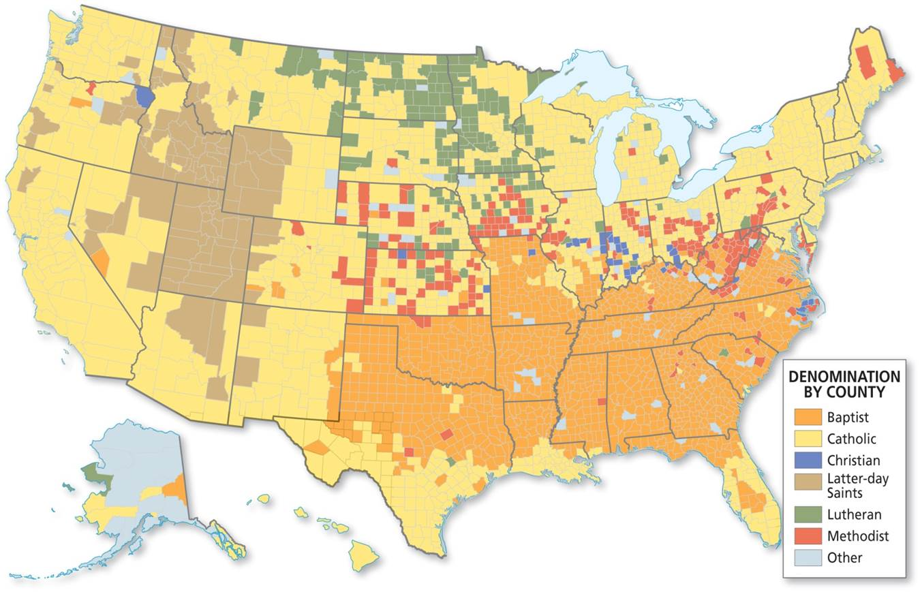
Majority religious affiliation in every county in the United States.
Notes:
Figure 10.9

Slide 52
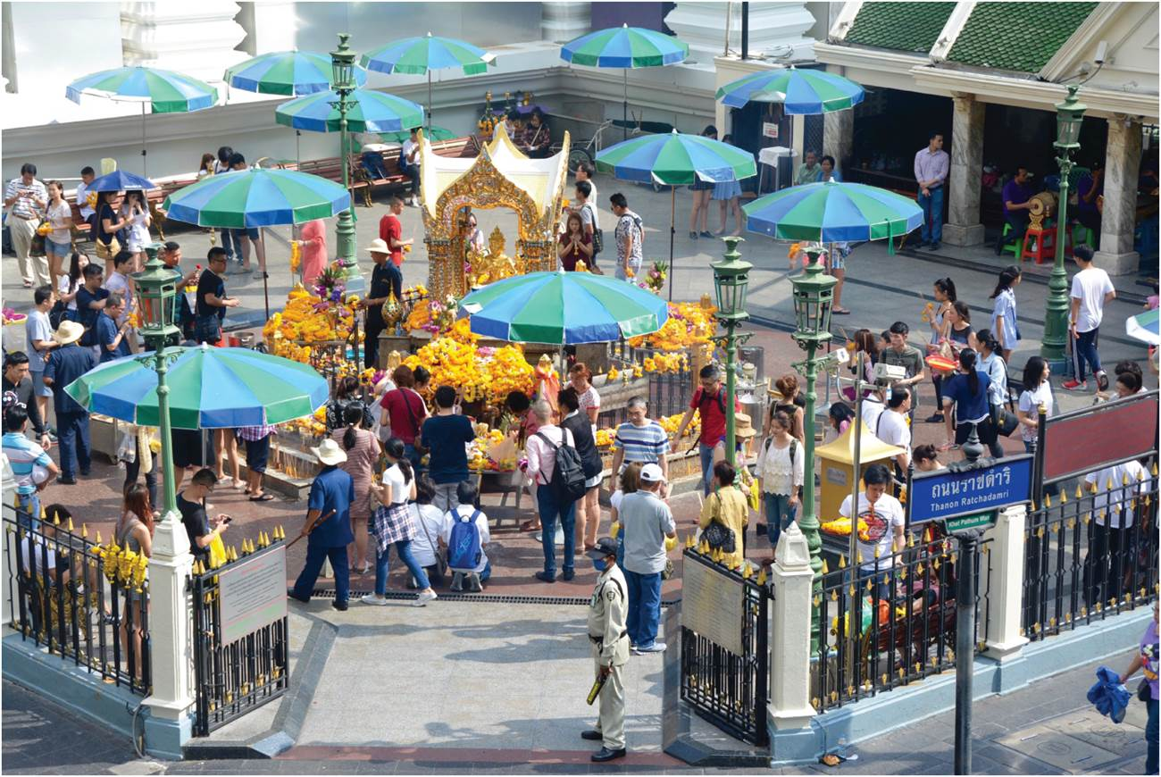
The Geographies of Religious Belief
Affiliation differences at regional and local levels
  Place influences religious practice and wider politics
Religion and Urban Public Space
  Religiosity declines with modernization, urbanization
  Yet urban spaces also include sacred sites or public displays of faith communities
Shrine in downtown Bangkok, Thailand.
Notes:
Figure 10.10

Slide 53
The Religious Organization of Space
Religion and the Environment
  Environmental change a major theme in sacred stories from animism, incorporated by universalizing religions
  Sky-based monotheistic religions displaced more Earth-based beliefs of polytheism
  From “ecstatic worship” to more formalized, authoritative forms
The “axial age” and rise of major religions
  Reflect collective experience of living in city-states
  Growing awareness of other regions and cities
  Useful to empire to justify social hierarchy

Slide 54
The Religious Organization of Space
Sacred sites
  Place-based animists filled landscape with spiritual significance
  Universal religions separated sacred sites
Sites of overlapping significance
  Source of friction
    Jerusalem
Pilgrimage
  Sacred sites become places of pilgrimage
  Search for spiritual revelation through physical endeavor
  World’s largest is the hajj, as Muslims make pilgrimage to Mecca

Slide 55
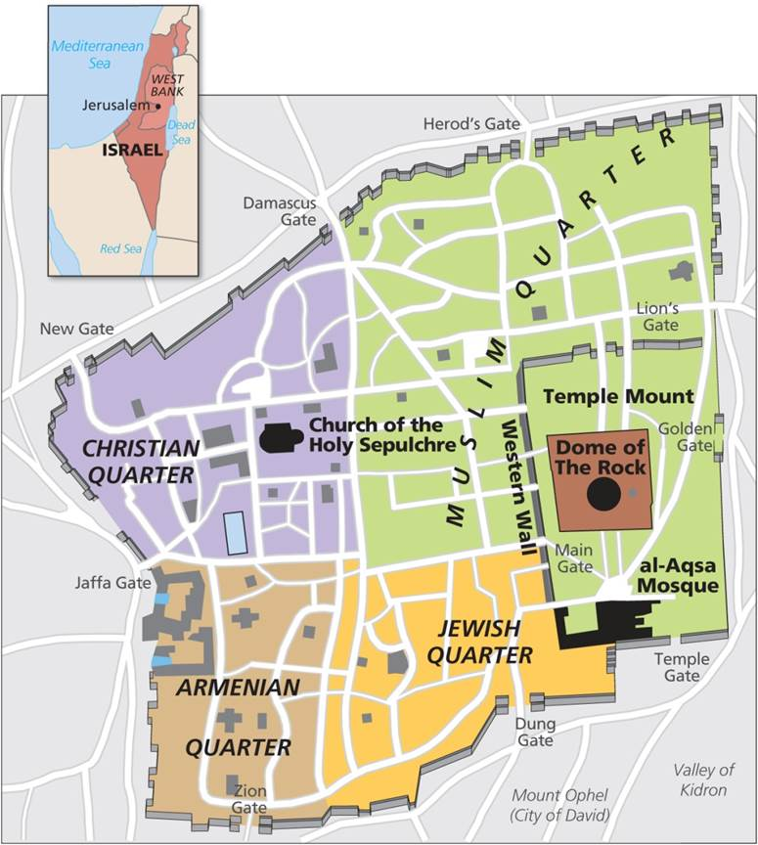
Jerusalem
Ancient history starts with physical site
  An oasis near a mount
  Overlapping sacred space of three world religions
  Cycles of destruction and rebuilding
Center of conflict
  Creation of Israel and Palestinian territory
  Building of Jewish settlements a political act
Sacred sites in Jerusalem.
Notes:
Box 10.2 Figure

Slide 56
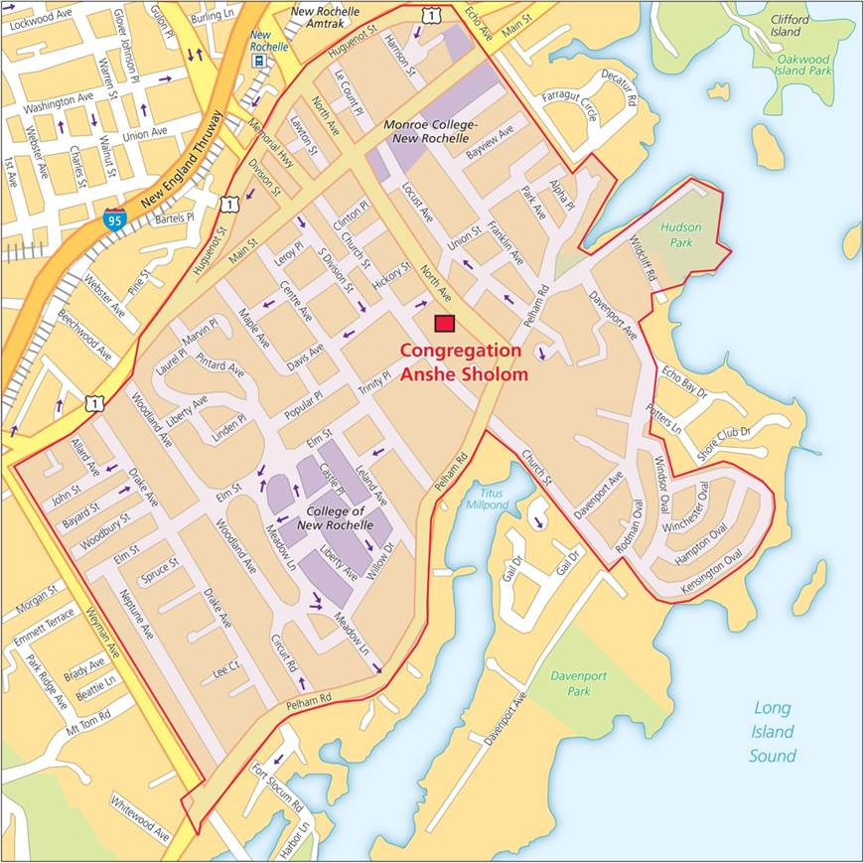
The Religious Organization of Space
Variation in religious and secular spaces
  Global variation in religion’s worth to self
  Societies regulate religious practice in the public sphere
  Each society varies in expression of public and private religious space
  Rise of secular public spaces
Spatial Organization of Religion
  Territorial administrative units of religion
An eruv in New Rochelle, New York.
Notes:
Figure 10.11

Slide 57
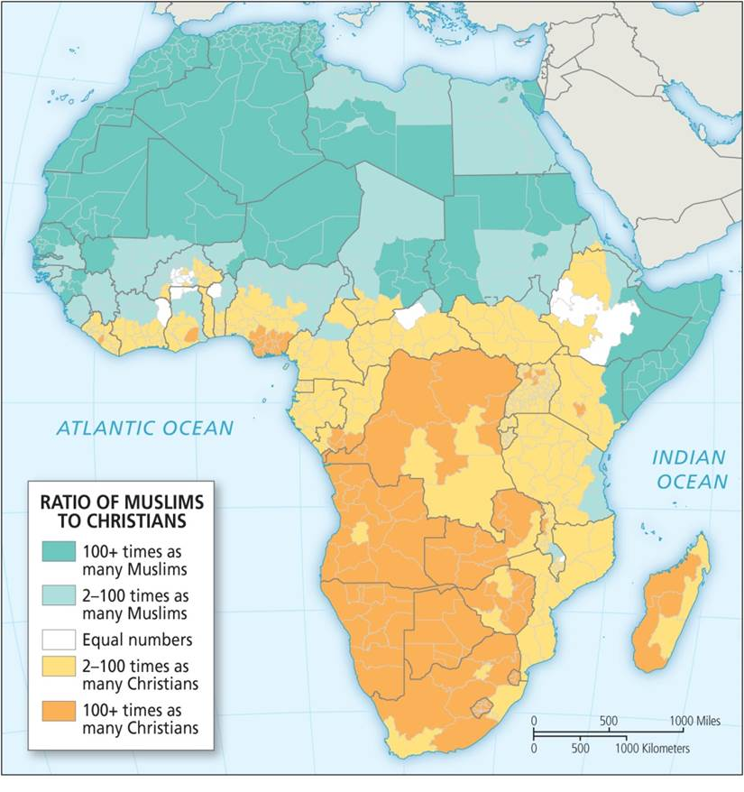
The Religious Organization of Space
Religious Conflict
  Borders between faith communities
  Different religious groups sharing same national space
  Sectarian divisions in faith communities
  Intensified by language and ethnic difference, or socio-economic and political marginalization
Also intensified by illogical boundaries set during colonial period
Muslims and Christians in Africa.
Notes:
Figure 10.12

Slide 58
Religion and Society
Identity
  Religious belief folded up with other forms of identity that have a spatial component
  National identity, religion, and conflict
Globalization
  Religion as culture
  Today’s cultural globalization coincides with expression of religious diversity and fundamentalism
  Movement of peoples and ideas diffused religions further
  Through diasporas, identities can be recast
Only with separation of church and state can religions have equality

Slide 59
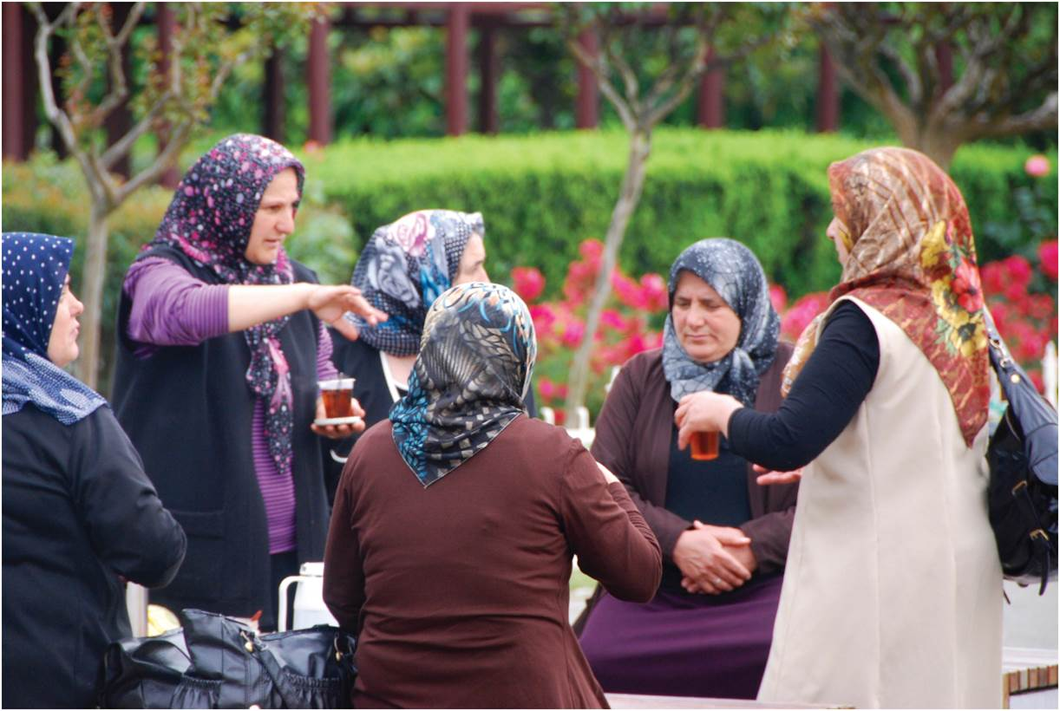
Religion and Society
Social Difference: Gender
  Religion’s role in differentiating genders
  Patriarchal character of monotheistic religions
Witness to Power
  Religion has reinforced power arrangements, but also to resist or advance political sphere
Women in Istanbul, Turkey.
Notes:
Figure 10.13

Slide 60
Religion & Politics
Freedom of religion
  Historically the exception rather than the “rule.”
Theocracy
  Church rules directly – government based on “scriptures.”
Separation of church and state
  Islamic fundamentalists oppose it – favor theocracy
  Instituted by United States Constitution to preserve religious freedom.
Terrorism – unacceptable resort of those who feel marginalized – usually more about power than it is about religion (emotional excuse for violence)

Slide 61
Social Impact of Religion
Gender roles
  Women’s rights, duties, obligations, opportunities, etc.
  Patriarchal or matriarchal societies
Diet and food preparation restrictions
  Kosher – ruled relate to how acceptable food is prepared
  Pork – forbidden to Jews & Muslims
  Beef – unacceptable to Hindus – many are vegetarians
  Alcohol – forbidden to Muslims
Ethics and morals
  Guidelines for the “good” life
Schools and social and medical institutions

Slide 62
Economic Impact
Burial practices – costs
  Time constraints
  Disposal methods & preparations
Protestantism and capitalism
  “Protestant work ethic.” – version of Calvinism
Catholic Church and capitalism
  Usury was considered sinful in the early church
  Individualism with a social conscience
Confucianism verses individualism

Slide 63
Religion and Environment
Burial practices
  Health considerations in India
Origin of the world
  All have some creation story which usually indicates the place of humans in that creation
Relationship with nature
  Exploitive approach – Christianity in practice rather in teaching
  Adaptive approach – Animism and most “Eastern” religions

Slide 64
Other Differences
Nature of God
  Diest
  Personal
Relation to others
  Naturally ecumenical
  Universalizing – emphasis on proselytizing
  Ethnic – no emphasis on proselytizing

Slide 65
Multi-religious State
Where two religions compete to write the laws, a means of working together is needed to avoid possible conflict
  N. Ireland & Canada
  Lebanon
  Philippines
  Nigeria, Sudan,
  Division of India in 1948
  Sri Lanka

Slide 66
Chapter Summary
Three types of religion: animism, religions that emerged in Asia, and monotheistic religions that developed in the Middle East.
The major religions have diffused out from their origin areas.
The “axial age” from 900 to 200 bce saw creation of the great religious traditions, including two main hearth areas of northern India (Buddhism, Hinduism, and Sikhism) and Middle East (Judaism, Christianity, and Islam). All spread throughout the world.
Substantial differences within the major religions, like the Sunni–Shia divide in Islam or Catholic–Protestant divide in Christianity.
Also major differences within certain countries’ religious belief. The US, for example, has a rich range of religious diversity.
Religious beliefs and worship strong in cities around the world.
The environmental movement is informed by religious beliefs.

Slide 67
Chapter Summary
The profound relationship between religion and space is expressed in the notion of sacred sites, the religious organization of space, and the spatial expression of beliefs and practices.
All religious have special areas, sites considered sacred. These are honored and visited in pilgrimages.
The division between religion and secular space can be a contentious issue in many countries and cities.
Religious conflicts can occur over space and about place.
Religious conflicts are most severe when they overlap with differences in wealth, access to power, race, and ethnicity.
Religion is an important source of personal identity, although its importance varies around the world.

Slide 68
Chapter Summary
Globalization is a crucial background to the rise of religious fundamentalism around the world.
Religion plays an important role for immigrants in securing community ties and maintaining identity.
Religion can play an important role in assigning and reinforcing social roles such as gender differences.
Religious beliefs are used to legitimize but also to question existing social relations.

