Slide 1
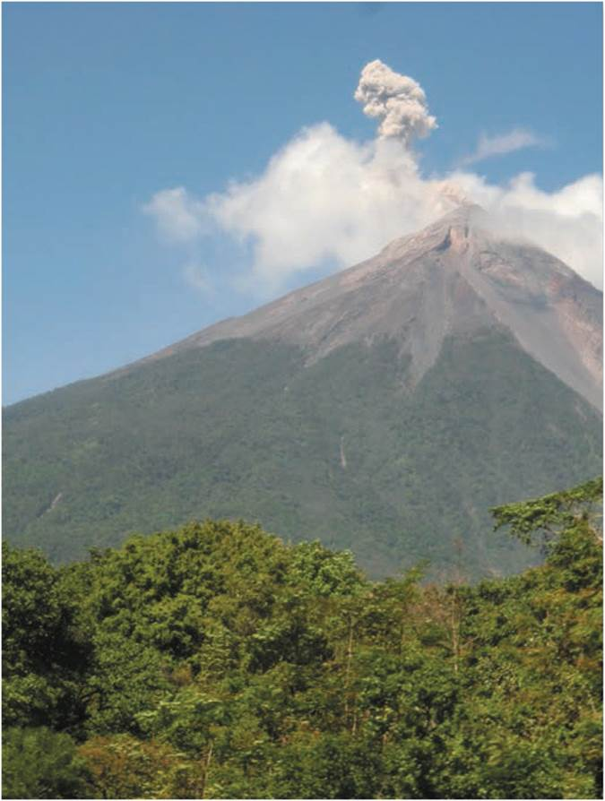
Chapter 1: The Home Planet
“A brief account of the planet we call home. Attention is paid to the evolution of the Earth, its emerging
physical geography, and its humanization.”
An active volcano just outside the city of Antigua in Guatemala.
Notes:
Figure 1.3

Slide 2
Chapter Learning Objectives
Recall the theories that describe the formation, size, and structure of the universe.
Recognize and describe the effects of Earth’s interactions with the Sun and Moon.
Summarize the complex tectonic history of Earth and relate its bearings on human populations.
Describe the developments that are associated with human life on Earth.
Relate the major anthropogenic changes that are impacting Earth.

Slide 3
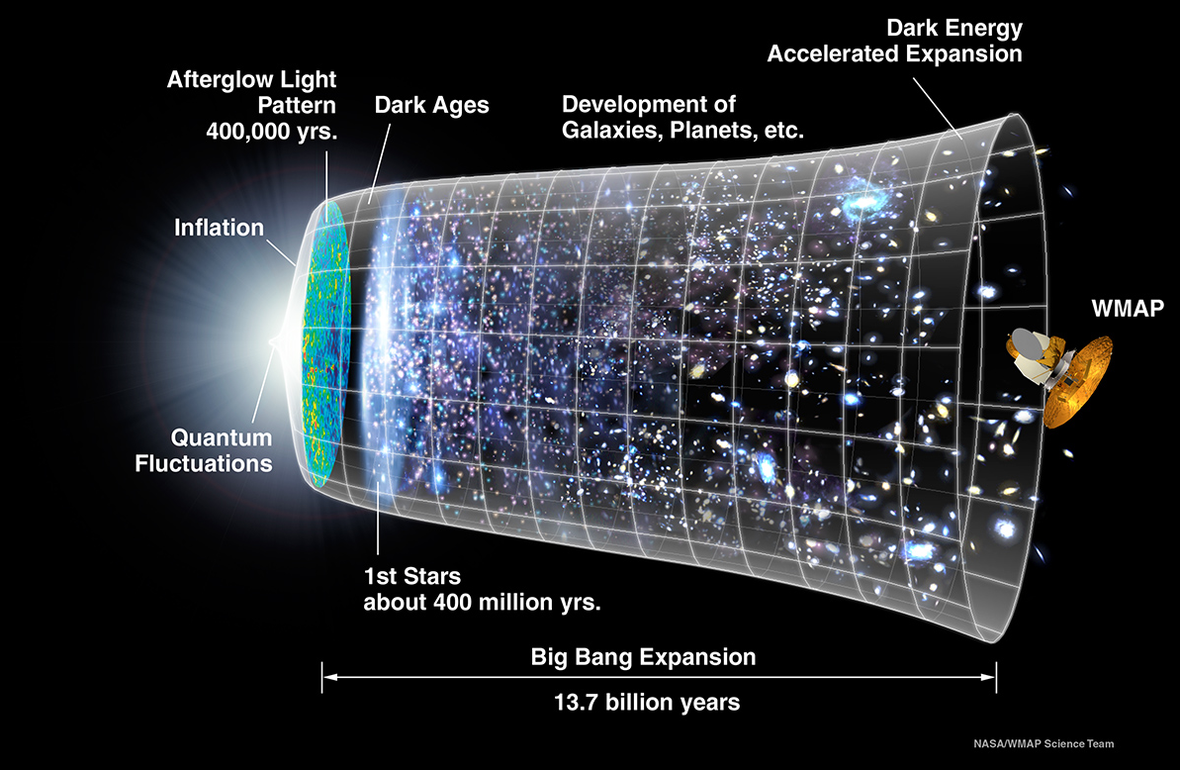
The Big Picture
Big Bang Theory
  Energy and forces in motion that created the Universe
  Dark energy overcame gravity
Earth is in the Milky Way galaxy stretching across 100,000 light years
The expansion of the universe that started with the Big Bang occurred 13.7 billion years ago.
Source: © NASA/WMAP Science Team on Learner.org.
Notes:
Source: © NASA/WMAP Science Team on Learner.org.

Slide 4
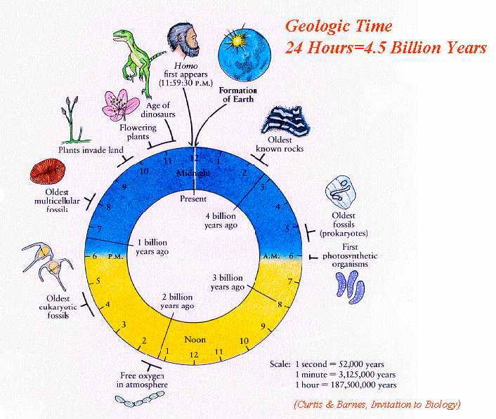
Geologic Time – in 24 hours
Humans have been around for ½ of one minute on this scale.

Slide 5
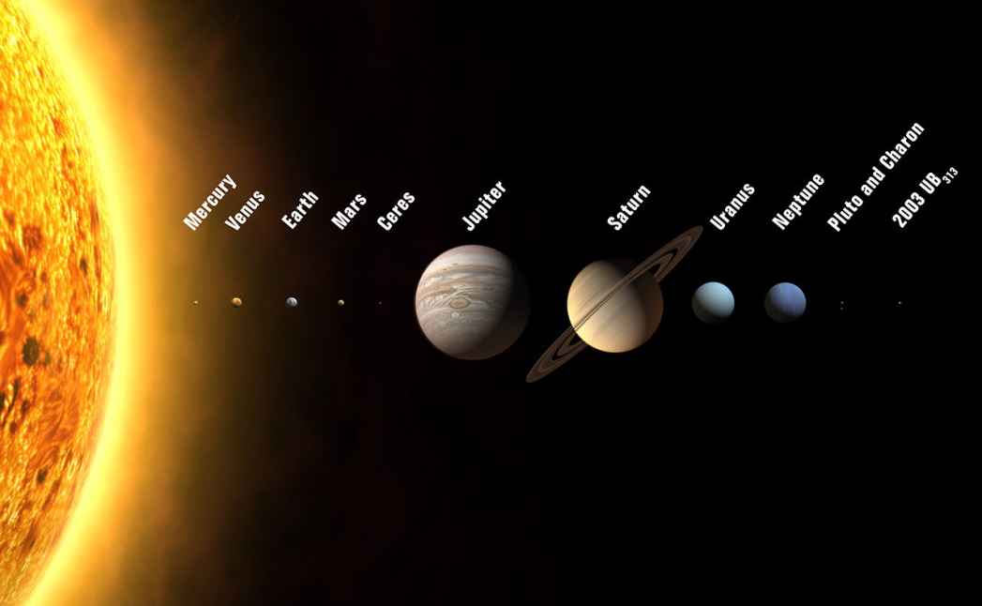
Poor Pluto
From 1930 to 2006, Pluto was the ninth and farthest planet
Reclassified as dwarf planet or plutoid
Maintains an eccentric orbit at the edge of the solar system
What is the difference between a “plant” and a “solar system body”? Does everyone agree?
Source: © International Astronomical Union on Wikimedia Commons.
Notes:
Source: © International Astronomical Union on Wikimedia Commons.

Slide 6
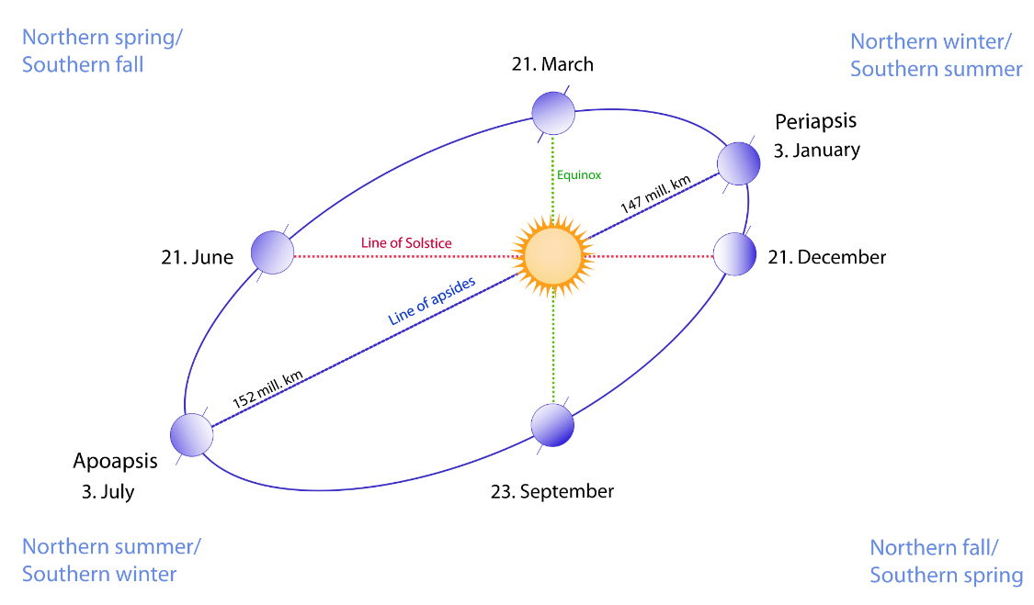
Earth and Sun
Earth’s orbit
  Revolution and the calendar year
  Tilt and the seasons
  Rotations and the
  diurnal cycle
Shifts in Earth’s orbit can account for long-term climate changes
  Angle of tilt moves
  Orbit shape varies
Earth’s revolution, rotation, and tilt influence the varying amount of the Sun’s energy reaching Earth’s curved surface creating seasons.
Source: © Frank Horst on Wikimedia Commons.
Notes:
Source: © Frank Horst on Wikimedia Commons.

Slide 7
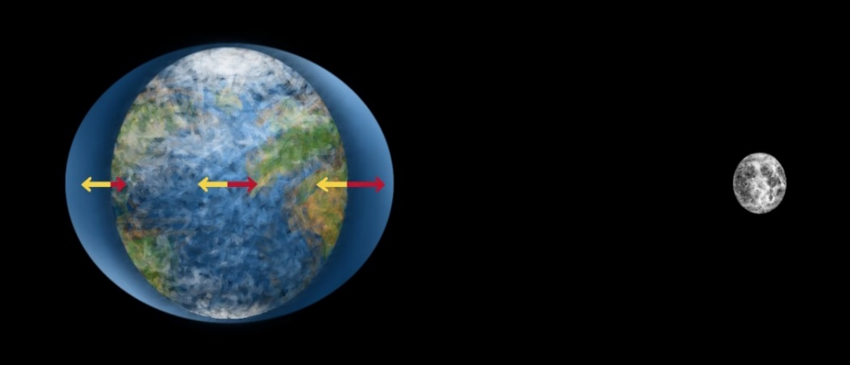
Rhythms to Life on Earth
Asteroid impact created the Moon
Moon’s gravitational pull creates the tides
Lunar cycle and calendar months
Effect of yearly, monthly, daily cycles
  Seasonal affective disorder (SAD)
Tidal bulges result from the interaction of gravitational and centrifugal forces. Pull of gravity is shown in red arrows and centrifugal spinning shown in yellow arrows.
Source: © Wikimedia Commons.
Notes:
Source: © Wikimedia Commons.

Slide 8
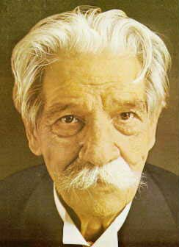
Conclusion from a healthy world view
"The deeper we look into nature the more we recognize that it is full of life, and the more profoundly we know that all life is a secret, and we are all united to all this life."
Albert Schweitzer

Slide 9
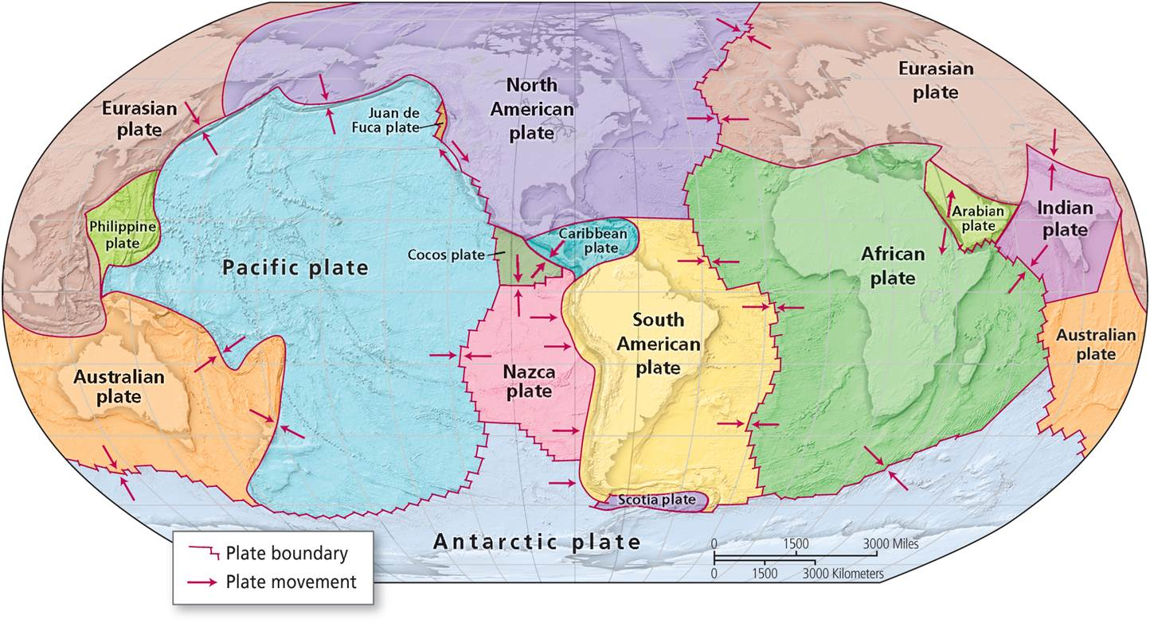
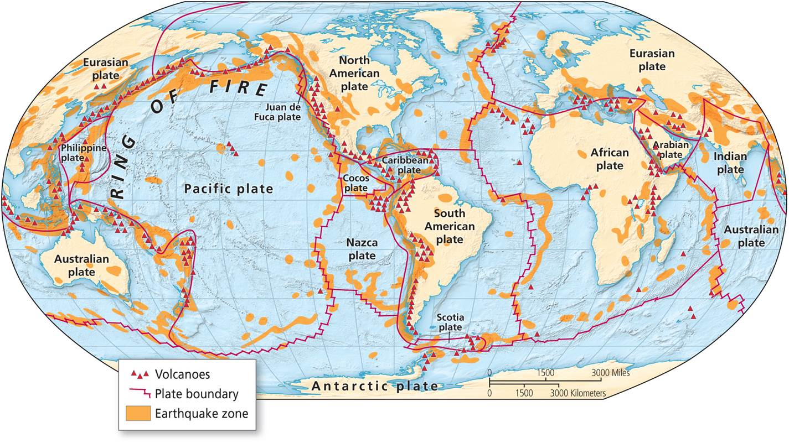
Plate Tectonics
Tectonic plates sit atop molten mantle currents
Plates are constantly moving
  Create landforms, earthquakes, and volcanoes
Notes:
Figures 1.1, 1.2

Slide 10
Plate Boundaries
The Earth’s crust is broken up into massive tectonic plates. The plates are constantly moving, pulled by the circulation of molten rock within the Earth.
Notes:
Figure 1.1

Slide 11
Process of Continental Drift
Appears to be generated by heat-sustained convection cells in the interior (particularly the asthenosphere which is not solid)
Movement occurs where plate boundaries abut
  Divergence – spreading along mid-ocean ridges which lie above and upwelling in the cell
  Convergence (subduction) – colliding plates over the downward portion of a convection cell
  Ring of Fire – largely an area of subduction

Slide 12
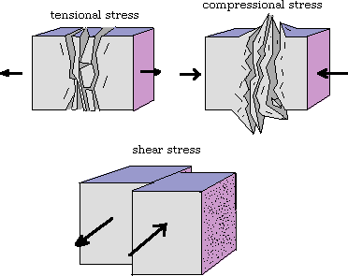
Types of Crustal Forces
Tensional – dragging action
Compres-sional – pulling action
Sheer – oblique action

Slide 13
Earthquakes and Volcanos
Location of seismic activity (earthquakes and volcanoes). Notice their clustering along plate boundaries. There is an area of intense seismic activity, referred to as the Pacific Ring of Fire, around the Pacific Ocean.
Notes:
Figure 1.2

Slide 14
Earth’s Past Tectonic Configurations
Plates coalesced and broke up apart
  Rodinia and Pangaea supercontinents
  Current break up
Tectonic catastrophes create environmental stressors that impact life developing on earth
  Human evolution
  Global climate change
Notes:
Figures 1.1, 1.2

Slide 15
Indo-Australian/Eurasian Plate Boundary
One of most active volcanic borders
Three influential
tectonic events
  Mount Toba erupted 70,000 years ago and created volcanic winter
  1883 island of Krakatoa eruption, tsunami and global air pollution
  2004 undersea earthquake created destructive tsunami on all sides of the Indian Ocean
Volcano just outside the city of Antigua in Guatemala.
Notes:
Figure 1.3

Slide 16
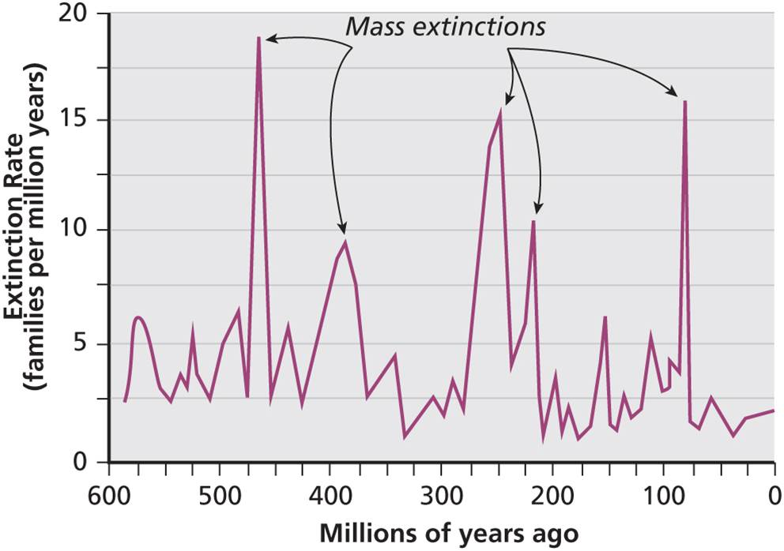
Life on Earth
Cycles of life and mass extinctions
  Various forms of life emerged and disappeared
Infamous extinction of dinosaurs
  Thought to result from an asteroid impact, or massive sulfur dioxide poisoning with acid rain
Five spikes in extinction events, each with its own causes and consequences.
Notes:
Figure 1.4

Slide 17
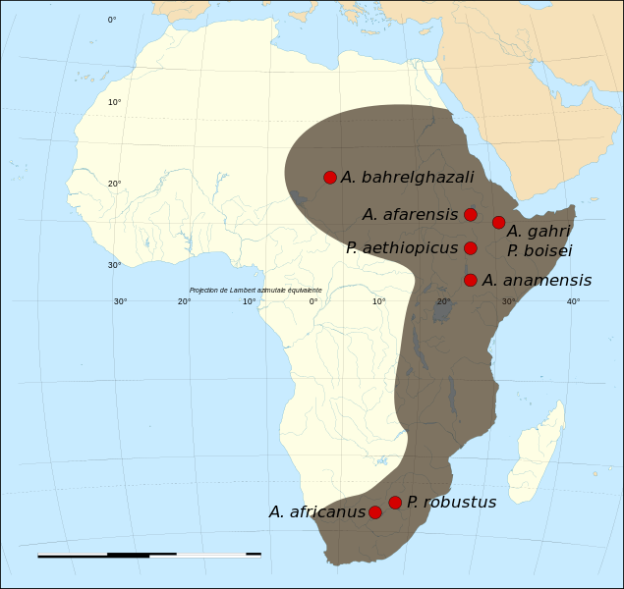
Life on Earth
Age of mammals
  65 million to 1.8 million years ago
  First hominid stood up near 4 million years go
  Between 2 and 3 million years ago at least 8 different hominids
  All life at this time had to adjust to constant environmental change
Hominid fossil sites and spread of early hominids.
Source: © Wikimedia Commons.
Notes:
Source: © Wikimedia Commons.

Slide 18
Five Extinction Events
Five spikes in extinction events, each with its own causes and consequences.
Notes:
Figure 1.4

Slide 19
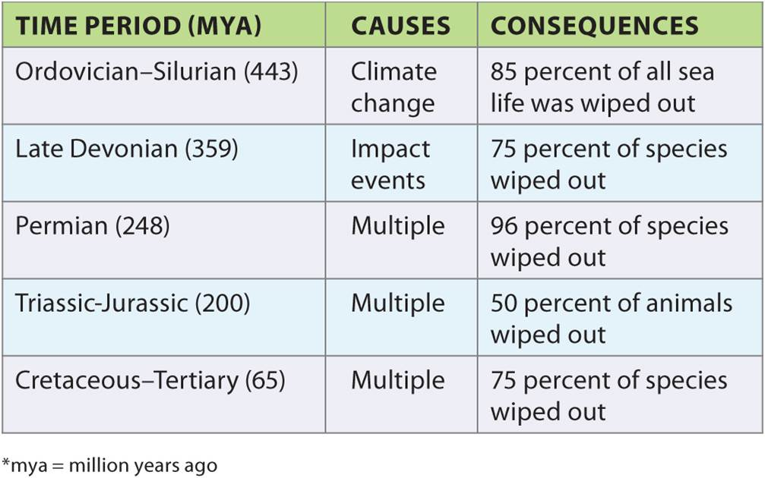
Mass Extinction Events
Table 1.1
Details the causes and consequences of the five extinction events.
Notes:
Table 1.1

Slide 20
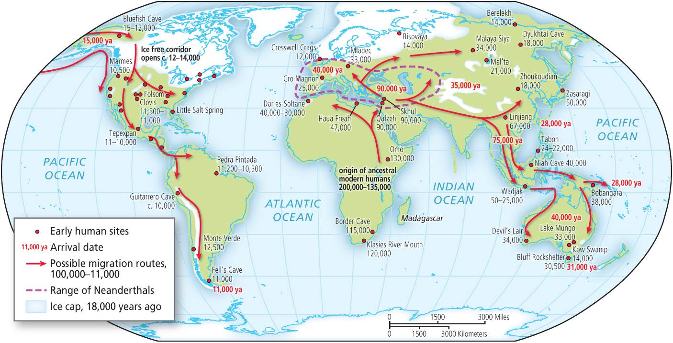
A Humanized World - Migrations
Out of Africa
  A rising consensus about human origins in Africa
  Evidence of genetic variation and distance-decay effect
  Human diffusions took form of budding
  One migration during Ice Age occurred across the exposed land bridge to populate Americas
The first humans migrated out of Africa and established early human sites.
Notes:
Figure 1.5

Slide 21
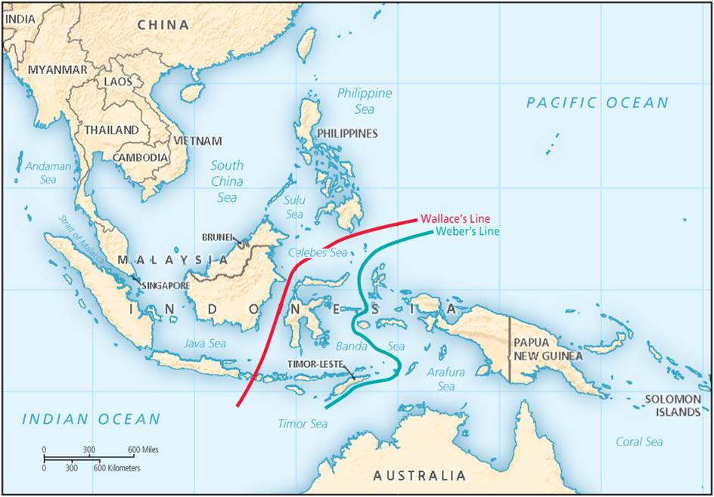
Wallace’s Line
Alfred Wallace, d.1913 collected samples across Malay Archipelago
Biogeographical zone of transition between Australian and Asian biotas
  Weber’s line to the east
  Difference in mobility between flora and fauna
  Result of plate tectonics bringing two separate biological realms in contact
Biogeographical zone of transition between Wallace and Weber’s lines.
Notes:
Box 1.2 Figure

Slide 22
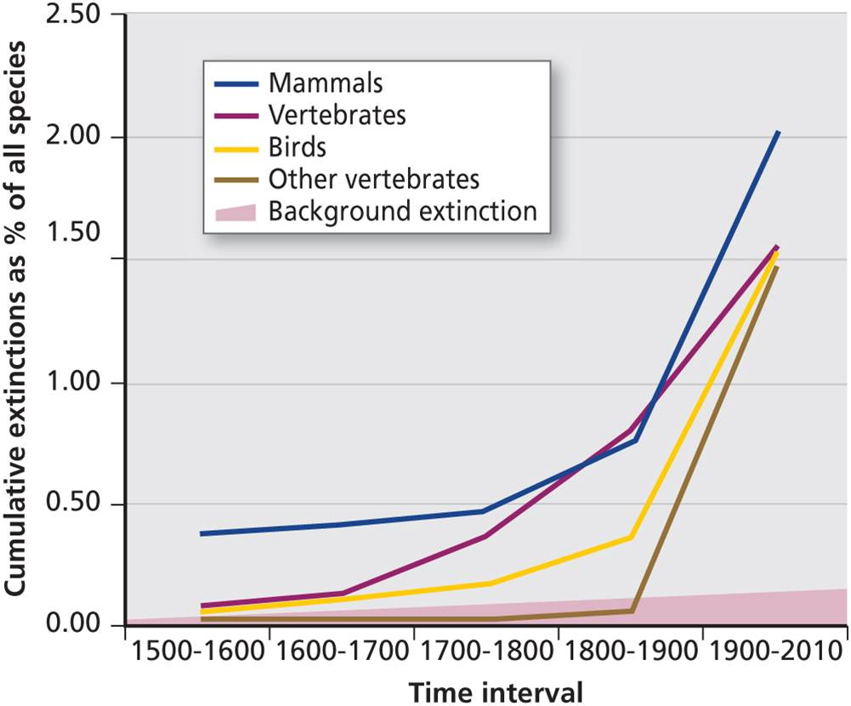
A Humanized World
Humans continually moved, settled new areas
Environmental impacts
  Competition between hominid groups
  Pleistocene Overkill, extinction of megafauna and overkill in America
Humanization of the Earth was marked by ecological changes and extinction.
Notes:
Figure 1.6

Slide 23
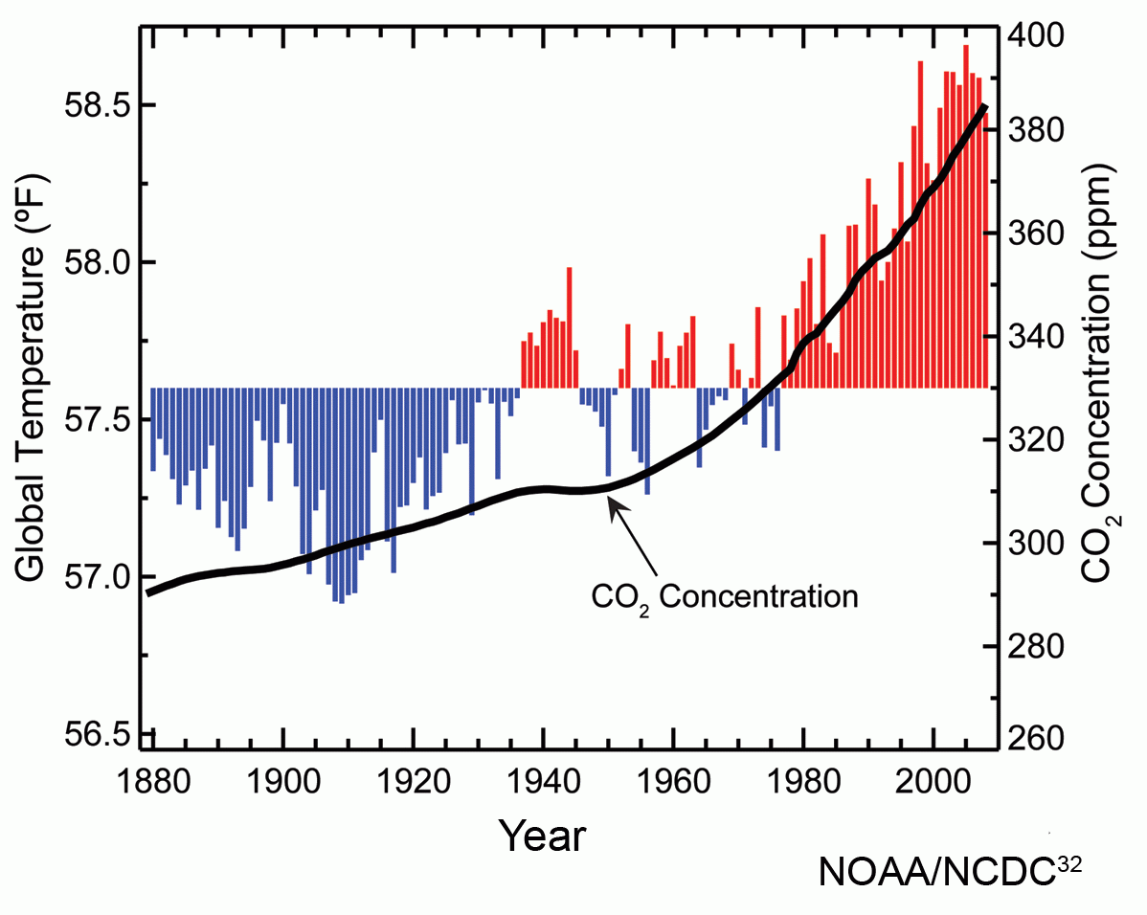
Climate Change
Over Earth’s history, its climate has varied
  Recent past 1,000 years has a Medieval Warm Period and Little Ice Age
Past 100 years, average temperatures increasing again due to anthropogenic climate change
  Humans contribute greenhouse gases like carbon dioxide that warm the atmosphere
Global annual average temperature and atmospheric carbon dioxide.
Source: © NOAA/NCDC on Wikimedia Commons.
Notes:
Source: © NOAA/NCDC on Wikimedia Commons.

Slide 24
Climate Change Impacts and Responses
Current and Future Impacts
  Melting glaciers
  Thawing of permafrost
  Shifting ranges of flora and fauna
  Possible 6th extinction
  More extreme weather like drought, flood, storms
  Threatened ecosystems on land and in oceans
  Arctic Amplitude
Adaptation
  Engineered and technological solutions
  Changing behaviors
Mitigation
  Slow or alleviate expected changes
  Carbon footprint and individual emissions

Slide 25
Next: the four most important sentences you will ever contemplate. The survival of humanity may hinge on how seriously humans are willing to be guided by these laws.

Slide 26
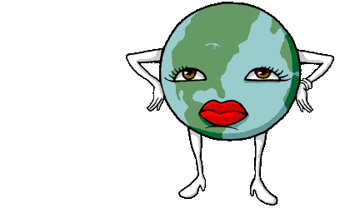
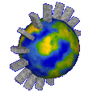
The Four Laws of Ecology
Human survival may depend on humans understanding and valuing these laws and in considering them whenever decisions affect the environment.

Slide 27
Four Laws of Ecology: From Barry Commoner’s book The Closing Circle
Everything is connected
  Everything on earth is interconnected much like a huge spider web
Everything goes somewhere
  Elements of the system may change but don’t cease to exist
Nature knows best
  What nature creates is biodegradable
There’s no such thing as a free lunch
  There are consequences (costs) for every action

Slide 28
Chapter Summary
The universe is thought to have been formed with the Big Bang. Forces, matter, and energy interact to form galaxies, star systems, planetary bodies.
Earth revolves as it rotates around the Sun tilted and wobbling. Basis for daily and yearly calendars.
Created out of an asteroid impact with Earth, the Moon influences the tides and is basis for the division of time into months.
Seasons and lunar cycle can affect life in profound ways, such as Seasonal Affective Disorder (SAD).

Slide 29
Chapter Summary
Earth’s crust formed 4.5 million years ago. Crust is broken into several, moving tectonic plates. A variety of geologic features can be found at plate boundaries.
Configuration of landmasses has changed over Earth’s history, forming supercontinents and then breaking them apart.
Human movements and developments have been influenced by tectonic events, climate shifts, and resulting environmental stressors.

Slide 30
Chapter Summary
Life on Earth began around 2.2 billion years ago. Several phases of evolution occurred and died out. At least five major mass extinctions have occurred.
First humans are thought to have migrated out of Africa, settled into subgroups, and continued to spread over the planet.
As human groups grew in number and expanse, their impact on other organisms and on the environment has grown precipitously.
Current warming associated with anthropogenic climate change will have widespread effects. Reponses will be in adaptation or mitigation.

