Slide 1
U.S. Gets Poor Score on Life Expectancy
Organizations for Economic Co-operation and Development (OECD) report

Slide 2

OECD REPORT
The USA ranked 26th – that’s shameful for the richest country in the world
Life expectancy in the U.S. has risen in the past few decades. While in 1970 life expectancy at birth was 70.9 years, it rose to 78.7 year by 2011. However, most of the developed world is improving faster than this country. And despite the fact that the U.S. spends vastly more per capita on health care than any other country, Americans’ life expectancy is only 26th highest.

Slide 3
As might be expected, residents in countries with higher life expectancy tend to be healthier. In six of the 10 countries, more than three quarters of adult residents surveyed in 2011 reported being in good health, compared to the OECD average of 69%. Residents of countries with high life expectancy also tend to have lower incidence of serious diseases and lower rates of death when they contract these illnesses. The majority of these countries have below-average rates of cancer mortality and diabetes. As might be expected, residents in countries with higher life expectancy tend to be healthier. In six of the 10 countries, more than three quarters of adult residents surveyed in 2011 reported being in good health, compared to the OECD average of 69%. Residents of countries with high life expectancy also tend to have lower incidence of serious diseases and lower rates of death when they contract these illnesses. The majority of these countries have below-average rates of cancer mortality and diabetes.

Slide 4
In countries where health care spending is very low, life expectancy tends to be far lower than most of the developed world. Indonesia and India both spent less than $200 per capita on health expenditure as of 2011. Both countries had an average life expectancy at birth of less than 70 years. Other nations that spent less than $1,000 per resident on health were China, Mexico, South Africa, and Turkey. None had an average life expectancy of over 75 years — while the OECD average is 80 years. In South Africa, the average life expectancy is just 53 years.
Meanwhile, the U.S. spent $8,508 per capita on health care in 2011, more than $2,800 higher than the next country. The U.S. was 26th among the 40 countries measured by the OECD.
Affordability and access to care are major factors that may be leading these countries’ residents to longer lives. A high rate of health insurance coverage

Slide 5
10. Norway
> Life expectancy: 81.4
> GDP per capita: $61,060 (the highest)
> Health spending per capita: $5,669 (2nd highest)
> Pct. of adults reporting good health: 73.3 (15th highest)
Likely due to large oil reserves in the North Sea, Norway has been among the wealthiest nations in the world for several years now. Only the U.S. spent more on health care per capita than Norway in 2011. Unlike the U.S., however, health coverage in Norway is universal, like nearly all other OECD countries. Like other members of the European Union, the country provides health coverage to visiting EU residents. In 2011, 17% of Norwegians were smoking daily, below the OECD average, and nearly 50% less than in 1990, the largest reduction in smoking habits out of all countries reviewed.

Slide 6
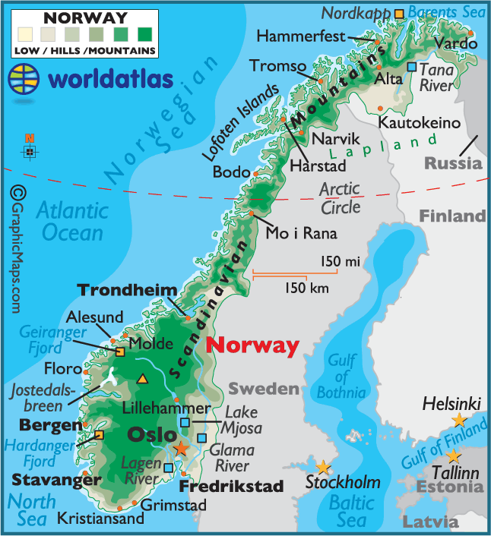
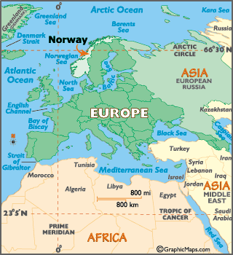

Slide 7
9. Israel
> Life expectancy: 81.8
> GDP per capita: $28,958 (18th lowest)
> Health spending per capita: $2,239 (16th lowest)
> Pct. of adults reporting good health: 81.5 (6th highest)
Among the nations with the highest life expectancy, Israel spent the least on health care in 2011. The country’s GDP per capita is also low relative to the rest of the nations with high life expectancy. Despite the populace’s reported long life-expectancy, the proportion of elderly Israelis over 65 was well below the OECD average of 15.1%, at 9.9% in 2010. More than many other countries measured by the OECD, Israel’s population has been relatively young in recent years, and it’s population is growing. Alcohol consumption in Israel was among the lowest in 1990 and continues to be relatively low as of 2007, the most recent data available. Between those years, however, alcohol consumption among adults increased by over 33%, one of the largest increases.

Slide 8
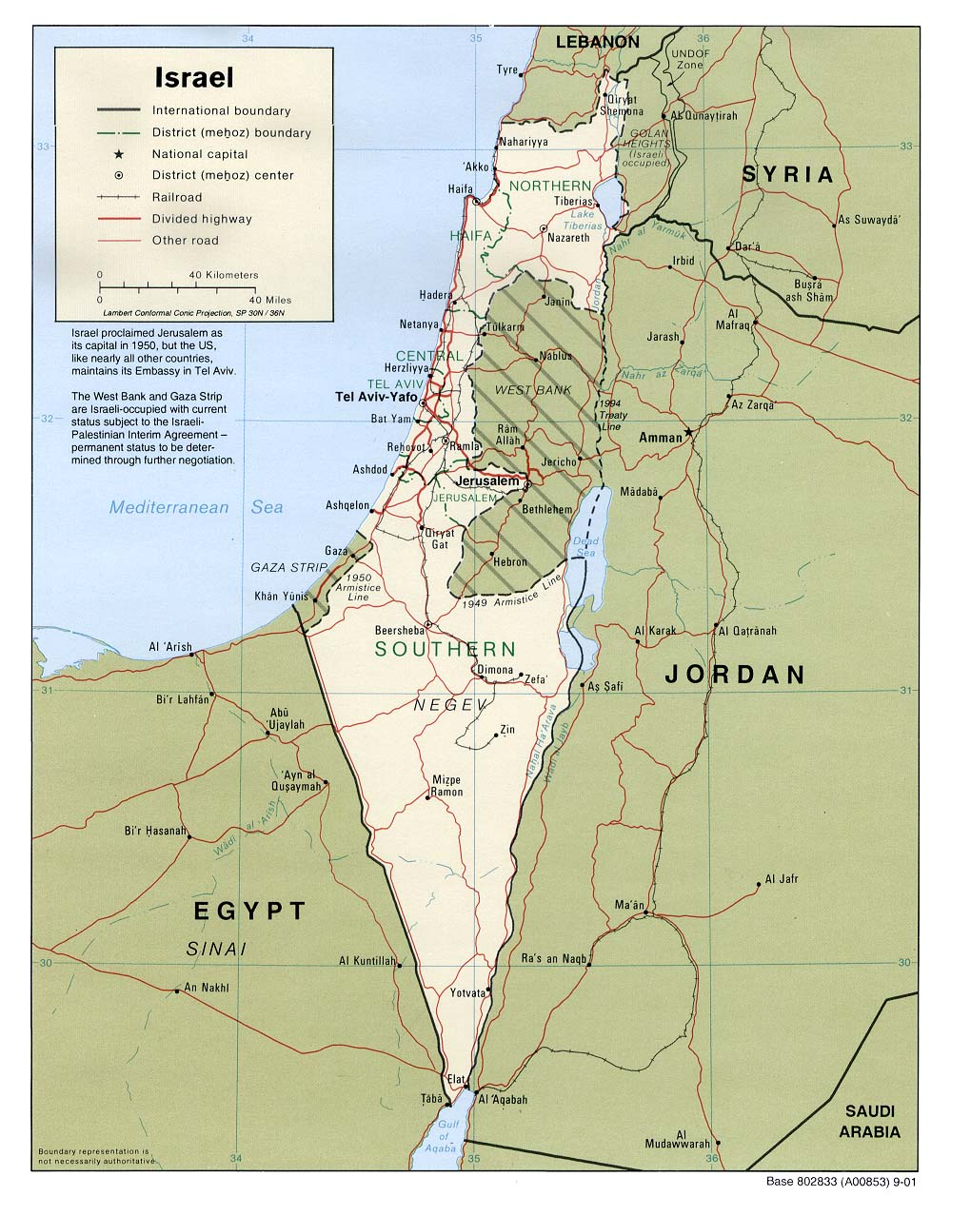
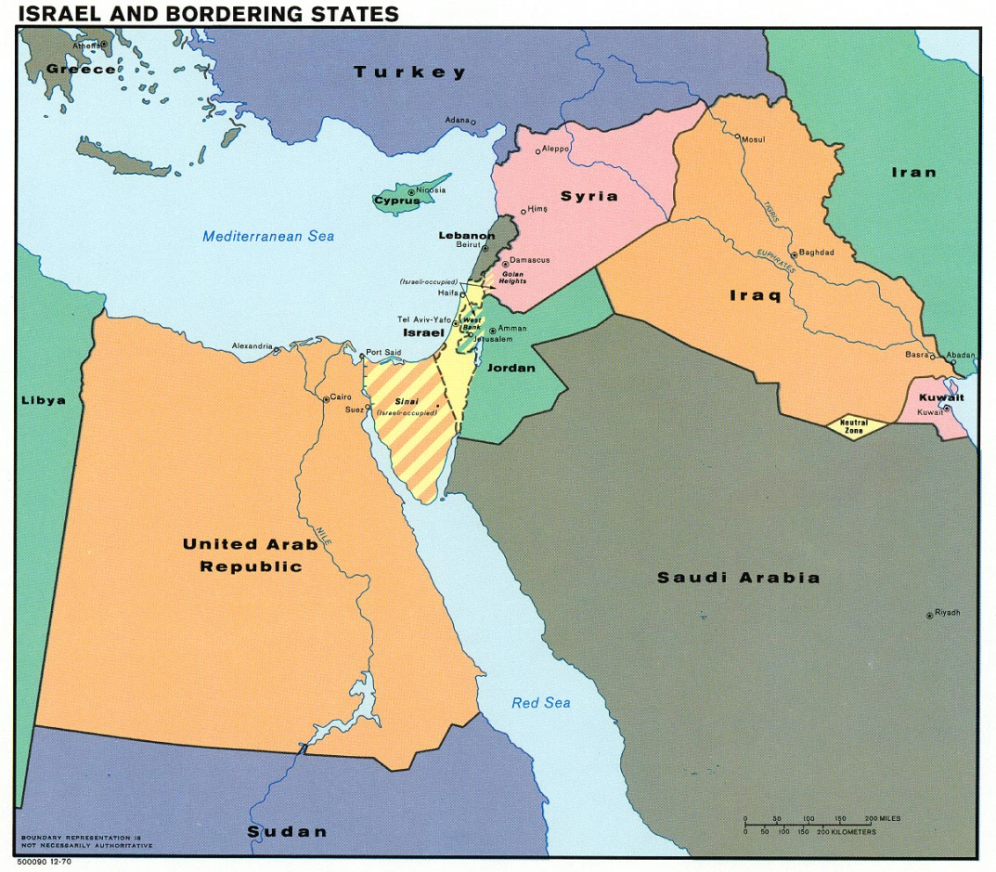

Slide 9
8. Sweden
> Life expectancy: 81.9
> GDP per capita: $41,461 (8th highest)
> Health spending per capita: $3,925 (12th highest)
> Pct. of adults reporting good health: 79.9 (8th highest)
In 1970, Sweden’s life expectancy at birth was the best in the world at 74.8 years. By 2011, life expectancy rose to almost 82 years. Sweden is renowned for its universal health care system, which was introduced in 1913 and was the world’s first. Further, HelpAge International’s “Global AgeWatch 2013 Index” ranked Sweden the best country for older people to live in this year. The country had one of the lowest rates of cancer mortality among nations reviewed by the OECD. Just 13.1% of Swedes smoked daily in 2011, better than every nation reviewed except for India.

Slide 10
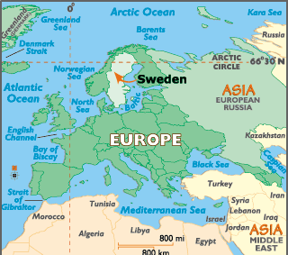
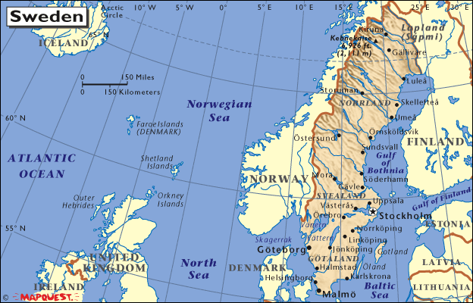

Slide 11
7. Australia
> Life expectancy: 82.0
> GDP per capita: $44,201 (4th highest)
> Health spending per capita: $3,800 (13th highest)
> Pct. of adults reporting good health: 85.4 (4th highest)
Australian adults were among the most likely in the developed world to state they were in good health, at 85.4% as of 2011. This trails just three other nations: the U.S., Canada, and New Zealand. But despite claims they are healthy, Australians were more likely to be obese than residents in nearly all other OECD nations. Only Mexico and the U.S. had higher obesity rates than Australia’s. One factor in which the country performs well is smoking. Just 15.1% of adults smoked as of 2010, versus an average of 20.9% across the OECD.

Slide 12
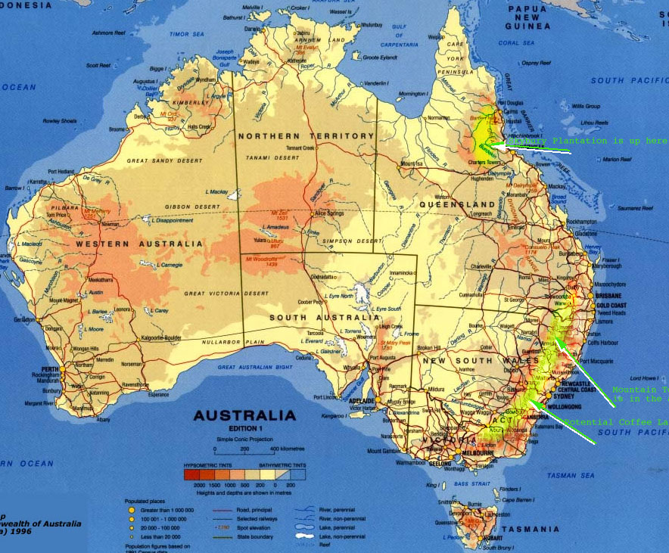
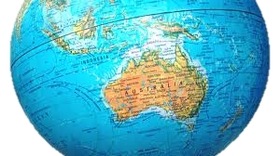

Slide 13
6. France
> Life expectancy: 82.2
> GDP per capita: $35,395 (16th highest)
> Health spending per capita: $4,118 (10th highest)
> Pct. of adults reporting good health: 67.6 (15th lowest)
The life expectancy of French women — as well as Japanese women — was nearly 86 years in 2011, the longest of all countries measured by the OECD. On the other hand, the life expectancy of French males — 78.7 — was just 13th that year. More than 5% of France’s population was over 80 years old in 2010, more than every country reviewed except for Japan and Italy. Death from cerebrovascular diseases, which includes strokes and aneurisms, occurred at among the lowest rates, at around 40 deaths per 100,000 French residents, second only to Switzerland.

Slide 14
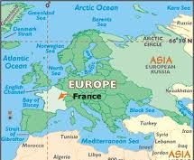
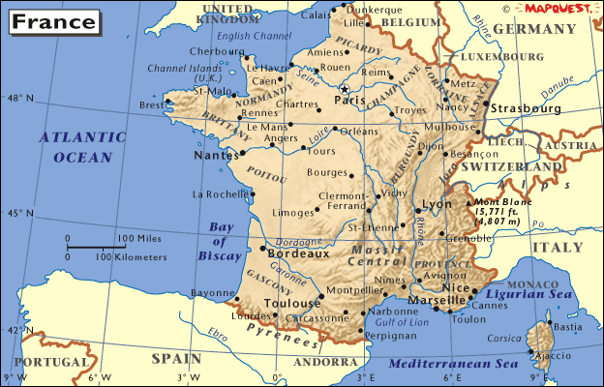

Slide 15
5. Spain
> Life expectancy: 82.4
> GDP per capita: $33,045 (18th highest)
> Health spending per capita: $3,072 (20th highest)
> Pct. of adults reporting good health: 75.3 (13th highest)
The life expectancy of a Spanish child born in 2011 was 82.4 years. The country’s mortality rates from cancer, heart disease, and cerebrovascular disease were all lower than the OECD averages. Spain had just 3.2 hospital beds per 1,000 residents in 2011, versus 4.8 on average for the OECD and 13.4 beds per 1,000 residents in Japan. Spain’s population is expected to age in the coming decades, and in 2050 more than 36% are expected to be senior citizens, the highest proportion of any nation in Europe.

Slide 16
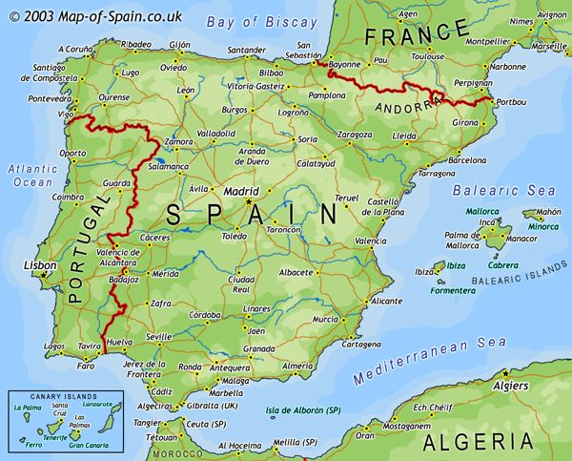
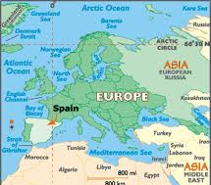

Slide 17
4. Iceland
> Life expectancy: 82.4
> GDP per capita: $36,611 (14th highest)
> Health spending per capita: $3,305 (17th highest)
> Pct. of adults reporting good health: 77.8 (9th highest)
Among Icelandic men, life-expectancy at birth was over 80 years in 2011, the highest compared with men in all other countries reviewed by the OECD. Women in Iceland, however, were expected to live 84 years, only eighth highest out of the 40 nations measured. Only 14.3% of Iceland’s population were daily smokers as of 2011, less than all but three other countries reviewed. Alcohol consumption in 1990 was low compared with most European countries. Eighteen later, alcohol consumption was still relatively low, at just over seven liters per person, less than most other developed nations. However, Icelanders’ alcohol consumption had increased by 40%, more than almost every country surveyed by the OECD. Among Icelandic adults between the ages of 20 and 80 years, just over 3% were estimated to have had diabetes in 2011, the lowest proportion of any country reviewed and considerably better than the U.S.’s 9.8% rate.

Slide 18
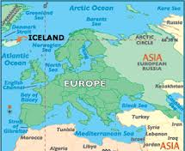
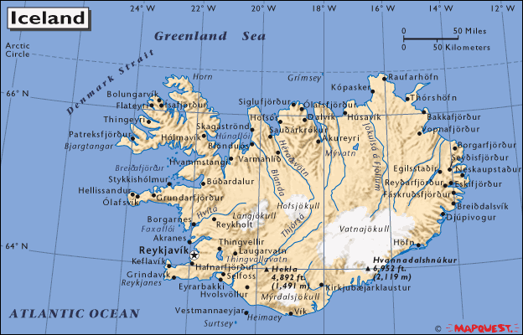

Slide 19
3. Japan
> Life expectancy: 82.7
> GDP per capita: $33,843 (17th highest)
> Health spending per capita: $3,213 (18th highest)
> Pct. of adults reporting good health: 30 (the lowest)
Although life expectancy at birth in Japan was tied with Italy for second-highest out of all nations measured by the OECD, Japanese women were expected to have the longest lives when compared to women in all the other countries measured. Japan also had the largest elderly population as of 2010. That year, 23% of the population was at least 65 years old, while 6.4% was at least 80 years old, both the most of any country the OECD reviewed. These numbers are expected to jump substantially to 38.8% and 16.5%, respectively, by 2050. Japan’s population is quite healthy by several measures. Mortality due to heart disease occurred just 39 times per 100,000 people, lower than in any other country and more than three times better than the U.S. Just 4.1% of Japanese adults were obese in 2011, versus 36.5% in the U.S.

Slide 20
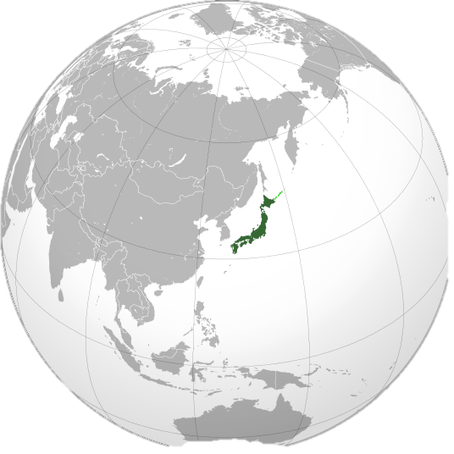
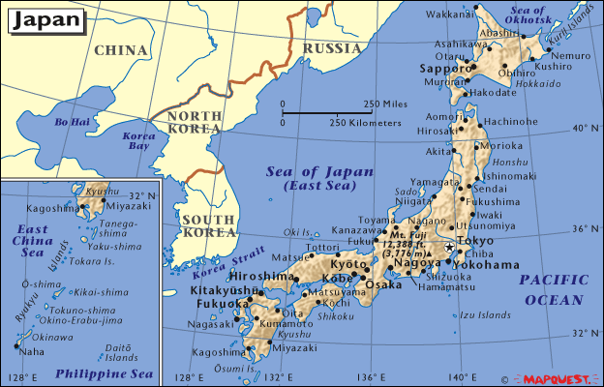

Slide 21
2. Italy
> Life expectancy: 82.7
> GDP per capita: $32,648 (19th highest)
> Health spending per capita: $3,012 (20th lowest)
> Pct. of adults reporting good health: 64.7 (11th lowest)
Italian health care spending totaled just over $3,000 per capita in 2011, lower than many nations measured by the OECD. There were more than four doctors per 1,000 residents in 2011, more than the OECD average of 3.16 per 1,000 and the highest measured. Although smoking rates in Italy did not drop as dramatically in recent years as in other countries, alcohol consumption fell and just 10% of adults were obese, compared with an adult obesity rate of 17.6% across the OECD. The country has also had to deal with the changing dietary habits of its residents who consume much less than before the “Mediterranean diet” — a diet that emphasized fruits, vegetables, and olive oil and is often regarded as very healthy.

Slide 22
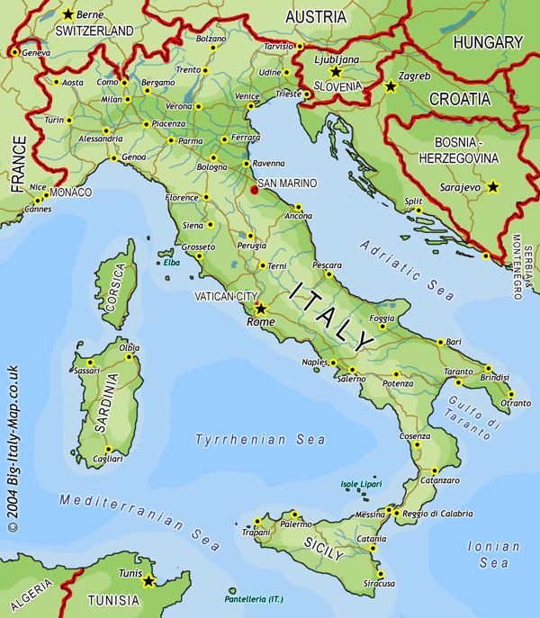
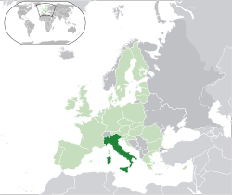

Slide 23
1. Switzerland
> Life expectancy: 82.8
> GDP per capita: $51,227 (2nd highest)
> Health spending per capita: $5,643 (3rd highest)
> Pct. of adults reporting good health: 81.3 (7th highest)
Switzerland had the world’s longest life expectancy at birth at nearly 83 years as of 2011 — 10 years longer than it was in 1970. Switzerland’s health care expenditure totalled $5,643 per person, the third highest out of countries measured by the OECD. Resident’s out of pocket expenditures accounted for 3.8% of household income, more than in all but 6 OECD nations. Although the Alpine country is hardly alone in providing residents with universal coverage, Switzerland’s system has frequently been compared to the Affordable Care Act because it requires residents to purchase private health insurance. Swiss residents are quite healthy, with lower cerebrovascular and cancer mortality rates than nearly all other nations measured by the OECD.

Slide 24
