Slide 1
Hunger is a 'silent crisis' in the USA
Marisol Bello, USA TODAY April 16 & 17, 2014

Slide 2
Poverty, which contributes to hunger, has remained stubbornly high, he says. The poverty rate — defined by the federal government as annual income of $23,550 for a family of four — is 15%. "This shows tens of millions of Americans are still struggling," he says. She says reductions in government programs such as food stamps coupled with rising costs of food, housing and utilities force poor families to choose between buying food and paying bills. "This is a massive public health crisis, and it is a silent crisis," she says. In November, Congress reduced food stamp benefits to 47 million people. On average, a family of four receiving $668 a month saw that allotment drop by $36.

Slide 3
Where Risk of Hunger is Greatest
States in the South have the nation’s highest raters of what the government calls “food insecurity” – meaning that at some point in the year, a household eats less, does not eat nutritious meals, or goes hungry because there is not enough money for food.

Slide 4

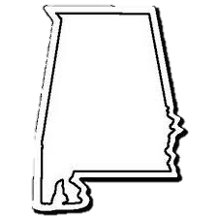
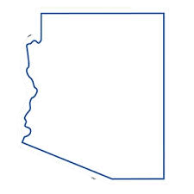
Alabama Alaska Arizona
18.6% 14% 17.8%

Slide 5
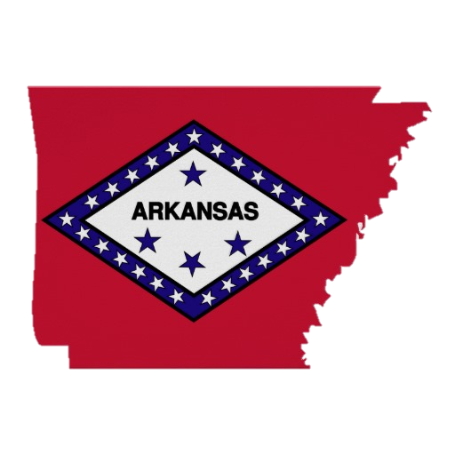
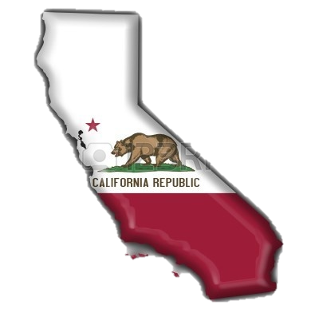

Arkansas California Colorado
19.4% 16.2% 14.6%

Slide 6
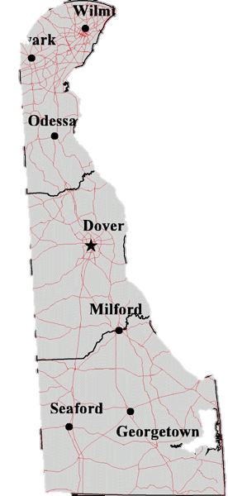
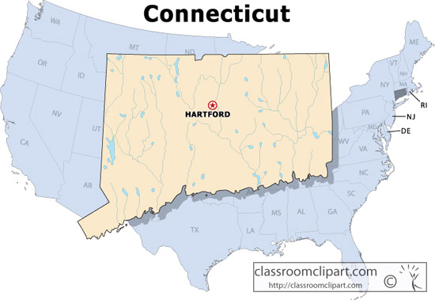
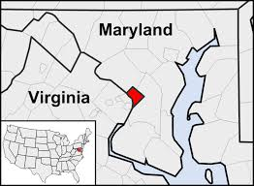
Connecticut Delaware D.C.
13.9% 13% 14.5%

Slide 7
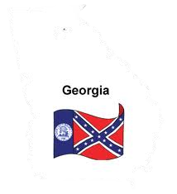
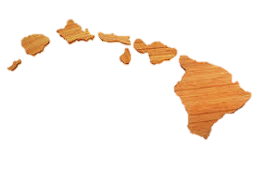
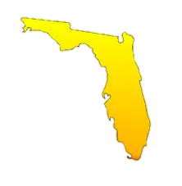
Florida Georgia Hawaii
17.9% 18.9% 14.2%

Slide 8
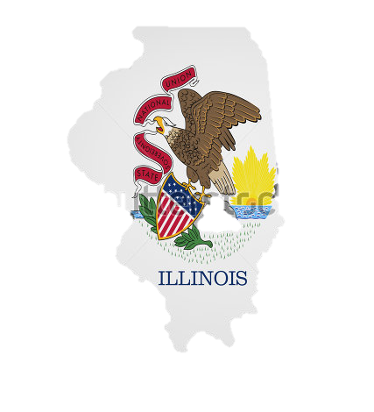
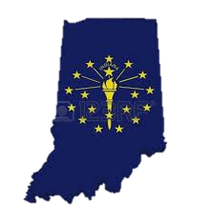
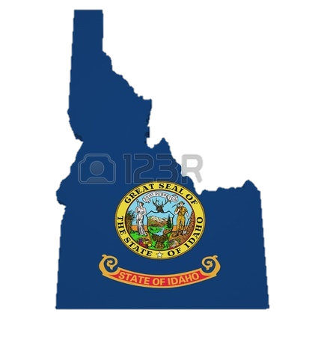
Idaho Illinois Indiana
15.8% 14.2% 15.7%

Slide 9
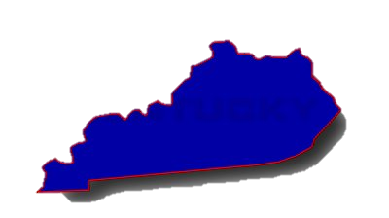
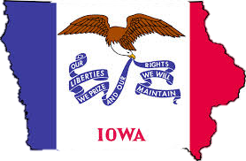
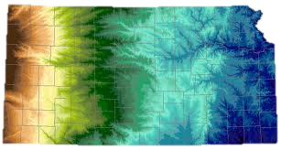
Iowa Kansas Kentucky
12.7% 14.8% 16.7%

Slide 10
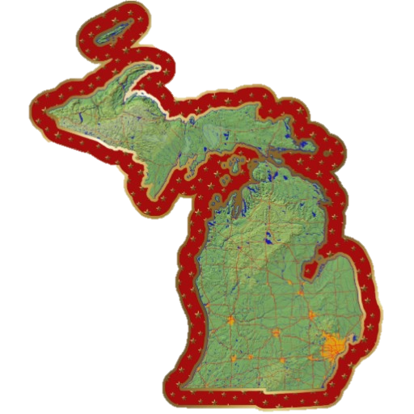
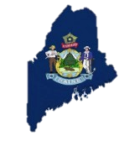
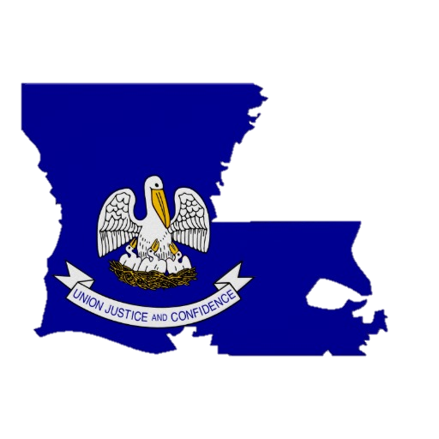
Louisiana Maine Michigan
16.9% 15.5% 16.8%

Slide 11
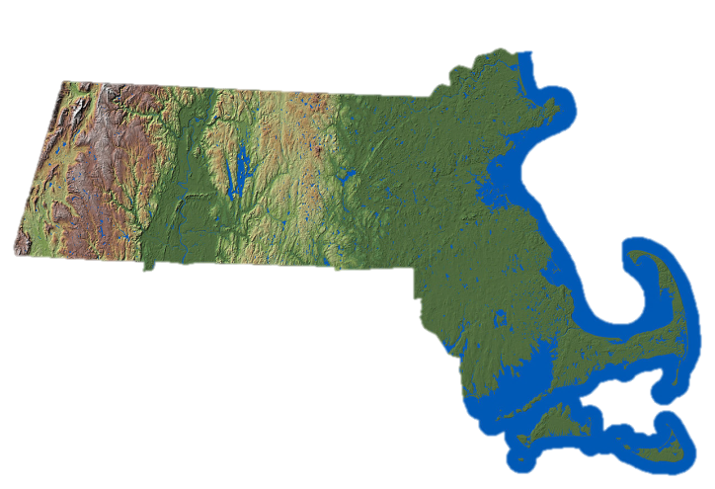
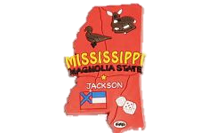
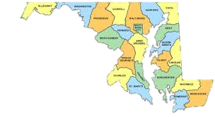
Maryland Massachusetts Mississippi
12.1% 11.9% 22.3%

Slide 12
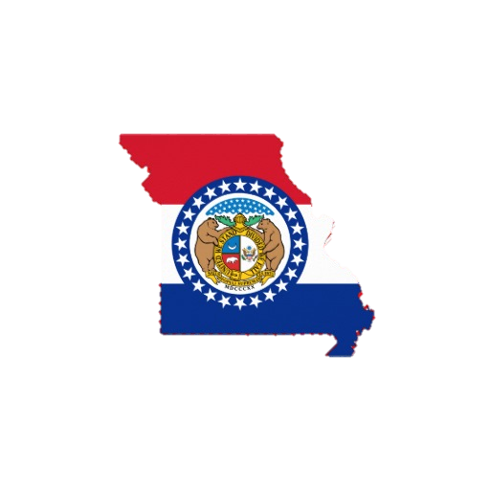
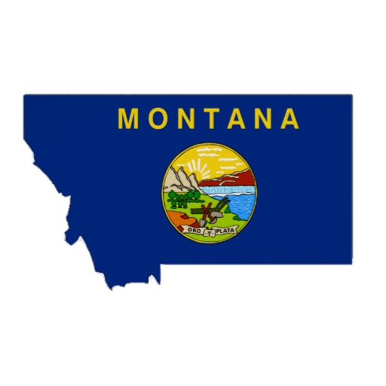
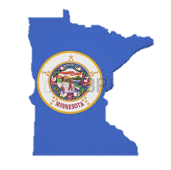
Minnesota Missouri Montana
10.7% 17.1% 14.6%

Slide 13
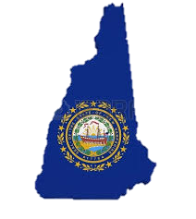

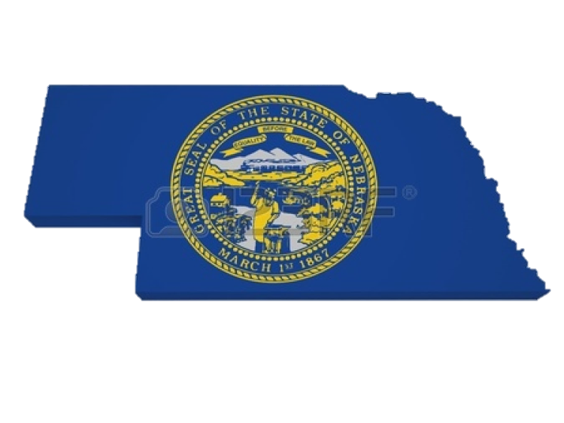
Nebraska Nevada New Hampshire
13.4% 16.8% 10.9%

Slide 14
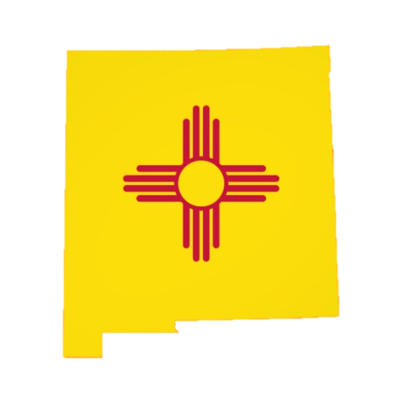
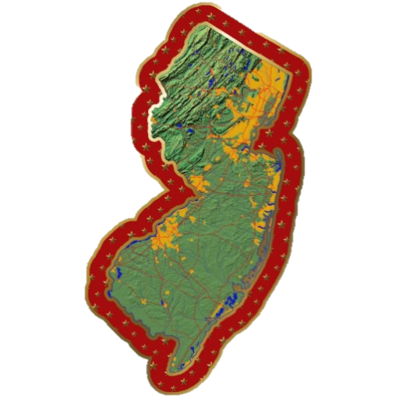
New Jersey New Mexico
13% 18.6%

Slide 15
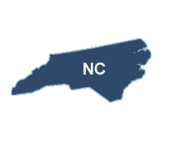
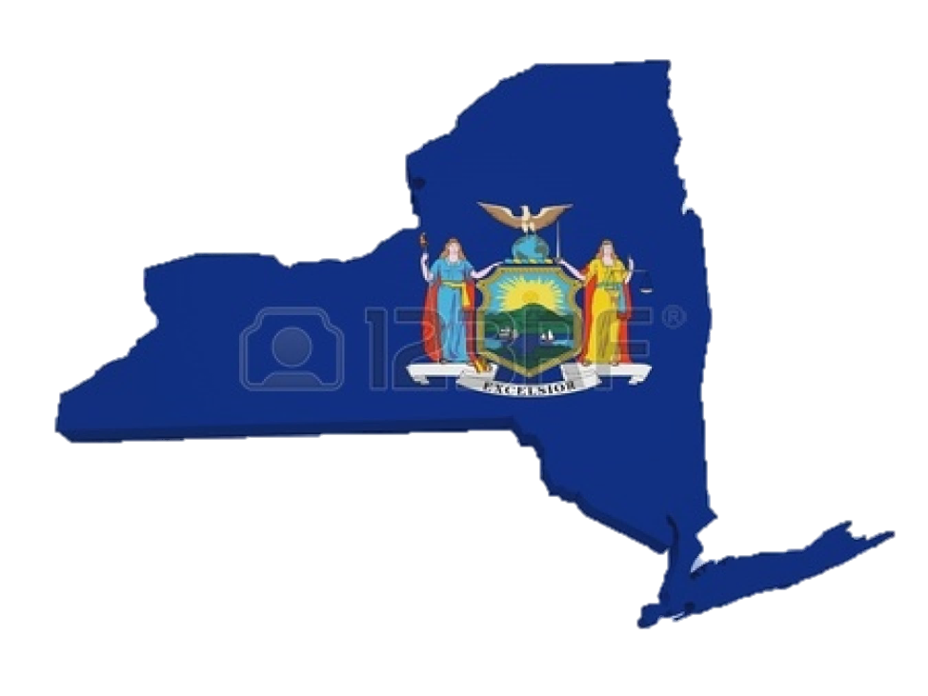
New York North Carolina
14.1% 18.6%

Slide 16
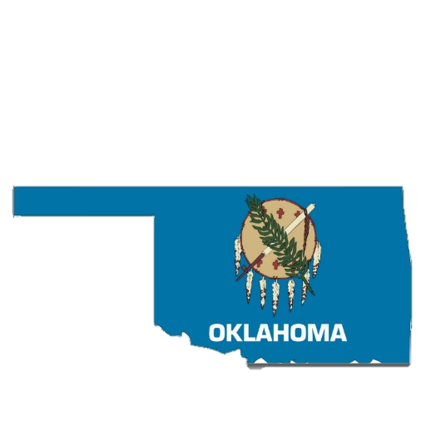
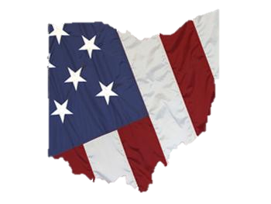
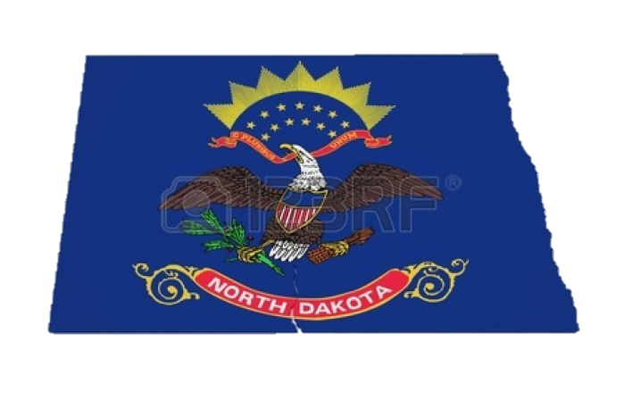
North Dakota Ohio Oklahoma
7.7% 17.2% 17.2%

Slide 17
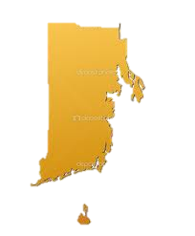
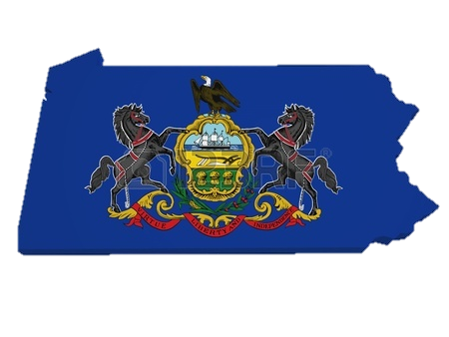
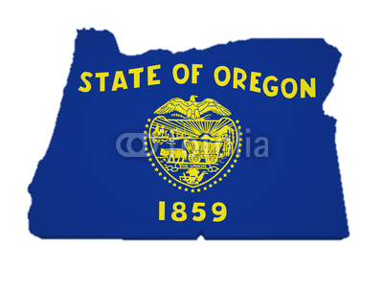
Oregon Pennsylvania Rhode Island
16.7% 14.3% 14.7%

Slide 18
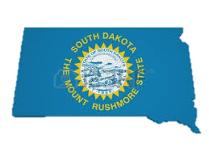
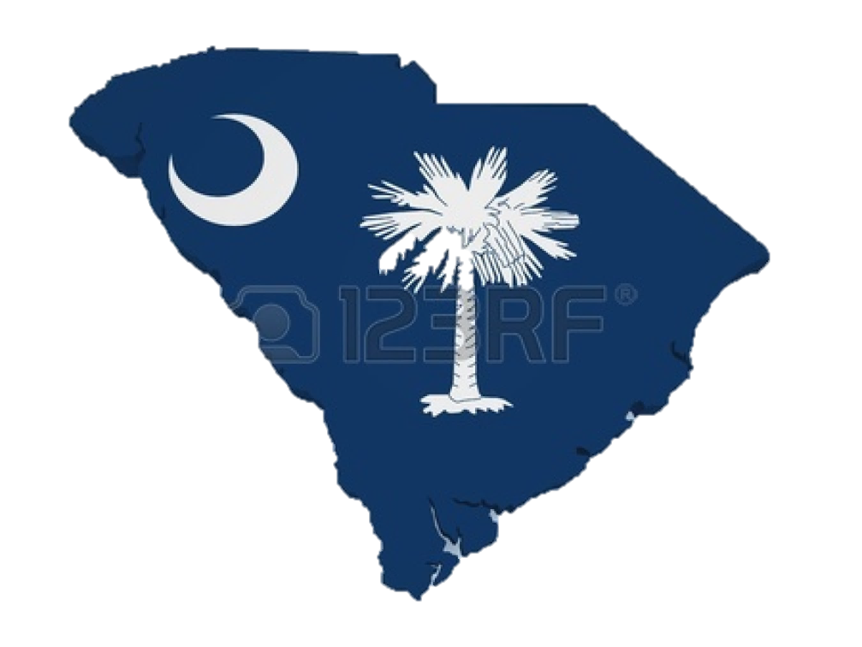
South Carolina South Dakota
18% 12.3%

Slide 19
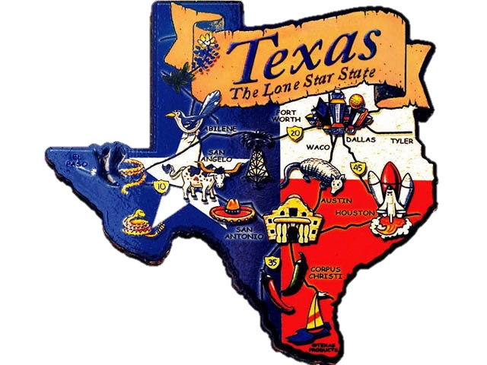
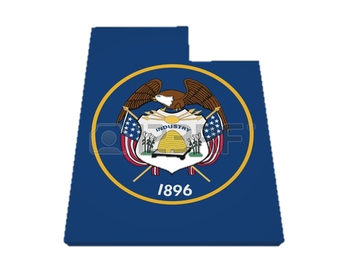
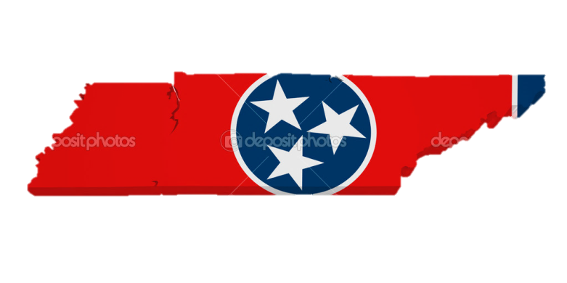
Tennessee Texas Utah
17.1% 18.3% 15.5%

Slide 20
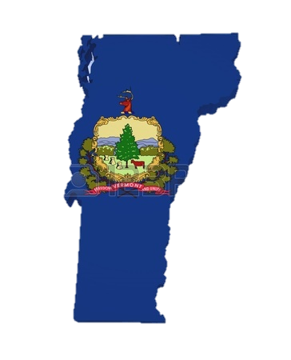
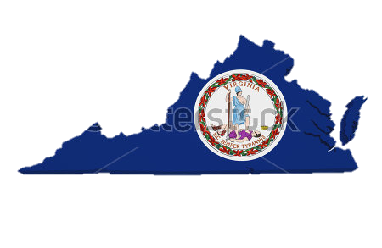
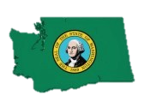
Vermont Virginia Washington
13.4% 12.1% 15%

Slide 21
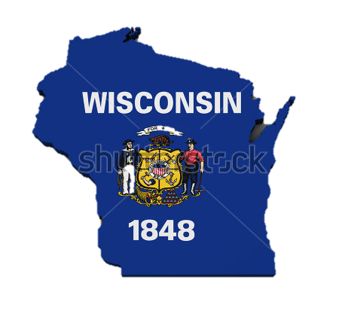
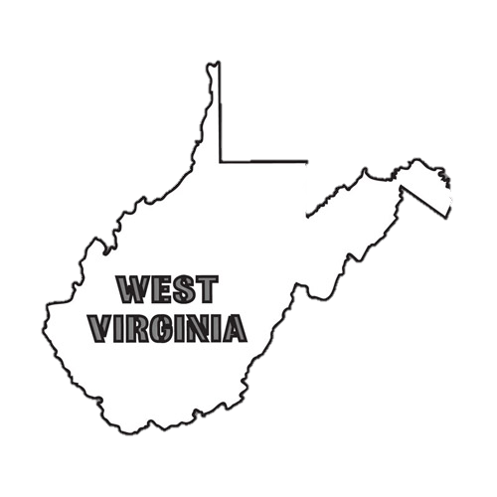

W. Virginia Wisconsin Wyoming
15% 12.6% 13%

