Slide 1
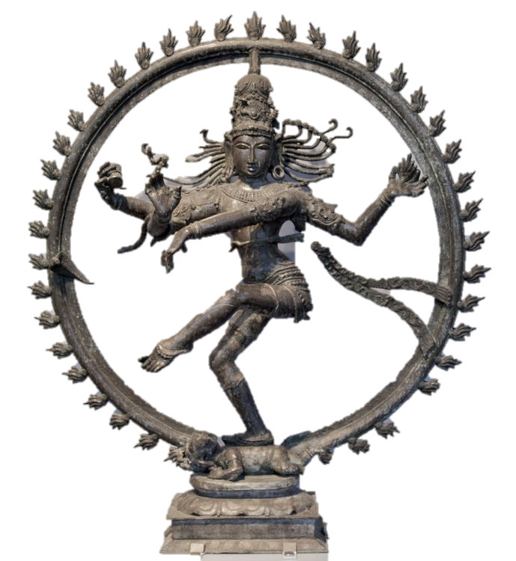

How to Convert to Hinduism

Slide 2
No strict process or ceremony
Hinduism is the majority religion of India and Nepal, with its teachings reaching as far as Indonesia, Mauritius, Fiji, UAE, Qatar, Sri Lanka and Bangladesh. As a spiritual philosophy, Hinduism concerns itself with the refinement of one’s karma, or moral uprightness, in order to break the cycle of Samsara, the endless repetition of birth, death and reincarnation. Unlike many major religions, Hinduism does not adhere to any strict concept of orthodoxy, and therefore converting to the Hindu faith is as easy as having a willingness to understand its beliefs and engage in its practices.

Slide 3
Part 1: Becoming a Follower of Hinduism

Slide 4
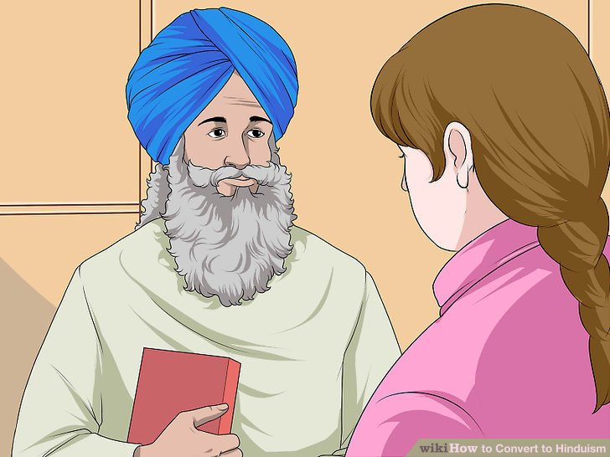
1. Understand that conversion to Hinduism is all about practice. There is no official conversion process or ceremony for converting to the Hindu faith. To become a follower, one needs only to have the will and the commitment to study the scriptures and abide the proper practices. While Hinduism is a highly traditional religion founded on ritual, it is not exclusive in the sense that one must be formally recognized in order to be a practitioner.
Hinduism preaches the very principle that there is no need for conversion; the wisdom of the universe is available to all, if only they're willing to seek it.

Slide 5
2. Find a sect that will accept you. Do some research to see if there are any Hindu temples or organizations in your area and find out what the requirements are to join. Many contemporary Hindu sects are happy to take on Western followers and anyone else who is interested in learning Hindu doctrine. Consider whether the beliefs and practices of the sect you’re thinking of joining are in alignment with what you wish to gain from becoming a follower.
Most people who practice the Hindu religion are born into it, and consider it something of a birthright. There are those that claim that you cannot “convert” to Hinduism; if you were not born Hindu, you never will be. However, this is a somewhat dated position, as Hinduism has become a major world religion and many people flock to learn its ways.
Two prominent examples of Western sects that have embraced the Hindu religion are the Hare Krishnas and the school of Transcendental Meditation.

Slide 6


Slide 7
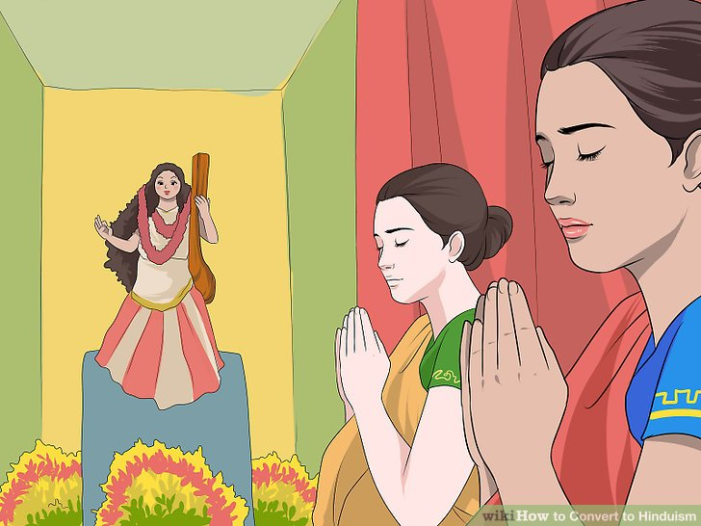
3. Involve yourself in ritual worship. Once you become part of a Hindu temple or organization, you will be expected to participate in puja, or ritual worship. Puja ceremonies are most often composed of many different symbolic actions, such as cleansing idols representing Hindu deities, making offerings and recitation of spiritual scriptures. Taking part in puja will help you understand more about Hindu rituals and their religious significance.^{[7]} In addition to its role as a communal practice, puja is considered a highly individual devotion, and a good deal of prayer and offerings are performed from the privacy of one’s home.

Slide 8
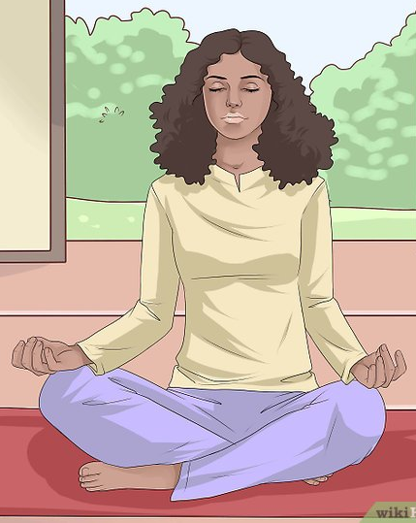
4. Practice yoga and meditation. Learn the proper asanas, or meditative yoga motions, to supplement prayer and ritual offerings. In the Hindu religion, meditation can be performed either from a resting position, as it done conventionally, or through the practice of yoga, which is essentially a form of moving meditation. Traditionally, yoga involves transitioning through a series of strenuous postures that serve to purify the body and make the mind and spirit receptive to the blessings of enlightenment.
Though it’s become a trendy form of exercise in the West, the practice of yoga is considered an integral part of of the spiritual duties of the Hindu follower. Yoga requires you to be supple, which promotes proper breath control and circulation, strengthening your body and enhancing your ability to focus.

Slide 9

5. Commit to improving your karma. Seek to live a good live, to be mindful of the suffering of the world, to show kindness to others and to implement the wisdom of the Vedas, or classical scriptures. Karma is a tenant central to Hindu philosophy and lies at the heart of all human interaction. It is effectively an inventory of one’s moral character, and through the cultivation of pure karma comes the possibility of freeing oneself from the cycle of reincarnation.
Karma can be understood as a sort of meter—if your karma is bad, or low, you will be visited by hardship and injustice, even in your subsequent lives. But if your karma meter is full, if you’ve always acted with good intentions and devoted yourself to lessening the suffering in the world, you stand a chance of attaining liberation and thus being freed from Samsara.

Slide 10
Part 2: Connecting with the Hindu Community

Slide 11
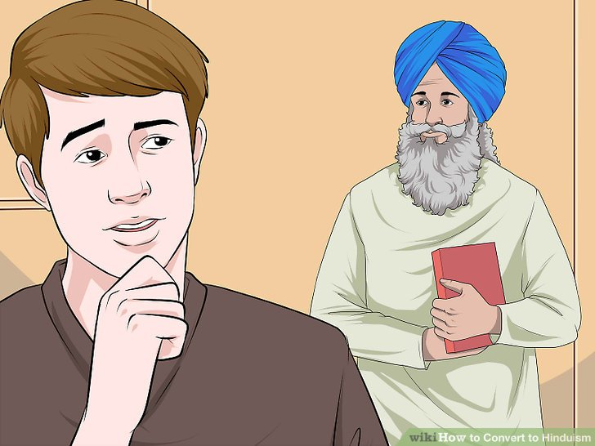
1 Become a member of a temple. See if there are any Hindu temples or community centers where you live that would allow you to join their congregation. The widespread acceptance of the major world religions has made finding places of worship in unlikely locations more common. As a member of a temple, you will be guided through puja and be given advice on yoga meditation and understanding the Vedas (scriptures), which will help you on your spiritual journey.
Unfortunately, it is still somewhat common for Westerners and those of other religious foundations to be rejected from practicing Hinduism in a formal capacity. If this happens to you, keep looking until you find a temple that will accept you, or continue your study and worship on your own.

Slide 12
Take part in ritual practices. Learn about different ritual activities from the leaders of your temple or community and incorporate them into your practice. In addition to puja and yoga, there are many other rituals that encompass important aspects of Hinduism. While most of these are spiritual in nature and center around paying tribute to divinity, others are more personal and practical, and function almost as good-luck rituals or reminders of the need to excel in your station of life.[12]
Puja is the most commonplace form of ritual in Hinduism, and is usually performed every day. Other important rituals for the Hindu follower to observe include making offerings and sacrifices (symbolic in meaning) to the various deities of the pantheon, decorating the body with markings that represent spiritual aims and sitting in meditation of the truths of the Vedas.
Other more sophisticated rituals, collectively identified as a yajna, require the oversight of qualified holy men and typically entail systematic group offerings and blessings. These rituals are more akin to what you might expect to find in churches where Abrahamic religions are practiced. If you belong to a Hindu temple or spiritual community, a yajna is likely to be conducted by the group's most prominent leaders.

Slide 13
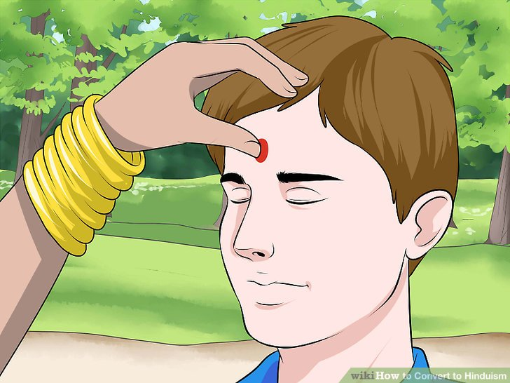

Slide 14
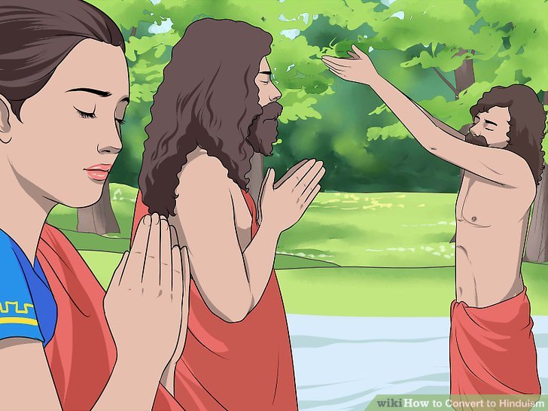
3. Attend Hindu celebrations and festivals. Hindu festivals are based around the seasons and usually commemorate or symbolize important events in Hindu theology. Some of these celebrations, such as Makar Sankranti, require visiting cultural landmarks like the Ganges river, but many holy events can be honored anywhere with prayers and offerings particular to the day. In becoming immersed in the Hindu religion, make an effort to learn the significance marking these occasions and take part in observing them.
Among the most venerated annual Hindu festivities are Holi, a celebration of springtime and rebirth occurring the day after the full moon in early March; Diwali, the "row of lights" ceremony that commemorates the end of the Vikram calendar; and Mahashivaratri, a birthday celebration for Shiva, one of the three highest deities in the Hindu religion. The majority of Hindu celebrations are scheduled by the Vikram calendar, which follows a lunar progression, and fall on notable days of the moon cycle.

Slide 15

4. Undertake a spiritual pilgrimage. If you have fully committed yourself to following the Hindu religion, you might plan a pilgrimage to visit holy sites in India and its outlying regions and pay your respects. Embarking on a pilgrimage will offer you a rare opportunity to see the shrines of deities and saints, refocus your spiritual devotion and purify yourself of sins and impurities. Pilgrimages are time-consuming and expensive undertakings and may not be feasible for all practitioners, but they are venerated tradition in Hinduism nonetheless.
Some of the most famous sites for pilgrimages include the “big four” Indian towns Puri, Rameshwaram, Dwarka and Badrinath, as well as Nepalese stops like the Pashupatinath Temple. A small percentage of larger Hindu organizations that are funded by local communities may offer all-expense-paid group pilgrimage opportunities for those who could not otherwise afford them. Check and see if your temple or organization is one of these.

Slide 16
Part 3: Understanding Hindu Beliefs

Slide 17
1. Accept your differences. If you come from a place with vastly different religious background, not all Hindu beliefs and precepts will make sense to you at first. You may also encounter some opposition to your becoming a follower of the religion if you were not born into it. Be patient with these differences and try to see beyond them. You have a right to pursue your own spiritual path, and nothing should hold you back once you have decided to devote yourself to the Hindu religion.
Much of the cultural exclusion of Hinduism stems from the Indian caste system, in which people are born into certain social classes from which they can neither raise or lower themselves. Because non-Indians are outside of the sacred caste, they are also thought to be necessarily outside of Hindu spirituality.
If you cannot find a temple or group to join and are forced to continue your practice from home, don’t despair. There are many modern gurus who are willing to share their teachings with followers through recorded content like books and audio recordings, and communal interaction can be found through chat rooms and international conventions.

Slide 18


Slide 19

2. Recognize the dharma. Dharma is a complex term with several different interpretations, referring to the natural order of the universe, the “right way of living” or the comprehensive teachings of the deities. These notions form the fundamental principles of Hinduism. Even though you may not understand their meaning or application right away, strive to extract as much practical wisdom as you can from the scriptures you study. As you progress in your practice, the connectivity of these concepts will open up to you.
All Hindu beliefs have their place. Rather than getting caught up in the more fantastic elements of the scriptures, concentrate on understanding what they offer in terms of truth and knowledge.

Slide 20

3. Know the significance of karma. Be mindful of the notion of karma at all times and consider how your actions influence your own morality as well as the well-being of others. Your karma should be at the center of every decision you make. Auditing your actions brings you closer to realizing moksha, or spiritual liberation, but it also ensures that you’re making the right choices at any given time.
Karma is more complex than simply penalty or reward for your actions. It is a common thread that runs through consecutive rebirths. Introspection of one’s karmic state creates a kind of feedback system for evaluating the goodness of one’s lives.
Bad karma is thought to follow an individual through their different lifetimes, accounting for the seemingly random nature of misfortune in the world.

Slide 21

4. Strive for spiritual liberation. Meditate often on salvation and the means to attain it. The ultimate purpose of any religion is to transcend the struggle of human existence and come to actualize the divine aspects of the self. This can be achieved through a focused approach to spiritual learning. Try to apply the wisdom that you gain to your everyday life. You’ll find that through enlightened consciousness, the quality of your own life will improve, which will allow you to positively affect the lives of the people around you.
Moksha can simultaneously be understood as a literal spiritual “breakthrough” after which the mysteries of existence seem to dissolve, or as a purposefully maintained state that recognizes the need for compassion, selflessness and acceptance.

Slide 22
What about the caste system?
These people are Mleccha but initiated into Brahmanism!
Their Varna is Brahmin and their caste is "No caste", since they are from Non Indian origin.

Slide 23

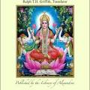
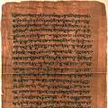
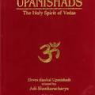

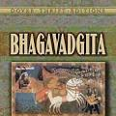

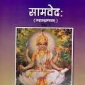
Sacred writings
Ramayan
Rigveda
Vedas
Upanishads
Mahabharata
Bhagavad Gita
Atharvaveda
Samaveda
As with any religion, to really understand it, one must read, mark, and inwardly digest the principles for leading a good life

