Slide 1
Culture Change
All cultures undergo change – what varies most is the rate at which the change occurs.

Slide 2
Change rates
Urban-industrial, democratic societies tend to be more amenable to cultural change.
Traditional, agricultural societies tend to be more resistant to cultural change.

Slide 3
Cultural elements
Long-held philosophies and/or religions tend to be very resistant to cultural change.
Gender roles tend to be slow to change
Clothing fashions tend to change more easily, particularly in urban-industrial societies
Changes in technology tend to be accepted with less resistance
Languages change – old terms fall out of use, new terms come into use, some terms gain new meanings.

Slide 4
Changes from 1930-50 to the present.
Those who remember the period 1930-50, will recognize much of what follows.
Those who were raised from the 1980s to the present may not have heard of much of what follows.
I know some of you will not understand this message, but I bet you know someone who might.

Slide 5
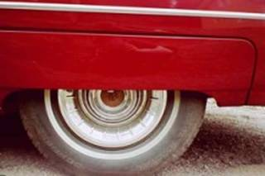
I came across this phrase yesterday. 'FENDER SKIRTS.'
Fender Skirt

Slide 6
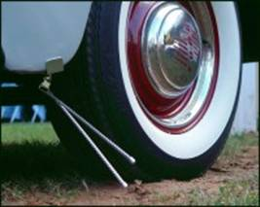
Fender skirt is a term I haven't heard in a long time, and thinking about 'fender skirts' started me thinking about other words that quietly disappear from our language with hardly a notice like 'curb feelers.'

Slide 7
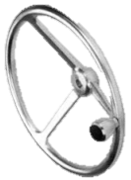
And 'steering knobs.' (AKA) 'suicide knob,' 'neckers knobs.'

Slide 8
Since I'd been thinking of cars, my mind naturally went that direction first. Any kids will probably have to find some older person over 50 to explain some of these terms to you.

Slide 9
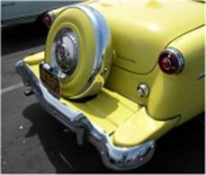
Remember 'Continental kits?' They were rear bumper extenders and spare tire covers that were supposed to make any car as cool as a Lincoln Continental.

Slide 10
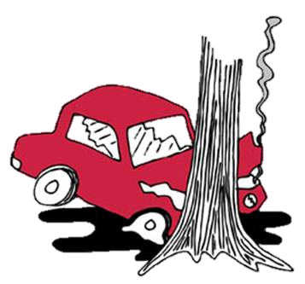
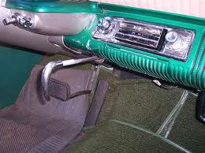
When did we quit calling them 'emergency brakes? At some point 'parking brake' became the proper term. But I miss the hint of drama that went with 'emergency brake.'

Slide 11
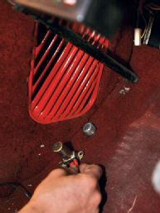
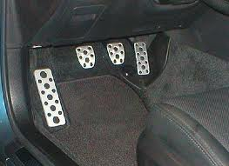
I'm sad, too, that almost all the old folks are gone who would call the accelerator the 'foot feed.' Many today do not even know what a clutch is or that the dimmer switch used to be on the floor. For that matter, the starter was down there too.
Clutch
Dimmer Switch

Slide 12

Didn't you ever wait at the street for your daddy to come home, so you could ride the 'running board' up to the house?

Slide 13
Non-automobile terms

Slide 14
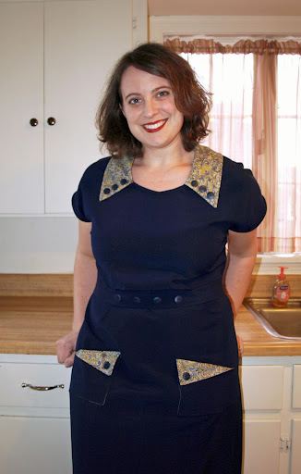
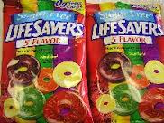
Here's a phrase I heard all the time in my youth but never anymore - 'store-bought.' Of course, just about everything is store-bought these days. But once it was bragging material to have a store-bought dress or a store-bought bag of candy.

Slide 15

'Coast to coast' is a phrase that once held all sorts of excitement and now means almost nothing. Now we take the term 'worldwide' for granted. This floors me.

Slide 16
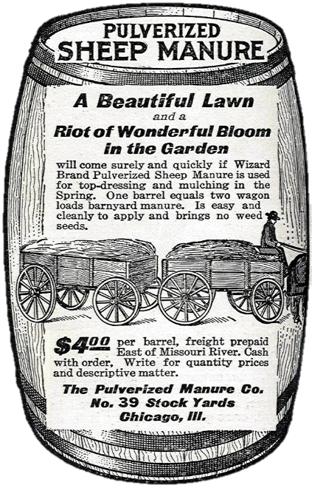
Higher west of the Mississippi
Some may remember that many processed or manufactured products cost more west of the Mississippi or Missouri rivers. Radio adds often added “higher west of the Mississippi.”
West of the Missouri, they had to pay for the shipping costs

Slide 17

On a smaller scale, 'wall-to-wall' was once a magical term in our homes. In the '50s,everyone covered his or her hardwood floors with, wow, wall-to-wall carpeting! Today, everyone replaces their wall-to-wall carpeting with hardwood floors. Go figure.

Slide 18
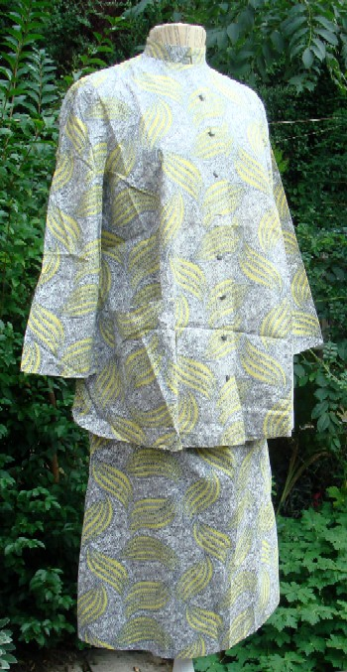
When was the last time you heard the quaint phrase 'in a family way?' It's hard to imagine that the word 'pregnant' was once considered a little too graphic, a little too clinical for use in polite company, so we had all that talk about stork visits and 'being in a family way' or simply 'expecting.' When was the last time you saw a woman in a “maternity dress”?

Slide 19
Apparently 'brassiere' is a word no longer in usage. I said it the other day and my daughter cracked up. I guess it's just 'bra' now.
'Unmentionables' probably wouldn't be understood at all.

Slide 20
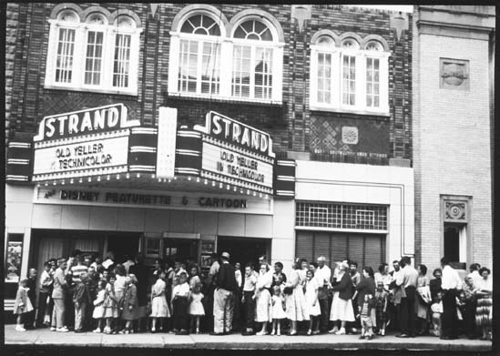

I always loved going to the 'picture show,' but I considered 'movie' an affectation.

Slide 21
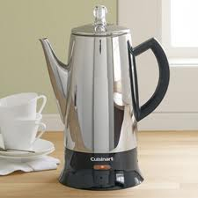
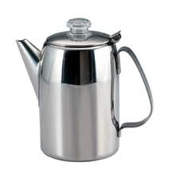
Here's a word I miss - 'percolator.' That was just a fun word to say. And what was it replaced with 'Coffee maker.' How dull... Mr. Coffee, I blame you for this.

Slide 22
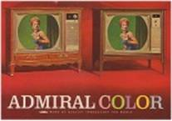
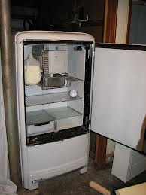
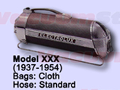
I miss those made-up marketing words that were meant to sound so modern and now sound so retro. Words like 'Dyna Flow' and 'Electrolux' and 'Frigidaire'. For many immigrants, like my grandmother, “Frigidaire” was generic for refrigerator. She had a General Electric “Frigidaire.” How many remember the refrigerator being called the “ice box”? Introducing the 1963 Admiral TV, now with 'Spectra Vision!'

Slide 23
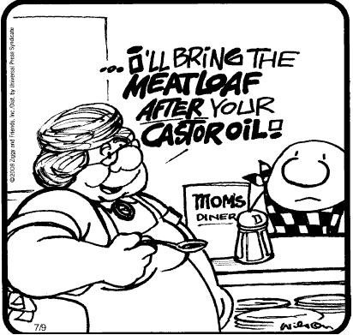
Food for thought. Was there a telethon that wiped out lumbago? Nobody complains of that anymore. Maybe that's what Castor oil cured, because I never hear mothers threatening kids with Castor Oil anymore.

Slide 24
Some words aren't gone, but are definitely on the endangered list. The one that grieves me most is 'supper. 'Now everybody says 'dinner.' Save a great word.

Slide 25
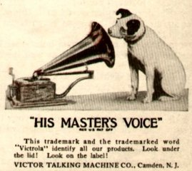
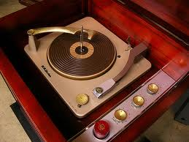
When was the last time you heard someone talk of playing music on the Victrola, or the record player, or the Hi-Fi, or the “stereo”? How many today even know what a “record” was? In 30 years, will the current generation be asking, “What was a CD?”

Slide 26
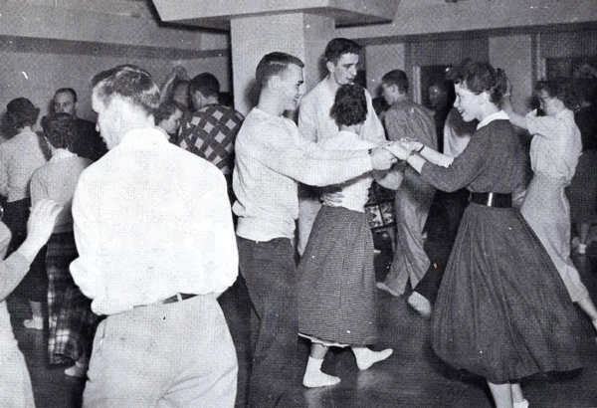
How many young people today would know what a “sock hop” was?

Slide 27
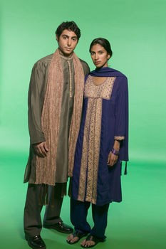
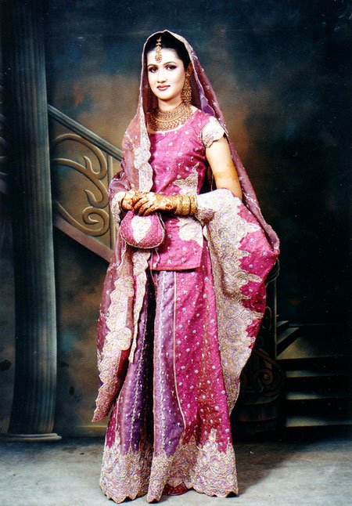
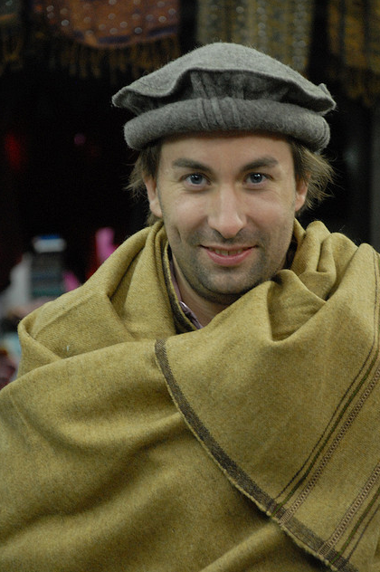
Traditional Pakistani Dress

Slide 28
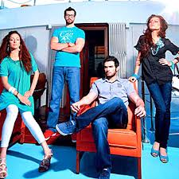
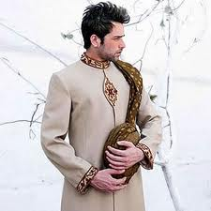
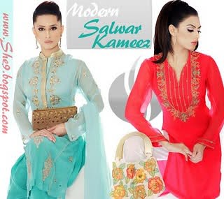
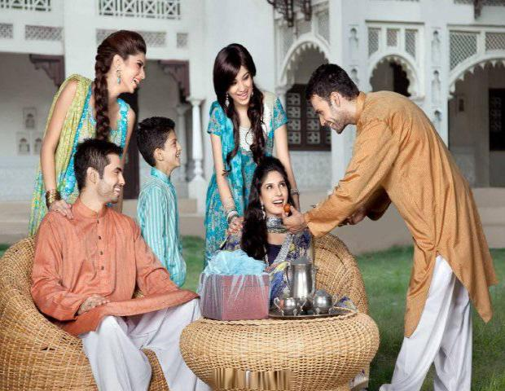
Modern Pakistani Dress

Slide 29
How about some new terms that wouldn’t have made sense 50 years ago?
Cell phone
Smart phone
Land line
Blue-ray
Blackberry (not the fruit)
Internet
Android tablet
I-Pad
E-mail
URL
The cloud (not in the sky)
I-Pad
MP3 Player
DVD
Dish TV
LCD or LED
Solar panel
AWD SUV
Twitter
Euro

Slide 30
What can we learn from this?
Keep in mind that there are only two constants in life:
Change
Death
No individual or society can escape from them, so the only response is to accept and adapt as comfortably as possible.
Individuals can and do change, even if reluctantly
Societies can and do change, even if reluctantly

