Slide 1
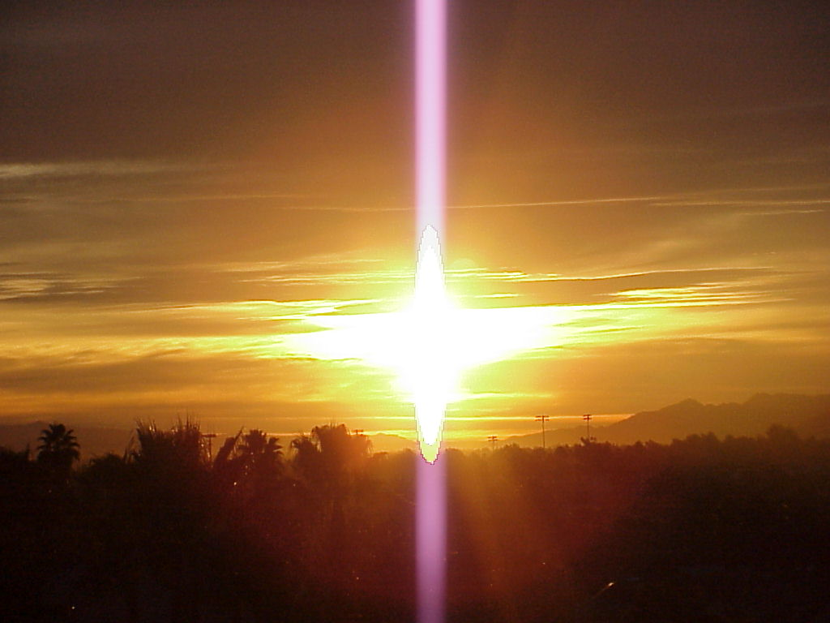
What I Believe

Slide 2
~~I BELIEVE ~~
A Birth Certificate shows that we were born. A Death Certificate shows that we died. Pictures show that we live! Have a seat. Relax . . . And read this slowly.

Slide 3
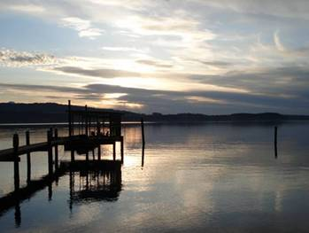
I Believe... That just because two people argue, it doesn't mean they don't love each other. And just because they don't argue, it doesn't mean they do love each other.

Slide 4
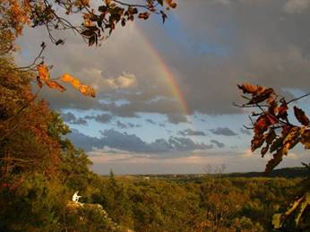
I Believe... That we don't have to change friends if we understand that friends change.

Slide 5
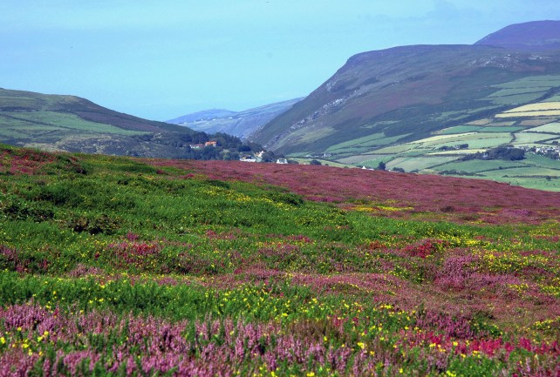
I Believe... That no matter how good a friend is, they're going to hurt you every once in a while, and you must forgive them for that.

Slide 6
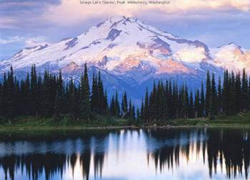
I Believe... That true friendship continues to grow, even over the longest distance. Same goes for true love.

Slide 7
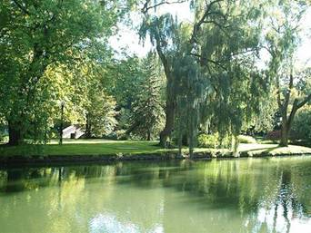
I Believe... That you can do something in an instant that will give you heartache for life.

Slide 8
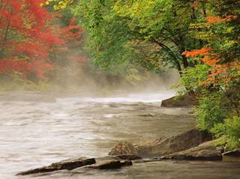
I Believe... That it's taking me a long time to become the person I want to be.

Slide 9
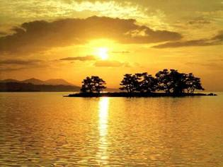
I Believe... That you should always leave loved ones with Loving words. It may be the last time you see them.

Slide 10
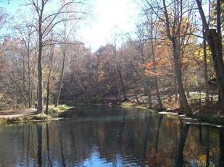
I Believe... That you can keep going long after you think you can't.

Slide 11
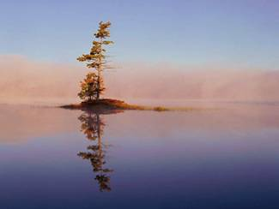
I Believe... That we are responsible for what we do, no matter how we feel.

Slide 12
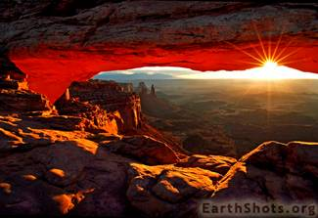
I Believe... That either you control your attitude or it controls you.

Slide 13
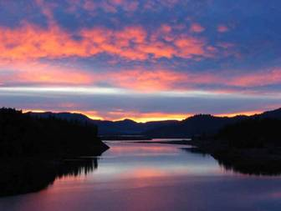
I Believe... That heroes are the people who do what has to be done, when it needs to be done, regardless of the consequences.

Slide 14
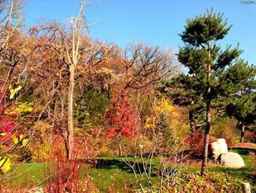
I Believe... That my best friend and I can do anything or nothing and have the best time.

Slide 15
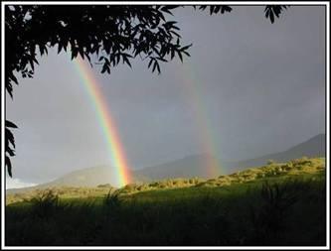
I Believe... That sometimes the people you expect to kick you when you're down will be the ones to help you get back up.

Slide 16
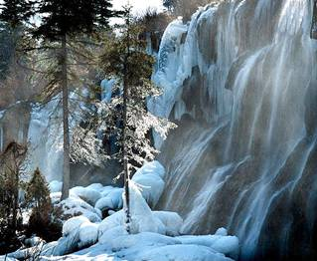
I Believe... That sometimes, when I'm angry, I have the right to be angry, but that doesn't give me the right to be cruel.

Slide 17
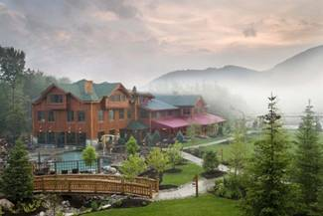
I Believe... That maturity has more to do with what types of experiences you've had and what you've learned from them, and less to do with how many birthdays you've celebrated.

Slide 18
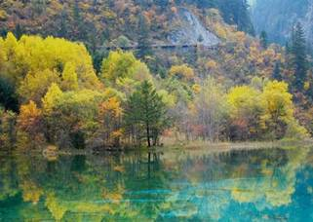
I Believe... That it isn't always enough to be forgiven by others. Sometimes you have to learn to forgive yourself.

Slide 19
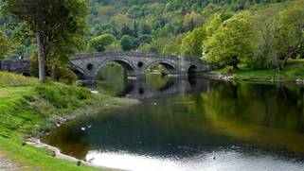
I Believe... That no matter how bad your heart is broken, the world doesn't stop for your grief.

Slide 20
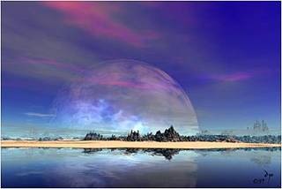
I Believe... That our background and circumstances may have influenced who we are, but, we are responsible for who we become.

Slide 21
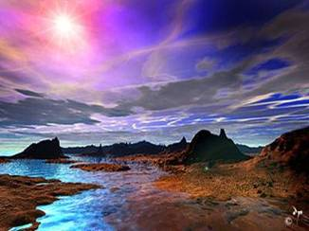
I Believe... That you shouldn't be so eager to find out a secret. It could change your life forever.

Slide 22
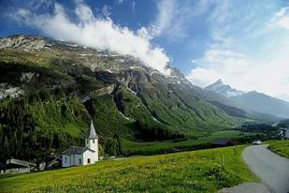
I Believe... Two people can look at the exact same thing and see something totally different.

Slide 23
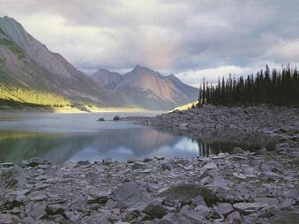
I Believe... That your life can be changed in a matter of hours by people who don't even know you.

Slide 24
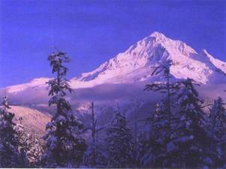
I Believe... That even when you think you have no more to give, when a friend cries out to you, you will find the strength to help.

Slide 25
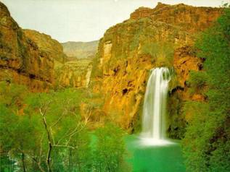
I Believe... That credentials on the wall do not make you a decent human being.

Slide 26
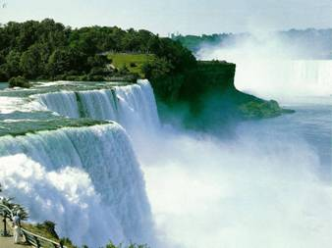
I Believe... That the people you care about most in life are taken from you too soon.

Slide 27
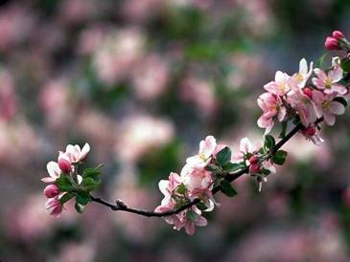
I Believe... That you should send this to all of the people that you believe in. I just did.

Slide 28
'The happiest of people don't necessarily have the best of everything; They just make the most of everything they have.
May you be blessed.

Slide 29
