Slide 1
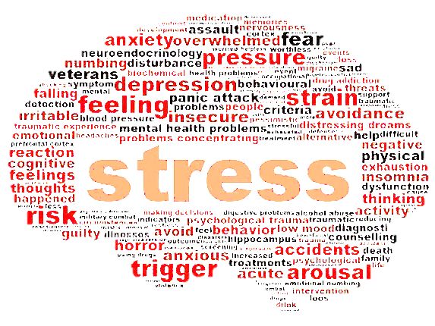
Ways to Bust Stress . . . . . .
From Beliefnet

Slide 2
The degree of stress we experience on a daily basis might be a cultural norm but personal priorities, personal choices and our purposeful reactions to stress can limit the negative health effects of stress. Here are a few suggestions to reduce stress in your life.

Slide 3


Slide 4
Stress is a part of everyday life. Without it we would never get off the couch, never worry about our work efforts, what our kids are up to, never put out the fire or avoid the car that veers into our lane!
The degree of stress that we encounter on a constant basis in modern society, however, has reached epidemic proportions.
Stress can be linked to weight gain, heart disease and depression. It increases the risk of diabetes, hypertension, arthritis and osteoporosis. Stress impairs cognitive function over time, reducing creativity, memory and problem-solving skills. Headaches, sexual dysfunction, irritability, problems sleeping and addictive behaviors are often stress-related.

Slide 5
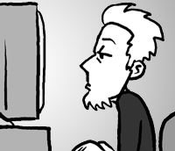
The degree of stress we experience on a daily basis might be a cultural norm but personal priorities, personal choices and our purposeful reactions to stress can limit the negative health effects of stress. Pick a few of these suggestions below to reduce stress in your life and promote health and healing in your body.

Slide 6

Spiritual Triathlon
This is my personal method for keeping my focus throughout the day. Every morning when I wake up I spend 5 minutes saying all that I am grateful for, 5 minutes in prayer and 5 minutes reading my Bible or something inspirational.

Slide 7

Schedule Relaxation
Write it down in your planner and stick to it. Make time at least once a week to do something you love–something that refreshes you. Maybe that’s a game of tennis, spending an hour alone with a good book or taking a yoga class.

Slide 8

Pour Yourself a Cup
Many varieties of hot tea have calming effects on the body and can help lower blood pressure. Try green or black tea or herbal teas with chamomile.

Slide 9
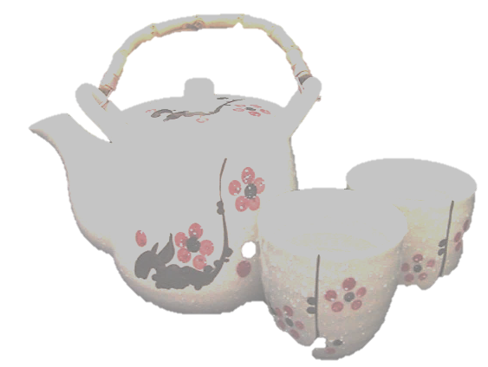
Consider the Japanese Tea Ceremony
Get an interesting, but practical, teapot.
Create your own ritual (don’t get elaborate or take too much time – keep it simple so you don’t start rushing to complete it)
Prepare the tea according to your ritual and then enjoy your tea (don’t rush through it)
Consider some relaxing background music to play while you prepare and enjoy your tea.
A 15-20 minute break can be very refreshing, so consider tea time as time well spent.

Slide 10

Ask Yourself Why
The next time you’re racing around trying to accomplish too many things in too short a time, ask yourself why you’re doing it, who it really serves, what belief its based on, whether this feeling is really what you want, whether this is a value or principle you want to base your life on. “Worry does not empty tomorrow of its sorrow; it empties today of its strength.” ~Corrie Ten Boom

Slide 11

Expel Excess Adrenaline
Before, during and after stressful situations, walk briskly for 5 minutes, run up a flight of stairs, do backward pushups on your chair, or do 5 minutes of deep breathing. A short burst of physical activity can expel anxiety and give you clarity and calm.

Slide 12

Just Say "No"
I promise it’s ok! Don’t spread yourself too thin or you won’t be able to give 100% of your efforts to any of the tasks you attempt. Your value does not depend upon how much you do for others at the expense of your own time, relationships and health.

Slide 13

Nix the Caffeine, Nicotine and Alcohol
Don’t add to nervous energy with stimulants and don’t mask stress with alcohol. The long-term effects compound the negative effects of stress.

Slide 14

Use Your Senses
Find colors that soothe you, wear fabrics that please you. Take a scented bath, play music you love. Paint, get a massage, or take a walk in the woods. “Life is not measured by the number of breaths we take, but by the number of moments that take our breath away.” ~Hilary Cooper

Slide 15
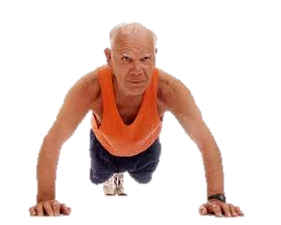
Exercise Regularly
Regular exercise helps expel built-up tension, stress hormones and clears the mind. Exercise helps to release endorphins, the brain’s natural feel-good chemicals. I recommend Burst Training for the most health benefits.

Slide 16
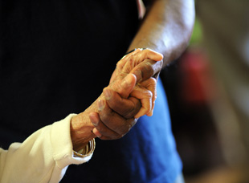
Serve Someone Else
Related to connecting with others, try volunteering at a soup kitchen, making meals for parents with a newborn baby or helping with home repairs for an elderly neighbor. Remind yourself that it’s not always all about you. “If you change the way you look at things, the things you look at change.” ~Wayne Dwyer

Slide 17

Share Responsibility
Delegating really is an important skill. Instead of complaining about how much you have to accomplish, teach your kids to cook, share the credit with a co-worker, or work out sports shuttling with another parent.

Slide 18
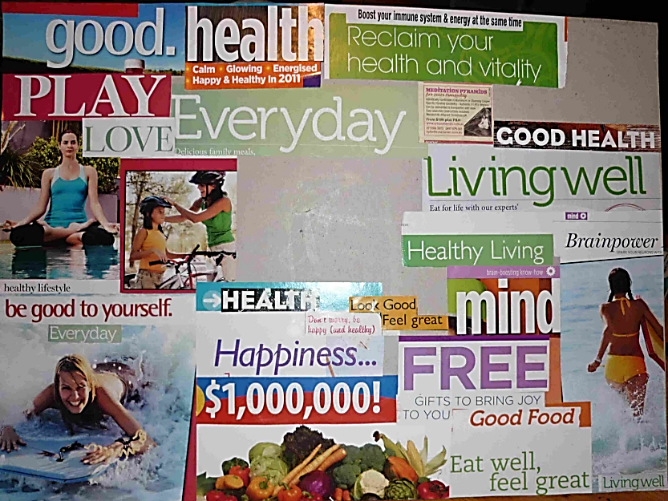
Make a Vision Board
Write down your goals and post them on a board where it can be seen every day. What do you want to accomplish? Who do you want to become? Print out pictures to visually remind yourself of what is most important to you. “Life is a journey, not a destination.” ~Rumi
Vision Board for Simple Living

Slide 19

Be Prepared
You can combat alarmist or catastrophic thinking by being prepared. Keep a change of clothes in the car, create an emergency fund for car repairs, have an alternative proposal in mind at work

Slide 20

Take a Deep Breath
Try deep breathing for a few minutes every day. Tighten and release muscles. Hum to release nitric oxide and improve blood pressure.

Slide 21
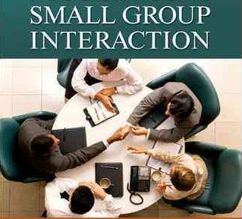
Connect with Others
Making time for social connection is very important and restorative. Social connection is what makes us a part of something larger than ourselves and our worries. It gives us perspective.

Slide 22

Sleep
Staying up late to get more done robs you of your total productivity. It dulls your mind, increases stress, promotes weight gain and contributes to mood swings.

