Slide 1
Thoughts To Ponder

Slide 2
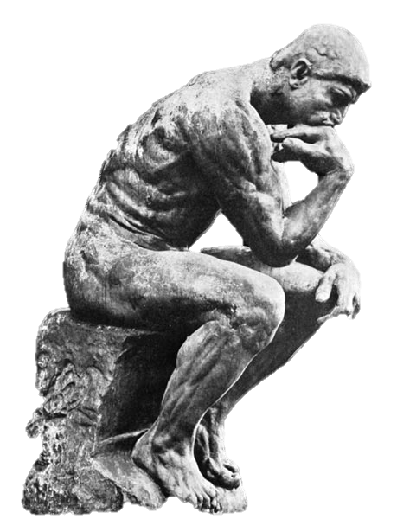

Slide 3
The best way to get even is to forget.

Slide 4


Slide 5
Feed your faith and your doubts will starve to death..

Slide 6


Slide 7
God wants spiritual fruit, not religious nuts..

Slide 8


Slide 9
Some folks wear their halos much too tight...

Slide 10


Slide 11
Unless you can create the WHOLE universe in 5 days, Then perhaps giving "advice" to God, isn't such a good idea!

Slide 12


Slide 13
Sorrow looks back, worry looks around, and faith looks up...

Slide 14
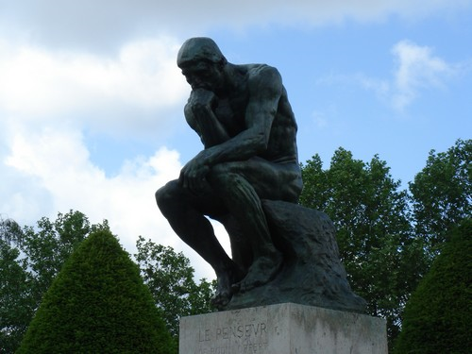

Slide 15
Standing in the middle of the road is dangerous. You will get knocked down by the traffic from both ways.

Slide 16
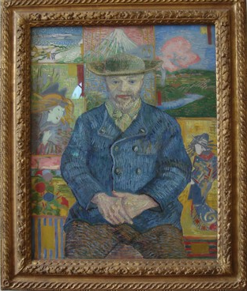

Slide 17
Words are windows to the heart.

Slide 18


Slide 19
It isn't difficult to make a mountain out of a molehill just add a little dirt.

Slide 20


Slide 21
A successful marriage isn't finding the right person-it's being the right person.

Slide 22


Slide 23
The mighty oak tree was once a little nut that held its ground.

Slide 24


Slide 25
To forgive is to set the prisoner free, and then discover the prisoner was you.

Slide 26
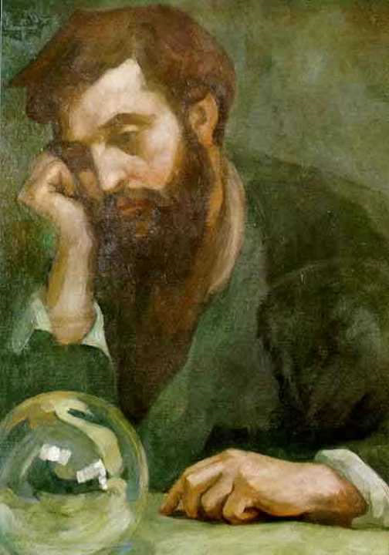

Slide 27
You have to wonder about humans, they think God is dead and Elvis is alive!

Slide 28
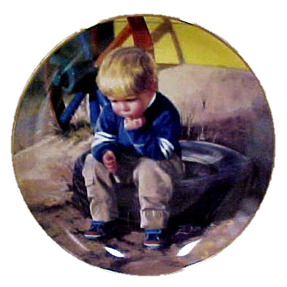

Slide 29
You'll notice that a turtle only makes progress when it sticks out its neck...

Slide 30


Slide 31
If the grass is greener on the other side of the fence, you can bet the water bill is higher.

Slide 32
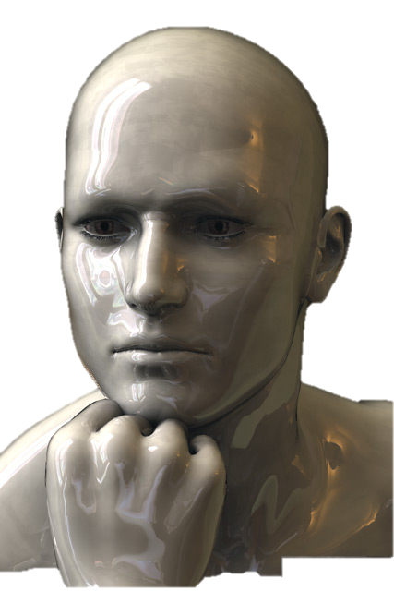

Slide 33
Keep smiling!
And...if you see someone's missing one.... give them one of yours!

Slide 34


