Slide 1
MEMORIAL DAY
A day to recognize our debts and be grateful

Slide 2
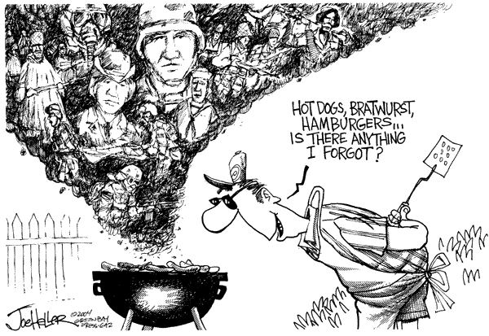

Slide 3
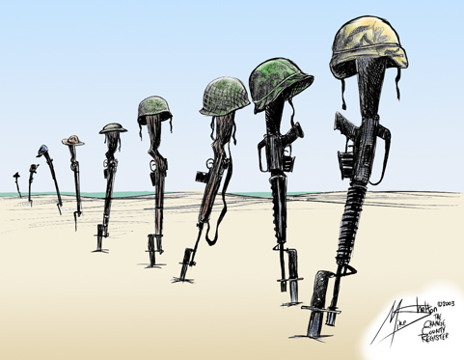

Slide 4
It is the
VETERAN, not the preacher, who has given us freedom of religion.

Slide 5
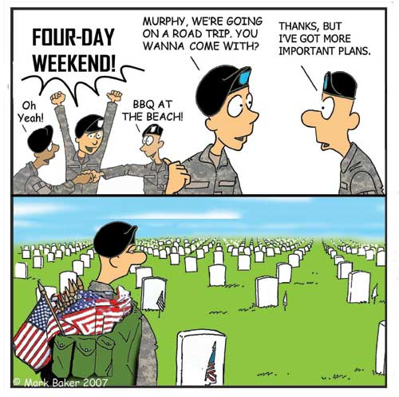

Slide 6
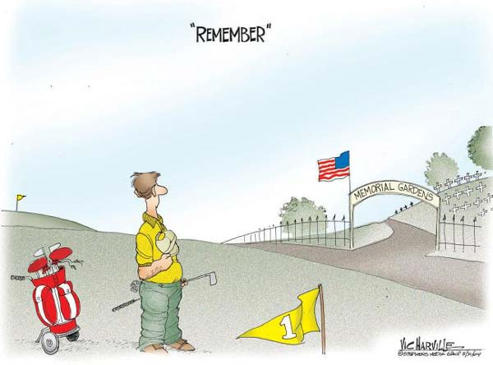

Slide 7
It is the VETERAN, not the reporter, who has given us freedom of the press.

Slide 8
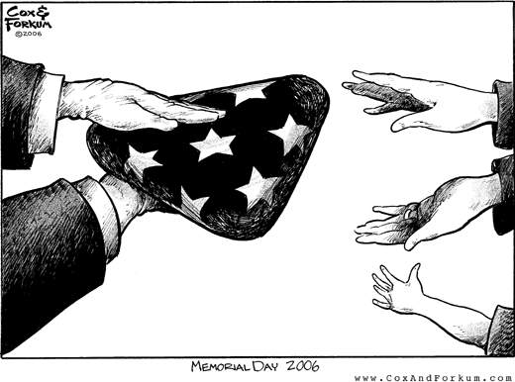

Slide 9
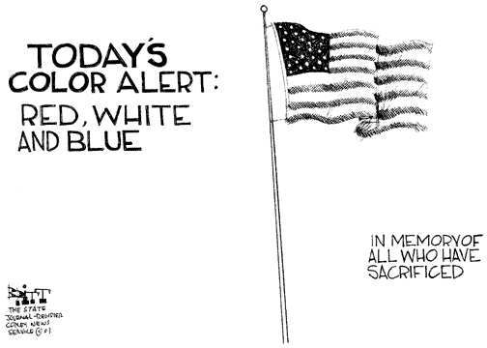

Slide 10
It is the VETERAN, not the poet, who has given us freedom of speech.

Slide 11
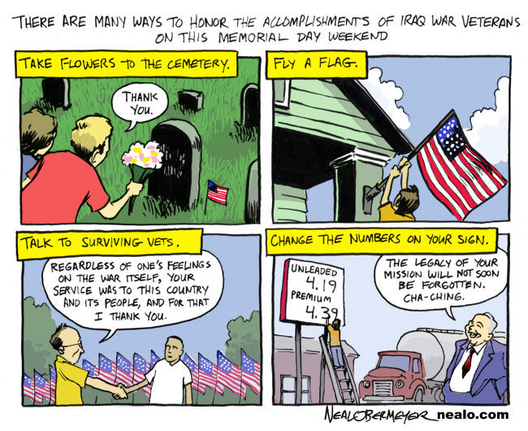

Slide 12
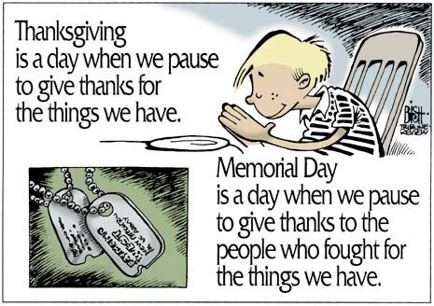

Slide 13
It is the VETERAN, not the campus organizer, who has given us freedom to assemble.

Slide 14
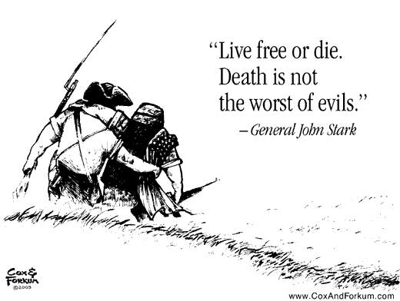

Slide 15
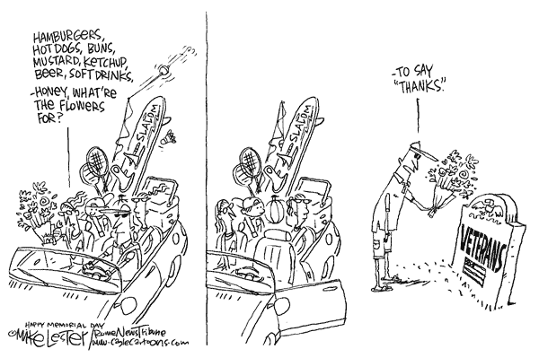

Slide 16
It is the VETERAN, not the lawyer, who has given us the right to a fair trial.

Slide 17
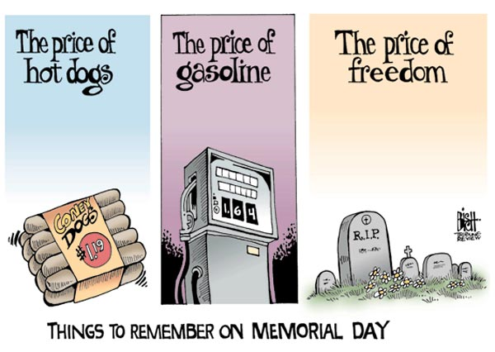

Slide 18
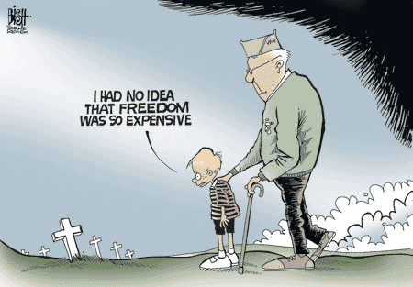

Slide 19
It is the VETERAN, not the politician,
Who has given us the right to vote.

Slide 20
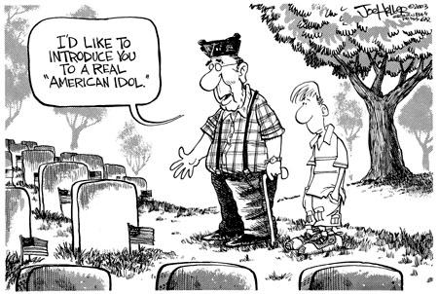

Slide 21
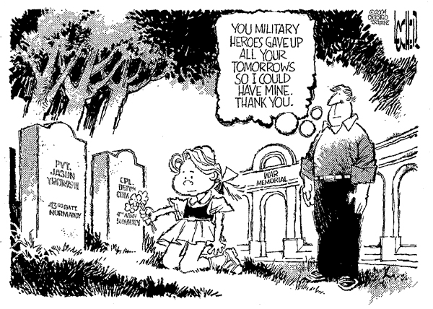

Slide 22
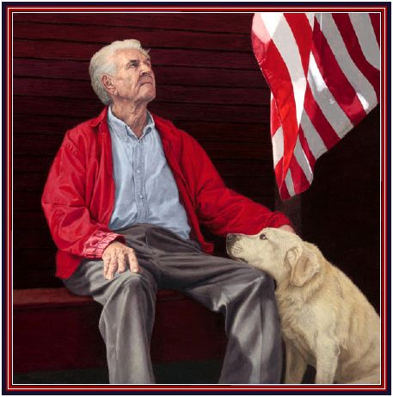

Slide 23
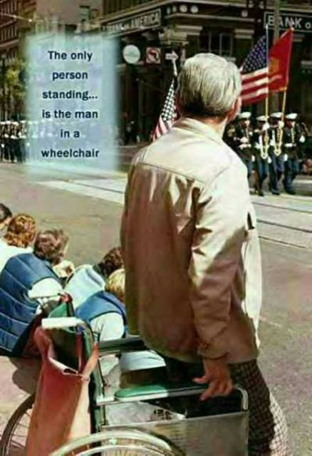
It is the
VETERAN who salutes the Flag,

Slide 24
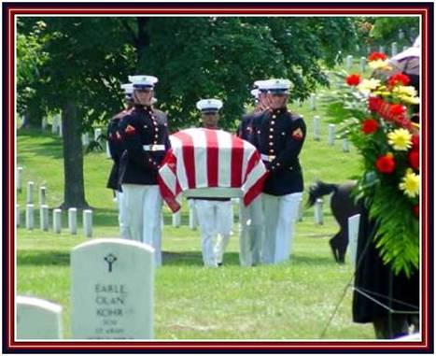
It is the VETERAN who serves under the Flag,
ETERNAL REST GRANT THEM O LORD, AND LET PERPETUAL LIGHT SHINE UPON THEM.

Slide 25
Memory
If we forget them,
We may forget what they fought for . . . .
If we forget what they fought for,
We may lose what they fought for!
May that never happen!

Slide 26
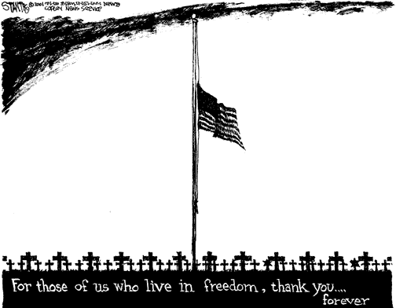

Slide 27
I'd be EXTREMELY proud if this message reached as many as possible. We can be very proud of our young men and women in the service no matter where they serve.
God Bless them all!!!
Makes you proud to be an AMERICAN!!!!
IN GOD WE TRUST!

