Slide 1
Great Minds to Inspire you in Life
Some thoughts to ponder.

Slide 2
"We are what we repeatedly do. Excellence, then, is not an act, but a habit." Aristotle

Slide 3
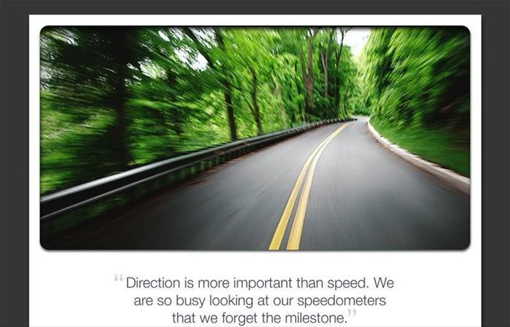

Slide 4
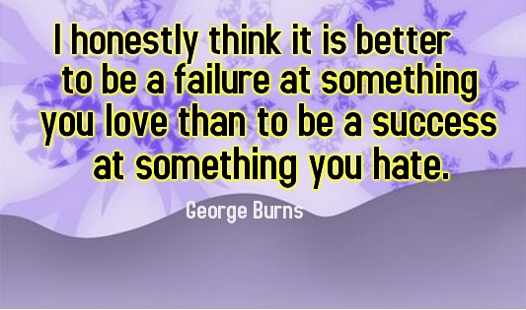

Slide 5
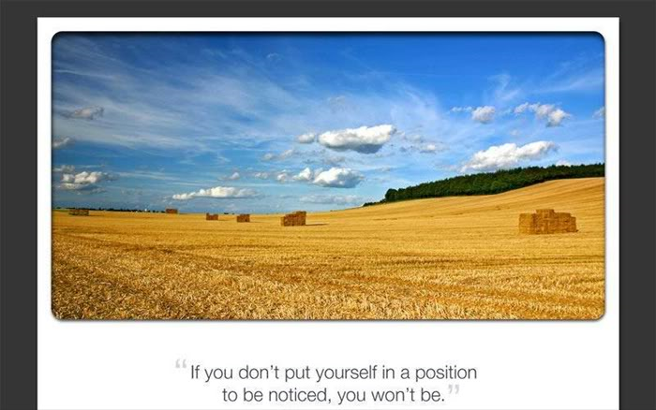

Slide 6
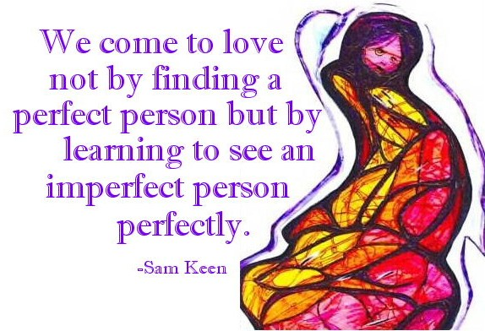

Slide 7


Slide 8


Slide 9
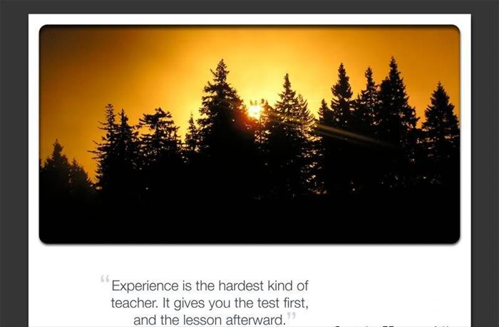

Slide 10
"The purpose of life is to live it, to taste experience to the utmost, to reach out eagerly and without fear for newer and richer experience." ~Eleanor Roosevelt

Slide 11
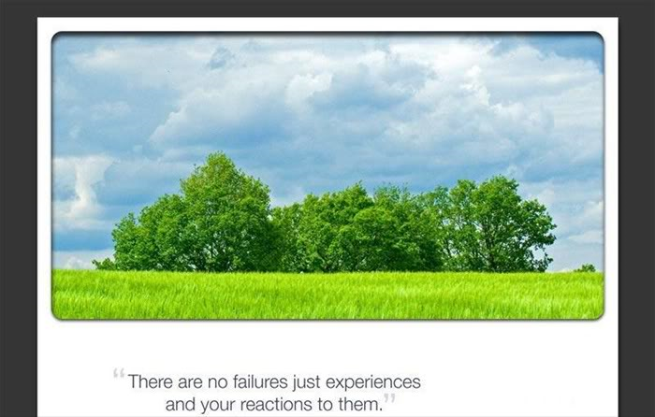

Slide 12
"The greatest revolution in our generation is the discovery that human beings, by changing the inner attitudes of their minds, can change the outer aspects of their lives"--William James

Slide 13
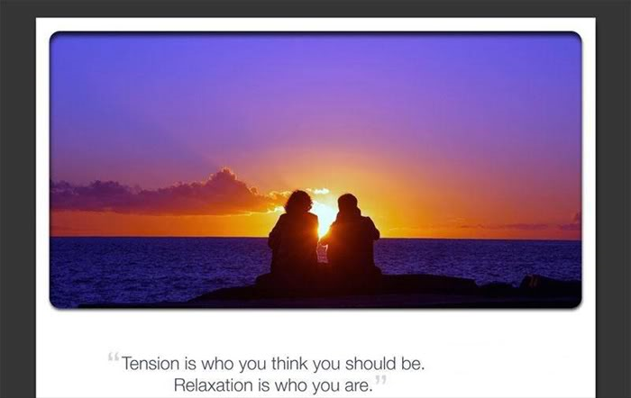

Slide 14
Remember happiness doesn’t depend upon who you are or what you have; it depends solely on what you think.
~ Dale Carnegie

Slide 15
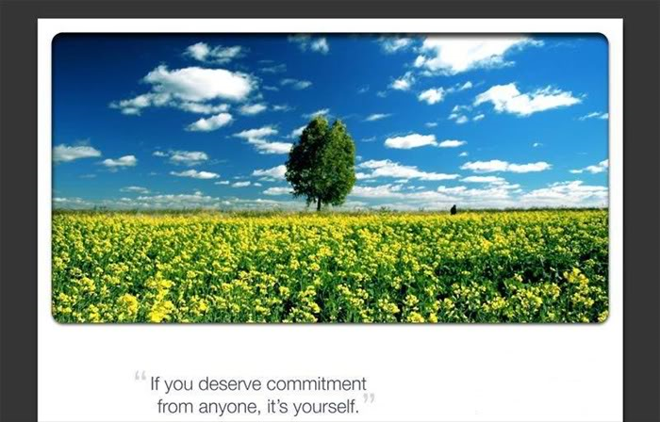

Slide 16


