Slide 1
Faith: Everyone’s Got It
Joe Naumann

Slide 2
Faith
Faith is the confident belief or trust in the truth or trustworthiness of a person, idea, or thing. The word "faith" can also refer to a religion itself or to religion in general.
Faith is in general the persuasion of the mind that a certain statement is true.^{[5}It is also the belief and the assent of the mind to the truth of what is declared by another, based on his or her authority and truthfulness.

Slide 3
Bottom Line
Ultimately, all person’s lives are based on taking a “leap of faith” in something or someone – some foundational truth upon which their lives are based.
  For some, it’s the Bible, Quran, or other sacred scripture.
  For some, it’s a charismatic leader (often religious, but also secular).
  For some it’s a philosophy of living such as Confucianism.
  For some it’s their own “reasoning” mind.

Slide 4
Some Considerations
If one is honest, one must admit that the foundational truth upon which one’s life is bases is something that cannot be “proven.”
It’s important to try to understand the faith “foundations” of others:
  Lack of knowledge and understanding often leads to misunderstandings and even violence.
  If I cannot prove the truth of my foundational beliefs, then it is very presumptuous of me to judge those of others.

Slide 5
Some positive visual expressions of individual faith

Slide 7
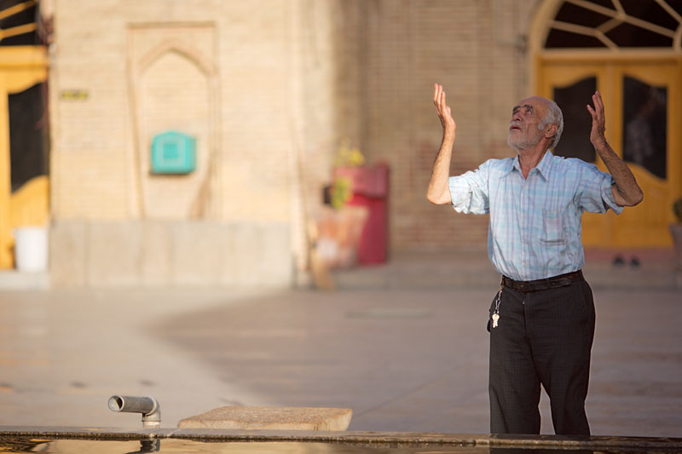

Slide 8
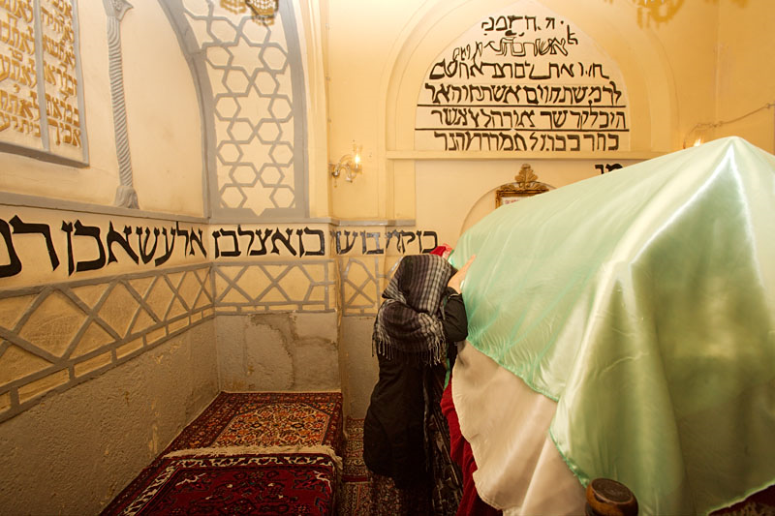

Slide 9
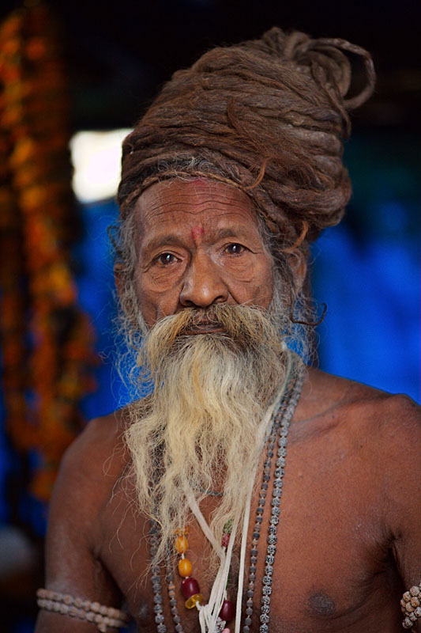

Slide 10


Slide 11
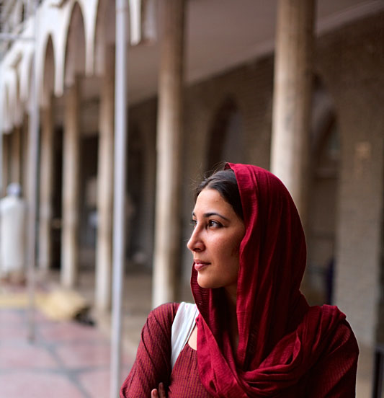

Slide 12


Slide 13
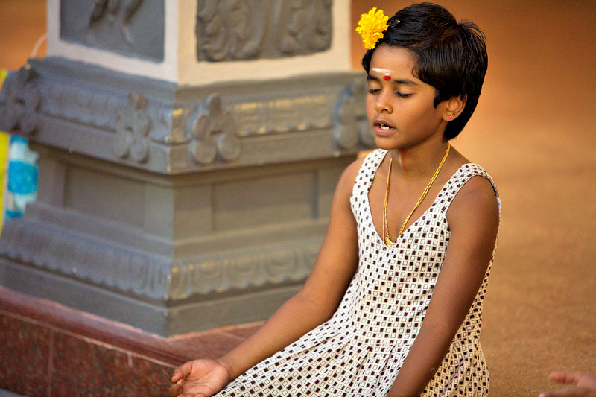

Slide 14
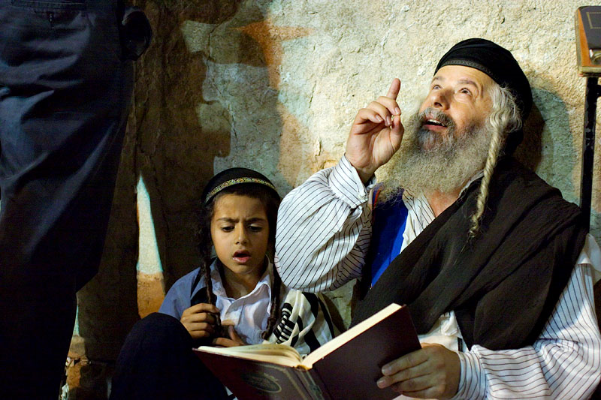

Slide 15
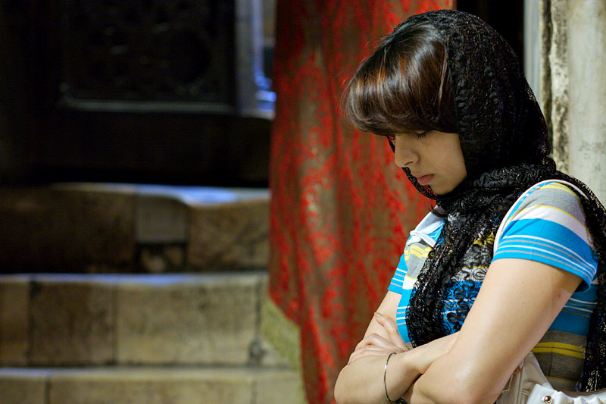

Slide 16
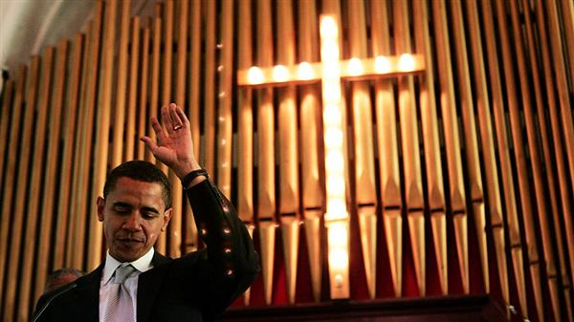

Slide 17
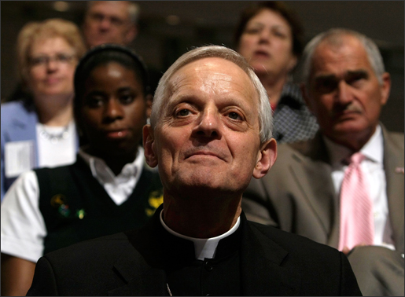

Slide 18
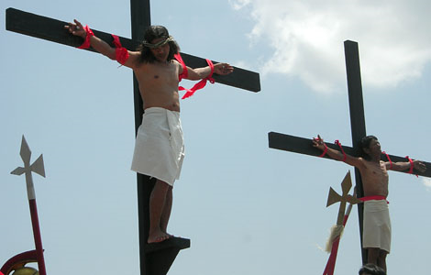

Slide 19
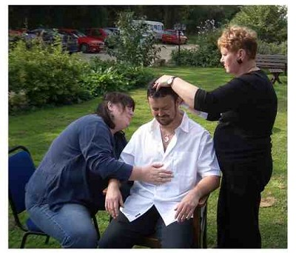

Slide 20


Slide 21
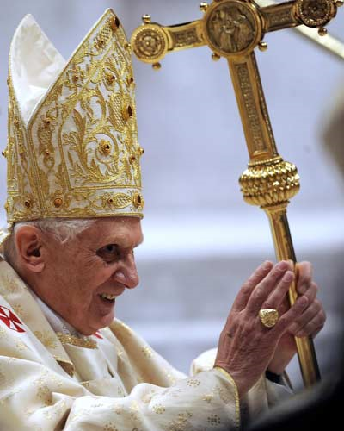

Slide 22


Slide 23


Slide 24
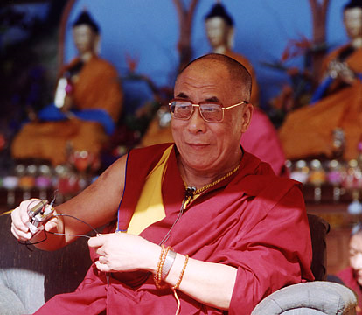

Slide 25
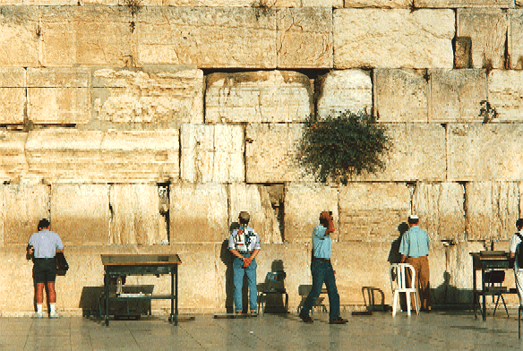

Slide 26
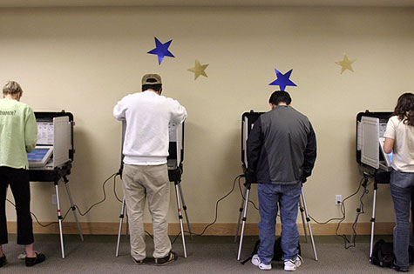

Slide 27


Slide 28

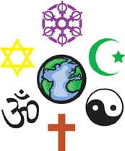
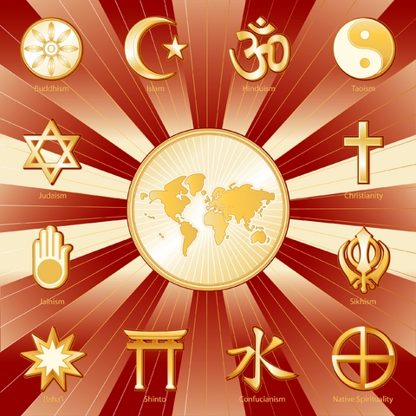
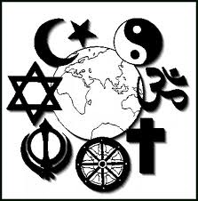

Slide 29
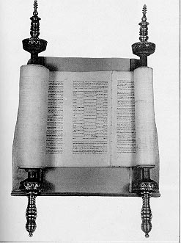
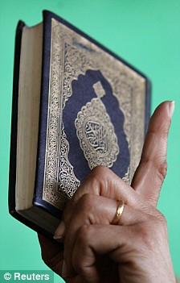
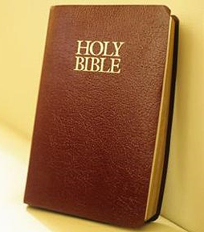
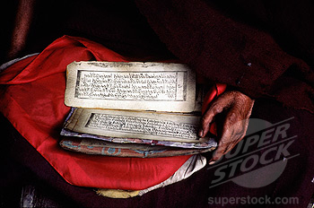

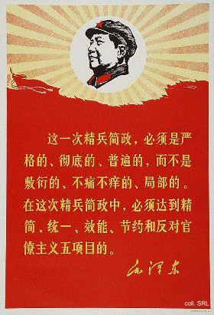

Slide 30
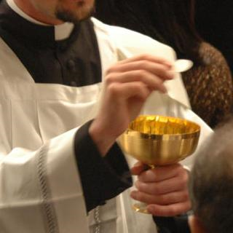

Slide 31
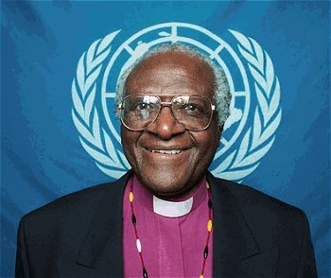

Slide 32
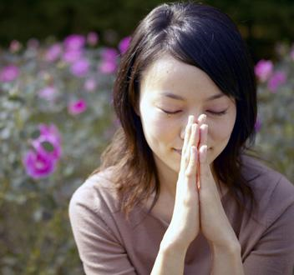

Slide 33
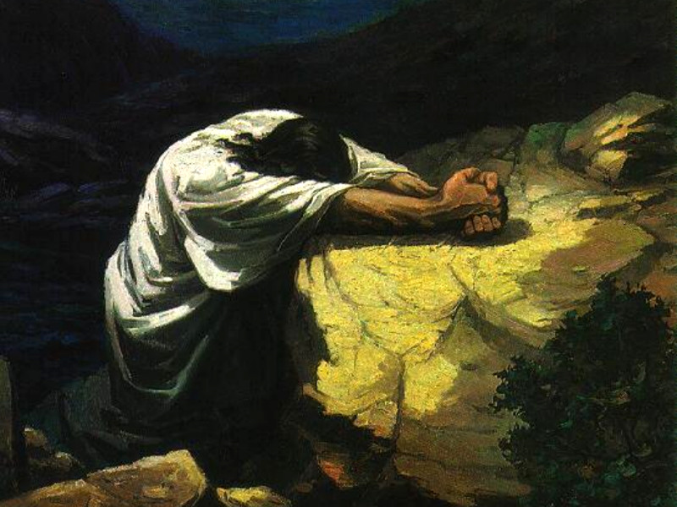

Slide 34
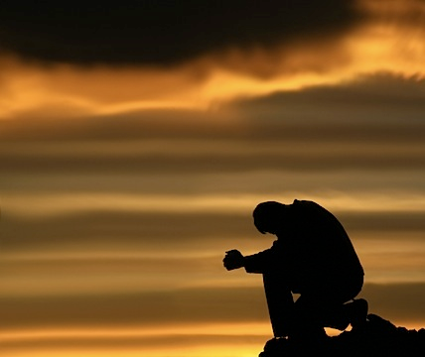

Slide 35
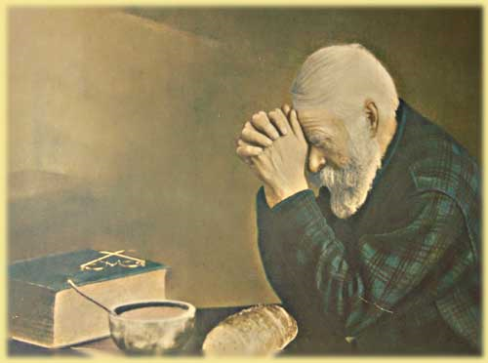

Slide 36
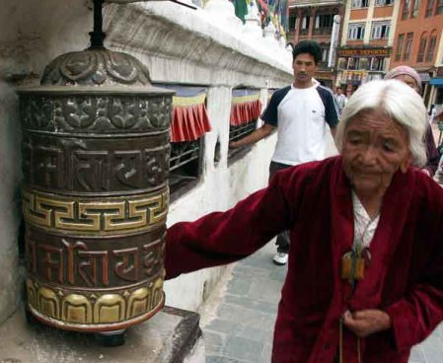

Slide 37
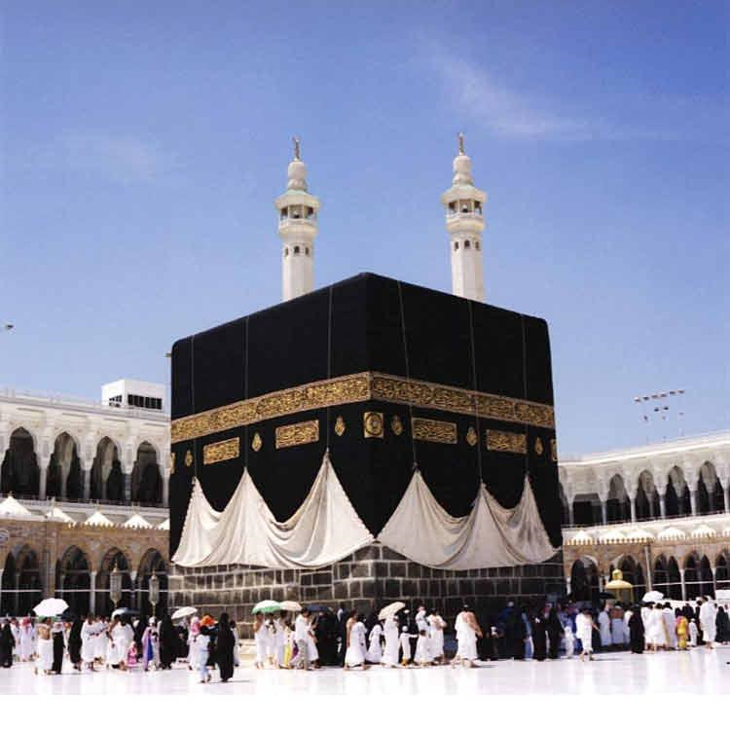

Slide 38
One cannot truly know another culture until one understands the basic, or fundamental, beliefs, accepted by faith, that are generally held by most people.
  Knowing what people do is not difficult
  Understanding why they do it (why it seems logical to them) is much more difficult.
Children absorb these beliefs from parents and neighbors by a process much like brainwashing – biases and prejudices are passed on this way too. They develop attitudes they never chose for themselves.

