Slide 1
Comments made in the year 1955!
That’s only 55 years ago!

Slide 2
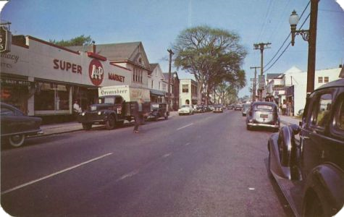
‘I’ll tell you one thing, if things keep going the way they are, it’s going to be impossible to buy a week’s groceries for $10.00. ‘

Slide 3
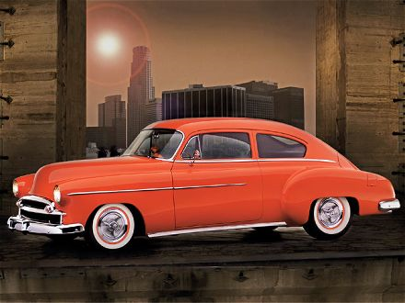
‘Have you seen the new cars coming out next year? It won’t be long before $1,000.00 will only buy a used one.’

Slide 4
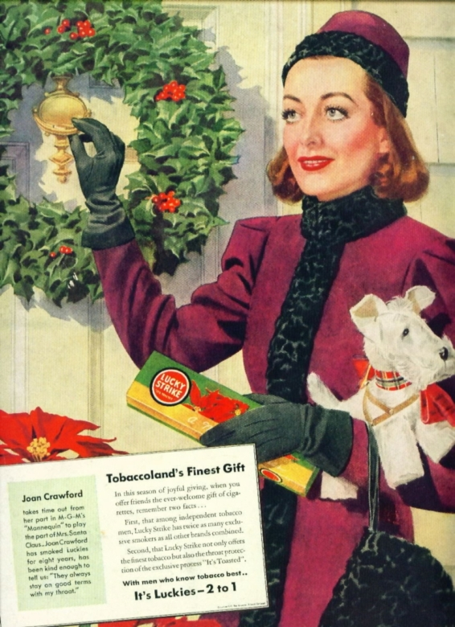
‘If cigarettes keep going up in price, I’m going to quit; 20 cents a pack is ridiculous. ‘

Slide 5
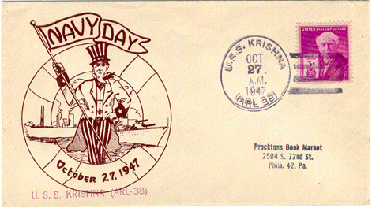
‘Did you hear the post office is thinking about charging 7 cents just to mail a letter.’

Slide 6
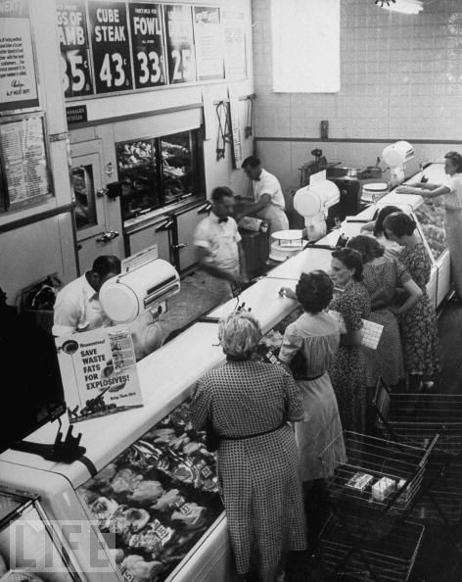
‘If they raise the minimum wage to $1.00, nobody will be able to hire outside help at the store.’

Slide 7
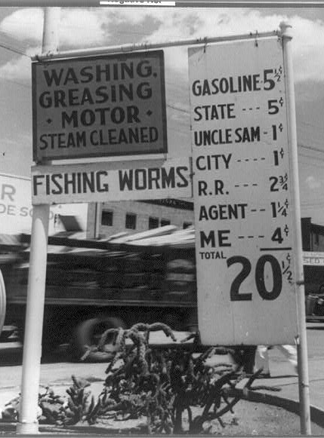
‘When I first started driving, who would have thought gas would someday cost 25 cents a gallon. Guess we’d be better off leaving the car in the garage.’

Slide 8
‘I’m afraid to send my kids to the movies any more. Ever since they let Clark Gable get by with saying DAMN in ‘GONE WITH THE WIND’, it seems every new movie has either HELL or DAMN in it.’

Slide 9
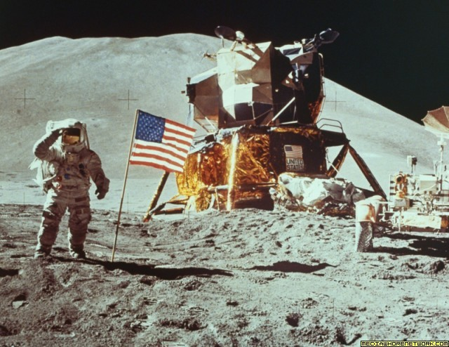
‘I read the other day where some scientist thinks it’s possible to put a man on the moon by the end of the century. They even have some fellows they call astronauts preparing for it down in Texas.’

Slide 10
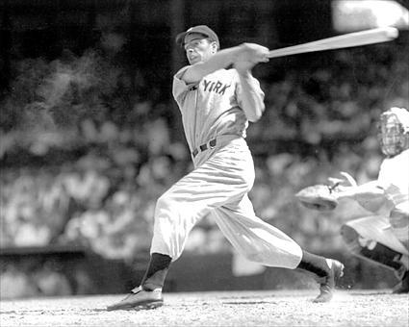
‘Did you see where some baseball player just signed a contract for $50,000 a year just to play ball? It wouldn’t surprise me if someday they’ll be making more than the President. ‘

Slide 11
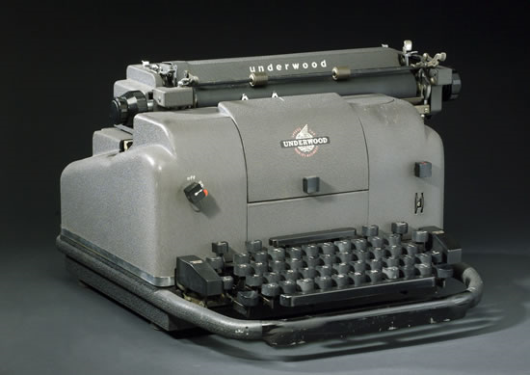
‘I never thought I’d see the day all our kitchen appliances would be electric. They are even making electric typewriters now. ‘

Slide 12
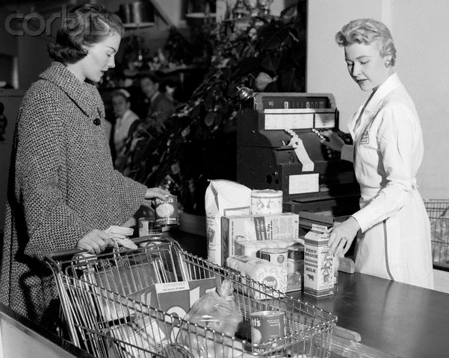
‘It’s too bad things are so tough nowadays. I see where a few married women are having to work to make ends meet. ‘

Slide 13
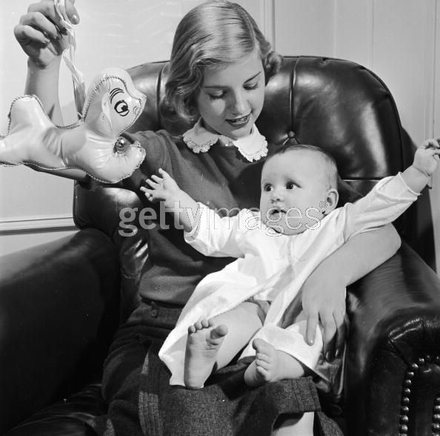
‘It won’t be long before young couples are going to have to hire someone to watch their kids so they can both work.’

Slide 14
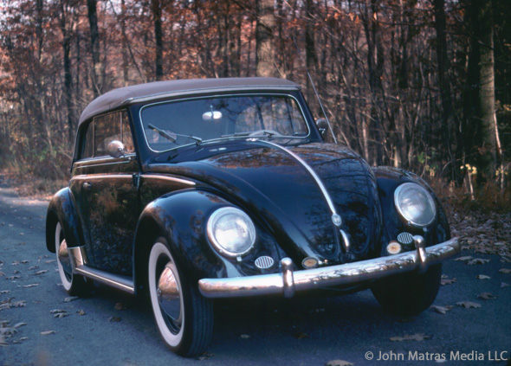
‘I’m afraid the Volkswagen car is going to open the door to a whole lot of foreign business.’

Slide 15
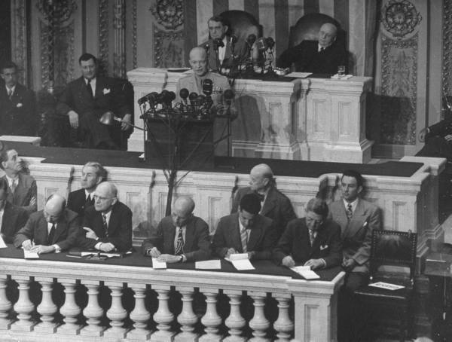
‘Thank goodness I won’t live to see the day when the Government takes half our income in taxes. I sometimes wonder if we are electing the best people to government.’

Slide 16

‘The drive-in restaurant is convenient in nice weather, but I seriously doubt they will ever catch on.’

Slide 17
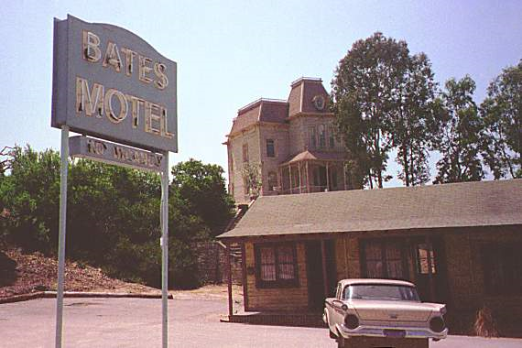
‘There is no sense going on short trips anymore for a weekend. It costs nearly $2.00 a night to stay in a hotel.’

Slide 18
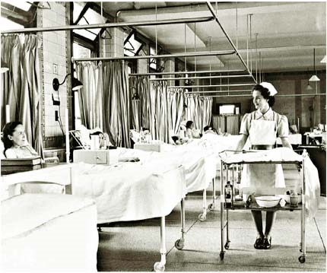
‘No one can afford to be sick anymore. At $15.00 a day in the hospital, it’s too rich for my blood.’

Slide 19
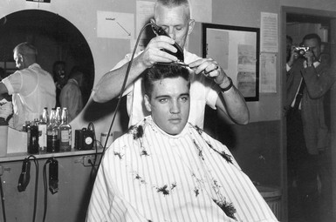
‘If they think I’ll pay 30 cents for a hair cut, forget it.’

Slide 20
Have a Great Day!

