Slide 1


8 Ways to Increase Hope
Some helpful techniques
By Naomi Drew

Slide 2
"I've been so overwhelmed by what's going on these days," a mother recently said regarding world events. "I feel like there's nothing I can do and the world's spinning out of control." Her words echo the sentiments so many of us feel each time we pick up a paper or turn on the news. War on the horizon, nuclear weapons in North Korea, a family of six killed by a fire bomb in Baltimore, the massacre in Bali -- the list goes on. Right now, it's easy to lose hope. However, loss of hope doesn't have to be the path we walk down.

Slide 3
You see, hope is actually something we create. It's not something that magically appears from an outside source. We each have within us the capacity to generate hope. It's critical that we be absolutely intentional about nurturing hope in our lives and the lives of our children. Now more than ever, overcoming fear and holding onto hope are essential. The eight steps below will enable you do this. Try these steps yourself and teach them to your kids. Do some of these as a family. Know that it is within your control to become more hopeful. Don't let the news be your undoing. You can take charge.

Slide 4

Be Kind to Yourself
Think about what you need most, and then do it. Is it a cup of tea, a brisk walk, some downtime, quiet music, a little rest, or reading inspirational literature? Whatever it is, grant yourself permission to do it, even for just a few minutes. If you're at work, take a "care-break" where you take care of you for a brief moment. These small moments accumulate and transform the texture of our days.

Slide 5
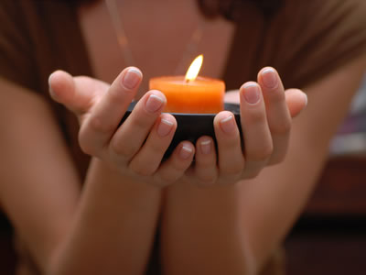
Create a Daily 5-Minute Silence Ritual
Light a candle and pray, meditate or reflect. You don't have to believe in any particular deity to make this work. Just silently reflecting in front of a lit candle is extremely nurturing and healing. This may be the one time of day when you feel connected to your own soul, and perhaps even something larger. Don't skip this step -- it's very powerful.

Slide 6

Curtail Your Intake of News
Oversaturation with news right now is detrimental to emotional health. If you read the newspaper in the morning, let that be enough. You don't need to turn on the TV or radio too, especially before bed. Consider putting a complete moratorium on news at least once a week. Anything you missed will be there tomorrow. Drastically curtail any news you let your children watch.

Slide 7

Treat Each Day Like a Precious Gift
Be vigilant in looking for things and people to appreciate. What if today was the last day of your life? How would you want to live it? Ask yourself this question throughout the day. It will help you let go of the countless petty annoyances that tend to throw most of us off balance. Shift your gaze to appreciation. Who and what are you grateful for? Make a list each day and add to it.

Slide 8

Take a Break
Every morning, afternoon and night, take a 30-second break to look at the sky, breathe deeply and offer thanks. Even though the world has its problems, the sun still rises in the sky each morning, and we're awake and alive when we get out of bed. Let the sky be a touchstone to hope. Think of other people around the world as you look at the sky, and know that we all share this planet together. Among all of us, we have the ability to create solutions to the problems that now exist.
Trust that this is so.

Slide 9

Express Love Tangibly
Hugs, words, notes, acts of kindness -- be indiscriminately generous with all of them. Surprise a friend with a hug. Hug and kiss your kids longer and with deeper feeling. If you like how the clerk treated you in the store, thank her. Leave your partner small notes expressing gratitude for kind acts. Doing all of this adds warmth and positive energy to our lives and the lives of people around us. It's also very comforting both to the giver and receiver of each loving act.

Slide 10
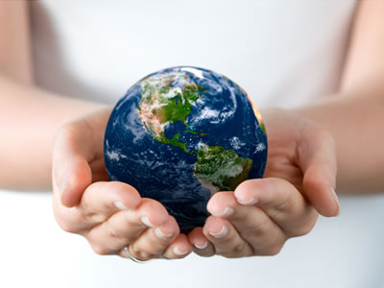
Say This Affirmation Every Day
Say this affirmation every day and see where it leads you: "I am the key to peace."
Most of us believe, erroneously, that peace will come from people or institutions much larger than we. Just the opposite is true. Peace starts with each individual and it will only come to this world from the people themselves. It is critical that we each create peace in the small and large moments of our lives. We must live it in our words and actions rather than giving in to fear, hatred, or resignation.

Slide 11

Make a Difference
Reach out beyond your normal scope. This is your opportunity to live your greatest promise, highest self. Don't wait. Each time we make a difference in the lives of others, we create hope in ourselves. By reaching out to someone in need, be it your neighbor, a Guatemalan orphan, or people in a homeless shelter, we add a little more peace and hope to the world. Our accumulated gestures of care and compassion will ultimately transform our lives and the lives of others. We are each the source of that transformation. Knowing this gives me hope.

