Slide 1
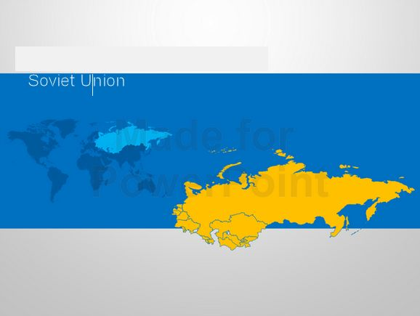
Soviet Realism

Slide 2
Socialist realism is a style of realistic art that was developed in the Soviet Union and became a dominant style in various other socialist countries. Socialist realism is characterized by the glorified depiction of communist values, such as the emancipation of the proletariat, in a realistic manner. Although related, it should not be confused with social realism, a broader type of art that realistically depicts subjects of social concern. Socialist realism was the predominant form of art in the Soviet Union from its development in the early 1920s to its eventual fall from popularity in the late 1960s. While other countries have employed a prescribed canon of art, socialist realism in Russia persisted longer and was more restricted than elsewhere in Europe.

Slide 3
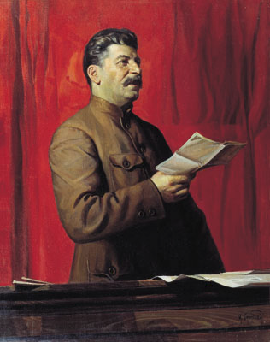
Examples: Painting
Common themes: Patriotic workers; Leadership of Lenin; Achievements under Communism; Military power; Significant Historic Events; etc.

Slide 4
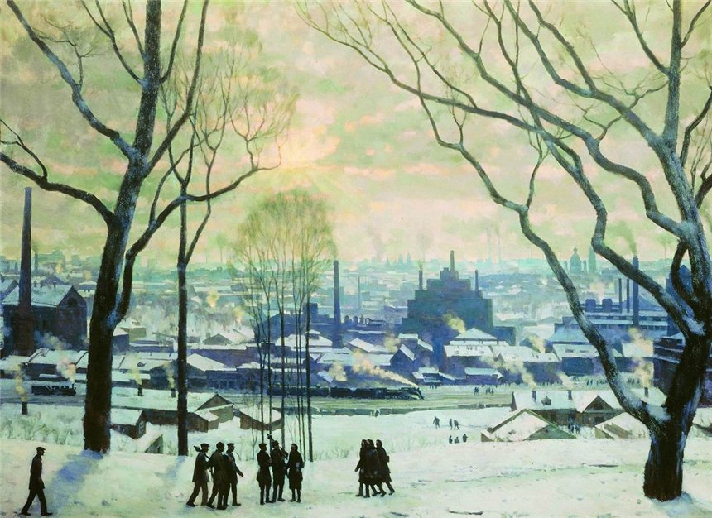

Slide 5
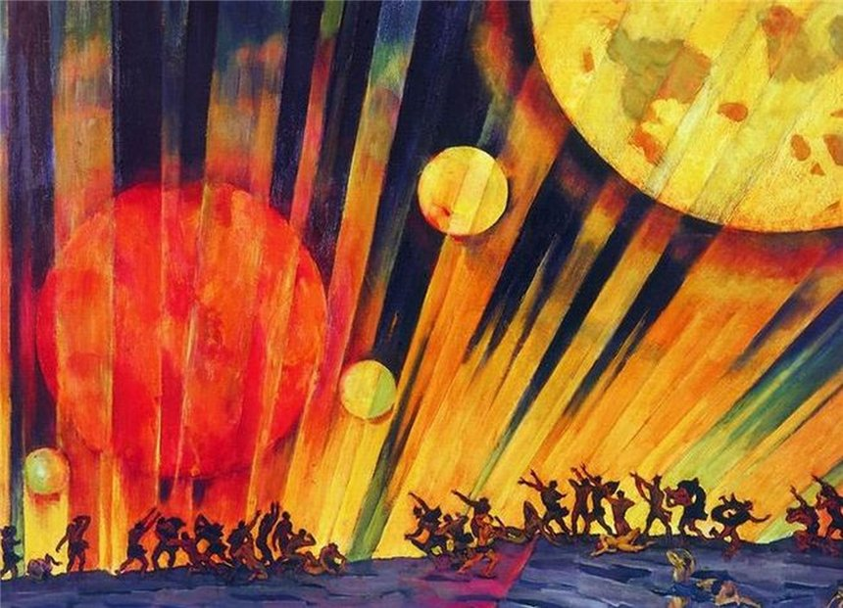

Slide 6
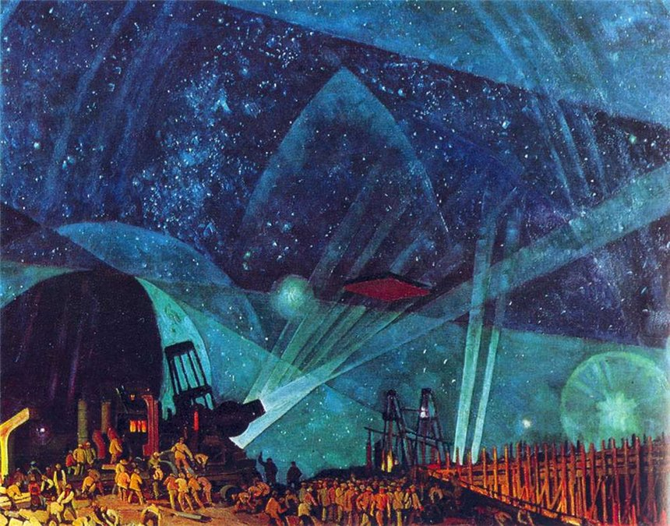

Slide 7
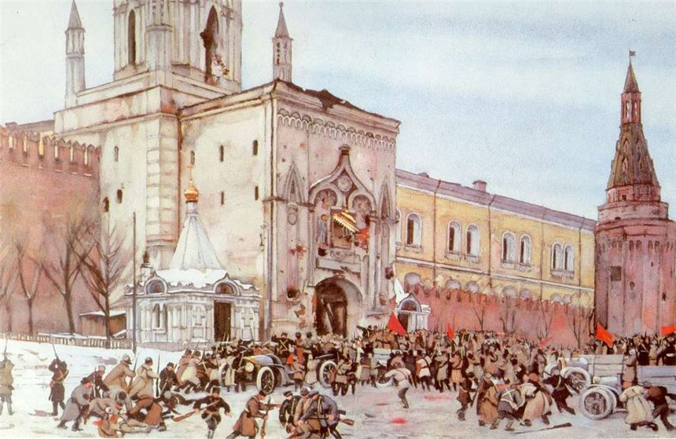

Slide 8
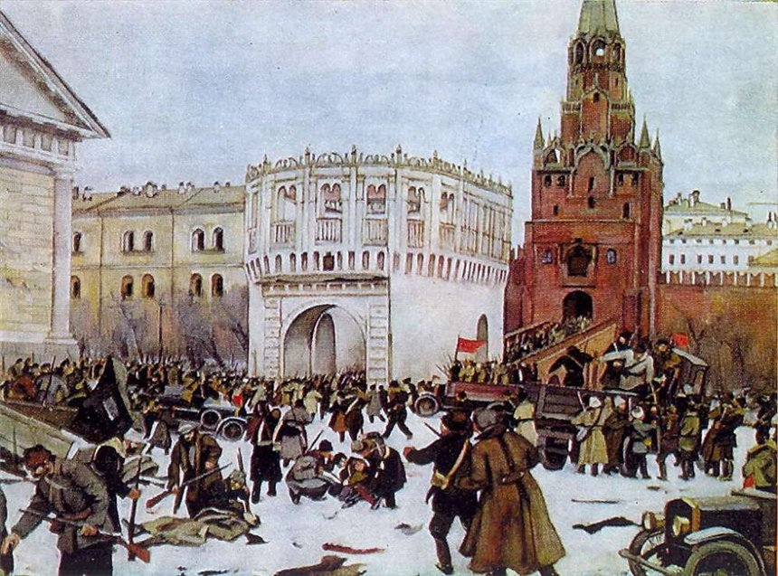

Slide 9
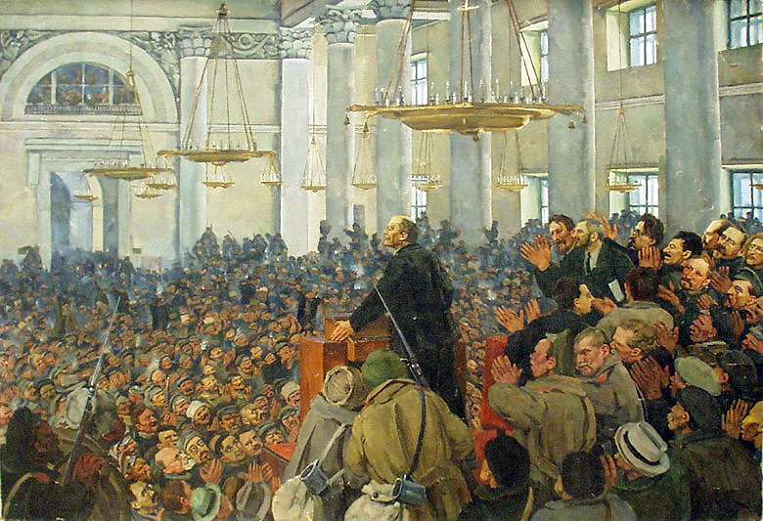

Slide 10
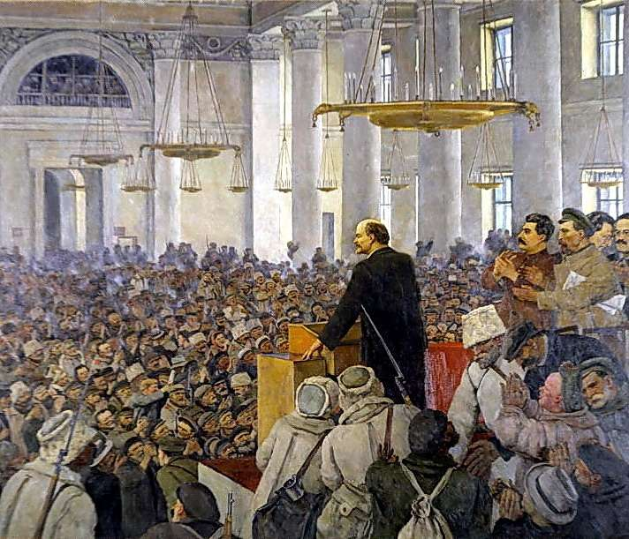

Slide 11
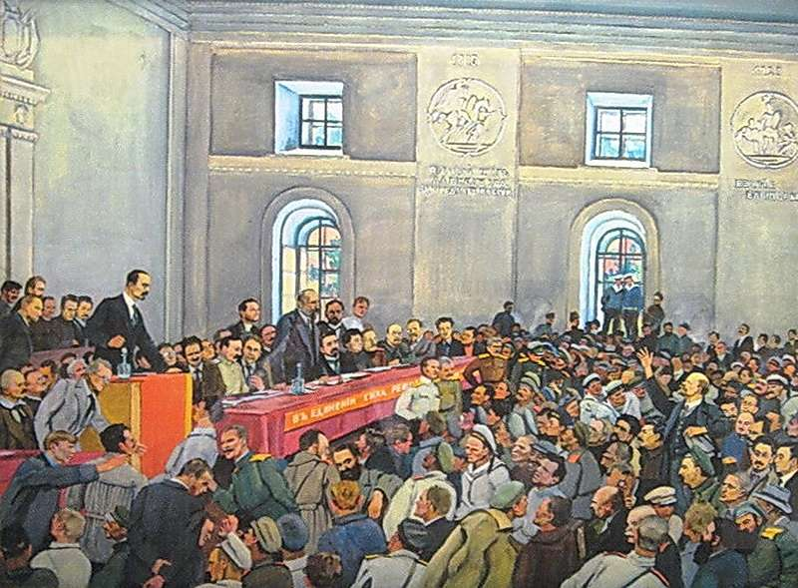

Slide 12
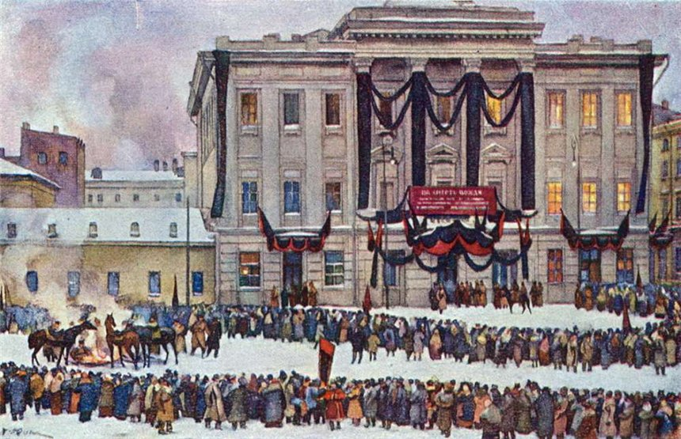

Slide 13
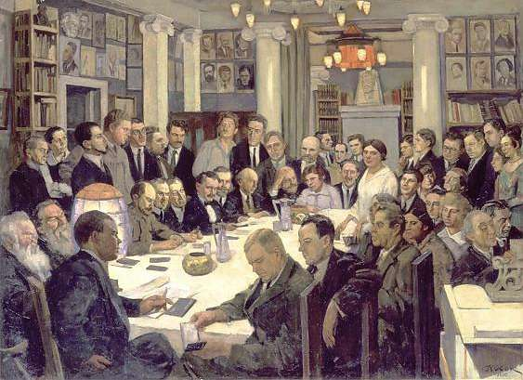

Slide 14
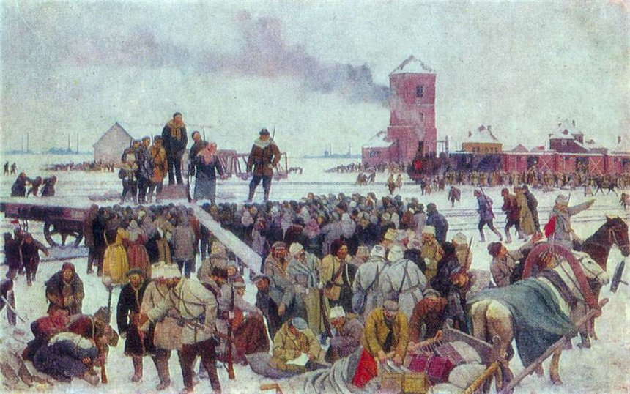

Slide 15
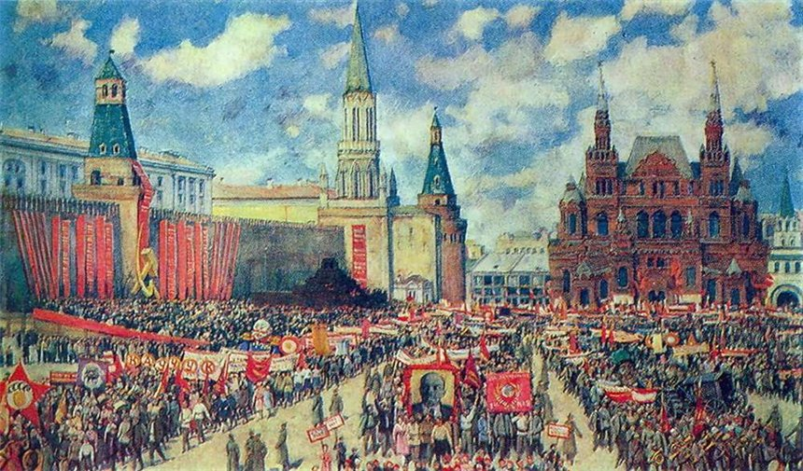

Slide 16
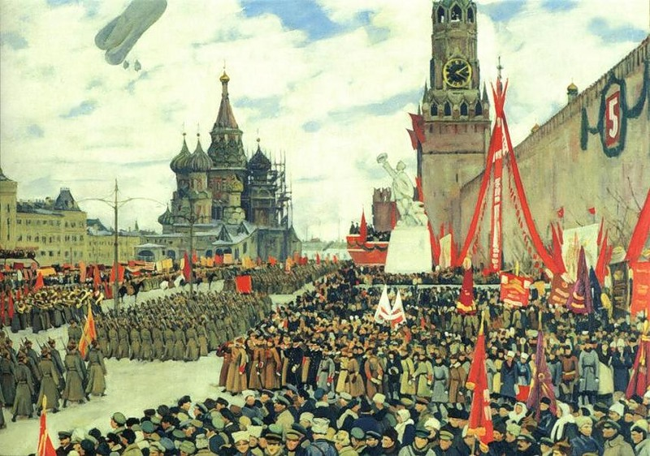

Slide 17
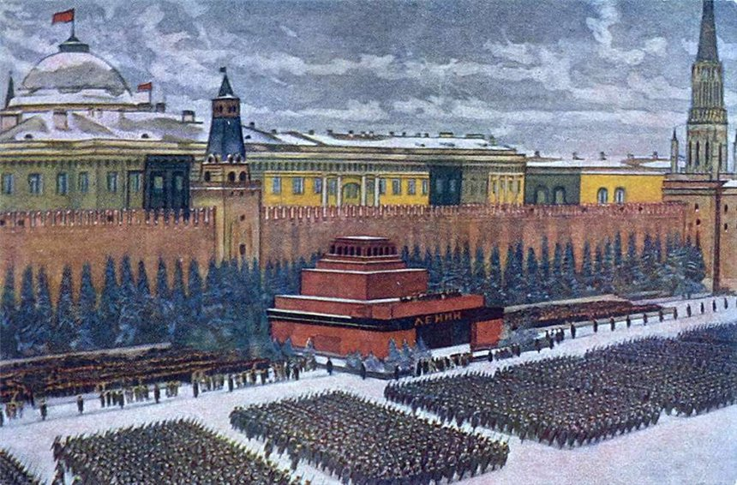

Slide 18
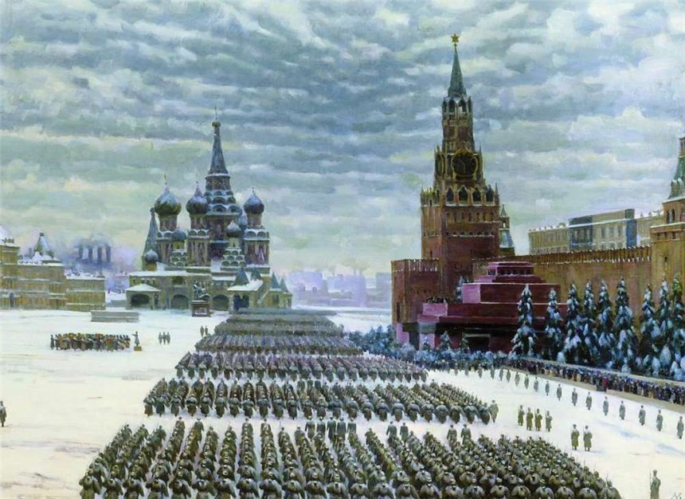

Slide 19
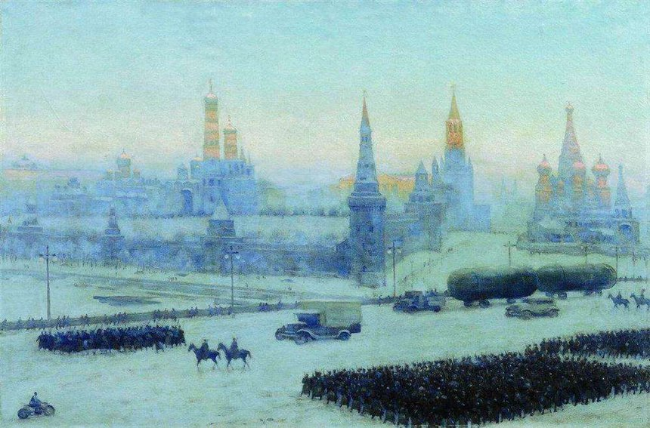

Slide 20
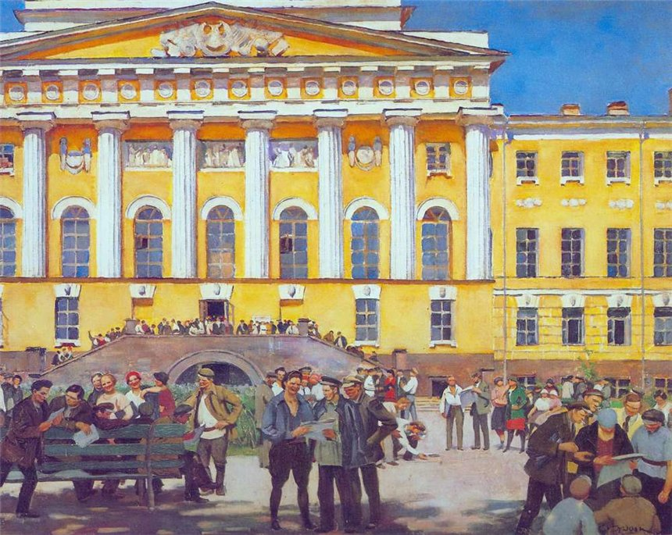

Slide 21
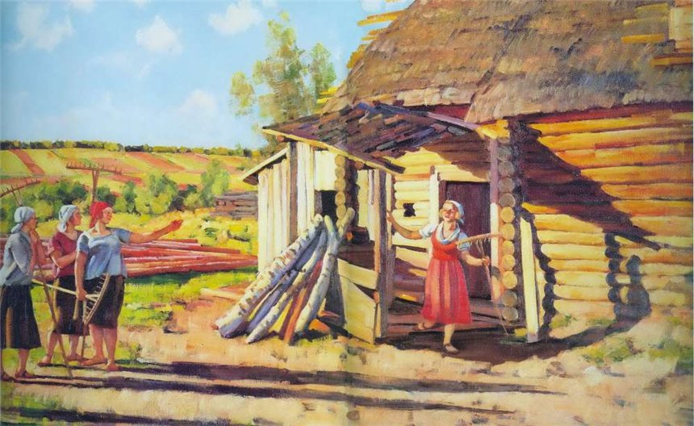

Slide 22
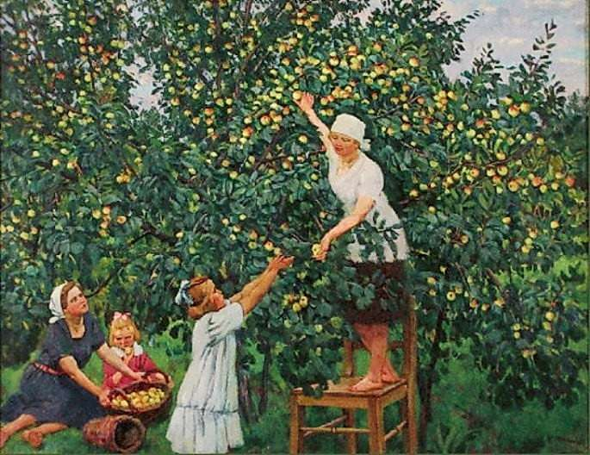

Slide 23
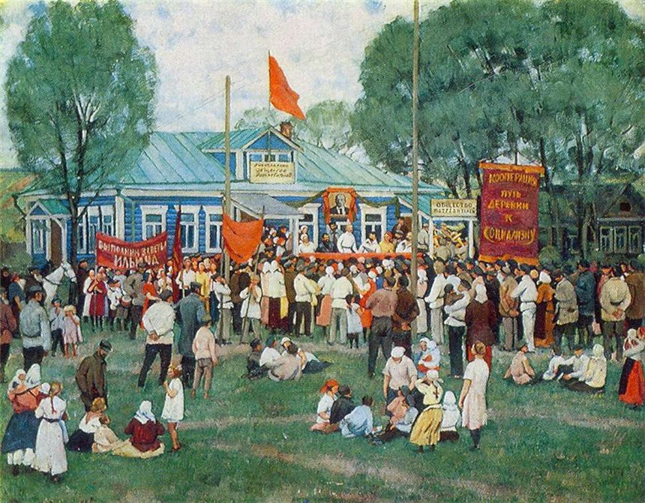

Slide 24
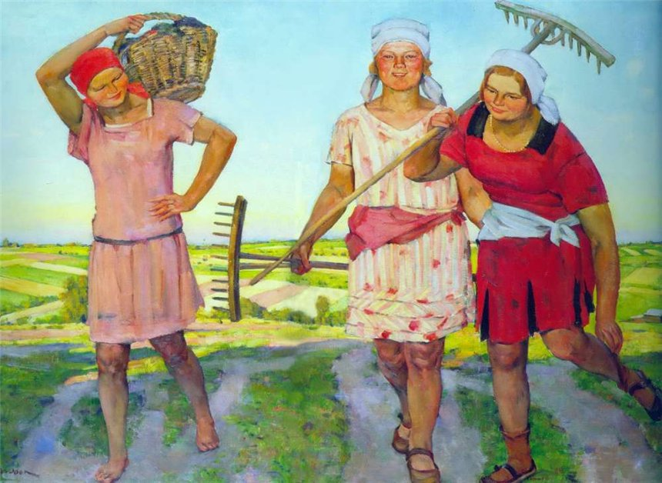

Slide 25
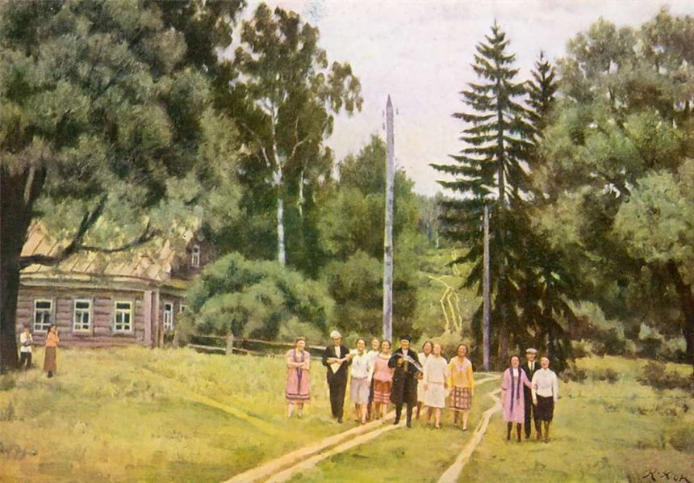

Slide 26
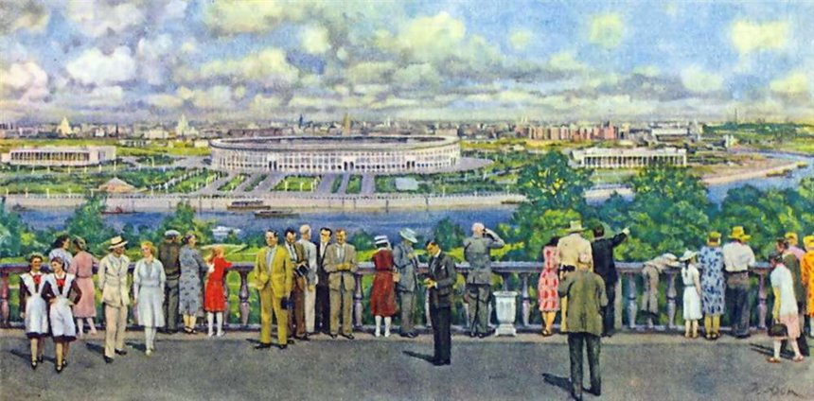

Slide 27
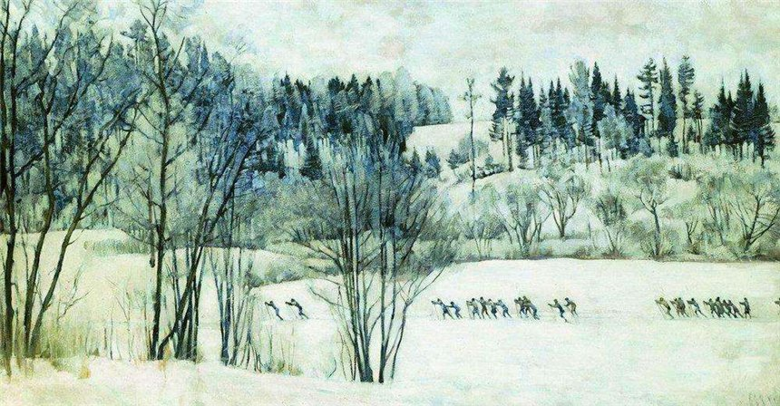

Slide 28
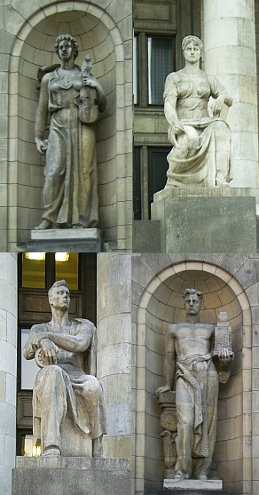
Art - Sculpture

Slide 29
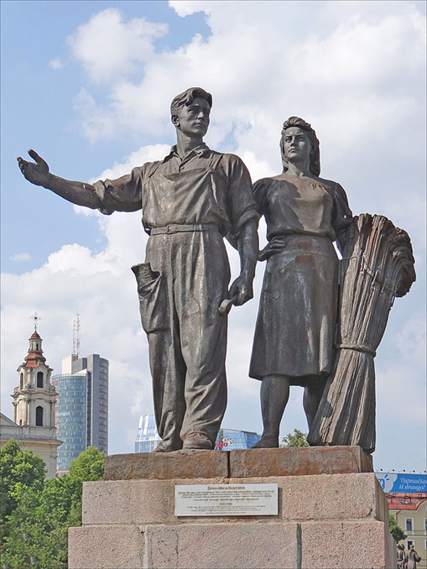

Slide 30
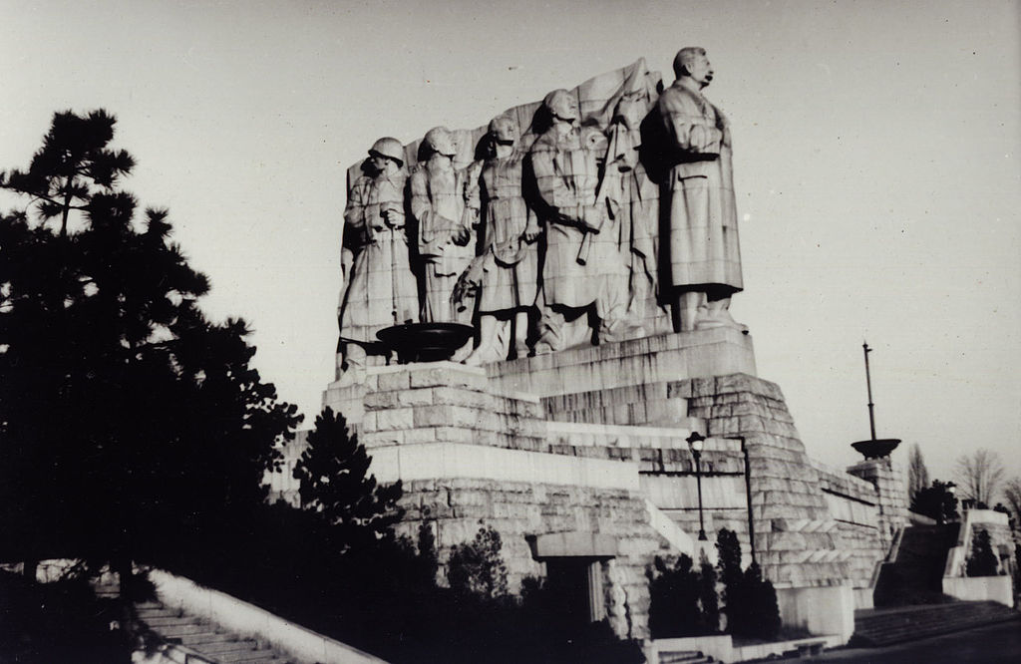

Slide 31
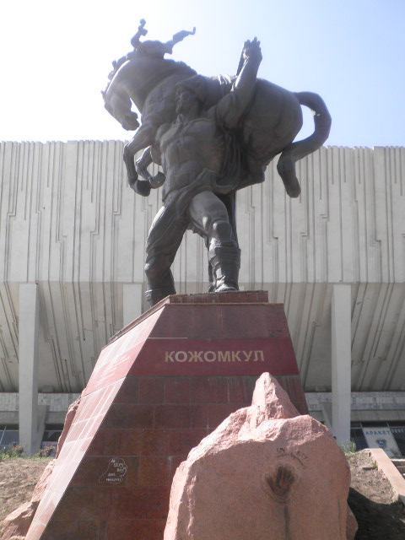

Slide 32
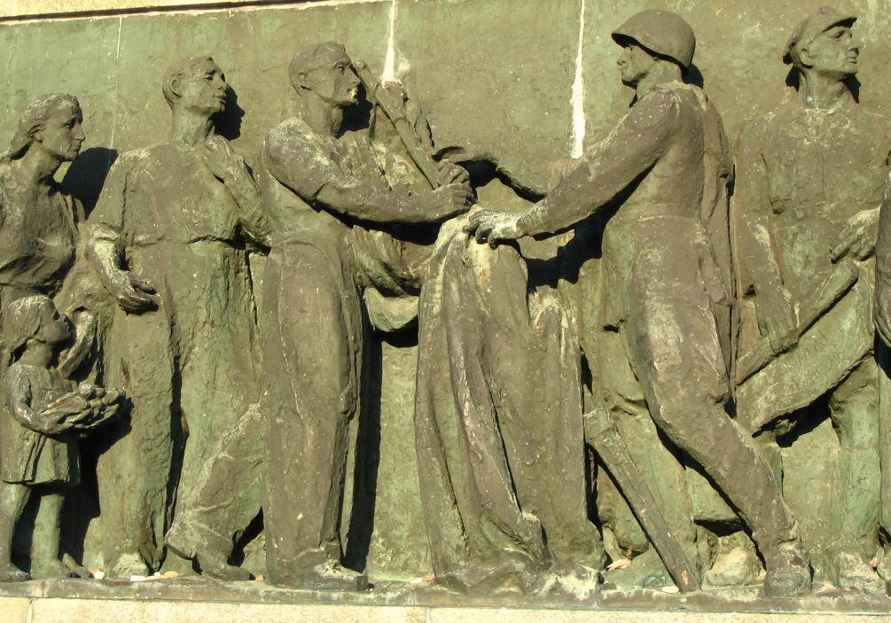

Slide 33
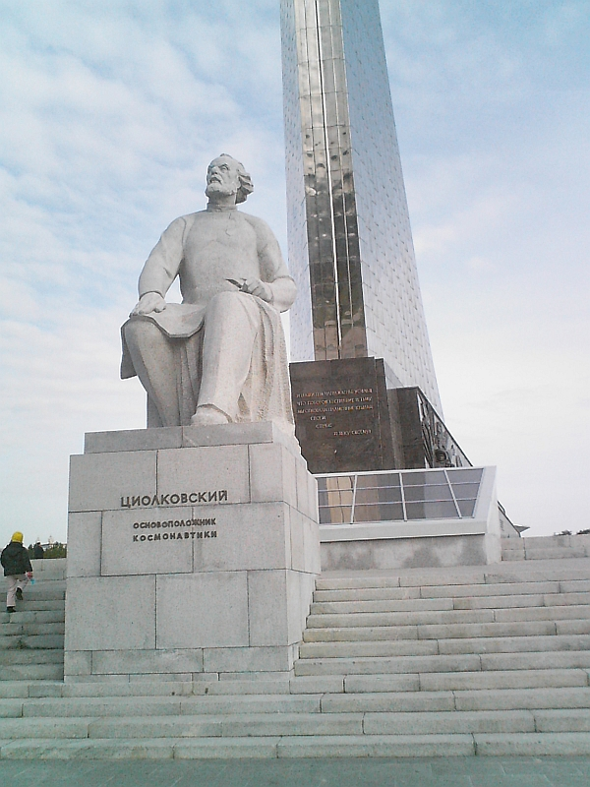

Slide 34
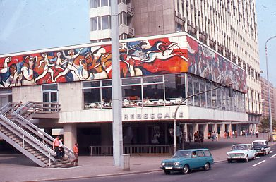
Architecture

Slide 35
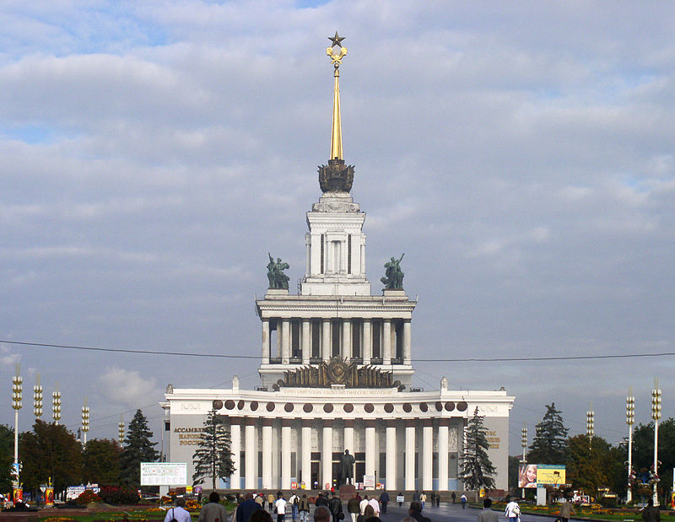

Slide 36
These themes affected all areas of art.
Movies
Theater
Dance
Literature
Music
Architecture

