Slide 1
Judaism – Ultraorthodox Jewish Wedding

Slide 2
The badeken. A beat of drums; the music rises. The groom, linked elbows with his father on the right, with his bride’s father on the left, makes his way, head bent, toward the women’s side of the hall, escorted by an entourage of male married family members. They march down a makeshift aisle till the groom reaches the bridal throne. A stop. A fluttering of white cloth: the dek tichel. Hands trembling, the groom places the dek tichel on the bride’s head, concealing her face. The bride’s father steps forward, places his hands on the bride’s covered head, whispers his blessing. First the biblical version: “Our sister, may you be to thousands and ten thousands,” echoing the blessing received by the matriarch Rebecca thousands of years ago.

Slide 3
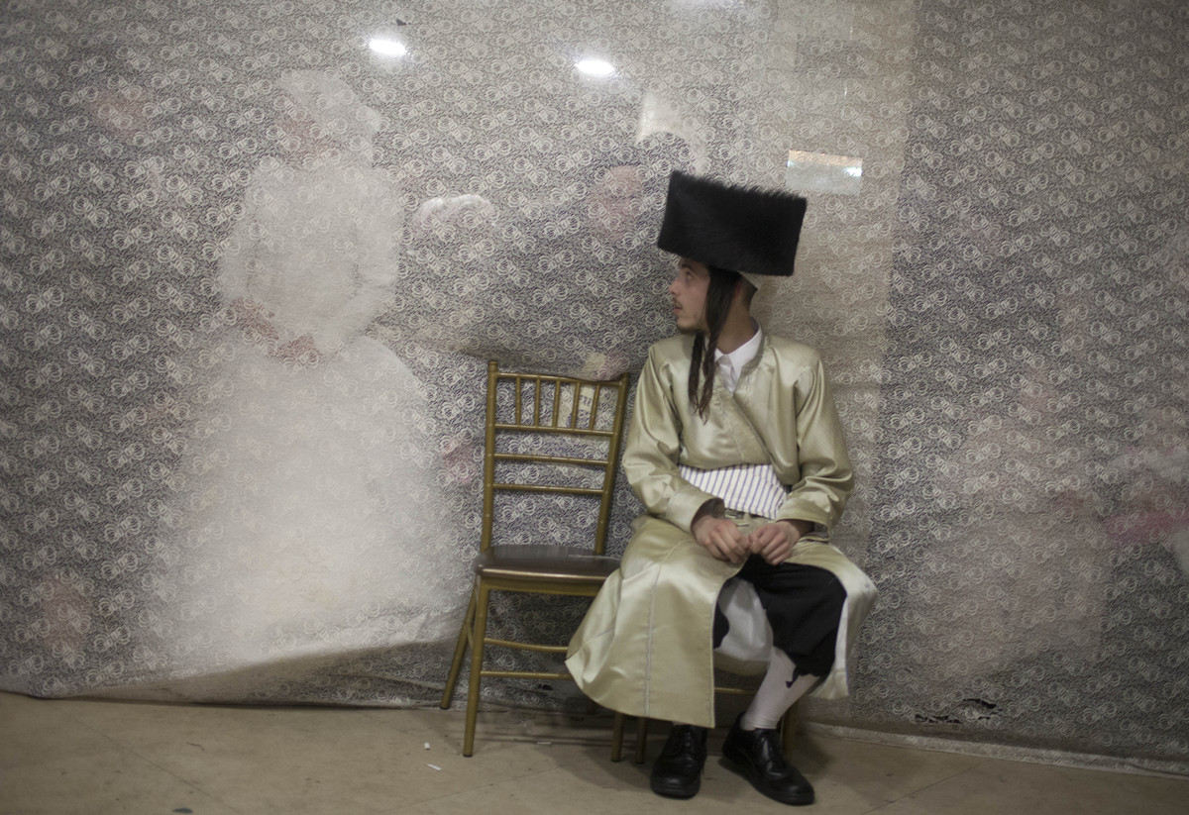

Slide 4
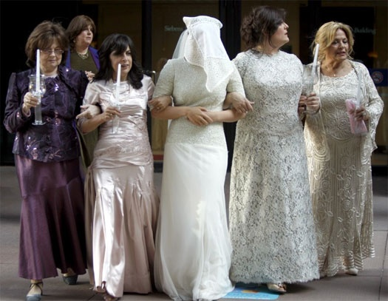
Weddings are ritualistic by nature, but Hasidic weddings take ritual to an extreme. There is a protocol for each portion of the wedding night, even down to details that would generally constitute spontaneity, such as when to cry and when to smile. Each step is prescribed, and each rite, laden with meaning. Ironically, the participants themselves are often unaware of these meanings, even as they follow the customs religiously.

Slide 5
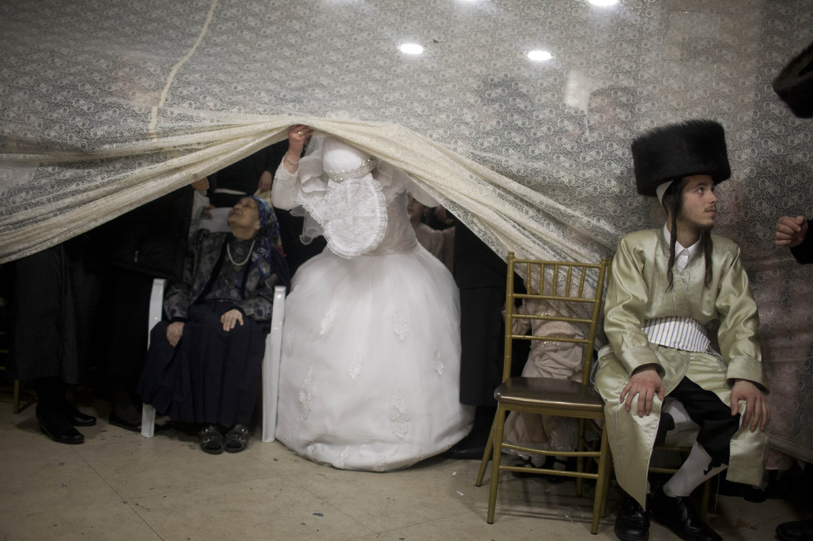

Slide 6
Then, a blessing from the heart: My child, be happy. Be healthy. Be loved. “Der zeide zul benchen,” the bride’s mother calls out. And the grandfather is hustled forward. Lays his hands on the bride’s head, shuts his eyes tightly as he blesses her, a single tear trickling out. It is done. The entourage pivots. Marches back the way they had come. Women hurl confetti or hupen, wood shavings, at the groom. The mothers help the bride stand up. Face still covered, she is led out, across the large hall, and off to the bridal room.

Slide 7
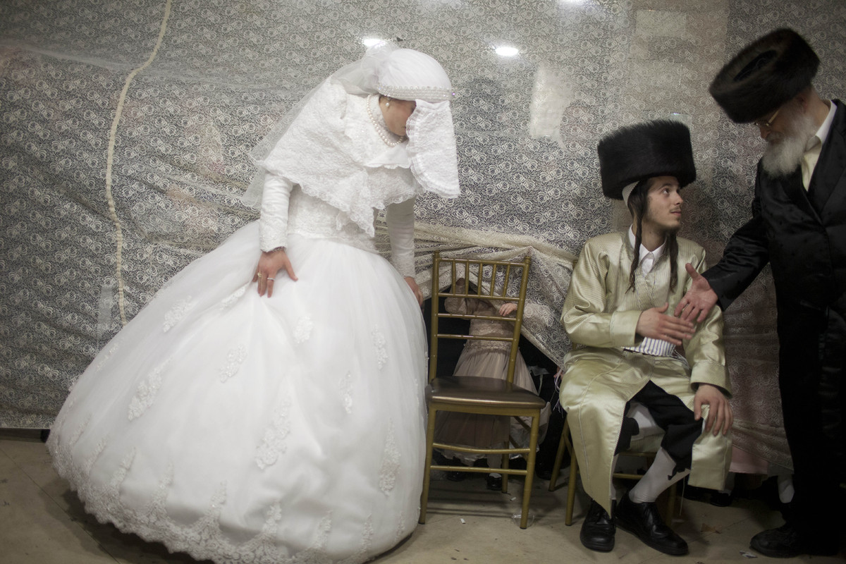

Slide 8
I write “Hasidic” weddings as opposed to “Jewish” weddings, because though most traditional Jewish weddings include all the basic ceremonial rites—chuppah, breaking of plate, yichud—Hasidic weddings feature additional social mores. Acceptable codes of behavior form the nexus of every close knit community, and the Hasidic community is no exception. Hence, the bride’s and groom’s parents are not only expected to walk their children to the chuppah, but must also produce some tears in the process. Or at least scrunch up their faces in a really sad (Hasidim call it “emotional”) expression. The same rule applies at the mitzvah tantz in the latter part of the wedding. When the bride and groom dance hand in hand—the only time in their lives they will dance together in public—the audience (at the risk of being labeled “weird” or “cold”) must dutifully be teary-eyed.

Slide 9
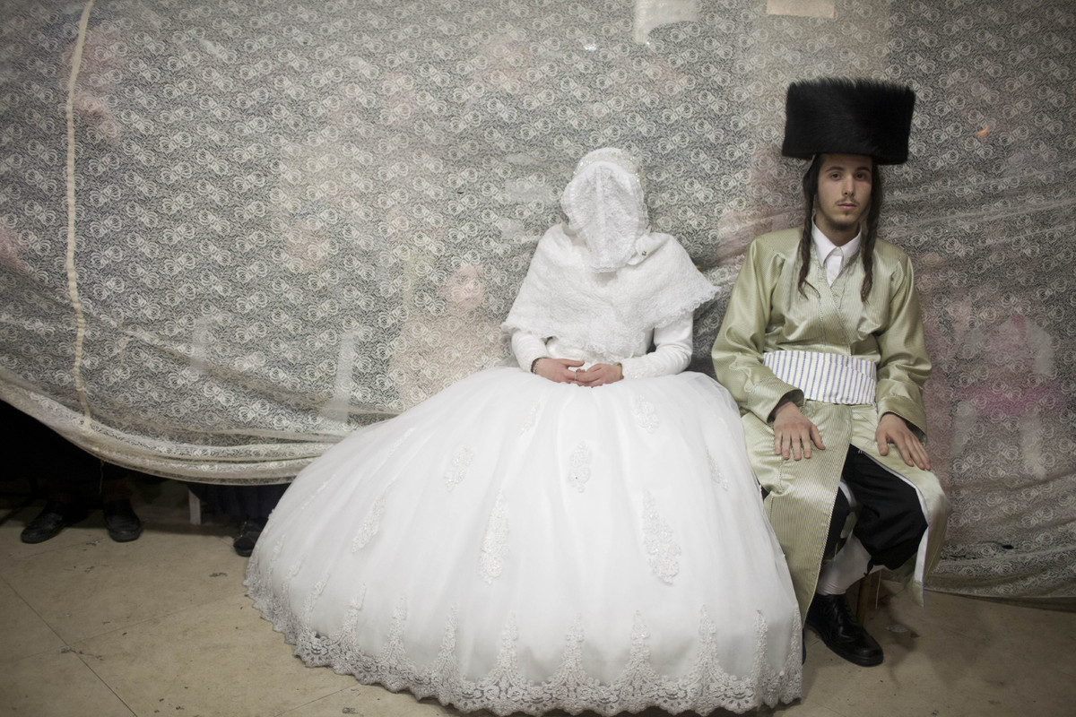

Slide 10
But let us start at the beginning. Forty or fifty girls and women mill about the wedding hall. They form little groups, schmoozing quietly, nibbling on grilled vegetables or sesame chicken from the smorgasbord. At last, the music starts. That’s the cue. The girls and women turn, as one, to the still shut doors. They smile in a hazy kind of way, their mouths slightly open in anticipation. There is nothing to see yet, save the white doors trimmed in gold, but they know—this isn’t the first wedding they’ve been to, after all—what is about to happen. A moment. Another. And…the doors swish open and in they flutter: the bride, flanked by her mother on the right, her groom’s mother on the left, round bouquet of white lilies-in-the-valley clutched in her hands.

Slide 11
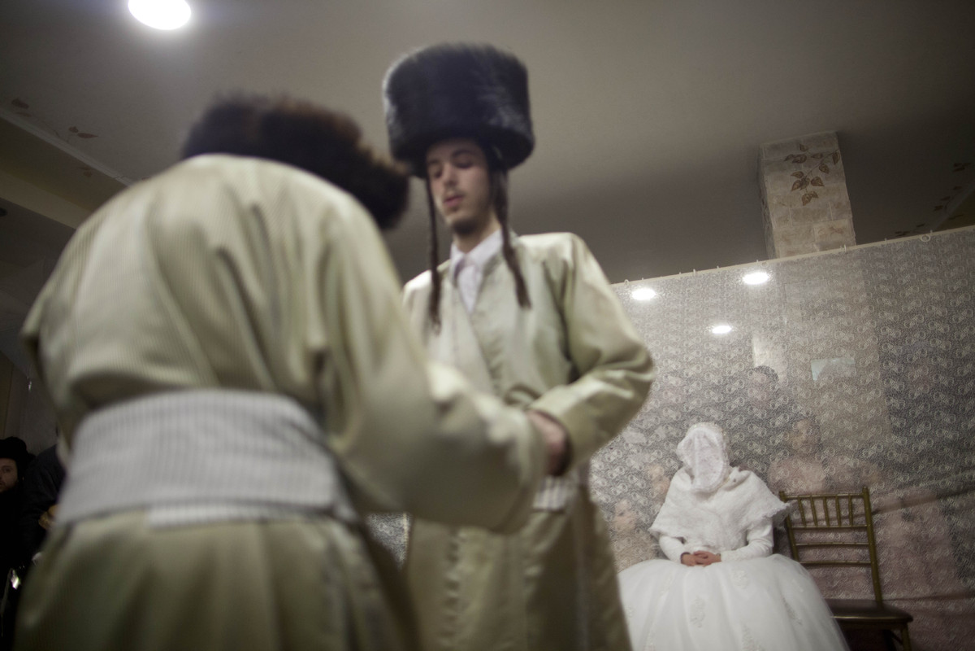

Slide 12
The bride smiles self-consciously. The mothers smile too, a pinched tautness to their professionally made up faces. Tension. Always there is tension before the chuppah. The trio marches, hypnotically, precisely, their heels lending them poise, their long dresses swishing softly, jewelry shimmering prism-like in the glow of the hall’s immense chandelier. A flash from the photographer’s camera. The music drums, the wedding guests cluster instinctively in the center of the hall beneath the chandelier, smiles grown wider, two women clapping their hands softly, a few tapping toes to the music’s rhythm, a girl pulling at her skirt awkwardly, a woman clasping her hands in front of her sucked in stomach. The smell of grilled meats wavers across the hall, splicing the potent scent of roses. The bride and her escorts arrive to the stage.

Slide 13
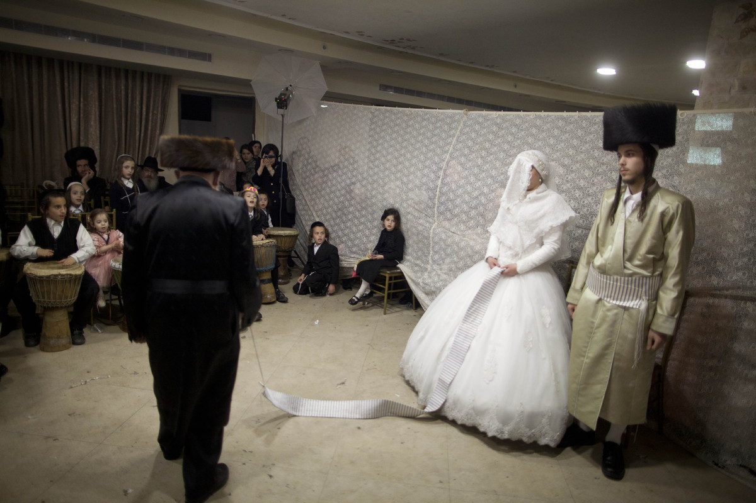

Slide 14
The bride and her escorts arrive to the stage. Gingerly, the bride steps onto it, the mothers still holding onto her, seating her daintily on the bridal throne, spreading her gown, lifting her veil so that it flows over the back of the throne. Then the mothers get into position. The groom’s mother stands at the bride’s left, the bride’s mother on her right. At the mothers’ sides are two identical urns filled with ivory roses set on fluted white pedestals. The back of the stage is artfully shirred and draped in white sheer fabric, and more flowers sit, at varying heights, in glass bowls and vases. All is in place: flowers laid out strategically, mothers standing, bride on throne, flowing gown radiating elegantly. The kabbalas panim has begun.

Slide 15
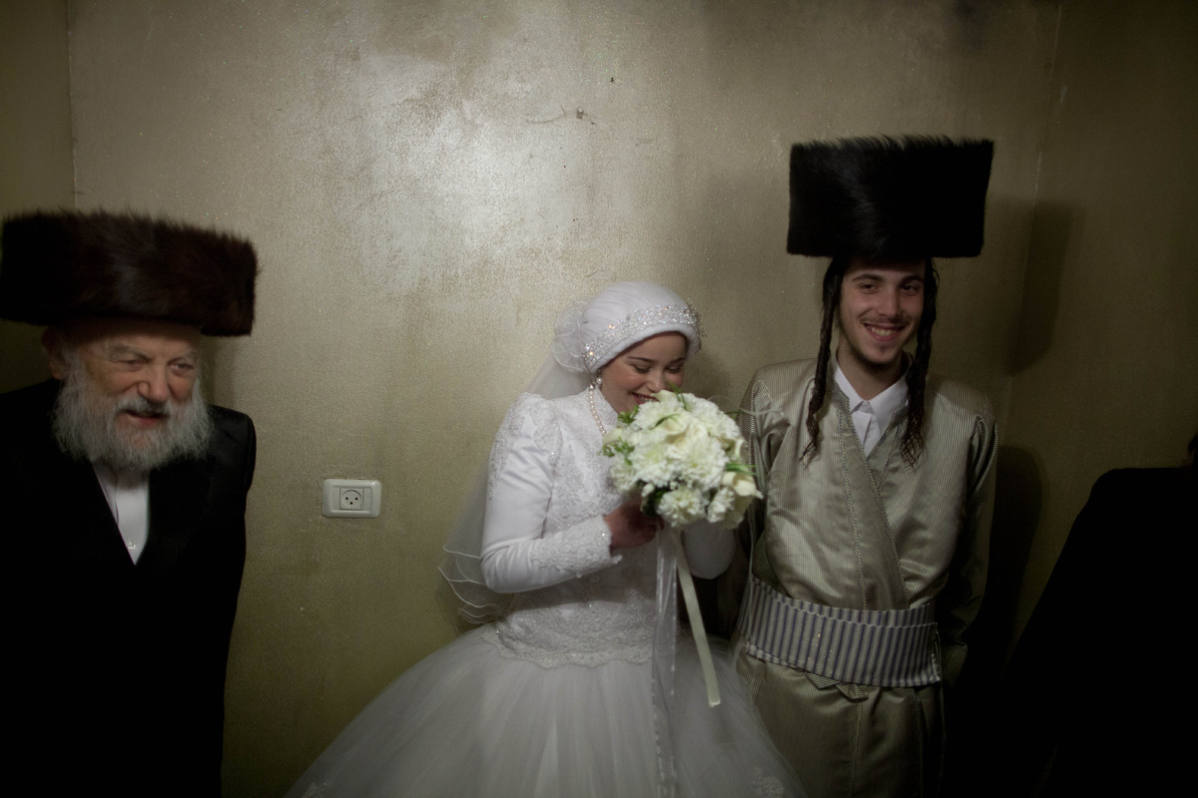

Slide 16
The Hasidic wedding officially begins with the kabbalas panim, literally “greeting the faces.” In other words, a reception. The reception for the bride is an affair of dramatic pageantry, including music, dancing, and a receiving line of mazel tov wishers; the groom’s reception, contrastingly, is low key and somber. There is no official “marching in” on the boy’s side. Instead, after a day of fasting and praying, the groom is brought to the wedding hall, usually by his parents, and directly sits down at a table in a designated kabbalas panim room. No music plays, and hence, no dancing takes place, at a groom’s reception. While male guests slowly filter into the room, a grommer (literally, rhymer”) chants verses to the groom in a solemn tone. These lines are composed by the grommer beforehand, their themes generally related to the enormity and significance—spiritually, mentally, and emotionally—of a person’s wedding day.

Slide 17
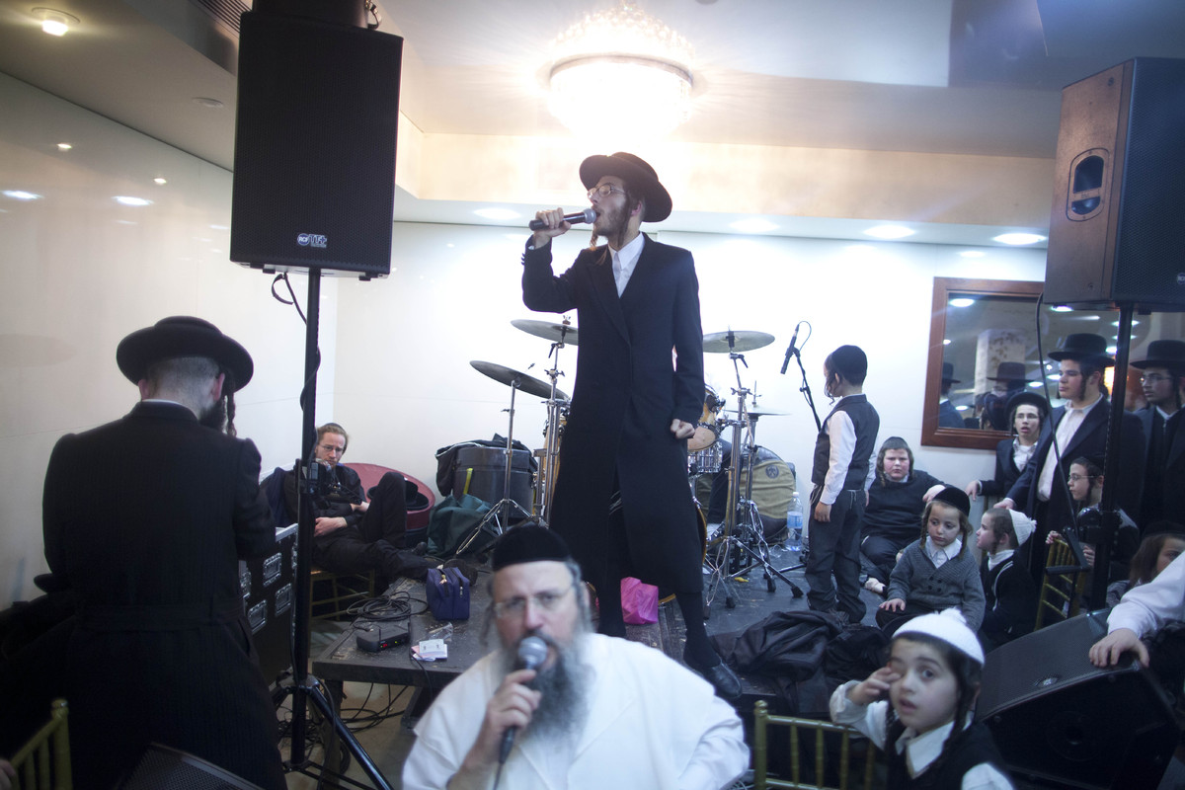

Slide 18
While the groom sits in quiet speculation or perhaps recites Psalms, and the bride smiles and thanks her well-wishers, girls and women form a circle and dance. Two or three decades ago, the norm was that most guests, regardless of age, would join the dancing circle if they so wished. But in the last twenty or so years, it is generally the unmarried or newly married girls—the brides’ friends—who comprise this circle. The occasional 40 or 50-year-old woman may join, but the act is likely to set off an exchange of smirks among the younger dancing group. Needless to say, this isn’t a rigid rule, merely the social standard, and exceptions—depending on the type of crowd and their number—often exist.

Slide 19
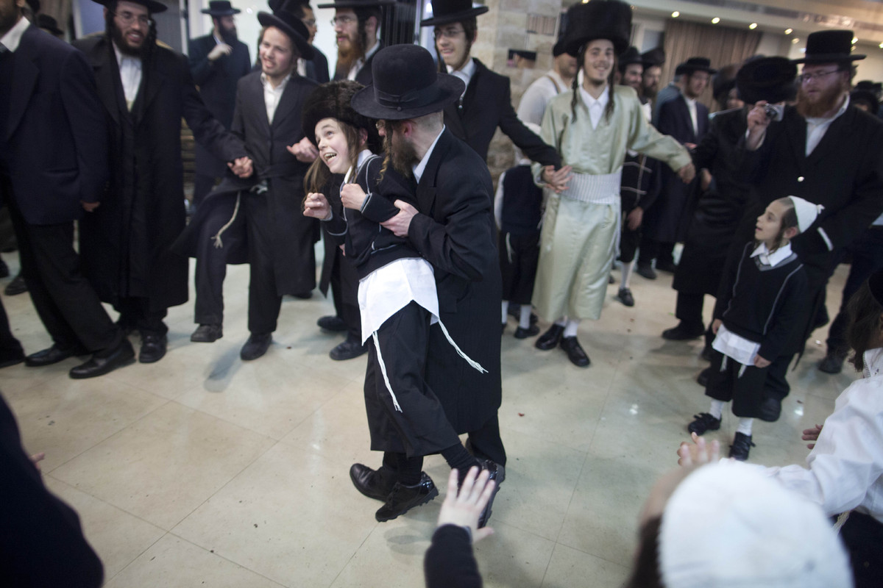

Slide 20
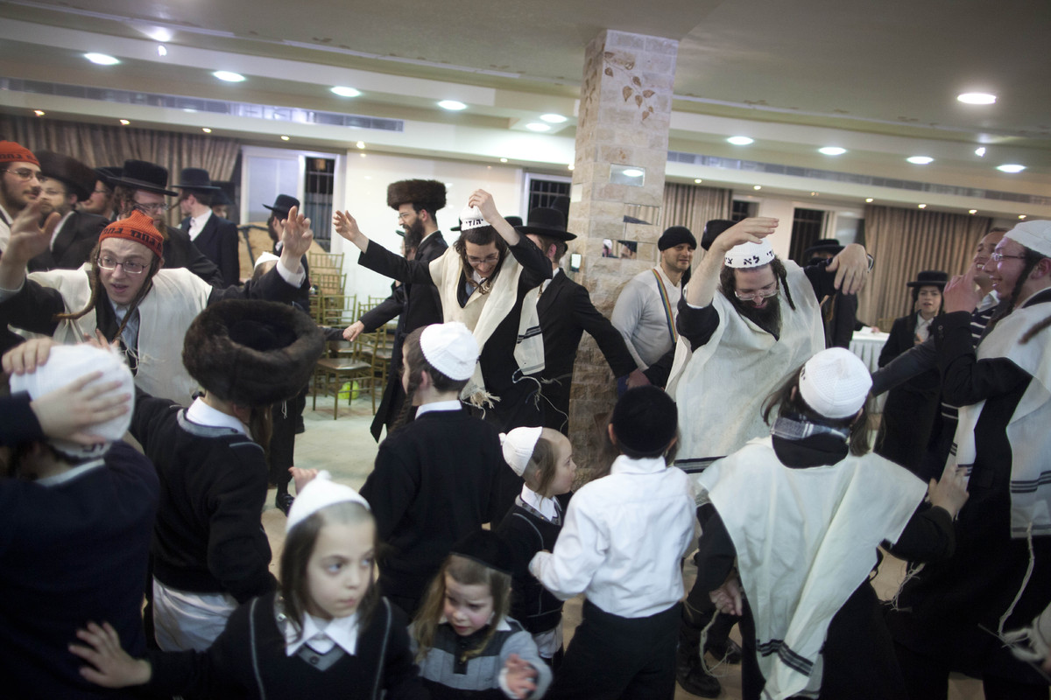

Slide 21
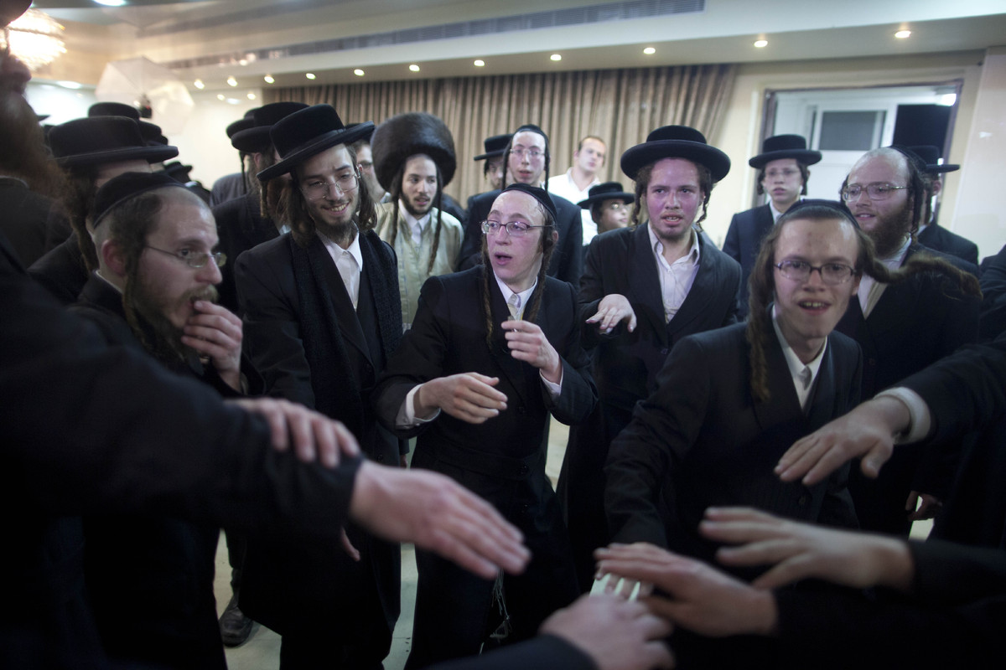

Slide 22
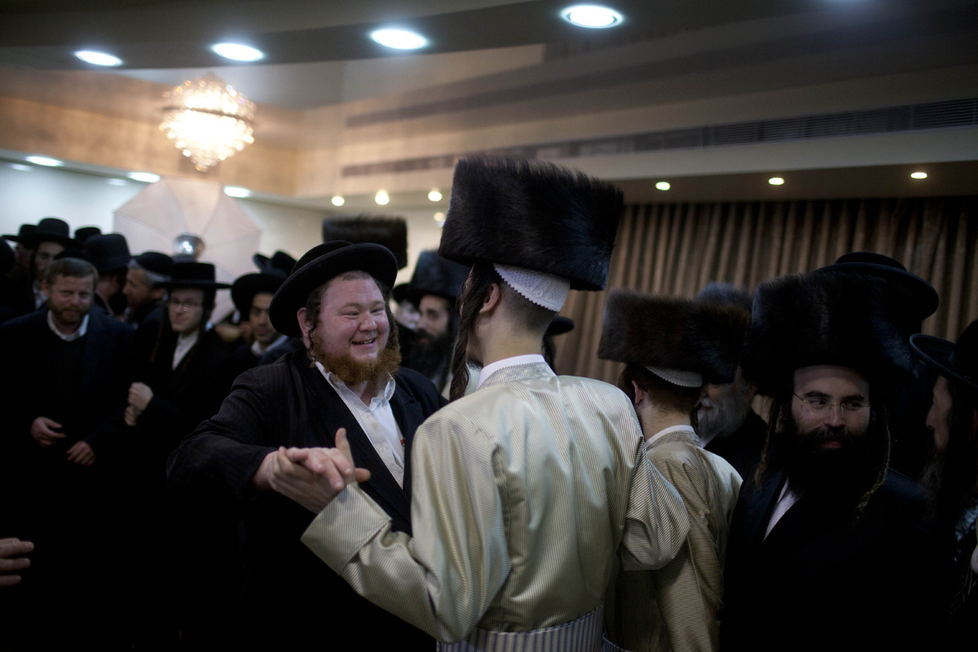

Slide 23
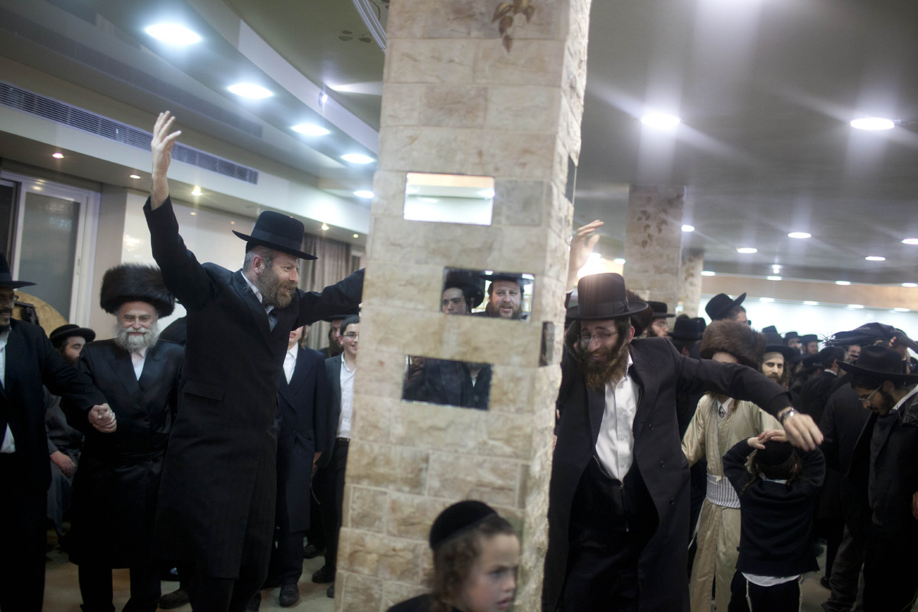

Slide 24
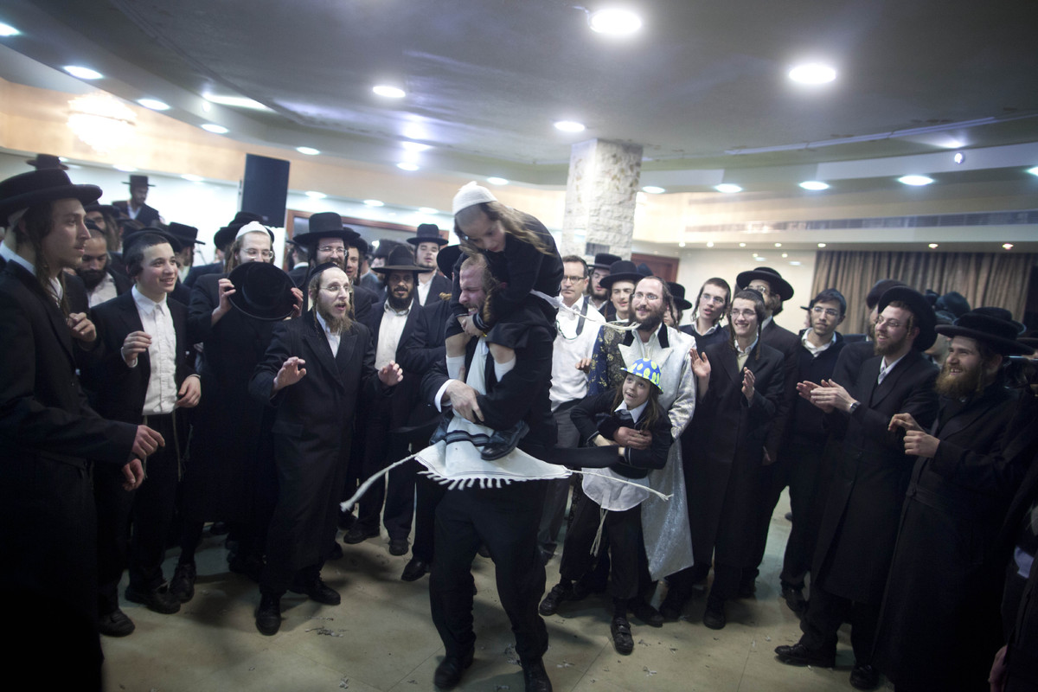

Slide 25
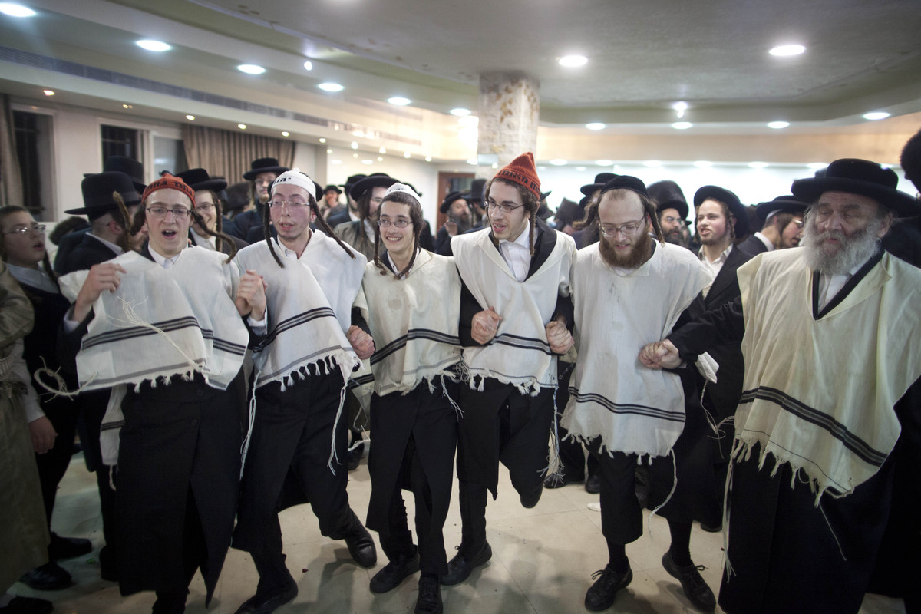

Slide 26
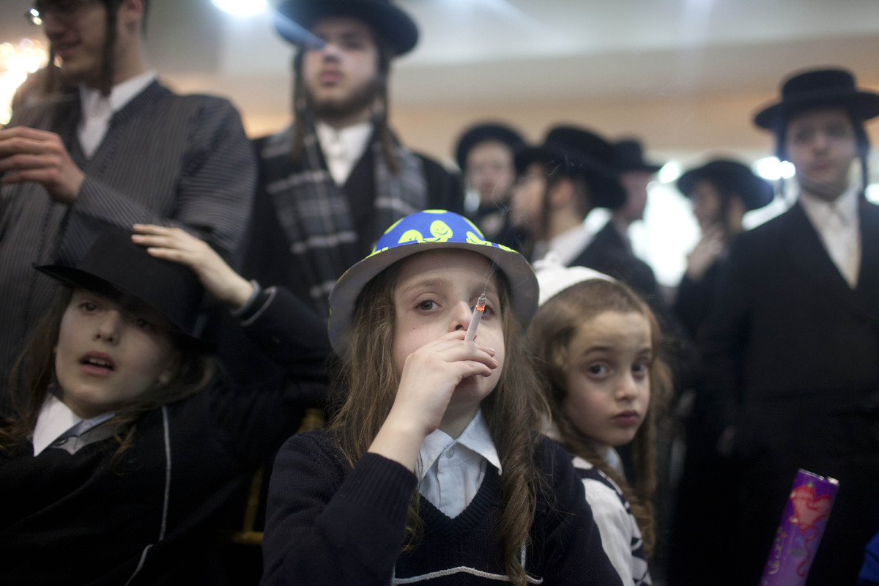

Slide 27
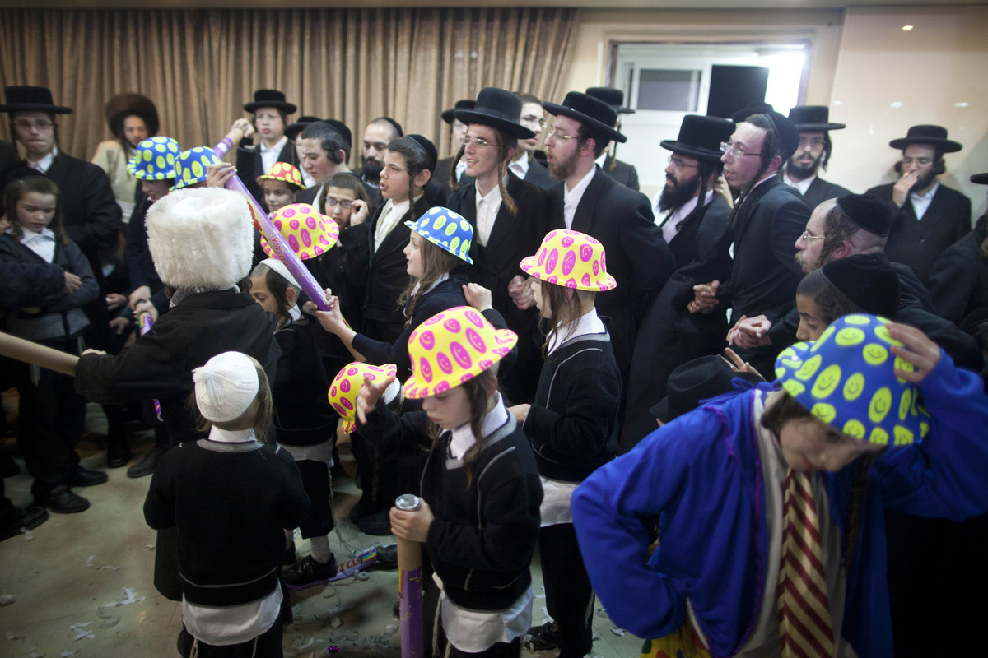

Slide 28
