Slide 1






















Hungarian Culture
Hungarian Christmas

Slide 2
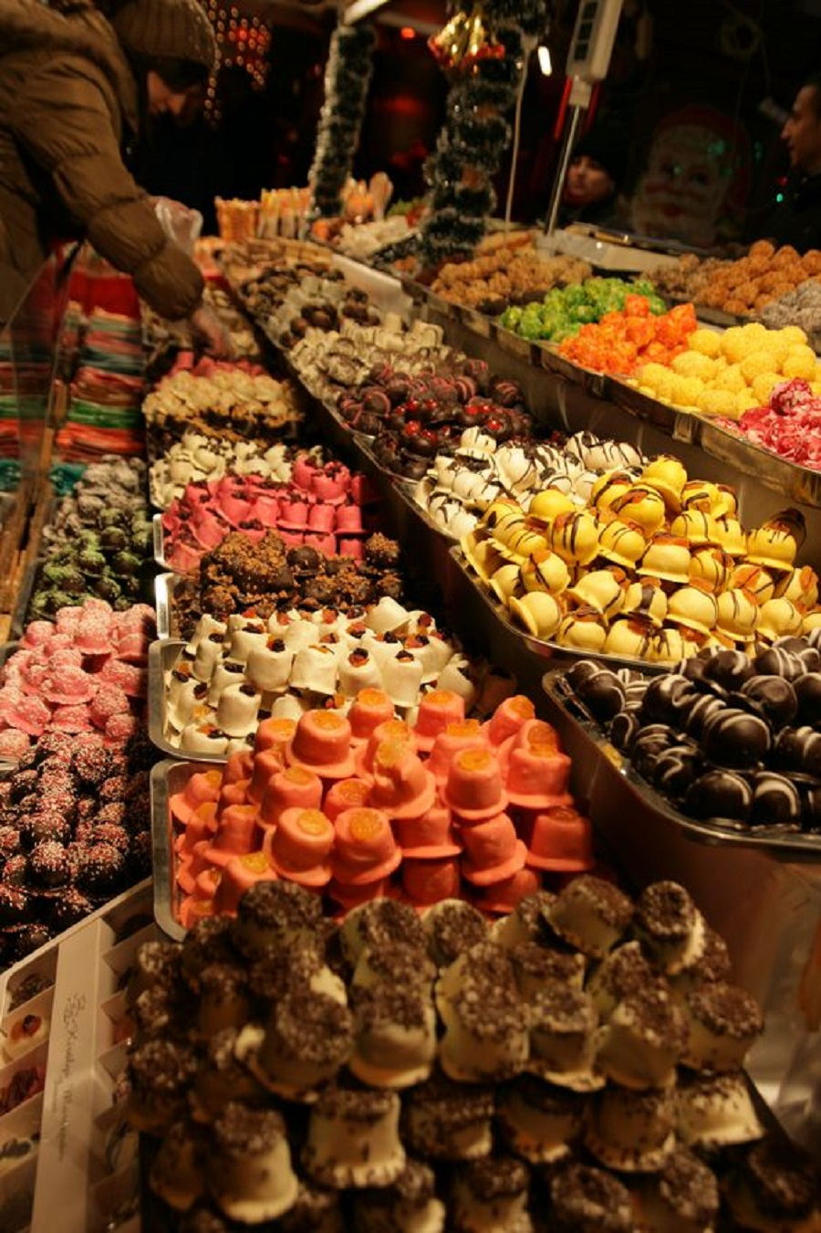
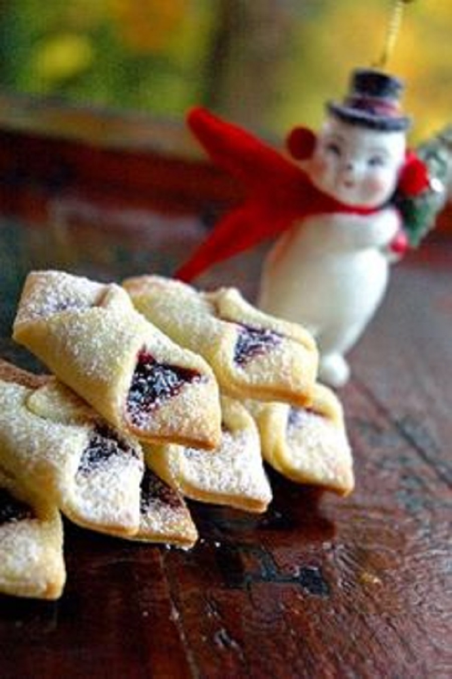
Christmas Treats

Slide 3
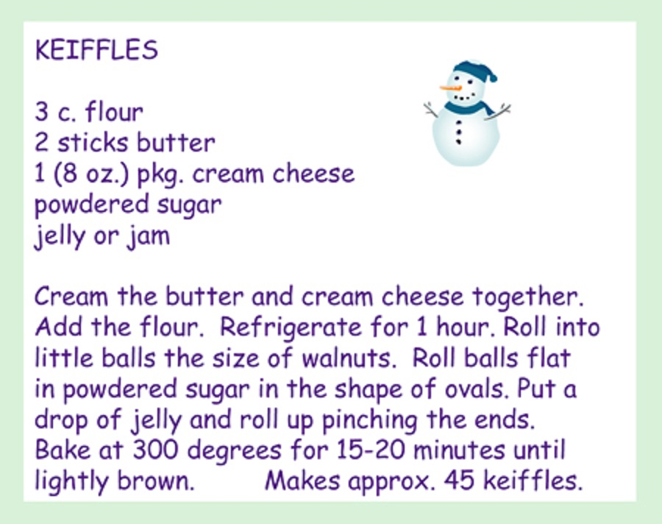
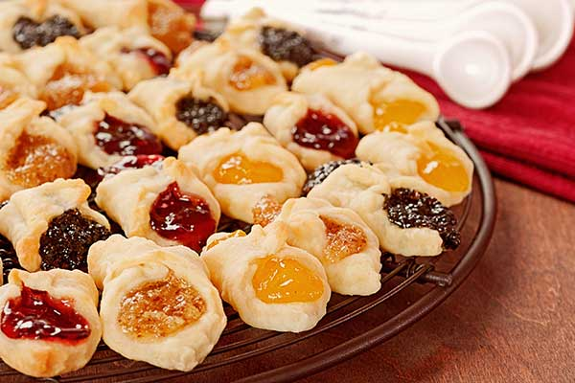

Slide 4
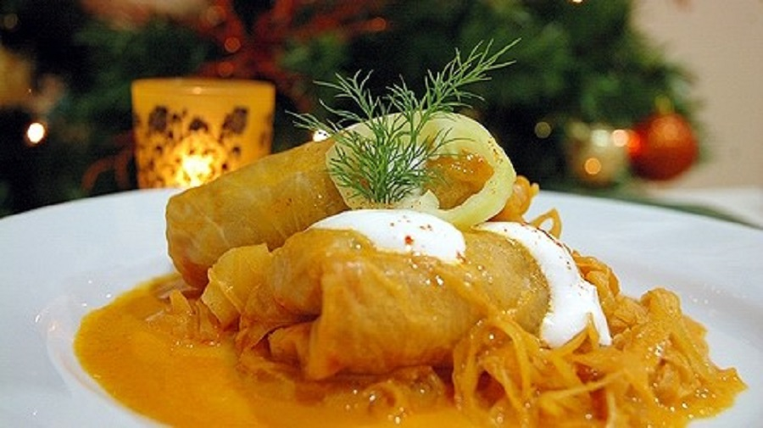

Slide 5
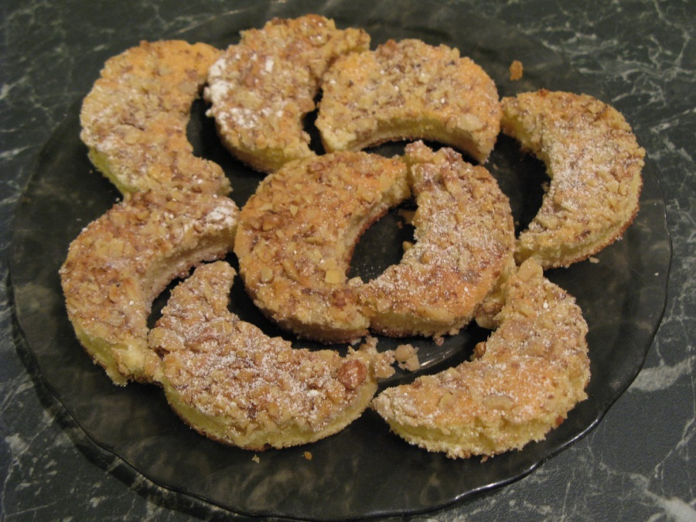

Slide 6
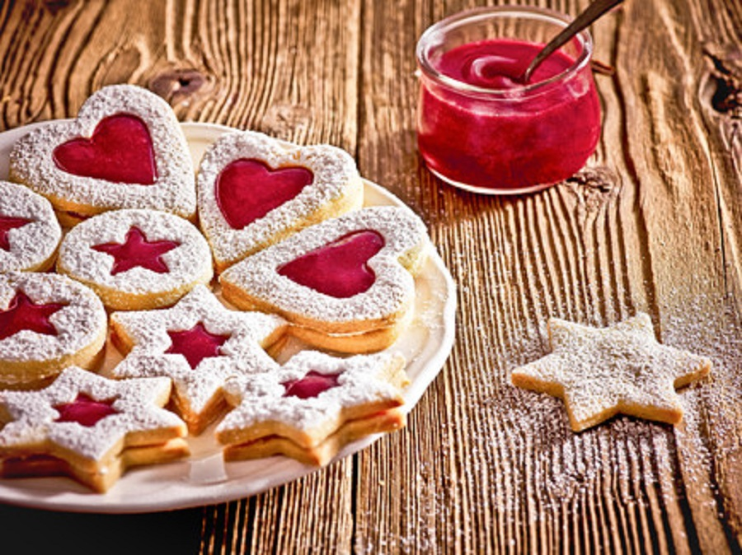

Slide 7
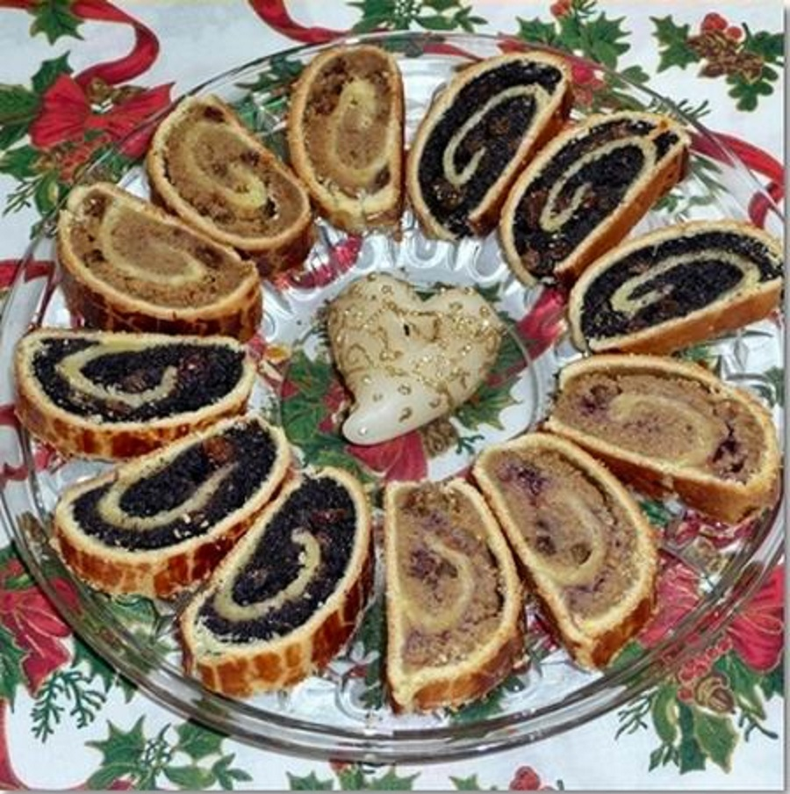

Slide 8
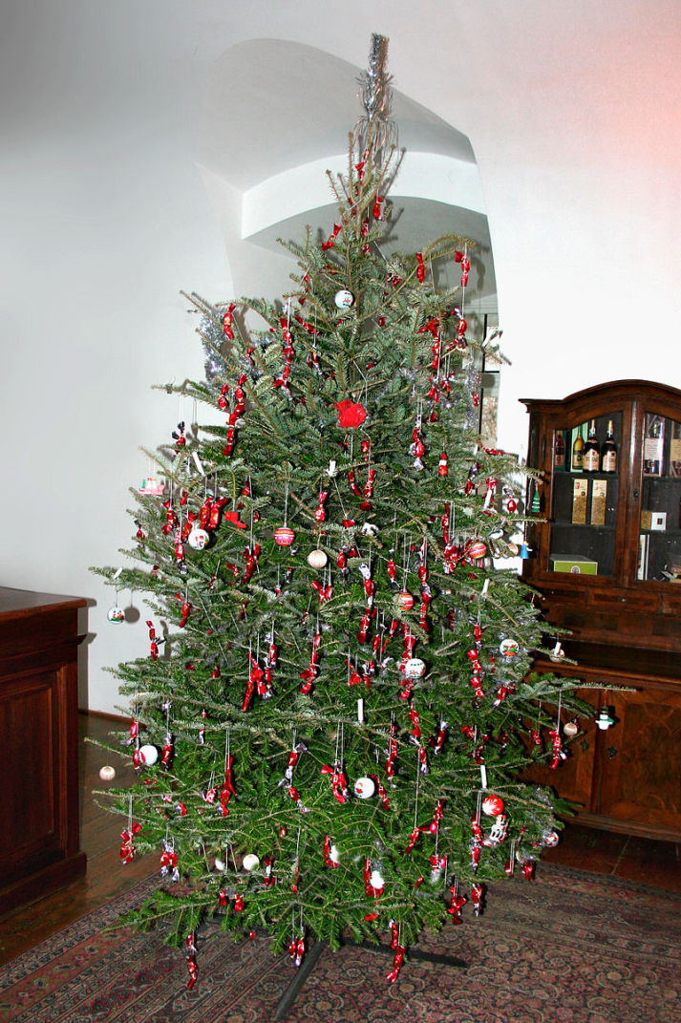
Other Christmas Traditions

Slide 9
Advent
The holiday season starts with Advent in Hungary, too. Advent wreaths can be seen in stores, schools, offices, and in almost every home. This time of year is the preparation for Christmas. Candles are decorated with red and gold ribbons symbolizing life and brightness. Most children get Advent calendars with a small gift or candy for every day before Christmas. Lights and decoration however stay inside the houses - streets and houses are not as spectacular there as they are in the US. Also, we never decorate a tree before the Holy night. Christmas trees can be seen during advent only in stores symbolizing holiday shopping.

Slide 10
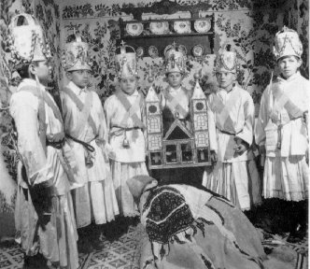
A group of boys performs a Bethlehem Play.
The largest Christmas-tradition is the "Bethlehem play," which has a great written literature as well. Some days before Christmas groups of boys go house-to-house with a model of the holy family. They perform a short play about the child Jesus with songs and poems usually in costums. The first written document about the "Betlehemes" groups was dated in 1600's. Some folk and non-profit groups are dedicated to preserve the atmosphere and custom of this tradition.

Slide 11
Santa Claus
The Hungarian Santa, called Mikulás, (Me-ku-lash) visits children on December 6th, St. Nicholas' Day, which is the name day of "Miklós." Chidren put boots in the windows, like stockings hang by the fireplace on Christmas Eve all over the USA. If the child has been good, Mikulás leaves the boot filled with goodies - traditionally with candies, tangerines, walnuts, apples, dates and chocolate Mikulás figurines. Also, most children get small toys and books. If the child has been bad, the boot will contain just a switch usually with a devil-figure attached, indicating a beating is in order. Since no child is all good or all bad, most get the switch and the treat.
Usually Mikulás-day is celebrated in schools and in work-places for the workers' children. Children sing Mikulás-songs and when he comes in bravest children go to him, sit to his lap and tell a poem or sing a song. Then Mikulás calls them one by one, praising them for the good things they did and mentions bad things as well. These personal messages - of course - based on previous parents' notes. Usually Mikulás plays with them for a while or they watch a movie together.
There is no Mrs. Santa in Hungary, but Mikulás often comes with one or two small evil boys, called "krampusz (kromm-puhs)."

Slide 12
Christmas Eve at Home
We decorate trees on the holy night in immediate families. Christmas is a private, family holiday in Hungary, we don't go to parties. Most families decorate the tree together, but some families keep the older tradition that tree should be a surprise for children who even believe it was bought by angels. When I was a child I so truly believed it that I SAW angels flying around with small trees in their hands. Children enter the room only when the small tree bells ring and music arises. Gifts lay around the tree with small labels saying the name of someone in the family. Family-members sing Christmas songs together, then open their gifts and spend the night together. The menu for Christmas night is usually fish or cabbage with the special poppy-bread called "beigli."

Slide 13
The Midnight Mass service is very popular in Hungary. Most people go to Church after their Christmas meal.
On Christmas Day people visit their families.
In Hungarian Happy/Merry Christmas is 'Kellemes karácsonyi ünnepeket'.

