Slide 1
SULTAN OMAR ALI SAIFUDDIN MOSQUE IN BANDAR SERI BEGAWAN, BRUNEI

Slide 2
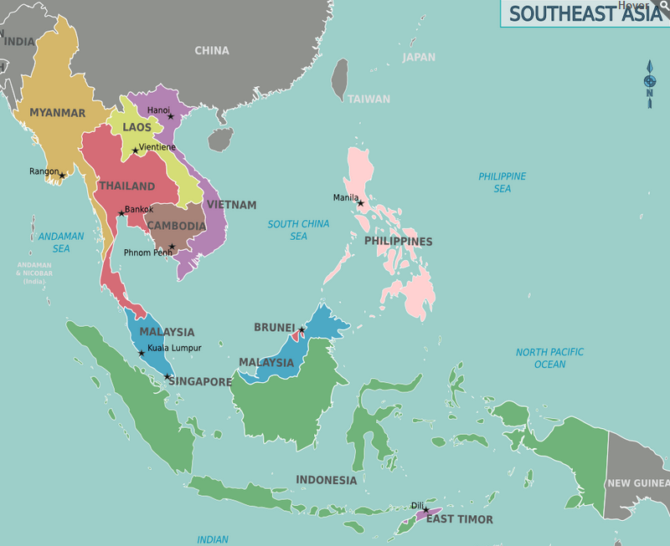

Slide 3
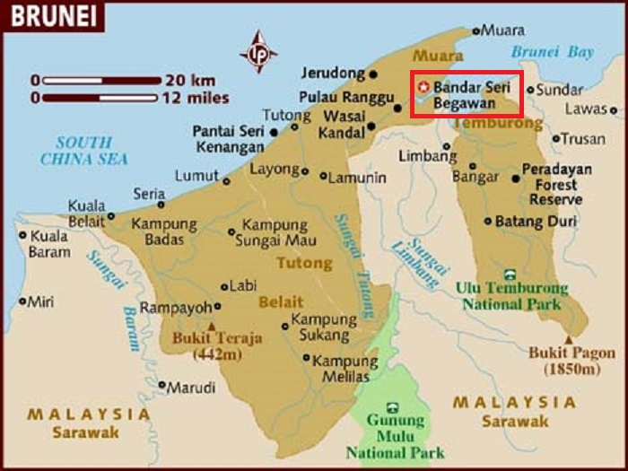

Slide 4
THE MOSQUE

Slide 5
Sultan Omar Ali Saifuddien Mosque is an Islamic mosque located in Bandar Seri Begawan, the capital of the Sultanate of Brunei. The mosque is often considered as one of the most beautiful mosques in the Asia Pacific, it is a place of worship for the Muslim community, a major historical site and a famous tourist attraction of Brunei.
Named after Omar Ali Saifuddien III, the 28th Sultan of Brunei who also initiated its construction, the mosque serves as a symbol of the Islamic faith in Brunei and dominates the skyline of Bandar Seri Begawan. The building was completed in 1958 and is an example of modern Islamic architecture.
The mosque unites Mughal architecture and Italian styles and was designed by the architect and sculptor Rudolfo Nolli. The Brunei Times reported on May 5, 2007.

Slide 6
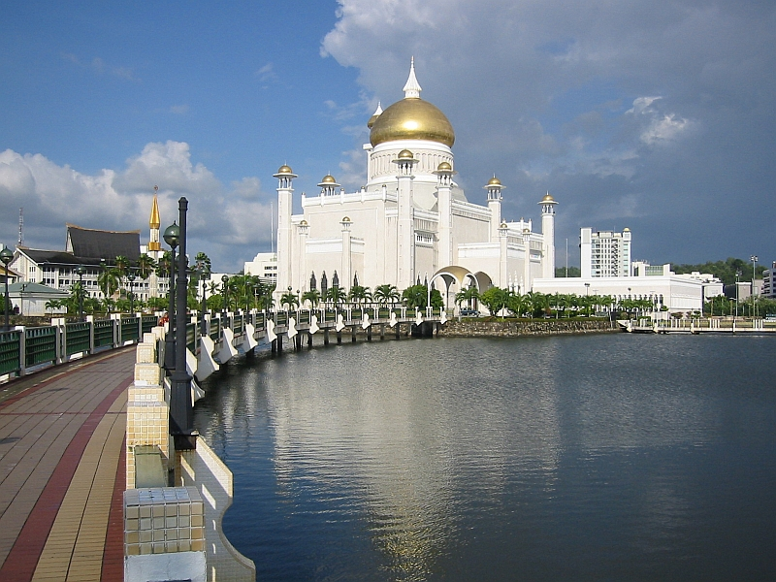

Slide 7
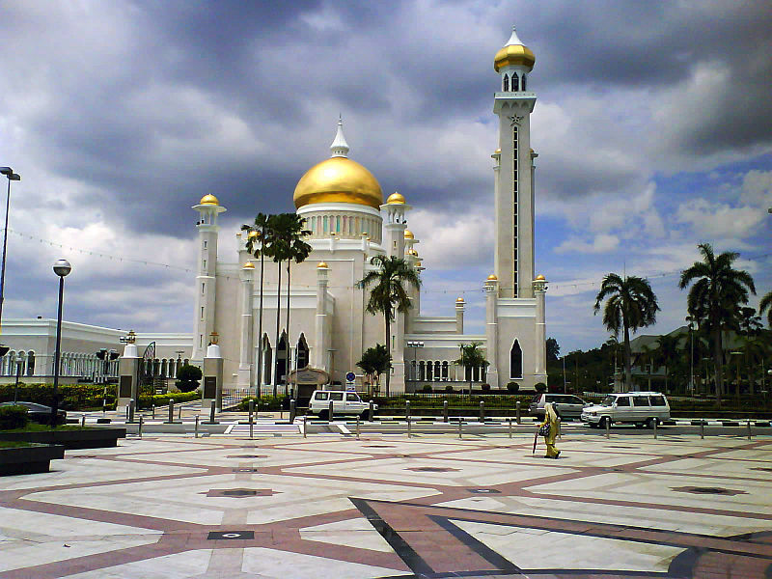

Slide 8
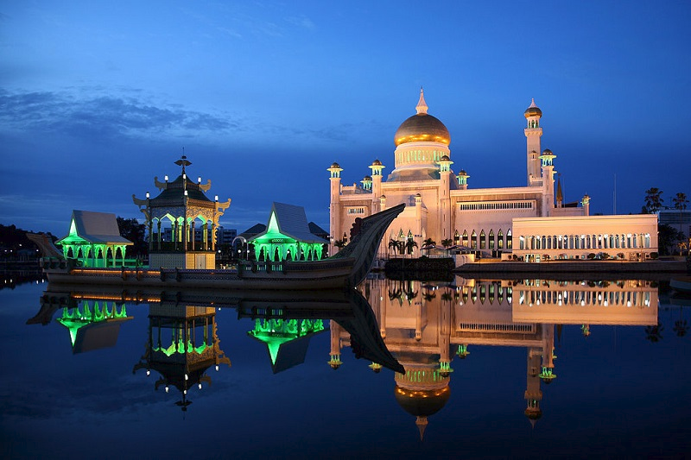

Slide 9
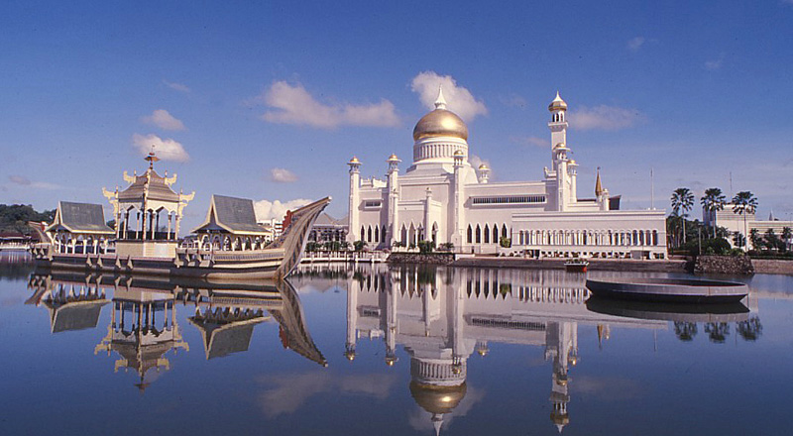

Slide 10
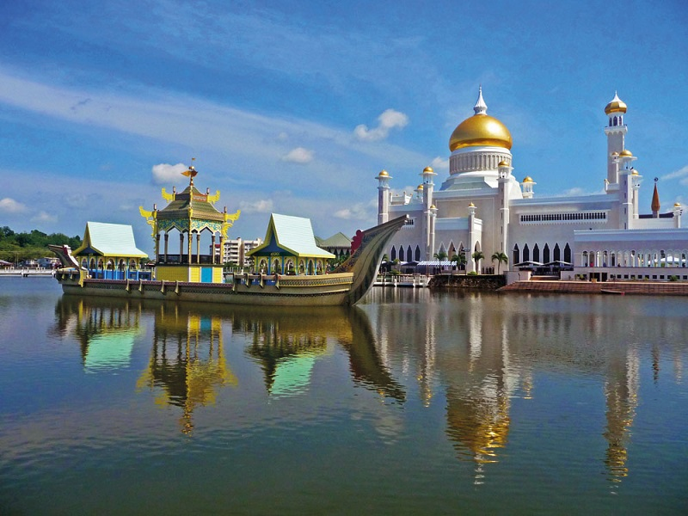

Slide 11
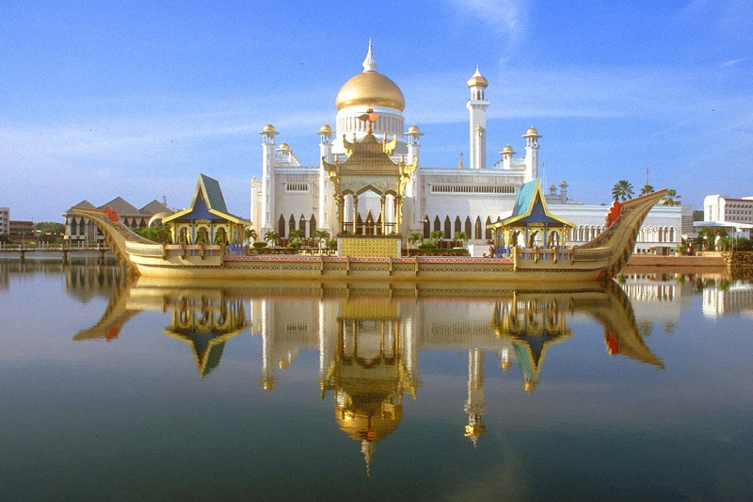

Slide 12
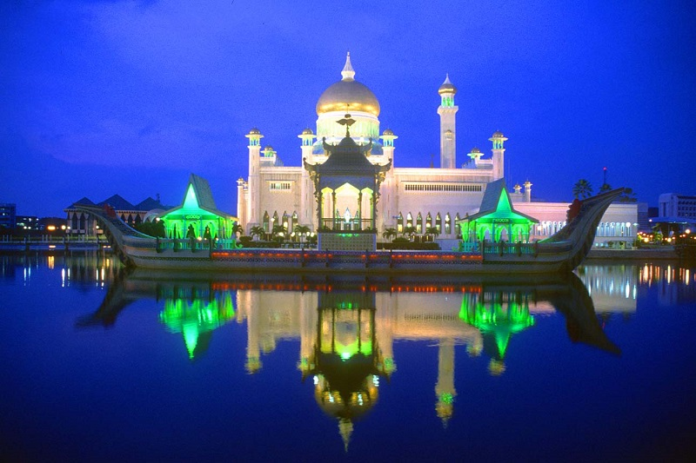

Slide 13
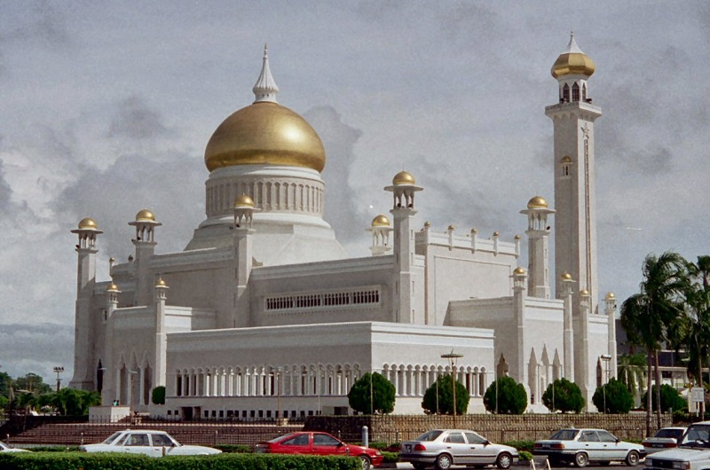

Slide 14
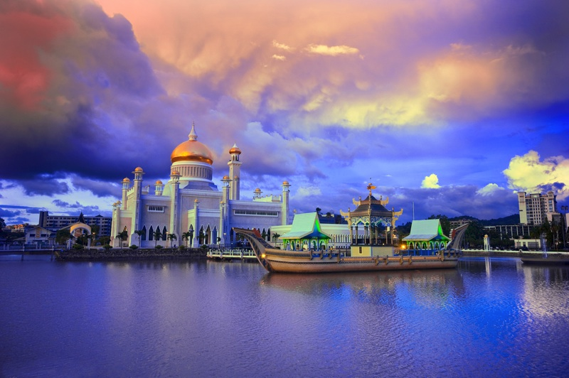

Slide 15
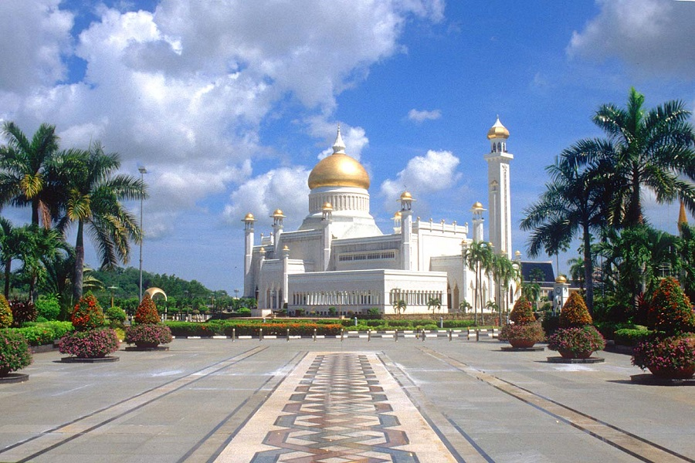

Slide 16
BEAUTIFUL FROM ANY ANGLE, AT ANY TIME OF DAY OR NIGHT, AND OUTSIDE AND INSIDE TOO!

Slide 17
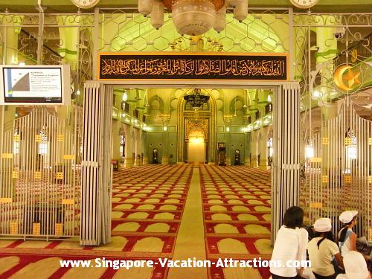
INTERIOR VIEWS

Slide 18
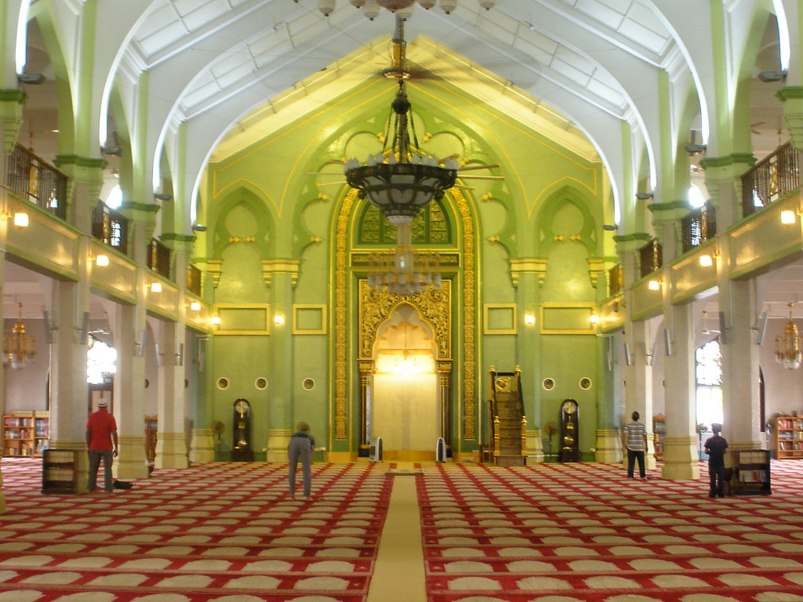

Slide 19
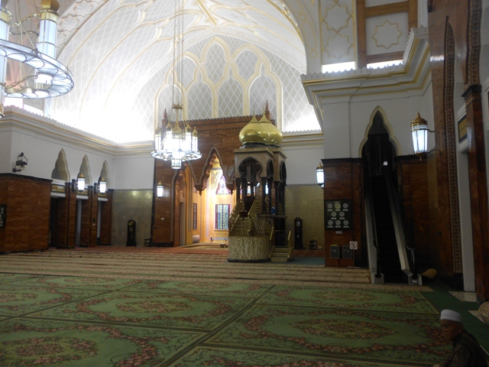

Slide 20
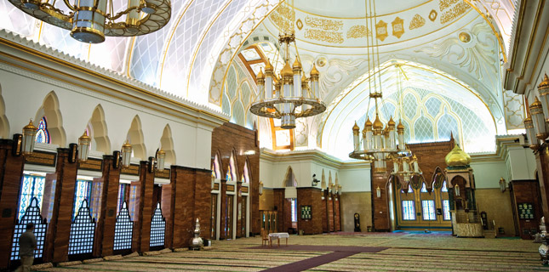

Slide 21
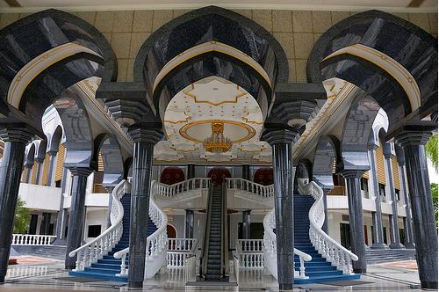

Slide 22
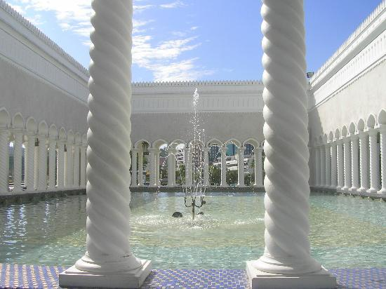

Slide 23
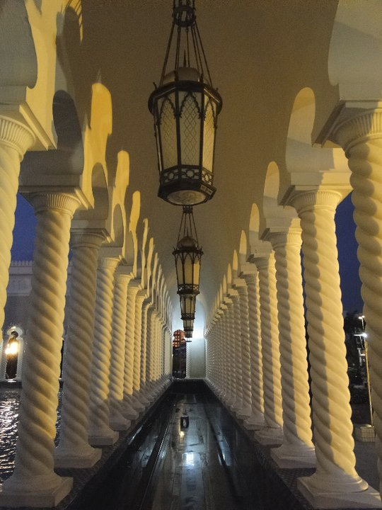

Slide 24
