Slide 1
Immigrants are moving to these US cities
Interesting demographic statistics

Slide 2
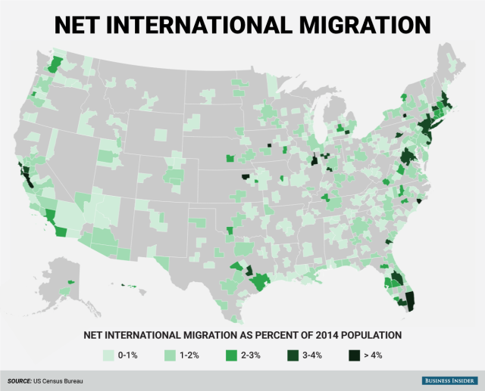

Slide 3
The top 10 metro-area destinations for immigrants are a mix of: big cosmopolitan cities like New York and Miami, tech hubs like San Jose and Palo Alto, and college towns like Lafayette, Indiana, and Manhattan, Kansas:

Slide 4
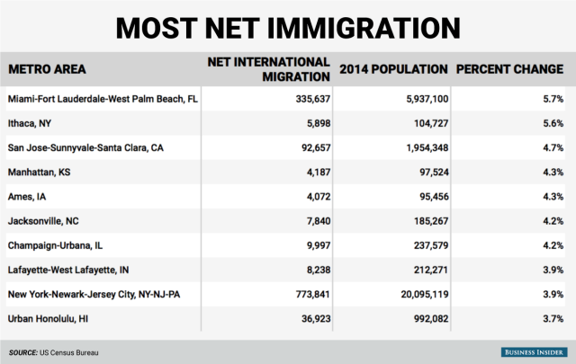

Slide 5
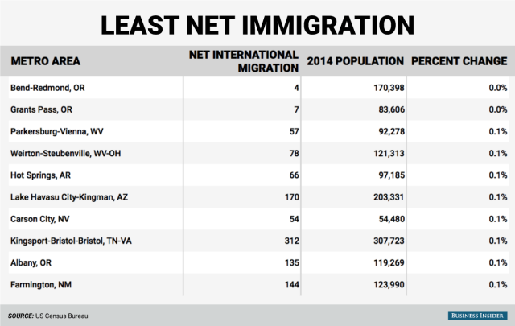

Slide 6
Always view statistical data critically . . .
Information from the U.S. Census Bureau is factual. Of course it is possible to take only selected bits of information and not report the complete situation to mislead the general public. Politicians and special interest groups are very good at misleading people with selected bits of truth while leaving out other bits.

Slide 7

The following slide has information from Fox News which is not an unbiased source of information. Since 2007, there has also been a flow of Latinos back to Mexico. That would change the results somewhat and would give a more accurate picture of the demographics. This would probably be a good example of reporting a half-truth that can be misleading.

Slide 8
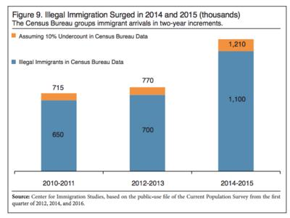
Census: Illegal Immigration Up 57% To 550,000, One New Albuquerque A YEAR

Slide 9
Analyst Steven A. Camarota wrote in the Center's report that all immigration, legal and illegal combined, is on the rise with 3.1 million new immigrants, a 39 percent increase in 2014 and 2015.
The increase includes new arrivals from countries in Latin America other than Mexico. More immigrants came from South Asia (such as Pakistan and India) and East Asia (such as China and Vietnam.)

