Slide 1
Holy Week Observances Around The World
Variations on Themes

Slide 2
Palm Sunday signals the start of Holy Week in the Christian religion. Festivals around the world celebrate the resurrection of Jesus Christ from the dead on Easter Sunday.

Slide 3
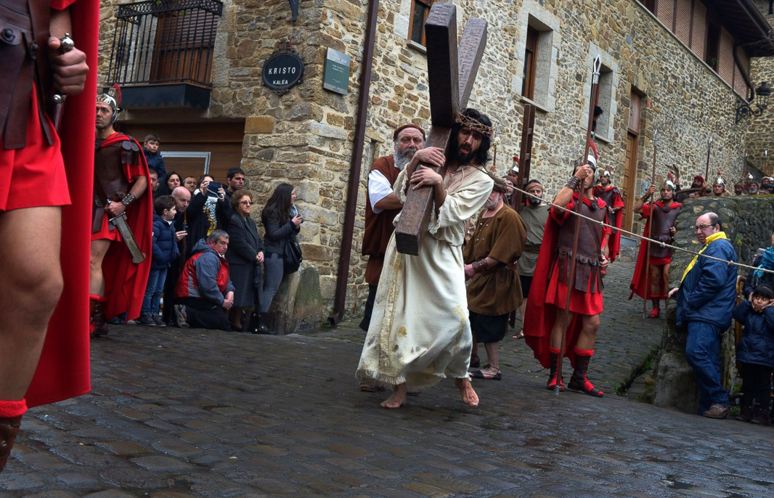
a scene from the "Via Crucis" during Holy Week in the Basque town of Balmaseda, in northern Spain,

Slide 4
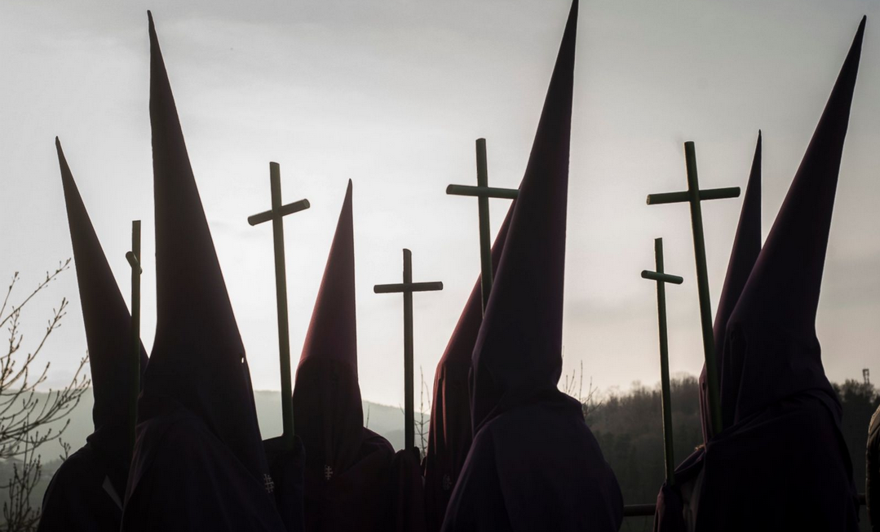
Penitents parade with crosses during a Holy Week procession in the northern Spanish Basque village of Segura

Slide 5
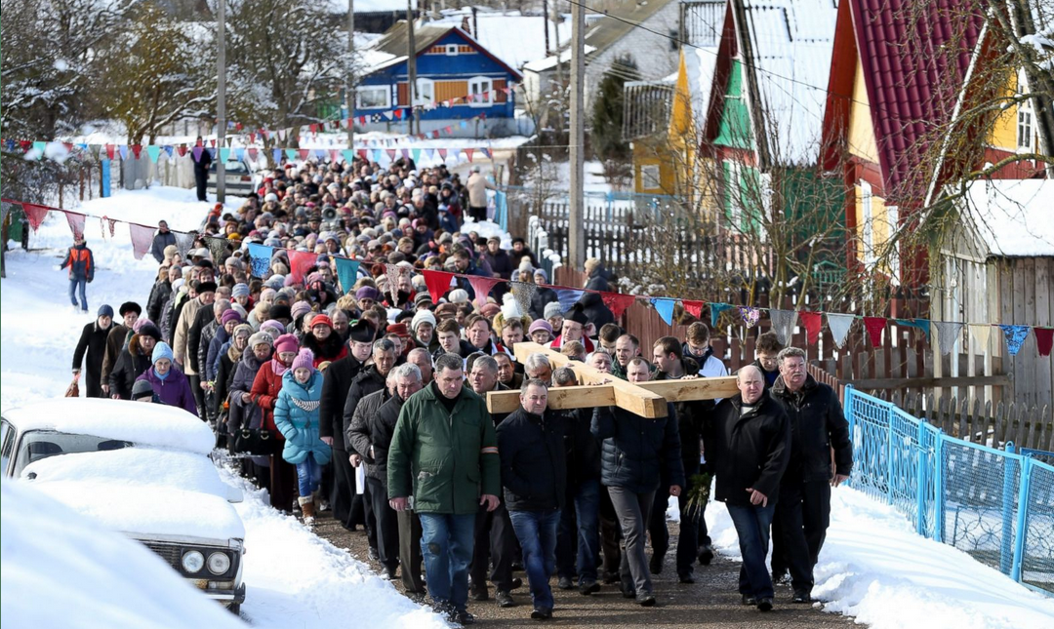
Belarussian Catholics carry a wooden cross during a procession celebrating Palm Sunday in the town of Oshmiany, Belarus,

Slide 6
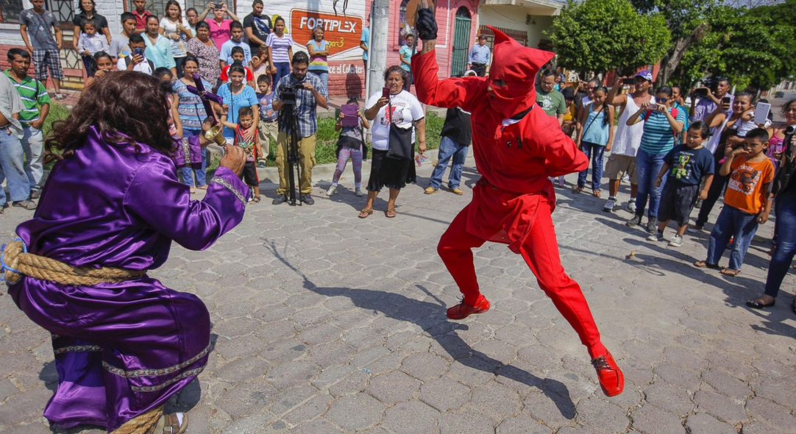
A man performing in costume as a traditional character called a Talciguin (R), a representation of the devil, engages in a mock battle with a man representing Jesus (L) as part of Holy Monday, a tradition in the town of Texistepeque, 83 kilometeres from San Salvador, El Salvador, on March 21, 2016.

Slide 7
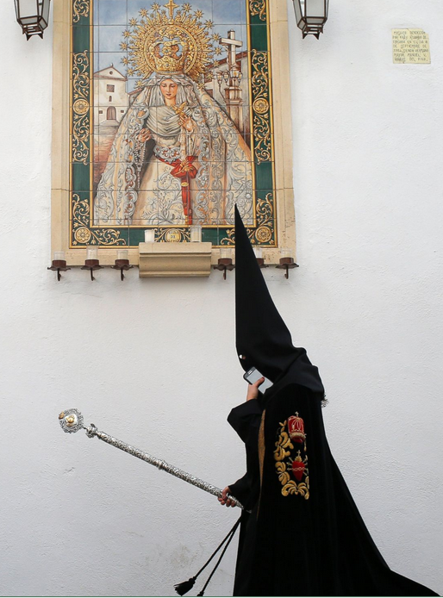
A penitent from "La Sangre" brotherhood walks to the church prior to the Holy Week procession on March 22, 2016, in Cordoba, Spain.

Slide 8
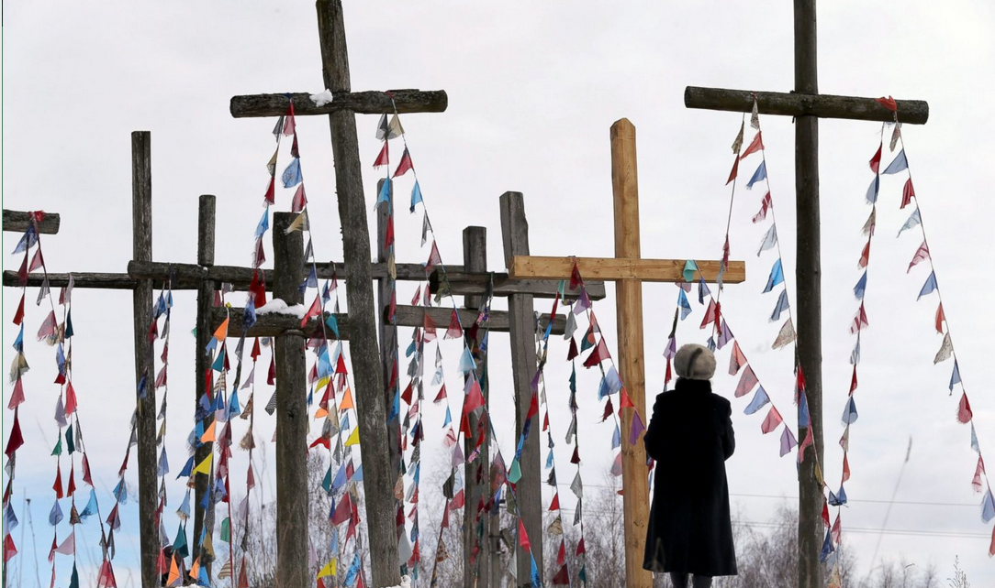
A Belarussian Catholic believer stands on a hill with wooden crosses during a procession celebrating Palm Sunday in the town of Oshmiany, Belarus, on March 20, 2016.

Slide 9
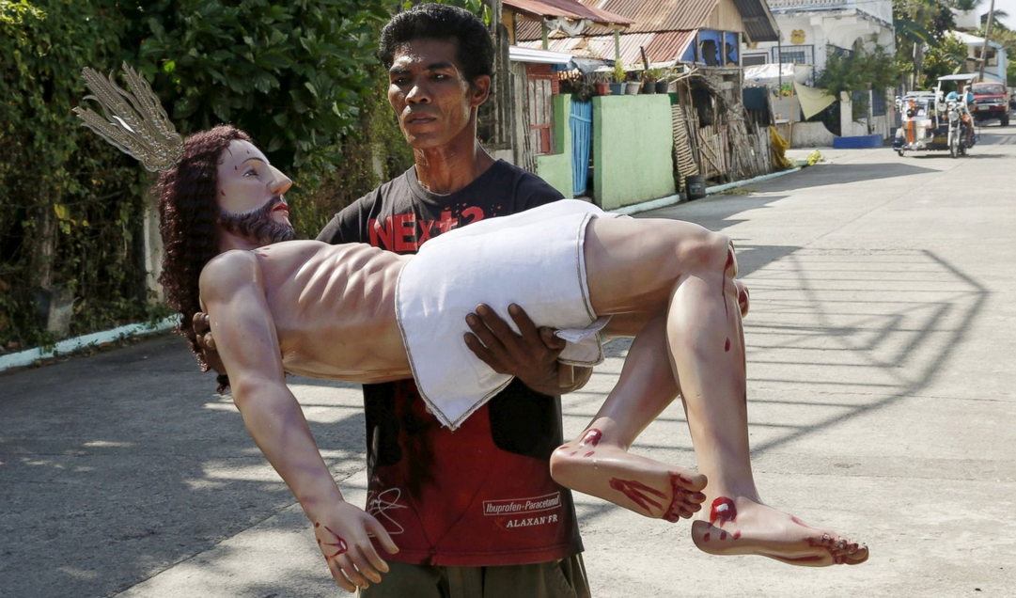
A resident carries a statue of Jesus Christ to the church in preparation for the Good Friday procession in Gasan, Marinduque, Philippines, on March 25, 2016.

Slide 10
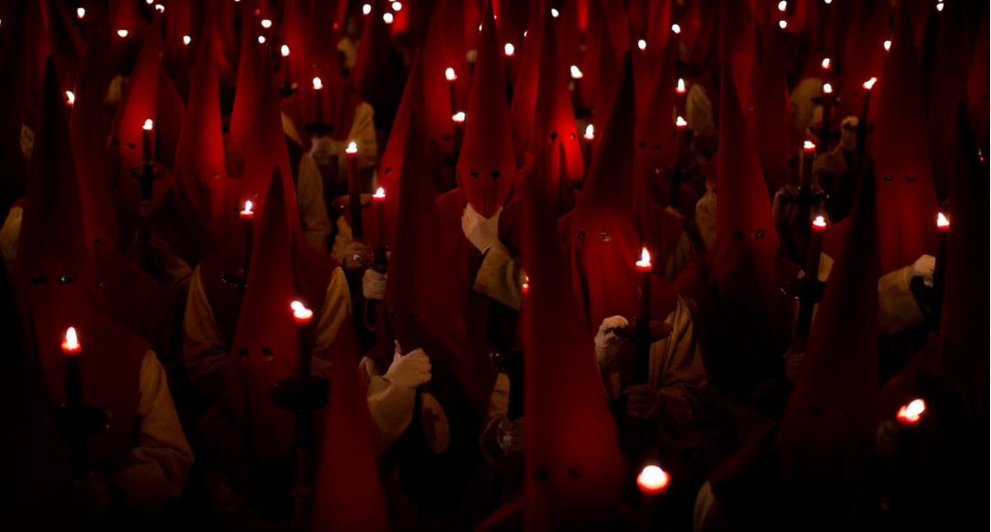
Penitents hold their candles as they take part in the "Procesion del Silencio" brotherhood during the Holy Week on March 23, 2016, in Zamora, Spain.

Slide 11
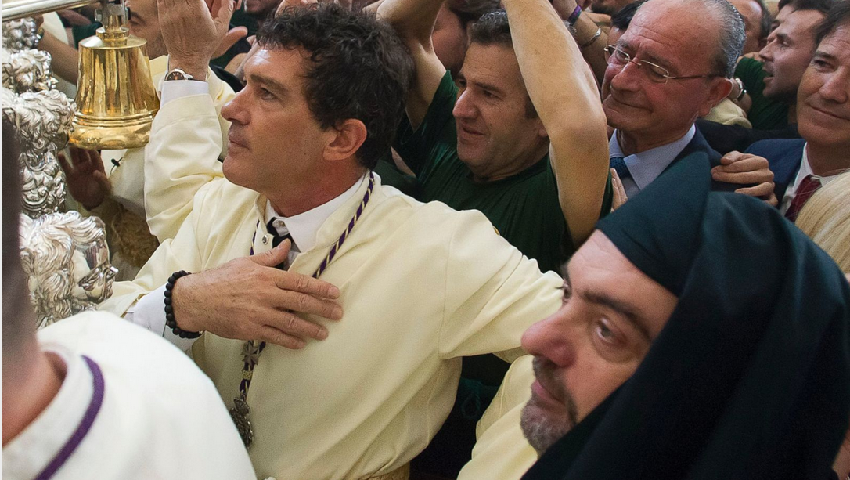
Antonio Banderas attends the Maria Santisima de Lagrimas y Favores procession during the Holy Week celebration on March 20, 2016, in Malaga, Spain.

Slide 12
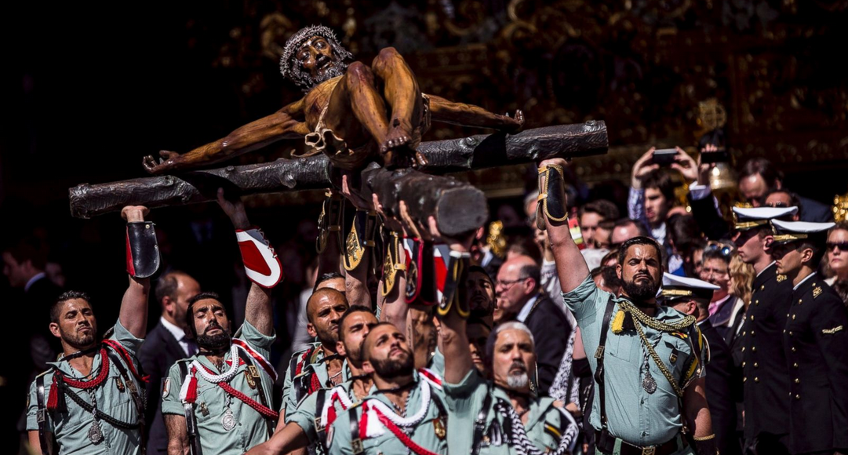
Spanish legionary men carry the sculpture of Christ of the Good Dead, also known as Christ of Mena, during its procession on March 24, 2016, in Malaga, Spain.

Slide 13
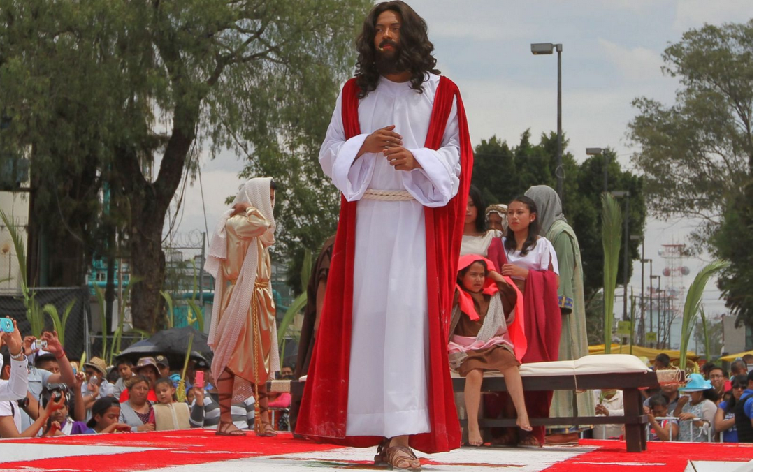
A man plays the role of Jesus during Holy Week on March 20, 2016, in Iztapalapa, Mexico.

Slide 14
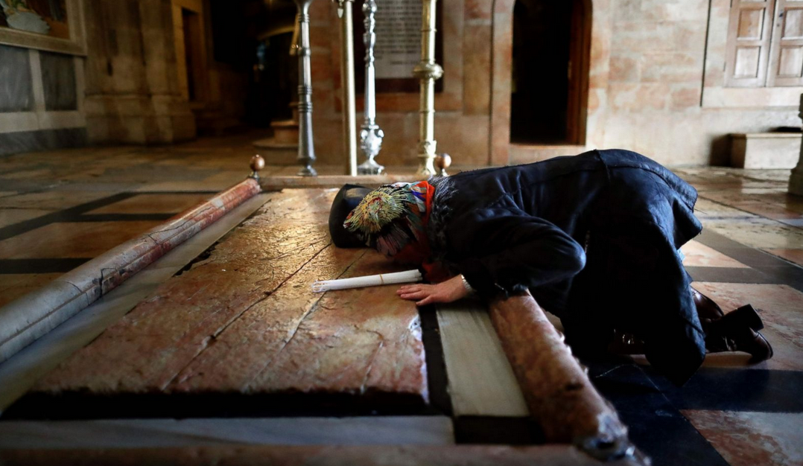
A Christian worshipper prays on the Stone of Anointing at the entrance of the Church of the Holy Sepulchre in the Jerusalem's Old City on March 23, 2016.

Slide 15
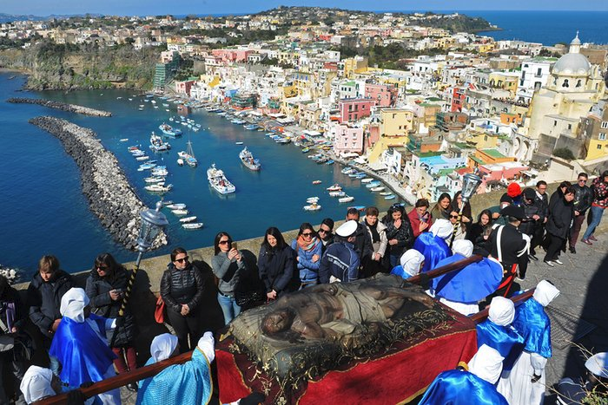
People watch as a wooden statue of Christis paraded through the street on the island off the coast of Naples

Slide 16
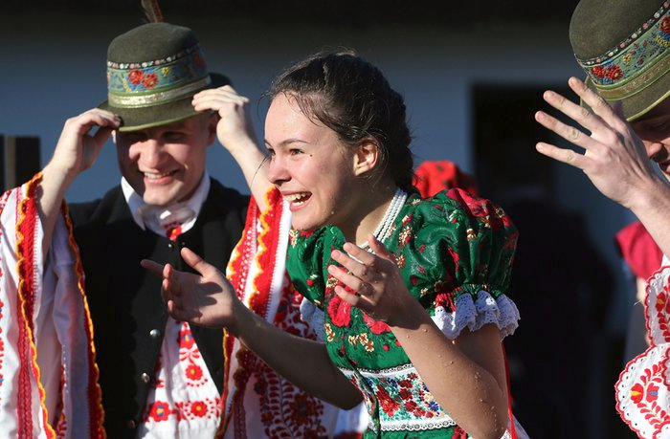
Mezőkövesd, Hungary: a young woman is soaked after men threw buckets of water over her in an Easter folk tradition

Slide 17
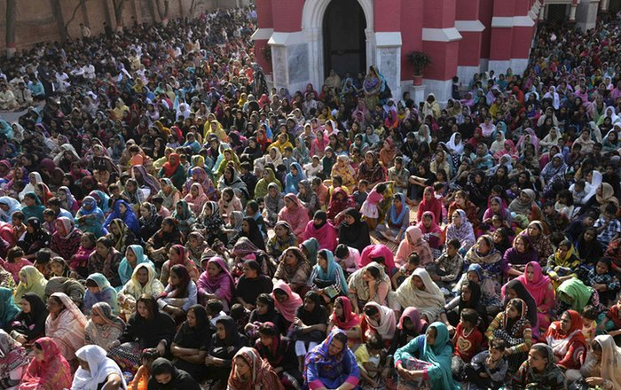
Lahore, Pakistan Worshippers attend mass at St Anthony’s church

Slide 18
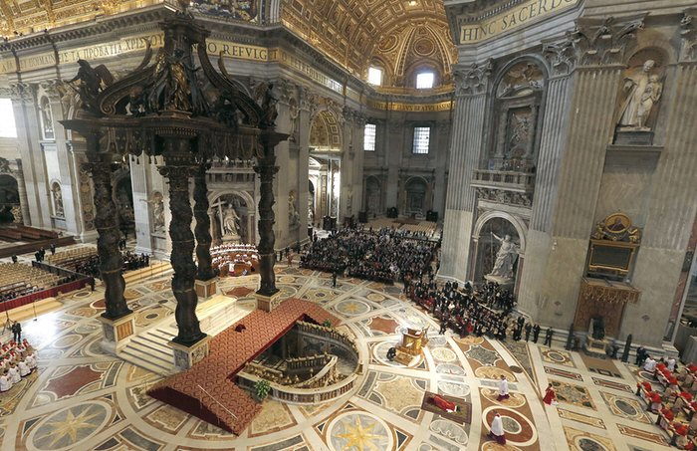
Pope Francis lies to pray during the celebration of the Lord’s Passion on Good Friday at St Peter’s Basilica

Slide 19
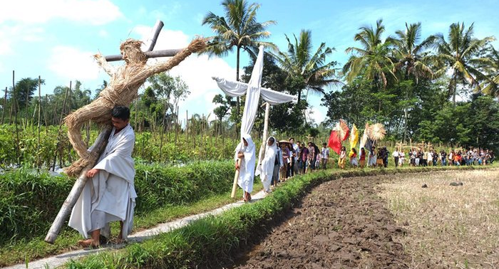
Java, Indonesia
Christians carry crosses during a Good Friday procession in the city of Magelang

Slide 20
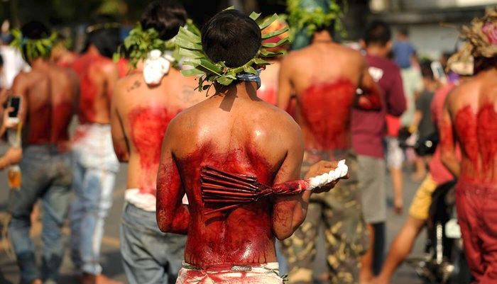
Pampanga, Philippines
Penitents whip their backs with bamboo during a re-enactment of the crucifixion

Slide 21
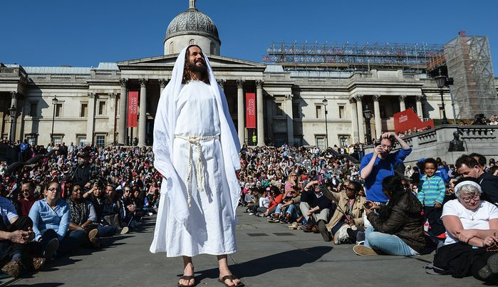
London, UK: Actor James Burke-Dunsmore from the Wintershall Charitable Trust plays Jesus in an open-air performance of the Passion of Jesus in Trafalgar Square

Slide 22
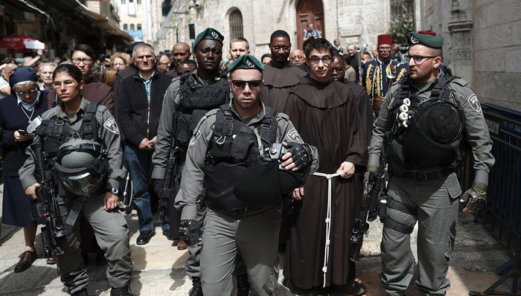
erusalem, Israel
Police officers escort Franciscan priests along the Via Dolorosa (Way of Suffering) in the Old City, the route that Jesus Christ carried the cross to his crucifixion, according to tradition

Slide 23
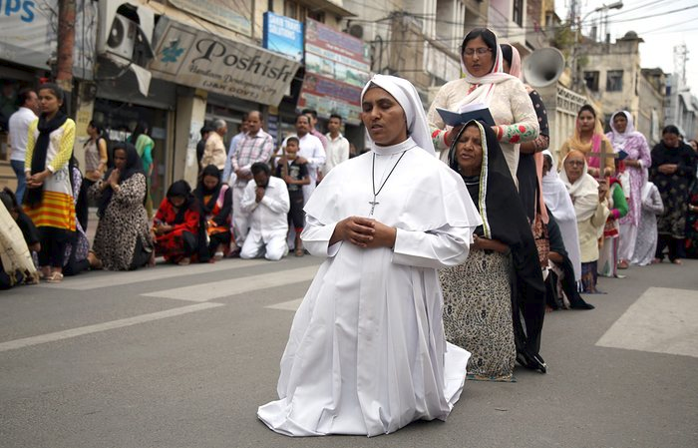
Jammu, India
Christians offer prayers during a Stations of the Cross service commemorating Jesus’s death

Slide 24
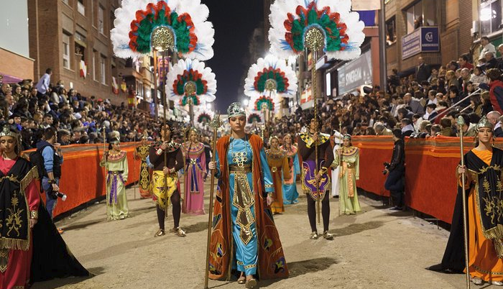
Lorca, Murcia, Spain
Holy Week is celebrated throughout Spain with hundreds of costumed processions through the streets. Performers from the Paso Blanco museum recreate stories from the Bible

Slide 25
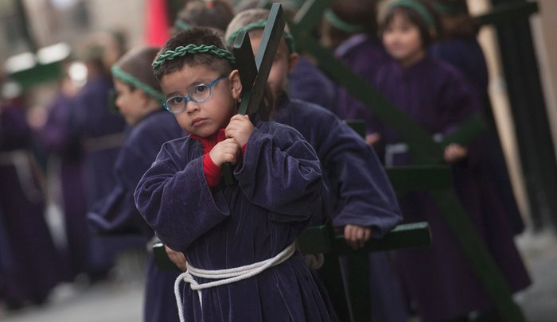
Segura, Gipuzkoa
Children carry crosses during a parade in the northern Basque village in Spain

Slide 26
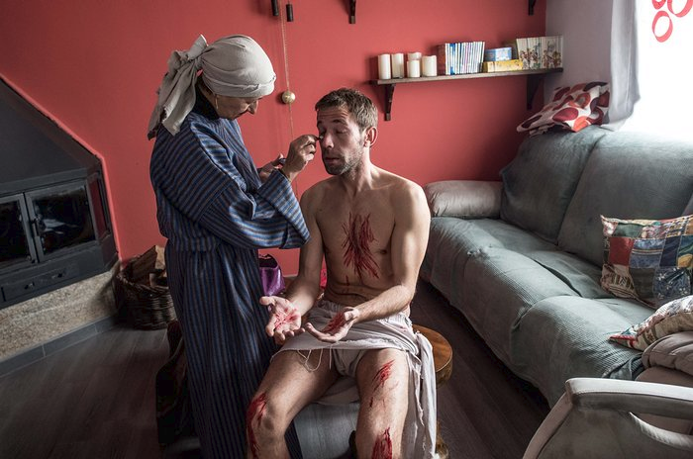
Hiendelaencina, Guadalajara, Mexico
Concha helps Felipe get ready for his part as Jesus Christ in the Good Friday re-enactment of the crucifixion. The village’s 140 residents use their own funds to make the costumes and props

Slide 27
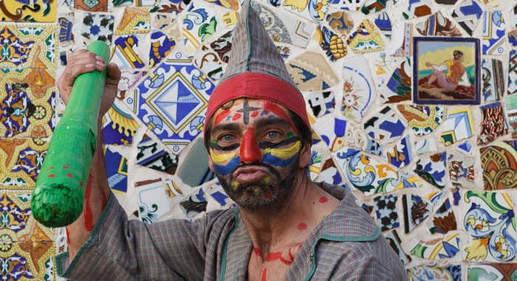
Cuevas del Almanzora, Andalucia, Spain:
Men dress as jesters and torment Jesus as he is paraded through the streets carrying the cross

Slide 28
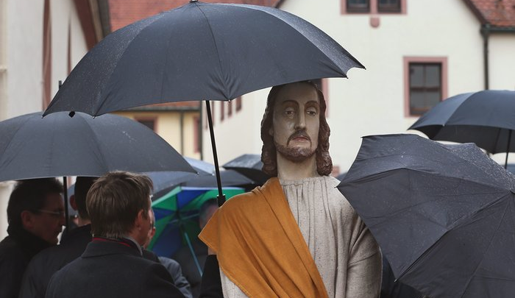
Lohr am Main, Germany
People shelter a figure of Jesus with an umbrella, one of 13 life-size figures used, as they parade in the rain

Slide 29
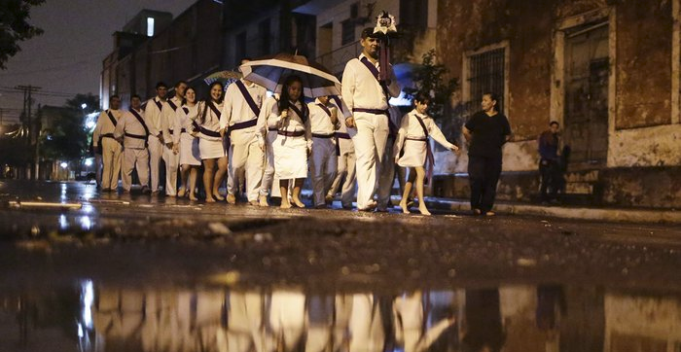
Asunción, Paraguay
Catholics walk barefoot in the rain singing religious songs during their procession through the city

Slide 30
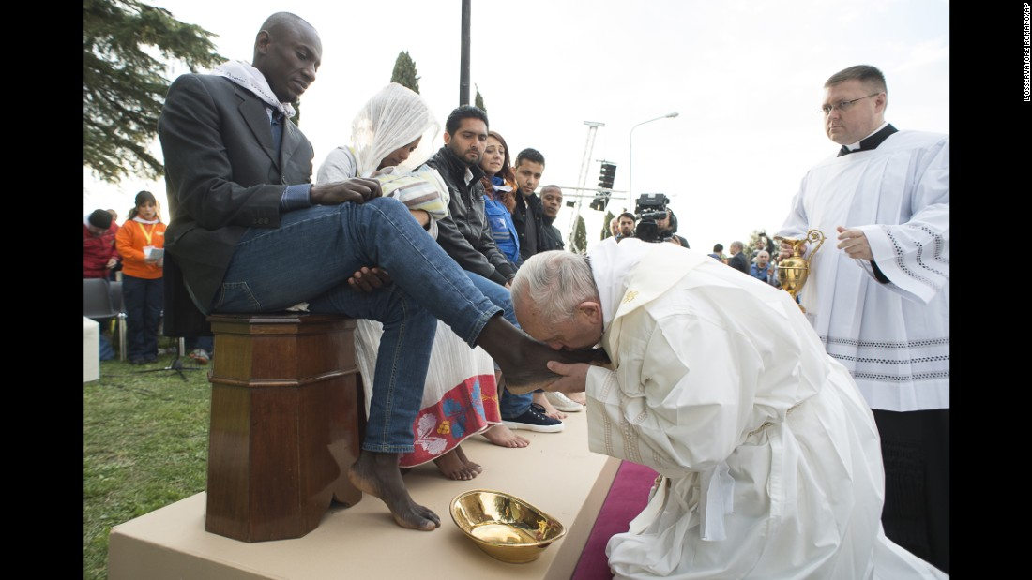
Pope Francis kisses a man's foot at a refugee center outside of Rome on Thursday, March 24. The Pope washed and kissed the feet of Muslim, Orthodox, Hindu and Catholic refugees

Slide 31
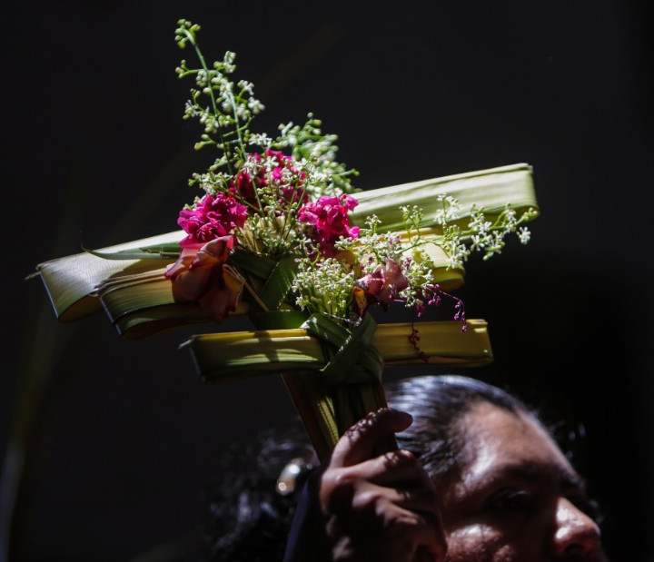
Catholic attends a Palm Sunday Mass in Managua, Nicaragua, on March 20.

Slide 32
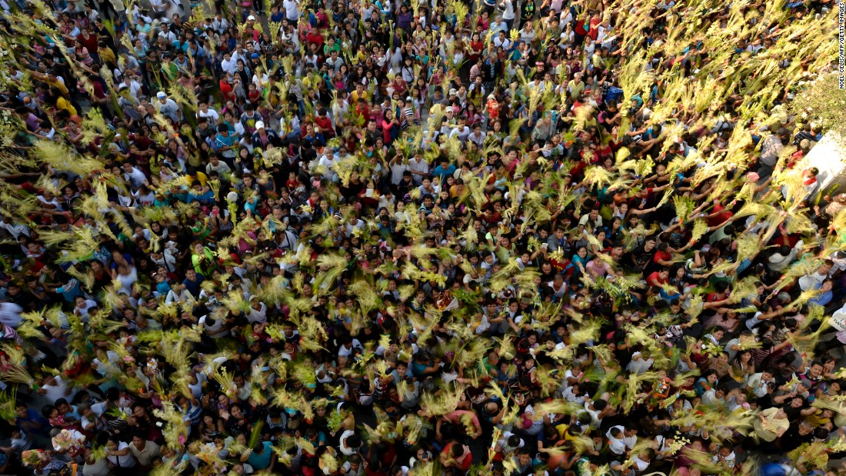
People wave palm fronds during a Palm Sunday Mass in Bulacan, Philippines, on March 20.

Slide 33
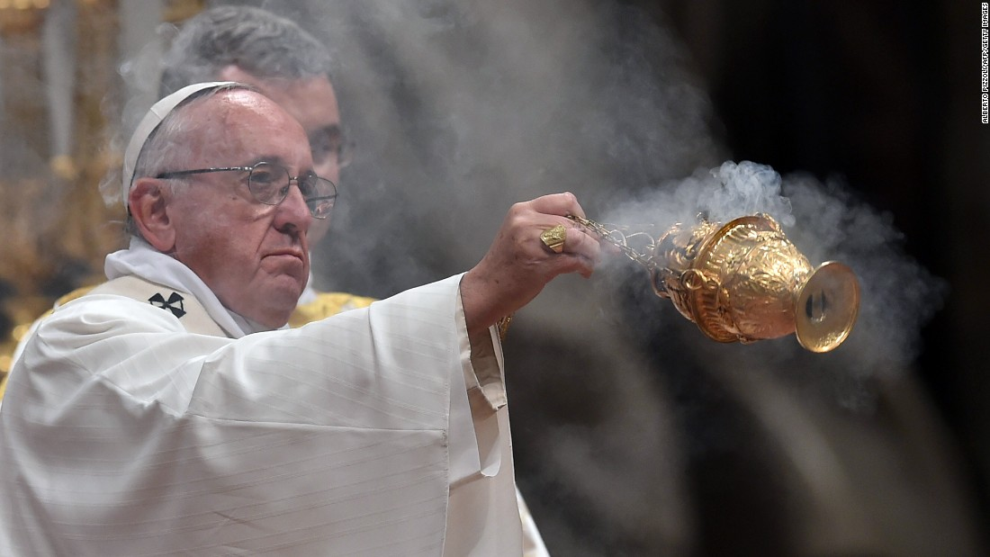
Pope Francis swings a censer during the Easter Vigil at St. Peter's basilica on Saturday, March 26, at the Vatican.

Slide 34
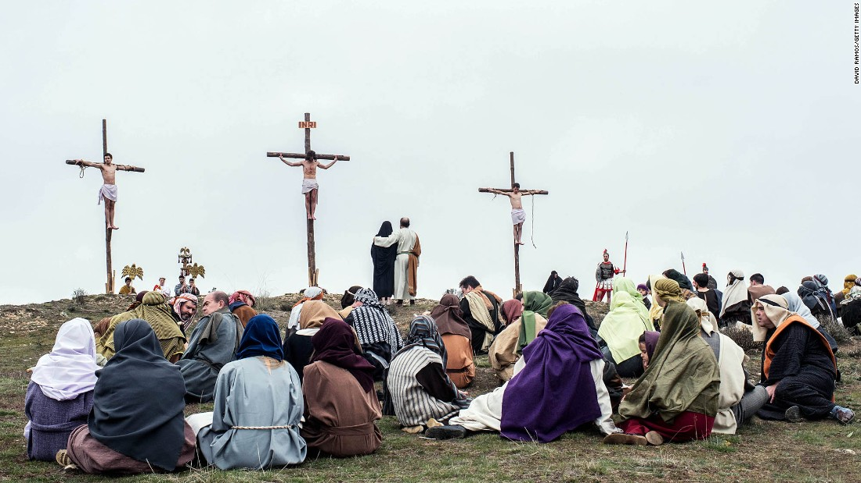
An actor portraying Jesus is crucified (he isn’t killed) as residents of Hiendelaencina, Spain, dress in period clothing to perform a re-enactment of Christ's suffering on March 25.

