Slide 1
Guy Turns 700 Year Old Abandoned Cave Dwelling Into Vacation Home

Slide 2
The Rockhouse is a unique luxury cave retreat, hand sculpted from a Triassic sandstone escarpment near the Wyre Forest in rural Worcestershire. Set in 3 acres of woodland on the banks of Honey Brook, The Rockhouse has been occupied for over 700 years.
When the site was deserted in 1962 it reverted back to its ‘natural state’ – until it was painstakingly and sympathetically refurbished in 2015 ‘almost single handedly’ by enthusiast and owner Angelo Mastropietro.

Slide 3
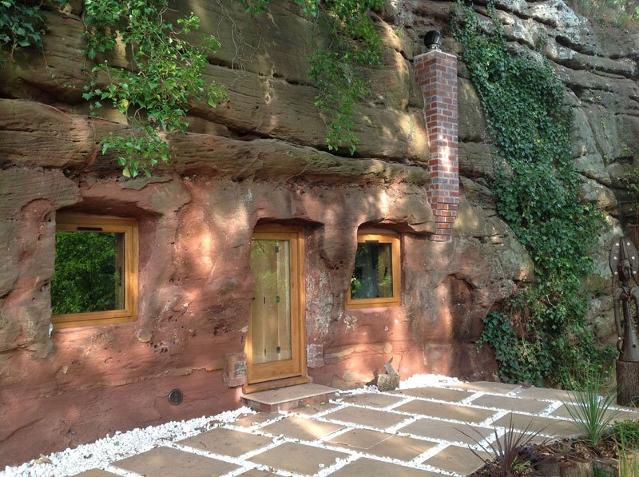

Slide 4
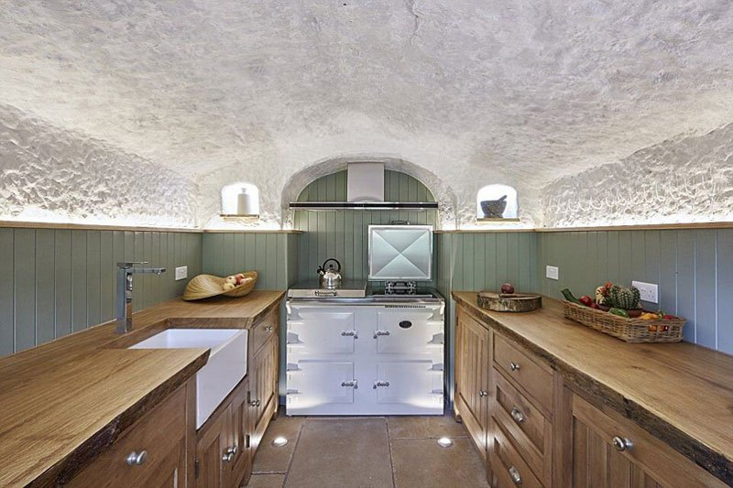

Slide 5
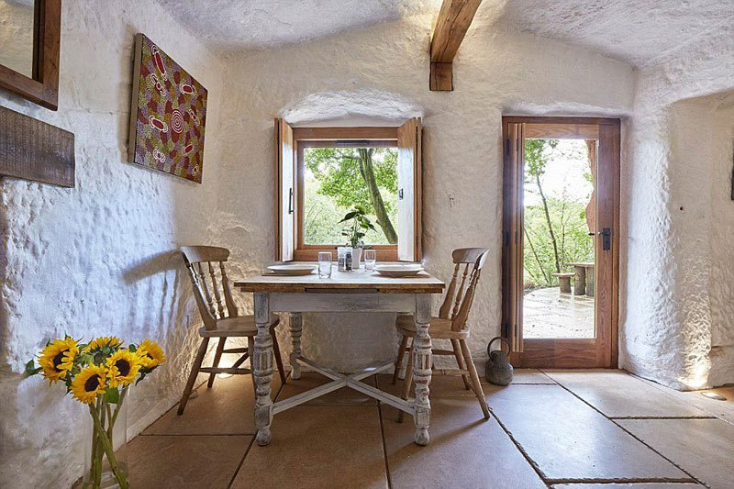

Slide 6
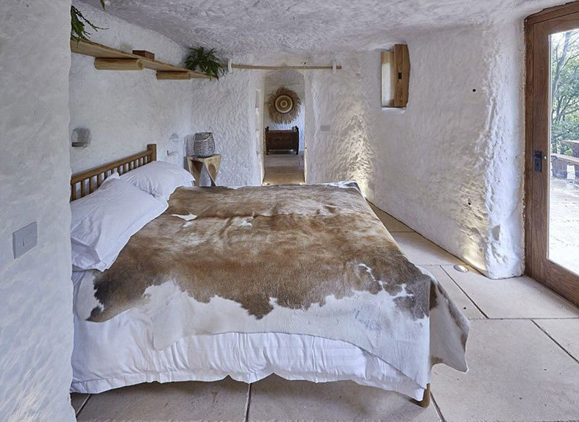

Slide 7
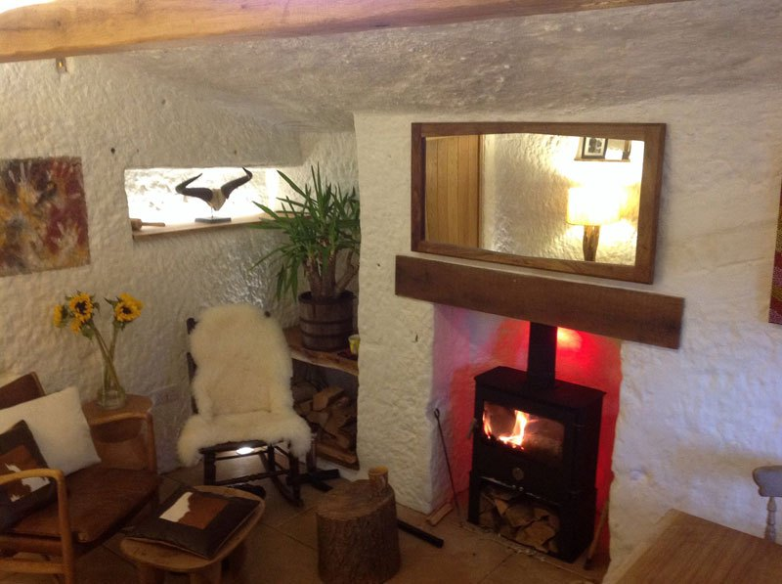

Slide 8
According to the BBC, Angelo Mastropietro came across the site near Kidderminster when he sheltered there during a rain storm in 1999. He bought it at auction for £62,000 in 2010 after seeing it advertised as a ‘Fred Flintstone’ house, and submitted a planning application to Wyre Forest District Council.
Angelo spent around 1,000 hours breaking, cutting and burrowing the rock, excavating between 70 and 80 tons of rubble by hand. All of the fresh running water comes from Angelo’s own bore hole, which he sank 80 metres into the ground.

Slide 9
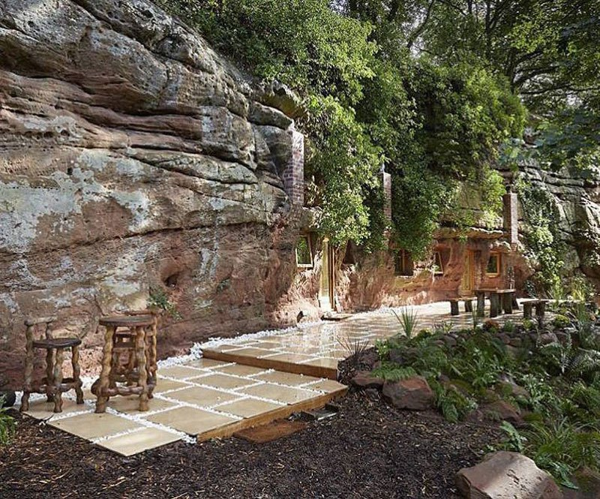

Slide 10
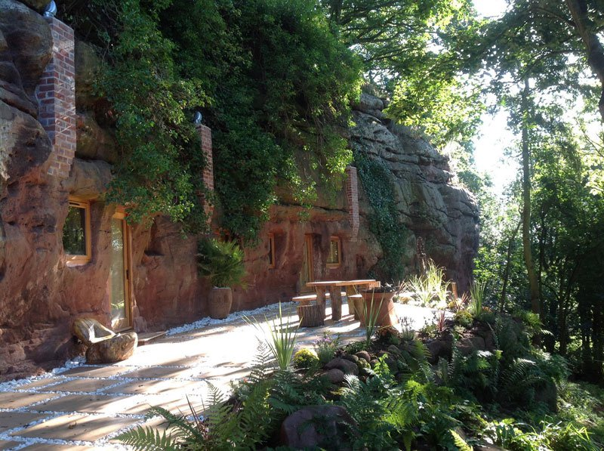

Slide 11
