Slide 1
​Good Son - Loving Caring!
A Hero

Slide 2
SLIDE TITLE
Chen Xinyin, 48, has had a hard life. He lost his arms after suffering an electric shock at the age of seven, but still started working on the family farm. At the age of 20, his father died, leaving just Chen and his ailing mother to fend for themselves. As his mother got sicker and life got harder, someone suggested that Chen consider begging, but angrily replied, “I have no arms but I have good feet. I can’t go make that sort of money.”
Since losing his arms, Chen has learned to cook, farm, and weave baskets. In 2014, the He has even managed to make a profit year on year. , south-west China, resident began to take care of his 91-year-old mother full time, even feeding her with a spoon between his teeth. The winters are hard for Chen Since he finds it difficult to put socks on, and he often suffers from frostbite.

Slide 3
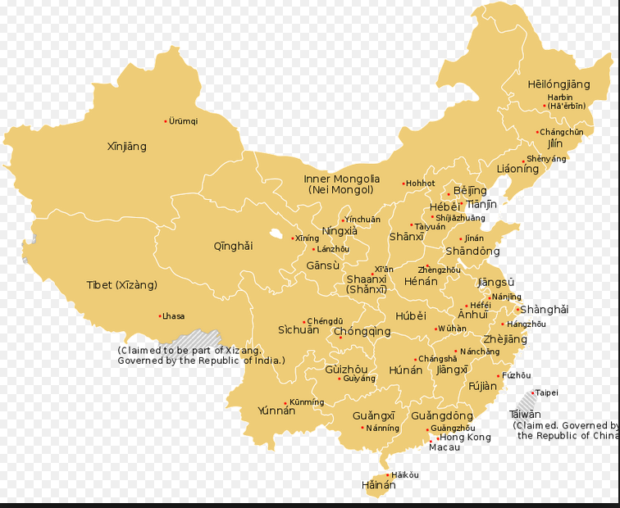

Slide 4
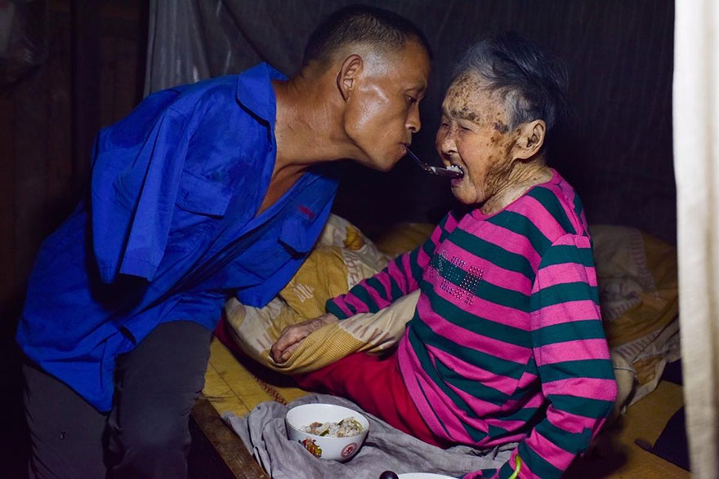
At 14 he began to work on the family farm, and at 20, his father died. He takes care of his invalid mother too.

Slide 5
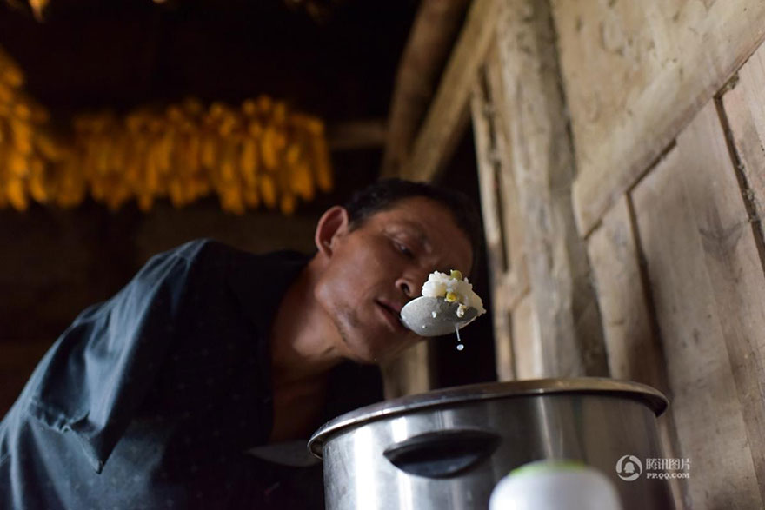
Chen was forced to learn to do everything with is feet, even cooking

Slide 6
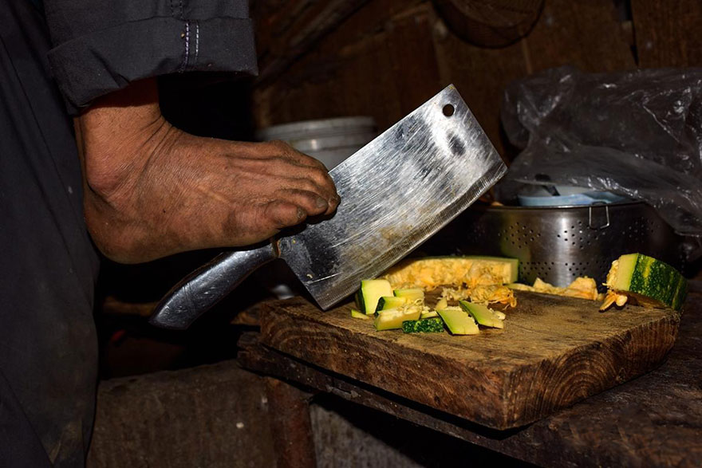
He has a scar on his foot from the first time he tried to use a knife

Slide 7
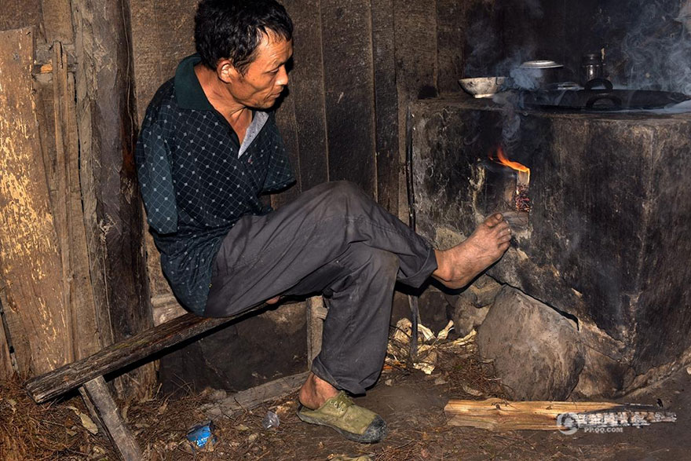

Slide 8
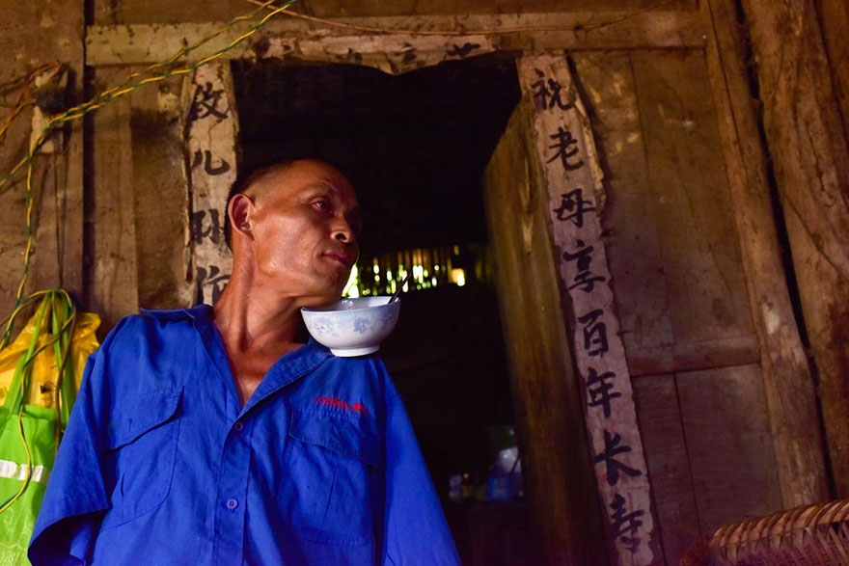
Chen uses the rest of his body to make up for his lack of arms

Slide 9
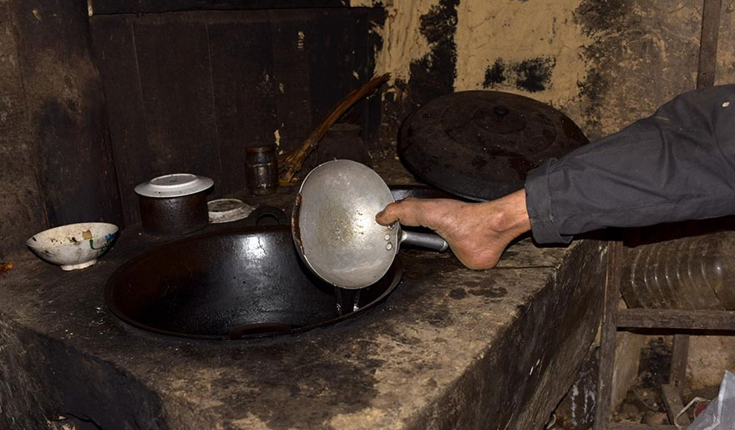
There’s no one to help with the housework since his mother became paralysed

Slide 10
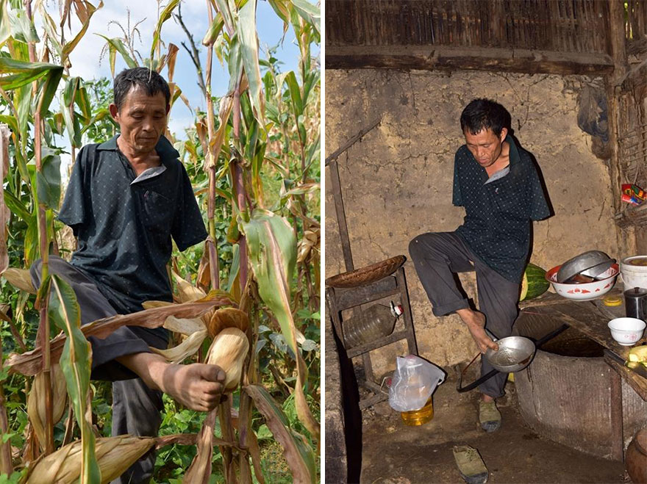
So Chen farms and takes care of their house

Slide 11
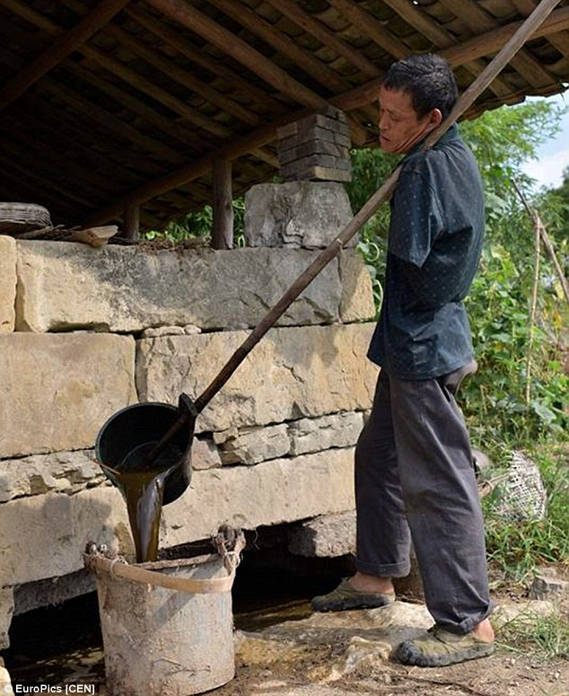
Using his face and shoulders, Chen Xinyin is able to pick up bigger objects - from food bowls to farm ladles

Slide 12
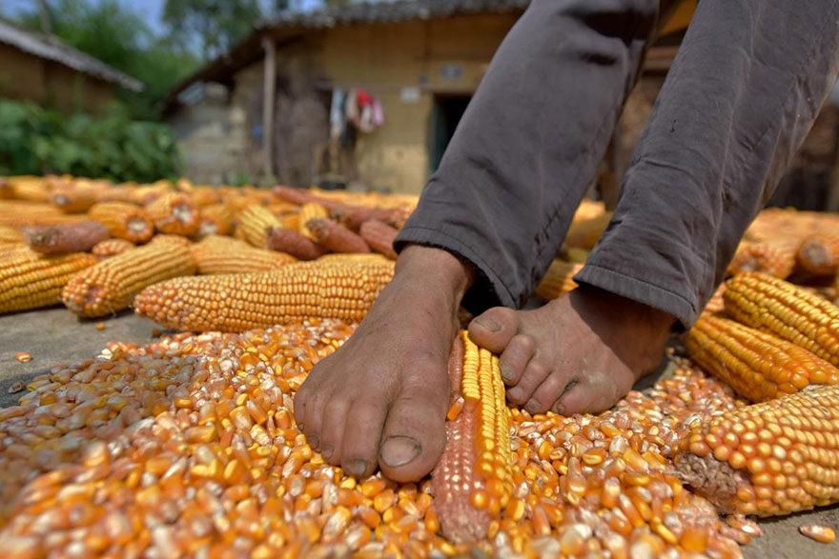
Once, someone suggested that Chen go and beg instead of farming

Slide 13
Dignity is not the only reason for rejecting the idea.
Chen Xinyin is also worried about who will be left to take care of his mother if he leaves.
While many would have reached out for help, Chen Xinyin is adamant about doing as many things himself as possible.
Somehow, he even finds the time to help his neighbors in times of need.

Slide 14
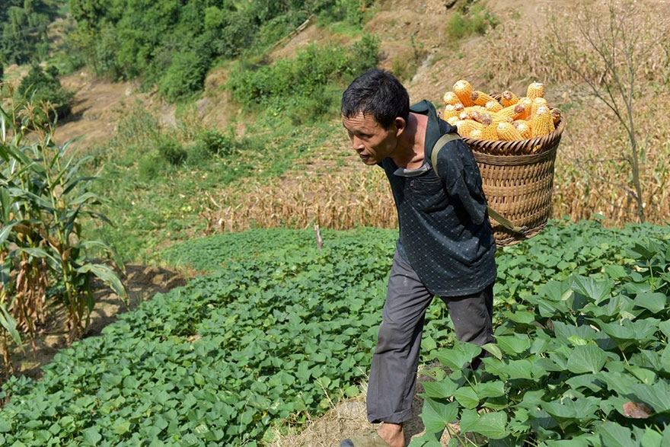
“I have no arms but I have good feet. I can’t go make that sort of money,” he replied

Slide 15
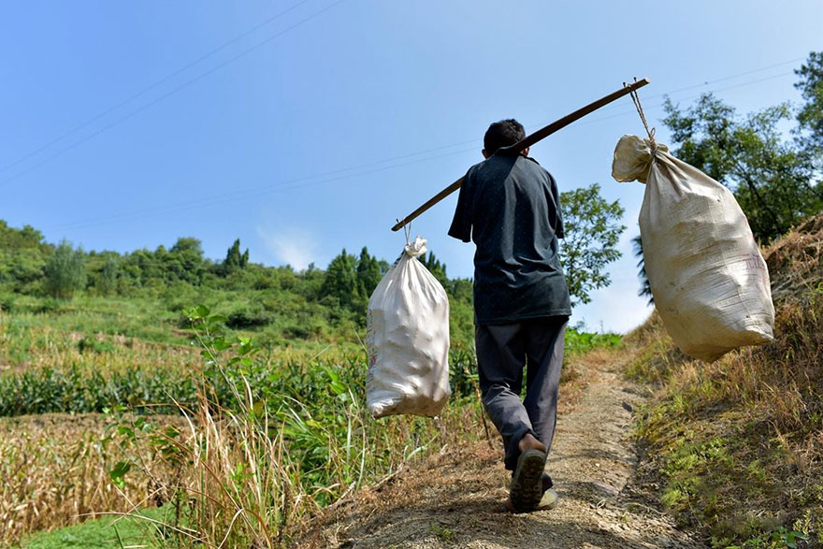
Some heroes don’t see themselves as being heroic – they just keep on doing what they can do and doing it to the best of their ability. They truly are heroes!

Slide 16
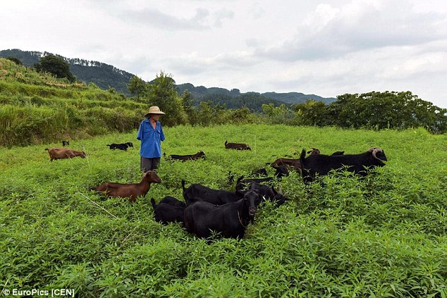
Now he runs his smallholding of cultivated farmland and raises a flock of 24 sheep, two buffalos and four hens. He has even managed to make a profit year on year.

