Slide 1
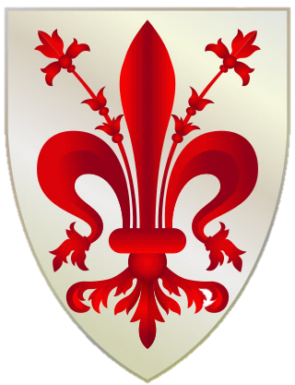
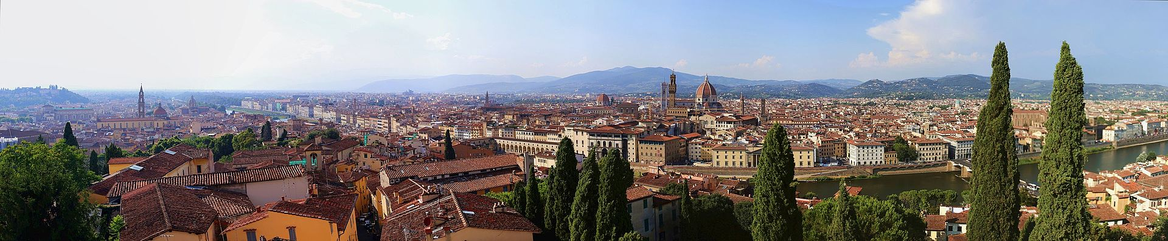
Florence, Italy
Culture Hearth of the Renaissance

Slide 2
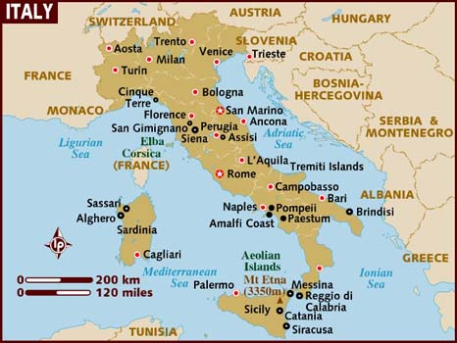
Florence is the capital city of the Italian region of Tuscany and of the Metropolitan City of Florence. It is the most populous city in Tuscany, with 383,083 inhabitants, expanding to over 1,520,000 in the metropolitan area.

Slide 3
The Historic Centre of Florence attracts 13 million tourists each year, and Euromonitor International ranked the city as the world's 89th most visited in 2012, with 1.8 million visitors. It was declared a World Heritage Site by UNESCO in 1982. The city is noted for its culture, Renaissance art and architecture and monuments. Due to Florence's artistic and architectural heritage, it has been ranked by Forbes as one of the most beautiful cities in the world.
Florence is an important city in Italian fashion, being ranked in the top 51 fashion capitals of the world; furthermore, it is a major national economic centre, as well as a tourist and industrial hub. In 2008, the city had the 17th highest average income in Italy.

Slide 4
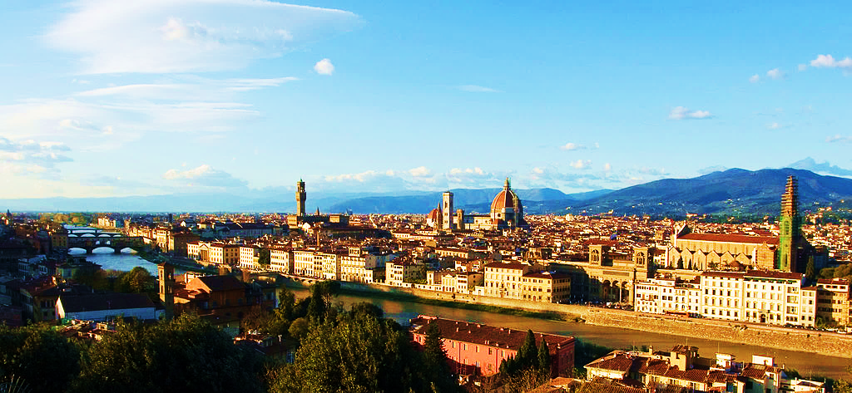
City view in the Arno's valley, in the background the Apennine mountains

Slide 5
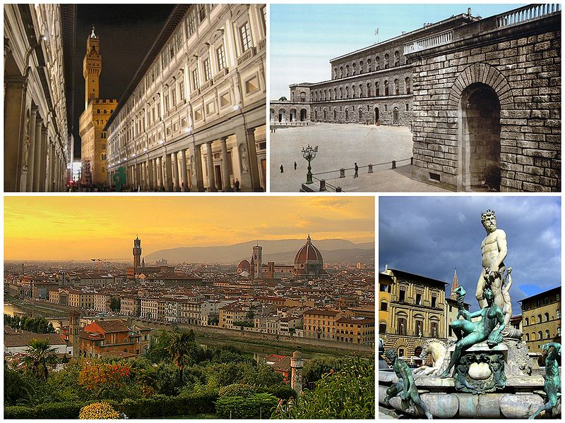
A collage of Florence showing the Galleria degli Uffizi (top left), followed by the Palazzo Pitti, a sunset view of the city and the Fountain of Neptune in the Piazza della Signoria.

Slide 6
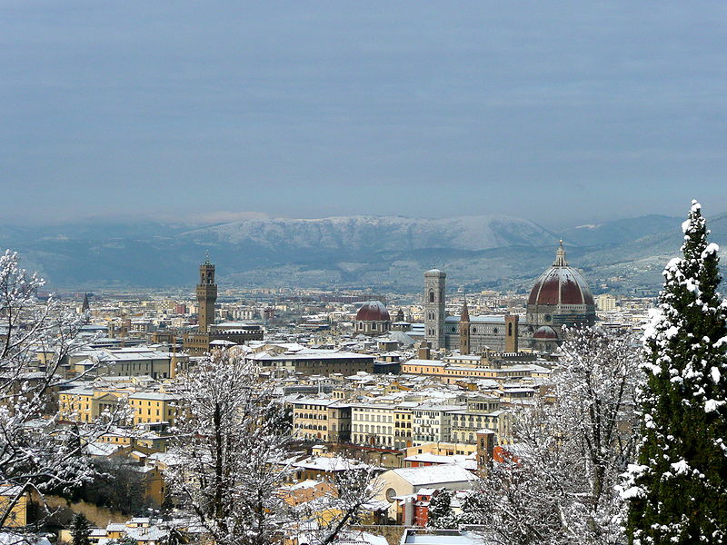
Florence under the snow in December 2009. It was unusually deep for Florence.

Slide 7
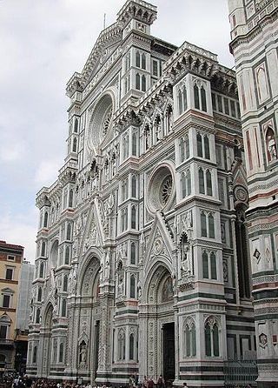
The façade of the Cathedral

Slide 8
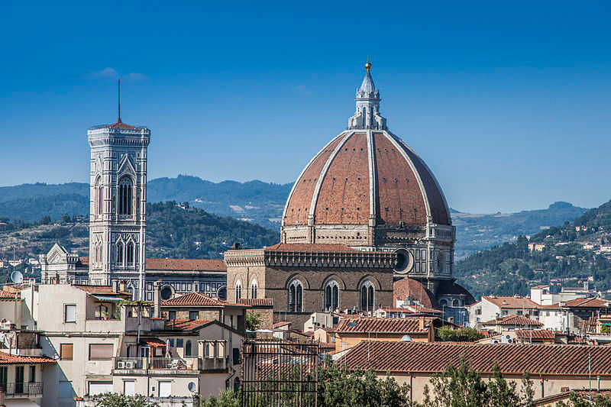
Cathedral Dome and Bell Tower

Slide 9
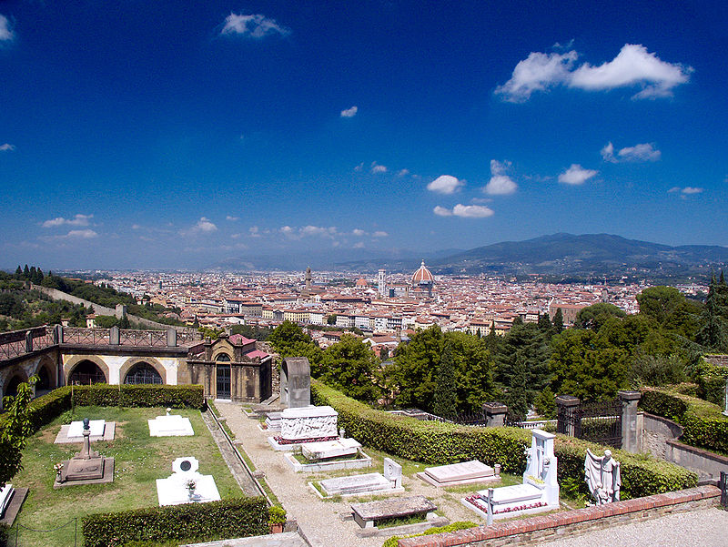
Porte Sante cemetery, burial place of notable figures of Florentine history.

Slide 10
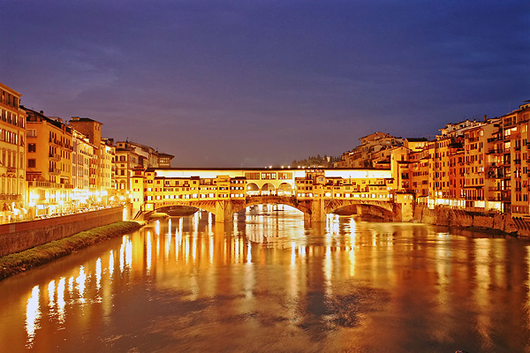
Ponte Vecchio, which spans the Arno river

Slide 11
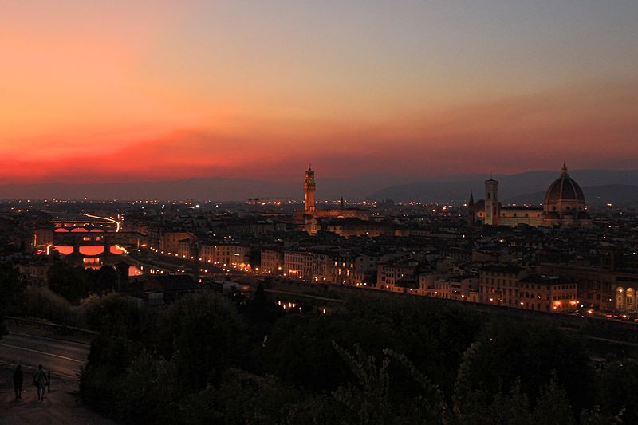
Florence at night from Piazzale Michelangelo

Slide 12
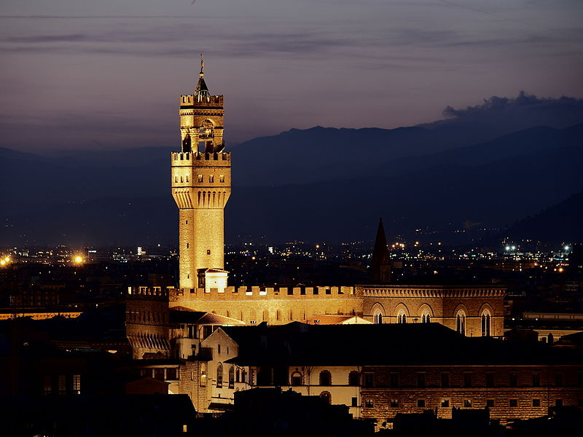
Palazzo Vecchio

Slide 13
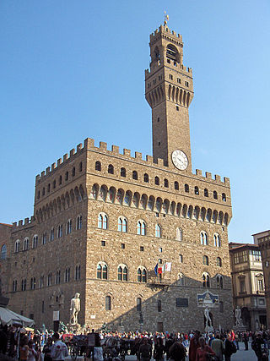
The Palazzo della Signoria, better known as the Palazzo Vecchio (English:The Old Palace)

Slide 14
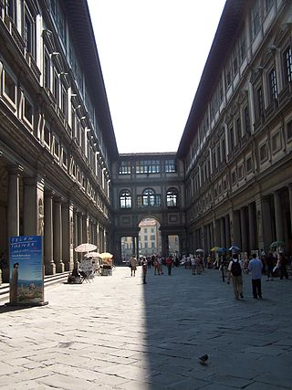
Piazzale degli Uffizi (The Uffizi is one of the major art museums.)

Slide 15
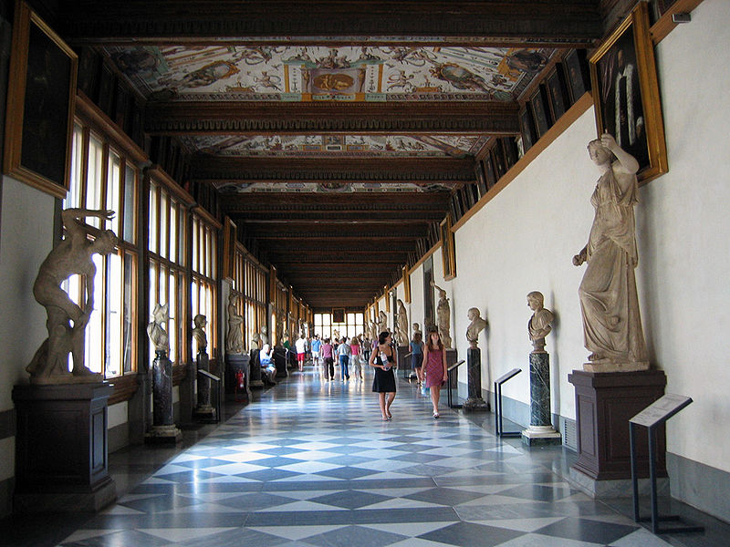
Uffizi hallway

Slide 16
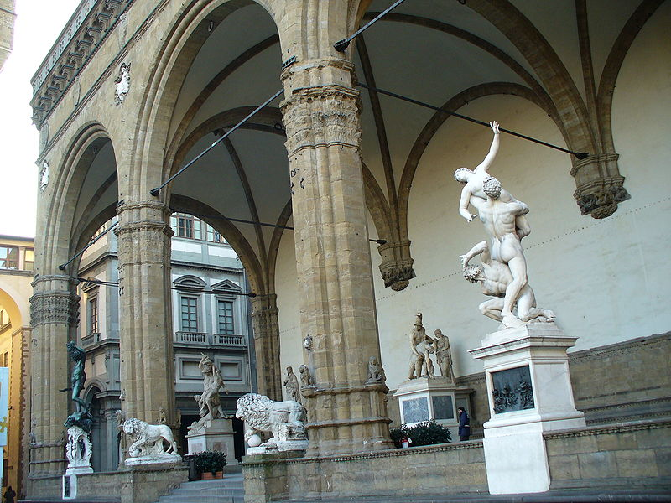
Sculptures in the Loggia dei Lanzi

Slide 17
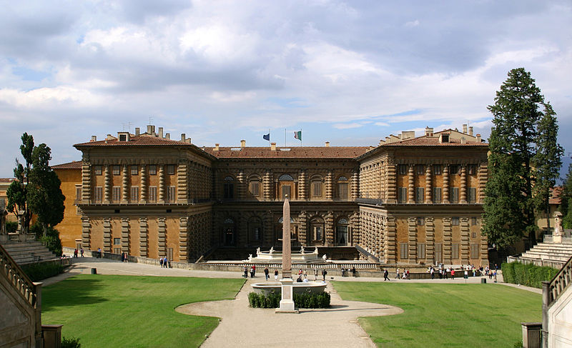
Palazzo Pitti on Boboli Gardens' side

Slide 18
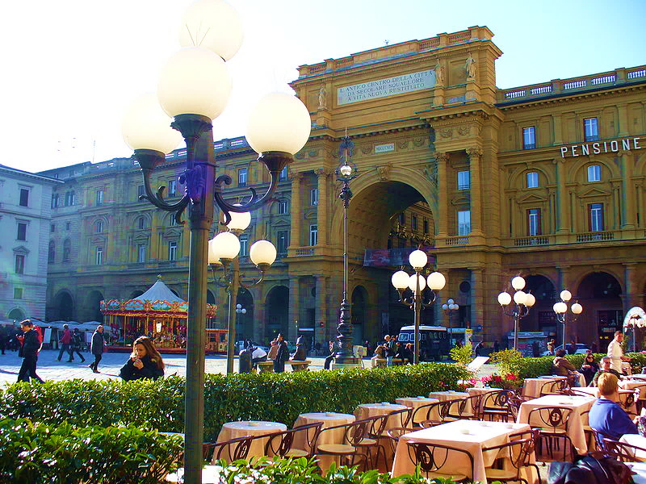
Piazza della Repubblica

Slide 19
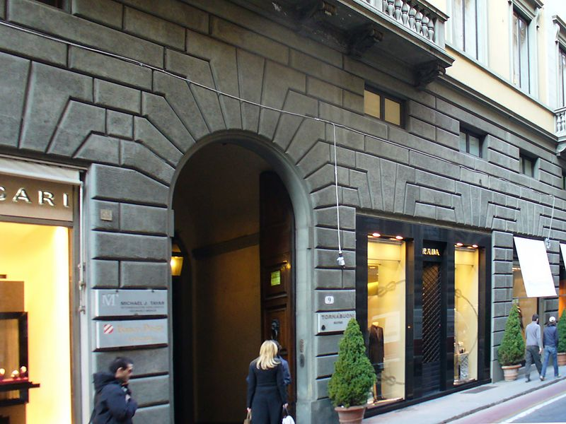
Luxury boutiques along Florence's prestigious Via de' Tornabuoni.

Slide 20
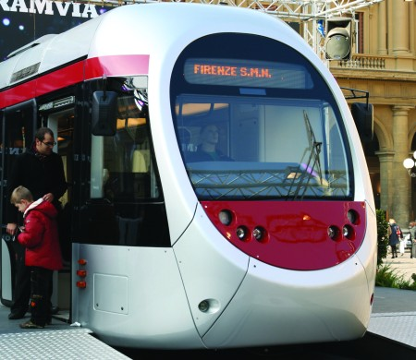
Tramway Sirio in Florence

