Slide 1

Explorers Find Ancient Native American Treasure Deep in the Desert
From LifeDaily

Slide 2
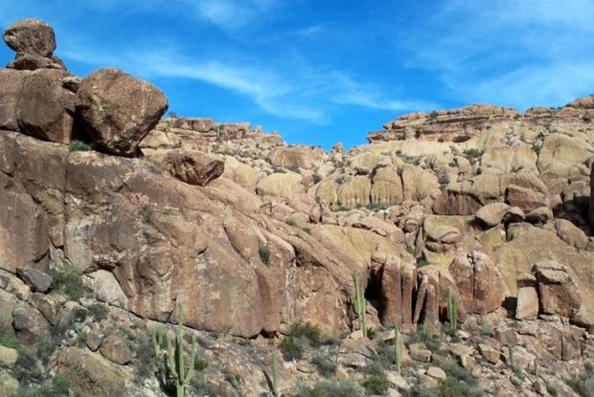
SLIDE TITLE
Thousands of years ago, the Apache Indians hid something remarkable deep inside this impassible mountain range. These foreboding hills are known as the Superstition Mountains, and buried deep within them is an amazing secret.

Slide 3
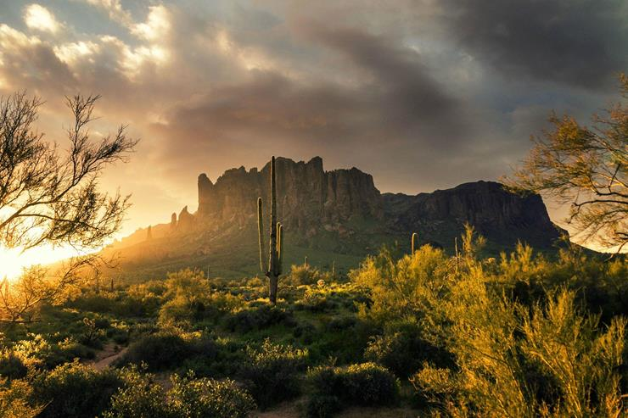
The Mountains
The Superstition Mountains in Arizona, commonly referred to as “Superstitions” by locals cover 160,000 acres of barren desolate terrain. At the center of these magnificent mountains is Superstition Mountain, a 3,000 foot high monolith, which appears to lord over the rest of this rugged territory. It is even said that deep within these beautiful mountains lies a secret of untold value.

Slide 4
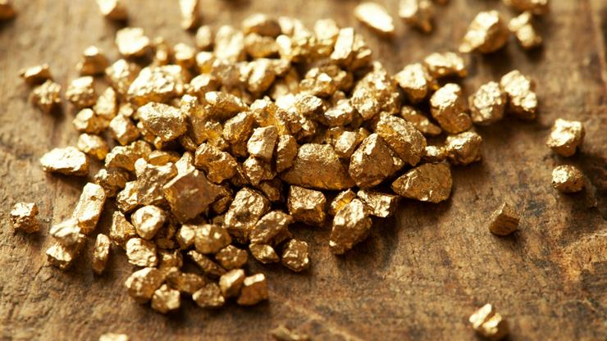
A Secret in the Desert

Slide 5
According to legend, the richest deposit of gold in America lies hidden in the Superstition Mountains, a secret known as the Lost Dutchmen’s Gold Mine. This remarkable treasure is said to be linked to the ancient golden cities built by the Native American tribes of the American Southwest. Over the past 300 years, many explorers have gone in search of the fabled gold and riches, hiding deep within the mountains. And many have never returned…

Slide 6
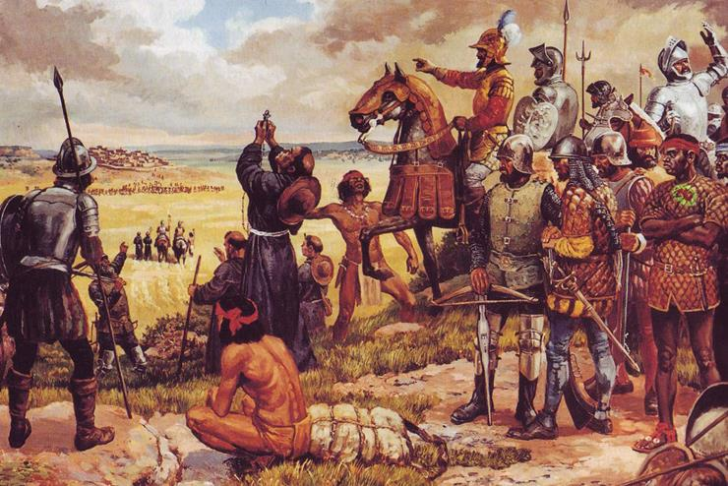
The Conquistadors
The Spanish arrived in 1540.

Slide 7
The Apache Indian tribes called this desolate, unforgiving landscape home and considered Superstition Mountain to be sacred ground as it was the home of their Thunder God. When the Spanish arrived in 1540, led by Francisco Vasquez de Coronado, the conquistadors cared little about the Apache customs or beliefs, and violently made their way into Apache territory. Hunting whispers of what they believed to be the legendary “Seven Golden Cities of Cibola.”

Slide 8
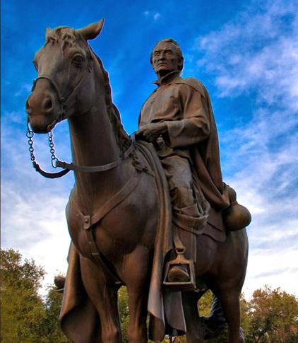
The Fabled Cibola
Unfortunately, Coronado never found Cibola, or any gold for that matter. But the rumors persisted and a century and a half later, Jesuit priest Eusebio Francisco Kino, whose original duty was to establish Christian missions, became lured by the tales. His first exploration into the region did uncover several promising sources of gold. Though it is not known if he found the Dutchman’s Mine. However, these expeditions enraged the Apache, who decided that they would no longer tolerate any trespassers in their lands.

Slide 9
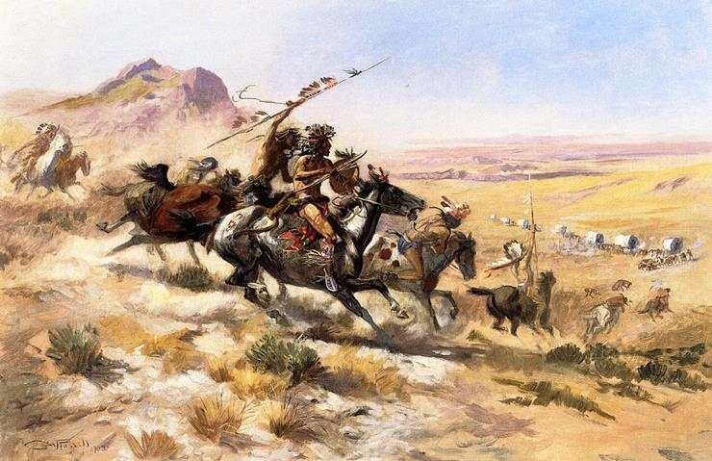
Hunted by the Apache
In 1846, Enrico, Pedro, Ramon, and Manuel Peralta, decided to risk the wrath of the Apache and make another foray into Arizona for the legendary gold. They were successful and returned from the mountains laden with gold. and planning another trip. Pedro returned to Arizona the next year and found even more gold, but he and his caravan were attacked by the Apache and would never return home.

Slide 10
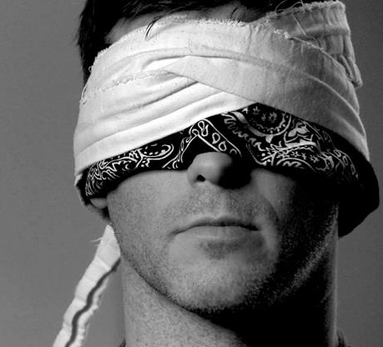
Abraham Thorne
Twenty years later, Dr. Abraham Thorne, an Army doctor at Fort MacDowell, AZ began to help care for the Apache Indians at a nearby reservation, earning their trust and respect. In time, he was offered an opportunity to be led to the gold in the Superstitions in 1870. Thorne agreed to be blind-folded for the 20 mile trip and was led to a canyon where he was given an enormous chunk of gold. Unfortunately, Thorne got greedy…

Slide 11
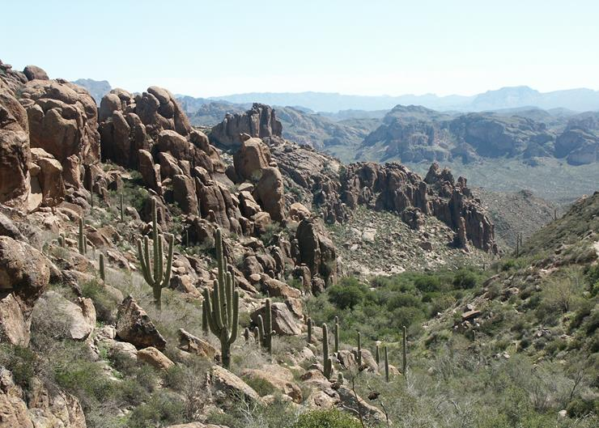
Thorne’s Mistake

Slide 12
Once in the canyon, Thorne was allowed to remove the blindfold and took a mental picture of the area. The Apache let him pick up as much as he could before the doctor was once again blind-folded for the trip back to the reservation. Dr. Thorne was determined to find that place again so he and few friends rode out into the desert. Though they miraculously found the place , they never lived to enjoy their newfound wealth. They were discovered by the Apache, who killed them all before they could escape with the gold.

Slide 13
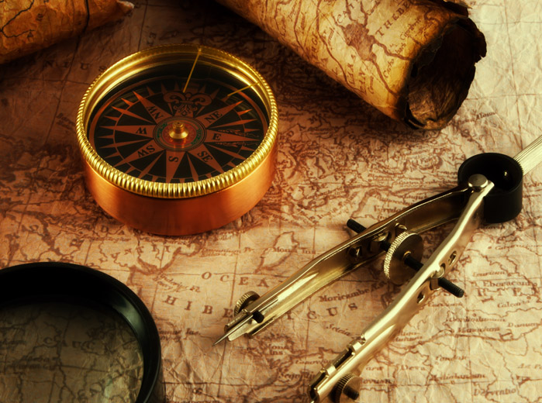
History’s Mysteries
In 1870, Jacob Waltz, a friend of the slain Peralta brothers, heard tell of the treasure still lurking in the Superstitions. He was an astute and talented miner and geologist and knew that there might be other ways to find the gold then just following Indian trails. So he began to piece together known clues and geological studies of the mountain range. And his skills and patience were soon rewarded…

Slide 14
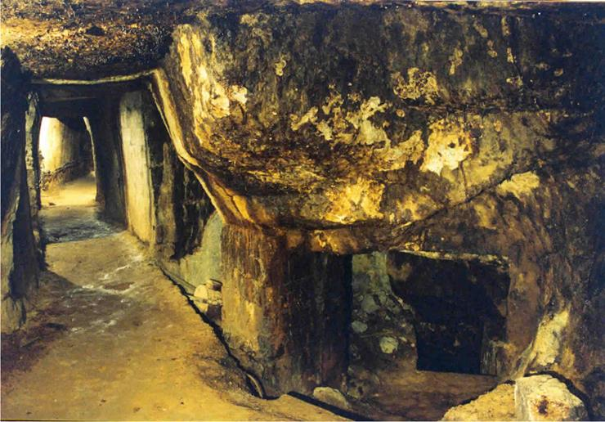
A Rich Find
Waltz, who was nicknamed “The Dutchman”, had found the perfect place to prospect in the Superstitions. He mined and found exactly what he and so many before him had come to find; a rich deposit of gold of incalculable value. When Waltz was 80 years old, he decided to hide his mine to protect it. So he dug a six-foot-deep hole at its entrance. He then laid down two rows of logs and topped them with dirt and stones.

Slide 15
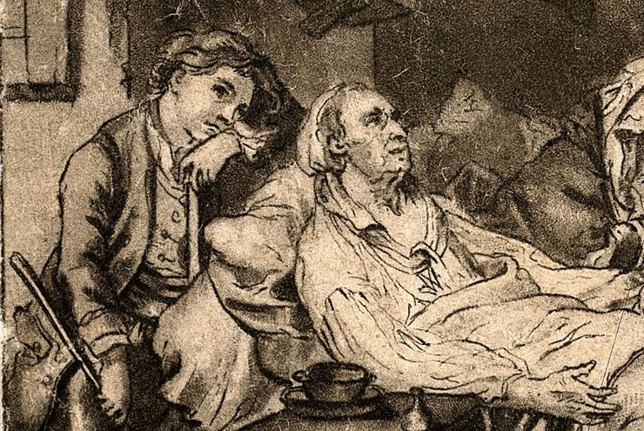
Proof Positive
Soon after closing up the mine, Jacob Waltz contracted pneumonia and was taken to the home of his friend Julia Thomas. It is said that on his deathbed, Waltz revealed to Julia that he had gold from the mine hidden underneath his bed. He explained that it was this gold that he had been living on his entire adult life. When they opened the box, he explained that his mine still had enough gold left in it to make them all millionaires.

Slide 16
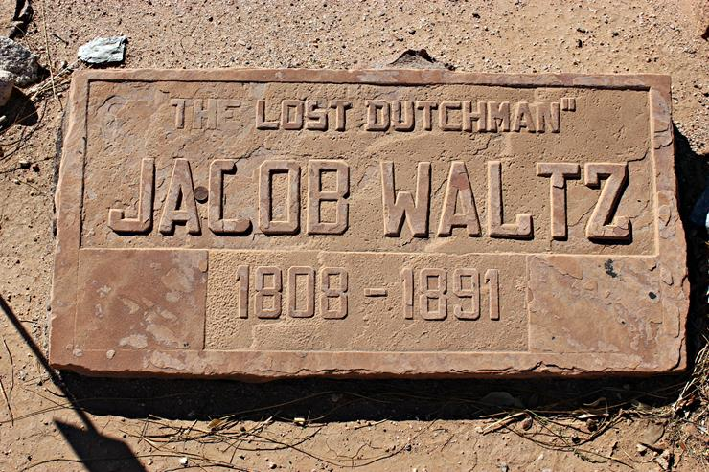
Dead and Buried
As his end drew near, The Dutchman gave Julia and a local miner, Rhinehart Petrasch, clues to the mine’s location. Unfortunately, Waltz died before he could make them a map of the treasure’s exact location. The only directions Julia and Petrasch had when they ventured out into the mountains were the details Waltz had relayed to them on his deathbed. Taking these verbal clues, Julia and Rhinehart drew a map of where to find the gold

Slide 17
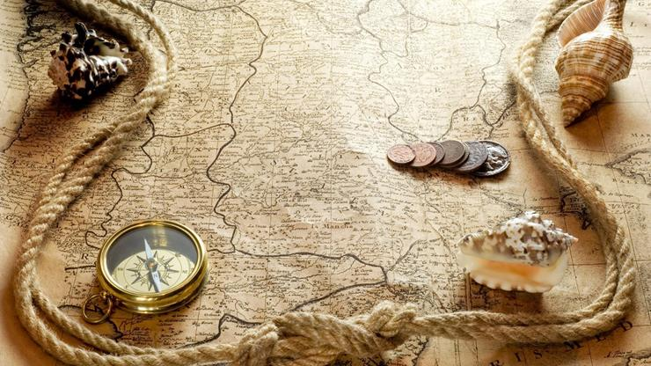
A Treasure Map

Slide 18
Walt said, that “the setting sun shines into the entrance to my mine and glitters on the gold, so it must have faced to the west.” He added that they needed to take the first forge on the south side from the western edge of the range. Julia and the other miner were so anxious to get in the mountains, that they embarked on their journey in mid-summer, when the mountains were hottest…which proved to be disastrous.

Slide 19
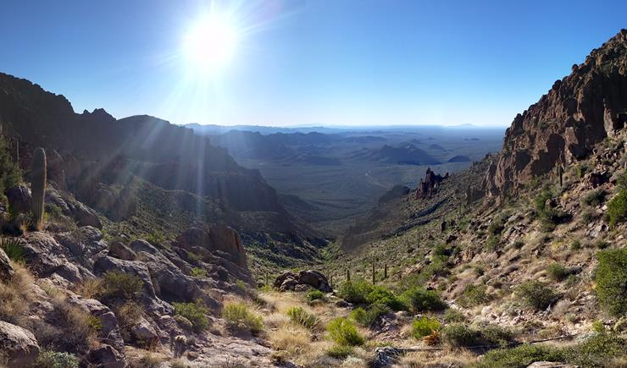
Expedition

Slide 20
Sadly, Julia invested everything she owned into the expedition to no avail, as Waltz’ verbal recollection of the mine’s location had proven useless. She returned penniless and never again attempted to return to the Superstition Mountains. Rhinehart Petrasch however, continued in vain to search for the mine for the next 50 years. When he realized he would never find it, he took his own life.

Slide 21
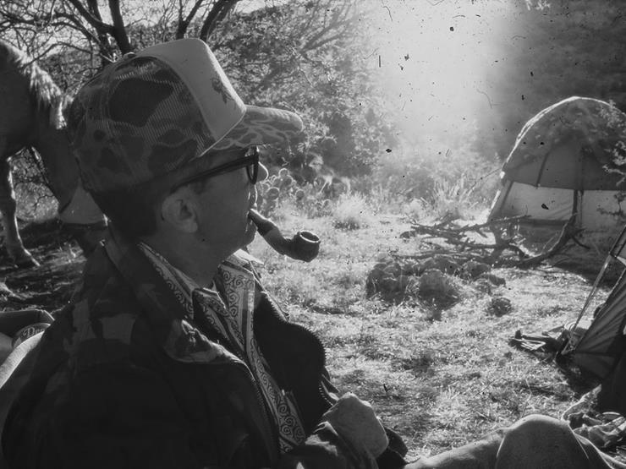
A Century Later
One hundred years later, a modern-day treasure hunter named Walt Gassier claimed that he had found the Dutchman’s mine. Using clues handed down from Jacob’s death-bed description, Gassler had spent most of his free time looking for the legendary mine. But his health began to fail, so he contacted two other prospectors, Bob Corbin and Tom Kollenborn. He gave both of them his notes and a map of what he believed to be the mine’s true location…

Slide 22

Dead on the Trail
From the clues he had pieced together, Walt Gassler was convinced that the mine existed. Yet he refused to give all of his information to Corbin and Kollenborn. He was determined to find the treasure himself first. Some days later, Walt hiked alone into the Superstitions. His body was found three days later by a local rancher. He had died of a heart attack, while alone on the trail.

Slide 23

A Surprising Visit
One month after Walt’s death, Tom Kollenborn recieved a surprising visit from Roland Gassler, Walt’s son. His father had shown him some of the gold he had found while hunting for the Dutchman’s mine and he was sure that with Kollenborn’s help, he could piece together the final clues to find the mine themselves. Tom obliged and gave Roland his father’s notes. Then, sometime later, Tom was approached by a different stranger who claimed that he too was Roland Gassler…

Slide 24
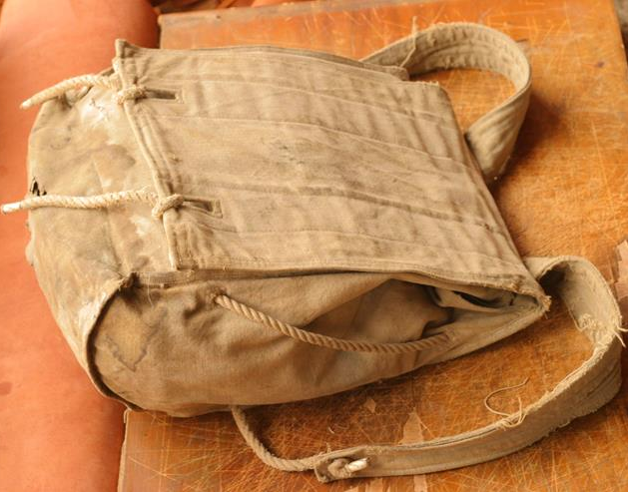
An Impostor?
The man showed Tom an ID that confirmed he was indeed the real Roland Gassler. It became clear that the first Roland Gassler was an imposter who only wanted Walt’s map. But where had he gotten the alleged gold ore sample? When they’d found Walt’s body, the Sheriff’s report listed a backpack among his belongings, which the real Roland Gassler had never received.

Slide 25

But What Really Happened?
When “The Dutchman”, Jacob Waltz died, he left behind a box of gold, a list of clues, and a legend of lost treasure that still remains largely lost to time. Some even believe that the fake Roland Gassler may have been in the mountains the day Walt died and may have stolen the backpack.

Slide 26
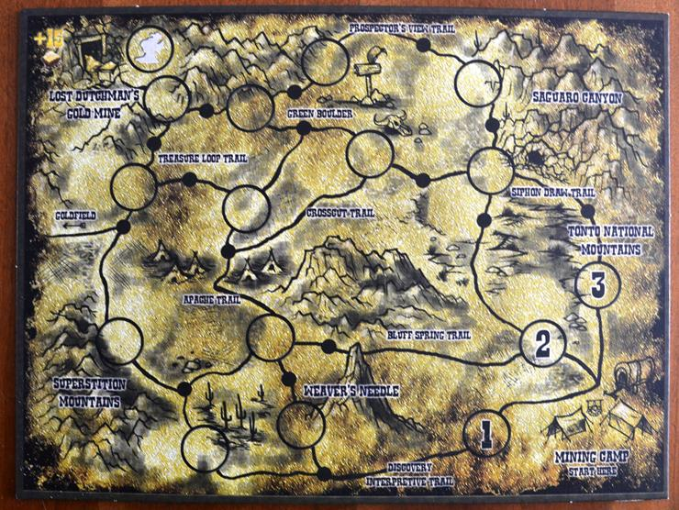
Over the course of the last 300 years, the mystery of the Dutchman’s mine has claimed the lives of hundreds of people, including the Peraltas, Thorne, Walt Gassler, and even the Dutchman himself. We may never know where the Apache kept their sacred, golden treasure, or if Cibola did indeed exist somewhere in the Superstitions.

Slide 27
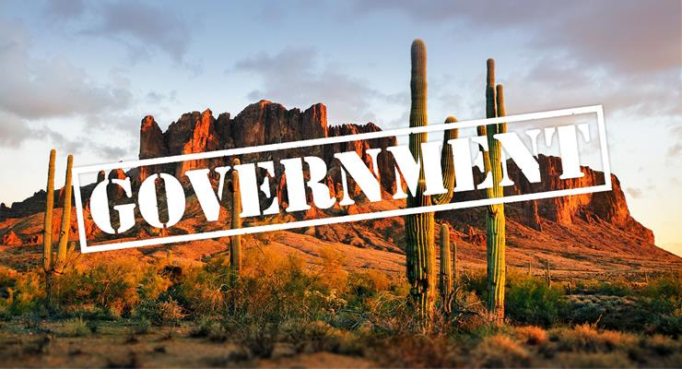
Lost to Time

Slide 28
Though it still has never been entirely recovered, it is estimated that the wealth of gold within the Superstition Mountains may be worth over 200 million dollars in today’s market. Today, the Superstition Mountains have been reclassified as a federally owned wilderness area. That means that if the mine were finally found, by anyone, all the gold would belong to the U.S. government.

