Slide 1
BEFORE CHAINSAWS....THIS IS TRULY AMAZING
Even those who don't live in a log home will enjoy this blast from the past!

Slide 2
Before chainsaws were invented, the logging industry in the United States & Canada was a seriously challenging occupation and we are only talking about 125 years ago. In the Pacific Northwest there were forests full of monster trees and cutting them down was done by hand.

Slide 3
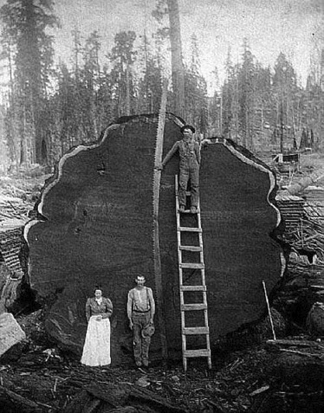
Look at the length of the two-man hand saw and heavy duty axes above that they used to drop these tremendous trees. It is almost inconceivable to think of cutting down a tree this size with a hand saw.

Slide 4
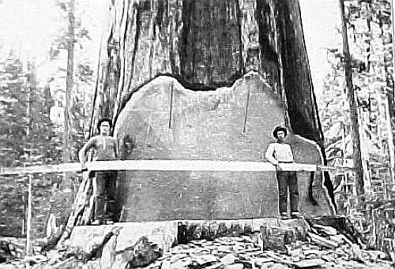

Slide 5
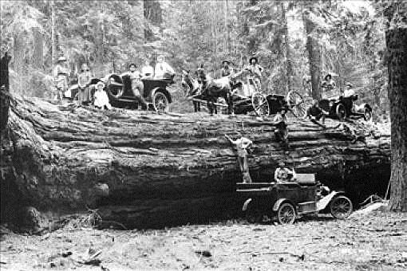
The work required very strong men (and horses) working long days for minimal pay. Could you imagine doing this to earn a living?

Slide 6
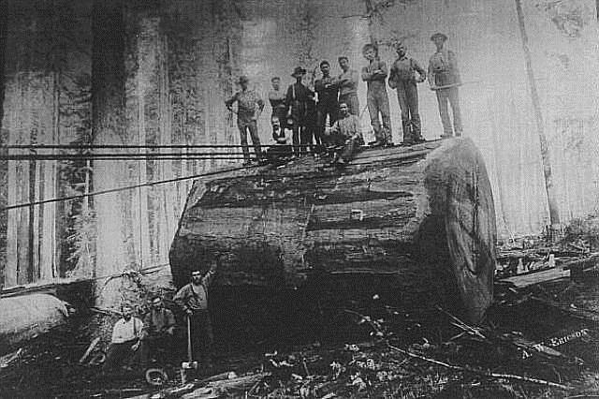
After a tree was finally felled, it took a week or more to cut it up into sections that could be managed (somehow) and transported by train to a saw mill.

Slide 7
Maneuvering the logs down the mountain to the train was a complex job. I didn't do any research on this, but I would be willing to bet that many men lost their lives doing this dangerous work. One slip and a hunk of wood as big as a hotel is rolling your way! The other question that begs an answer is how did they get those logs up onto the flatbeds of that train?

Slide 8
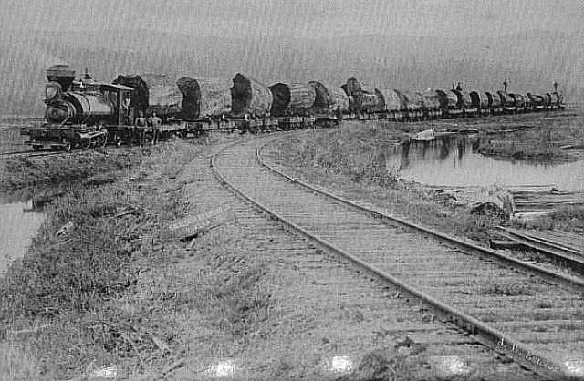

Slide 9
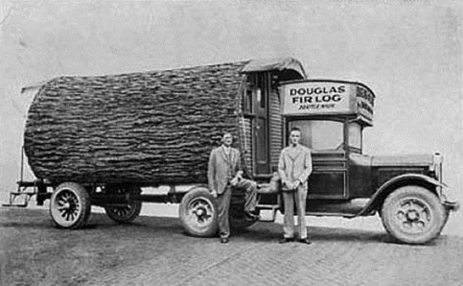
Hollowed out logs became the company's mobile office. Can you imagine stacking such logs to build a log home? Two courses would produce a 30' ceiling. Maybe that's why it was easier to hollow out a tree.

Slide 10
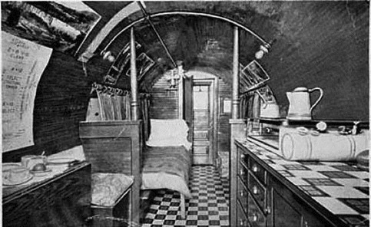
A long time before anyone ever thought of a mobile home or RV, hollowed out logs were also used to house and feed the logging crews

Slide 11
We are accustomed to our modern conveniences like electricity and gasoline powered chainsaws, and it is always such a mind-boggling experience to see how such monumental tasks were performed before these conveniences appeared on the scene. Remember that the previous picture shows a hollowed-out log made into a travel trailer.
Once upon a time --- People weren't afraid to work physically hard for a living ----------- Check out the additional pictures

Slide 12
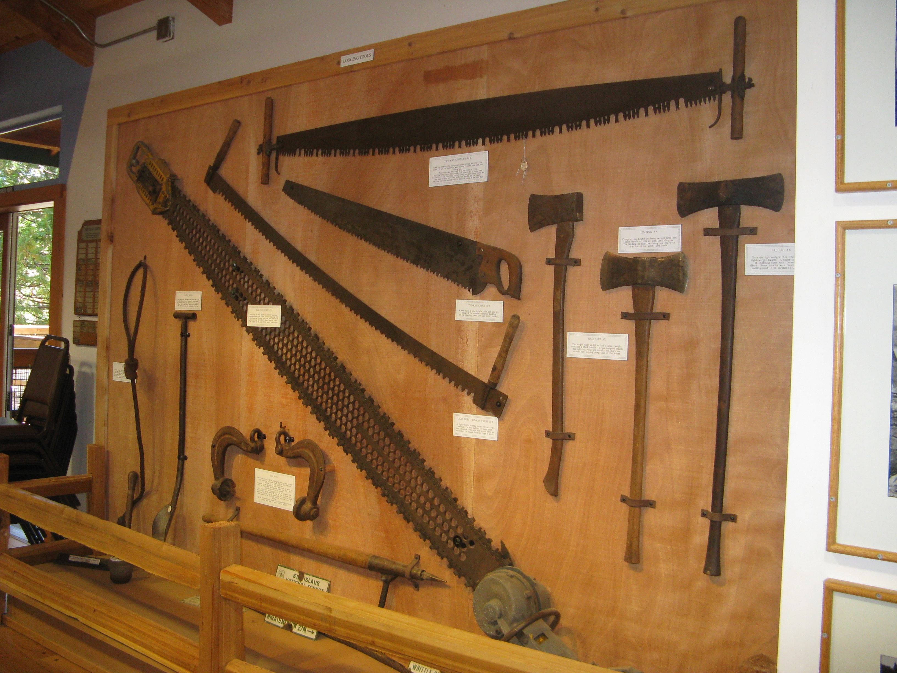
Logging tools

Slide 13
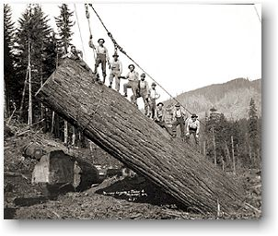

Slide 14
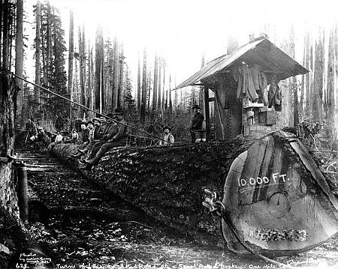

Slide 15
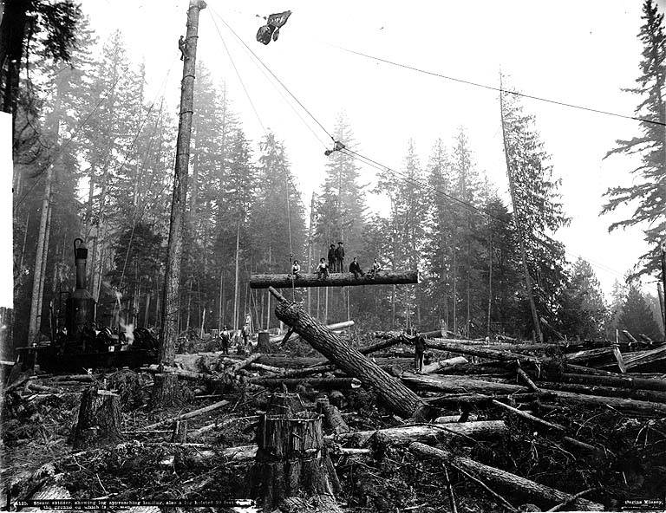

Slide 16
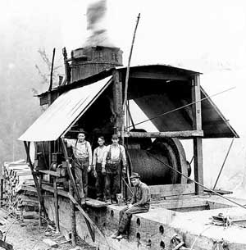

Slide 17
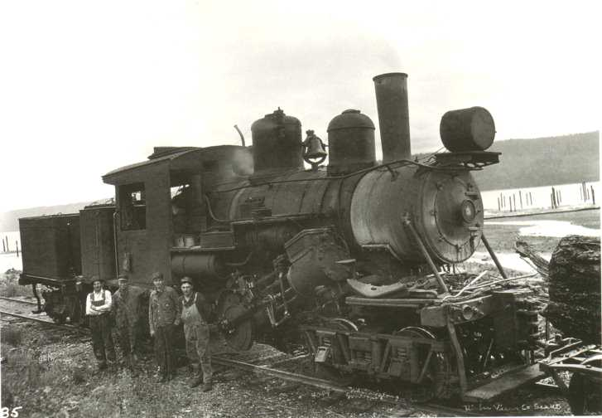

Slide 18
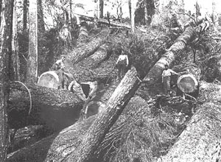

Slide 19
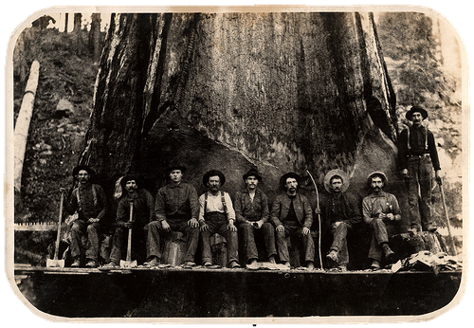

Slide 20
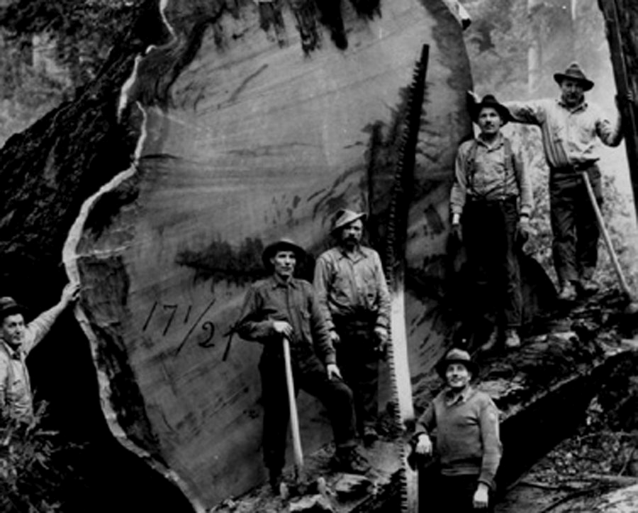

Slide 21
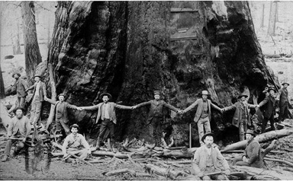

Slide 22
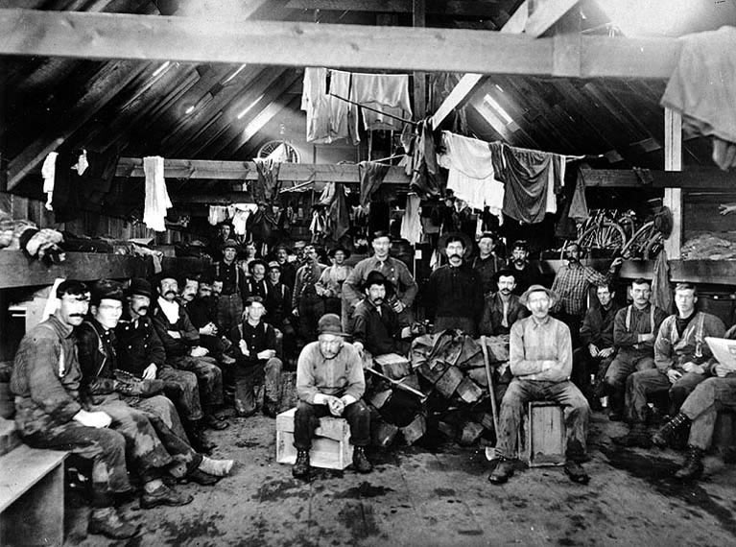
Inside a Bunkhouse at a Logging Camp, circa 1900

Slide 23
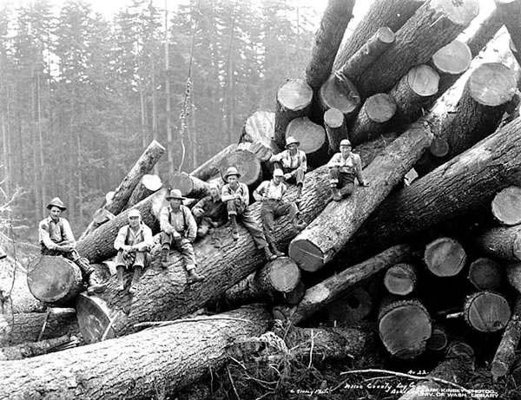

Slide 24
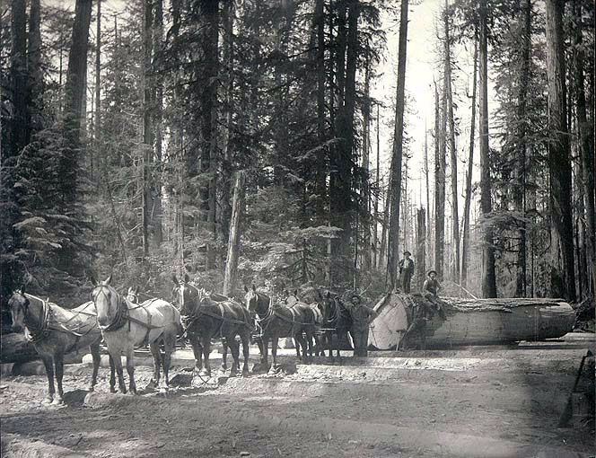

Slide 25
Forests in America Today
NASA's Earth Observatory just released a map illustrating where all the trees are in America. The map was created over six years by Josef Kellndorfer and Wayne Walker of the Woods Hole Research Center (WHRC) in collaboration with the U.S. Forest Service and U.S. Geological Survey.

Slide 26
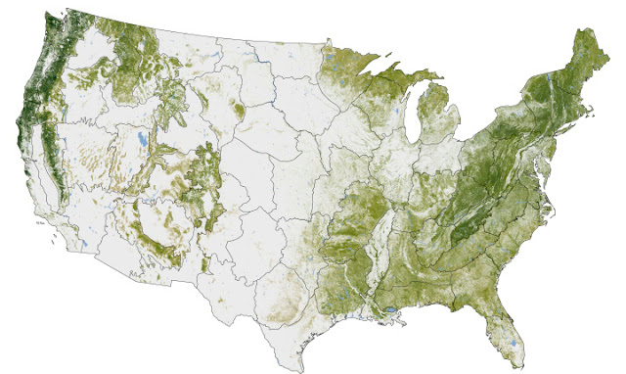
The dark swaths of green represent parts of the country with the greatest concentration of biomass. You can see dense tree cover in the Pacific Northwest as well New England, which has been reforested after intensive logging in the 18th and 19th centuries.

