Slide 1
Amazing Wood Art By Alexander Penteshin

Slide 2
Alexander Penteshin is a Russian painter, restorer and woodcarver. He creates carved furniture and pictures using various styles and techniques. He sticks lime bars together leaving bark on the side ones. It gives the impression that a picture is entirely carved out of a tree trunk. Pictures executed in this way are all unique as the traces of knots never repeat themselves.

Slide 3
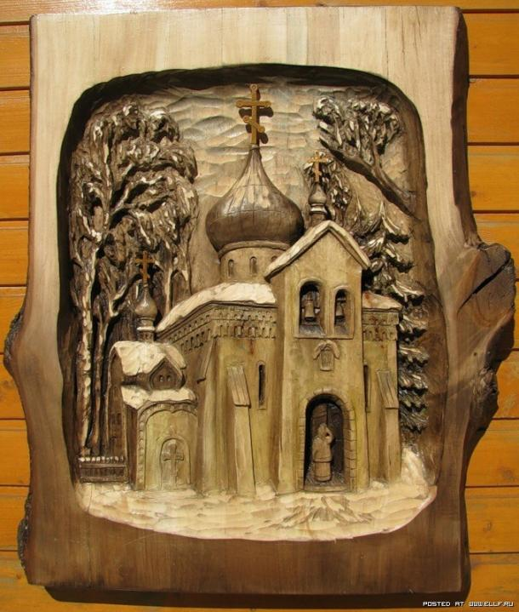

Slide 4
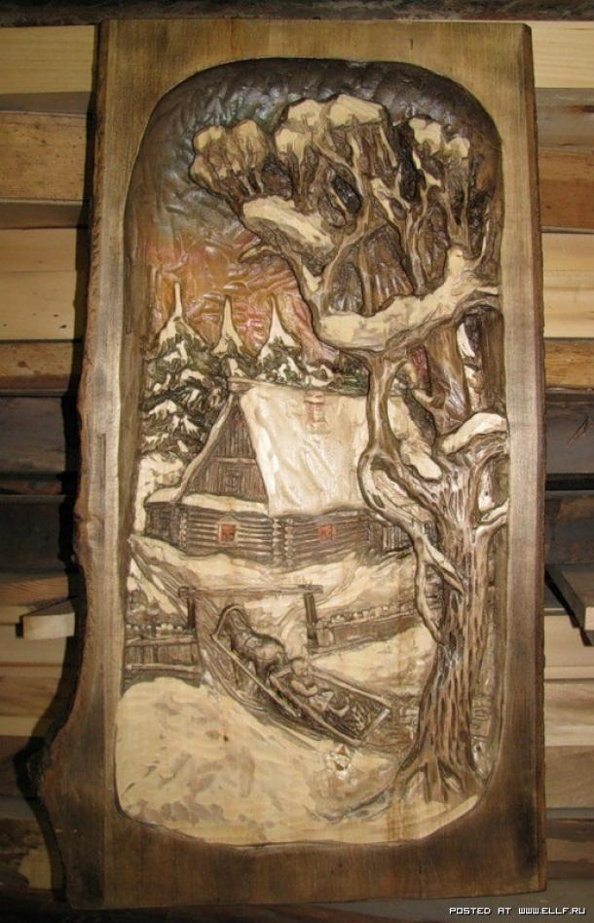
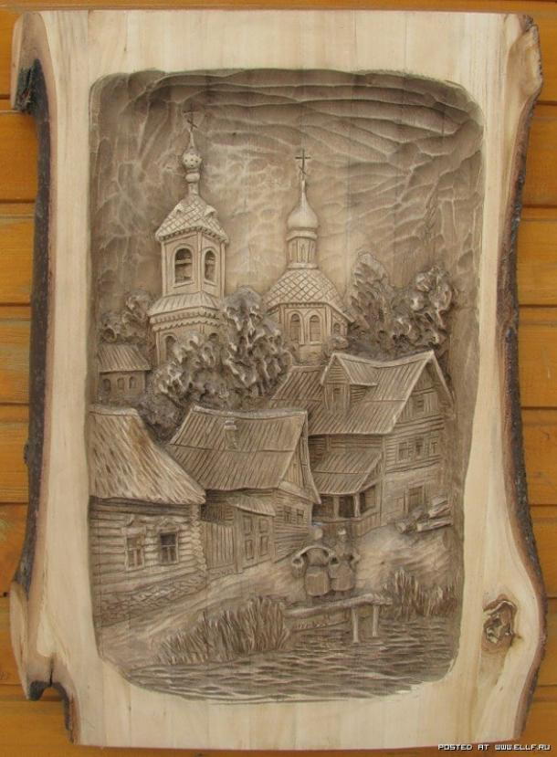

Slide 5
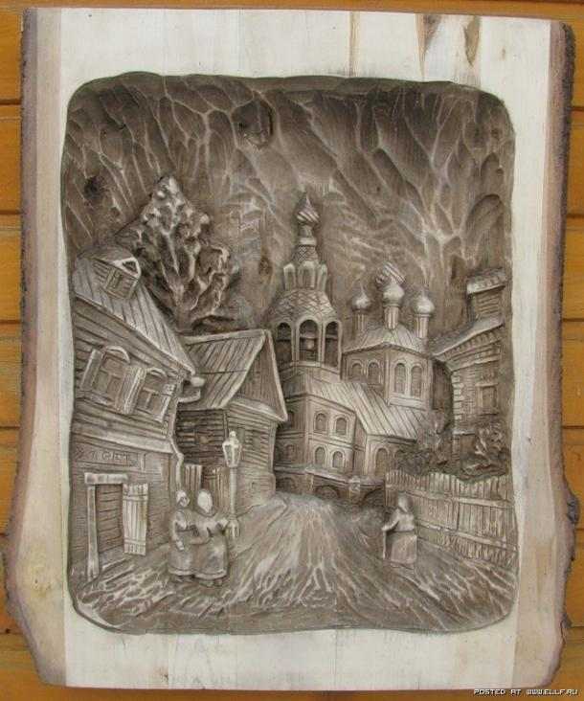

Slide 6
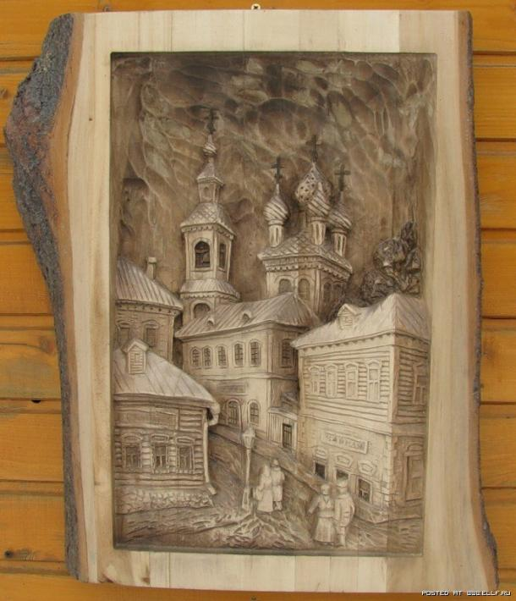

Slide 7
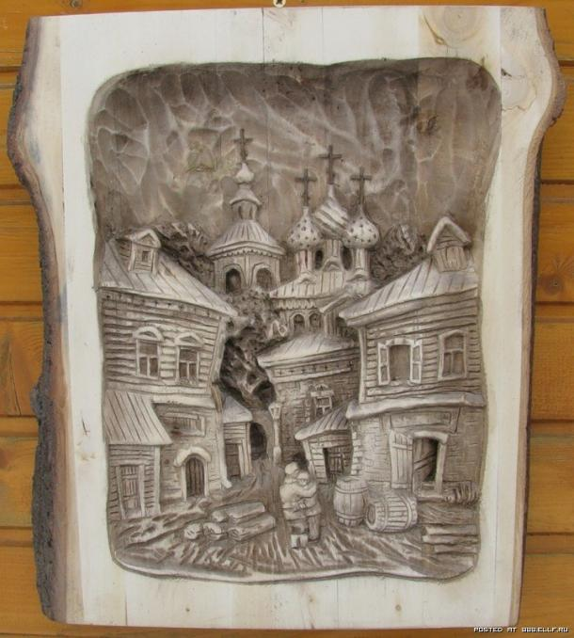

Slide 8
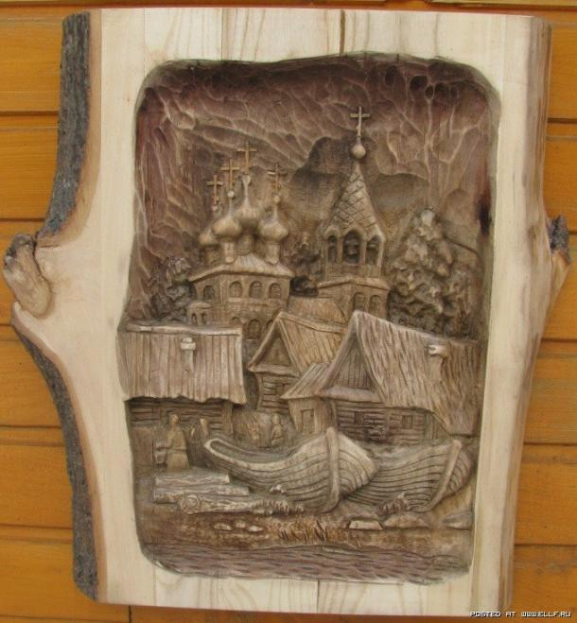

Slide 9
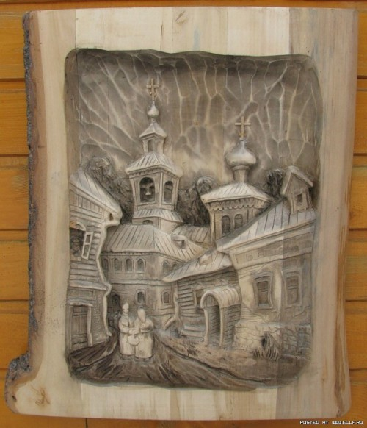

Slide 10
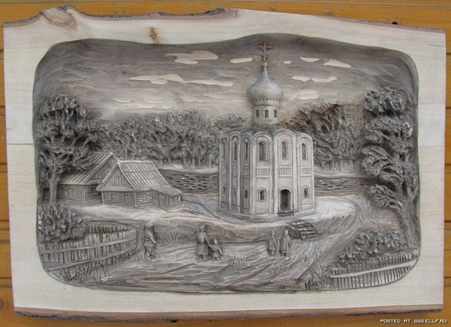

Slide 11
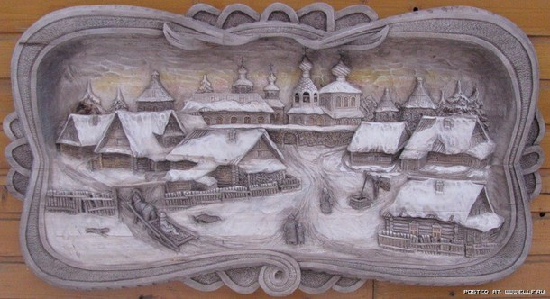

Slide 12
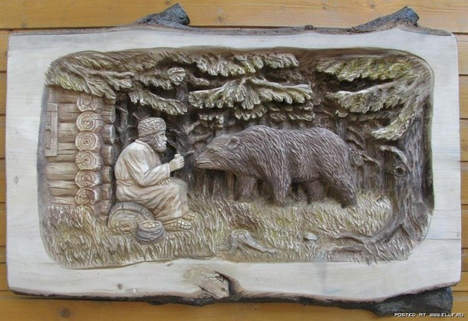

Slide 13
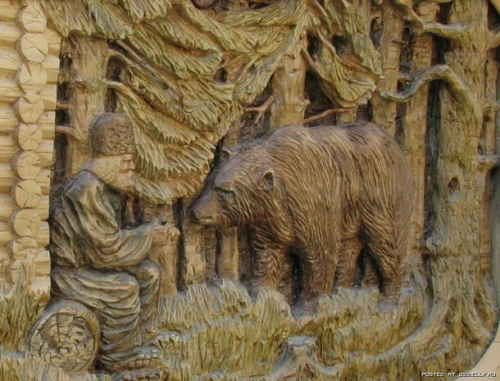

Slide 14
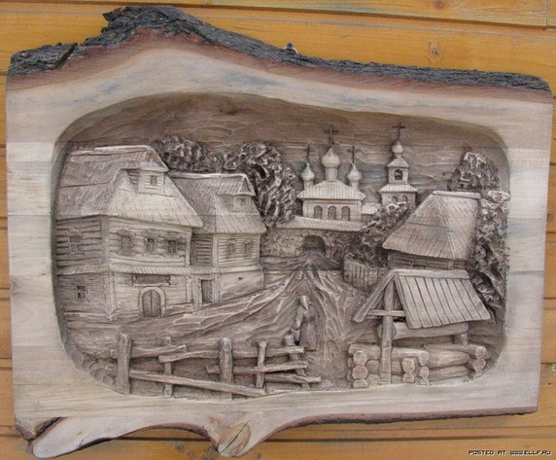

Slide 15
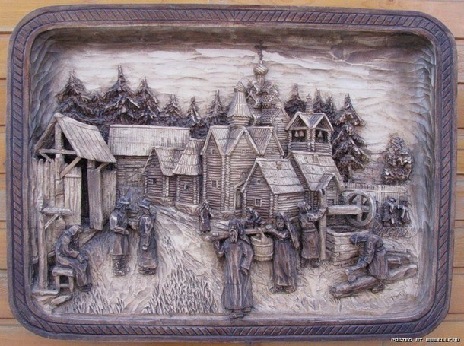

Slide 16
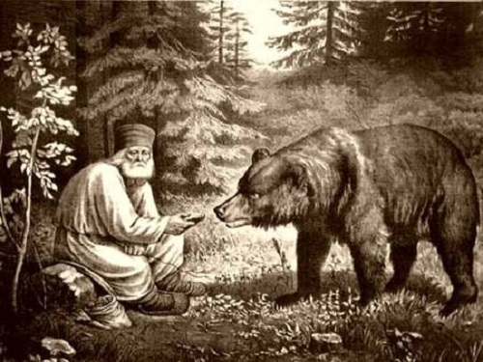

Slide 17
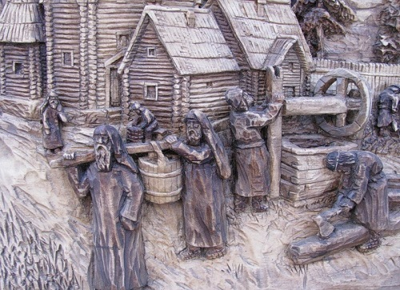

Slide 18
