Slide 1
He Bought 4 Shipping Containers and Stacked Them
Many things can have new uses, so we should use them in new ways whenever it is possible.

Slide 2
The Great Recession of the late 2000’s crippled almost every major economy in the world and affected millions of people especially those who have mortgages in their home. With the recovery of housing bubble crisis getting painfully slow, some people are just as clever and artistic enough to make a relatively beautiful house out of scrap materials.
The reddit user kriegercontainers might have just gone one step ahead from these artists. The photos below show the transformation of these shipping containers to a wonderful house.

Slide 3
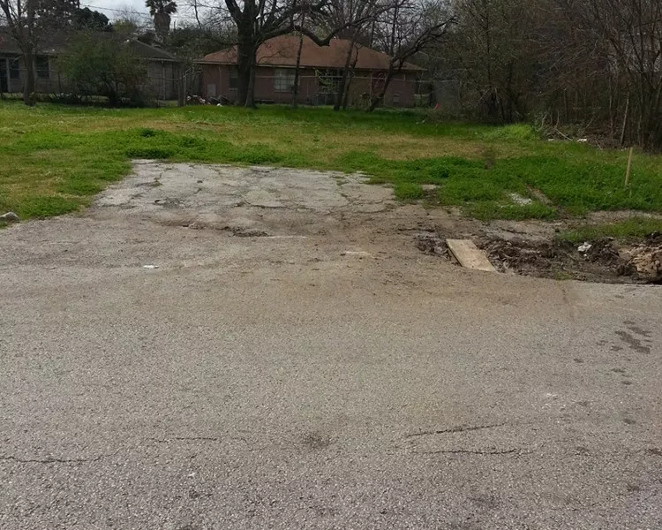
Who would have thought that this vacant lot will be the site of a container home soon?

Slide 4
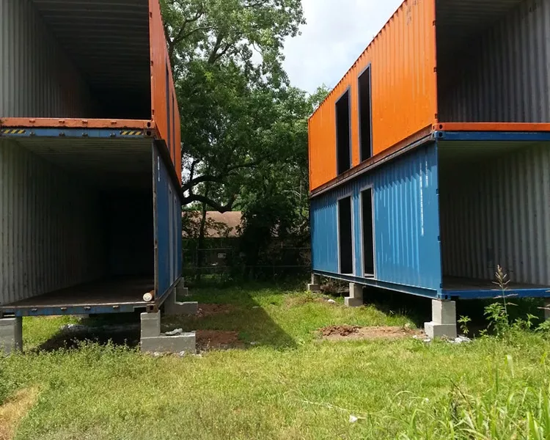
Then wild shipping containers appeared! Oops. These are the key materials.

Slide 5
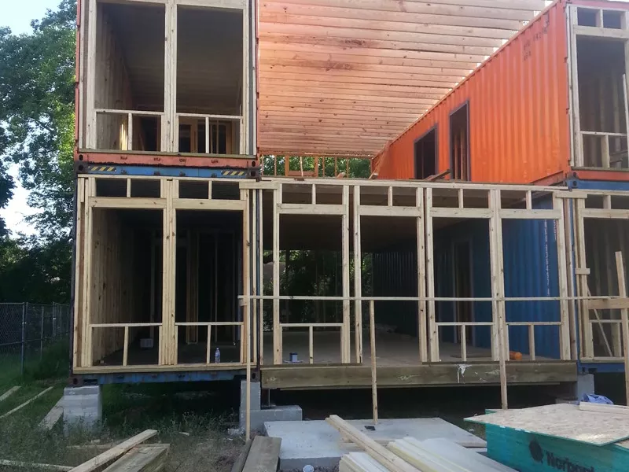
Some framing done to ensure these are measured properly.

Slide 6
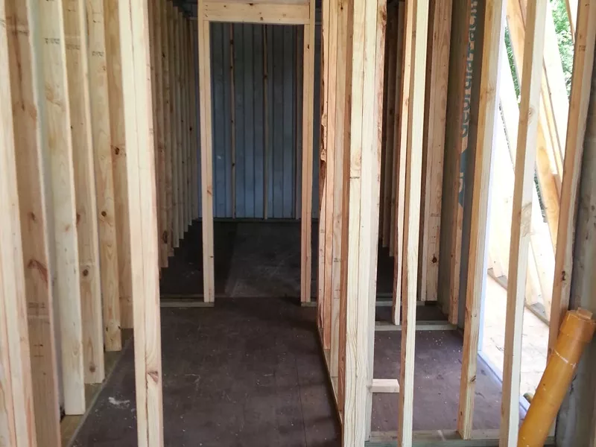
These are metals which will fry you in the scorching sun. Hence, he also added insulation in these containers.

Slide 7
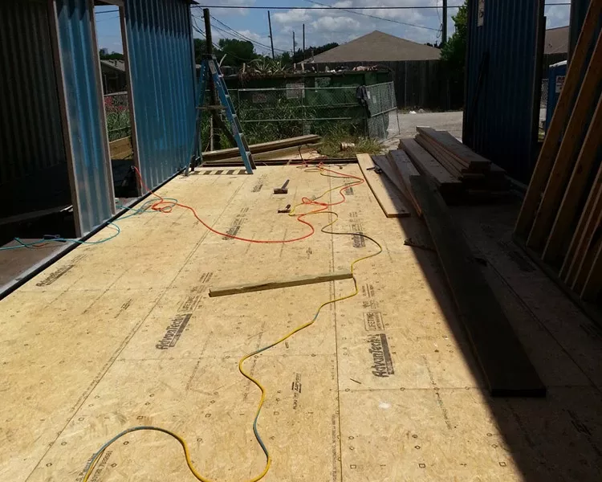
This is now beginning to look like a house.

Slide 8
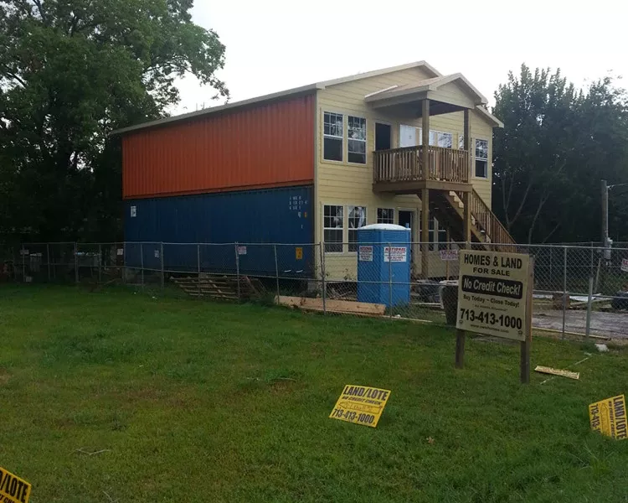
While still unpainted, this is pretty much the façade of this container home. Amazing.

Slide 9
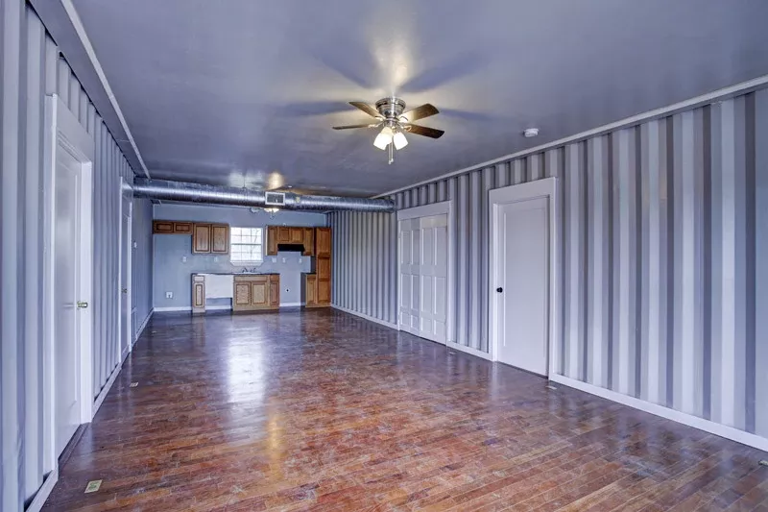
Its living room and kitchen area are more exquisite than my whole house combined.

Slide 10
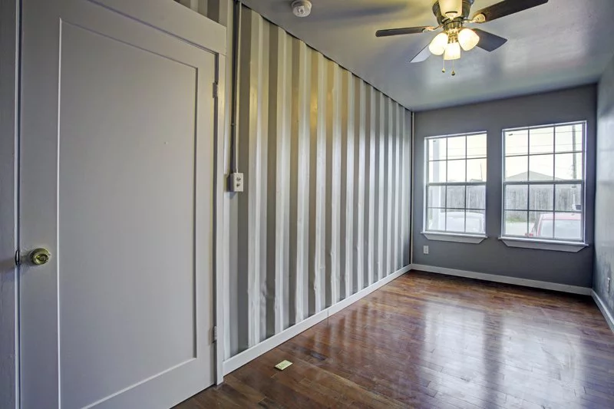
While containers are still seen, the wall gives industrial vibes to the ones who go inside.

